Slide 1

Introduction to Thermal Energy and Its Applications
Understanding Forms, Transfer, and Environmental Impact for Sustainable Energy Solutions

Slide 2
Table of Contents
Introduction to Thermal Energy
Forms of Thermal Energy
Thermal Energy in Real-World Scenarios
Importance of Thermal Energy
Lesson Objectives
Guided Practice: Thermal Energy Transfer
Independent Practice: Design a Thermal Energy-…
Subject Knowledge: Thermal Energy Transfer
Subject Knowledge: Thermal Energy and the Envi…
Common Errors and Misconceptions
Common FAQs
Group Activities: Thermal Energy Audit
Digital Integration: Simulation Software
04
05
06
07
08
09
10
11
12
13
14
15
16

Slide 3
Table of Contents
Review and Reflection
Summative Assessment
Formative Assessment
Conclusion
Teaching Tips
Key Takeaways
Reflection Questions
Next Steps
17
18
19
20
21
22
23
24

Slide 4
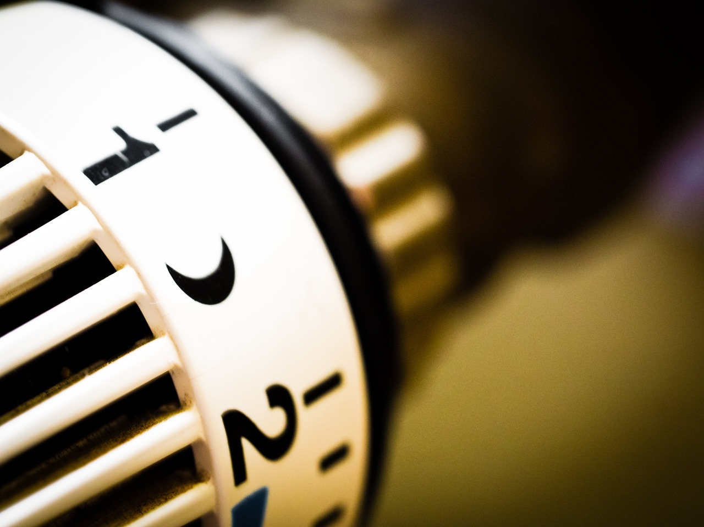
Introduction to Thermal Energy
Fundamental Concept in Physics
Importance in System Design
Daily Life Applications
Thermal energy is a fundamental concept in physics that has numerous applications in our daily lives.
It is the energy transferred from one body to another due to a temperature difference.
Understanding thermal energy is crucial for designing and optimizing thermal energy systems.
This knowledge helps in creating efficient and sustainable solutions.
Thermal energy plays a significant role in various everyday activities.
From heating homes to cooking food, its applications are vast and essential.
4
Introduction to Thermal Energy and Its Applications

Slide 5
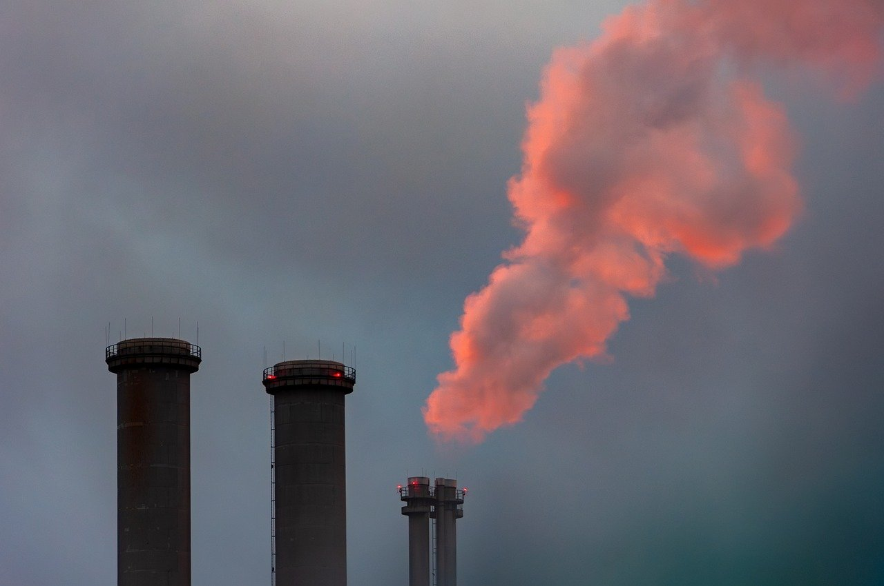
Forms of Thermal Energy
Conduction
Convection
Radiation
Transfer of thermal energy through direct contact between particles.
This process occurs in solids, where particles are closely packed.
Transfer of thermal energy through the movement of fluids.
This mechanism is common in liquids and gases, creating currents.
Transfer of thermal energy through electromagnetic waves.
It does not require a medium and can occur in a vacuum.
5
Introduction to Thermal Energy and Its Applications

Slide 6
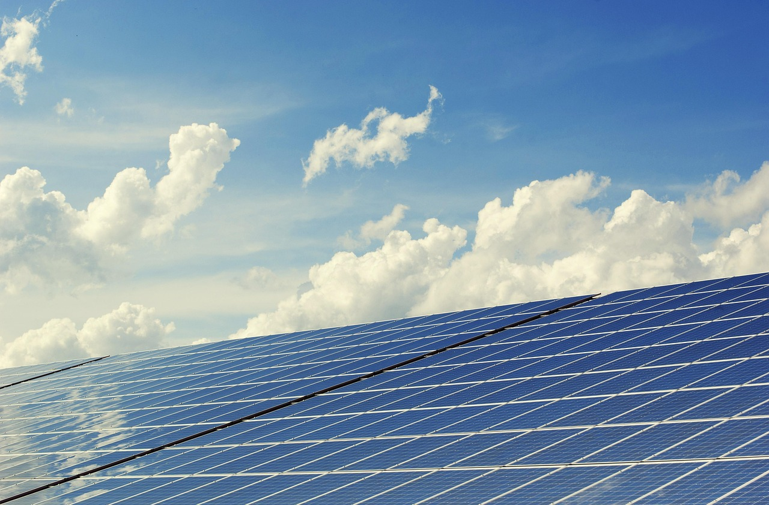
Thermal Energy in Real-World Scenarios
Heating and Cooling Systems
Solar Panels
Refrigeration
Thermal energy is used to regulate temperature.
This ensures comfort and efficiency in various environments.
Thermal energy is converted into electrical energy.
This process harnesses renewable energy for sustainable power.
Thermal energy is removed to produce cooling.
This is essential for food preservation and industrial applications.
6
Introduction to Thermal Energy and Its Applications

Slide 7

Importance of Thermal Energy
Environmental Sustainability
Energy System Optimization
Innovative Problem Solving
Thermal energy has significant implications for environmental sustainability.
It plays a key role in reducing carbon footprints and promoting green energy solutions.
It is essential for designing and optimizing thermal energy systems.
Efficient thermal energy systems contribute to better resource utilization and cost savings.
Understanding thermal energy is crucial for developing innovative solutions to real-world problems.
It enables advancements in technology and addresses challenges in various industries.
7
Introduction to Thermal Energy and Its Applications

Slide 8
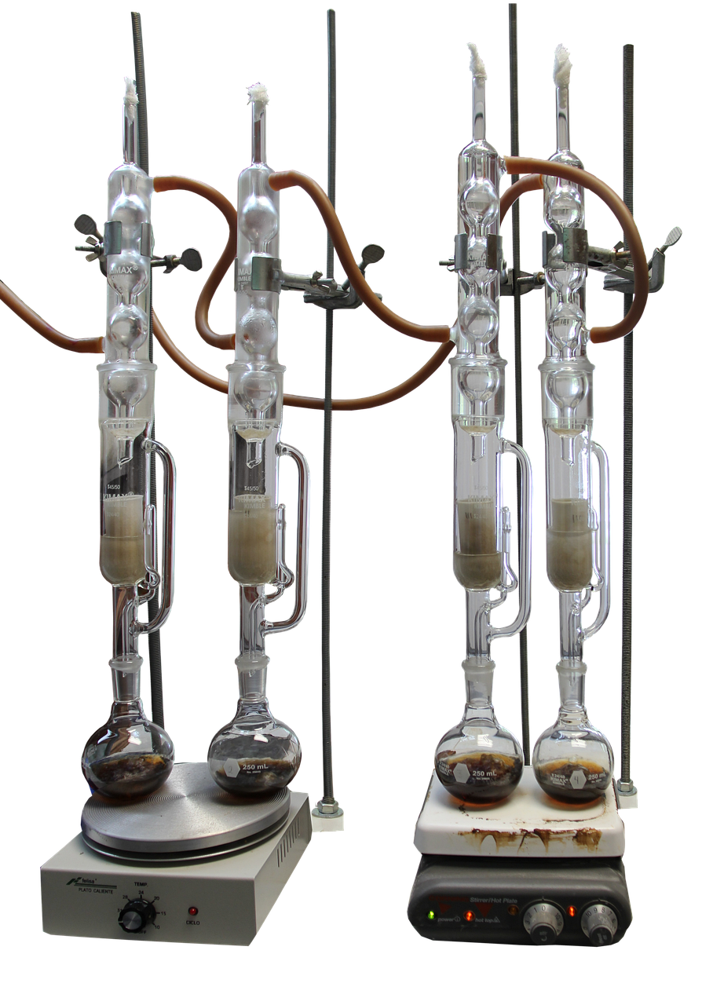
Lesson Objectives
Forms and Applications of Thermal Energy
Evaluating Thermal Energy Technologies
Analyze the different forms of thermal energy.
Explain how they are used in various real-world applications.
Evaluate the effectiveness of different thermal energy technologies.
Discuss their impact on energy efficiency and sustainability.
Problem-Solving with Thermal Energy
Mathematics in Thermal Energy
Create a solution to a real-world problem related to thermal energy.
Explore innovative approaches to address challenges in this field.
Apply mathematical concepts to solve problems related to thermal energy.
Utilize calculations to optimize energy usage and system design.
8
Introduction to Thermal Energy and Its Applications

Slide 9
Guided Practice: Thermal Energy Transfer
Pair Activity on Thermal Energy Transfer
Utilizing a Word Bank for Clarity
Teacher Support for Individual Needs
Students will work in pairs to match the different forms of thermal energy transfer with their definitions.
This activity encourages collaboration and understanding of key concepts.
Students will use a word bank with key terms and definitions to complete the activity.
The word bank serves as a helpful tool to guide students through the task.
The teacher will provide one-on-one support to students who need it.
This ensures that all students can successfully engage with the material.
9
Introduction to Thermal Energy and Its Applications

Slide 10
Independent Practice: Design a Thermal Energy-Efficient Device
Designing Thermal Energy-Efficient Devices
Material and Constraint Guidelines
Teacher Support and Feedback
Students will design and create a thermal energy-efficient device, such as a solar oven or a thermal energy-efficient container.
This activity encourages creativity and application of thermal energy concepts.
Students will be provided with a set of materials and constraints, such as budget and resource limitations.
These constraints will help students think critically and innovate within given boundaries.
The teacher will provide feedback and guidance to students as needed.
This ensures that students stay on track and refine their designs effectively.
10
Introduction to Thermal Energy and Its Applications

Slide 11
Subject Knowledge: Thermal Energy Transfer
1
2
3
Definition of Thermal Energy Transfer
Forms of Thermal Energy Transfer
Importance in System Design
Thermal energy transfer refers to the movement of thermal energy from one body to another.
It is a fundamental concept in understanding energy interactions.
There are three main forms of thermal energy transfer: conduction, convection, and radiation.
Each form operates through distinct mechanisms and conditions.
Understanding thermal energy transfer is crucial for designing and optimizing thermal energy systems.
This knowledge helps improve efficiency and sustainability in energy applications.
11
Introduction to Thermal Energy and Its Applications

Slide 12
Subject Knowledge: Thermal Energy and the Environment
Impact of Thermal Energy on the Environment
Environmental Implications of Thermal Energy
Sustainability in Thermal Energy Systems
Thermal energy has a significant impact on the environment, contributing to climate change and energy waste.
The production and consumption of thermal energy can result in greenhouse gas emissions.
Understanding the environmental implications of thermal energy is essential for developing sustainable systems.
Responsible thermal energy systems can mitigate negative environmental effects.
Developing sustainable thermal energy systems is crucial for reducing energy waste.
Sustainability efforts can help address the challenges posed by greenhouse gas emissions.
12
Introduction to Thermal Energy and Its Applications

Slide 13
Common Errors and Misconceptions
1
Thermal Energy vs. Temperature
Thermal energy is not the same as temperature.
They are distinct concepts often misunderstood.
2
Heat Flow Misconceptions
Heat does not always flow from a hotter body to a cooler body.
This challenges a common oversimplification.
3
Insulation's Versatility
Insulation is not only used to keep things warm.
It serves multiple purposes beyond temperature control.
13
Introduction to Thermal Energy and Its Applications

Slide 14
Common FAQs
1
Understanding Thermal Energy and Temperature
Thermal energy refers to the total energy of the particles in a system.
Temperature is a measure of the average kinetic energy of the particles.
2
Thermal Energy in Electricity Production
Thermal energy is used in the production of electricity through the use of steam turbines or gas turbines.
This process converts heat into mechanical energy and then into electrical energy.
3
Thermal Energy in Daily Life
Thermal energy is present in all aspects of our daily lives, from the heating and cooling of our homes to the functioning of our electronic devices.
It plays a crucial role in maintaining comfort and powering technology.
14
Introduction to Thermal Energy and Its Applications

Slide 15

Group Activities: Thermal Energy Audit
1
Group Collaboration
Students will work in groups to conduct a thermal energy audit of a school building or a residential home.
The teacher will provide guidance and feedback to students as needed.
2
Identifying Heat Dynamics
Students will identify areas of heat loss and gain.
They will analyze these areas to suggest improvements to increase energy efficiency.
3
Teacher's Role
The teacher will provide guidance and feedback to students as needed.
This ensures that students stay on track and understand the audit process.
15
Introduction to Thermal Energy and Its Applications

Slide 16

Digital Integration: Simulation Software
Modeling Real-World Scenarios
Students will use simulation software to model real-world thermal energy scenarios.
This hands-on approach helps in understanding complex thermal energy concepts.
Analyzing Variable Effects
Students will explore and analyze the effects of different variables on thermal energy transfer.
This analysis fosters critical thinking and problem-solving skills.
Guided Learning Experience
The teacher will provide guidance and feedback to students as needed.
This ensures students stay on track and achieve learning objectives.
16
Introduction to Thermal Energy and Its Applications

Slide 17
Review and Reflection
Student Reflection
Identifying Support Areas
Teacher's Role in Feedback
Students will review and reflect on what they have learned about thermal energy.
This process helps them consolidate their understanding and identify key takeaways.
Students will identify areas where they need additional support or review.
This step ensures they can focus on topics that require more attention.
The teacher will provide feedback and guidance to students as needed.
This support helps address individual learning gaps effectively.
17
Introduction to Thermal Energy and Its Applications

Slide 18
Summative Assessment
Weightage of Written Test
Project-Based Assessment
Presentation Skills
Design Challenge Component
Written test: 40%
This is the highest contributing component in the summative assessment.
Project-based assessment: 30%
This evaluates practical application and creativity.
Presentation: 15%
This focuses on communication and delivery.
Design challenge: 15%
This tests problem-solving and innovative thinking.
18
Introduction to Thermal Energy and Its Applications

Slide 19

Formative Assessment
Class Discussions
Quizzes and Games
Class discussions are held weekly.
They provide an opportunity for students to engage and share ideas.
Quizzes and games are conducted bi-weekly.
These activities are designed to reinforce learning in an interactive way.
Project-Based Check-Ins
Self-Assessment and Reflection
Project-based check-ins occur bi-weekly.
They help monitor progress and ensure students stay on track with their projects.
Self-assessment and reflection are done weekly.
This practice encourages students to evaluate their own learning and growth.
19
Introduction to Thermal Energy and Its Applications

Slide 20
Conclusion
Thermal Energy in Daily Life
Thermal energy is a fundamental concept in physics that has numerous applications in our daily lives.
Understanding thermal energy is crucial for designing and optimizing thermal energy systems.
Real-World Applications
Students will be able to apply thermal energy concepts to real-world scenarios and technologies.
This knowledge bridges the gap between theoretical understanding and practical implementation.
Optimizing Energy Systems
Designing efficient thermal energy systems is essential for sustainable development.
Mastery of these concepts enables innovation in energy technologies.
20
Introduction to Thermal Energy and Its Applications

Slide 21

Teaching Tips
1
Differentiated Instruction
Provide students with different learning pathways and activities.
This approach caters to diverse learning needs and styles.
2
Visual Aids
Use diagrams, charts, and graphs to help students visualize complex concepts.
These tools make abstract ideas more tangible and easier to understand.
3
Hands-On Activities
Provide students with hands-on activities to explore thermal energy concepts in a practical and interactive way.
This method encourages active learning and engagement.
21
Introduction to Thermal Energy and Its Applications

Slide 22
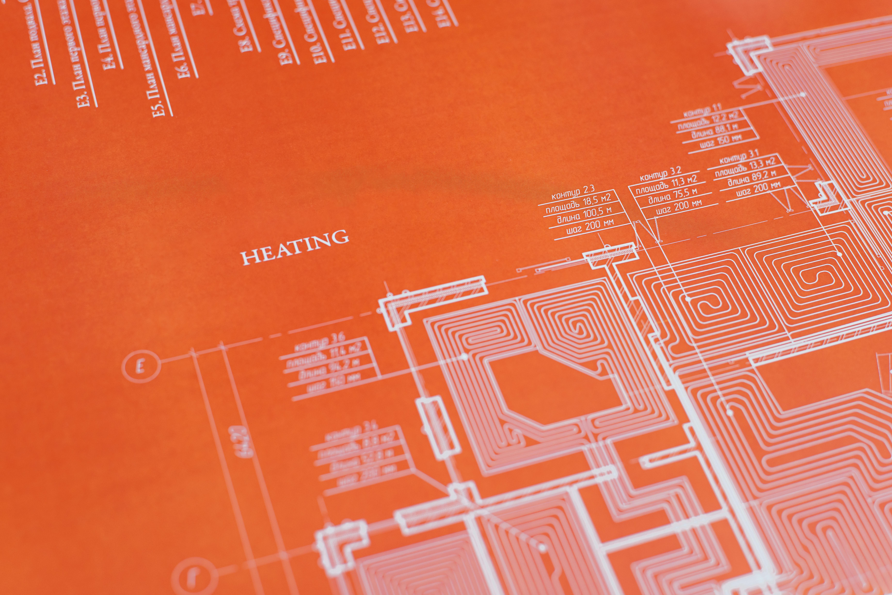
Key Takeaways
Thermal Energy Forms and Applications
Real-World Applications of Thermal Energy
Understanding of thermal energy forms and their applications.
This includes the study of how thermal energy is utilized in various industries and technologies.
Ability to apply thermal energy concepts to real-world scenarios.
This involves practical knowledge and skills to address everyday challenges using thermal energy.
Critical Thinking and Problem-Solving
Environmental Sustainability and Energy Efficiency
Development of critical thinking and problem-solving skills.
These skills are essential for analyzing and addressing complex issues related to thermal energy.
Understanding of the importance of thermal energy in environmental sustainability and energy efficiency.
This highlights the role of thermal energy in reducing environmental impact and promoting sustainable practices.
22
Introduction to Thermal Energy and Its Applications

Slide 23

Reflection Questions
1
2
3
Evaluating Lesson Effectiveness
Real-World Application of Concepts
Enhancing Engagement and Understanding
How effectively did the lesson cater to mixed-ability groups?
This question helps assess inclusivity and adaptability in teaching methods.
How well did students apply thermal energy concepts to real-world scenarios?
This reflection focuses on the practical understanding and relevance of the lesson.
What adjustments can be made to improve student engagement and understanding?
This inquiry aims to identify areas for pedagogical improvement.
23
Introduction to Thermal Energy and Its Applications

Slide 24
Next Steps
Lesson 2: Exploring Thermal Energy
Lesson 2 focuses on understanding how thermal energy manifests in everyday life.
It provides insights into practical applications and phenomena related to thermal energy.
Lesson 3: Designing Energy-Efficient Systems
Lesson 3 emphasizes the creation of systems that optimize thermal energy usage.
It explores strategies and designs for improving energy efficiency in various contexts.
Lesson 4: Thermal Energy and Environmental Impact
Lesson 4 examines the relationship between thermal energy and environmental sustainability.
It discusses the implications of thermal energy use on ecological balance and climate change.
24
Introduction to Thermal Energy and Its Applications

