Slide 1


Material World: A Journey Through Natural and Man-Made Materials
Exploring the Properties, Production, and Environmental Impact

Slide 2
Table of contents
Exploring Materials: Natural vs Man-Made
What Are Materials?
Natural Materials
Man-Made Materials
Material Sorting Game
How Materials Are Made
Material Properties
Environmental Awareness
Fun Material Exploration
Conclusion
01
02
03
04
05
06
07
08
09
10

Slide 3
Table of contents
Q&A and Interaction
Key Features of Natural Materials
Benefits of Man-Made Materials
Steps to Material Detective Challenge
Timeline of Material Production
SWOT Analysis of Material Exploration
Revenue Growth in Material Education
Interactive Material Sorting Grid
Material Detective Activity Suggestions
11
12
13
14
15
16
17
18
19

Slide 4

Exploring Materials: Natural vs Man-Made
1
Exploring Materials
Natural vs Man-Made
Material World: A Journey Through Natural and Man-Made Materials
1

Slide 5
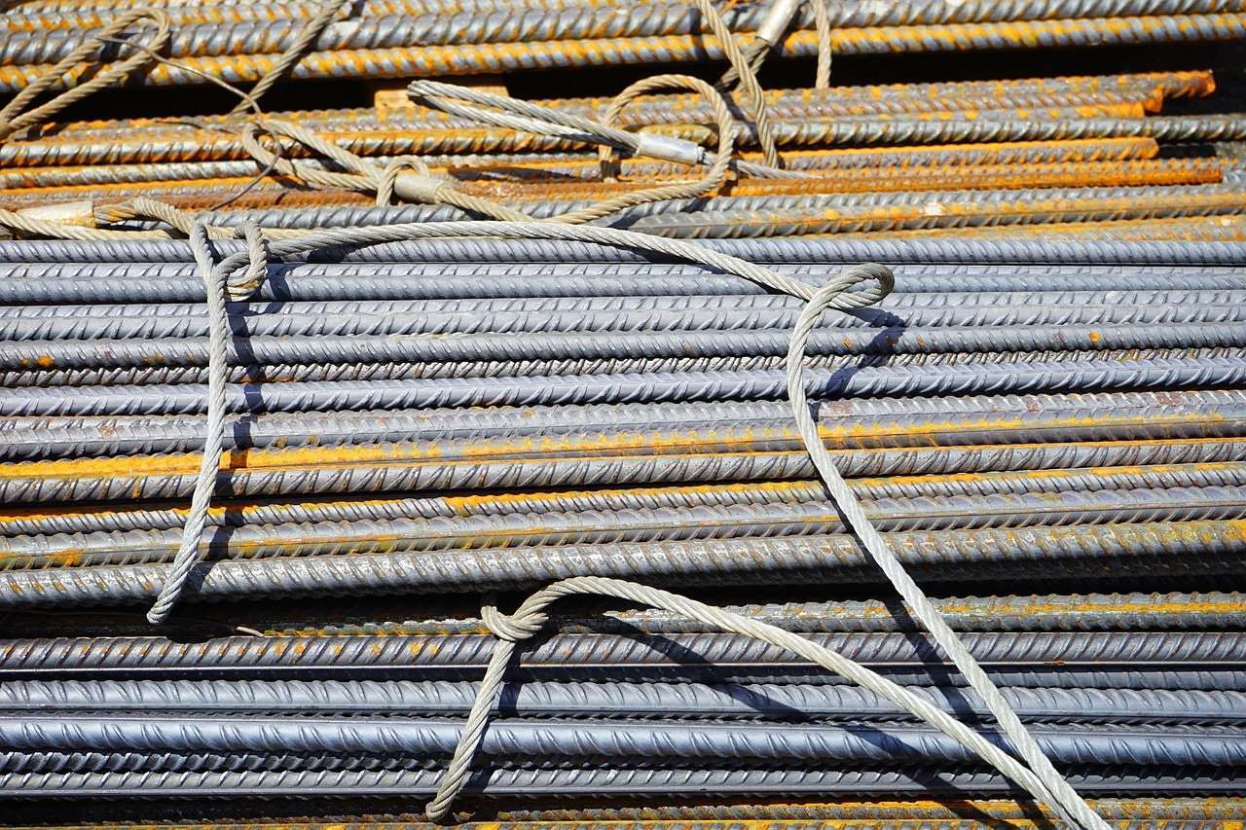
What Are Materials?
Definition
Key Points
Materials are substances we use to make things
Materials are all around us
They come from different sources
Some are found in nature
Some are created by humans
Material World: A Journey Through Natural and Man-Made Materials
2

Slide 6

Natural Materials
Natural Materials
Directly from nature
Not changed by humans
Examples:
Wood from trees
Stones from mountains
Material World: A Journey Through Natural and Man-Made Materials
3

Slide 7

Man-Made Materials
Man-Made Materials
Created by humans
Processed and transformed
Examples:
- Plastic
- Synthetic fabrics
Material World: A Journey Through Natural and Man-Made Materials
4

Slide 8

Material Sorting Game
Material Detective Challenge
Identify whether materials are natural or man-made
Use your observation skills
Look at texture, origin, and appearance
Grid of material images for interactive sorting
Material World: A Journey Through Natural and Man-Made Materials
5

Slide 9
Natural Resource
How Materials Are Made
Materials start as resources from nature.
Examples: Trees for wood, plants for cotton.
01
Extraction/Collection
Resources are gathered or extracted.
Wood is cut from trees, cotton is harvested from plants.
02
Processing
03
Resources undergo processing.
Wood is cut into planks, cotton is spun into yarn.
Final Product
04
Processed materials become final products.
Wood becomes furniture, cotton becomes clothing.
Material World: A Journey Through Natural and Man-Made Materials
6

Slide 10
Material Properties
Texture
Flexibility
Strength
Color
1
2
3
4
Describes the surface quality of the material, e.g., smooth, rough, or patterned.
Indicates how easily the material can bend or flex without breaking.
Measures the material's ability to withstand force or pressure without breaking.
Refers to the appearance of the material, including hue, saturation, and brightness.
Material World: A Journey Through Natural and Man-Made Materials
7

Slide 11

Environmental Awareness
3
Caring for Our Materials
Respect natural resources, Recycle when possible, Use materials wisely
Material World: A Journey Through Natural and Man-Made Materials
8

Slide 12
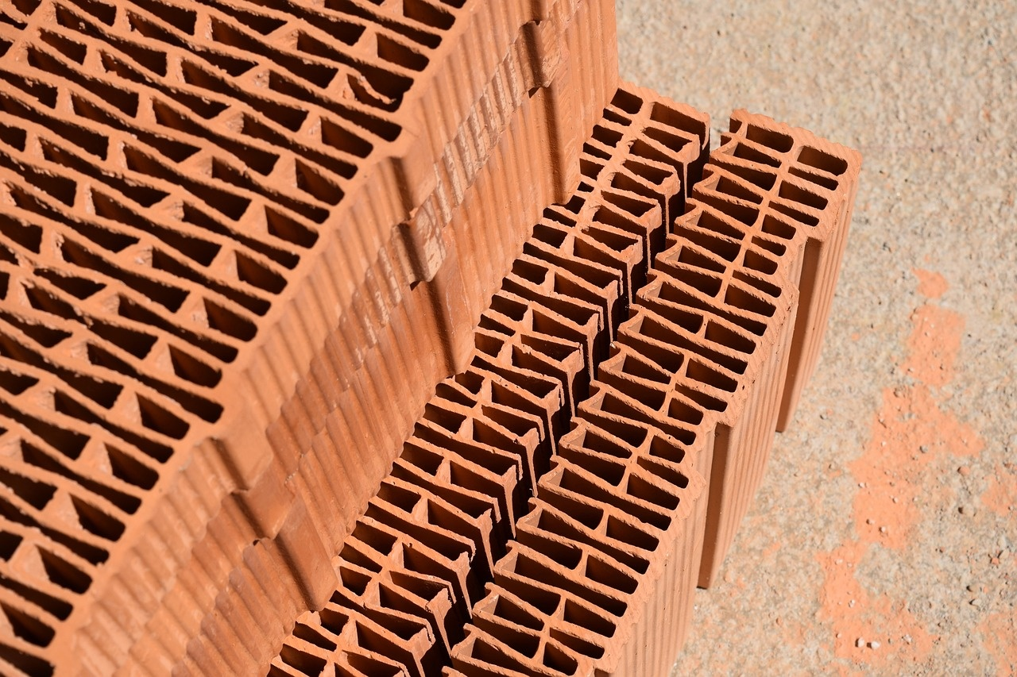
Fun Material Exploration
Fun Material Exploration
Touch different materials
Collect natural objects
Draw material discoveries
Ask questions
Material World: A Journey Through Natural and Man-Made Materials
9

Slide 13

Conclusion
Natural vs Man-Made
Material Properties
We learned about the differences between materials that come from nature and those created by humans.
We explored the various characteristics of materials, including texture, flexibility, strength, and color.
Material Detectives
Learning Journey
We discovered that we can identify whether materials are natural or man-made by observing their texture, origin, and appearance.
Remember, materials are all around us, and we can continue to explore and learn about them every day!
Material World: A Journey Through Natural and Man-Made Materials
10

Slide 14

Q&A and Interaction
Encouragement for student participation
Placeholder for student questions
Colorful, welcoming design
Ask open-ended questions
Provide positive feedback
Create a safe environment for sharing
Designate a section for questions
Encourage students to write down their questions
Review and address questions regularly
Use bright colors
Incorporate engaging visuals
Ensure readability and accessibility
Material World: A Journey Through Natural and Man-Made Materials
11

Slide 15
01
Directly from nature
Key Features of Natural Materials
02
Not changed by humans
03
Examples:
Wood from trees
Stones from mountains
Cotton from plants
Leaves
Rocks
Material World: A Journey Through Natural and Man-Made Materials
12

Slide 16

Benefits of Man-Made Materials
Man-Made Materials
Created by humans
Processed and transformed
Examples:
Plastic
Synthetic fabrics
Material World: A Journey Through Natural and Man-Made Materials
13

Slide 17
01
Observe Carefully
Steps to Material Detective Challenge
Look at the texture, origin, and appearance of the materials.
02
Identify Natural vs Man-Made
Determine whether the materials are from nature or created by humans.
03
Use Your Detective Skills
Pay attention to details and characteristics of each material.
Material World: A Journey Through Natural and Man-Made Materials
14

Slide 18

Timeline of Material Production
01
03
05
Stone Age (2.5 million years ago)
Iron Age (1200 BCE–550 CE)
Modern Era (20th century–present)
02
04
Humans used stones as tools and weapons.
Iron became the dominant material for tools and weapons.
Advancements in materials science leading to the development of plastics, composites, and nanomaterials.
Bronze Age (3300–1200 BCE)
Industrial Revolution (18th–19th centuries)
Bronze, an alloy of copper and tin, was widely used for tools and weapons.
Introduction of machinery and mass production of materials like steel and textiles.
Material World: A Journey Through Natural and Man-Made Materials
15

Slide 19

SWOT Analysis of Material Exploration
Strengths
Weaknesses
Abundance of natural materials in the environment
Diverse range of man-made materials for specific purposes
Limited availability of certain natural materials
Environmental impact of manufacturing man-made materials
Opportunities
Threats
Innovation in sustainable material production
Exploration of new materials for advanced applications
Depletion of natural resources
Pollution caused by improper disposal of materials
Material World: A Journey Through Natural and Man-Made Materials
16

Slide 20
Revenue Growth in Material Education
25%
$10,000
Enrollment Increase
Fundraising Revenue
Material World: A Journey Through Natural and Man-Made Materials
17

Slide 21
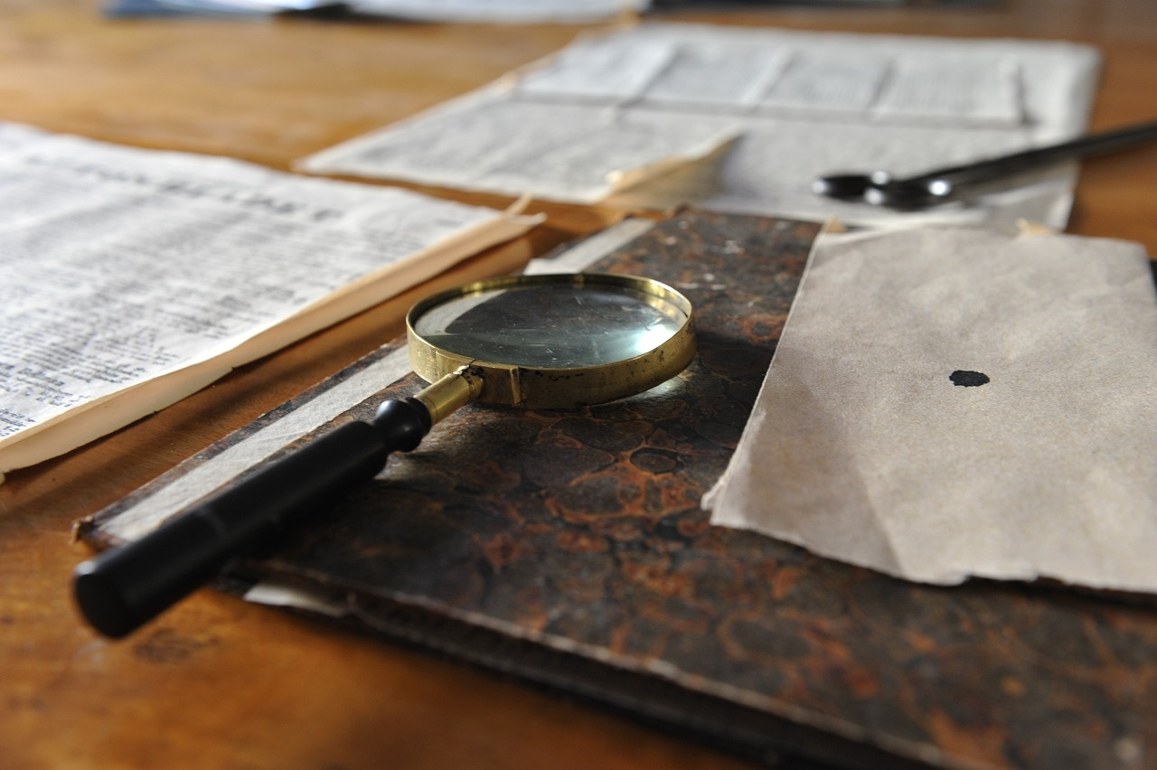
Interactive Material Sorting Grid
Material Detective Challenge
1. Identify whether materials are natural or man-made
2. Use your observation skills
3. Look at texture, origin, and appearance
Grid of material images for interactive sorting
Material World: A Journey Through Natural and Man-Made Materials
18

Slide 22

Material Detective Activity Suggestions
Fun Material Exploration
Touch different materials
Collect natural objects
Draw material discoveries
Ask questions
Material World: A Journey Through Natural and Man-Made Materials
19

