Slide 1


Introduction to Geospatial Technology
Exploring Mapping, Spatial Analysis, and Real-World Applications

Slide 2
Introduction to Geospatial Technology
2
Table of Contents
Introduction to Geospatial Technology
What is Geospatial Technology?
Types of Maps
GIS Software
Spatial Analysis
Real-World Applications
Case Study: Urban Planning
Group Activity: Mapping a Local Park
Independent Practice: Geospatial Technology Pr…
Common Errors and Misconceptions
FAQs
Objectives
Vocabulary
04
05
06
07
08
09
10
11
12
13
14
15
16

Slide 3
Introduction to Geospatial Technology
3
Table of Contents
Resources
Conclusion
Reflection Questions
Next Steps
17
18
19
20

Slide 4

Introduction to Geospatial Technology
4
Introduction to Geospatial Technology
Overview of Geospatial Technology
Applications of Geospatial Technology
Key Concepts in Geospatial Technology
Geospatial technology combines geography, computer science, and spatial analysis to understand and interpret geographic data.
It has numerous applications in various fields, including urban planning, emergency response, and environmental conservation.
This lesson will introduce you to the fundamental concepts of geospatial technology, including mapping, spatial analysis, and geographic information systems (GIS).

Slide 5
Introduction to Geospatial Technology
5
What is Geospatial Technology?
Definition of Geospatial Technology
Components of Geospatial Technology
Applications in Problem Solving
Fields of Application
Geospatial technology is the use of computer hardware, software, and data to analyze and interpret geographic data.
It involves the use of geographic information systems (GIS), global positioning systems (GPS), and remote sensing technologies.
Geospatial technology is used to solve real-world problems, such as navigating, tracking climate change, and responding to emergencies.
It has numerous applications in various fields, including urban planning, emergency response, and environmental conservation.

Slide 6
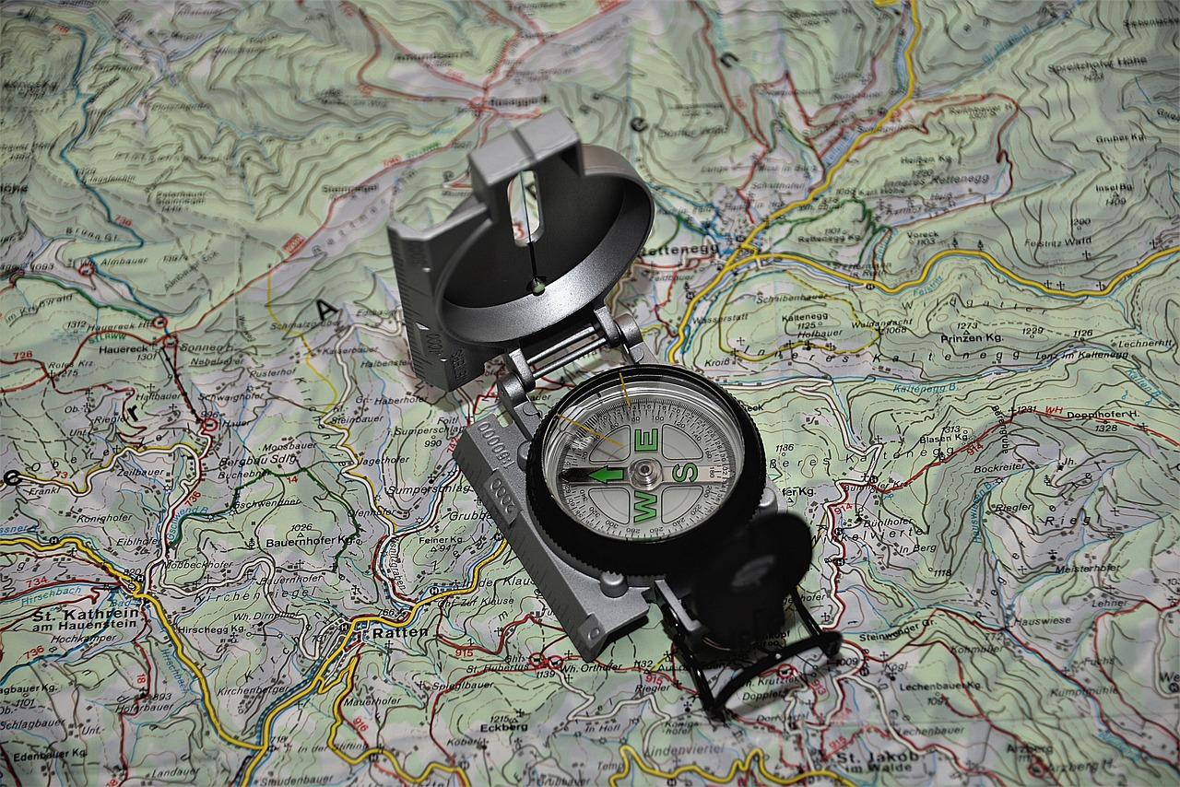
Introduction to Geospatial Technology
6
Types of Maps
Topographic Maps
Thematic Maps
Show the physical features of an area, such as mountains, rivers, and valleys.
Show the distribution of a particular feature or phenomenon, such as population density or climate.
Interactive Maps
Examples of Maps
Allow users to interact with the data, such as zooming in and out, and clicking on features for more information.
Google Maps, Apple Maps, and National Geographic Maps.

Slide 7

Introduction to Geospatial Technology
7
GIS Software
Purpose of GIS Software
Examples of GIS Software
GIS software is used to create, edit, and analyze geographic data.
Examples of GIS software: ArcGIS, QGIS, and Google Earth.
Spatial Analysis Capabilities
Applications of GIS Software
GIS software is used to perform spatial analysis, such as buffering, overlay, and network analysis.
GIS software is used in various fields, including urban planning, emergency response, and environmental conservation.

Slide 8

Introduction to Geospatial Technology
8
Spatial Analysis
Definition of Spatial Analysis
Techniques in Spatial Analysis
Applications of Spatial Analysis
Examples of Spatial Analysis
Spatial analysis is the process of analyzing and interpreting geographic data to understand patterns, relationships, and trends.
Spatial analysis involves the use of various techniques, such as buffering, overlay, and network analysis.
Spatial analysis is used to solve real-world problems, such as tracking the spread of disease, analyzing traffic patterns, and optimizing emergency response.
Examples of spatial analysis: analyzing the distribution of population, tracking the movement of wildlife, and identifying areas of high crime rates.

Slide 9

Introduction to Geospatial Technology
9
Real-World Applications
Urban Planning
Geospatial technology is used to analyze and visualize data on population growth, land use, and infrastructure.
Emergency Response
Geospatial technology is used to quickly assess damage and identify areas of need.
Environmental Conservation
Geospatial technology is used to track the movement and behavior of wildlife, monitor and analyze environmental phenomena, and develop targeted conservation strategies.
Examples of Real-World Applications
Tracking the spread of disease, analyzing traffic patterns, and optimizing emergency response.

Slide 10
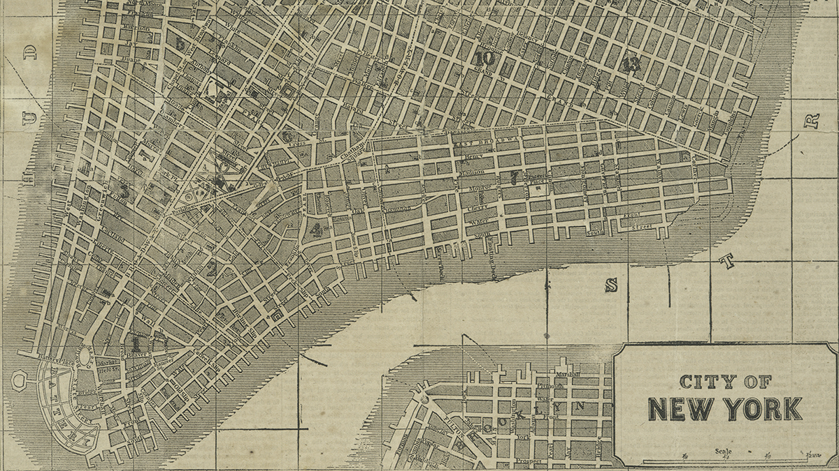
Introduction to Geospatial Technology
10
Case Study: Urban Planning
Introduction to the Case Study
Data Collection
The city of New York is experiencing rapid population growth.
Needs to develop a plan to manage its infrastructure.
The city collects data on population growth, land use, and infrastructure.
Uses GIS software for data collection.
Analysis of Data
Conclusion and Plan Development
The city analyzes the data to identify areas of high population density.
Focuses on traffic congestion and infrastructure needs.
The city develops a plan to optimize its infrastructure.
Includes new public transportation systems and expansion of green spaces.

Slide 11

Introduction to Geospatial Technology
11
Group Activity: Mapping a Local Park
Introduction to the Activity
Data Collection
Students will work in groups to create a map of a local park using GIS software.
Students will collect data on the park's features, such as trails, amenities, and vegetation.
Analysis
Conclusion
Students will analyze the data to identify areas of high use, potential hazards, and opportunities for improvement.
Students will present their findings and recommendations for improving the park.

Slide 12

Introduction to Geospatial Technology
12
Independent Practice: Geospatial Technology Project
Introduction to the Project
Project Ideas
Project Requirements
Grading Criteria
Students will work individually to design and implement a geospatial technology project that applies the concepts and skills learned in the lesson.
Students can choose from a variety of project ideas, such as analyzing the distribution of population, tracking the movement of wildlife, or optimizing emergency response.
Students will need to collect and analyze data, create a map or visualization, and write a report on their findings.
Students will be graded on the completeness and accuracy of their project, as well as their ability to apply geospatial technology concepts and skills.

Slide 13

Introduction to Geospatial Technology
13
Common Errors and Misconceptions
Common Errors in Geospatial Data
Geospatial data is not always accurate or reliable.
Spatial analysis can be complex and require specialized skills.
Misconceptions About Geospatial Technology
Geospatial technology is not just about mapping.
It also involves analyzing and interpreting geographic data.
Examples of Errors and Misconceptions
Assuming that geospatial data is always accurate.
Thinking that spatial analysis is only used for mapping.
Tips to Avoid Errors and Misconceptions
Always validate geospatial data.
Use multiple sources.
Consider the limitations of spatial analysis.

Slide 14

Introduction to Geospatial Technology
14
FAQs
What is Geospatial Technology?
Applications of Geospatial Technology
Geospatial technology is the use of computer hardware, software, and data to analyze and interpret geographic data.
Geospatial technology has numerous applications in various fields, including urban planning, emergency response, and environmental conservation.
Understanding GIS Software
What is Spatial Analysis?
GIS software is used to create, edit, and analyze geographic data.
Spatial analysis is the process of analyzing and interpreting geographic data to understand patterns, relationships, and trends.

Slide 15
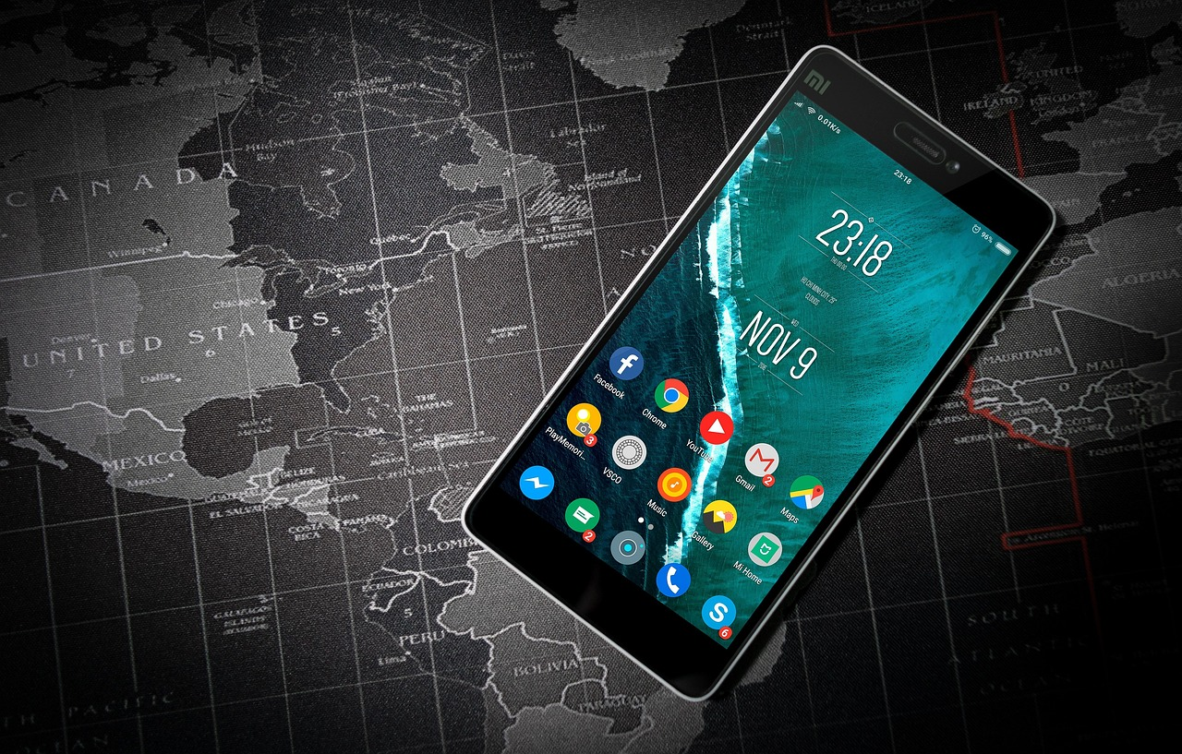
Introduction to Geospatial Technology
15
Objectives
Defining Geospatial Technology
Types of Maps and Their Uses
Define geospatial technology and explain its importance.
Describe the different types of maps and their uses.
Understanding Spatial Analysis
Real-World Applications
Explain the concept of spatial analysis and its applications.
Apply geospatial technology concepts and skills to real-world problems.

Slide 16

Introduction to Geospatial Technology
16
Vocabulary
Geospatial Technology
GIS
Spatial Analysis
Mapping
The use of computer hardware, software, and data to analyze and interpret geographic data.
Geographic information system, a computer-based system for analyzing and interpreting geographic data.
The process of analyzing and interpreting geographic data to understand patterns, relationships, and trends.
The process of creating a visual representation of geographic data.

Slide 17
Introduction to Geospatial Technology
17
Resources
ArcGIS Software
National Geographic Map Skills Workbook
ArcGIS software: a GIS software package used for analyzing and interpreting geographic data.
National Geographic Map Skills Workbook: a workbook that provides interactive exercises and activities for learning map skills.
GPS Devices
Online Geospatial Technology Tutorials
GPS devices: handheld devices used for navigating and collecting geographic data.
Online geospatial technology tutorials: tutorials and videos that provide step-by-step instructions on using GIS software and performing spatial analysis.

Slide 18
Introduction to Geospatial Technology
18
Conclusion
Power of Geospatial Technology
Applications Across Fields
Solving Real-World Problems
Geospatial technology is a powerful tool for analyzing and interpreting geographic data.
It has numerous applications in various fields, including urban planning, emergency response, and environmental conservation.
By applying geospatial technology concepts and skills, you can solve real-world problems and make informed decisions.

Slide 19

Introduction to Geospatial Technology
19
Reflection Questions
Learning Outcomes
What did you learn about geospatial technology in this lesson?
Real-World Applications
How can you apply geospatial technology concepts and skills to real-world problems?
Challenges and Limitations
What are some potential challenges and limitations of using geospatial technology?
Skill Development
How can you continue to learn and develop your skills in geospatial technology?

Slide 20

Introduction to Geospatial Technology
20
Next Steps
Skill Development
Real-World Application
Continue to learn and develop your skills in geospatial technology.
Apply geospatial technology concepts and skills to real-world problems.
Career Exploration
Staying Current
Explore career opportunities in geospatial technology.
Stay up-to-date with the latest developments and advancements in geospatial technology.

