Slide 1


Understanding International Systems: Evolution, Challenges, and Global Cooperation
A Comprehensive Overview of the Dynamics Shaping Global Politics, Organizations, and Governance

Slide 2
Table of Contents
Introduction to International Systems
The Treaty of Westphalia (1648)
The Concert of Europe (1815-1914)
The League of Nations (1920-1946)
The United Nations (1945-present)
Globalization and International Systems
Contemporary Challenges in International Relat…
International Organizations and Global Governa…
Non-State Actors and International Systems
Human Rights and International Systems
Conclusion
Key Takeaways
Reflection Questions
04
05
06
07
08
09
10
11
12
13
14
15
16

Slide 3
Table of Contents
Next Steps
Additional Resources
Conclusion and Final Thoughts
Final Reflection
17
18
19
20

Slide 4

Introduction to International Systems
Definition of International Systems
Factors Shaping International Systems
Importance of Understanding International Systems
International systems refer to the complex network of relationships between states, international organizations, and non-state actors that shape global politics, economies, and societies.
These systems are integral to understanding the interconnected nature of the modern world.
The evolution of international systems has been shaped by a range of factors, including politics, economics, and technology.
These elements collectively influence the dynamics and structure of global interactions.
Understanding international systems is crucial for navigating the complexities of global affairs and addressing global challenges.
This knowledge enables effective decision-making in a rapidly changing world.
4
Understanding International Systems: Evolution, Challenges, and Global Cooperation

Slide 5

The Treaty of Westphalia (1648)
Foundation of Nation-States
Principles of Sovereignty
Lasting Impact on Diplomacy
The Treaty of Westphalia marked the beginning of the modern system of nation-states, where sovereignty and non-interference in internal affairs became the guiding principles of international relations.
The treaty recognized the authority of individual states to govern their own territories and affairs, laying the foundation for the modern system of international relations.
The Treaty of Westphalia established the principle of sovereignty, allowing states to govern without external interference.
This principle became a cornerstone of international relations and diplomacy.
The Treaty of Westphalia has had a lasting impact on international relations, shaping the principles of sovereignty, non-interference, and diplomacy.
Its influence continues to be felt in the way modern states interact and resolve conflicts.
5
Understanding International Systems: Evolution, Challenges, and Global Cooperation

Slide 6

The Concert of Europe (1815-1914)
Origins and Purpose
Mechanisms of Operation
Legacy and Limitations
The Concert of Europe was a system of diplomacy and collective security that emerged after the Napoleonic Wars.
It aimed at maintaining balance and stability on the continent.
The Concert of Europe was characterized by regular meetings and negotiations between European powers.
These interactions helped to prevent major conflicts and maintain peace in Europe.
The Concert of Europe ultimately failed to prevent the outbreak of World War I.
However, it laid the groundwork for the development of modern international organizations.
6
Understanding International Systems: Evolution, Challenges, and Global Cooperation

Slide 7

The League of Nations (1920-1946)
Foundation and Purpose
Global Collaboration
Legacy and Influence
The League of Nations was an international organization established after World War I, aimed at promoting collective security and preventing future wars.
It was the first international organization to bring together nations from around the world to address global challenges.
The League of Nations brought together nations to promote peace and security on a global scale.
This marked a significant step in international cooperation and addressing worldwide issues.
Despite its limitations, the League of Nations laid the groundwork for modern international organizations.
It served as a precursor to the United Nations, shaping the framework for global governance.
7
Understanding International Systems: Evolution, Challenges, and Global Cooperation

Slide 8

The United Nations (1945-present)
1
Foundation and Purpose
The United Nations is an international organization established in 1945, aimed at promoting peace, security, and cooperation among nations.
It serves as a platform for dialogue and collaboration among member states to address global issues.
2
Impact on International Relations
The United Nations has played a crucial role in shaping international relations, from promoting decolonization to addressing global challenges such as climate change and human rights.
Its initiatives have influenced policies and fostered global partnerships to tackle pressing issues.
3
Evolution and Reforms
The United Nations has undergone significant reforms and expansions since its establishment, including the creation of new agencies and programs to address emerging global challenges.
These changes reflect its adaptability and commitment to addressing the needs of a changing world.
8
Understanding International Systems: Evolution, Challenges, and Global Cooperation

Slide 9
Globalization and International Systems
Defining Globalization
Emergence of New Global Actors
Opportunities and Challenges
Globalization refers to the increasing interconnectedness of the world's economies, societies, and cultures.
It has transformed the way nations interact and operate on a global scale.
Globalization has led to the emergence of new global actors, such as multinational corporations and non-governmental organizations.
These actors have challenged the traditional state-centric model of international relations.
Globalization has created new opportunities for international cooperation and collaboration.
However, it has also raised concerns about inequality, environmental degradation, and cultural homogenization.
9
Understanding International Systems: Evolution, Challenges, and Global Cooperation

Slide 10
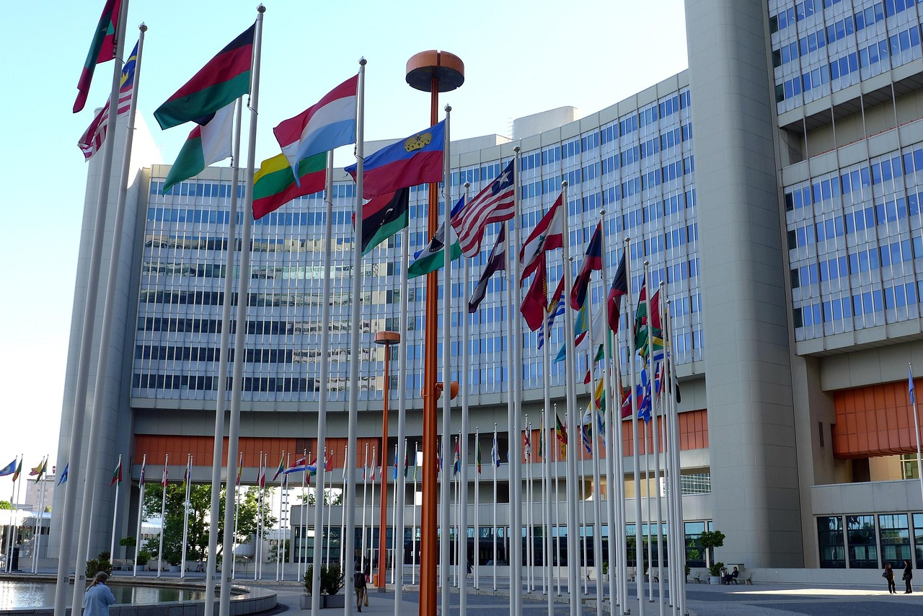
Contemporary Challenges in International Relations
1
Challenges in International Relations
Contemporary international relations are characterized by a range of challenges, including climate change, human rights, and conflict resolution.
These issues demand coordinated efforts and innovative solutions from the global community.
2
Emerging Global Powers
The rise of new global powers, such as China and India, has created new opportunities for international cooperation and collaboration.
However, it also raises concerns about the distribution of power and influence in the international system.
3
Adapting International Systems
International systems must adapt to address these challenges and promote peace, security, and cooperation among nations.
This adaptation is crucial for ensuring stability and fostering global partnerships.
10
Understanding International Systems: Evolution, Challenges, and Global Cooperation

Slide 11
International Organizations and Global Governance
1
2
3
Role of International Organizations
Understanding Global Governance
Challenges Faced by International Organizations
International organizations, such as the United Nations, play a crucial role in promoting global governance and addressing global challenges.
They serve as platforms for cooperation and coordination among nations to tackle pressing global issues.
Global governance refers to the system of rules, norms, and institutions that regulate global interactions and address global challenges.
It provides a framework for managing international relations and fostering collective action.
International organizations must work together to promote cooperation and address global challenges.
However, they face challenges such as funding, legitimacy, and effectiveness in achieving their goals.
11
Understanding International Systems: Evolution, Challenges, and Global Cooperation

Slide 12
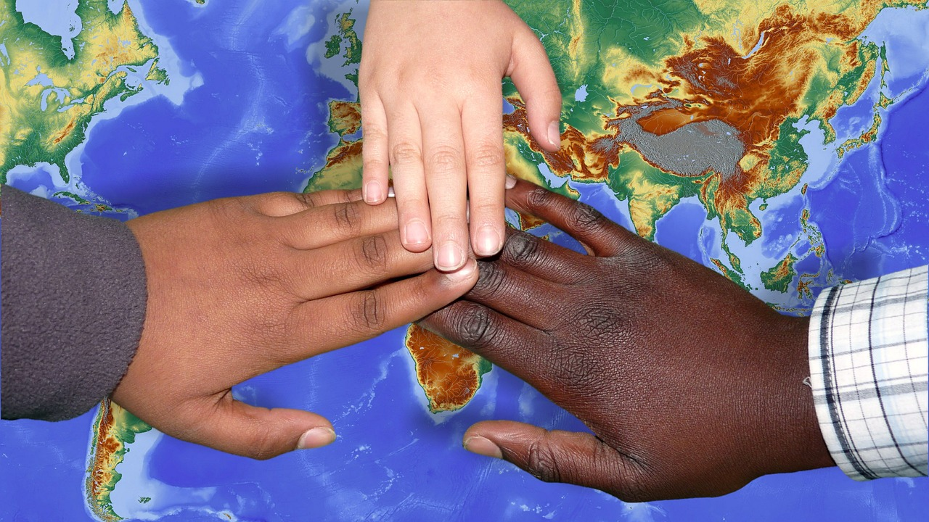
Non-State Actors and International Systems
1
2
3
Role of Non-State Actors
Challenges of Non-State Actors
Adapting International Systems
Non-state actors, such as multinational corporations and non-governmental organizations, play an increasingly important role in international systems.
They influence global policies and contribute to addressing international challenges.
Non-state actors raise concerns about accountability, transparency, and legitimacy.
Their growing influence necessitates mechanisms to ensure ethical and responsible behavior.
International systems must adapt to the growing influence of non-state actors.
Promoting cooperation and collaboration between states and non-state actors is essential for global progress.
12
Understanding International Systems: Evolution, Challenges, and Global Cooperation

Slide 13

Human Rights and International Systems
Fundamental Role of Human Rights
International Human Rights Instruments
Challenges in Human Rights Implementation
Human rights are a fundamental aspect of international systems, promoting dignity, justice, and equality for all individuals.
They serve as a cornerstone for fostering global cooperation and mutual respect among nations.
International systems have established a range of human rights instruments and mechanisms, including the Universal Declaration of Human Rights and the International Criminal Court.
These frameworks aim to protect individuals and hold violators accountable on a global scale.
Human rights are essential for promoting peace, security, and cooperation among nations, but also face challenges such as implementation, enforcement, and cultural relativism.
Addressing these challenges requires collective efforts and innovative solutions from the international community.
13
Understanding International Systems: Evolution, Challenges, and Global Cooperation

Slide 14

Conclusion
Evolution of International Systems
Importance of Understanding Global Affairs
Adapting to Emerging Challenges
International systems have evolved significantly since the Treaty of Westphalia, shaped by a range of factors including politics, economics, and technology.
This evolution highlights the dynamic nature of global interactions and the need for continuous adaptation.
Understanding international systems is crucial for navigating the complexities of global affairs and addressing global challenges.
It provides a framework for analyzing and responding to the interconnected issues facing the world today.
International systems must adapt to promote peace, security, and cooperation among nations.
They must also address emerging global challenges such as climate change, human rights, and conflict resolution.
14
Understanding International Systems: Evolution, Challenges, and Global Cooperation

Slide 15

Key Takeaways
1
The Treaty of Westphalia
The Treaty of Westphalia marked the beginning of the modern system of nation-states.
It established principles that continue to influence international relations today.
2
Impact of Globalization
Globalization has led to the emergence of new global actors and challenges.
These changes demand innovative approaches to governance and cooperation.
3
Adapting International Systems
International systems must adapt to promote peace, security, and cooperation among nations.
Such adaptations are crucial for addressing contemporary global issues.
15
Understanding International Systems: Evolution, Challenges, and Global Cooperation

Slide 16

Reflection Questions
1
Key Factors in Evolution
What are the key factors that have shaped the evolution of international systems?
These factors include historical events, power dynamics, and technological advancements.
2
Globalization and Non-State Actors
How have globalization and non-state actors influenced international systems?
They have introduced new dimensions of interconnectivity and shifted traditional power structures.
3
Challenges and Solutions
What are the major challenges facing international systems today, and how can they be addressed?
Challenges include climate change, inequality, and conflict, which require collaborative global efforts to resolve.
16
Understanding International Systems: Evolution, Challenges, and Global Cooperation

Slide 17
Next Steps
1
Globalization's Impact
Explore the rise of globalization and its impact on international systems.
Understand how interconnected economies and cultures shape global dynamics.
2
Contemporary Challenges
Examine contemporary challenges in international relations, such as climate change and human rights.
Analyze the implications of these challenges on global stability and cooperation.
3
Global Governance
Develop a deeper understanding of international organizations and global governance.
Investigate their roles in addressing worldwide issues and fostering collaboration.
17
Understanding International Systems: Evolution, Challenges, and Global Cooperation

Slide 18
Additional Resources
United Nations Website
International Relations Textbook
Online Course on Coursera
Explore the official United Nations website for comprehensive information on global issues.
Visit [www.un.org](http://www.un.org) to access resources and updates on international relations.
Dive into 'International Relations' by Joshua S. Goldstein and Jon C. Pevehouse for an in-depth understanding.
This textbook is a key resource for students and professionals in the field.
Enroll in the 'International Relations' course on Coursera to enhance your knowledge.
This online course offers flexible learning opportunities for global studies enthusiasts.
18
Understanding International Systems: Evolution, Challenges, and Global Cooperation

Slide 19
Conclusion and Final Thoughts
1
Complexity of International Systems
International systems are complex and dynamic, shaped by a range of factors including politics, economics, and technology.
Understanding international systems is crucial for navigating the complexities of global affairs and addressing global challenges.
2
Promoting Global Cooperation
By working together, we can promote peace, security, and cooperation among nations.
Collaborative efforts are essential to address emerging global challenges effectively.
3
Navigating Global Affairs
Understanding the dynamics of international systems is key to addressing global challenges.
This knowledge enables nations to work towards sustainable solutions for global issues.
19
Understanding International Systems: Evolution, Challenges, and Global Cooperation

Slide 20
Final Reflection
Learning About International Systems
Applying Knowledge to Real-World Scenarios
Implications for Global Governance
What did you learn about international systems?
How can you apply your knowledge of international systems to real-world scenarios?
How can you apply your knowledge of international systems to real-world scenarios?
What are the implications of international systems for global governance and cooperation?
What are the implications of international systems for global governance and cooperation?
What did you learn about international systems?
20
Understanding International Systems: Evolution, Challenges, and Global Cooperation

