Slide 1
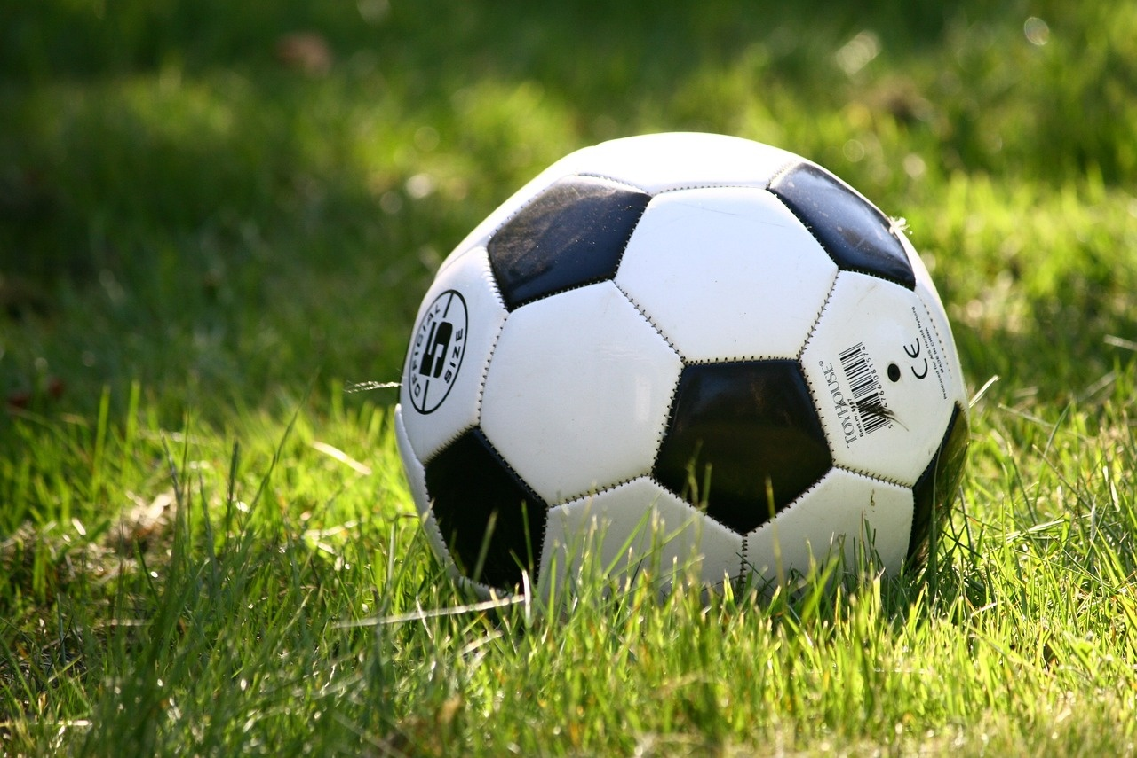
Mastering Football Fundamentals
A Comprehensive Guide to Football Basics and Skill Development

Slide 2
Table of contents
01
02
03
04
05
06
Introduction
Personalized Homework Assignment
Touchdown Time: Mastering the Fundamentals of Football
Learning Objectives
Football Basics 🏈
Skill Drill

Slide 3

1
Introduction
01
Adaptive homework assignments
02
Tailoring content and difficulty
Enhance student learning and engagement.
Creates a personalized learning experience.
03
Benefits
Better understanding
Positive attitude towards learning
Sense of accomplishment
Mastering Football Fundamentals

Slide 4
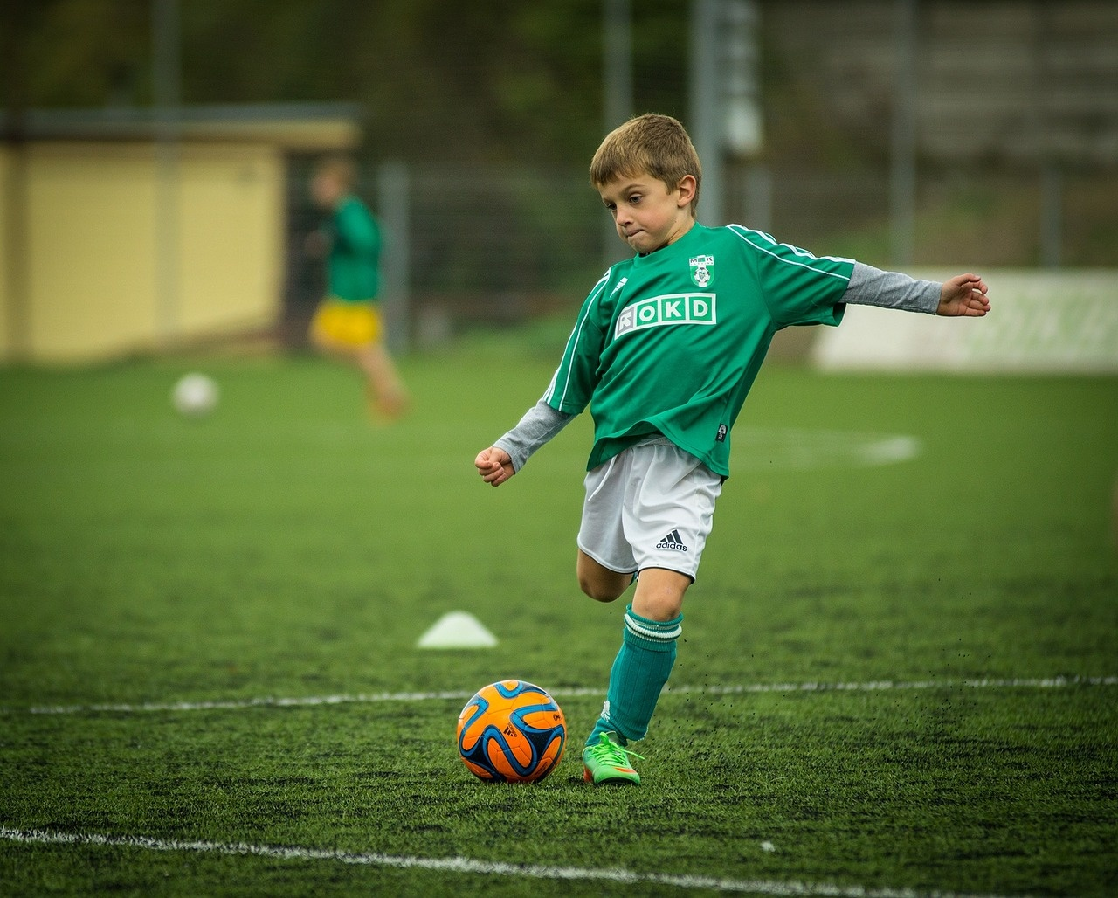
2
Personalized Homework Assignment
01
Football Basics 🏈
02
Skill Drill
Explain the objective of the game and the roles of the offense and defense.
Estimated time: 10 minutes
Practice passing, receiving, and tackling techniques.
Estimated time: 20 minutes
Mastering Football Fundamentals

Slide 5
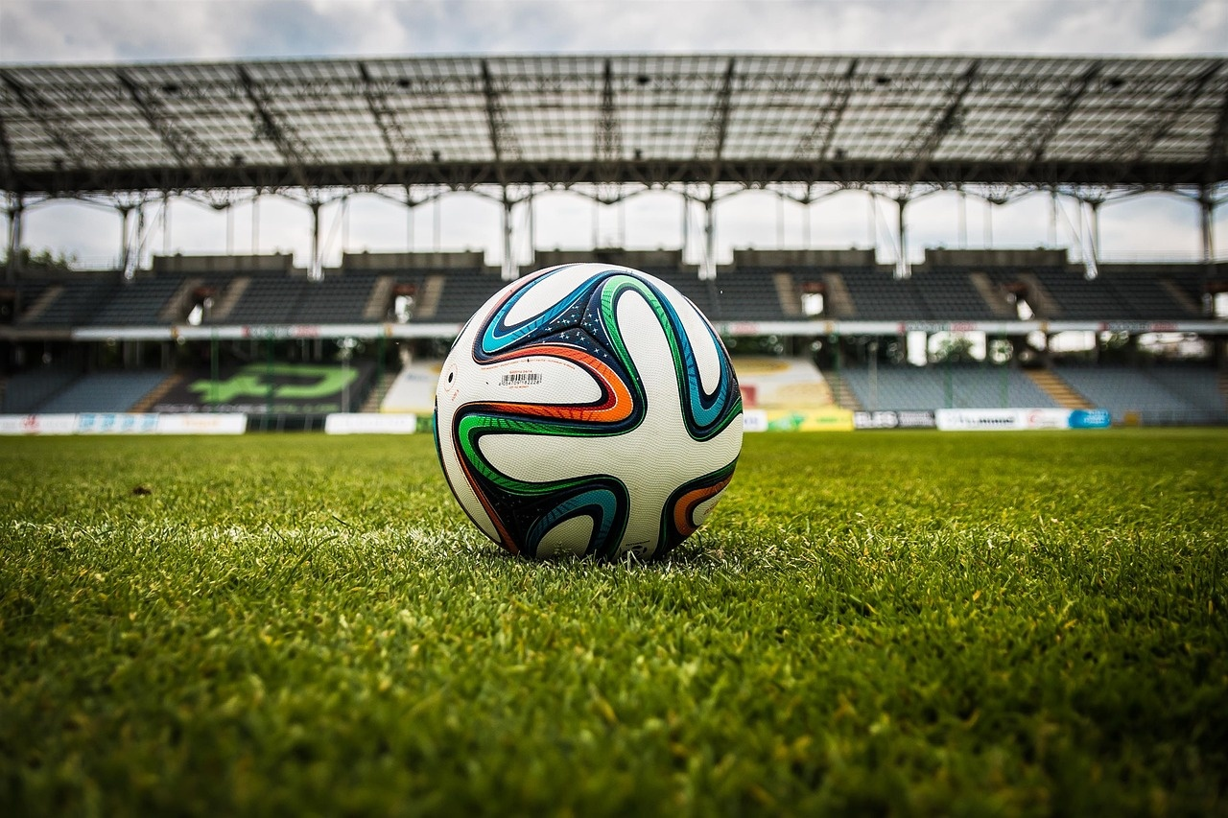
3
Touchdown Time: Mastering the Fundamentals of Football
Football Basics 🏈
Explain the objective of the game and the roles of the offense and defense.
Estimated time: 10 minutes
Skill Drill
Practice fundamental skills such as passing, catching, and tackling.
Focus on technique and precision to improve overall performance.
Mastering Football Fundamentals

Slide 6
4
Learning Objectives
01
02
03
Understand the basic rules and objectives of the game of football
Develop proficiency in identifying and executing fundamental football skills
Apply critical thinking to analyze game scenarios and make strategic decisions
Learn the rules of the game
Understand the objectives of each team
Familiarize with the roles of each player
Practice dribbling
Improve passing accuracy
Enhance shooting techniques
Study different game scenarios
Learn to make quick decisions
Understand strategic plays
Mastering Football Fundamentals

Slide 7
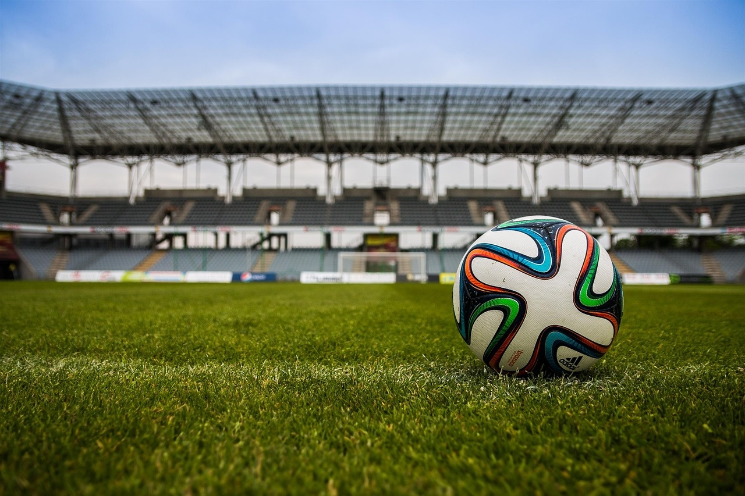
5
Football Basics 🏈
01
Objective of the Game
02
Roles of Offense and Defense
The main objective of football is to score points by advancing the ball into the opposing team's end zone for a touchdown or by kicking it through the opponent's goalposts for a field goal.
Offense: The team with possession of the ball, aiming to score points.
Defense: The team without possession of the ball, working to prevent the offense from scoring.
03
Key Positions
04
Basic Rules
Quarterback: Leader of the offense, responsible for passing or running the ball.
Running Back: Primary ball carrier, running with the ball to gain yards.
Wide Receiver: Catches passes from the quarterback to advance the ball down the field.
Linebacker: Defensive player who stops the run, covers receivers, and rushes the quarterback.
Each team has 11 players on the field at a time.
The game is divided into four quarters, each lasting 15 minutes.
Teams can advance the ball by running or passing, with the ultimate goal of scoring touchdowns or field goals.
Mastering Football Fundamentals

Slide 8
6
Skill Drill
01
02
03
04
Passing Accuracy
Dribbling Skills
Shooting Technique
Defensive Positioning
Practice short, medium, and long-range passes to improve accuracy.
Set targets to aim for to enhance precision.
Focus on proper technique and follow-through.
Work on close ball control by weaving through cones or defenders.
Practice quick changes of direction and speed.
Incorporate feints and tricks to deceive opponents.
Practice shooting with both feet to become a versatile striker.
Focus on striking the ball cleanly with the correct part of the foot.
Work on accuracy and power in various shooting scenarios.
Learn to anticipate the opponent's movements and position yourself effectively.
Practice tackling techniques to dispossess opponents safely.
Work on marking and tracking runners to maintain defensive shape.
Mastering Football Fundamentals

