Slide 1
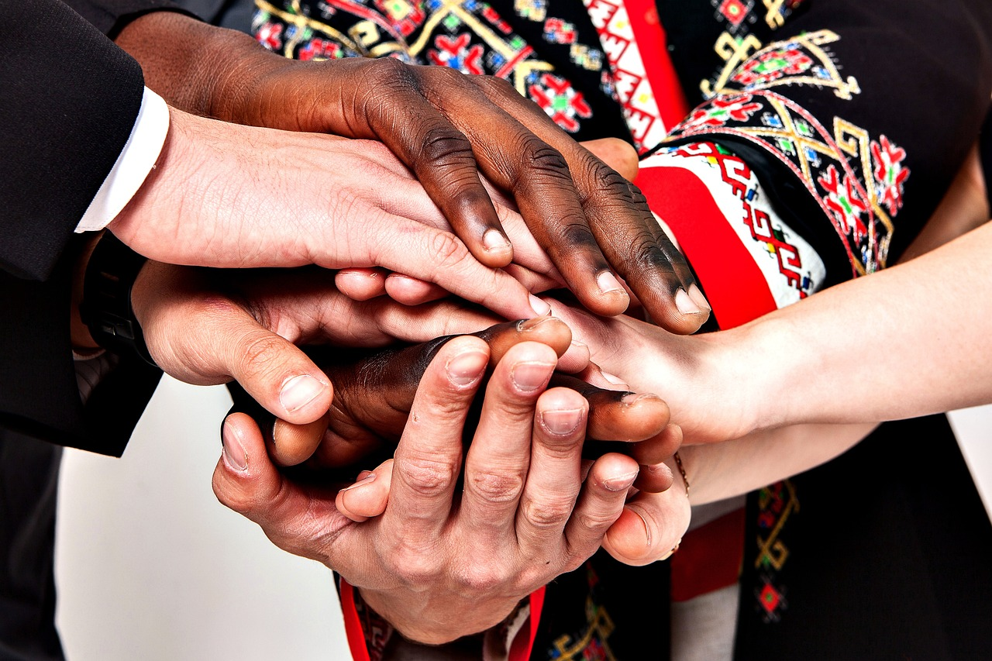
Understanding Boundaries and Consent
Building Respectful and Healthy Relationships through Personal Space and Mutual Agreement

Slide 2
Table of Contents
Introduction to Boundaries and Consent
Why are Boundaries Important?
What is Personal Space?
Asking for Permission
Respecting Boundaries
Boundary Role-Play
Consent Scenarios
Boundary Mapping
Feelings and Needs
Assertiveness and Self-Advocacy
Healthy Relationships
Conclusion
Reflection Questions
04
05
06
07
08
09
10
11
12
13
14
15
16

Slide 3
Table of Contents
Next Steps
Additional Resources
Final Thoughts
Assessment and Evaluation
Conclusion and Summary
17
18
19
20
21

Slide 4
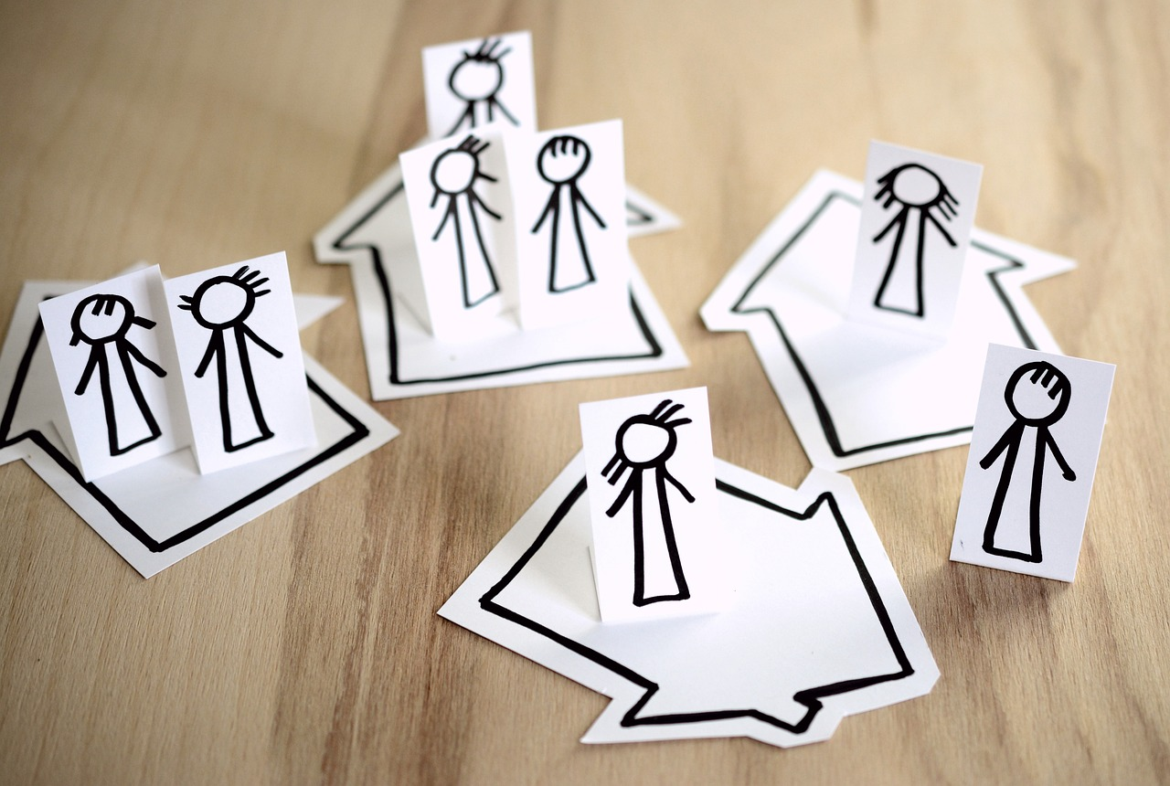
Introduction to Boundaries and Consent
Understanding Boundaries
The Concept of Consent
Importance of Boundaries and Consent
Boundaries are like magic circles around our body that keep us safe.
They help us define personal space and protect our emotional and physical well-being.
Consent is when someone agrees to something, like a hug or a touch.
It ensures mutual respect and understanding in interactions.
Boundaries and consent are essential for healthy relationships.
They promote trust, safety, and respect among individuals.
4
Understanding Boundaries and Consent

Slide 5

Why are Boundaries Important?
Creating a Safe Space
Fostering Healthy Relationships
Respecting Personal Space
Boundaries help us feel safe and comfortable.
They ensure that everyone knows their limits and respects them.
They help us build strong and healthy relationships.
Boundaries encourage mutual respect and understanding.
Boundaries are like rules that help us respect each other's space.
They prevent conflicts and promote harmony in interactions.
5
Understanding Boundaries and Consent

Slide 6

What is Personal Space?
Understanding Personal Space
Respecting Boundaries
The Importance of Comfort Zones
Personal space is the area around our body that we feel comfortable with.
It's like having our own special bubble that we can control.
We need to respect others' personal space to build trust.
Strong relationships are built on mutual understanding of personal boundaries.
Personal space contributes to our sense of comfort and security.
It plays a key role in social interactions and emotional well-being.
6
Understanding Boundaries and Consent

Slide 7

Asking for Permission
Importance of Asking Permission
Examples of Asking Permission
Respecting Responses
We need to ask for permission before touching or hugging someone.
This ensures respect for personal boundaries and comfort.
We can say 'May I give you a hug?' or 'May I hold your hand?'
These phrases help communicate our intentions clearly.
It's essential to respect others' answers, even if it's no.
Acknowledging their decision shows empathy and understanding.
7
Understanding Boundaries and Consent

Slide 8

Respecting Boundaries
1
Building Trust Through Boundaries
We need to respect others' boundaries to build trust and strong relationships.
Respecting boundaries fosters mutual understanding and strengthens connections.
2
Permission Before Physical Contact
We can respect boundaries by not touching or hugging someone without permission.
Seeking consent ensures comfort and maintains personal space.
3
Listening and Understanding Needs
We can also respect boundaries by listening to others and understanding their needs.
Active listening helps in recognizing and honoring individual preferences.
8
Understanding Boundaries and Consent

Slide 9

Boundary Role-Play
Introduction to Boundary Role-Play
Let's practice respecting boundaries through role-playing!
This activity helps us understand the importance of personal space and consent.
Scenario Practice
We can act out different scenarios, like asking for permission or respecting someone's space.
These role-plays allow us to explore real-life situations in a safe environment.
Key Reminder
Remember to always respect others' boundaries and answers.
This ensures a positive and respectful interaction for everyone involved.
9
Understanding Boundaries and Consent

Slide 10
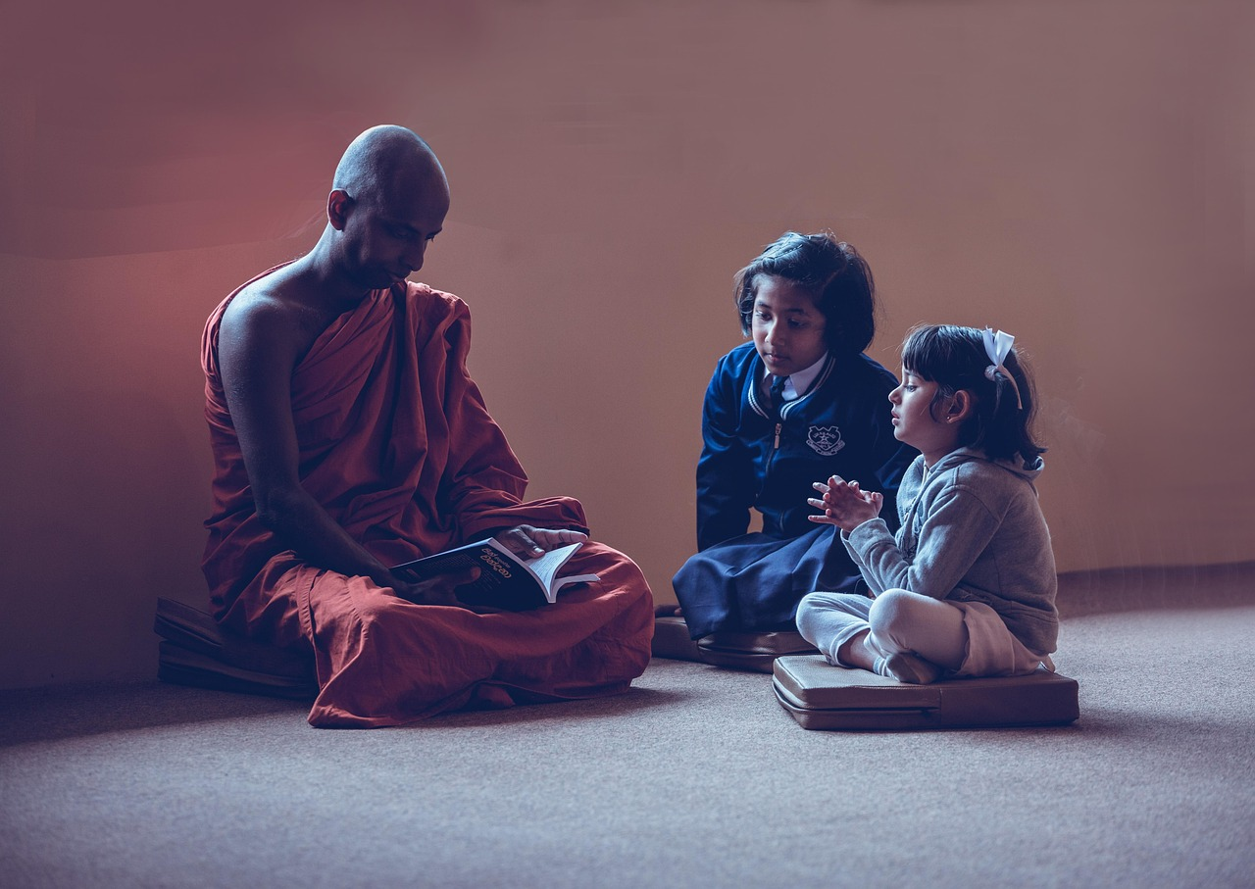
Consent Scenarios
1
Understanding Consent
Let's discuss different scenarios that require consent.
For example, if someone wants to borrow a toy or give a hug.
2
Critical Thinking in Scenarios
We need to think critically about what we would do in each scenario.
Consent is essential in everyday interactions.
3
Respecting Boundaries
Recognizing the importance of asking for consent is key.
It helps in building trust and mutual respect.
10
Understanding Boundaries and Consent

Slide 11

Boundary Mapping
1
2
3
Visualizing Personal Space
Adding Safety Elements
Creative Expression
Let's create a boundary map to visualize our personal space!
We can draw a picture of ourselves and our boundary.
We can also include things that make us feel safe.
These elements help us create a comforting environment.
Drawing and mapping our boundaries is a form of self-expression.
It allows us to better understand and communicate our needs.
11
Understanding Boundaries and Consent

Slide 12

Feelings and Needs
Understanding Feelings and Needs
Using 'I' Statements
Example of Expressing Feelings
We need to understand and express our feelings and needs.
This helps in building better communication and relationships.
We can use 'I' statements to communicate our feelings and needs.
This approach makes our communication more personal and clear.
For example, 'I feel happy when you respect my boundary.'
Such statements help in expressing emotions effectively.
12
Understanding Boundaries and Consent

Slide 13

Assertiveness and Self-Advocacy
Setting Boundaries
Expressing Needs
Advocating for Respect
We need to be assertive and advocate for ourselves.
We can say 'no' or 'stop' if someone is not respecting our boundary.
We need to be assertive and advocate for ourselves.
We can also use kind words to express our needs and feelings.
We need to be assertive and advocate for ourselves.
We can say 'no' or 'stop' if someone is not respecting our boundary.
13
Understanding Boundaries and Consent

Slide 14
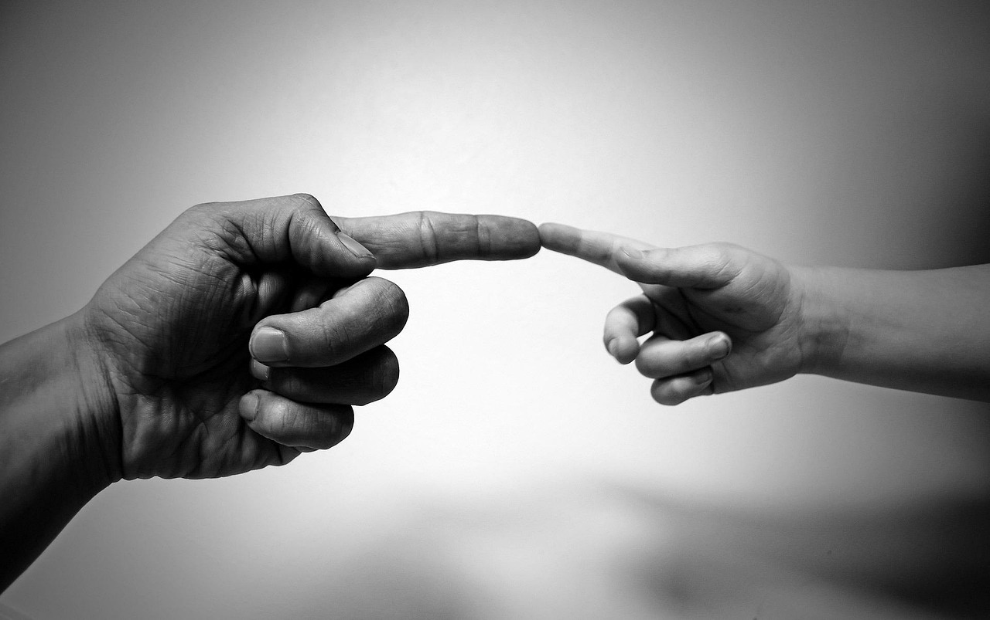
Healthy Relationships
1
Foundations of Healthy Relationships
Healthy relationships are built on respect, trust, and communication.
We need to respect others' boundaries and feelings.
2
Building Strong Connections
We can build strong and healthy relationships by being kind and empathetic.
Respect and empathy are key to fostering meaningful connections.
3
The Role of Communication
Open and honest communication strengthens relationships.
It helps in understanding and addressing each other's needs effectively.
14
Understanding Boundaries and Consent

Slide 15

Conclusion
1
Understanding Boundaries
We learned about boundaries and consent today!
We need to respect others' boundaries and ask for permission.
2
Respecting Others
Respecting boundaries is essential for healthy relationships.
Asking for permission shows care and understanding.
3
Building Healthy Relationships
Let's practice respecting boundaries and building healthy relationships!
Healthy relationships are built on mutual respect and consent.
15
Understanding Boundaries and Consent

Slide 16

Reflection Questions
1
2
3
Learning About Boundaries and Consent
Challenges in Respecting Boundaries
Applying Lessons to Daily Life
What did you learn about boundaries and consent today?
How can you apply what you learned to your daily life?
What are some challenges you might face when respecting boundaries?
How can you overcome them?
How can you apply what you learned to your daily life?
What did you learn about boundaries and consent today?
16
Understanding Boundaries and Consent

Slide 17
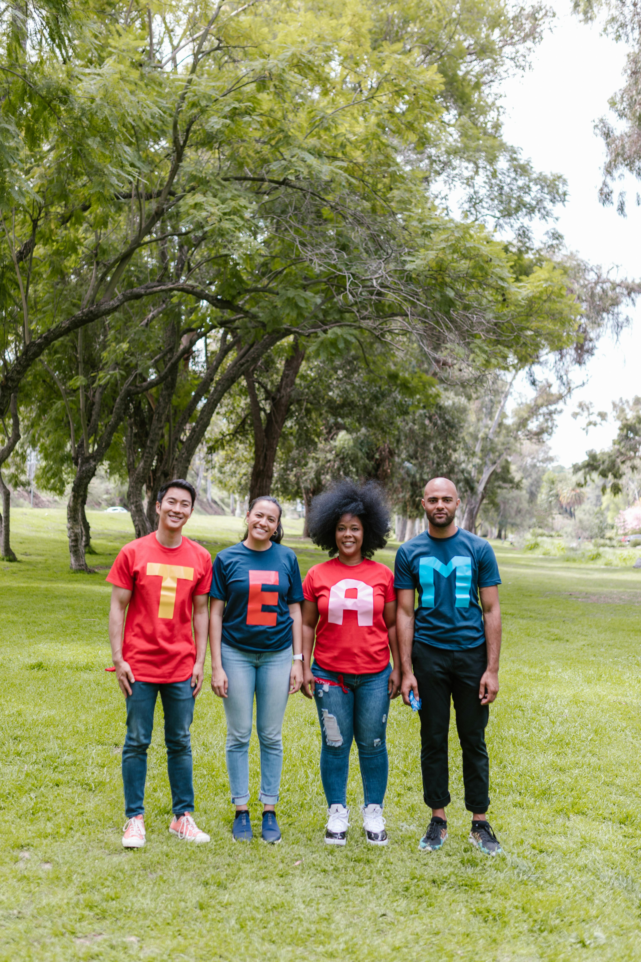
Next Steps
Learning Social Skills
Practicing Healthy Relationships
Creating a Positive Community
We will continue to learn about social skills and relationships.
This will help us understand how to interact effectively with others.
We will practice respecting boundaries and building healthy relationships.
This is essential for fostering trust and mutual respect.
Let's work together to create a positive and respectful community.
Collaboration is key to achieving a supportive environment.
17
Understanding Boundaries and Consent

Slide 18
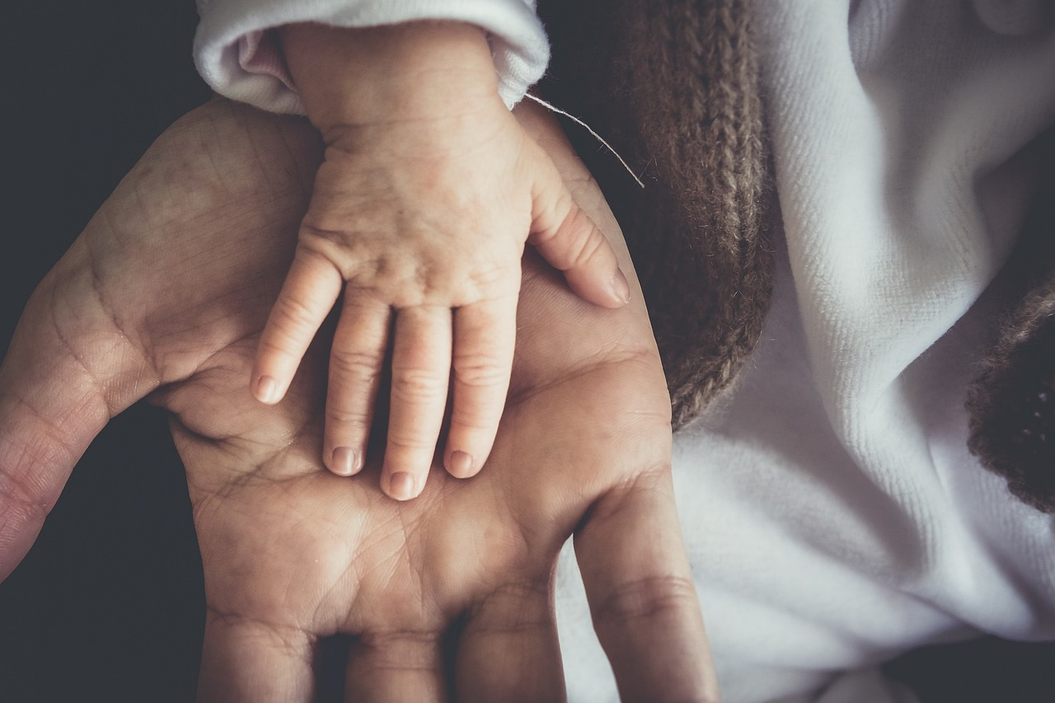
Additional Resources
Trusted Adults
Books and Videos
Learning Opportunities
You can talk to a trusted adult, such as a parent or teacher.
They can provide guidance and support on boundaries and consent.
You can also read books or watch videos about boundaries and consent.
These resources can help you understand the topic better.
There are many resources available to help you learn more about boundaries and consent.
Exploring these can enhance your knowledge and awareness.
18
Understanding Boundaries and Consent

Slide 19

Final Thoughts
1
Understanding Boundaries
Boundaries are like magic circles around our body that keep us safe.
They help us maintain personal space and emotional security.
2
The Importance of Consent
Consent is when someone agrees to something, like a hug or a touch.
It ensures mutual respect and understanding in interactions.
3
Building Healthy Relationships
Respecting each other's boundaries is key to strong relationships.
This practice fosters trust and emotional well-being.
19
Understanding Boundaries and Consent

Slide 20
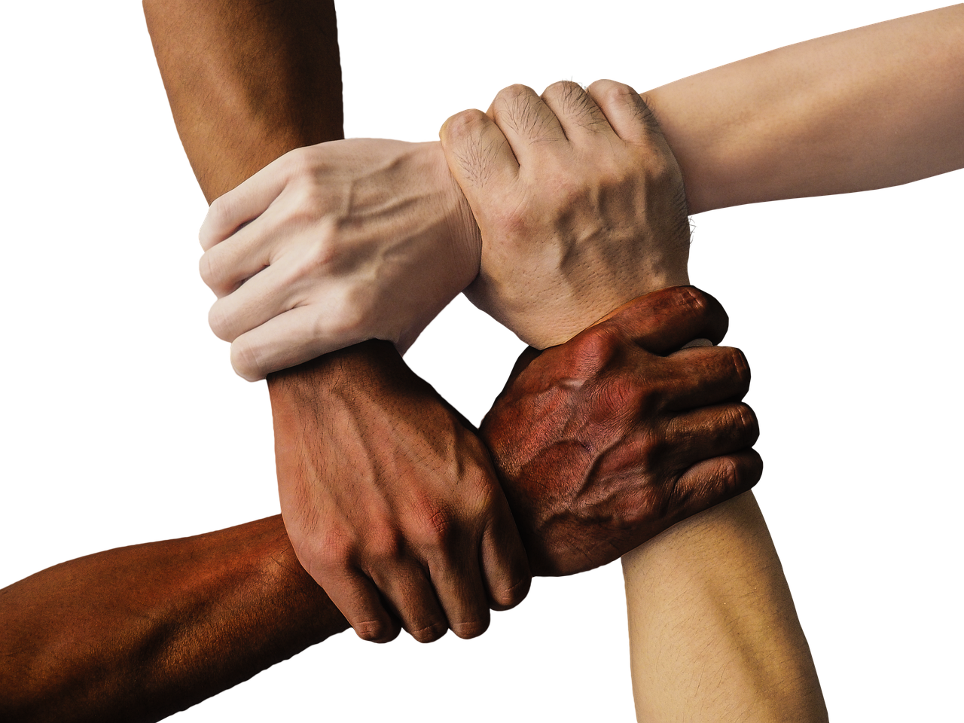
Assessment and Evaluation
Understanding Boundaries and Consent
We will assess your understanding of boundaries and consent through quizzes and discussions.
This will help ensure a clear grasp of these essential concepts.
Respecting Boundaries and Relationships
We will evaluate your ability to respect boundaries and build healthy relationships.
This evaluation will focus on fostering mutual respect and understanding.
Creating a Respectful Community
Let's work together to create a positive and respectful community.
Collaboration is key to achieving this shared goal.
20
Understanding Boundaries and Consent

Slide 21
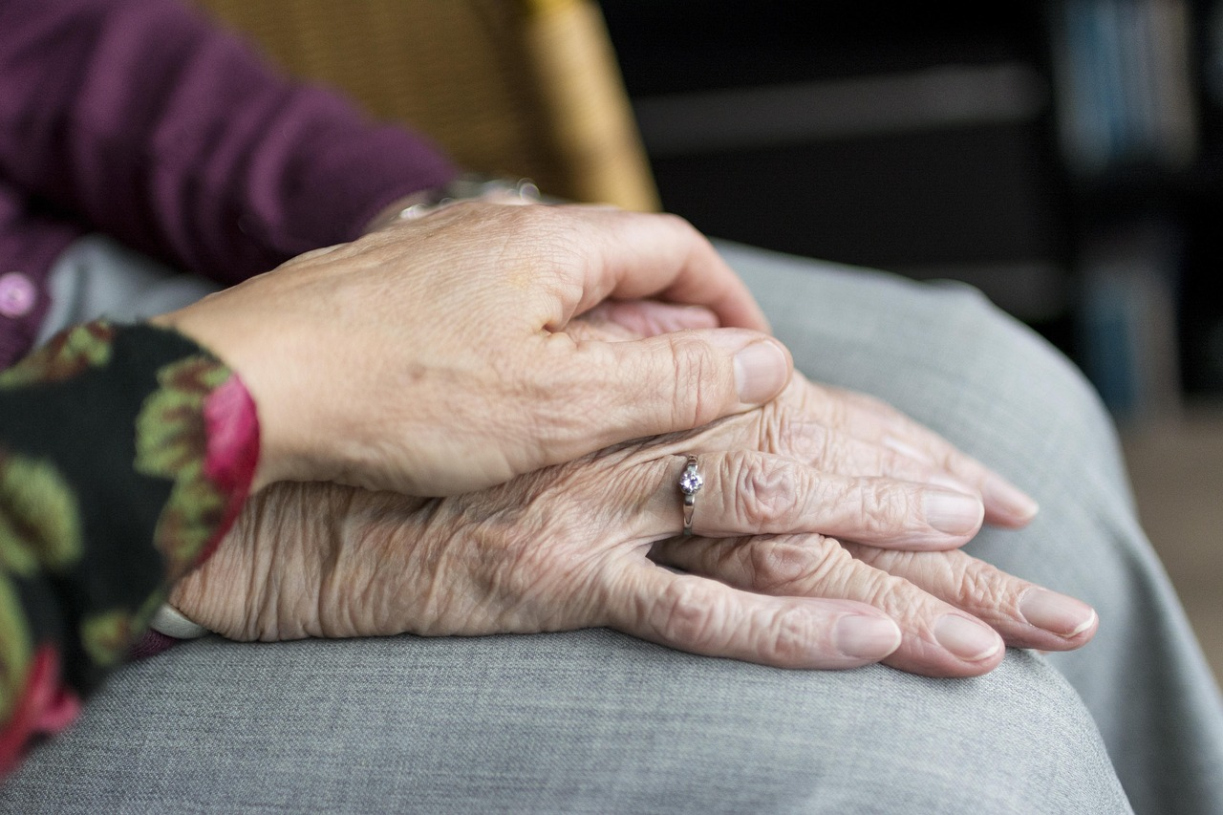
Conclusion and Summary
Understanding Boundaries
Respecting Others
Practicing Healthy Relationships
We learned about boundaries and consent today!
Boundaries help us maintain respect and understanding in relationships.
We need to respect others' boundaries and ask for permission.
Respecting boundaries is essential for building trust and mutual respect.
Let's practice respecting boundaries and building healthy relationships!
Healthy relationships thrive on mutual respect and understanding.
21
Understanding Boundaries and Consent

