Slide 1

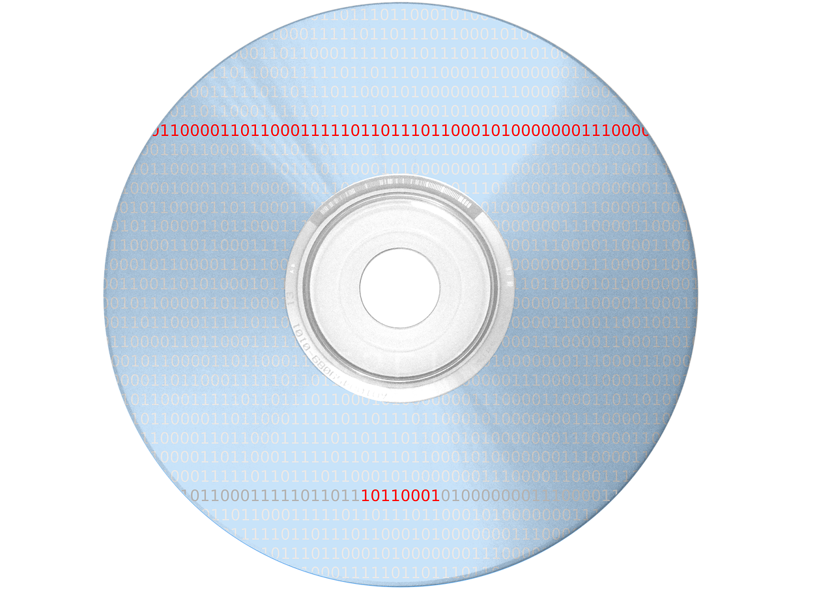
Understanding Number Base Systems and Their Applications
Exploring Binary, Hexadecimal, and Programming Concepts in Technology and Digital Media

Slide 2
Table of Contents
Introduction to Number Base Systems
What is Binary?
What is Hexadecimal?
Converting Between Number Base Systems
Real-World Applications of Number Base Systems
Introduction to Programming Concepts
Binary Code in Computer Programming
Hexadecimal Colors in Web Design
Number Base Systems in Cryptography
Binary Search in Data Analysis
Number Base Systems in Computer Networks
Common Errors and Misconceptions
Conclusion
04
05
06
07
08
09
10
11
12
13
14
15
16

Slide 3
Table of Contents
Key Takeaways
Next Steps
Reflection Questions
Additional Resources
Parent Engagement
Safety Considerations
Teaching Tips
Homework and Extension Activities
Final Thoughts
17
18
19
20
21
22
23
24
25

Slide 4

Introduction to Number Base Systems
Understanding Number Base Systems
Common Number Base Systems
Importance in Technology
Number base systems are a way of representing numbers using a specific set of digits and place values.
Understanding number base systems is essential in computer programming and digital media.
The most common number base systems are decimal (base 10), binary (base 2), and hexadecimal (base 16).
These systems are widely used in various fields, including mathematics and technology.
Number base systems play a crucial role in computer programming.
They are fundamental to the functioning of digital media and electronic devices.
4
Understanding Number Base Systems and Their Applications

Slide 5

What is Binary?
Understanding Binary
Binary in Computing
Foundation of Digital Technology
Binary is a base-2 number system that uses only two digits: 0 and 1.
It is a fundamental concept in mathematics and computing.
Binary numbers are used in computer programming to represent instructions and data.
This allows computers to process and store information efficiently.
Binary is the foundation of all digital technology.
It underpins the operation of modern devices like smartphones, computers, and more.
5
Understanding Number Base Systems and Their Applications

Slide 6

What is Hexadecimal?
Understanding Hexadecimal
Hexadecimal is a base-16 number system that uses 16 digits: 0-9 and A-F.
It is a compact way to represent numbers, especially in computing contexts.
Hexadecimal in Digital Media
Hexadecimal numbers are used in website design and digital media to represent colors and graphics.
This system allows precise specification of colors using combinations of digits and letters.
Applications in Programming
Hexadecimal is commonly used in computer programming and web development.
It simplifies the representation of binary data and memory addresses.
6
Understanding Number Base Systems and Their Applications

Slide 7

Converting Between Number Base Systems
Importance in Programming and Digital Media
Decimal to Binary Conversion Process
Binary to Decimal Conversion Process
Converting between number base systems is an essential skill in computer programming and digital media.
It enables efficient data representation and manipulation in various applications.
Decimal to binary conversion involves dividing the decimal number by 2 and keeping track of the remainders.
This method systematically breaks down the number into its binary components.
Binary to decimal conversion involves multiplying the binary digits by the corresponding powers of 2.
This approach reconstructs the decimal value from its binary representation.
7
Understanding Number Base Systems and Their Applications

Slide 8
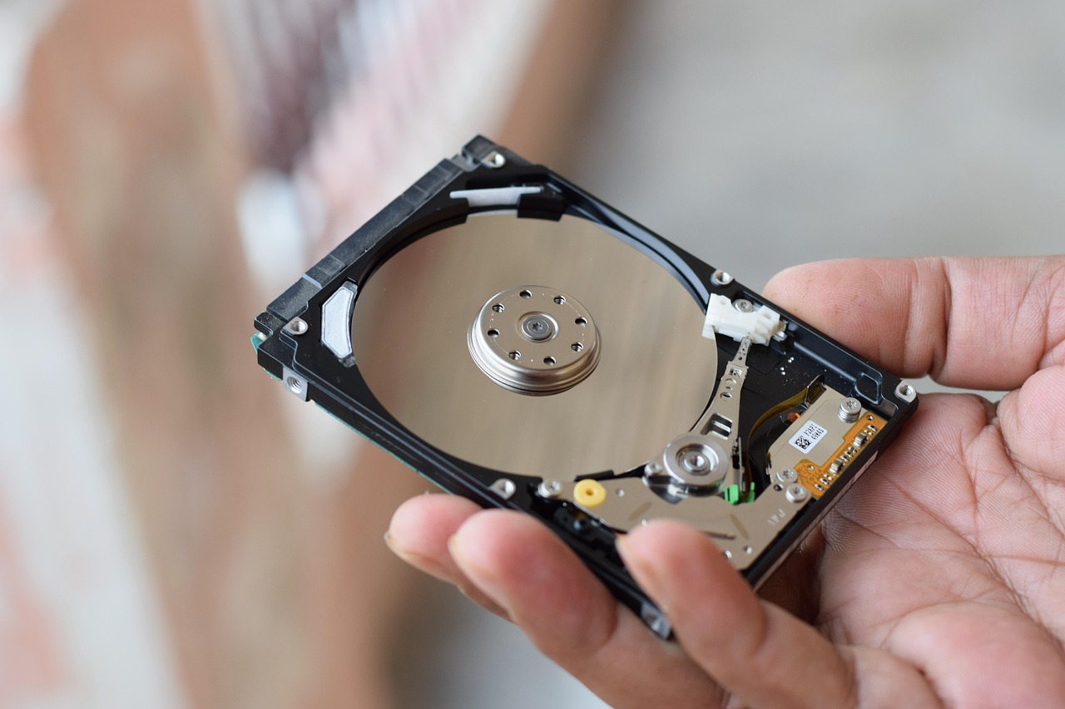
Real-World Applications of Number Base Systems
Computer Programming
Number base systems are used in computer programming to write instructions that a computer can understand.
These systems enable programmers to communicate effectively with machines.
Data Storage and Retrieval
Number base systems are used in data storage and retrieval to represent and store data efficiently.
This ensures that large amounts of information can be processed and accessed quickly.
Cryptography
Number base systems are used in cryptography to create secure codes and ciphers.
These systems play a crucial role in protecting sensitive information.
8
Understanding Number Base Systems and Their Applications

Slide 9

Introduction to Programming Concepts
Designing and Testing Instructions
Role of Programming Languages
Key Programming Concepts
Programming involves designing, writing, and testing instructions that a computer can execute.
These instructions are essential for creating functional software applications.
Programming languages, such as Scratch or Python, are used to write programs.
These languages provide the syntax and structure needed to communicate with computers.
Programming concepts, such as variables and loops, are used to solve problems and complete tasks.
They form the building blocks for creating efficient and effective programs.
9
Understanding Number Base Systems and Their Applications

Slide 10

Binary Code in Computer Programming
Role of Binary Code
Structure of Binary Code
Application in Programming
Binary code is used in computer programming to represent instructions and data.
It is the fundamental language that computers understand.
Binary code is made up of 0s and 1s that a computer can understand.
These binary digits are the building blocks of all computer operations.
Binary code is used in low-level programming languages, such as assembly language.
These languages interact directly with the hardware of a computer.
10
Understanding Number Base Systems and Their Applications

Slide 11
Hexadecimal Colors in Web Design
Introduction to Hexadecimal Colors
Structure of Hexadecimal Codes
Role in Web Development
Hexadecimal colors are used in web design to represent colors and graphics.
They are an essential tool for creating visually appealing websites.
Hexadecimal colors are represented using a six-digit code, such as #FF0000.
This code specifies the intensity of red, green, and blue in the color.
Hexadecimal colors are widely used in web development.
They help developers design websites with precise and consistent color schemes.
11
Understanding Number Base Systems and Their Applications

Slide 12

Number Base Systems in Cryptography
Role of Number Base Systems in Cryptography
Binary and Hexadecimal in Encryption
Secure Passwords and Keys
Number base systems are used in cryptography to create secure codes and ciphers.
They play a fundamental role in ensuring data security.
Binary and hexadecimal numbers are used to represent encrypted data.
These systems simplify the representation of complex encryption algorithms.
Number base systems are used to create secure passwords and encryption keys.
This ensures robust protection against unauthorized access.
12
Understanding Number Base Systems and Their Applications

Slide 13

Binary Search in Data Analysis
Introduction to Binary Search
Binary search is an efficient algorithm used to find a specific item in a large dataset.
It is widely used in computer science and data analysis for its speed and efficiency.
How Binary Search Works
Binary search works by dividing the search space in half.
It repeatedly searches for the item in one of the two halves until the item is found.
Applications in Data Analysis
Binary search is used in data analysis to quickly find specific data points.
This makes it a valuable tool for handling large datasets efficiently.
13
Understanding Number Base Systems and Their Applications

Slide 14

Number Base Systems in Computer Networks
Role of Number Base Systems in Networking
Number base systems are used in computer networks to assign IP addresses and perform routing operations.
They play a crucial role in ensuring efficient communication between devices.
Binary and Hexadecimal in Network Protocols
Binary and hexadecimal numbers are used to represent IP addresses and network protocols.
These systems simplify the representation and processing of complex data.
Security Applications of Number Base Systems
Number base systems are used to create secure network protocols and encryption methods.
This ensures the protection of sensitive information in computer networks.
14
Understanding Number Base Systems and Their Applications

Slide 15
Common Errors and Misconceptions
Binary vs Decimal Confusion
Hexadecimal Code Misuse
Challenges with Binary Search
Confusing binary and decimal numbers is a common error.
This can lead to significant mistakes in calculations and programming.
Incorrect use of hexadecimal codes can lead to errors in web design and digital media.
Such errors can affect the visual and functional aspects of digital projects.
Difficulty with binary search can lead to errors in data analysis.
This can result in inefficiencies and inaccuracies in processing large datasets.
15
Understanding Number Base Systems and Their Applications

Slide 16
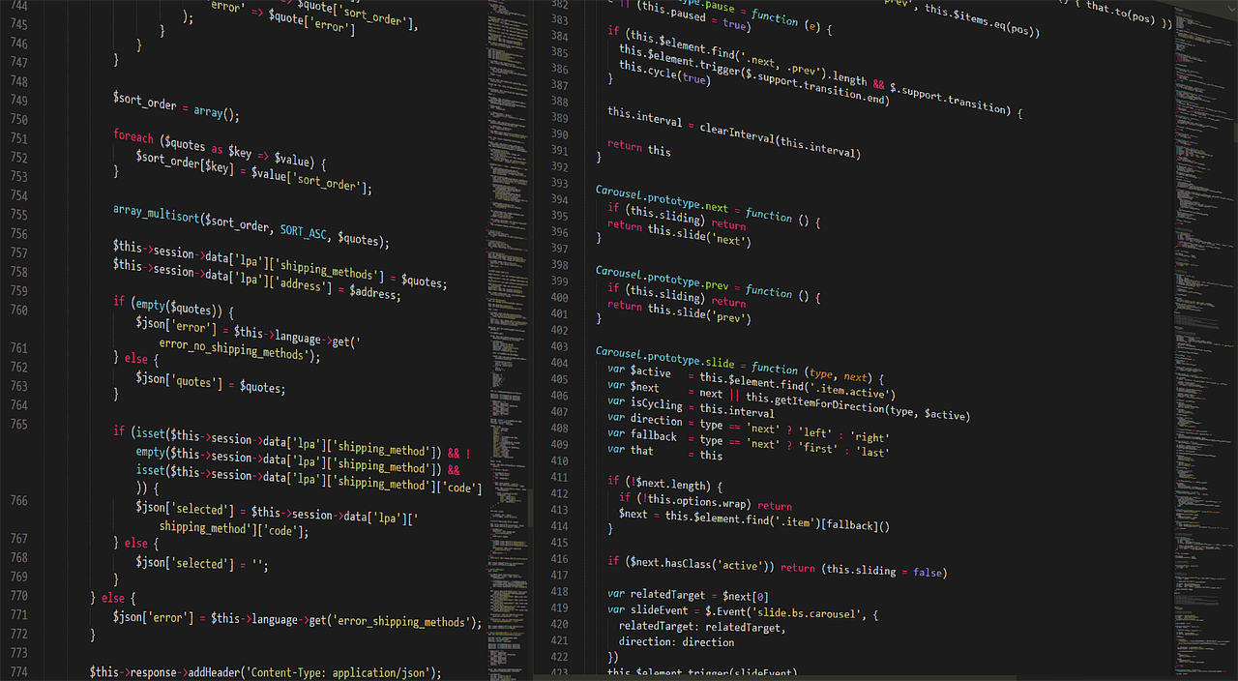
Conclusion
Importance of Number Base Systems
Real-World Applications
Educational Benefits
Number base systems are essential in computer programming and digital media.
Understanding these systems is crucial for solving real-world problems and creating innovative solutions.
By applying number base systems to real-world problems, students can develop essential skills.
These skills include critical thinking, problem-solving, and creativity.
Learning number base systems fosters a deeper understanding of computational concepts.
It equips students with tools to approach challenges in technology and science.
16
Understanding Number Base Systems and Their Applications

Slide 17
Key Takeaways
Understanding Number Systems
Programming Fundamentals
Real-World Applications
Understanding of binary, decimal, and hexadecimal number systems.
Application of number base systems in real-world problems and basic programming concepts.
Introduction to programming languages and concepts, such as variables and loops.
Application of number base systems in real-world problems and basic programming concepts.
Understanding of binary, decimal, and hexadecimal number systems.
Introduction to programming languages and concepts, such as variables and loops.
17
Understanding Number Base Systems and Their Applications

Slide 18
Next Steps
Introduction to Programming Languages
Introduction to programming languages, such as Scratch or Python.
These languages serve as foundational tools for learning coding and computational thinking.
Data Representation and Storage
Data representation and storage, including how data is represented in binary, decimal, and hexadecimal number systems.
Understanding these systems is crucial for grasping how computers process and store information.
Cryptography and Coding Theory
Cryptography and coding theory, including how number base systems are used to create secure codes and ciphers.
This field explores the mathematical principles behind secure communication and data protection.
18
Understanding Number Base Systems and Their Applications

Slide 19

Reflection Questions
Engagement and Active Learning
Meeting Learning Objectives
Real-World Application
How effectively did the lesson engage students and promote active learning?
Consider the strategies used to capture student interest and encourage participation.
How well did the lesson meet the learning objectives, and what adjustments can be made to improve student understanding?
Reflect on the alignment of the lesson with its goals and identify areas for improvement.
What opportunities were provided for students to apply their knowledge and skills in real-world contexts, and how can these opportunities be expanded in future lessons?
Evaluate the practical applications of the lesson and explore ways to enhance them.
19
Understanding Number Base Systems and Their Applications

Slide 20

Additional Resources
Interactive Learning Tools
Programming Software
Real-World Applications
Online tutorials and practice exercises for converting between number base systems.
These resources provide hands-on experience to enhance understanding of number base conversions.
Programming software and tools, such as Scratch or Python.
These tools are essential for applying number base systems in coding and computational tasks.
Real-world examples and case studies of number base systems in computer programming and digital media.
These examples demonstrate practical uses and relevance of number base systems in technology.
20
Understanding Number Base Systems and Their Applications

Slide 21

Parent Engagement
Collaborative Coding Sessions
Informative Newsletters
Interactive Workshops
Parent-child coding sessions to work on projects together.
These sessions foster collaboration and strengthen the parent-child bond through shared learning experiences.
Number base systems newsletter to keep parents informed about their child's learning.
These newsletters provide insights into the concepts being taught and help parents stay engaged.
Parent-teacher coding workshops to learn about number base systems and programming concepts.
These workshops enable parents to better understand and support their child's educational journey.
21
Understanding Number Base Systems and Their Applications

Slide 22

Safety Considerations
Understanding Responsible Computer Use
Ensuring students understand the importance of responsible computer use and online safety.
This includes teaching them about the potential risks and how to avoid them.
Guidelines for Safe Computer Usage
Providing guidelines for students to follow when working with computers and other electronic devices.
These guidelines help students navigate technology responsibly and securely.
Rules for Classroom and Online Behavior
Establishing clear rules and expectations for classroom behavior and online interactions.
This ensures a safe and respectful environment for all students.
22
Understanding Number Base Systems and Their Applications

Slide 23
Teaching Tips
Real-World Applications
Using real-world examples to illustrate the application of number base systems.
This helps students understand the practical relevance of the topic.
Hands-On Practice
Providing hands-on activities to practice converting between number base systems.
This approach reinforces learning through active engagement.
Collaborative Learning
Encouraging collaboration and feedback among students to promote active learning.
This fosters a supportive and interactive classroom environment.
23
Understanding Number Base Systems and Their Applications

Slide 24
Homework and Extension Activities
Binary Code Crackdown
Hexadecimal Hunt
Programming Puzzle
Converting decimal numbers to binary and vice versa.
Explore the fundamentals of binary systems in computing.
Finding and decoding hexadecimal codes in real-world contexts.
Learn how hexadecimal is used in digital systems.
Creating a simple program using a programming language.
Develop problem-solving skills through hands-on coding exercises.
24
Understanding Number Base Systems and Their Applications

Slide 25
Final Thoughts
Importance in Computer Programming
Real-World Applications
Skill Development
Number base systems are essential in computer programming and digital media.
Understanding number base systems is crucial for solving real-world problems and creating innovative solutions.
By applying number base systems to real-world problems, students can develop essential skills in critical thinking, problem-solving, and creativity.
Understanding these systems enables innovative solutions to complex challenges.
Students gain critical thinking and creativity by mastering number base systems.
These skills are vital for addressing real-world challenges effectively.
25
Understanding Number Base Systems and Their Applications

