Slide 1

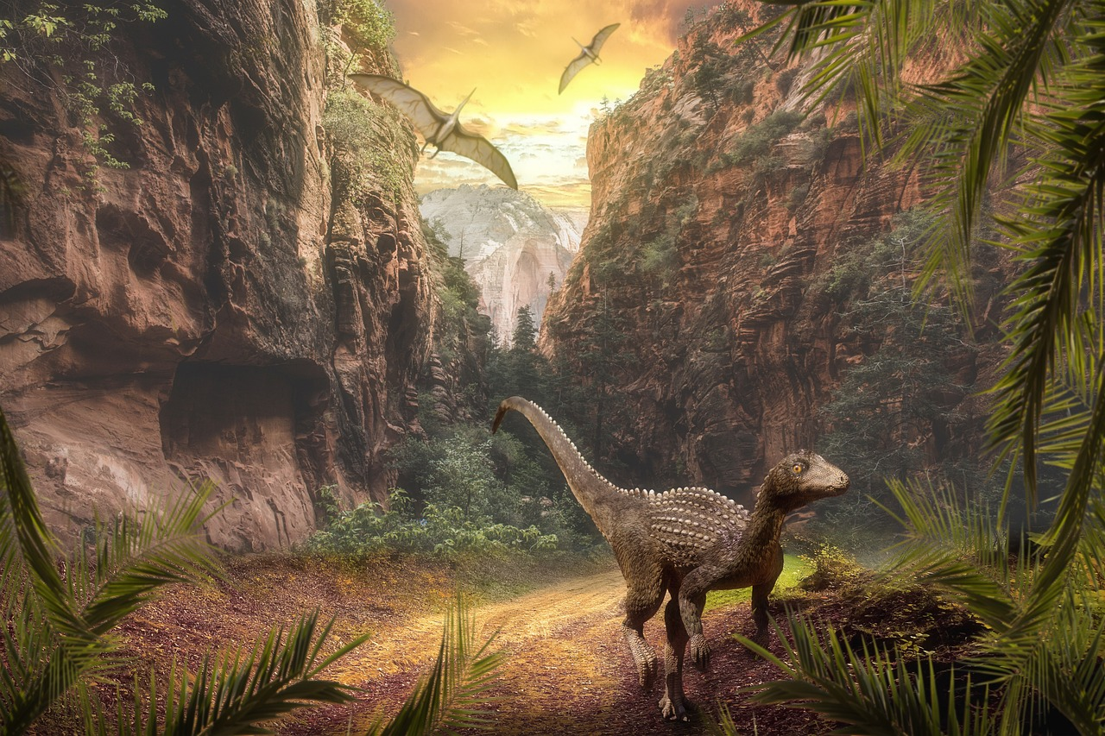
The Fascinating World of Dinosaurs
Exploring Their Habitats, Behavior, Evolution, and Legacy

Slide 2
Table of Contents
Welcome to the World of Dinosaurs!
What is a Dinosaur?
Dinosaur Classification
Dinosaur Habitats and Environments
Dinosaur Behavior and Social Structure
Fossilization and Paleontology
Dinosaur Diet and Digestion
Dinosaur Senses and Communication
Dinosaur Migration and Habitat
Dinosaur Extinction and Evolution
Fun Dinosaur Facts!
Interactive Activities
Conclusion
04
05
06
07
08
09
10
11
12
13
14
15
16

Slide 3
Table of Contents
Quiz Time!
Answer Key
Additional Resources
Thank You!
17
18
19
20

Slide 4
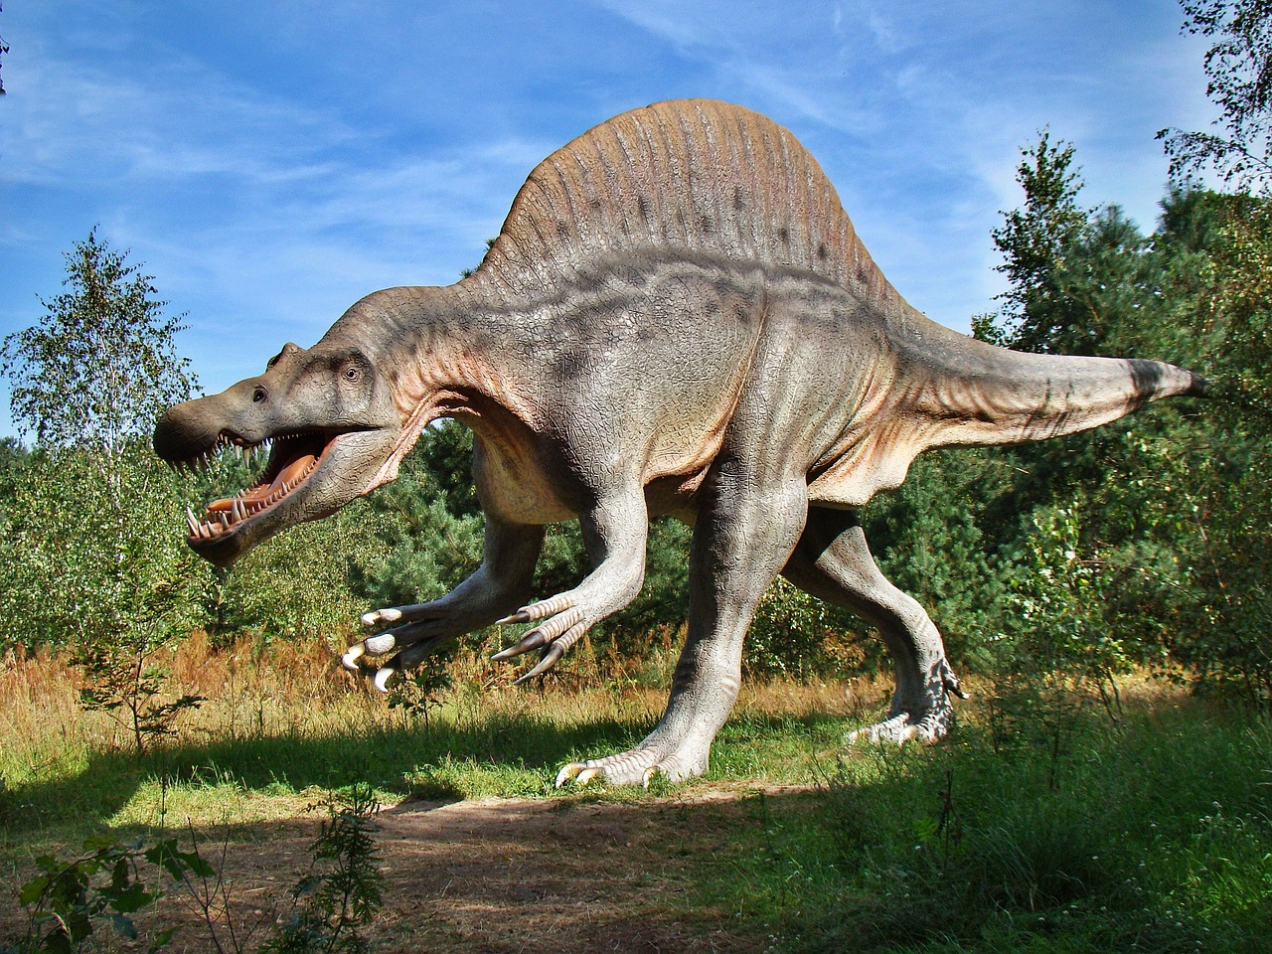
Welcome to the World of Dinosaurs!
Exploring Dinosaur Habitats
Types and Traits of Dinosaurs
A Journey Through Prehistory
Discover the fascinating world of dinosaurs and their habitats.
Learn how these incredible creatures adapted to their environments.
Learn about the different types of dinosaurs and their characteristics.
Understand what made each species unique in the prehistoric world.
Get ready for an exciting journey through time and explore the prehistoric world!
Experience the wonders of a time when dinosaurs roamed the Earth.
4
The Fascinating World of Dinosaurs

Slide 5
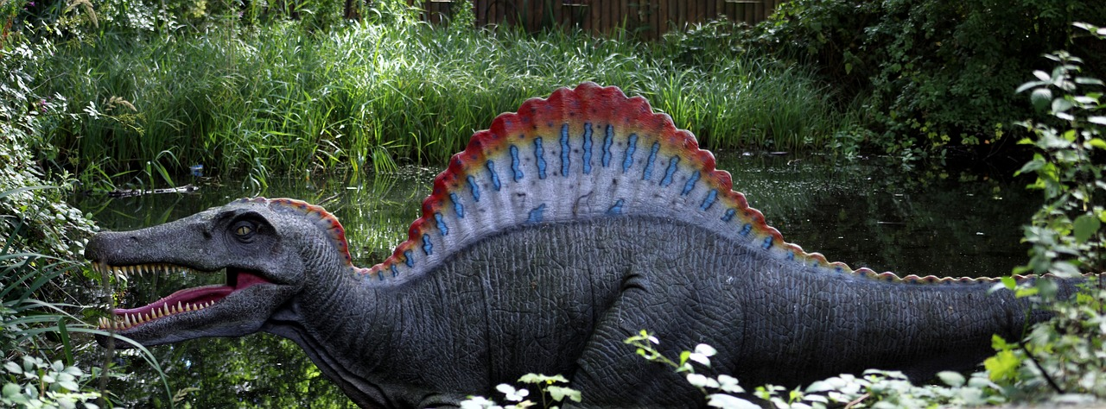
What is a Dinosaur?
Introduction to Dinosaurs
Dinosaur Diversity
Era of Dinosaurs
A dinosaur is a type of reptile that lived during the Mesozoic Era.
Dinosaurs were characterized by their scaly skin, laid eggs, and varied sizes.
There were over 1,000 known species of dinosaurs.
These species ranged from small to giant in size.
Dinosaurs thrived during the Mesozoic Era.
This era is often referred to as the Age of Dinosaurs.
5
The Fascinating World of Dinosaurs

Slide 6
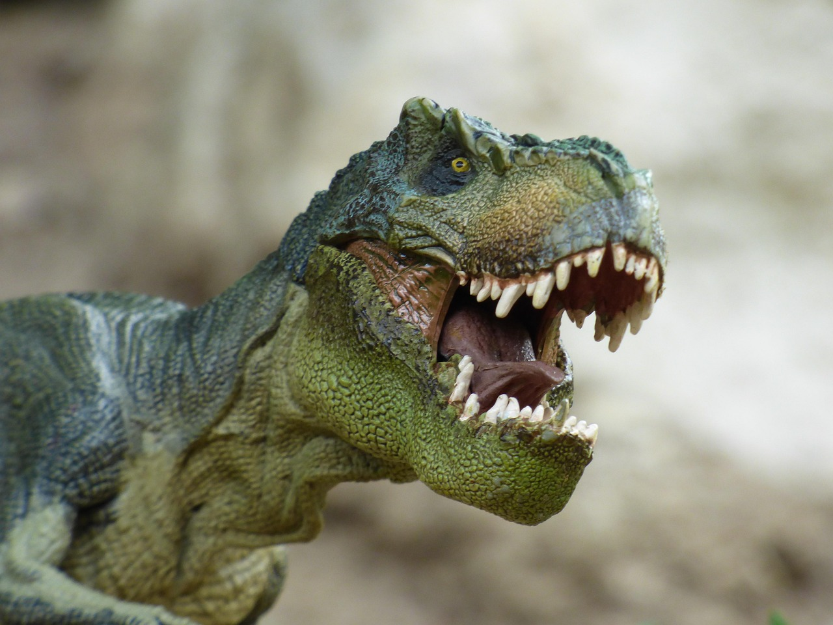
Dinosaur Classification
Main Groups of Dinosaurs
Ornithischia: The Herbivorous Dinosaurs
Saurischia: The Carnivorous Dinosaurs
Dinosaurs are classified into two main groups: Ornithischia and Saurischia.
These groups are based on differences in their hip structures.
Ornithischia includes herbivorous dinosaurs, such as Triceratops and Stegosaurus.
These dinosaurs were primarily plant-eaters and had specialized teeth for grinding vegetation.
Saurischia includes carnivorous dinosaurs, such as Tyrannosaurus and Velociraptor.
These dinosaurs were meat-eaters and often had sharp teeth and claws for hunting prey.
6
The Fascinating World of Dinosaurs

Slide 7
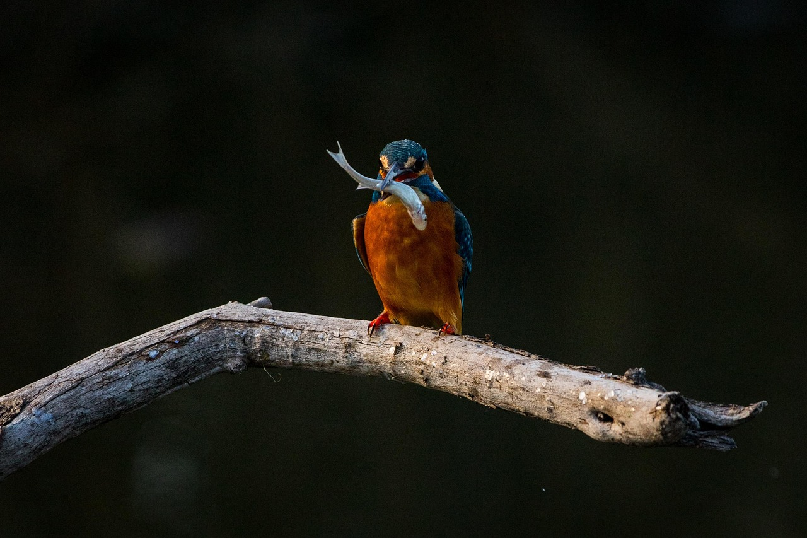
Dinosaur Habitats and Environments
1
Diverse Dinosaur Habitats
Dinosaurs lived in various habitats, including deserts, forests, and oceans.
Different habitats supported different types of dinosaurs, each with unique adaptations.
2
Adaptations for Survival
Different types of dinosaurs developed unique adaptations to thrive in their specific habitats.
These adaptations allowed them to survive and dominate their environments.
3
Dinosaurs and Ecosystems
Dinosaurs played a crucial role in shaping their ecosystems and environments.
Their presence influenced the balance and structure of prehistoric ecosystems.
7
The Fascinating World of Dinosaurs

Slide 8
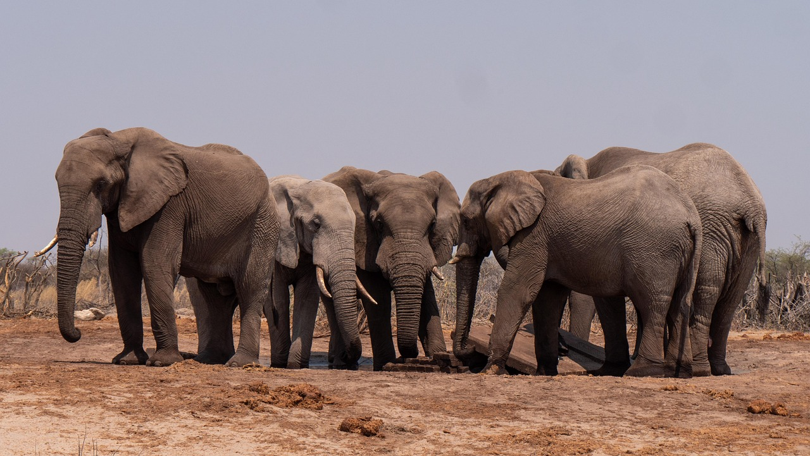
Dinosaur Behavior and Social Structure
1
Herding and Group Living
Many species of dinosaurs lived in groups, while others were solitary.
Dinosaurs exhibited complex behaviors, including herding.
2
Nesting and Reproduction
Dinosaurs exhibited complex behaviors, including nesting.
These behaviors suggest a level of parental care and social structure.
3
Communication Methods
Dinosaurs communicated with each other using vocalizations, body language, and visual displays.
These methods were essential for survival and interaction within their environments.
8
The Fascinating World of Dinosaurs

Slide 9
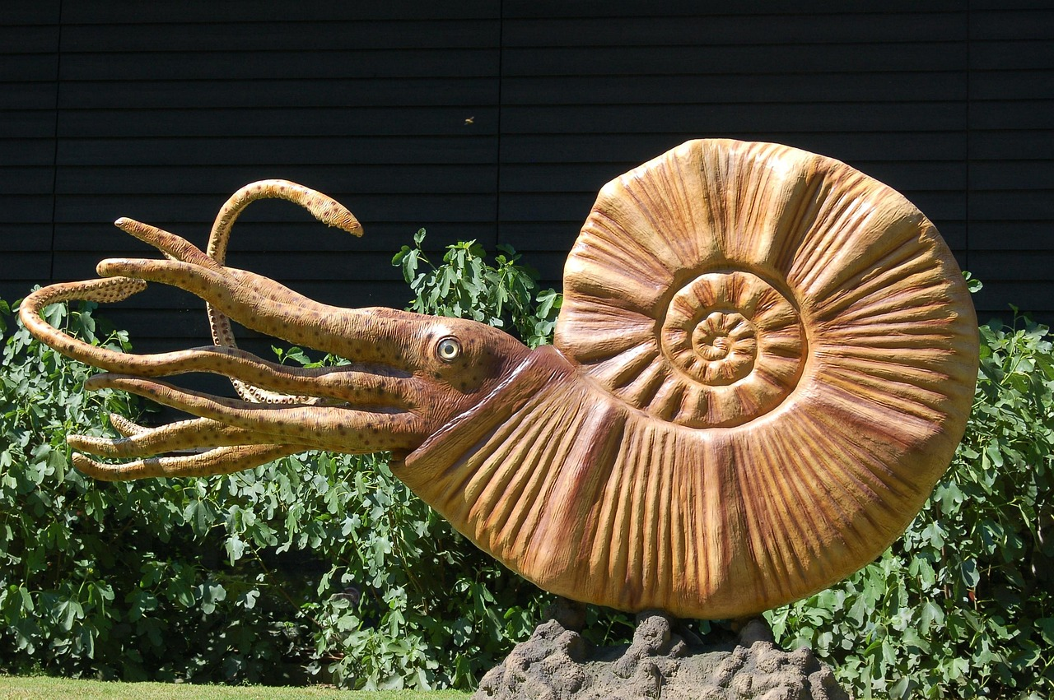
Fossilization and Paleontology
1
2
3
What Are Fossils?
The Role of Paleontologists
The Process of Fossilization
Fossils are the remains or impressions of ancient organisms, including dinosaurs.
They provide a window into the distant past, preserving evidence of life from millions of years ago.
Paleontologists study fossils to learn about the history of life on Earth.
Their work helps us understand how organisms evolved and interacted with their environments.
Fossilization is a complex process that involves rapid burial, protection from scavengers, and mineralization.
This rare process ensures the preservation of ancient life forms for scientific study.
9
The Fascinating World of Dinosaurs

Slide 10
Dinosaur Diet and Digestion
Herbivorous Dinosaurs
Carnivorous Dinosaurs
Omnivorous Dinosaurs
Herbivorous dinosaurs, such as Stegosaurus, had specialized digestive systems.
These systems were adapted to process plant material efficiently.
Carnivorous dinosaurs, such as Tyrannosaurus, had sharp teeth and powerful jaws.
These features allowed them to hunt and consume meat effectively.
Omnivorous dinosaurs, such as Oviraptor, had a mix of herbivorous and carnivorous traits.
This combination enabled them to eat both plants and animals.
10
The Fascinating World of Dinosaurs

Slide 11
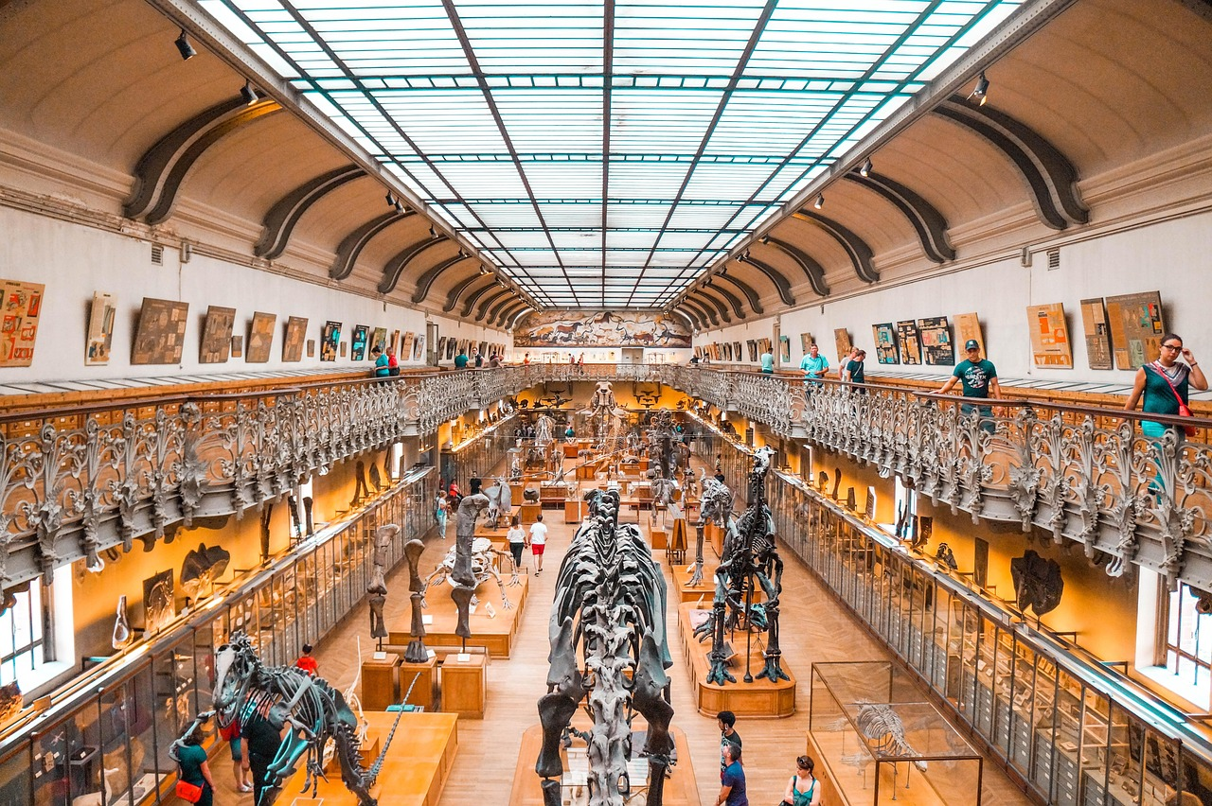
Dinosaur Senses and Communication
Diverse Sensory Abilities
Communication Methods
Adaptations for Survival
Dinosaurs had a range of senses, including vision, hearing, and smell.
Many dinosaurs had excellent eyesight, while others had keen hearing or smell.
Dinosaurs used vocalizations, body language, and visual displays to communicate with each other.
These methods helped them interact and convey messages effectively.
The sensory and communication abilities of dinosaurs were crucial for their survival.
They used these skills to find food, avoid predators, and interact socially.
11
The Fascinating World of Dinosaurs

Slide 12
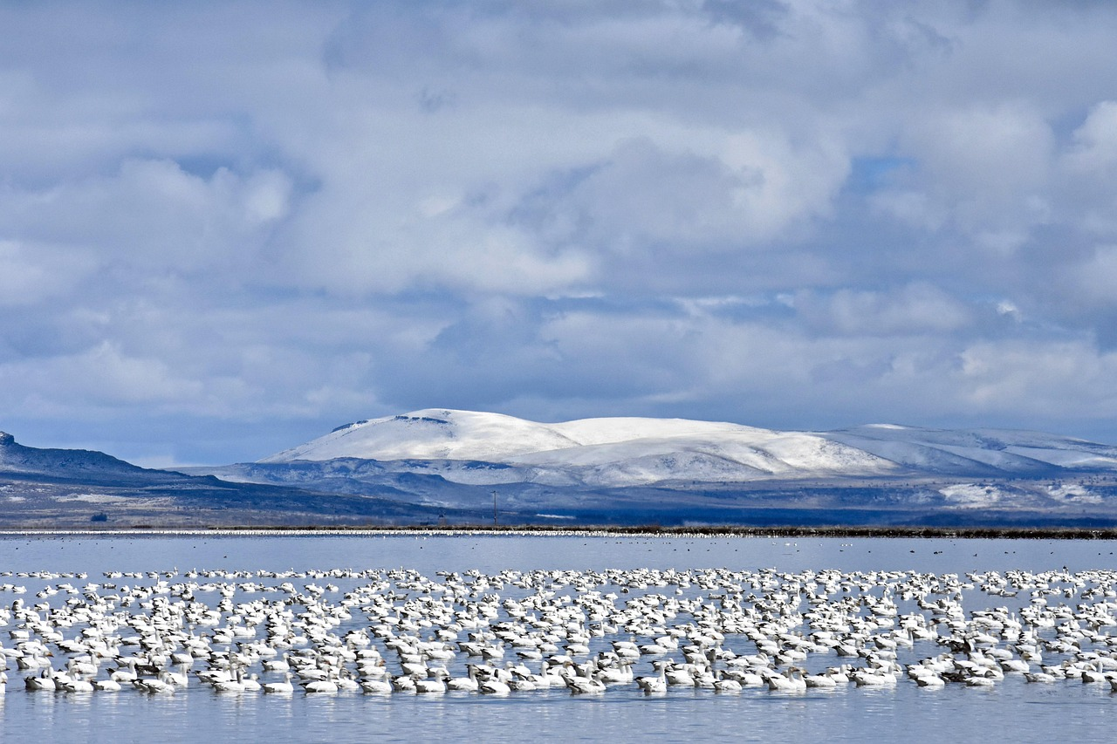
Dinosaur Migration and Habitat
Dinosaur Migration Patterns
Adaptation to Diverse Habitats
Species-Specific Preferences
Many dinosaurs migrated across vast distances in search of food, shelter, and breeding grounds.
Migration patterns varied among different dinosaur species.
Dinosaurs adapted to different habitats, including deserts, forests, and oceans.
These adaptations allowed them to thrive in a variety of environmental conditions.
Habitat preferences were unique to each dinosaur species.
This diversity in preferences contributed to their widespread distribution.
12
The Fascinating World of Dinosaurs

Slide 13
Dinosaur Extinction and Evolution
Theories Behind Dinosaur Extinction
Impact of Extinction on Evolution
Unresolved Mysteries of the Past
The mass extinction event that led to the demise of the dinosaurs is still debated.
Theories include asteroid impact, volcanic eruptions, and climate change.
The evolution of new species, including mammals and birds, followed the extinction of the dinosaurs.
This marked a significant shift in Earth's biodiversity.
Despite extensive research, the exact cause of the dinosaurs' extinction remains uncertain.
Scientists continue to explore various hypotheses to uncover the truth.
13
The Fascinating World of Dinosaurs

Slide 14
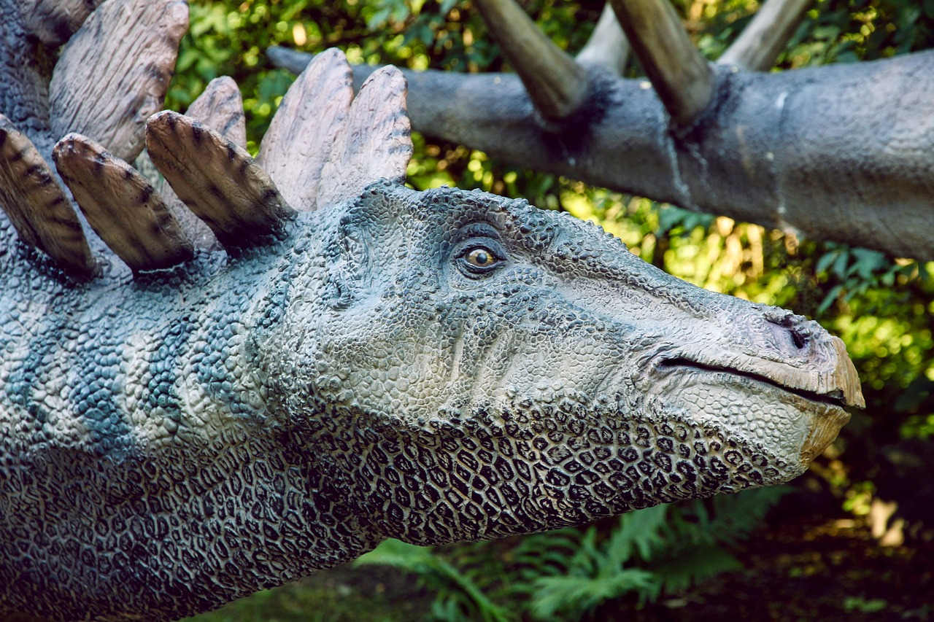
Fun Dinosaur Facts!
The Largest Dinosaur
The largest dinosaur that ever existed is the Argentinosaurus.
It was a massive herbivore that roamed the Earth millions of years ago.
The Fastest Dinosaur
The fastest dinosaur was the Velociraptor, which could run up to 40 miles per hour.
This speed made it an efficient predator in its time.
The Tiny-Brained Stegosaurus
The Stegosaurus had a brain the size of a walnut!
Despite its small brain, it was a large and iconic dinosaur.
14
The Fascinating World of Dinosaurs

Slide 15

Interactive Activities
Dinosaur Model Building
Create your own dinosaur model using clay or paper mache.
This activity encourages creativity and hands-on learning.
Fossil Excavation
Excavate a mock fossil using a sandbox or container filled with sand.
Participants can experience the thrill of being a paleontologist.
Dinosaur Scavenger Hunt
Find and identify different dinosaur species in a simulated environment.
This interactive game promotes observation and identification skills.
15
The Fascinating World of Dinosaurs

Slide 16
Conclusion
1
2
3
Dinosaurs: A Fascinating Legacy
Insights from the Past
The Wonder of Dinosaurs
Dinosaurs are fascinating creatures that continue to capture our imagination.
By learning about dinosaurs, we can gain insights into the history of life on Earth.
By studying dinosaurs, we uncover the mysteries of Earth's ancient history.
Their existence offers a glimpse into the evolution of life over millions of years.
Remember, the world of dinosaurs is full of wonder and discovery.
Keep exploring to unlock the secrets of these incredible creatures.
16
The Fascinating World of Dinosaurs

Slide 17
Quiz Time!
Largest Dinosaur Ever
Crested Dinosaur Mystery
Speediest Dinosaur
What was the largest dinosaur that ever existed?
This question explores the massive creatures that roamed the Earth millions of years ago.
Which dinosaur had a crest on its head?
This question delves into the unique physical features of certain dinosaurs.
What was the fastest dinosaur?
This question examines the swiftest species among the prehistoric giants.
17
The Fascinating World of Dinosaurs

Slide 18
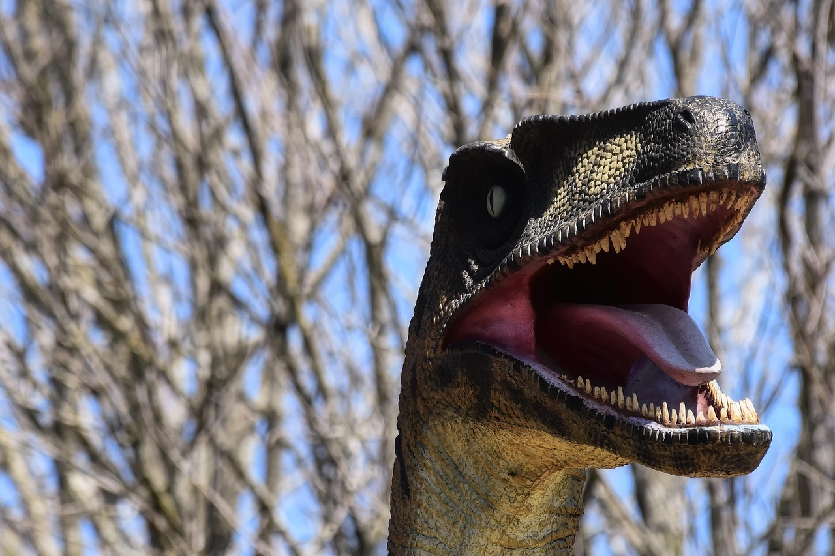
Answer Key
Argentinosaurus
Parasaurolophus
Velociraptor
Argentinosaurus is one of the largest known land animals to have ever existed.
It was a long-necked herbivorous dinosaur from the Late Cretaceous period.
Parasaurolophus is known for its distinctive long, curved cranial crest.
This herbivorous dinosaur lived during the Late Cretaceous period.
Velociraptor was a small, carnivorous dinosaur with a sickle-shaped claw on each foot.
It lived during the Late Cretaceous period and is known for its agility and intelligence.
18
The Fascinating World of Dinosaurs

Slide 19
Additional Resources
1
Explore with National Geographic Kids
National Geographic Kids offers engaging content about dinosaurs.
Discover fun facts, games, and videos tailored for young learners.
2
Visit the American Museum of Natural History
The American Museum of Natural History provides extensive resources on dinosaurs.
Explore exhibits, research, and educational materials for all ages.
3
Dive into Books and Documentaries
Expand your knowledge with dinosaur-themed books and documentaries.
These resources offer in-depth insights and captivating visuals for enthusiasts.
19
The Fascinating World of Dinosaurs

Slide 20

Thank You!
Thank You!
Thank you for joining us on this journey through the world of dinosaurs!
We hope you enjoyed exploring the fascinating history and mysteries of these incredible creatures.
20
The Fascinating World of Dinosaurs

