Slide 1
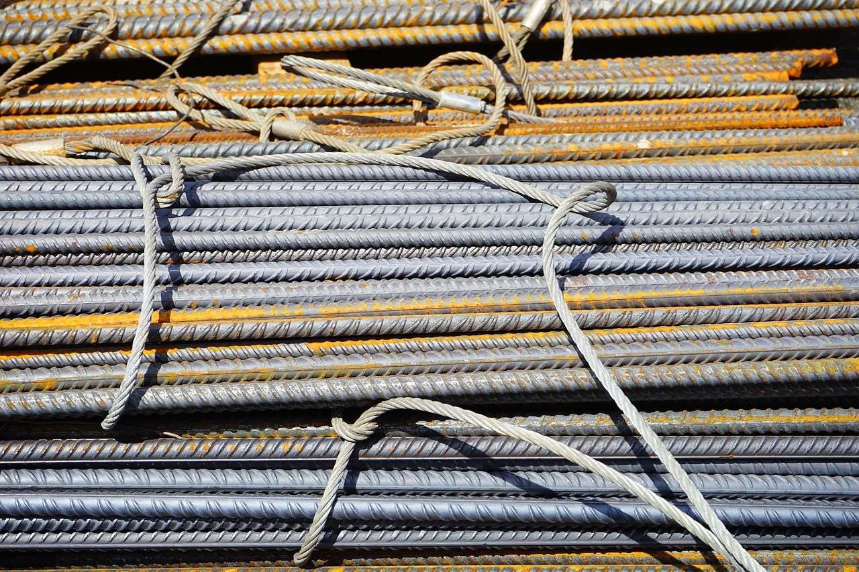
Exploring Materials: From Natural Resources to Everyday Objects
Understanding the Role and Impact of Materials in Daily Life

Slide 2

Table of contents
Lesson Introduction
Subject Knowledge
Materials and Resources Overview
Importance of Materials in Daily Life
Role of Natural Resources
Availability and Accessibility of Materials
Wood as a Building Material
Paper Production from Trees
Metals in Everyday Objects
Responsibility in Resource Usage
01
02
03
04
05
06
07
08
09
10

Slide 3
Lesson Introduction
Materials and Their Importance
Availability and Accessibility
Lesson Overview
Understanding and Appreciation
01
Materials are the physical substances that make up the world around us, such as metals, plastics, wood, glass, and textiles.
These materials are obtained from natural resources, which are the raw materials found in the environment that can be used to produce the things we need.
02
The availability and accessibility of materials are crucial for meeting human needs.
For example, wood is used to build homes, paper is made from trees, and metals are essential for constructing vehicles and machinery.
03
Throughout this lesson, students will delve into the significance of materials in our daily lives and how they play a vital role in sustaining human needs.
04
By understanding the relationship between materials and resources, students will gain a deeper appreciation for the natural world and the importance of responsible resource management.
1
/
Exploring Materials: From Natural Resources to Everyday Objects

Slide 4


Subject Knowledge
Definition of Materials
Source of Materials
Importance of Materials
01
Materials are the physical substances that make up the world around us.
Examples include metals, plastics, wood, glass, and textiles.
02
Materials are obtained from natural resources.
Natural resources are raw materials found in the environment.
03
Availability and accessibility of materials are crucial for meeting human needs.
Examples: wood for homes, paper from trees, metals from ores.
2
/
Exploring Materials: From Natural Resources to Everyday Objects

Slide 5

Materials and Resources Overview
01
02
03
Materials as Essential Substances
Importance of Availability and Accessibility
Sustainable Resource Management
Materials are the physical substances that make up the world around us, including metals, plastics, wood, glass, and textiles.
These materials are obtained from natural resources, which are raw materials found in the environment.
The availability and accessibility of materials are crucial for meeting human needs.
For example, wood is used for building homes, paper is made from trees, and metals are essential for various applications.
Understanding the role of materials in our daily lives helps in developing a deeper appreciation for natural resources.
Responsible usage of resources is necessary to ensure sustainability for future generations.
3
/
Exploring Materials: From Natural Resources to Everyday Objects

Slide 6
Importance of Materials in Daily Life
Definition of Materials
Source of Materials
Importance of Availability
01
Materials are physical substances that make up the world around us.
Examples include metals, plastics, wood, glass, and textiles.
02
Materials are obtained from natural resources.
Natural resources are raw materials found in the environment.
03
Availability of materials is crucial for meeting human needs.
Examples: wood for homes, paper from trees, metals for vehicles and machinery.
4
/
Exploring Materials: From Natural Resources to Everyday Objects

Slide 7
Role of Natural Resources
Materials as Essential Substances
Sourcing from Natural Resources
Crucial for Human Needs
Responsibility in Usage
01
Materials are the physical substances that make up the world around us, including metals, plastics, wood, glass, and textiles.
02
These materials are obtained from natural resources, which are the raw materials found in the environment that can be used to produce the things we need.
03
The availability and accessibility of materials are crucial for meeting human needs, such as using wood for building homes and paper made from trees.
04
Understanding the role of materials in our daily lives emphasizes the need to use natural resources responsibly to sustain our society.
5
/
Exploring Materials: From Natural Resources to Everyday Objects

Slide 8

Availability and Accessibility of Materials
01
02
Availability of Materials
Accessibility of Materials
Materials such as metals, plastics, wood, glass, and textiles are essential for meeting human needs.
These materials are obtained from natural resources found in the environment.
Wood is used for building homes.
Paper is produced from trees.
Metals are utilized in various industries for manufacturing products.
6
/
Exploring Materials: From Natural Resources to Everyday Objects

Slide 9
Wood as a Building Material
Natural Resource
Structural Integrity
Sustainability
Insulation Properties
Aesthetics
Wood is a versatile building material sourced from trees, which are renewable resources that play a vital role in the ecosystem.
Wood offers excellent structural strength, making it ideal for constructing buildings, furniture, and various other products.
Proper forest management practices ensure the sustainability of wood as a building material, promoting reforestation and responsible harvesting.
Wood provides natural insulation, helping to regulate indoor temperatures and reduce energy consumption in buildings.
The natural beauty of wood enhances the visual appeal of structures, creating warm and inviting spaces.
01
02
03
04
05
7
/
Exploring Materials: From Natural Resources to Everyday Objects

Slide 10
Paper Production from Trees
01
02
03
04
05
Harvesting Trees
Wood Processing
Pulp Formation
Paper Making
Drying and Finishing
Trees are harvested from sustainably managed forests.
Logs are transported to the paper mill for processing.
Logs are debarked and chipped into small pieces.
The wood chips are then cooked in a chemical solution to break them down into pulp.
The pulp is washed and screened to remove impurities.
It is then bleached to achieve the desired brightness.
The pulp is mixed with water and additives to create a slurry.
The slurry is spread onto a mesh screen to form a sheet of paper.
The paper sheet is dried using heated rollers.
It may undergo additional processes like calendaring for smoothness.
8
/
Exploring Materials: From Natural Resources to Everyday Objects

Slide 11
Metals in Everyday Objects
Aluminum
Steel
Copper
Gold
Iron
Used in beverage cans, foil, window frames, and aircraft construction.
Found in cars, buildings, appliances, and infrastructure like bridges and railways.
Utilized in electrical wiring, plumbing, roofing, and electronic devices.
Seen in jewelry, electronics, and dental work for its conductivity and corrosion resistance.
Essential in manufacturing tools, machinery, vehicles, and structural components.
01
02
03
04
05
9
/
Exploring Materials: From Natural Resources to Everyday Objects

Slide 12
Responsibility in Resource Usage
Materials
Natural Resources
Availability and Accessibility
01
Physical substances that make up the world around us
Examples include metals, plastics, wood, glass, and textiles
02
Raw materials found in the environment
Used to produce the things we need
03
Crucial for meeting human needs
Wood is used to build homes
Paper is made from trees
Metals are essential for manufacturing machinery and tools
10
/
Exploring Materials: From Natural Resources to Everyday Objects

