Slide 1

Mastering Unit Conversions: A Comprehensive Guide
Understanding the Importance, Techniques, and Applications of Measurement Transformations

Slide 2
Table of Contents
Introduction to Unit Conversions
Why Unit Conversions Matter
Units of Measurement
Conversion Factors
Converting Between Units
Real-World Applications
Practice Problems
Solutions to Practice Problems
Common Errors
Tips for Success
Real-World Scenario
Group Activity
Conclusion
04
05
06
07
08
09
10
11
12
13
14
15
16

Slide 3
Table of Contents
Assessment
Extension Activity
Reflection Questions
Next Steps
Final Thoughts
Additional Resources
Conclusion and Final Thoughts
17
18
19
20
21
22
23

Slide 4
Introduction to Unit Conversions
Everyday Importance
Accurate Communication
Real-World Applications
Unit conversions are vital for comparing measurements in daily life and various fields, including science and technology.
Converting units is essential for precise communication of measurements, especially in engineering and medicine.
This lesson will explore unit conversions and their practical applications in everyday scenarios.
4
Mastering Unit Conversions: A Comprehensive Guide

Slide 5
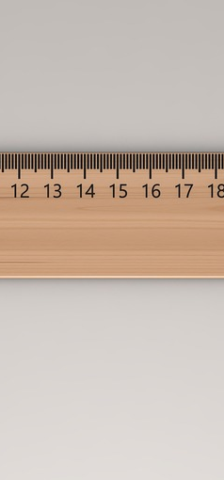
Why Unit Conversions Matter
Precision in Applications
Critical Thinking Skills
Unit conversions are vital in STEM disciplines.
They guarantee accuracy in tasks like cooking and construction.
Working with unit conversions sharpens analytical skills.
They deepen our grasp of how different measurements relate.
Safety in Practice
Career Success
Errors in unit conversions can have serious repercussions, especially in healthcare.
Exact conversions are crucial for upholding safety protocols.
A solid understanding of unit conversions is essential in many fields.
This skill enhances confidence and effectiveness in professional tasks.
5
Mastering Unit Conversions: A Comprehensive Guide

Slide 6
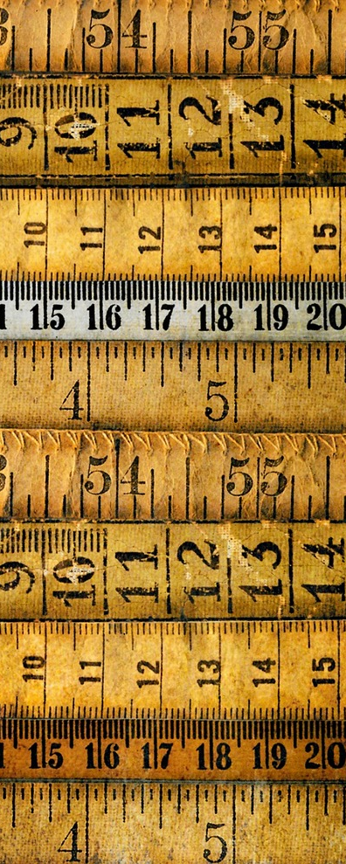
Units of Measurement
Length Units
Mass Units
Volume Units
Length is commonly measured in meters and centimeters.
Kilometers and miles are used for longer distances.
Mass is typically measured in grams and kilograms.
Pounds are primarily used in the U.S. for weight.
Volume is measured in liters and milliliters.
Gallons are used for larger quantities of liquid.
Time Units
Temperature Units
Time is measured in seconds, minutes, and hours.
Days are a standard unit for longer durations.
Temperature is measured in Celsius and Fahrenheit.
Kelvin is often used in scientific contexts.
6
Mastering Unit Conversions: A Comprehensive Guide

Slide 7
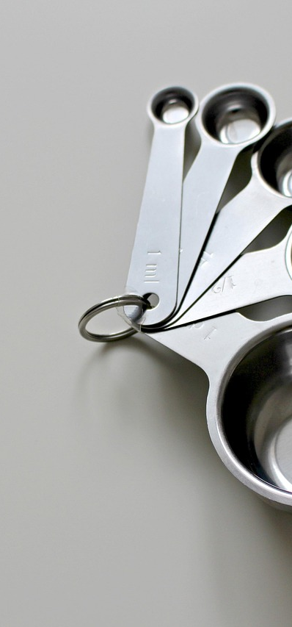
Conversion Factors
Unit Ratios
Measurement Examples
Conversion Utility
Conversion factors are ratios of equivalent units.
They are essential for converting measurements.
For example, 1 meter is equal to 100 centimeters.
For instance, 1 kilogram is equivalent to 1000 grams.
Conversion factors enable the transition between different measurement units.
They help in performing calculations in various fields.
7
Mastering Unit Conversions: A Comprehensive Guide

Slide 8

Converting Between Units
Unit Conversion Basics
Meters to Centimeters
To convert between units, use the conversion factor.
This ensures accurate measurements.
To convert 10 meters to centimeters, multiply by 100.
This results in 1000 cm.
Grams to Kilograms
Practice Makes Perfect
To convert 500 grams to kilograms, divide by 1000.
This equals 0.5 kg.
Regular practice in unit conversion enhances confidence and skill.
It helps you become proficient in using different units.
8
Mastering Unit Conversions: A Comprehensive Guide

Slide 9

Real-World Applications
Culinary Measurements
Construction Metrics
Measuring ingredients accurately is crucial for successful cooking.
Converting between units, such as cups to grams, ensures precision in recipes.
Accurate measurements are essential for building projects.
Converting between units like feet and meters helps in planning and execution.
Scientific Data
Daily Conversions
In science, precise measurements are vital for experiments and research.
Unit conversions are often necessary to compare data across different studies.
Everyday life often requires quick conversions, like currency or distance.
Understanding how to convert units can simplify various tasks, from shopping to travel.
9
Mastering Unit Conversions: A Comprehensive Guide

Slide 10
Practice Problems
Kilometers to Miles
Grams to Pounds
Liters to Gallons
Meters to Feet
To convert kilometers to miles, use the conversion factor of 0.621371.
For example, 25 kilometers is approximately 15.53 miles.
To convert grams to pounds, divide the number of grams by 453.592.
For instance, 500 grams is about 1.1 pounds.
To convert liters to gallons, multiply the number of liters by 0.264172.
For example, 2 liters is roughly 0.53 gallons.
To convert meters to feet, multiply the number of meters by 3.28084.
For instance, 10 meters is approximately 32.81 feet.
10
Mastering Unit Conversions: A Comprehensive Guide

Slide 11

Solutions to Practice Problems
Distance Conversion
Weight Conversion
25 kilometers equals 15.53 miles.
A practical conversion for travelers.
500 grams is equivalent to 1.1 pounds.
Useful for precise cooking measurements.
Volume Conversion
Length Conversion
2 liters translates to about 0.53 gallons.
Commonly used in recipes and liquid storage.
10 meters converts to 32.8 feet.
Essential for various construction projects.
11
Mastering Unit Conversions: A Comprehensive Guide

Slide 12

Common Errors
Common Errors in Calculations
Understanding Unit Confusion
Addressing Rounding Errors
Incorrect conversion factors can lead to significant errors. Always verify conversion factors for accuracy.
Misunderstanding units can distort data interpretation. Define and standardize units to avoid confusion.
Rounding errors can accumulate and affect results. Maintain precision in calculations until the final step.
12
Mastering Unit Conversions: A Comprehensive Guide

Slide 13

Tips for Success
Verify Factors
Always verify your conversion factors to ensure accuracy.
Incorrect factors can lead to significant errors.
Label Units
Clear labeling of units is essential for maintaining accuracy in calculations.
This helps avoid confusion and ensures precision.
Use Exact Values
Using exact values helps to minimize rounding errors, leading to more precise results.
Exact conversion factors are crucial for accurate outcomes.
Check Calculations
Check all calculations carefully to ensure correctness.
Double-checking your work can significantly reduce the likelihood of mistakes.
13
Mastering Unit Conversions: A Comprehensive Guide

Slide 14
Real-World Scenario
Road Trip Conversion
Recipe Measurement
Structure Dimensions
Converting distances between kilometers and miles is essential for accurate travel time and fuel calculations.
Cooking requires converting grams to cups for accurate ingredient measurements.
This conversion ensures the desired taste and texture in cooking.
Converting meters to feet is crucial for building design.
This ensures compliance with local codes.
14
Mastering Unit Conversions: A Comprehensive Guide

Slide 15

Group Activity
Real-World Problem Solving
Collaborate in teams to address practical challenges that require unit conversions.
Apply mathematical concepts to find solutions that can be used in daily scenarios.
Class Presentations
Share your team's innovative solutions with the class in a dynamic presentation.
Emphasize the creative strategies developed during your group discussions.
Peer Feedback Sessions
Engage with classmates to exchange insights on each other's work.
Provide thoughtful feedback that fosters improvement and deeper understanding.
15
Mastering Unit Conversions: A Comprehensive Guide

Slide 16

Conclusion
Everyday Importance
Unit conversions are essential in everyday life and STEM fields.
They help us understand and communicate measurements accurately.
Critical Thinking
Mastering unit conversions promotes critical thinking and problem-solving.
It encourages us to analyze and approach problems systematically.
Skill Development
Practice and apply unit conversions to develop your skills and confidence.
Regular practice leads to greater proficiency and ease in handling various tasks.
16
Mastering Unit Conversions: A Comprehensive Guide

Slide 17

Assessment
Unit Conversion Quiz
Real-World Application
Group Discussion
Challenge yourself with a fun multiple-choice quiz designed to enhance your understanding of unit conversions!
Test your knowledge and see how well you can convert between different units.
Implement unit conversions in a practical project, showcasing their importance in everyday scenarios like cooking or construction.
Explore how accurate conversions can impact real-life situations and decision-making.
Participate in lively discussions about the challenges of unit conversions and exchange valuable insights with your classmates.
Share your experiences and learn from others to deepen your understanding of the topic.
17
Mastering Unit Conversions: A Comprehensive Guide

Slide 18
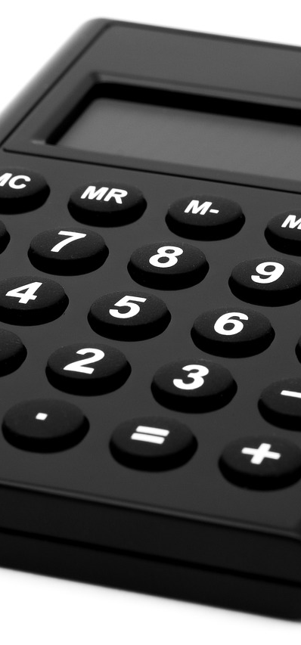
Extension Activity
Conversion Tool
Real-World Application
Interactive Game
Create a tool that simplifies measurement conversions.
Ensure it is easy to navigate and understand.
Examine how unit conversions play a crucial role in cooking and construction.
Highlight specific examples where accuracy is vital.
Develop a game that engages users with unit conversion challenges.
Incorporate various units and levels to enhance the experience.
18
Mastering Unit Conversions: A Comprehensive Guide

Slide 19

Reflection Questions
Unit Conversion Insights
Everyday Applications
Overcoming Challenges
I learned that unit conversions clarify measurements.
They are essential for accurate communication in various fields.
Unit conversions are vital in cooking, like converting grams to cups.
They help when traveling, such as changing miles to kilometers.
I improved my skills by practicing with practical examples.
Using apps made conversions quicker and easier.
19
Mastering Unit Conversions: A Comprehensive Guide

Slide 20

Next Steps
Developing Skills Through Regular Practice
Applying Knowledge to Real-World Scenarios
Exploring Advanced Conversion Topics
Engage in unit conversion exercises consistently to enhance your proficiency.
Regular practice reinforces understanding and builds confidence.
Utilize unit conversions in everyday situations and projects for practical experience.
This approach improves problem-solving abilities and contextual understanding.
Delve into complex conversions, such as those involving energy and force units.
A deeper understanding of these topics enriches your overall knowledge in the field.
20
Mastering Unit Conversions: A Comprehensive Guide

Slide 21

Final Thoughts
Essential Skill
Practice Required
Achieve Proficiency
Unit conversions are crucial for scientific calculations.
They are also important in everyday tasks.
Regular exercises help in mastering unit conversions.
Applying these skills in real-life situations enhances understanding.
Proficiency in unit conversions improves problem-solving skills.
Consistent practice leads to greater confidence in using these skills.
21
Mastering Unit Conversions: A Comprehensive Guide

Slide 22

Additional Resources
Discover Online Conversion Calculators and Tools
Access Measurement Conversion Charts and Tables
Review Real-World Examples and Case Studies
Explore a variety of calculators designed for unit conversion.
These tools simplify the conversion process.
Utilize detailed charts that cover a range of measurement units.
These tables provide quick references for accurate conversions.
Examine practical examples that demonstrate successful conversions.
These case studies showcase effective uses of conversion tools.
22
Mastering Unit Conversions: A Comprehensive Guide

Slide 23

Conclusion and Final Thoughts
Everyday Importance
Critical Thinking
Practice for Mastery
Unit conversions are essential in daily life and STEM fields.
They enable accurate communication of measurements.
Mastering unit conversions enhances critical thinking and problem-solving skills.
It encourages effective analysis and interpretation of data.
Regular practice reinforces understanding and builds confidence.
Applying unit conversions in real scenarios helps solidify your skills.
23
Mastering Unit Conversions: A Comprehensive Guide

