Slide 1
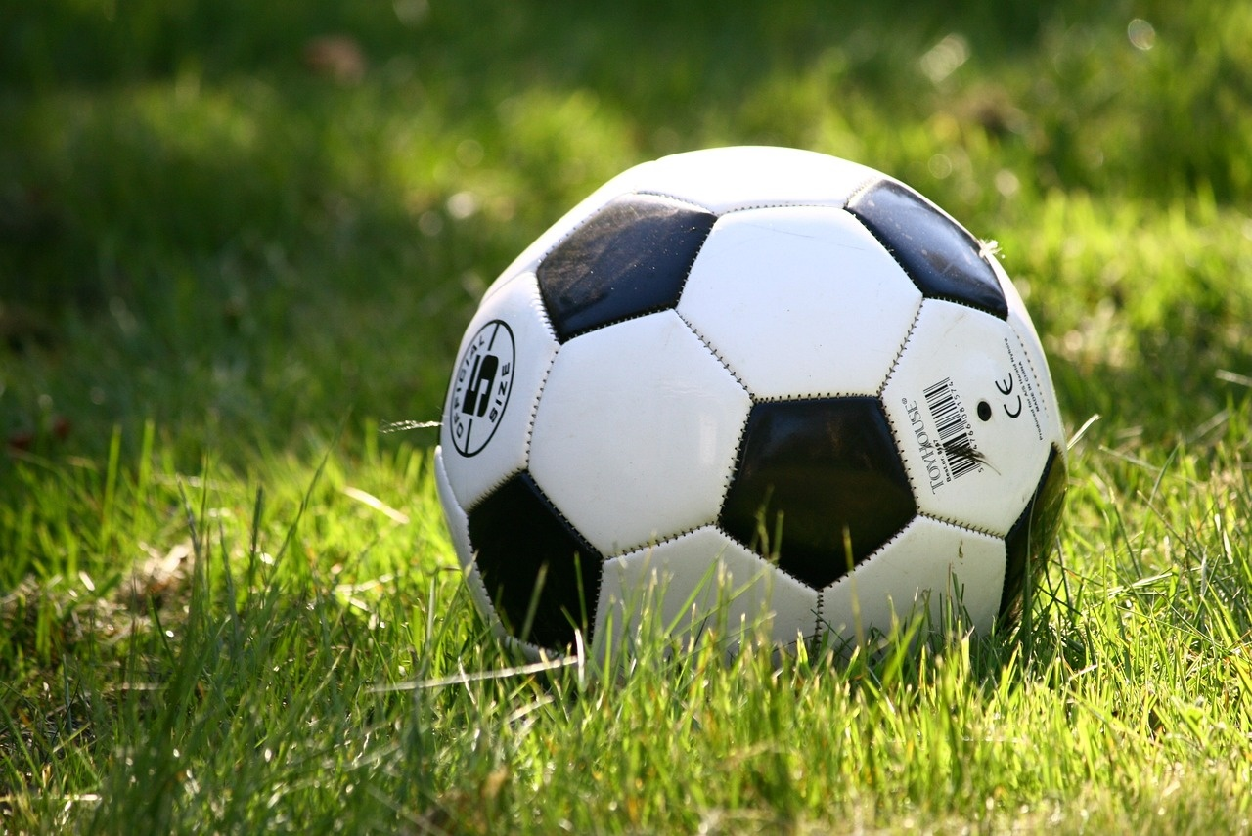
Mastering Football Fundamentals
A Comprehensive Guide to Personalized Homework Assignments, Football Basics, Skill Drills, and Adaptive Tasks

Slide 2

Table of contents
Introduction
Personalized Homework Assignment
Football Basics
Skill Drill
Touchdown Time: Mastering the Fundamentals of Footb…
Learning Objectives
Adaptive Tasks
01
02
03
04
05
06
07

Slide 3

Introduction
01
02
Introduction
Title
Adaptive Homework: Mastering the Fundamentals of Football
Adaptive homework assignments enhance student learning and engagement by tailoring content to individual needs.
Personalized tasks create a more effective learning experience, fostering a positive attitude towards learning.
Touchdown Time: Mastering the Fundamentals of Football
1
/
Mastering Football Fundamentals

Slide 4


Personalized Homework Assignment
Football Basics 🏈
Skill Drills
Game Analysis
01
Explain the objective of the game and the roles of the offense and defense.
Estimated time: 10 minutes
02
Practice fundamental football skills such as passing, catching, and tackling.
Estimated time: 20 minutes
03
Watch a football game and identify different strategies used by teams.
Write a short analysis on the effectiveness of these strategies.
Estimated time: 30 minutes
2
/
Mastering Football Fundamentals

Slide 5
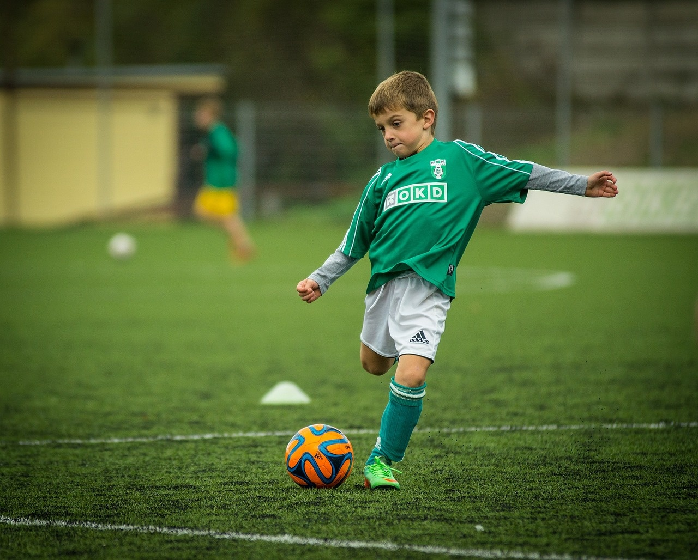
Football Basics
01
02
Objective of the Game
Offense and Defense Roles
The main goal in football is to score points by getting the ball into the opposing team's end zone, known as a touchdown.
Points can also be scored by kicking the ball through the goalposts for a field goal.
The offense is responsible for advancing the ball down the field to score.
The defense aims to stop the opposing team from scoring and regain possession of the ball.
3
/
Mastering Football Fundamentals

Slide 6
Skill Drill
Passing Accuracy Drill
Dribbling Agility Drill
Shooting Power Drill
Defensive Tackling Drill
01
Set up cones to practice short, medium, and long-range passes.
Focus on technique, footwork, and accuracy.
Repeat drills to improve consistency.
02
Set up a course with cones to practice quick changes in direction.
Emphasize close ball control and quick footwork.
Time yourself to track improvement in speed and agility.
03
Practice shooting from different angles and distances.
Work on generating power and accuracy in your shots.
Analyze your technique and adjust for better results.
04
Practice proper tackling technique to improve effectiveness.
Focus on timing, body positioning, and force.
Use tackling dummies or teammates for realistic scenarios.
4
/
Mastering Football Fundamentals

Slide 7
Touchdown Time: Mastering the Fundamentals of Football
Football Basics 🏈
Skill Drill
Game Strategy Analysis
01
Explain the objective of the game and the roles of the offense and defense.
Estimated time: 10 minutes
02
Practice passing, catching, and tackling techniques to enhance fundamental skills.
Estimated time: 20 minutes
03
Review game footage to identify strategic plays and decision-making processes.
Estimated time: 15 minutes
5
/
Mastering Football Fundamentals

Slide 8
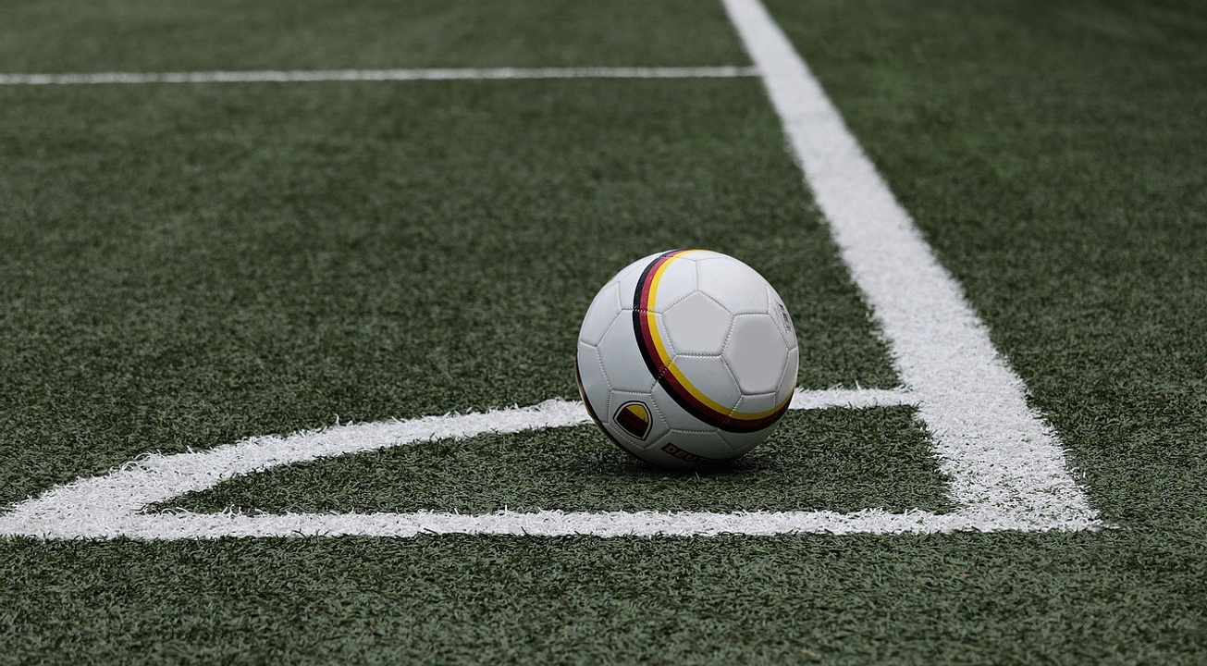
Learning Objectives
01
02
03
Understand the basic rules and objectives of the game of football
Develop proficiency in identifying and executing fundamental football skills
Apply critical thinking to analyze game scenarios and make strategic decisions
Explain the objective of the game and the roles of the offense and defense.
Estimated time: 10 minutes
Practice essential skills such as passing, receiving, and tackling.
Estimated time: 20 minutes
Evaluate different game situations and strategize plays accordingly.
Estimated time: 15 minutes
6
/
Mastering Football Fundamentals

Slide 9
Adaptive Tasks
Football Basics 🏈
Skill Drill
Game Analysis
Strategy Session
01
Explain the objective of the game and the roles of the offense and defense.
02
Practice fundamental football skills such as passing, catching, and tackling.
03
Watch a football game and analyze different plays, strategies, and player positions.
04
Develop a game plan for a hypothetical football match, considering both offensive and defensive tactics.
7
/
Mastering Football Fundamentals

