Slide 1
Exploring the Vital Role of UAE Mangroves
Understanding Their Importance, Threats, and Conservation Through 3D Modeling and Educational Strategies

Slide 2
Exploring the Vital Role of UAE Mangroves
2
Table of Contents
Introduction to UAE Mangroves
Importance of Mangroves
Threats to Mangroves
Conservation Efforts
Creating a 3D Model of UAE Mangroves
Designing the 3D Model
Building the 3D Model
Refining the 3D Model
Presentation and Feedback
Conclusion
Assessment and Evaluation
Extension Activities
Resources and Materials
04
05
06
07
08
09
10
11
12
13
14
15
16

Slide 3
Exploring the Vital Role of UAE Mangroves
3
Table of Contents
Teaching Tips and Strategies
Reflection and Self-Assessment
Next Steps and Future Lessons
Conclusion and Final Thoughts
17
18
19
20

Slide 4
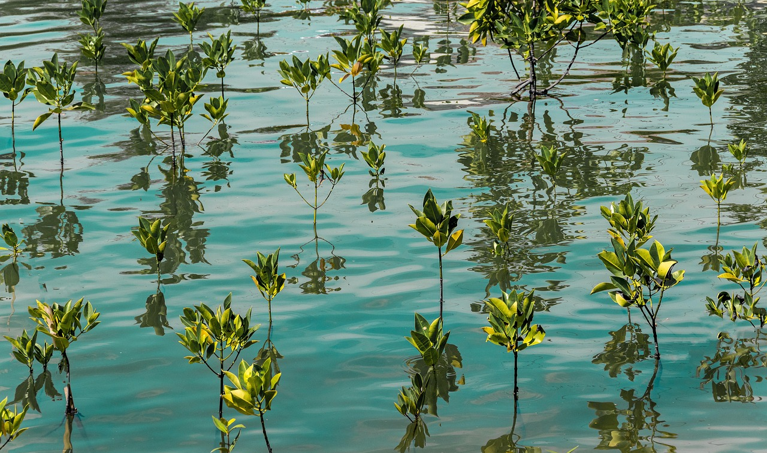
Exploring the Vital Role of UAE Mangroves
4
Introduction to UAE Mangroves
Vital Ecosystem
Diverse Habitat
Shoreline Protection
UAE mangroves are a unique and vital ecosystem.
They support a wide variety of life forms.
Mangroves provide habitat for a diverse range of plants and animals.
This biodiversity is essential for ecological balance.
Mangroves play a crucial role in protecting shorelines.
They help prevent erosion and support coastal stability.

Slide 5
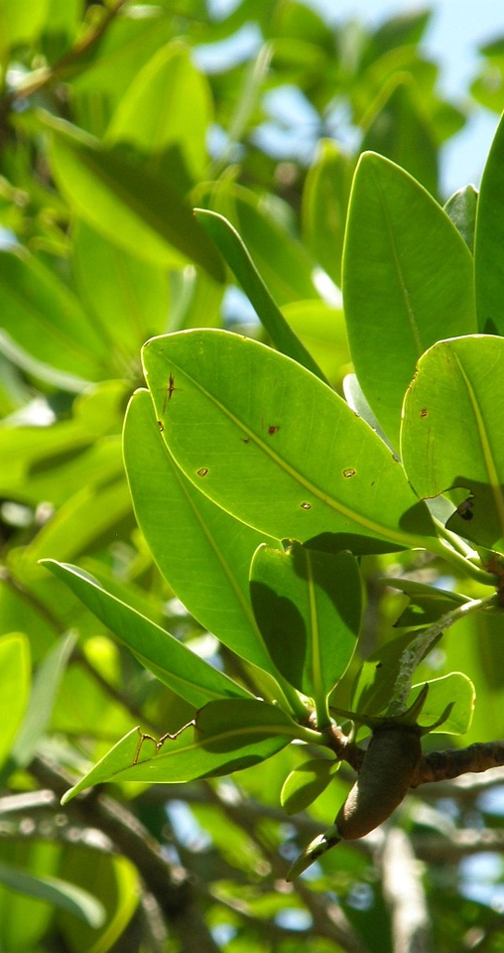
Exploring the Vital Role of UAE Mangroves
5
Importance of Mangroves
Erosion Protection
Biodiversity Support
Mangroves protect shorelines from erosion and storm damage.
Their complex root systems stabilize the coastline.
Mangroves support a wide range of marine life, including fish, birds, and mammals.
They provide critical habitats for various species.
Climate Mitigation
Economic Growth
Mangroves help to mitigate the effects of climate change by absorbing carbon dioxide.
They act as significant carbon sinks, reducing greenhouse gases in the atmosphere.
Mangroves provide economic benefits through tourism and fishing industries.
They attract visitors and support local economies through sustainable practices.

Slide 6
Exploring the Vital Role of UAE Mangroves
6
Threats to Mangroves
Habitat Loss
Industrial Pollution
Climate Impact
Overfishing Issues
Habitat destruction is a major threat to mangroves, often cleared for development.
This degradation significantly impacts these ecosystems.
Industrial pollution severely impacts mangrove health.
Toxic runoff leads to ecosystem degradation.
Climate change poses significant risks to mangroves.
Rising sea levels can lead to habitat loss and increased salinity.
Overfishing threatens mangrove biodiversity.
Destructive fishing practices disrupt the delicate balance of these ecosystems.

Slide 7

Exploring the Vital Role of UAE Mangroves
7
Conservation Efforts
Establishment of Protected Areas
Implementation of Sustainable Practices
Education and Awareness Initiatives
Protected areas and national parks are crucial for safeguarding biodiversity.
They provide essential habitats for numerous species and ecosystems.
Sustainable fishing and responsible land-use practices are vital for resource conservation.
These methods support ecological balance and benefit local communities.
Awareness campaigns highlight the significance of mangrove conservation.
These programs actively involve communities in protecting their natural environment.

Slide 8
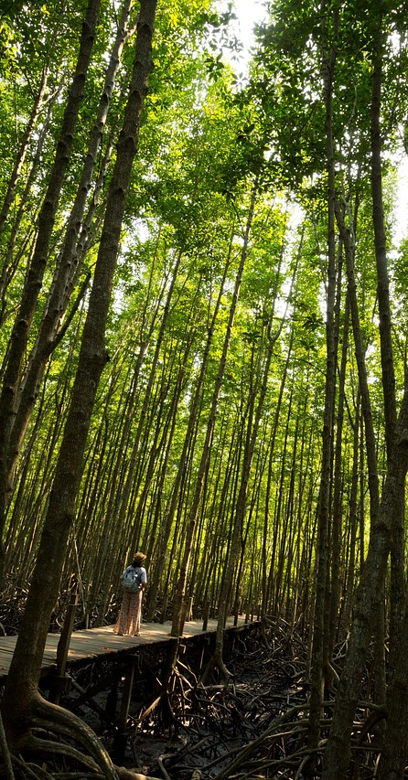
Exploring the Vital Role of UAE Mangroves
8
Creating a 3D Model of UAE Mangroves
Material Variety
Scale & Proportion
Utilize diverse materials like cardboard and clay to enhance visual appeal and structural integrity.
Ensure the model's scale accurately represents the mangroves to create a more engaging visual experience.
Natural Features
Realistic Details
Incorporate trees, wildlife, and water to depict the vibrant ecosystem of UAE mangroves.
Apply textures and colors to enhance the model's lifelike quality and immersion.

Slide 9
Exploring the Vital Role of UAE Mangroves
9
Designing the 3D Model
Research Planning
UAE Mangrove Features
Design References
Thorough research is vital for creating an effective 3D model.
It helps to organize ideas and streamline the design process.
UAE mangroves host unique tree species and wildlife.
A deep understanding of these features is essential for accurate representation.
Photographs of UAE mangroves should guide design decisions.
Real-world examples provide valuable insights into the ecosystem.

Slide 10
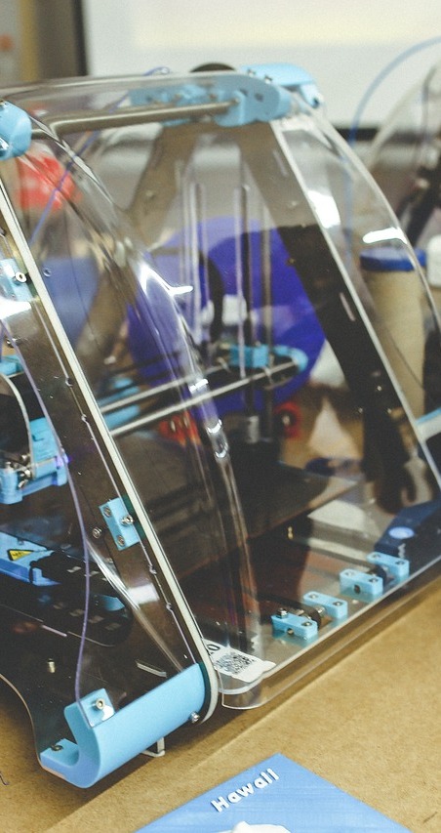
Exploring the Vital Role of UAE Mangroves
10
Building the 3D Model
Techniques
Details
Employ various methods like cutting and gluing to shape the model.
These techniques are fundamental for establishing a strong structure.
Integrate textures and colors to enhance the model's realism.
Such details elevate the visual impact and authenticity.
Scale & Proportion
Support Base
Maintain accurate scale and proportion for the model.
This precision is vital for a convincing representation.
Choose a robust base to ensure the model's stability.
A solid foundation improves both support and presentation.

Slide 11

Exploring the Vital Role of UAE Mangroves
11
Refining the 3D Model
Add Final Details
Refine Texture & Color
Adjust Scale & Proportion
Add elements like leaves or wildlife for realism.
These details enhance the overall appearance.
Adjust texture and color for a lifelike look.
Use various materials for depth.
Check the model for scale adjustments.
Ensure accurate proportions for believability.

Slide 12

Exploring the Vital Role of UAE Mangroves
12
Presentation and Feedback
Model Showcase
Peer Review
Refinement Process
Present the 3D model during class or at an exhibition.
Highlight its unique features and design elements.
Collect feedback from classmates and instructors.
Engage in discussions to uncover various perspectives on the model.
Utilize the feedback to enhance the model's design.
Focus on improving both functionality and aesthetic appeal.

Slide 13
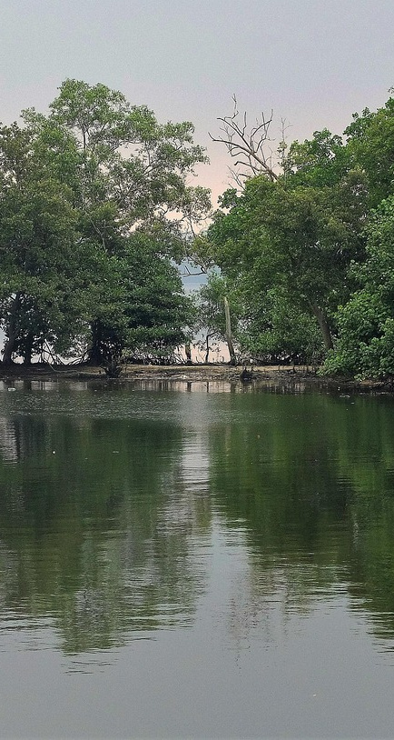
Exploring the Vital Role of UAE Mangroves
13
Conclusion
Interactive Learning
Mangrove Conservation Awareness
Creating a 3D model of UAE mangroves is an engaging way to explore these unique ecosystems.
This hands-on activity fosters a deeper understanding of their importance.
The model serves to highlight the critical need for mangrove conservation.
It raises awareness about the threats these ecosystems face and encourages proactive measures.

Slide 14
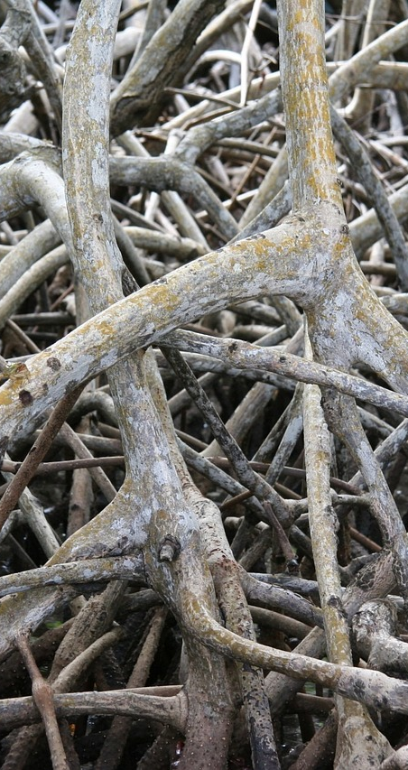
Exploring the Vital Role of UAE Mangroves
14
Assessment and Evaluation
Model Accuracy
Mangrove Importance
Evaluate the 3D model's accuracy and authenticity.
Verify that the model adheres to established representation standards.
Assess the significance of mangroves in the ecosystem.
Identify current threats to mangroves.
Teamwork Skills
Critical Thinking
Assess the student's teamwork and collaboration skills.
Foster effective communication within the team.
Assess the student's critical and creative thinking skills.
Enhance problem-solving skills using real-world scenarios.

Slide 15
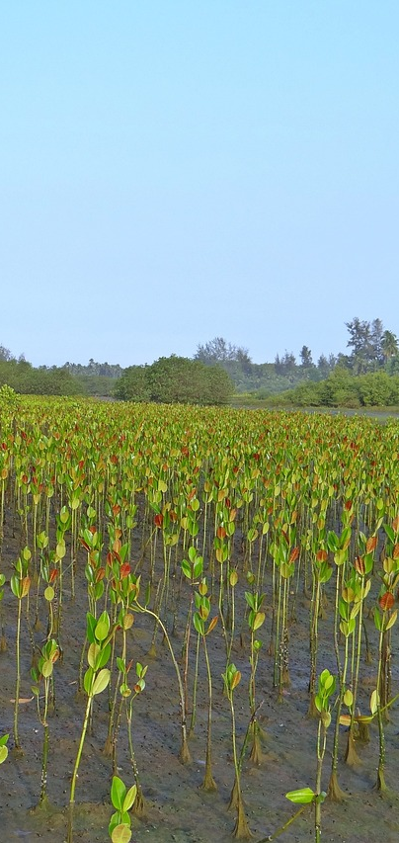
Exploring the Vital Role of UAE Mangroves
15
Extension Activities
VR Mangrove Experience
Awareness Campaign
Ecosystem Services Report
Create a virtual reality experience showcasing the UAE mangrove ecosystem.
This will immerse users in the beauty and importance of mangroves.
Launch a public service announcement to promote mangrove conservation.
Utilize social media to engage the community and spread awareness.
Conduct research on the vital ecosystem services provided by mangroves.
Highlight their contributions to biodiversity and coastal protection.

Slide 16

Exploring the Vital Role of UAE Mangroves
16
Resources and Materials
3D Printing Tools
UAE Mangrove References
Use cardboard, clay, or 3D printing software to create models.
These tools help visualize mangrove structures effectively.
Gather reference images of UAE mangroves.
Real-world examples enhance understanding of local ecosystems.
Mangrove Literature
Online Mangrove Resources
Explore books and articles on mangrove ecosystems and conservation.
These resources provide valuable insights into biodiversity and preservation efforts.
Access videos and websites focused on mangroves and their conservation.
These platforms offer extensive information for further learning.

Slide 17
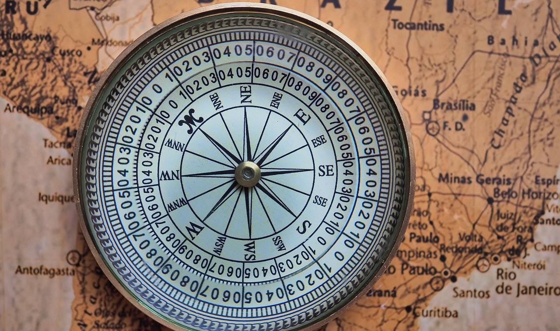
Exploring the Vital Role of UAE Mangroves
17
Teaching Tips and Strategies
Foster Autonomy
Real-World Relevance
Constructive Feedback
Empower students to take ownership of their learning process.
Encourage them to explore their passions and express their unique perspectives.
Integrate real-world scenarios to highlight the critical role of ecosystems like mangroves.
Explain how mangroves serve as natural barriers against storms and support diverse wildlife.
Deliver clear and specific feedback to help students identify areas for growth.
Foster an environment where students feel safe to ask questions and seek assistance.

Slide 18

Exploring the Vital Role of UAE Mangroves
18
Reflection and Self-Assessment
Learning Insights
Model Evaluation
Reflecting on the learning process highlights the skills developed during the project.
These insights are vital for applying knowledge in future projects.
Evaluating the accuracy of the 3D model ensures it authentically represents the mangrove ecosystem.
This assessment enhances our understanding of the ecosystem's intricate relationships.

Slide 19

Exploring the Vital Role of UAE Mangroves
19
Next Steps and Future Lessons
Ecosystem Services
Restoration Techniques
Conservation Planning
Examine the essential services that mangroves provide to our ecosystems.
These services include coastal protection and habitat for diverse wildlife.
Effective restoration methods for degraded mangrove ecosystems include planting native species and enhancing water flow.
These strategies aim to revive the ecological balance and improve biodiversity.
Develop a comprehensive conservation plan for mangroves in the UAE.
The plan must address threats and promote sustainable management practices.

Slide 20
Exploring the Vital Role of UAE Mangroves
20
Conclusion and Final Thoughts
3D Mangrove Model
Conservation Importance
Creating a 3D model of UAE mangroves provides an interactive learning experience about these unique ecosystems.
This approach enhances understanding and appreciation of mangrove environments.
Understanding and addressing the threats to mangrove conservation is essential for protecting biodiversity and coastal ecosystems.
Protecting these vital ecosystems is crucial for maintaining ecological balance.

