Slide 1
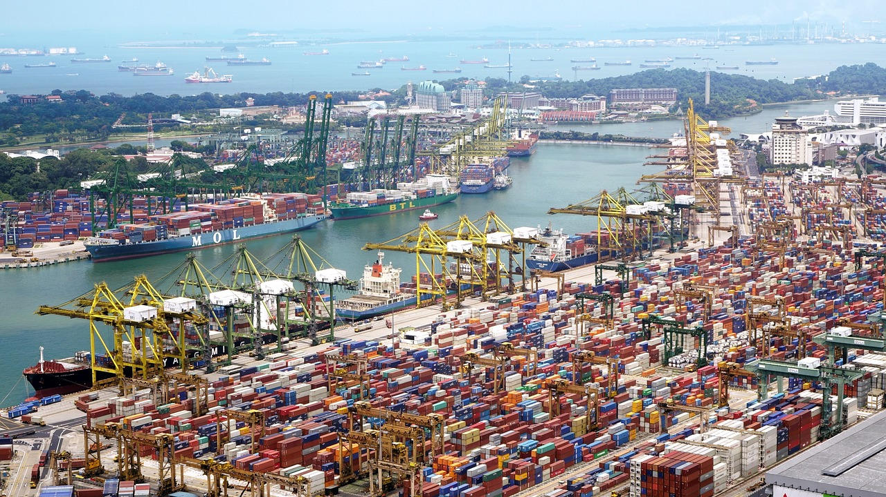

Comprehensive Guide to Export Requirements and Compliance
Ensuring Successful and Legal International Trade Operations

Slide 2
Comprehensive Guide to Export Requirements and Compliance
2
Table of Contents
Introduction to Export Requirements
What Are Export Requirements?
Types of Export Requirements
Export Documentation
Export Licenses and Permits
Customs Regulations
Product Classification and Tariffs
Export Controls and Restrictions
Compliance with International Standards
Incoterms and Their Role in Export
Packaging and Labeling Requirements
Export Insurance
Payment Methods in Export
04
05
06
07
08
09
10
11
12
13
14
15
16

Slide 3
Comprehensive Guide to Export Requirements and Compliance
3
Table of Contents
Role of Freight Forwarders and Customs Brokers
Export Compliance Programs
Penalties for Non-Compliance
Case Study: Successful Export Compliance
Common Challenges in Export Compliance
Resources for Exporters
Summary and Best Practices
17
18
19
20
21
22
23

Slide 4
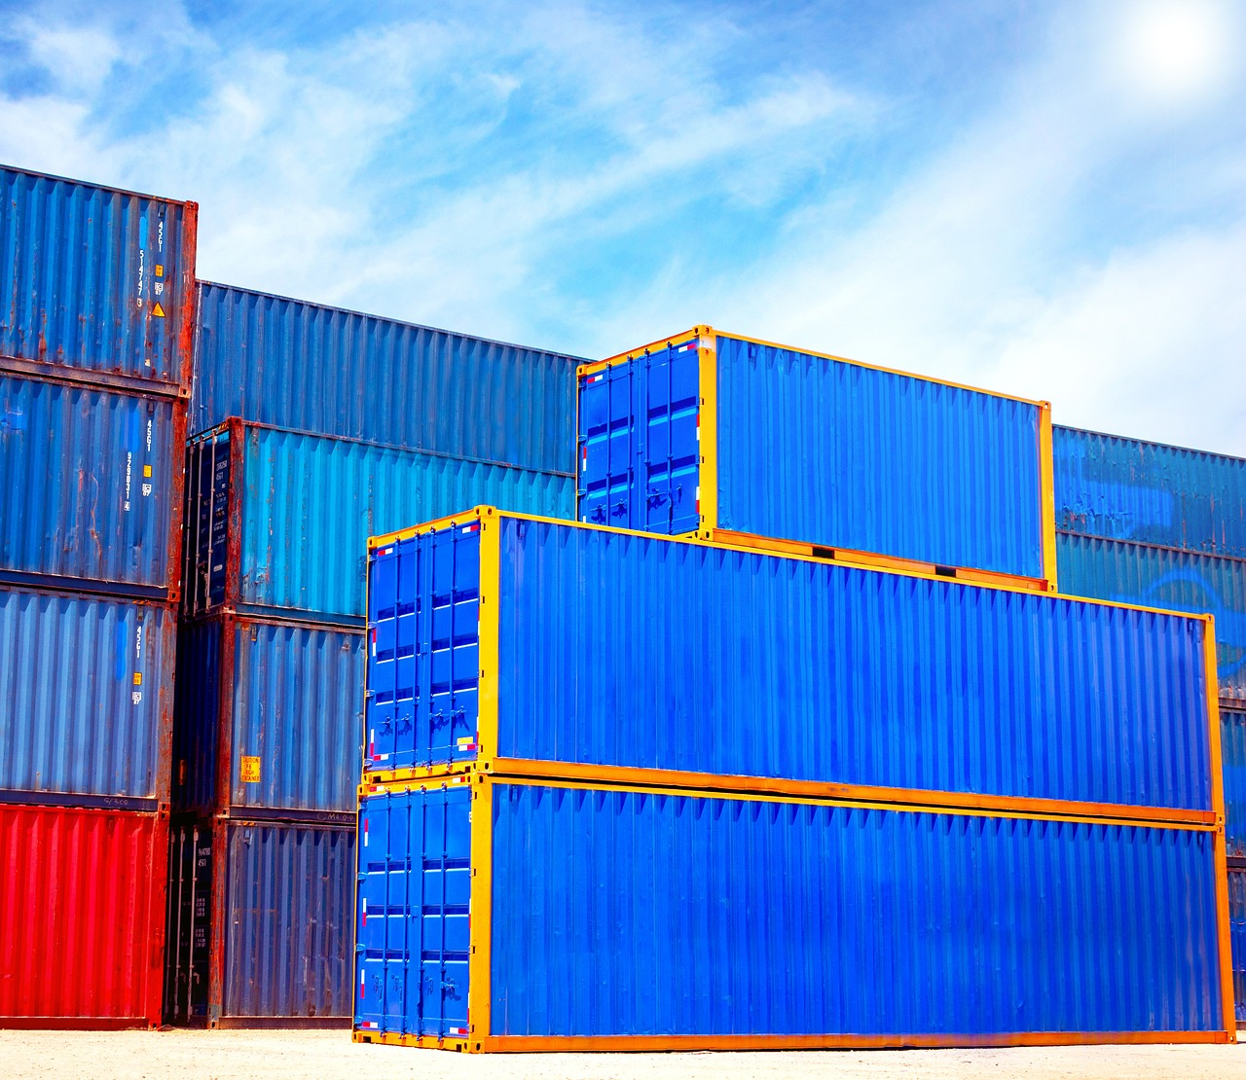
Comprehensive Guide to Export Requirements and Compliance
4
Introduction to Export Requirements
Importance of Export Requirements
Benefits of Proper Knowledge
Ensuring Compliance
Understanding export requirements is crucial for successful international trade.
These requirements ensure that goods move smoothly across borders, comply with legal standards, and meet the expectations of foreign markets.
Proper knowledge helps businesses avoid delays, penalties, and financial losses.
It enables companies to expand their global reach effectively.
Export requirements help businesses adhere to legal standards.
They also ensure that goods meet the expectations of foreign markets.

Slide 5

Comprehensive Guide to Export Requirements and Compliance
5
What Are Export Requirements?
Definition of Export Requirements
Export requirements are the set of rules, regulations, and documentation that exporters must follow to legally ship goods internationally.
They serve as a framework to control the flow of goods, protect national security, and ensure compliance with trade agreements.
Variability of Requirements
These requirements vary by country, product, and destination.
Making thorough understanding essential for exporters.
Purpose of Export Requirements
They serve as a framework to control the flow of goods, protect national security, and ensure compliance with trade agreements.
Exporters must adhere to these to ensure smooth international trade operations.

Slide 6
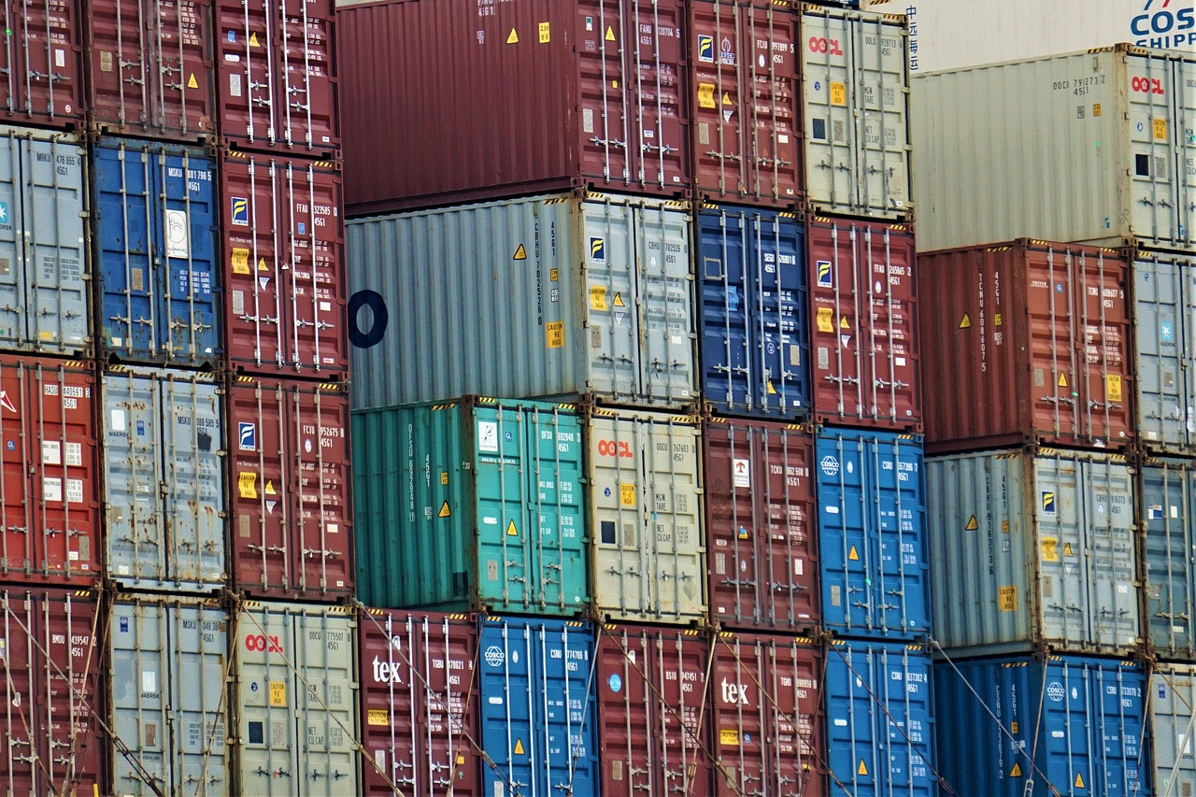
Comprehensive Guide to Export Requirements and Compliance
6
Types of Export Requirements
Documentation
Licensing
Compliance
Essential paperwork to accompany shipments.
Plays a vital role in facilitating legal and efficient international trade.
Permissions required for certain goods or destinations.
Ensures compliance with international trade laws.
Adherence to laws, standards, and regulations governing exports.
Critical for avoiding legal issues and ensuring smooth trade operations.

Slide 7

Comprehensive Guide to Export Requirements and Compliance
7
Export Documentation
Key Export Document: Commercial Invoice
Packing List: Shipment Details
Certificate of Origin: Proof of Production
Essential for detailing the transaction between buyer and seller.
Supports customs clearance and payment processing.
Specifies the contents and packaging of the shipment.
Facilitates regulatory compliance and smooth logistics.
Verifies the country where the goods were produced.
Ensures adherence to trade agreements and customs requirements.

Slide 8

Comprehensive Guide to Export Requirements and Compliance
8
Export Licenses and Permits
Understanding Export Licenses
Consequences of Non-Compliance
Government Oversight
Certain products or destinations require export licenses or permits to control sensitive goods or comply with trade restrictions.
Exporters must identify when licenses are necessary and apply through appropriate government agencies.
Failure to obtain required licenses can result in shipment delays, fines, or legal action.
Exporters must ensure compliance to avoid these potential penalties.
Export licenses are issued by appropriate government agencies.
These agencies ensure that trade restrictions and controls are adhered to.

Slide 9
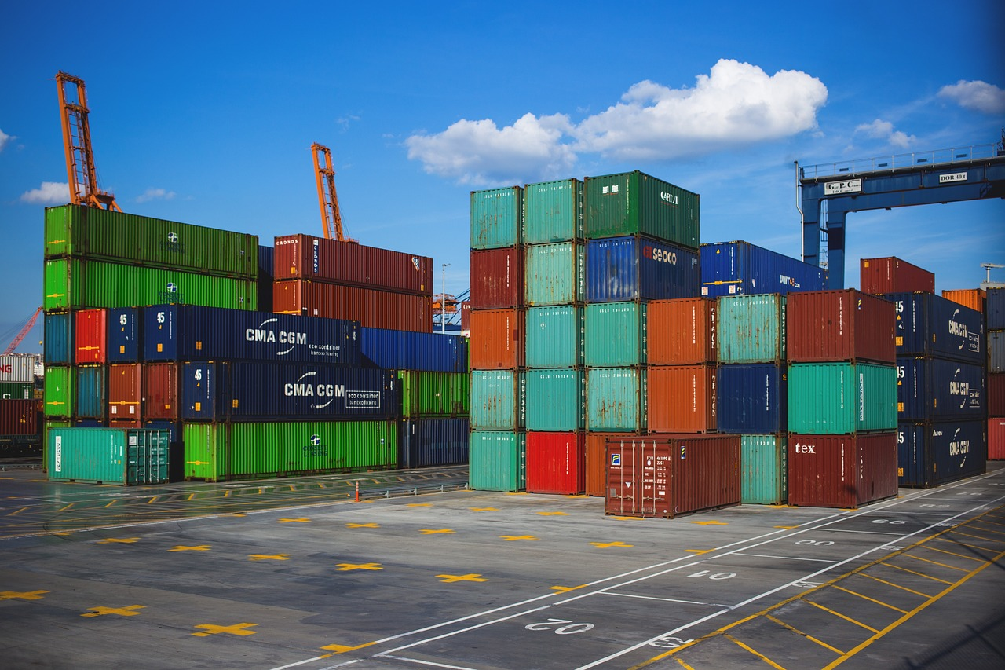
Comprehensive Guide to Export Requirements and Compliance
9
Customs Regulations
Overview of Customs Procedures
Exporter Responsibilities
Importance of Understanding Regulations
Customs procedures govern the import and export of goods across borders.
They ensure compliance with international trade laws and regulations.
Exporters must comply with customs declarations, inspections, and tariff payments.
Failure to meet these requirements can result in penalties or shipment delays.
Understanding customs regulations helps prevent shipment holds.
It also ensures timely delivery of goods to their destination.

Slide 10

Comprehensive Guide to Export Requirements and Compliance
10
Product Classification and Tariffs
Importance of HS Codes
Correctly classifying products using Harmonized System (HS) codes is essential for determining applicable tariffs and duties.
HS codes standardize product identification worldwide, facilitating customs processing.
Impact of Tariffs
Tariffs impact the cost and competitiveness of exported goods.
Accurate classification is critical to manage these costs effectively.
Role in Global Trade
HS codes play a vital role in simplifying international trade.
They ensure uniformity in product classification across borders.

Slide 11
Comprehensive Guide to Export Requirements and Compliance
11
Export Controls and Restrictions
Regulation of Sensitive Goods
Embargoes and Sanctions
Avoiding Violations and Penalties
Export controls regulate the shipment of sensitive or restricted goods.
These measures aim to protect national security and foreign policy interests.
Embargoes and sanctions may prohibit exports to certain countries or entities.
Such restrictions are crucial for maintaining international compliance.
Exporters must stay informed about these restrictions.
This awareness helps prevent violations and associated penalties.

Slide 12

Comprehensive Guide to Export Requirements and Compliance
12
Compliance with International Standards
Ensuring Product Quality and Safety
Enhancing Reputation
Facilitating Global Market Access
Adhering to international standards and certifications ensures product quality, safety, and market acceptance.
Standards may cover product specifications, environmental impact, and social responsibility.
Compliance enhances reputation and facilitates access to global markets.
Adhering to standards demonstrates commitment to quality and responsibility.
Meeting international standards opens doors to global markets.
It ensures products meet the expectations of diverse international consumers.

Slide 13

Comprehensive Guide to Export Requirements and Compliance
13
Incoterms and Their Role in Export
Defining Incoterms
Incoterms define the responsibilities of buyers and sellers regarding delivery, risk, and costs in international trade.
They provide a standardized framework to ensure clarity in global transactions.
Common Incoterms Examples
Common terms include FOB (Free on Board), CIF (Cost, Insurance, Freight), and DDP (Delivered Duty Paid).
These terms specify the division of costs and risks between the buyer and the seller.
Importance of Understanding Incoterms
Clear understanding of Incoterms prevents disputes and clarifies logistics arrangements.
This knowledge is essential for smooth international trade operations.

Slide 14

Comprehensive Guide to Export Requirements and Compliance
14
Packaging and Labeling Requirements
Importance of Proper Packaging
Labeling Essentials
Ensuring Product Integrity
Proper packaging protects goods during transit and complies with destination country regulations.
Meeting these requirements ensures product integrity and customer satisfaction.
Labeling must include product information, handling instructions, and compliance marks.
Proper labeling ensures adherence to regulations and clear communication with customers.
Meeting packaging and labeling requirements ensures product integrity.
It also plays a crucial role in achieving customer satisfaction.

Slide 15

Comprehensive Guide to Export Requirements and Compliance
15
Export Insurance
Protection Against Transit Risks
Types of Export Insurance Coverage
Ensuring Business Continuity
Export insurance safeguards shipments from damage, loss, or theft during transit.
This ensures that businesses can recover financially from unforeseen incidents.
Coverage options include marine insurance, credit insurance, and political risk insurance.
Each type addresses specific risks associated with international trade.
Securing appropriate insurance mitigates financial exposure.
It supports uninterrupted operations even in the face of adverse events.

Slide 16

Comprehensive Guide to Export Requirements and Compliance
16
Payment Methods in Export
Letters of Credit
Documentary Collections
Open Account
Secure payment guaranteed by banks.
This method ensures exporters receive payment upon fulfilling terms.
Banks handle documents but do not guarantee payment.
Exporters face moderate risk as payment is not assured.
Payment after goods are received, higher risk for exporters.
This method requires trust and careful risk management.

Slide 17
Comprehensive Guide to Export Requirements and Compliance
17
Role of Freight Forwarders and Customs Brokers
Freight Forwarders' Role
Customs Brokers' Assistance
Streamlining Export Processes
Freight forwarders coordinate the transportation and logistics of export shipments.
Their expertise streamlines export processes and reduces the risk of delays or errors.
Customs brokers assist with customs clearance, ensuring compliance with regulations and documentation.
Their expertise streamlines export processes and reduces the risk of delays or errors.
Freight forwarders and customs brokers work together to ensure smooth export operations.
Their combined efforts reduce the risk of delays or errors in international trade.

Slide 18

Comprehensive Guide to Export Requirements and Compliance
18
Export Compliance Programs
Purpose of Export Compliance Programs
Key Components of Compliance Programs
Benefits of Effective Compliance
Organizations develop export compliance programs to systematically manage export controls and regulations.
These programs ensure adherence to legal requirements and international trade standards.
These programs include employee training, internal audits, and record-keeping.
Such measures help organizations maintain transparency and accountability.
Effective compliance programs reduce legal risks and enhance operational efficiency.
They contribute to the organization's reputation and long-term success.

Slide 19

Comprehensive Guide to Export Requirements and Compliance
19
Penalties for Non-Compliance
Financial Consequences
Shipment Issues
Failure to meet export requirements can result in financial penalties and fines.
These penalties can have a significant impact on a company's bottom line.
Non-compliance may lead to shipment seizures or delays.
This can disrupt supply chains and customer satisfaction.
Loss of Export Privileges
Legal and Reputational Risks
Companies risk losing their export privileges or licenses.
This can severely limit their ability to operate internationally.
Non-compliance can lead to legal prosecution and reputational damage.
Such outcomes can harm a company's credibility and future opportunities.

Slide 20
Comprehensive Guide to Export Requirements and Compliance
20
Case Study: Successful Export Compliance
Comprehensive Compliance Program
Enhanced Customer Trust
Expanded Market Access
A multinational company implemented a comprehensive export compliance program, including staff training and automated documentation checks.
This approach minimized shipment delays and regulatory violations.
The program resulted in increased customer trust.
This was achieved through proactive compliance management.
The company successfully expanded its market access.
This case highlights the value of proactive compliance management.

Slide 21

Comprehensive Guide to Export Requirements and Compliance
21
Common Challenges in Export Compliance
Regulatory Challenges
Documentation Issues
Exporters often face obstacles such as complex and changing regulations.
These regulations require constant monitoring and adaptation to ensure compliance.
Incomplete or incorrect documentation is a common hurdle in export compliance.
Such errors can lead to delays, fines, or shipment rejections.
Product Classification Difficulties
Strategies for Overcoming Challenges
Determining the correct classification for products can be challenging.
This process is crucial for meeting regulatory requirements and avoiding penalties.
Continuous education, leveraging technology, and consulting experts are key strategies.
These approaches help exporters navigate complexities and maintain compliance.

Slide 22

Comprehensive Guide to Export Requirements and Compliance
22
Resources for Exporters
Government Support for Exporters
Government agencies such as export promotion councils and customs authorities play a crucial role in supporting exporters.
They provide essential services like compliance guidance and facilitation of export processes.
Digital Tools for Export Success
Online tools offer exporters resources like tariff lookup and documentation templates.
These tools simplify complex procedures and ensure accuracy in export documentation.
Industry Associations and Training
Industry associations provide exporters with training programs and expert guidance.
Their support helps businesses navigate challenges and improve their export strategies.

Slide 23
Comprehensive Guide to Export Requirements and Compliance
23
Summary and Best Practices
Compliance Essentials
Product Classification
Compliance Programs
Understand and comply with all documentation, licensing, and customs regulations.
This ensures adherence to legal requirements and smooth processing of shipments.
Classify products accurately and stay updated on tariffs and restrictions.
Proper classification avoids delays and ensures correct duties are applied.
Develop robust compliance programs and engage expert partners.
These programs help in maintaining consistency and addressing complex regulations.
Shipment Protection
Trade Success
Use proper packaging, labeling, and insurance to protect shipments.
This minimizes risks and ensures goods reach their destination safely.
Following these best practices ensures smooth, legal, and profitable international trade.
Adhering to these guidelines builds trust and fosters long-term business relationships.

