Slide 1


Mastering Effective Communication: Building Strong Connections
Exploring Para-verbal, Non-verbal Skills, Active Listening, and Overcoming Barriers

Slide 2
Mastering Effective Communication: Building Strong Connections
2
Table of Contents
Introduction to Effective Communication
What is Para-verbal Communication?
What is Non-verbal Communication?
Importance of Active Listening
Overcoming Communication Obstacles
Role of Technology in Communication
Effective Communication in Different Contexts
Strategies for Improvement
Common Errors in Communication
Conclusion
Key Takeaways
Reflection Questions
Next Steps
04
05
06
07
08
09
10
11
12
13
14
15
16

Slide 3
Mastering Effective Communication: Building Strong Connections
3
Table of Contents
Additional Resources
Conclusion and Final Thoughts
Final Reflection
17
18
19

Slide 4
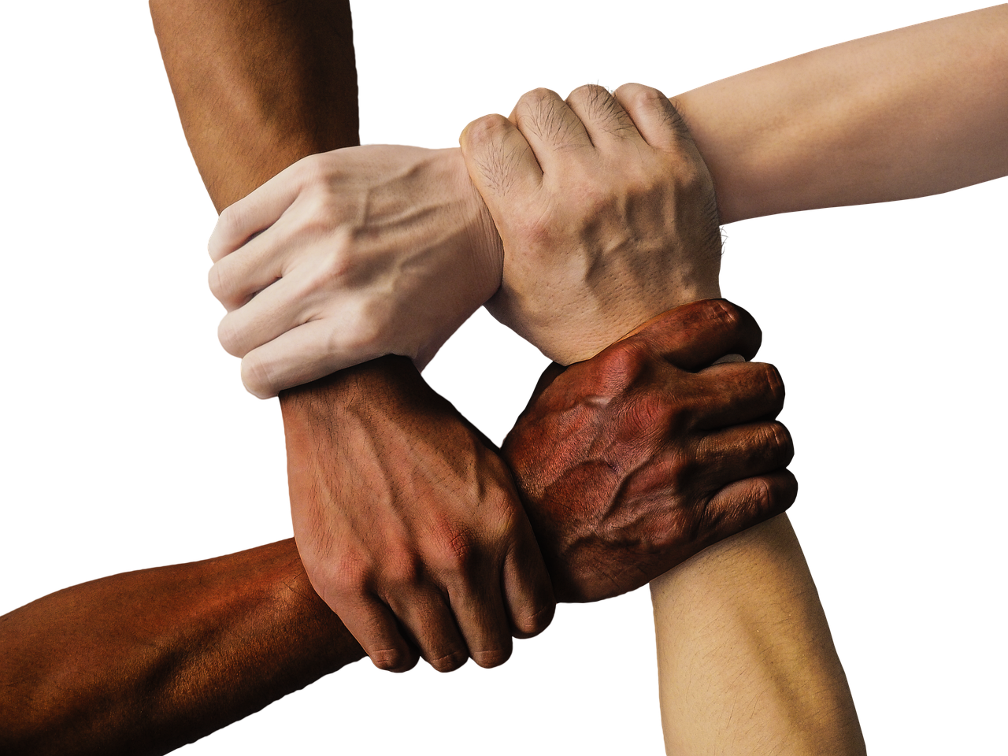
Mastering Effective Communication: Building Strong Connections
4
Introduction to Effective Communication
Foundation of Strong Relationships
Role of Para-verbal and Non-verbal Communication
Exploring and Improving Communication
Effective communication is the foundation of strong relationships and academic success.
It enables individuals to connect, understand, and collaborate effectively.
Para-verbal and non-verbal communication play a crucial role in conveying messages and building trust.
These elements often communicate more than words themselves.
In this lesson, we will explore the importance of para-verbal and non-verbal communication.
We will also develop strategies to enhance these essential skills.

Slide 5

Mastering Effective Communication: Building Strong Connections
5
What is Para-verbal Communication?
Definition of Para-verbal Communication
Role of Tone in Communication
Para-verbal communication refers to the way something is said, including tone, pitch, volume, and rate of speech.
It focuses on how the message is delivered rather than the words themselves.
Tone can convey emotions and attitudes, such as happiness, sadness, or anger.
It plays a crucial role in expressing the speaker's feelings.
Impact of Pitch on Engagement
Significance of Volume in Expression
Pitch can convey excitement, boredom, or interest.
It helps in maintaining the listener's attention and engagement.
Volume can convey confidence, nervousness, or urgency.
It influences how the message is perceived by the audience.

Slide 6

Mastering Effective Communication: Building Strong Connections
6
What is Non-verbal Communication?
Definition of Non-verbal Communication
Forms of Non-verbal Communication
Non-verbal communication refers to the way messages are conveyed without using words.
It encompasses various forms such as gestures, posture, and tone of voice.
Body language, facial expressions, and eye contact are all forms of non-verbal communication.
These cues often convey emotions and attitudes effectively.
Role of Non-verbal Cues
Cultural Impact on Interpretation
Non-verbal cues can reinforce or contradict verbal messages.
They play a crucial role in ensuring the clarity and intent of communication.
Cultural differences can impact the interpretation of non-verbal cues.
What is acceptable in one culture may be misunderstood in another.

Slide 7

Mastering Effective Communication: Building Strong Connections
7
Importance of Active Listening
The Role of Active Listening in Communication
Techniques to Demonstrate Active Listening
Benefits of Active Listening in Relationships
Active listening is essential for effective communication and building trust.
It ensures that the speaker feels heard and understood.
Maintaining eye contact, nodding, and using verbal cues can show interest and engagement.
These techniques encourage the speaker to share more openly.
Active listening can help resolve conflicts and improve relationships.
It fosters a deeper connection and mutual respect between individuals.

Slide 8
Mastering Effective Communication: Building Strong Connections
8
Overcoming Communication Obstacles
Understanding Communication Obstacles
Simplifying Language for Clarity
Seeking Clarification in Conversations
Leveraging Technology for Better Communication
Communication obstacles can arise from cultural, linguistic, or personal differences.
Being aware of these obstacles and using strategies to overcome them is crucial.
Strategies include using simple language and avoiding jargon.
These approaches help ensure messages are understood by diverse audiences.
Seeking clarification is a vital strategy to overcome misunderstandings.
It ensures that all parties are on the same page during communication.
Technology can facilitate communication across distances and cultures.
It bridges gaps and enhances understanding in diverse settings.

Slide 9
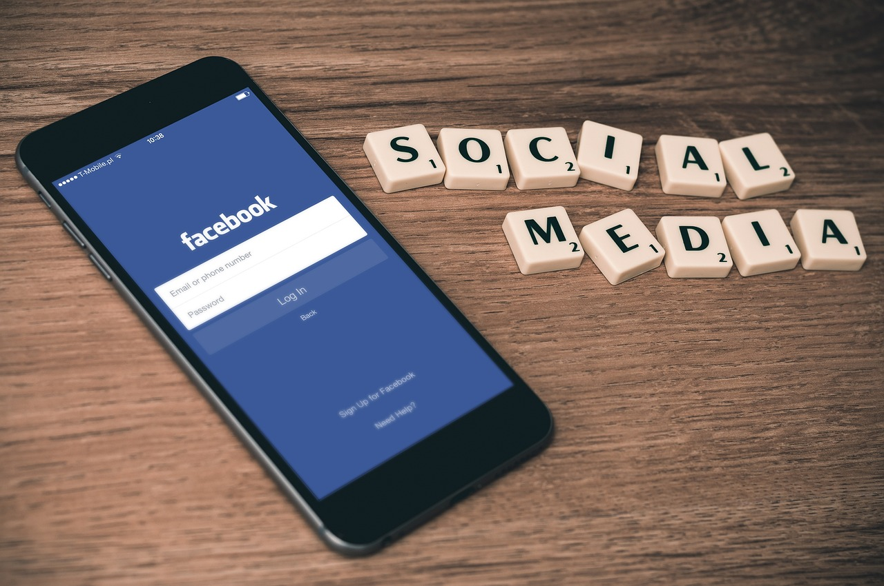
Mastering Effective Communication: Building Strong Connections
9
Role of Technology in Communication
Transformation in Communication
Challenges in Technological Communication
Awareness for Effective Communication
Technology has transformed the way we communicate, with social media, email, and messaging apps.
These tools have made communication faster and more accessible than ever before.
Technology can facilitate communication, but also create new challenges, such as misinterpretation and distraction.
These challenges can hinder the effectiveness of communication if not managed properly.
Being aware of the impact of technology on communication is essential for effective communication.
Understanding these impacts can help individuals navigate and optimize their communication strategies.

Slide 10
Mastering Effective Communication: Building Strong Connections
10
Effective Communication in Different Contexts
Importance of Effective Communication
Context-Specific Communication Strategies
Effective communication is essential in personal and professional relationships.
It helps in building trust, understanding, and collaboration among individuals.
Different contexts, such as work, school, or social media, require different communication strategies.
Tailoring communication methods to fit the context ensures clarity and relevance.
Audience and Purpose Awareness
Adapting Communication Styles
Being aware of the audience, purpose, and context is crucial for effective communication.
This awareness helps in delivering messages that resonate and achieve intended outcomes.
Adapting communication style to the context can improve relationships and achieve goals.
Flexibility in communication fosters better connections and mutual understanding.

Slide 11
Mastering Effective Communication: Building Strong Connections
11
Strategies for Improvement
Practicing Self-Awareness
Seeking Constructive Feedback
Practicing self-awareness and self-reflection can improve communication skills.
This helps individuals understand their own communication patterns and areas for growth.
Seeking feedback from others and being open to constructive criticism can help identify areas for improvement.
This approach fosters a growth mindset and encourages continuous learning.
Enhancing Active Listening
Adapting to Cultural Differences
Developing active listening skills and using positive non-verbal cues can enhance communication.
These skills ensure that messages are understood and relationships are strengthened.
Being aware of cultural differences and adapting communication style can improve relationships.
This sensitivity promotes mutual respect and effective collaboration.

Slide 12
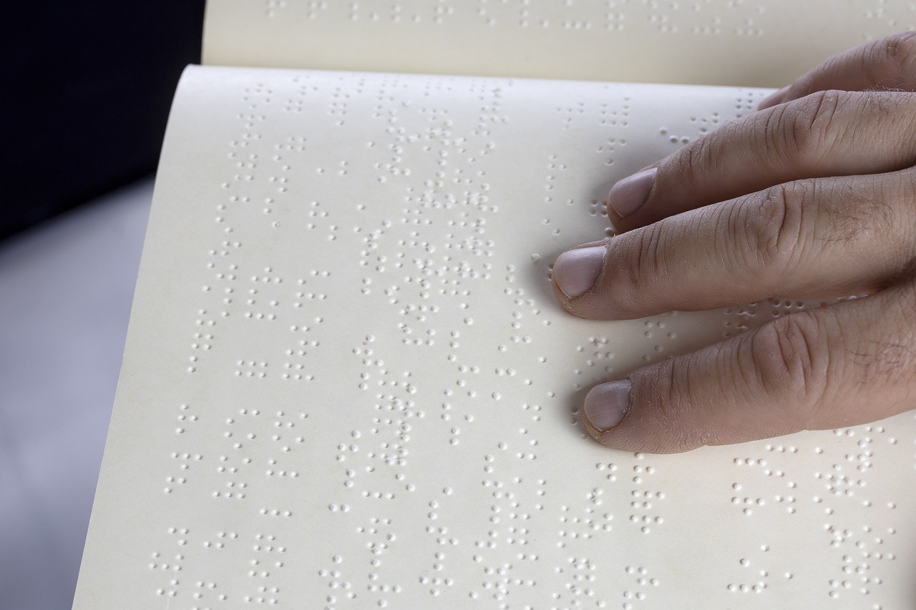
Mastering Effective Communication: Building Strong Connections
12
Common Errors in Communication
The Limitation of Words
Assuming that words are the only means of conveying meaning can lead to misinterpretation.
This can result in a failure to fully understand the intended message.
The Role of Non-Verbal Cues
Neglecting non-verbal cues can lead to misunderstandings and conflict.
These cues often carry significant emotional and contextual information.
Cultural Sensitivity in Communication
Being unaware of cultural differences can lead to unintentional offense or miscommunication.
Understanding cultural nuances is essential for effective interaction.

Slide 13

Mastering Effective Communication: Building Strong Connections
13
Conclusion
Importance of Communication
Enhancing Communication Skills
Effective communication is essential for building strong relationships.
It plays a crucial role in achieving academic success.
By understanding and developing para-verbal and non-verbal communication skills, individuals can improve their communication.
These skills help individuals achieve their goals.

Slide 14
Mastering Effective Communication: Building Strong Connections
14
Key Takeaways
The Role of Para-verbal and Non-verbal Communication
Para-verbal and non-verbal communication play a crucial role in conveying messages.
They are essential for building trust in interactions.
Importance of Active Listening and Self-awareness
Active listening and self-awareness are essential for effective communication.
These skills help in understanding and responding appropriately.
Adapting to Cultural Differences
Being aware of cultural differences can improve relationships.
Adapting communication style to these differences fosters better understanding.
Improving Communication Skills Through Practice
Practicing and seeking feedback can help improve communication skills.
This approach ensures continuous growth and refinement.

Slide 15

Mastering Effective Communication: Building Strong Connections
15
Reflection Questions
Overcoming Communication Challenges
Building Trust Through Communication
Enhancing Active Listening
What are some common challenges you face in communication, and how can you overcome them?
Reflect on personal experiences and identify actionable steps to address these challenges.
How can you use para-verbal and non-verbal communication to build trust and rapport with others?
Explore techniques like tone modulation and body language to enhance connections.
What strategies can you use to improve your active listening skills and adapt to different communication contexts?
Consider methods such as summarizing key points and adjusting to diverse conversational styles.

Slide 16

Mastering Effective Communication: Building Strong Connections
16
Next Steps
Mastering Positive Non-Verbal Cues
Seeking Constructive Feedback
Creating a Communication Improvement Plan
Practice using positive non-verbal cues, such as maintaining eye contact and using open body language.
These cues can significantly enhance the effectiveness of your communication.
Seek feedback from others on your communication style and identify areas for improvement.
This will help you understand how others perceive your communication and pinpoint areas to work on.
Develop a plan to improve your communication skills and achieve your goals.
A structured approach will ensure consistent progress and measurable results.

Slide 17
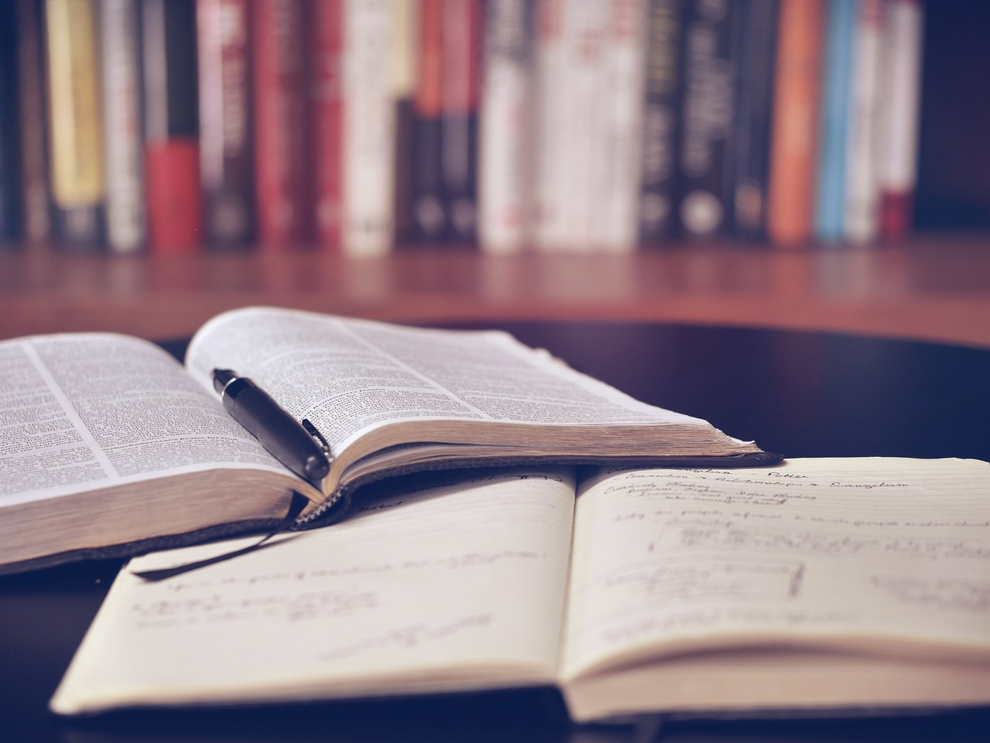
Mastering Effective Communication: Building Strong Connections
17
Additional Resources
Books and Articles
Online Courses and Workshops
TED Talks and Videos
Explore a variety of books and articles focused on effective communication and understanding non-verbal cues.
These resources provide insights into improving interpersonal skills and fostering better relationships.
Participate in online courses and workshops designed to enhance communication skills and resolve conflicts effectively.
These interactive sessions offer practical strategies and tools for personal and professional growth.
Watch TED talks and videos that emphasize the importance of communication and building strong relationships.
These visual resources inspire and educate on the transformative power of effective communication.

Slide 18

Mastering Effective Communication: Building Strong Connections
18
Conclusion and Final Thoughts
The Art of Effective Communication
Achieving Success Through Communication
Effective communication is a skill that can be developed and improved with practice and awareness.
By mastering para-verbal and non-verbal communication skills, individuals can build stronger relationships.
Effective communication helps individuals achieve their goals.
It is essential for succeeding in both personal and professional lives.

Slide 19

Mastering Effective Communication: Building Strong Connections
19
Final Reflection
Final Reflection
Take a moment to reflect on what you have learned and how you can apply it to your life.
What changes can you make to improve your communication skills and build stronger relationships?

