Slide 1



Understanding Global Warming and Its Impact
Exploring the Causes, Effects, and Solutions for a Sustainable Future

Slide 2
Table of contents
Introduction to Global Warming
The Carbon Cycle
Effects of Global Warming on the Great Barrier Reef
Rising Sea Levels and Geological Changes
Human Impact on the Environment
Renewable Energy Sources
Sustainable Practices
Climate Change Mitigation
Conclusion
Reflection Questions
01
02
03
04
05
06
07
08
09
10

Slide 3
Table of contents
Next Steps
Additional Resources
Assessment
Extension Activities
Parent Engagement
Safety Considerations
Teaching Tips
11
12
13
14
15
16
17

Slide 4

Introduction to Global Warming
Human Impact
Curriculum Focus
Environmental Effects
Global warming refers to the long-term increase in the Earth's average temperature.
Human activities, particularly the release of greenhouse gases like carbon dioxide and methane, primarily cause this increase.
The UK primary school curriculum emphasizes understanding global warming and its environmental effects.
Students will learn about the causes, effects, and solutions to global warming.
Global warming causes significant environmental changes.
This includes bleaching of the Great Barrier Reef and rising sea levels, which cause habitat loss and alter weather patterns.
Understanding Global Warming and Its Impact
1

Slide 5
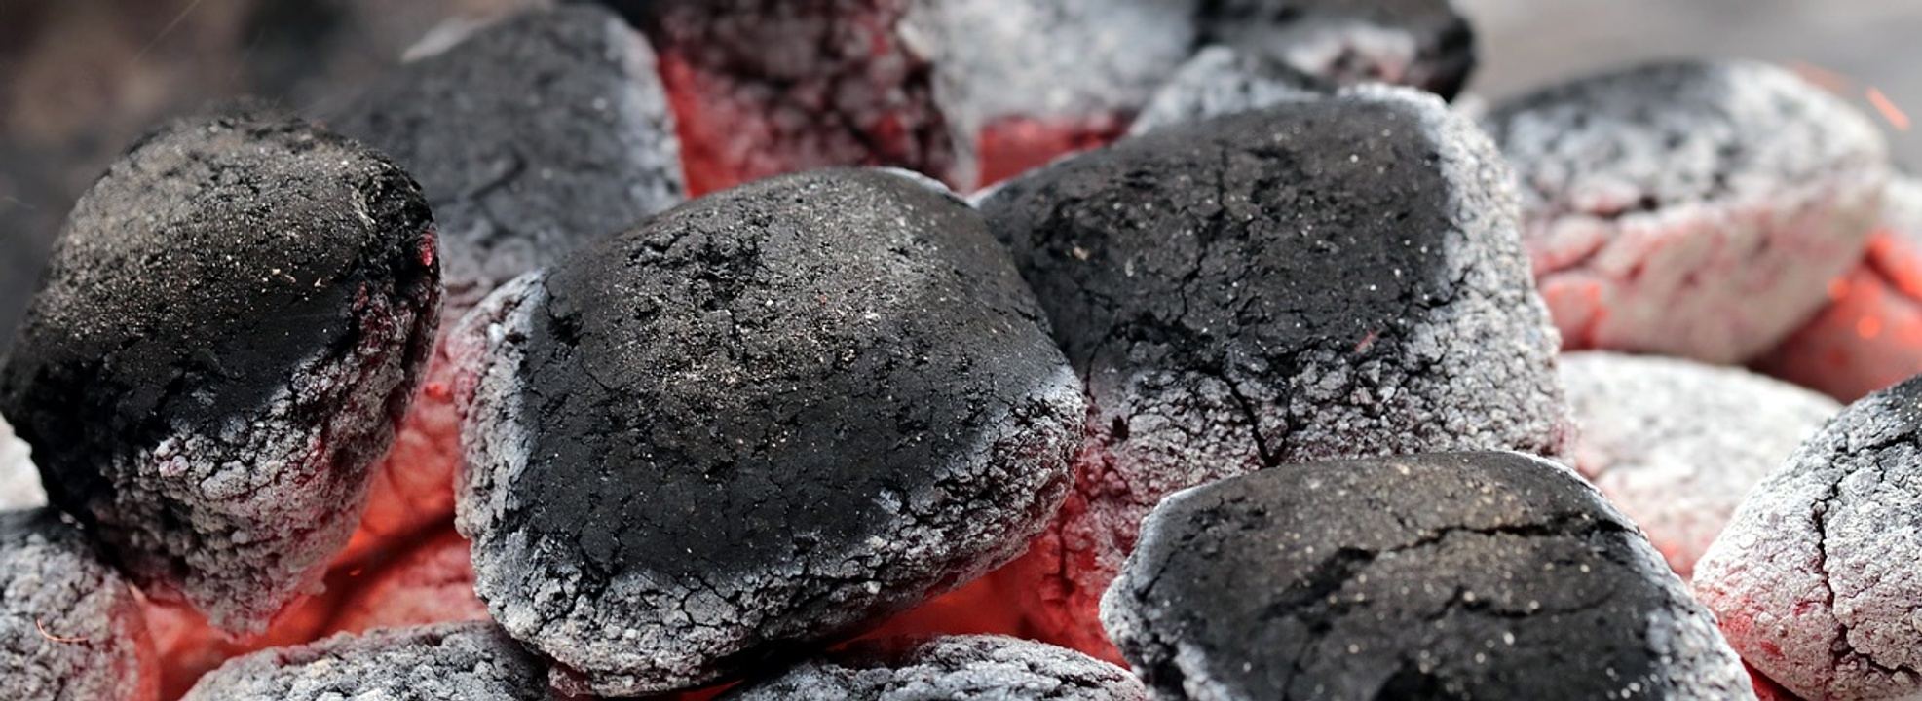
The Carbon Cycle
Carbon Components
Key Processes
Human Impact
Atmosphere: The layer of gases surrounding the Earth, crucial for carbon exchange.
Oceans: Large bodies of water that absorb and store carbon dioxide from the atmosphere.
Land: Terrestrial ecosystems that store carbon in soil and vegetation.
Photosynthesis: Plants convert carbon dioxide into oxygen and glucose, playing a vital role in the carbon cycle.
Respiration: Living organisms release carbon dioxide back into the atmosphere through breathing.
Decomposition: The breakdown of organic matter releases carbon back into the soil and atmosphere.
Burning fossil fuels increases carbon dioxide levels, contributing to climate change.
Deforestation reduces the number of trees that can absorb carbon dioxide.
Strategies to reduce emissions include transitioning to renewable energy and enhancing carbon capture technologies.
Understanding Global Warming and Its Impact
2

Slide 6
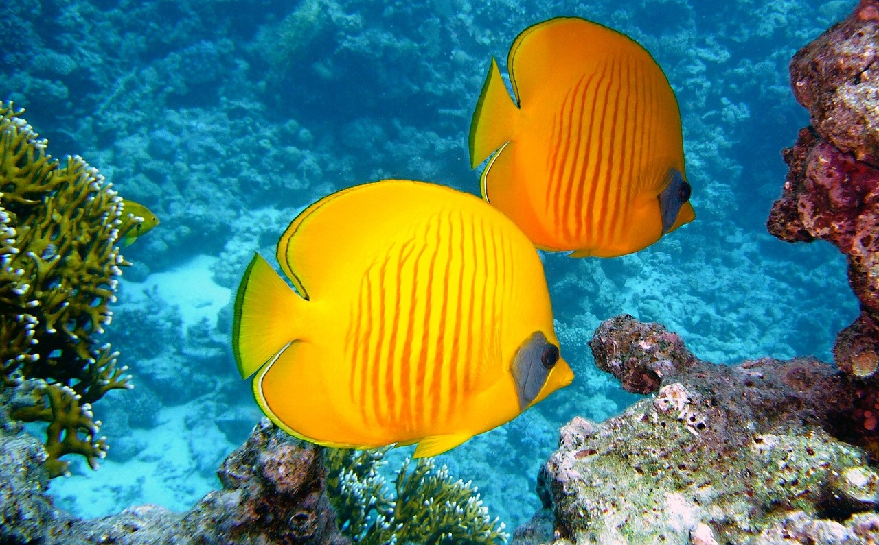
Effects of Global Warming on the Great Barrier Reef
Coral Bleaching
Sea-Level Rise
Ecosystem Impact
Coral bleaching occurs when corals expel the algae living in their tissues due to stress from rising water temperatures.
This process leads to a loss of color and vital nutrients, making corals more susceptible to disease and mortality.
Rising sea levels threaten the Great Barrier Reef by increasing the risk of flooding and erosion of coastal habitats.
This can lead to the loss of critical breeding grounds for marine species that rely on the reef ecosystem.
The combined effects of coral bleaching and sea-level rise disrupt the delicate balance of the reef ecosystem.
This results in decreased biodiversity and the potential collapse of marine life that depends on the reef for survival.
Understanding Global Warming and Its Impact
3

Slide 7
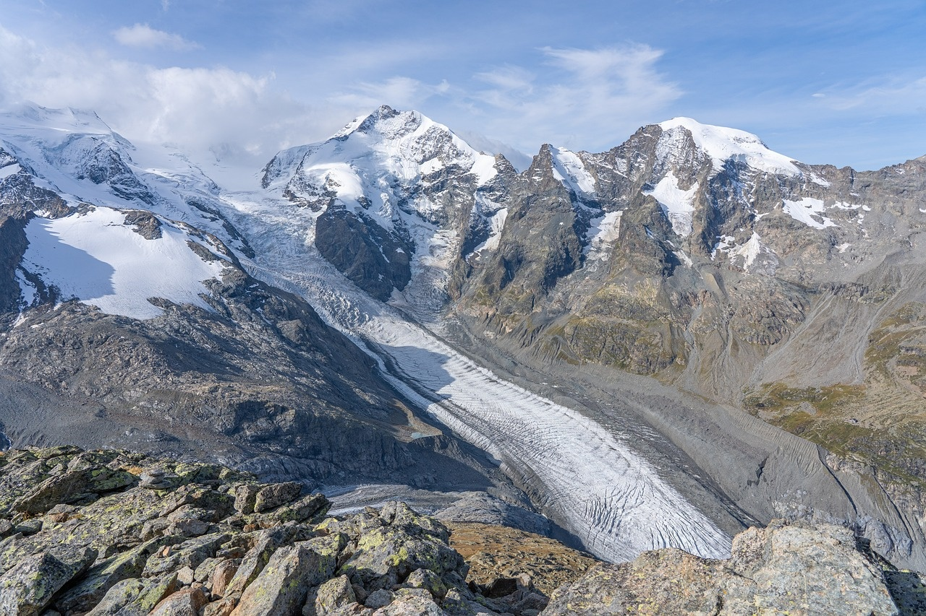
Rising Sea Levels and Geological Changes
Causes of Change
Human Impact
Ecosystem Strategies
Global warming leads to the melting of polar ice caps and glaciers, contributing to rising sea levels.
Thermal expansion of seawater as it warms also plays a significant role in increasing sea levels.
Coastal communities face increased flooding and erosion, threatening homes and infrastructure.
Rising sea levels can lead to displacement of populations, creating climate refugees.
Ecosystems such as mangroves and wetlands can act as natural barriers against rising seas.
Conservation and restoration of these ecosystems are essential for mitigating the impacts of sea level rise.
Understanding Global Warming and Its Impact
4

Slide 8
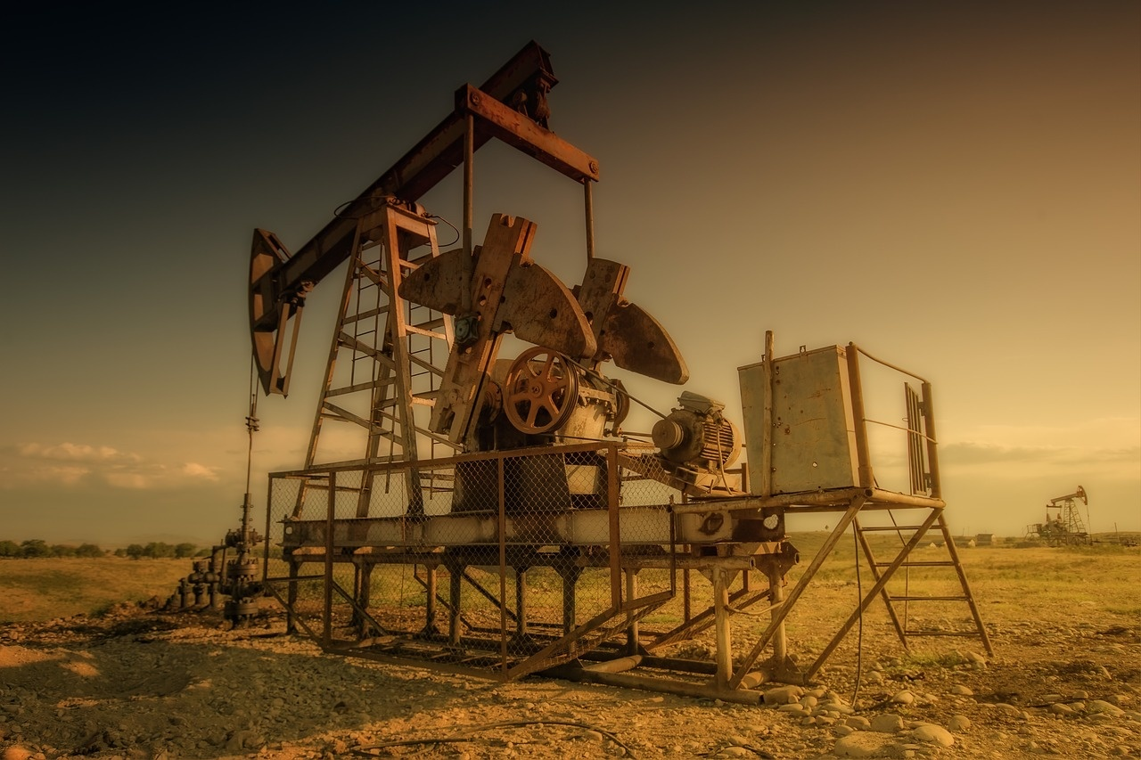
Human Impact on the Environment
Fossil Fuels
Carbon Cycle Impact
Emission Reduction Strategies
Burning fossil fuels for energy is a major source of greenhouse gas emissions.
This process releases carbon dioxide, contributing to global warming.
Human activities disrupt the natural carbon cycle, leading to increased atmospheric CO2 levels.
Deforestation and land-use changes further exacerbate this issue.
Transitioning to renewable energy sources can significantly lower carbon emissions.
Implementing energy efficiency measures is crucial for mitigating climate change.
Understanding Global Warming and Its Impact
5

Slide 9
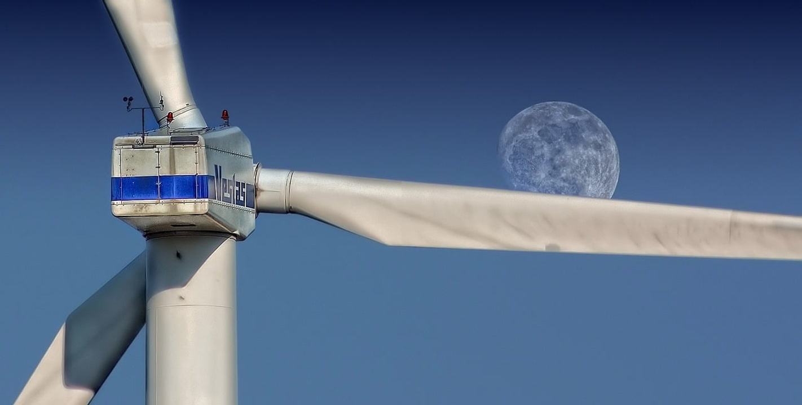
Renewable Energy Sources
Types of Energy
Benefits & Limitations
Community Solutions
Solar energy is harnessed from sunlight using solar panels.
Wind energy is generated by turbines that convert wind into electricity.
Hydro power is produced by the flow of water in rivers or dams.
Renewable energy reduces reliance on fossil fuels and lowers greenhouse gas emissions.
Solar and wind energy are intermittent and depend on weather conditions.
Communities can implement solar farms to provide local energy and reduce costs.
Installing wind turbines in rural areas can generate clean energy for local use.
Understanding Global Warming and Its Impact
6

Slide 10
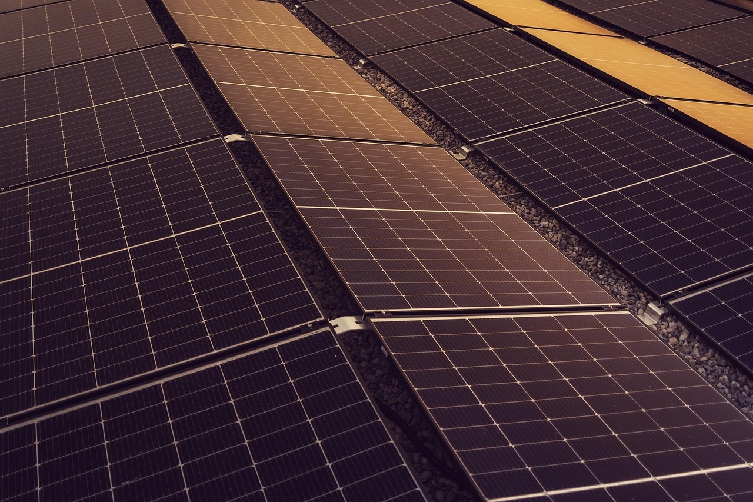
Sustainable Practices
Energy Reduction
Environmental Impact
Community Projects
Implementing energy-efficient appliances can significantly lower energy consumption.
Encouraging the use of public transport reduces reliance on fossil fuels.
Sustainable practices help decrease greenhouse gas emissions and combat climate change.
Recycling and waste reduction contribute to less pollution and resource conservation.
Engaging in local sustainability initiatives fosters community involvement and awareness.
Designing projects like community gardens can enhance local biodiversity and food security.
Understanding Global Warming and Its Impact
7

Slide 11
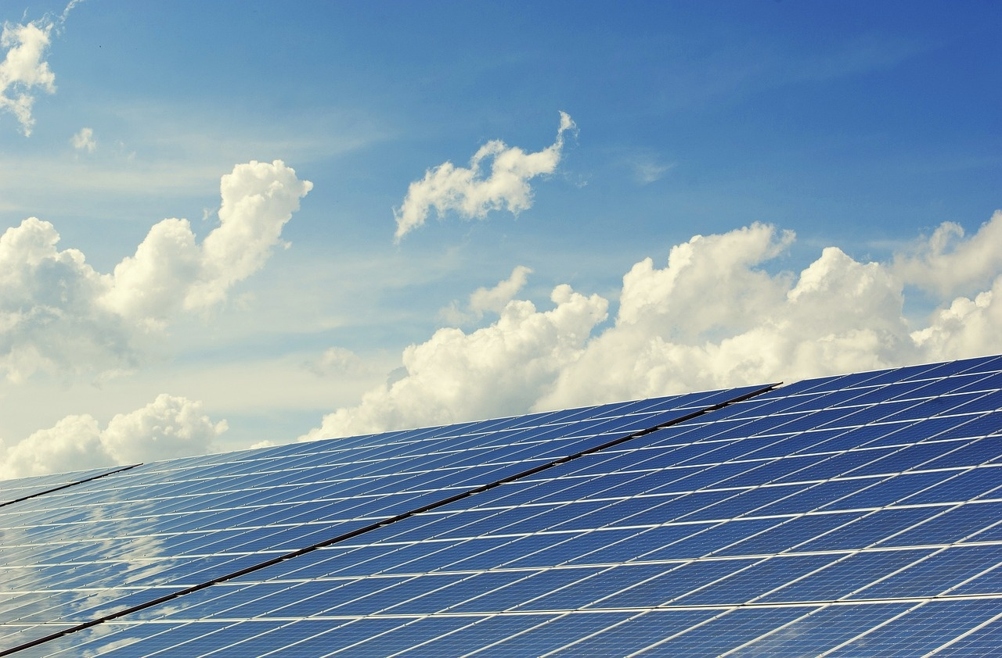
Climate Change Mitigation
Mitigation Strategies
Benefits & Challenges
Effectiveness Evaluation
Implement carbon capture to lower greenhouse gas emissions.
Promote reforestation to enhance carbon absorption and restore habitats.
Develop climate-resilient infrastructure to protect against climate impacts.
Stimulate growth in green sectors through innovative strategies.
Overcome high initial costs with strong community and political backing.
Measure success by tracking emission reductions and community resilience.
Identify gaps in current strategies to inform future climate action plans.
Understanding Global Warming and Its Impact
8

Slide 12

Conclusion
Immediate Action
Environmental Impact
Mitigation Strategies
Global warming is a pressing issue that requires immediate attention and action.
Simple actions can significantly reduce our carbon footprint.
Global warming leads to severe environmental changes, including rising sea levels and extreme weather events.
These changes threaten biodiversity and disrupt ecosystems.
Implementing renewable energy sources can greatly reduce greenhouse gas emissions.
Promoting sustainable practices in agriculture and transportation is essential for long-term solutions.
Understanding Global Warming and Its Impact
9

Slide 13
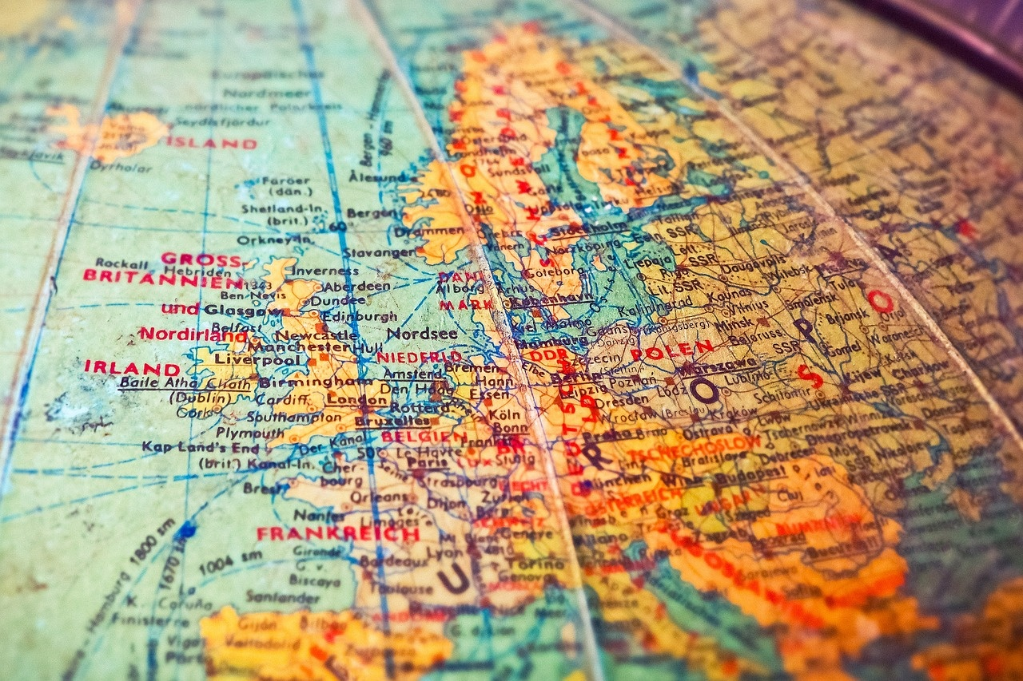
Reflection Questions
Global Warming Insights
Carbon Footprint Reduction
Sustainability Strategies
Global warming is causing significant changes in weather patterns, leading to extreme weather events.
It affects ecosystems, wildlife, and human health, highlighting the urgency for action.
You can reduce your carbon footprint by using public transport, recycling, and conserving energy.
Small changes in daily habits can collectively make a big difference in mitigating global warming.
Implementing renewable energy sources like solar and wind can significantly reduce greenhouse gas emissions.
Promoting sustainable agriculture and responsible consumption can help protect the environment for future generations.
Understanding Global Warming and Its Impact
10

Slide 14
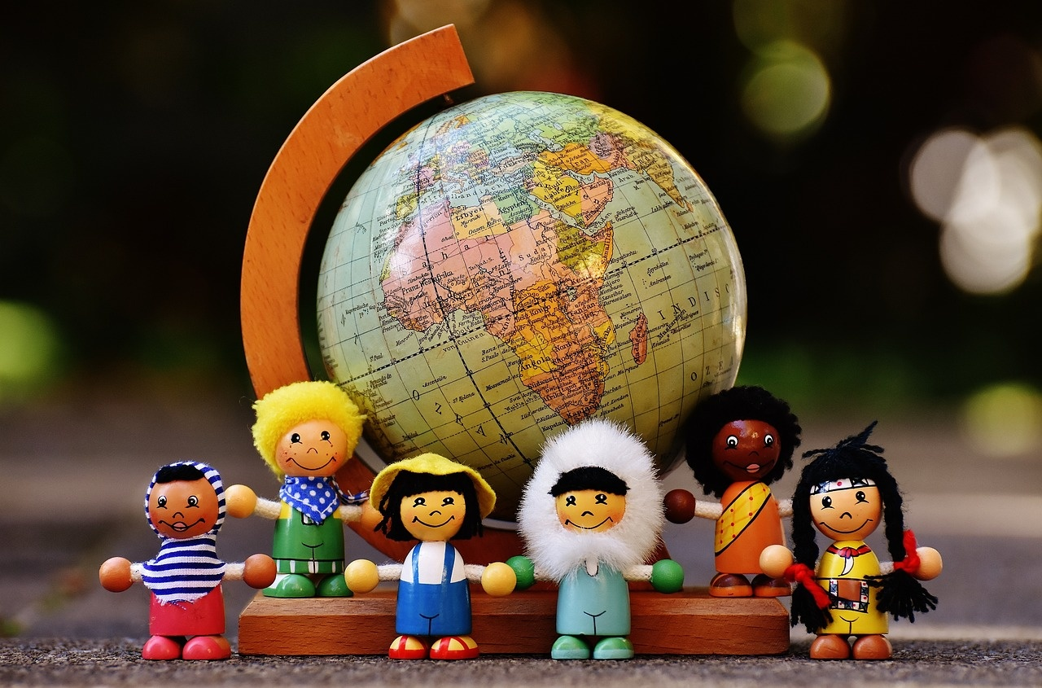
Next Steps
Learn About Global Warming
Adopt Sustainable Practices
Engage in Initiatives
Stay informed about the latest research and findings on global warming.
Understand its impact on ecosystems, weather patterns, and human health.
Make conscious choices to reduce waste and conserve energy in daily life.
Incorporate recycling, using public transport, and reducing plastic use.
Join local community efforts aimed at combating climate change.
Support global movements that advocate for environmental protection and sustainability.
Understanding Global Warming and Its Impact
11

Slide 15
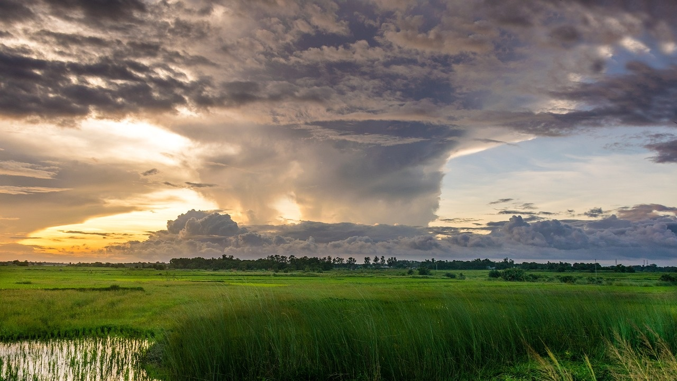
Additional Resources
Hurricane Book
Climate Websites
Environmental Films
"The Magic School Bus Inside a Hurricane" teaches kids about hurricanes. It presents the information in a fun and engaging way.
"The Lorax" highlights the importance of environmental stewardship.
NASA Climate Kids offers interactive activities to explore climate science.
National Geographic Kids provides articles and videos on environmental issues.
"An Inconvenient Truth" educates viewers about climate change. It emphasizes the urgency of the issue.
"The 11th Hour" showcases the need for immediate action to protect our planet.
Understanding Global Warming and Its Impact
12

Slide 16

Assessment
Formative Methods
Summative Approaches
Differentiated Assessment
Implement interactive quizzes to spark curiosity and assess comprehension.
Facilitate dynamic group discussions to enhance critical thinking and teamwork.
Encourage students to create engaging presentations that showcase their understanding.
Utilize creative poster projects to allow students to express their knowledge visually.
Design assessments that cater to the unique strengths of foundation, core, and extension learners.
Adopt flexible evaluation methods to reflect each student's individual growth and capabilities.
Understanding Global Warming and Its Impact
13

Slide 17
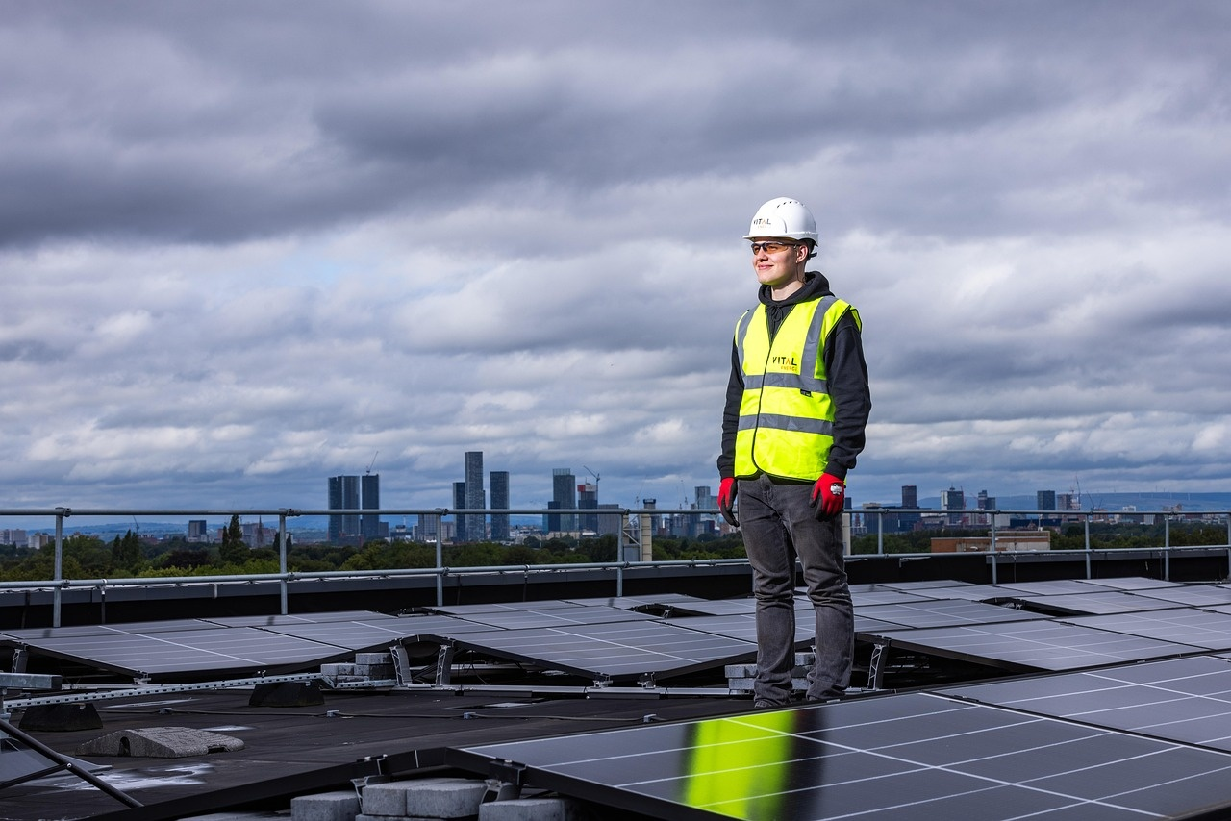
Extension Activities
Renewable Energy System
Carbon Footprint Awareness
Sustainability Initiatives
Design and implement a renewable energy system for a local community to promote sustainable energy use.
Engage community members in the planning and execution phases to ensure local needs are met.
Create a public service announcement highlighting the importance of reducing carbon footprints.
Utilize social media and local events to spread awareness and encourage community participation.
Participate in local or global initiatives aimed at addressing global warming.
Collaborate with organizations to promote sustainable practices and educate the public.
Understanding Global Warming and Its Impact
14

Slide 18

Parent Engagement
Feedback Loop
Carbon Footprint Tips
Sustainability Workshop
Encourage parent participation and feedback.
Their insights can directly improve lesson effectiveness.
Provide parents with actionable steps to reduce their children's carbon footprint.
Examples include using reusable bags and reducing water waste.
Invite parents to a workshop on global warming and sustainability.
Engage in hands-on activities and discussions to foster understanding.
Understanding Global Warming and Its Impact
15

Slide 19
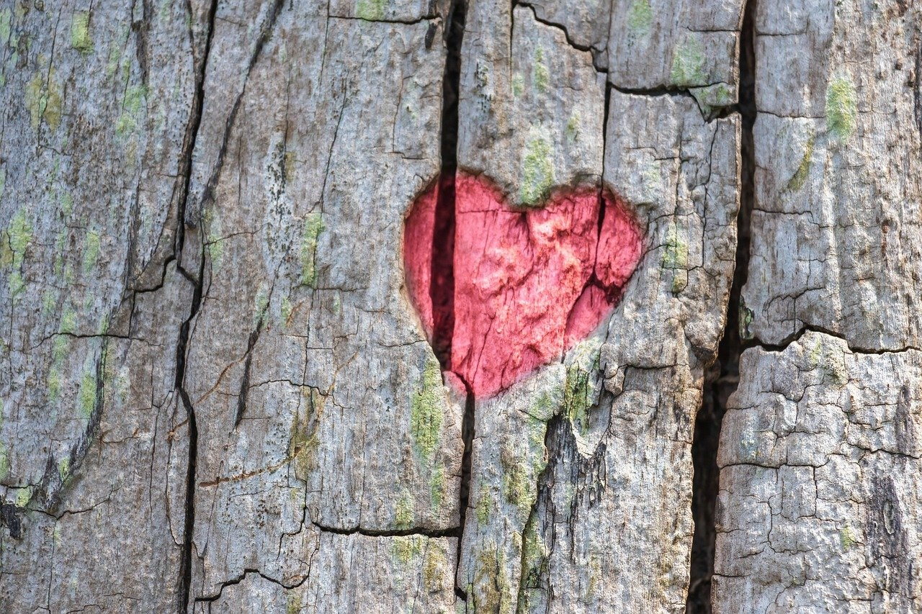
Safety Considerations
Emotional Awareness
Supportive Environment
Stress Management
Discussing climate change can evoke strong emotions. It's important for students to recognize and acknowledge these feelings.
Create a classroom atmosphere where students feel safe to express their thoughts. Encourage open dialogue and validate their feelings.
Promote regular breaks during discussions to help manage stress. Introduce activities like mindfulness or relaxation techniques to support mental well-being.
Understanding Global Warming and Its Impact
16

Slide 20

Teaching Tips
Real-Life Examples
Interactive Simulations
Critical Reflection
Use case studies to illustrate the tangible effects of climate change on various communities.
Include hands-on activities that immerse students in climate change scenarios, promoting engagement in problem-solving.
Prompt students to consider their learning and the broader implications of climate change, while providing feedback to enhance critical thinking.
Understanding Global Warming and Its Impact
17

