Slide 1
Introduction to Nouns and Verbs
Understanding the Building Blocks of Language: Nouns and Verbs in Sentence Structure

Slide 2
Introduction to Nouns and Verbs
2
Table of Contents
Introduction to Nouns and Verbs
What is a Noun?
What is a Verb?
Nouns and Verbs in Sentence Structure
Identifying Nouns and Verbs
Practicing with Nouns and Verbs
Noun and Verb Sorting Game
Creating Sentences with Nouns and Verbs
Common Errors and Misconceptions
Conclusion
Assessment and Evaluation
Extension Activities
Parent Engagement
04
05
06
07
08
09
10
11
12
13
14
15
16

Slide 3
Introduction to Nouns and Verbs
3
Table of Contents
Safety Considerations
Reflection and Next Steps
Final Thoughts
17
18
19

Slide 4
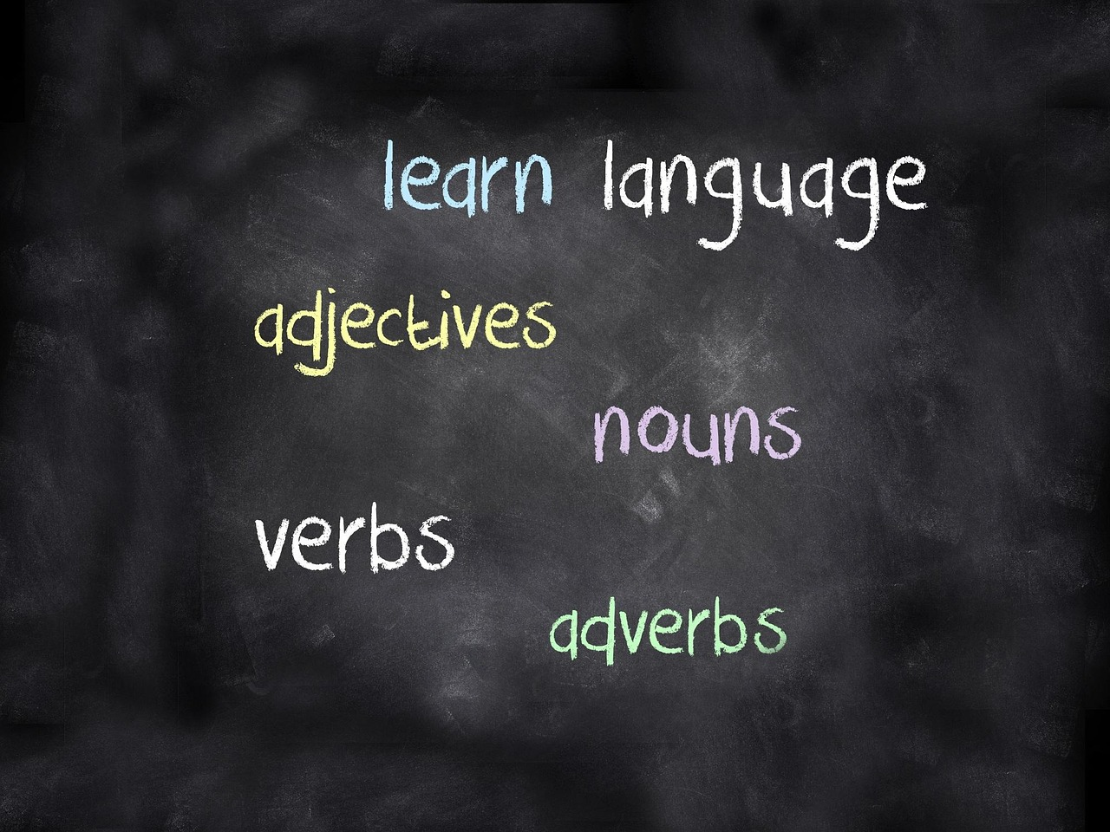
Introduction to Nouns and Verbs
4
Introduction to Nouns and Verbs
Welcome to the Lesson
Learning Objectives
Introduction to Language Basics
Welcome to our lesson on nouns and verbs!
In this lesson, we will learn about the basics of nouns and verbs and how they are used in language.
By the end of this lesson, you will be able to identify and define nouns and verbs.
You will also understand their roles in sentence structure.
Nouns and verbs are fundamental components of language.
They play crucial roles in forming meaningful sentences.

Slide 5

Introduction to Nouns and Verbs
5
What is a Noun?
Definition of a Noun
Examples of Nouns
A noun is a word that refers to a person, place, thing, or idea.
It serves as a fundamental building block in language.
Examples of nouns include cat, city, and happiness.
These words represent tangible and intangible entities.
Types of Nouns
Proper Nouns Explained
Nouns can be classified into proper nouns, common nouns, concrete nouns, and abstract nouns.
Each type serves a unique role in language structure.
Proper nouns refer to specific names of people, places, or organizations.
They are always capitalized in written English.

Slide 6

Introduction to Nouns and Verbs
6
What is a Verb?
Definition of a Verb
Examples of Verbs
A verb is a word that expresses action or a state of being.
It is one of the fundamental parts of speech in language.
Examples of verbs include run, jump, and think.
These words illustrate actions or mental processes.
Types of Verbs
Action vs Linking Verbs
Verbs can be classified into action verbs, linking verbs, and helping verbs.
Each type serves a unique function in sentence construction.
Action verbs describe physical or mental actions.
Linking verbs connect the subject to additional information about it.

Slide 7

Introduction to Nouns and Verbs
7
Nouns and Verbs in Sentence Structure
Collaboration of Nouns and Verbs
Impact of Sentence Structure
Illustrative Example
Nouns and verbs work together to form meaningful sentences.
Their interaction is essential for conveying clear ideas.
The order of nouns and verbs in a sentence can affect the meaning and emphasis.
This arrangement determines the focus and interpretation of the sentence.
For example: 'The dog bites the man' has a different meaning than 'The man bites the dog'.
This demonstrates how sentence structure can alter the intended message.

Slide 8

Introduction to Nouns and Verbs
8
Identifying Nouns and Verbs
Understanding Nouns and Verbs
Recognizing Nouns
To identify nouns and verbs, look at the function of the word in a sentence.
If the word refers to a person, place, thing, or idea, it is likely a noun.
Nouns represent people, places, things, or ideas.
For example, 'The cat' is a noun.
Identifying Verbs
Key Tips for Identification
Verbs describe actions or states of being.
For example, 'runs' is a verb.
Focus on the role of the word within the sentence.
This helps determine whether it is a noun or a verb.

Slide 9

Introduction to Nouns and Verbs
9
Practicing with Nouns and Verbs
Identifying Nouns and Verbs
Analyzing Sentence Structure
Grammar Practice Activity
Let's practice identifying nouns and verbs with some examples.
"The sun is shining" - What is the noun and verb in this sentence?
"The dog is barking" - What is the noun and verb in this sentence?
Practicing with nouns and verbs helps improve grammar skills.
Understanding nouns and verbs is essential for sentence construction.
This exercise focuses on identifying key parts of speech in sentences.

Slide 10
Introduction to Nouns and Verbs
10
Noun and Verb Sorting Game
Game Introduction
Examples for Sorting
Let's play a game to practice sorting nouns and verbs.
Sort the following words into two categories: nouns and verbs.
Examples: cat, run, city, jump.
Use these examples to understand the difference between nouns and verbs.

Slide 11
Introduction to Nouns and Verbs
11
Creating Sentences with Nouns and Verbs
Introduction to Sentence Creation
Example Sentence
Practice Activity
Now that we have learned about nouns and verbs, let's create some sentences using them.
Use the following nouns and verbs to create a sentence: dog, run, park.
Example sentence: "The dog runs in the park".
This demonstrates how nouns and verbs work together in a sentence.
Try creating your own sentences using the given nouns and verbs.
This will help reinforce your understanding of nouns and verbs.

Slide 12
Introduction to Nouns and Verbs
12
Common Errors and Misconceptions
Confusing Nouns and Verbs
Incorrect Identification
Action vs Linking Verbs
Dual-Function Words
Common errors and misconceptions about nouns and verbs include confusing nouns and verbs.
For example, the word 'light' can be both a noun and a verb.
Incorrectly identifying nouns and verbs is a frequent issue.
This can lead to misunderstandings in sentence structure and meaning.
Not understanding the difference between action verbs and linking verbs is a common problem.
This distinction is crucial for proper grammar usage.
Some words, like 'light,' serve as both nouns and verbs.
This dual functionality often causes confusion among learners.

Slide 13
Introduction to Nouns and Verbs
13
Conclusion
Building Blocks of Language
Improving Language Skills
Effective Communication
In conclusion, nouns and verbs are the building blocks of language.
Understanding the difference between nouns and verbs is crucial for effective communication.
By practicing and applying our knowledge of nouns and verbs, we can improve our language skills.
This practice helps us become better communicators.
Understanding nouns and verbs is essential for expressing ideas clearly.
It forms the foundation for mastering language and communication.

Slide 14

Introduction to Nouns and Verbs
14
Assessment and Evaluation
Quiz on Nouns and Verbs
Class Discussion
Evaluation Activities
To assess our understanding of nouns and verbs, we will complete a quiz.
The quiz will include multiple-choice questions and short-answer questions.
We will also participate in a class discussion to evaluate our understanding of nouns and verbs.
This discussion will help clarify any doubts and reinforce learning.
The activities aim to provide a comprehensive evaluation of our grasp on nouns and verbs.
They include both individual and group-based tasks for better understanding.

Slide 15

Introduction to Nouns and Verbs
15
Extension Activities
Noun and Verb Sorting Game
For extension, we can create a noun and verb sorting game.
This activity helps reinforce the understanding of nouns and verbs.
Short Story Writing
We can also write a short story using a variety of nouns and verbs.
This encourages creativity and practical application of grammar concepts.
Visual Project Creation
Additionally, we can create a visual project, such as a poster or infographic, to illustrate the difference between nouns and verbs.
This approach combines artistic skills with grammatical learning.

Slide 16

Introduction to Nouns and Verbs
16
Parent Engagement
Practicing Nouns and Verbs
Parents can support their child's learning by practicing nouns and verbs with them.
This helps children understand the basic building blocks of language.
Encouraging Reading and Writing
Parents can encourage their child to read and write using a variety of nouns and verbs.
This fosters creativity and improves their language skills.
Providing Feedback and Guidance
Parents can provide feedback and guidance to help their child improve their language skills.
Constructive feedback helps children refine their understanding and usage of language.

Slide 17

Introduction to Nouns and Verbs
17
Safety Considerations
Classroom Rules and Expectations
Mindfulness During Activities
Emergency Procedures and Protocols
To ensure a safe and respectful learning environment, we must follow classroom rules and expectations.
These rules help maintain order and mutual respect among all participants.
We must also be mindful of our own safety and the safety of others during activities.
This ensures that everyone can participate without unnecessary risks.
In case of an emergency, we will follow established procedures and protocols.
These measures are in place to protect everyone and ensure a swift response.

Slide 18

Introduction to Nouns and Verbs
18
Reflection and Next Steps
Reflection on Learning
Challenges in Understanding
Future Learning Goals
Let's reflect on what we have learned about nouns and verbs.
What did we learn? What did we find challenging?
What did we learn? What did we find challenging?
Next steps: We will build on our knowledge of nouns and verbs by learning about noun phrases and verb phrases.
Next steps: We will build on our knowledge of nouns and verbs by learning about noun phrases and verb phrases.
Let's reflect on what we have learned about nouns and verbs.

Slide 19
Introduction to Nouns and Verbs
19
Final Thoughts
Essential Components of Language
In conclusion, nouns and verbs are essential components of language.
By understanding and applying our knowledge of nouns and verbs, we can become effective communicators and improve our language skills.
Improving Communication Skills
By understanding and applying our knowledge of nouns and verbs, we can become effective communicators and improve our language skills.
In conclusion, nouns and verbs are essential components of language.

