Slide 1
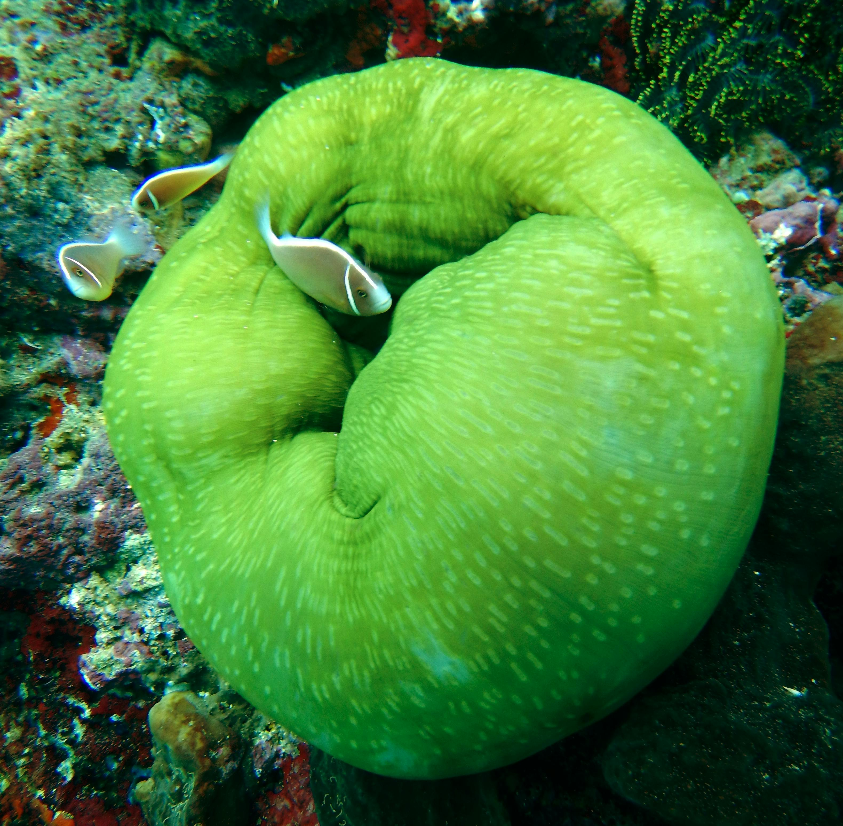


Coral Reefs: Ecosystems, Distribution, and Conservation
Exploring the Formation, Importance, Human Impacts, and Management of Coral Reefs Worldwide

Slide 2
Table of Contents
Introduction to Coral Reefs
Types of Coral Reefs
Geographic Distribution of Coral Reefs
Importance of Coral Reefs
Human Impacts on Coral Reefs
Mapping Task: Coral Reefs
Geographic Information Systems (GIS) and Coral…
Management Strategies for Coral Reefs
Case Study: The Great Barrier Reef
Conclusion
Assessment
Resources
Extension Activity
04
05
06
07
08
09
10
11
12
13
14
15
16

Slide 3
Table of Contents
Reflection Questions
Next Steps
Conclusion and Summary
References
Appendix
17
18
19
20
21

Slide 4
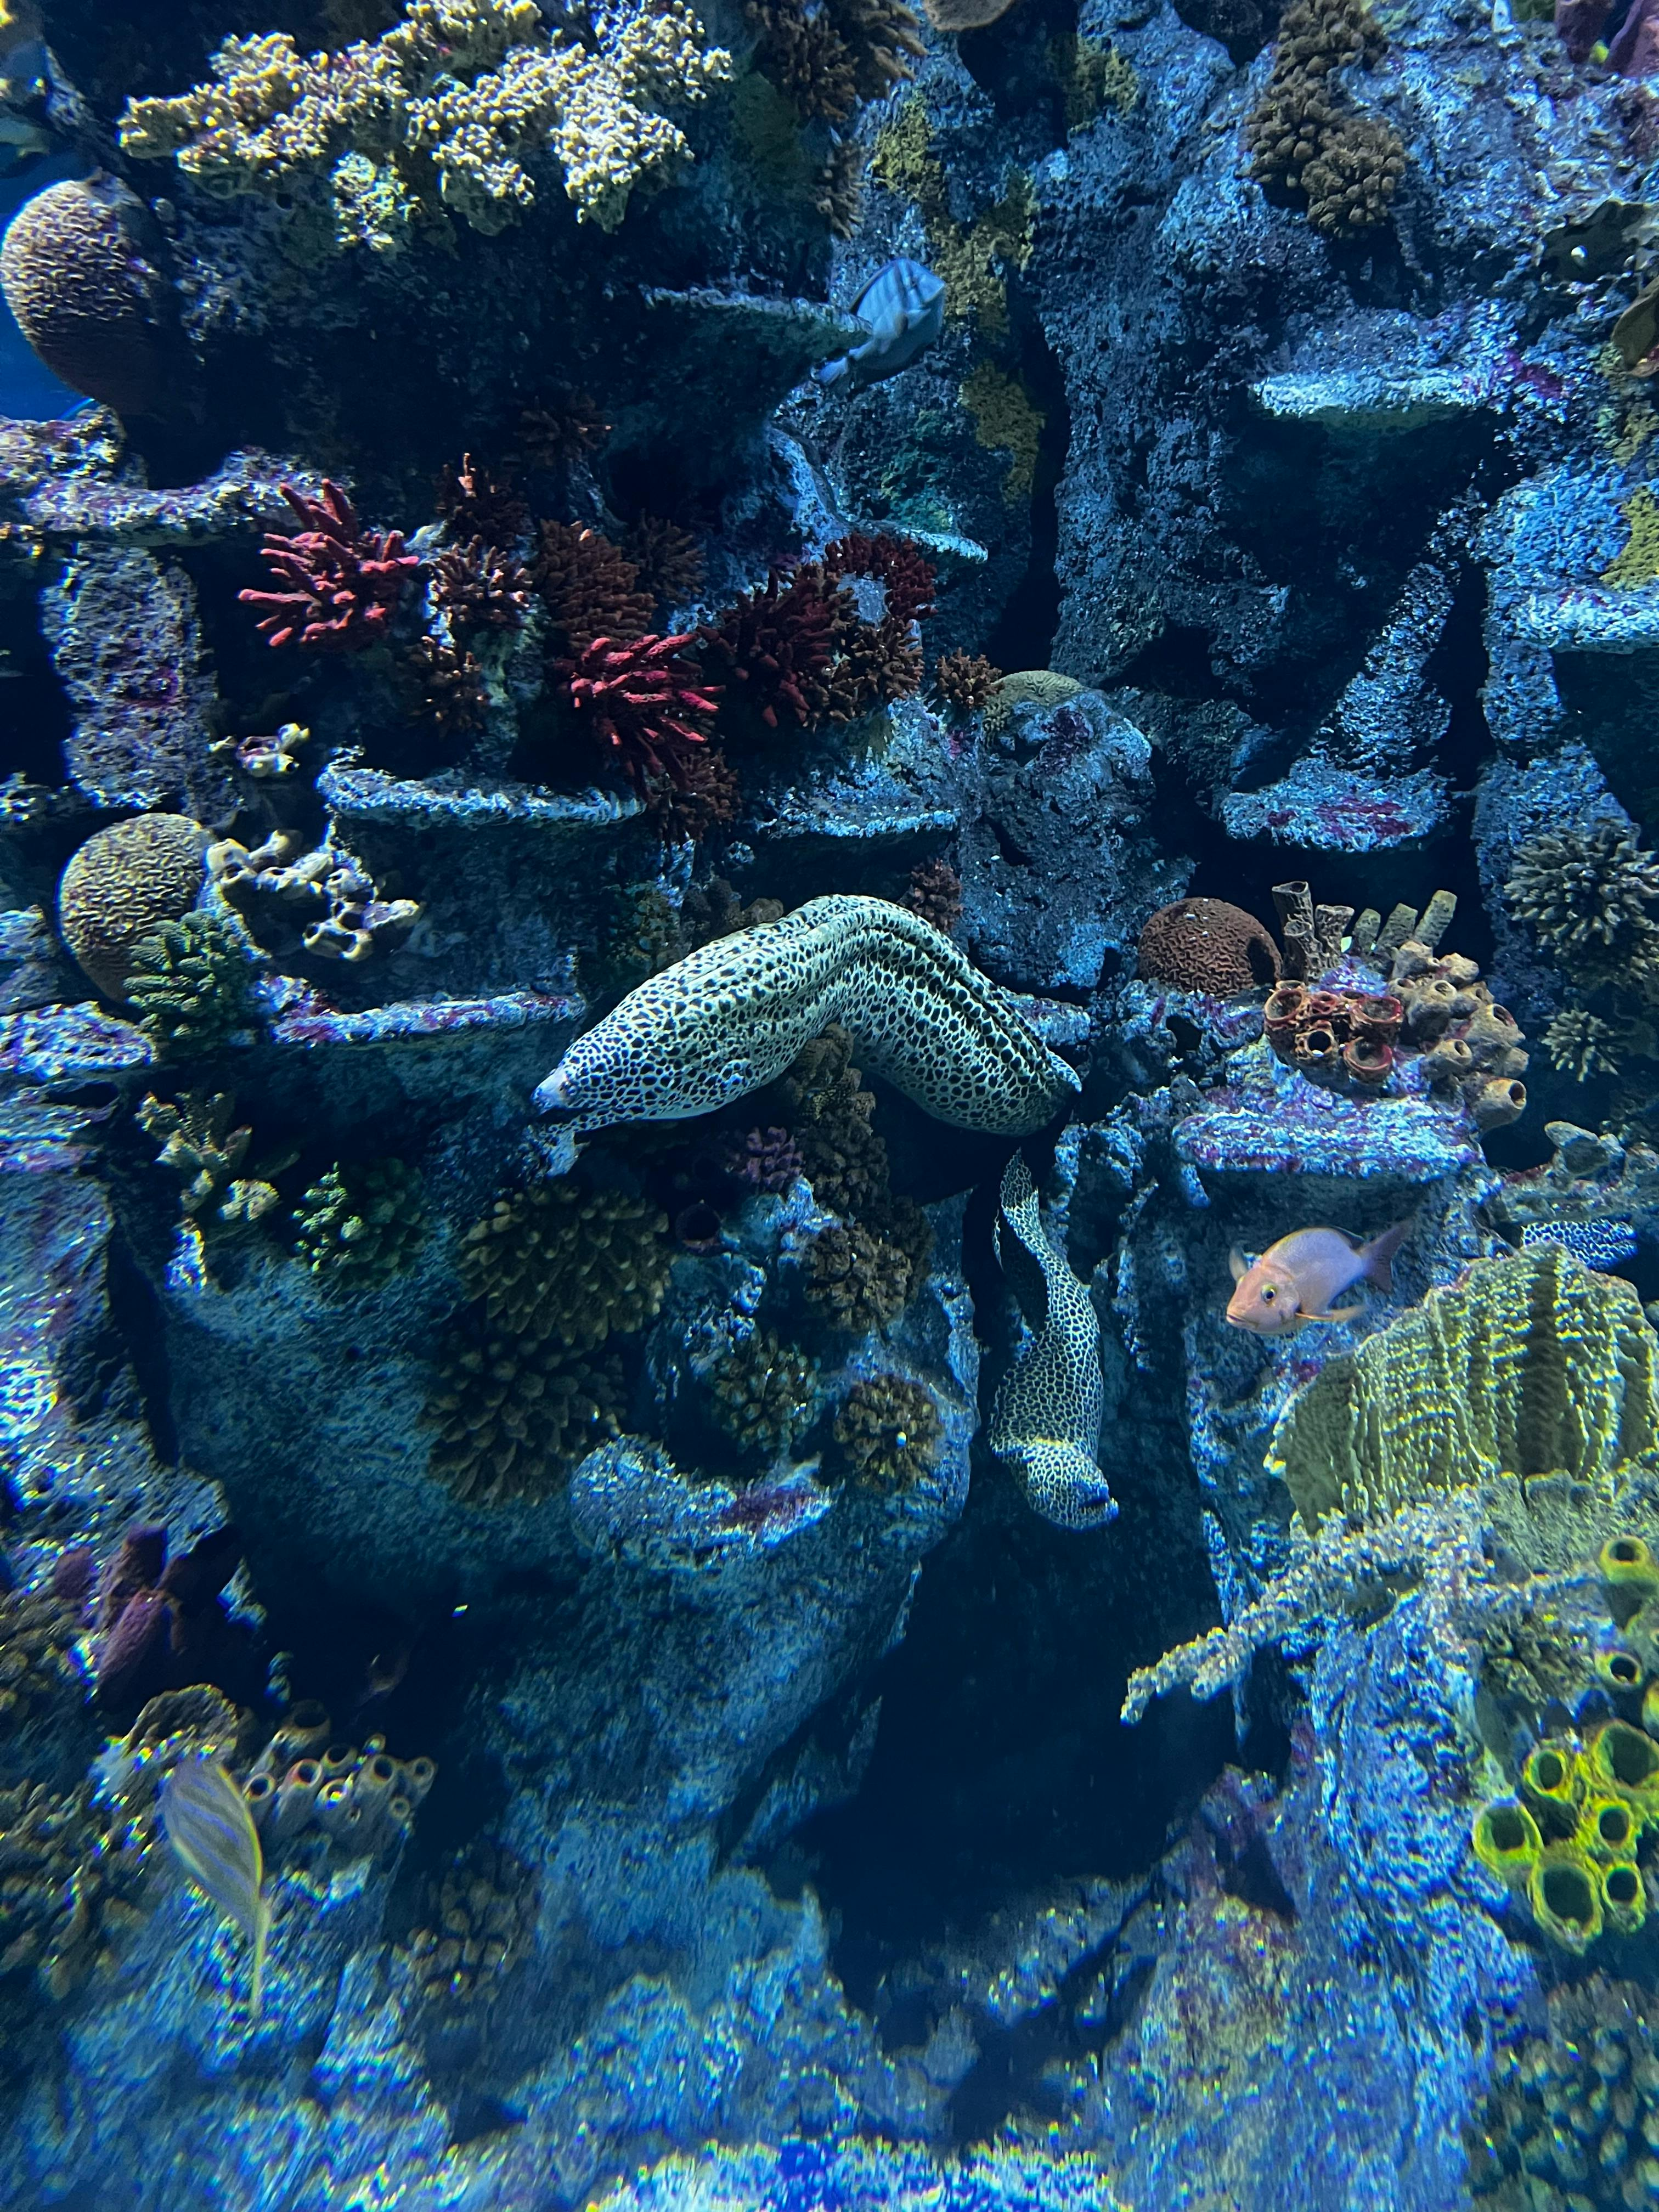
Introduction to Coral Reefs
Formation and Composition
Ecosystem Services
Global Distribution
Coral reefs are complex ecosystems formed by coral polyps and other organisms.
They are found in tropical and subtropical regions around the world, and are characterized by their diverse array of marine life.
Coral reefs provide important ecosystem services, including shoreline protection and water filtration.
They also serve as a habitat for a vast array of species, supporting marine biodiversity.
Coral reefs are predominantly located in tropical and subtropical regions.
These regions are home to some of the most diverse marine ecosystems on the planet.
Coral Reefs: Ecosystems, Distribution, and Conservation
4

Slide 5
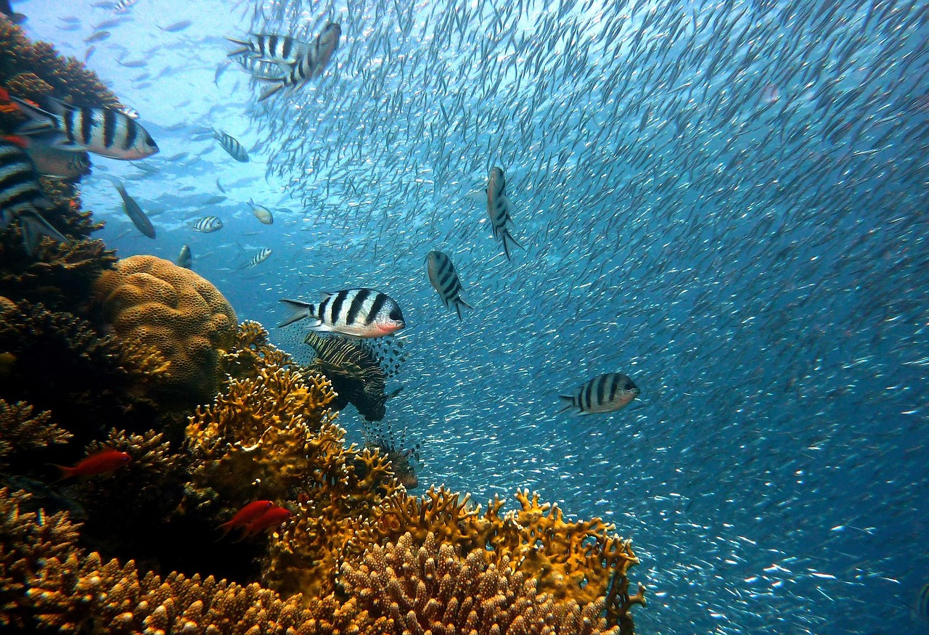
Types of Coral Reefs
Fringing Reefs
Barrier Reefs
Atolls
Fringing reefs are found close to shore.
They are characterized by their narrow, linear shape.
Barrier reefs are found further offshore.
They are characterized by their wide, flat shape.
Atolls are ring-shaped reefs.
They form around a lagoon.
Coral Reefs: Ecosystems, Distribution, and Conservation
5

Slide 6
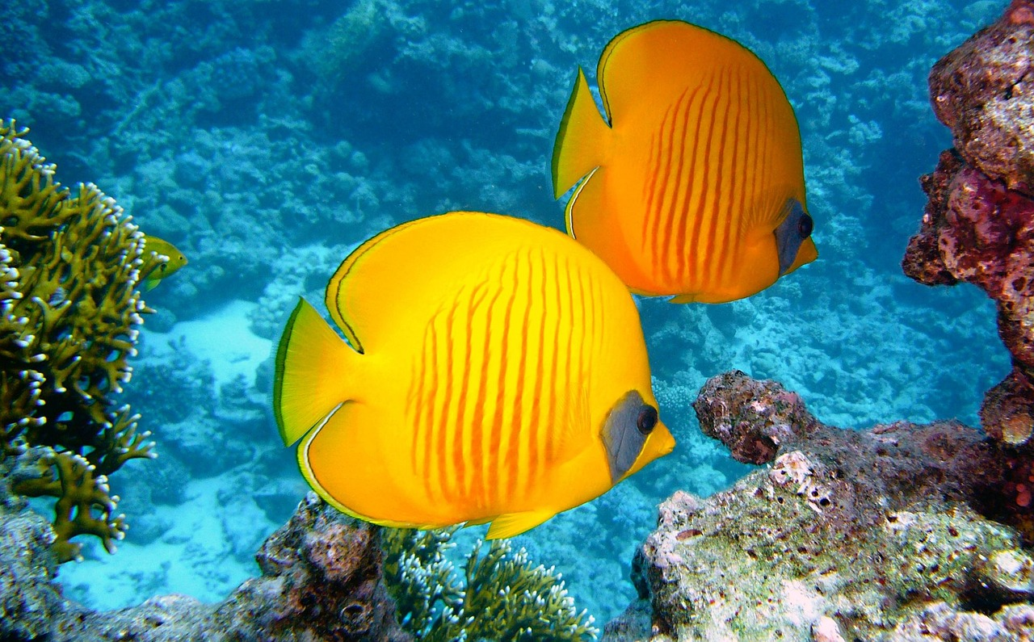
Geographic Distribution of Coral Reefs
Global Presence of Coral Reefs
Coral Reefs in the Red Sea
Caribbean Coral Reefs
Coral reefs are found in tropical and subtropical regions around the world, with the majority located in the Indo-Pacific region.
The Great Barrier Reef in Australia is the largest coral reef system in the world.
Coral reefs are also found in the Red Sea.
This region is known for its unique marine biodiversity.
Coral reefs are present in the Caribbean region.
These reefs support a wide variety of marine life.
Coral Reefs: Ecosystems, Distribution, and Conservation
6

Slide 7

Importance of Coral Reefs
Marine Biodiversity
Coastal Protection
Economic and Community Support
Coral reefs provide habitat for a diverse range of marine species, including fish, invertebrates, and algae.
They are essential for maintaining the balance of marine ecosystems.
They protect coastlines from erosion and provide shoreline protection.
This natural barrier helps mitigate the impact of storms and rising sea levels.
Coral reefs support commercial fisheries and provide livelihoods for communities.
They are vital for the economic well-being of millions of people globally.
Coral Reefs: Ecosystems, Distribution, and Conservation
7

Slide 8
Human Impacts on Coral Reefs
Human Activities and Coral Reef Damage
Climate Change Threats to Coral Reefs
Importance of Coral Reef Conservation
Human activities, such as overfishing, pollution, and coastal development, can damage coral reefs and impact the marine ecosystem.
These actions disrupt the delicate balance of marine life and degrade the health of coral reefs.
Climate change is also a major threat to coral reefs, causing coral bleaching and ocean acidification.
These phenomena weaken coral structures and reduce their ability to support marine biodiversity.
It is essential to manage and conserve coral reefs to protect these ecosystems and the services they provide.
Conservation efforts ensure the survival of coral reefs and their role in supporting marine life and human livelihoods.
Coral Reefs: Ecosystems, Distribution, and Conservation
8

Slide 9
Mapping Task: Coral Reefs
Global Coral Reef Mapping
Human Impacts on Coral Reefs
Geographic Features of Coral Reefs
Using a world map, identify and label the locations of different coral reefs, including the Great Barrier Reef, the Red Sea Coral Reef, and the New Caledonia Barrier Reef.
Analyze the geographic features of each reef, including their proximity to the coastline, depth, and surrounding ocean currents.
Consider the human impacts on each reef, including overfishing, pollution, and coastal development.
These activities threaten the biodiversity and ecological balance of coral reef ecosystems.
The Great Barrier Reef, the Red Sea Coral Reef, and the New Caledonia Barrier Reef each have unique geographic features.
Their locations are influenced by factors such as ocean currents, water temperature, and depth.
Coral Reefs: Ecosystems, Distribution, and Conservation
9

Slide 10
Geographic Information Systems (GIS) and Coral Reef Mapping
Mapping Coral Reefs with GIS
Conservation and Management Efforts
Educational Applications of GIS
GIS technology can be used to map and analyze the geographic distribution of coral reefs.
This allows for a better understanding of their locations and patterns.
GIS can help identify areas of high conservation value and prioritize management efforts.
This ensures resources are allocated effectively to protect coral reefs.
Students can use GIS to explore the spatial relationships between coral reefs and their surrounding environments.
This fosters a deeper understanding of ecological interactions and environmental factors.
Coral Reefs: Ecosystems, Distribution, and Conservation
10

Slide 11
Management Strategies for Coral Reefs
Conservation Through Protected Areas
Community-Based Reef Management
Shared Responsibilities in Coral Conservation
National parks and marine protected areas can help conserve coral reefs and protect them from human impacts.
These areas serve as sanctuaries, reducing stress on coral ecosystems and promoting biodiversity.
Community-based initiatives, such as reef restoration and marine conservation programs, can also help manage and conserve coral reefs.
These programs empower local communities to actively participate in protecting their marine environment.
Governments and individuals have roles and responsibilities in managing and conserving coral reefs.
Collaborative efforts between policymakers and citizens are essential for effective reef management.
Coral Reefs: Ecosystems, Distribution, and Conservation
11

Slide 12
Case Study: The Great Barrier Reef
Introduction to the Great Barrier Reef
Threats to the Reef
Conservation Efforts
The Great Barrier Reef is the largest coral reef system in the world, located off the coast of Australia.
It is a natural wonder and a vital ecosystem supporting diverse marine life.
The reef is facing threats from climate change, pollution, and overfishing.
These challenges are causing significant damage to its delicate ecosystem.
Management strategies, such as marine protected areas and reef restoration programs, are in place to conserve the reef.
These efforts aim to mitigate the impact of human activities and environmental changes.
Coral Reefs: Ecosystems, Distribution, and Conservation
12

Slide 13
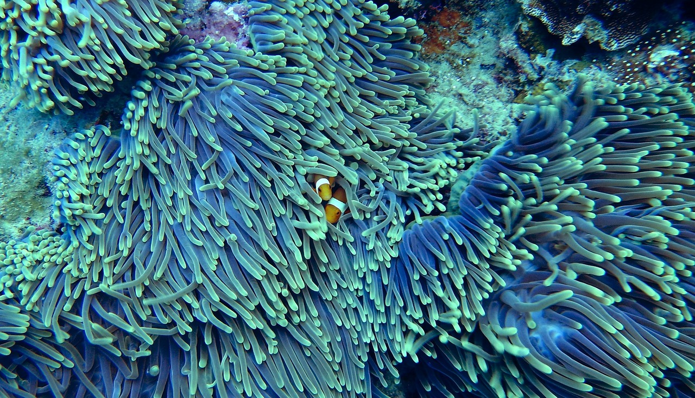
Conclusion
Importance of Coral Reefs
Human Impacts on Coral Reefs
Need for Conservation
Coral reefs are complex ecosystems that provide important ecosystem services.
They support marine biodiversity and protect coastlines from erosion.
Human activities like overfishing and pollution can damage coral reefs.
These impacts disrupt the marine ecosystem and reduce biodiversity.
It is essential to manage and conserve coral reefs to protect these ecosystems.
Conservation efforts ensure the sustainability of the services they provide.
Coral Reefs: Ecosystems, Distribution, and Conservation
13

Slide 14
Assessment
Understanding Coral Reefs
Mapping and Analysis Skills
Evaluating Management Strategies
Students will be assessed on their understanding of coral reefs and their geographic distribution.
This includes knowledge of their locations and the factors influencing their existence.
The mapping task will assess students' ability to identify and label the locations of different coral reefs.
Students will analyze the geographic features of these reefs as part of the assessment.
Students will be assessed on their ability to evaluate management strategies for addressing geographical issues.
This includes understanding the roles and responsibilities of individuals, groups, and governments.
Coral Reefs: Ecosystems, Distribution, and Conservation
14

Slide 15
Resources
Interactive Learning Tool
Research and Data Hub
Mapping and Analysis Tools
National Geographic Coral Reef Interactive offers an engaging way to explore coral reefs.
It provides interactive features to understand the biodiversity and importance of coral ecosystems.
The Australian Institute of Marine Science (AIMS) Coral Reef Website is a comprehensive resource for coral reef research.
It includes data, publications, and insights into the health and management of coral reefs.
GIS software, such as ArcGIS or QGIS, is essential for mapping and analyzing coral reef data.
These tools enable detailed spatial analysis and visualization of reef ecosystems.
Coral Reefs: Ecosystems, Distribution, and Conservation
15

Slide 16
Extension Activity
Multimedia Presentation on Coral Reefs
Case Study on Coral Reef Conservation
GIS Analysis of Coral Reef Distribution
Research and create a multimedia presentation about a specific type of coral reef.
Explore the unique characteristics and ecological importance of the chosen coral reef type.
Conduct a case study on a coral reef and evaluate the management strategies in place to conserve the reef.
Analyze the effectiveness of these strategies in preserving biodiversity and preventing degradation.
Use GIS technology to map and analyze the geographic distribution of coral reefs.
Investigate spatial relationships between coral reefs and their surrounding environments to understand ecological dynamics.
Coral Reefs: Ecosystems, Distribution, and Conservation
16

Slide 17
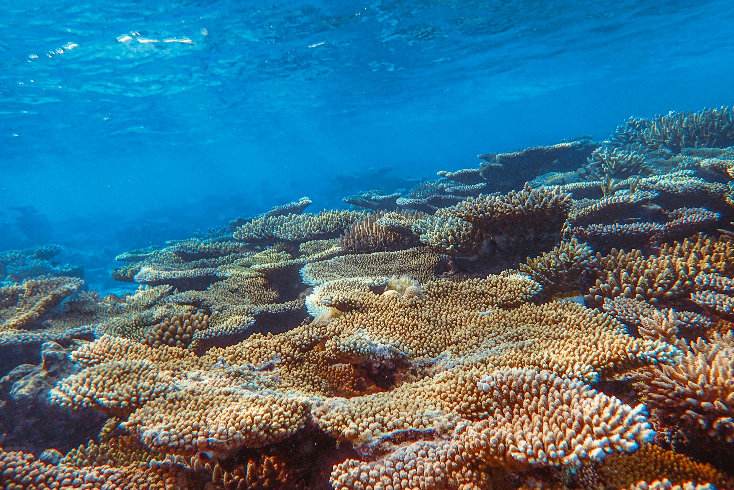
Reflection Questions
Impact of Human Activities
Importance of Coral Reefs
Conservation Strategies
How do human activities impact coral reefs and the marine ecosystem?
Human activities such as pollution, overfishing, and climate change significantly affect coral reefs and marine ecosystems.
What are the importance of coral reefs in supporting marine biodiversity and providing ecosystem services?
Coral reefs are vital for marine biodiversity and offer essential ecosystem services like coastal protection and supporting fisheries.
How can we manage and conserve coral reefs to protect these ecosystems and the services they provide?
Effective management and conservation strategies include establishing marine protected areas and reducing carbon emissions.
Coral Reefs: Ecosystems, Distribution, and Conservation
17

Slide 18
Next Steps
Understanding Coral Reefs
Evaluating Management Strategies
Applying Geographic Skills
Learn more about the geographic distribution of coral reefs and the human impacts on these ecosystems.
This knowledge is essential for addressing environmental challenges.
Evaluate management strategies and the roles and responsibilities of individuals, groups, and governments in response to geographical issues.
This evaluation helps in creating effective solutions for sustainable development.
Apply geographic skills and knowledge to real-world scenarios and case studies.
This application bridges the gap between theoretical learning and practical implementation.
Coral Reefs: Ecosystems, Distribution, and Conservation
18

Slide 19
Conclusion and Summary
Importance of Coral Reefs
Human Impacts on Coral Reefs
Need for Conservation
Coral reefs are complex ecosystems that provide important ecosystem services.
They support marine biodiversity and protect coastlines from erosion.
Human activities like overfishing and pollution can damage coral reefs.
These impacts disrupt the marine ecosystem and its balance.
It is essential to manage and conserve coral reefs to protect these ecosystems.
Conservation efforts ensure the sustainability of the services they provide.
Coral Reefs: Ecosystems, Distribution, and Conservation
19

Slide 20
References
Australian Curriculum Reference
National Geographic Insight
Marine Science Perspective
Australian Curriculum, Assessment and Reporting Authority. (2013). Australian Curriculum: Geography.
This reference provides insights into the geographical curriculum framework in Australia.
National Geographic. (2020). Coral Reefs.
This source explores the ecological significance and biodiversity of coral reefs.
Australian Institute of Marine Science. (2020). Coral Reefs.
This reference highlights scientific research and conservation efforts related to coral reefs.
Coral Reefs: Ecosystems, Distribution, and Conservation
20

Slide 21
Appendix
Resources and References
Resources and References
Additional Support Materials
Glossary of key terms related to coral reefs and geographic skills.
This section provides definitions and explanations for better understanding.
List of resources and references used in the presentation.
These materials support the information shared during the session.
Additional information and support materials for teachers and students.
These resources aim to enhance learning and teaching experiences.
Coral Reefs: Ecosystems, Distribution, and Conservation
21

