Slide 1
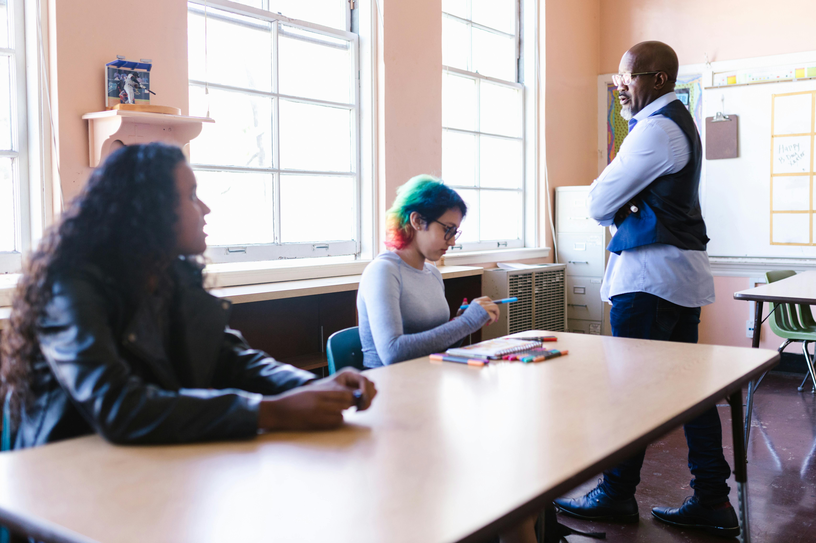

Foundations of Art Education: Procedures, Safety, and Creativity
Establishing a Positive and Productive Art Classroom Environment for Student Success

Slide 2
Foundations of Art Education: Procedures, Safety, and Creativity
2
Table of Contents
Introduction to Art Class
Importance of First Day Art Class Procedures
Lesson Objectives
Classroom Tour and Safety Protocols
Introduction to Art Techniques
Group Activity: Collaborative Mural
Art Supply Sorting Game
Classroom Rules and Expectations
Safety Protocols and Procedures
Introductory Art Techniques and Methods
Art Classroom Procedures
Assessment and Evaluation
Formative Assessment
04
05
06
07
08
09
10
11
12
13
14
15
16

Slide 3
Foundations of Art Education: Procedures, Safety, and Creativity
3
Table of Contents
Conclusion
Next Steps
Reflection Questions
Teaching Tips
Key Takeaways
Parent Engagement
17
18
19
20
21
22

Slide 4
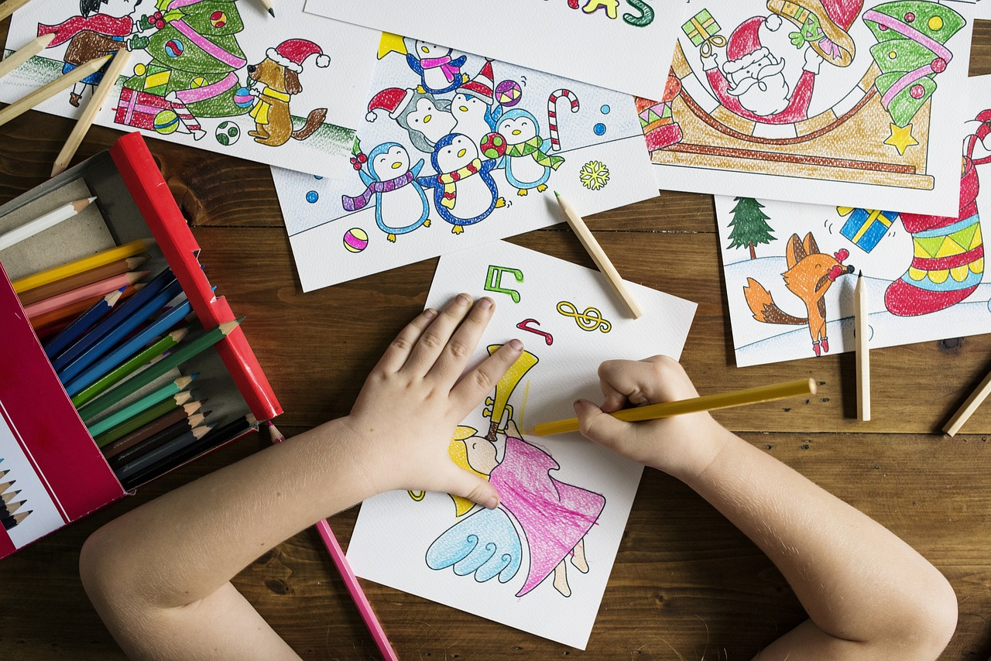
Foundations of Art Education: Procedures, Safety, and Creativity
4
Introduction to Art Class
Welcome to the World of Art
Setting the Tone for Success
Exploring Creativity Together
Welcome to the world of art, where creativity knows no bounds and self-expression is encouraged.
On the first day of art class, it's essential to establish a positive and productive learning environment that sets the tone for the rest of the year.
This lesson will introduce students to the fundamental procedures and expectations of the art classroom.
These include safety protocols, classroom rules, and introductory art techniques.
Art class is a journey into creativity and self-expression.
Students will learn to navigate the art world while adhering to essential guidelines.

Slide 5
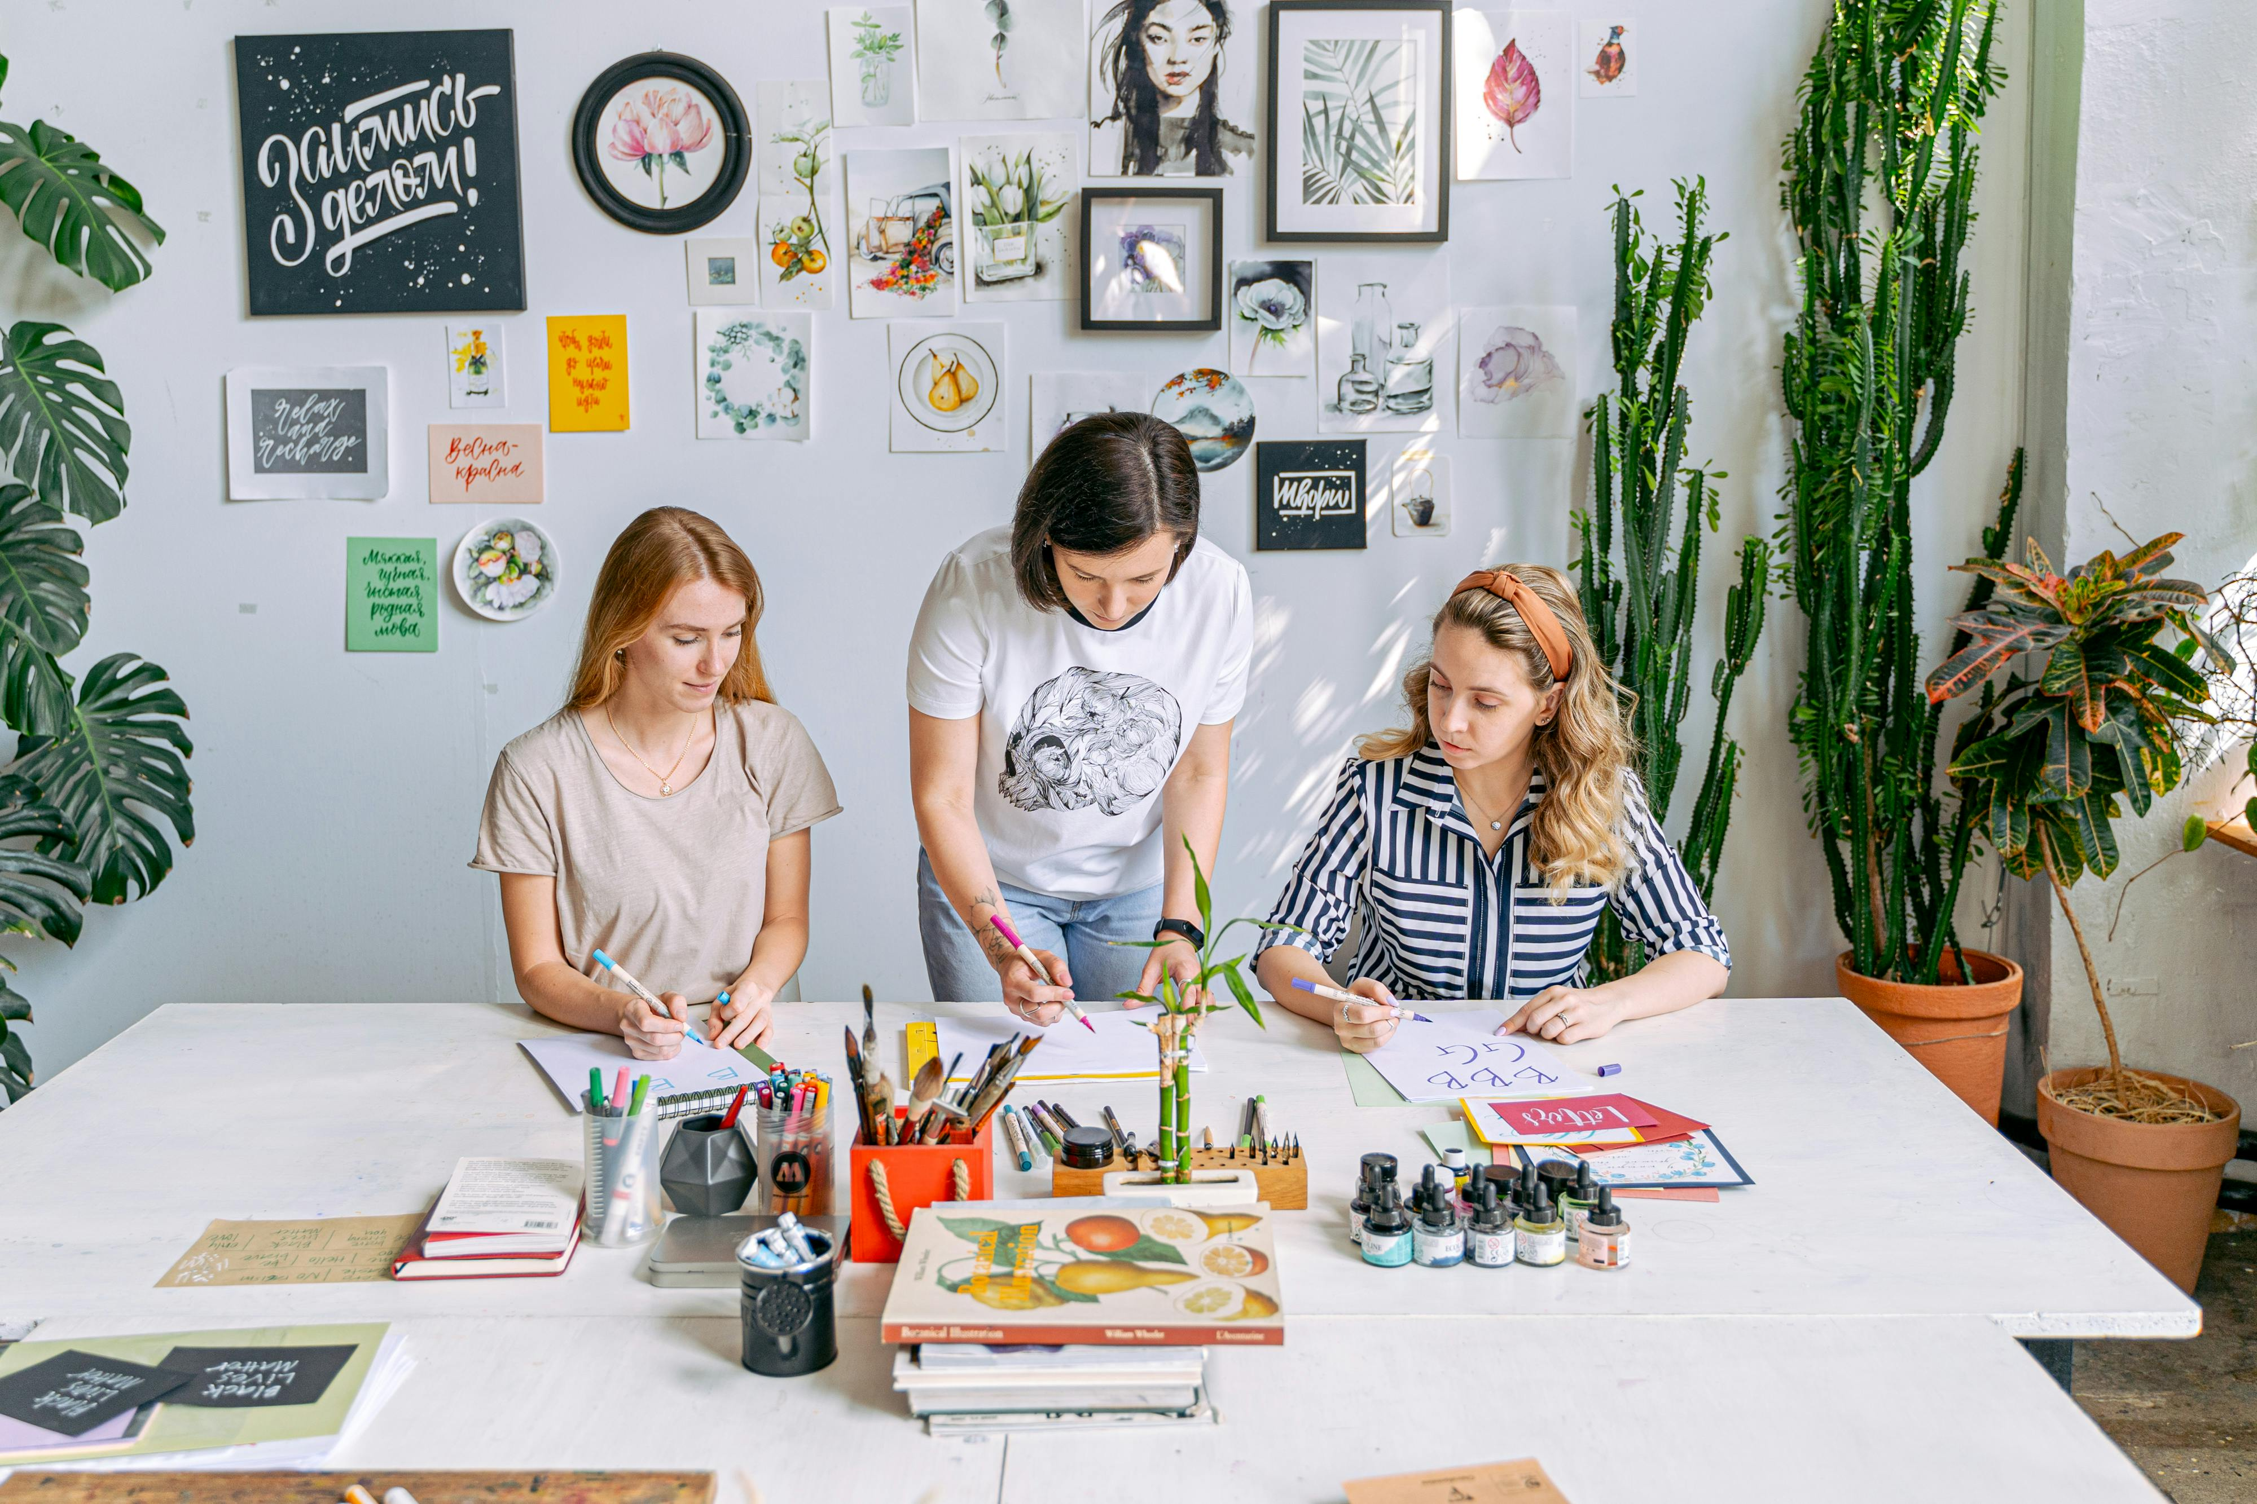
Foundations of Art Education: Procedures, Safety, and Creativity
5
Importance of First Day Art Class Procedures
Setting the Foundation for Art Education
Fostering Creativity and Community
Enhancing Critical Thinking Through Art
The first day of art class is crucial for 14-year-old students as it lays the groundwork for a successful and enjoyable art education experience.
By introducing students to the basics of art class etiquette, safety guidelines, and introductory art techniques, teachers can help students build confidence and develop their artistic skills.
This lesson will provide students with the opportunity to express themselves creatively and explore different art materials and techniques.
Teachers can foster a sense of community in the classroom by encouraging collaboration and mutual respect among students.
Students will develop their critical thinking skills by engaging with various art techniques and materials.
This approach helps them analyze and interpret their creative expressions in meaningful ways.

Slide 6
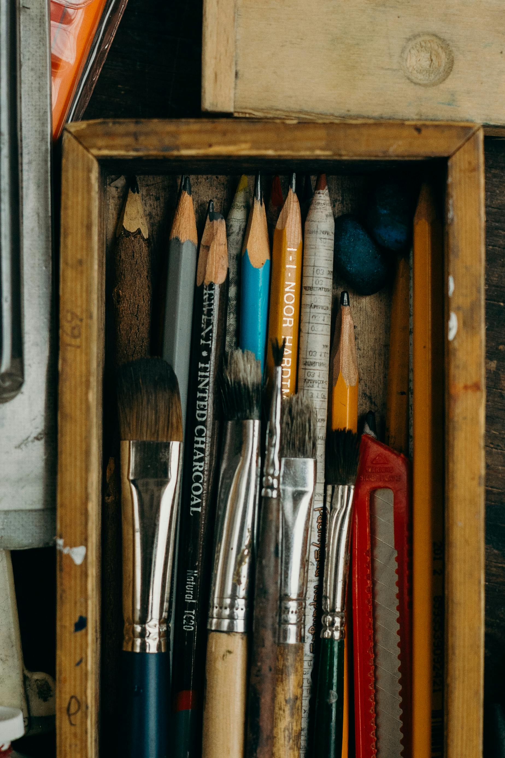
Foundations of Art Education: Procedures, Safety, and Creativity
6
Lesson Objectives
Analyzing Safety Protocols
Evaluating Organizational Systems
Upon completion of this lesson, students will be able to analyze the importance of safety protocols in the art classroom.
This includes understanding how these protocols contribute to a secure and productive learning environment.
Students will be able to evaluate the effectiveness of different organizational systems for maintaining a clean and efficient workspace.
This involves assessing various methods to optimize the functionality of the art classroom.
Visual Representation of Rules
Applying Introductory Art Techniques
Students will be able to create a visual representation of their understanding of classroom rules and expectations.
This task encourages creativity while reinforcing the importance of adhering to established guidelines.
Students will be able to apply introductory art techniques, such as color theory and texture, to a simple art project.
This hands-on activity helps students explore foundational concepts in art.

Slide 7

Foundations of Art Education: Procedures, Safety, and Creativity
7
Classroom Tour and Safety Protocols
Exploring the Art Classroom
Give students a tour of the art classroom, highlighting essential areas such as the supply closet, painting station, and sculpture area.
This helps students familiarize themselves with the workspace and understand where to find necessary materials.
Safety First in Art Activities
Discuss safety protocols, such as proper handling of art materials, cleaning up spills, and using protective gear.
Ensuring safety measures are followed prevents accidents and promotes a secure learning environment.
Respecting the Creative Space
Emphasize the importance of respecting the classroom and peers' work.
This fosters a collaborative and supportive atmosphere for artistic expression.

Slide 8
Foundations of Art Education: Procedures, Safety, and Creativity
8
Introduction to Art Techniques
Exploring Basic Art Techniques
Interactive Learning with Handouts
Illustrating Concepts Through Art
Introduce students to basic art techniques, such as color theory, texture, and composition.
Use examples of famous artworks to illustrate these concepts.
Provide students with a handout outlining the key terms and concepts.
Have them work in pairs to match the terms with their definitions.
Use examples of famous artworks to illustrate these concepts.
Introduce students to basic art techniques, such as color theory, texture, and composition.

Slide 9

Foundations of Art Education: Procedures, Safety, and Creativity
9
Group Activity: Collaborative Mural
Materials and Setup
Mural Creation Guidelines
Roles and Responsibilities
Assign each group a section of a large piece of paper or canvas and provide a variety of art materials.
Ensure the workspace is organized and ready for collaborative creativity.
Instruct the groups to create a collaborative mural that represents the art classroom procedures, including safety protocols, clean-up routines, and respect for peers' work.
Encourage teamwork and creativity while adhering to the theme of classroom procedures.
Each group member will have a specific role: designer, artist, critic, and presenter.
Clarify the responsibilities of each role to ensure smooth collaboration and effective presentation.

Slide 10
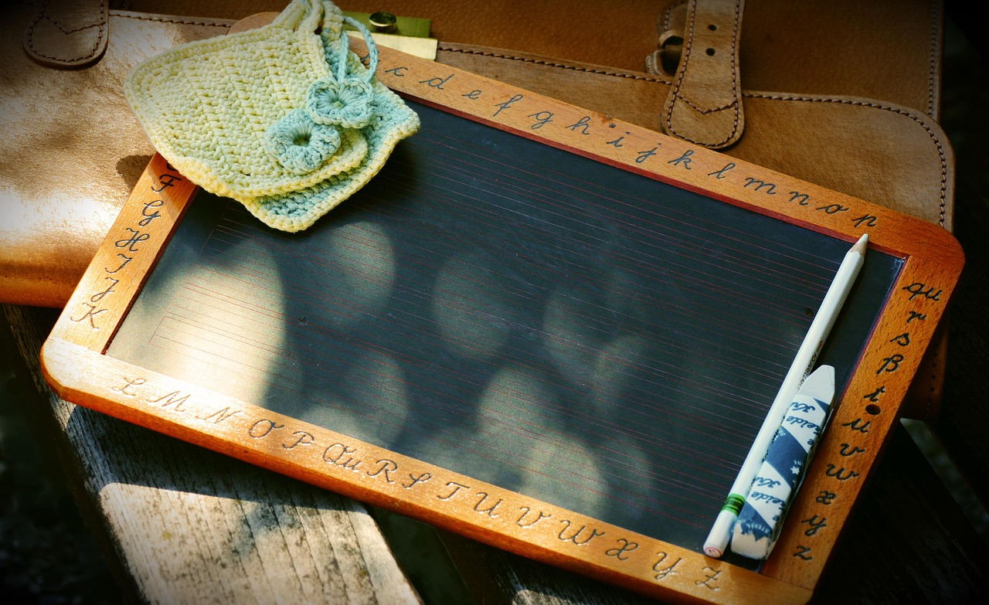
Foundations of Art Education: Procedures, Safety, and Creativity
10
Art Supply Sorting Game
Organizing Art Supplies
Team Roles in Action
Interactive Learning Experience
Prepare a set of art supplies, such as paints, brushes, and canvases, and divide them into categories.
Divide students into small groups and assign each group a set of supplies to sort into the corresponding categories.
Each group member will have a specific role: sorter, categorizer, checker, and recorder.
These roles ensure that every student actively participates in the sorting process.
This activity promotes teamwork and organizational skills among students.
It also provides a hands-on approach to learning about art supplies and their uses.

Slide 11
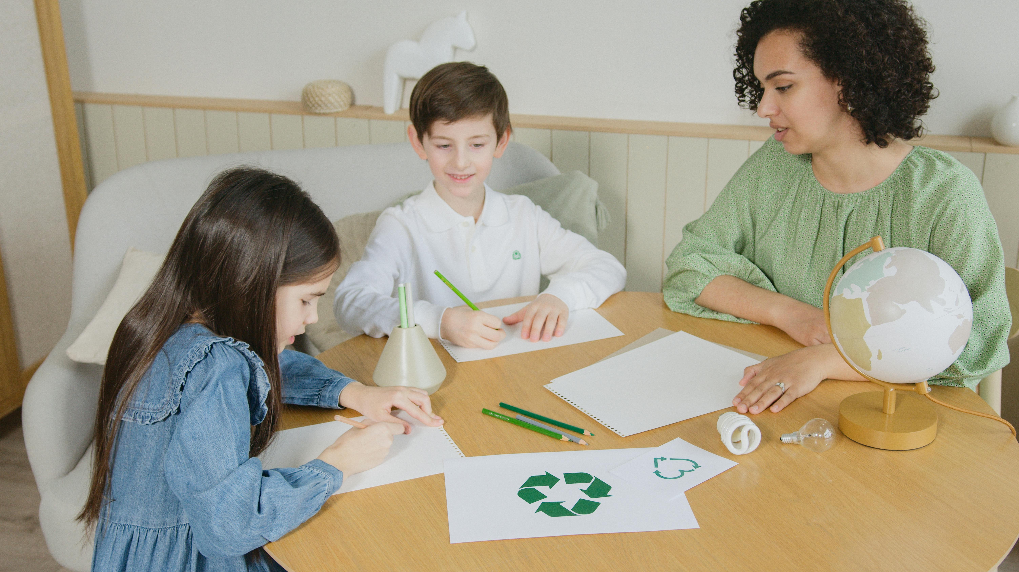
Foundations of Art Education: Procedures, Safety, and Creativity
11
Classroom Rules and Expectations
Purpose of Classroom Rules
Benefits of Clear Guidelines
Focus on Artistic Growth
Classroom rules and expectations are the guidelines that govern student behavior in an art classroom.
These rules and expectations are designed to ensure a safe and productive learning environment, where students can explore their creativity and develop their artistic skills.
By establishing clear rules and expectations, teachers can create a positive and supportive learning environment.
This promotes student engagement and creativity.
A structured environment allows students to focus on developing their artistic skills.
It ensures that creativity can flourish without unnecessary disruptions.

Slide 12
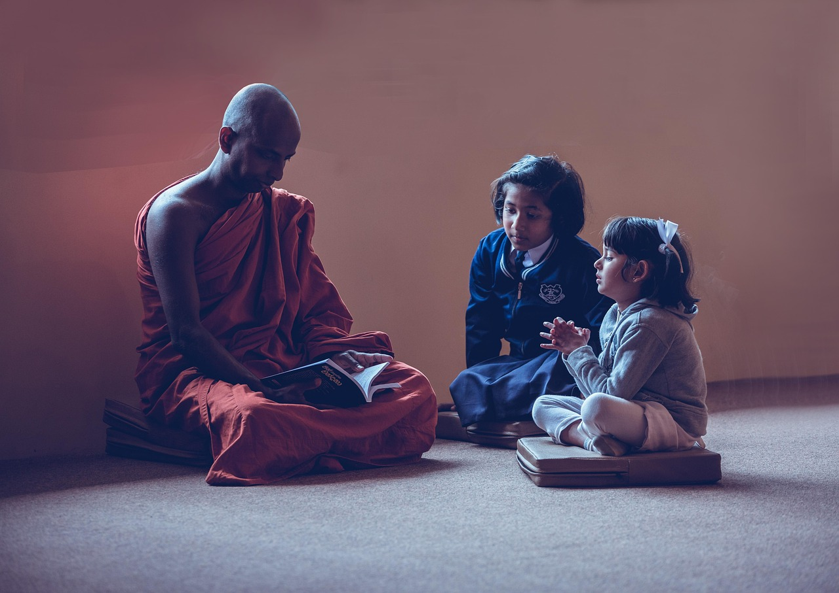
Foundations of Art Education: Procedures, Safety, and Creativity
12
Safety Protocols and Procedures
Purpose of Safety Protocols
Awareness of Hazards
Creating a Safe Environment
Safety protocols and procedures are the guidelines that ensure student safety in an art classroom.
These protocols and procedures are designed to prevent accidents and injuries.
Students are made aware of the potential hazards and risks associated with art materials and techniques.
This awareness is crucial for maintaining a safe environment.
By establishing clear safety protocols and procedures, teachers can create a safe and healthy learning environment.
This promotes student well-being and safety.

Slide 13
Foundations of Art Education: Procedures, Safety, and Creativity
13
Introductory Art Techniques and Methods
Understanding Basic Art Skills
Developing Artistic Skills
Exploring Creative Possibilities
Introductory art techniques and methods are the basic skills and methods that students need to learn in order to create artworks.
These techniques and methods include color theory, texture, and composition.
By learning these techniques and methods, students can develop their artistic skills.
They can create a wide range of artworks, from paintings and drawings to sculptures and prints.
Introductory art techniques open doors to creative exploration.
Students gain the ability to experiment with diverse artistic forms and expressions.

Slide 14
Foundations of Art Education: Procedures, Safety, and Creativity
14
Art Classroom Procedures
Definition of Art Class Procedures
Purpose of Clear Procedures
Benefits of Art Classroom Procedures
Art class procedures are the rules and guidelines that govern the behavior and actions of students in an art classroom.
These procedures are designed to ensure a safe and productive learning environment, where students can explore their creativity and develop their artistic skills.
By establishing clear procedures, teachers can create a positive and supportive learning environment.
This environment promotes student engagement and creativity.
Art classroom procedures help students focus on developing their artistic skills.
They also ensure that the classroom remains a safe and productive space for learning.

Slide 15

Foundations of Art Education: Procedures, Safety, and Creativity
15
Assessment and Evaluation
Summative Assessment Overview
The summative assessment for the first day of art class procedures will evaluate students' understanding of the classroom rules, safety protocols, and introductory art techniques.
It will include a written quiz, a classroom observation, an art project, and a self-assessment reflection.
Success Criteria for Assessment
The success criteria for these assessments will include demonstrated understanding of classroom rules and safety protocols.
Students must also show the ability to apply introductory art techniques and respect for peers' work and materials.
Assessment Methods
The assessment will be conducted through various methods including a written quiz, classroom observation, and an art project.
Additionally, students will complete a self-assessment reflection to evaluate their own learning and progress.

Slide 16
Foundations of Art Education: Procedures, Safety, and Creativity
16
Formative Assessment
Ongoing Feedback
Teacher Adjustments
Assessment Methods
The formative assessment for the first day of art class procedures will be ongoing and will provide feedback to students throughout the lesson.
The assessment will include classroom observation, peer feedback, self-assessment checklists, and exit tickets.
The teacher will use the feedback from these assessments to adjust the lesson plan.
Additional support or review will be provided as needed.
Classroom observation, peer feedback, self-assessment checklists, and exit tickets will be utilized.
These methods aim to ensure comprehensive evaluation and engagement.

Slide 17
Foundations of Art Education: Procedures, Safety, and Creativity
17
Conclusion
Setting the Tone for the Year
The first day of art class is a critical time to establish procedures, expectations, and safety protocols.
These foundational elements will set the tone for the rest of the year.
Creating a Positive Learning Environment
By introducing students to the art classroom and teaching them about safety considerations, teachers can foster engagement.
Providing opportunities for creative expression helps in building a supportive and inspiring atmosphere.
Emphasizing Core Values
Teachers should highlight the importance of respect, responsibility, and creativity in the art classroom.
Equipping students with the necessary tools and resources ensures their success.

Slide 18
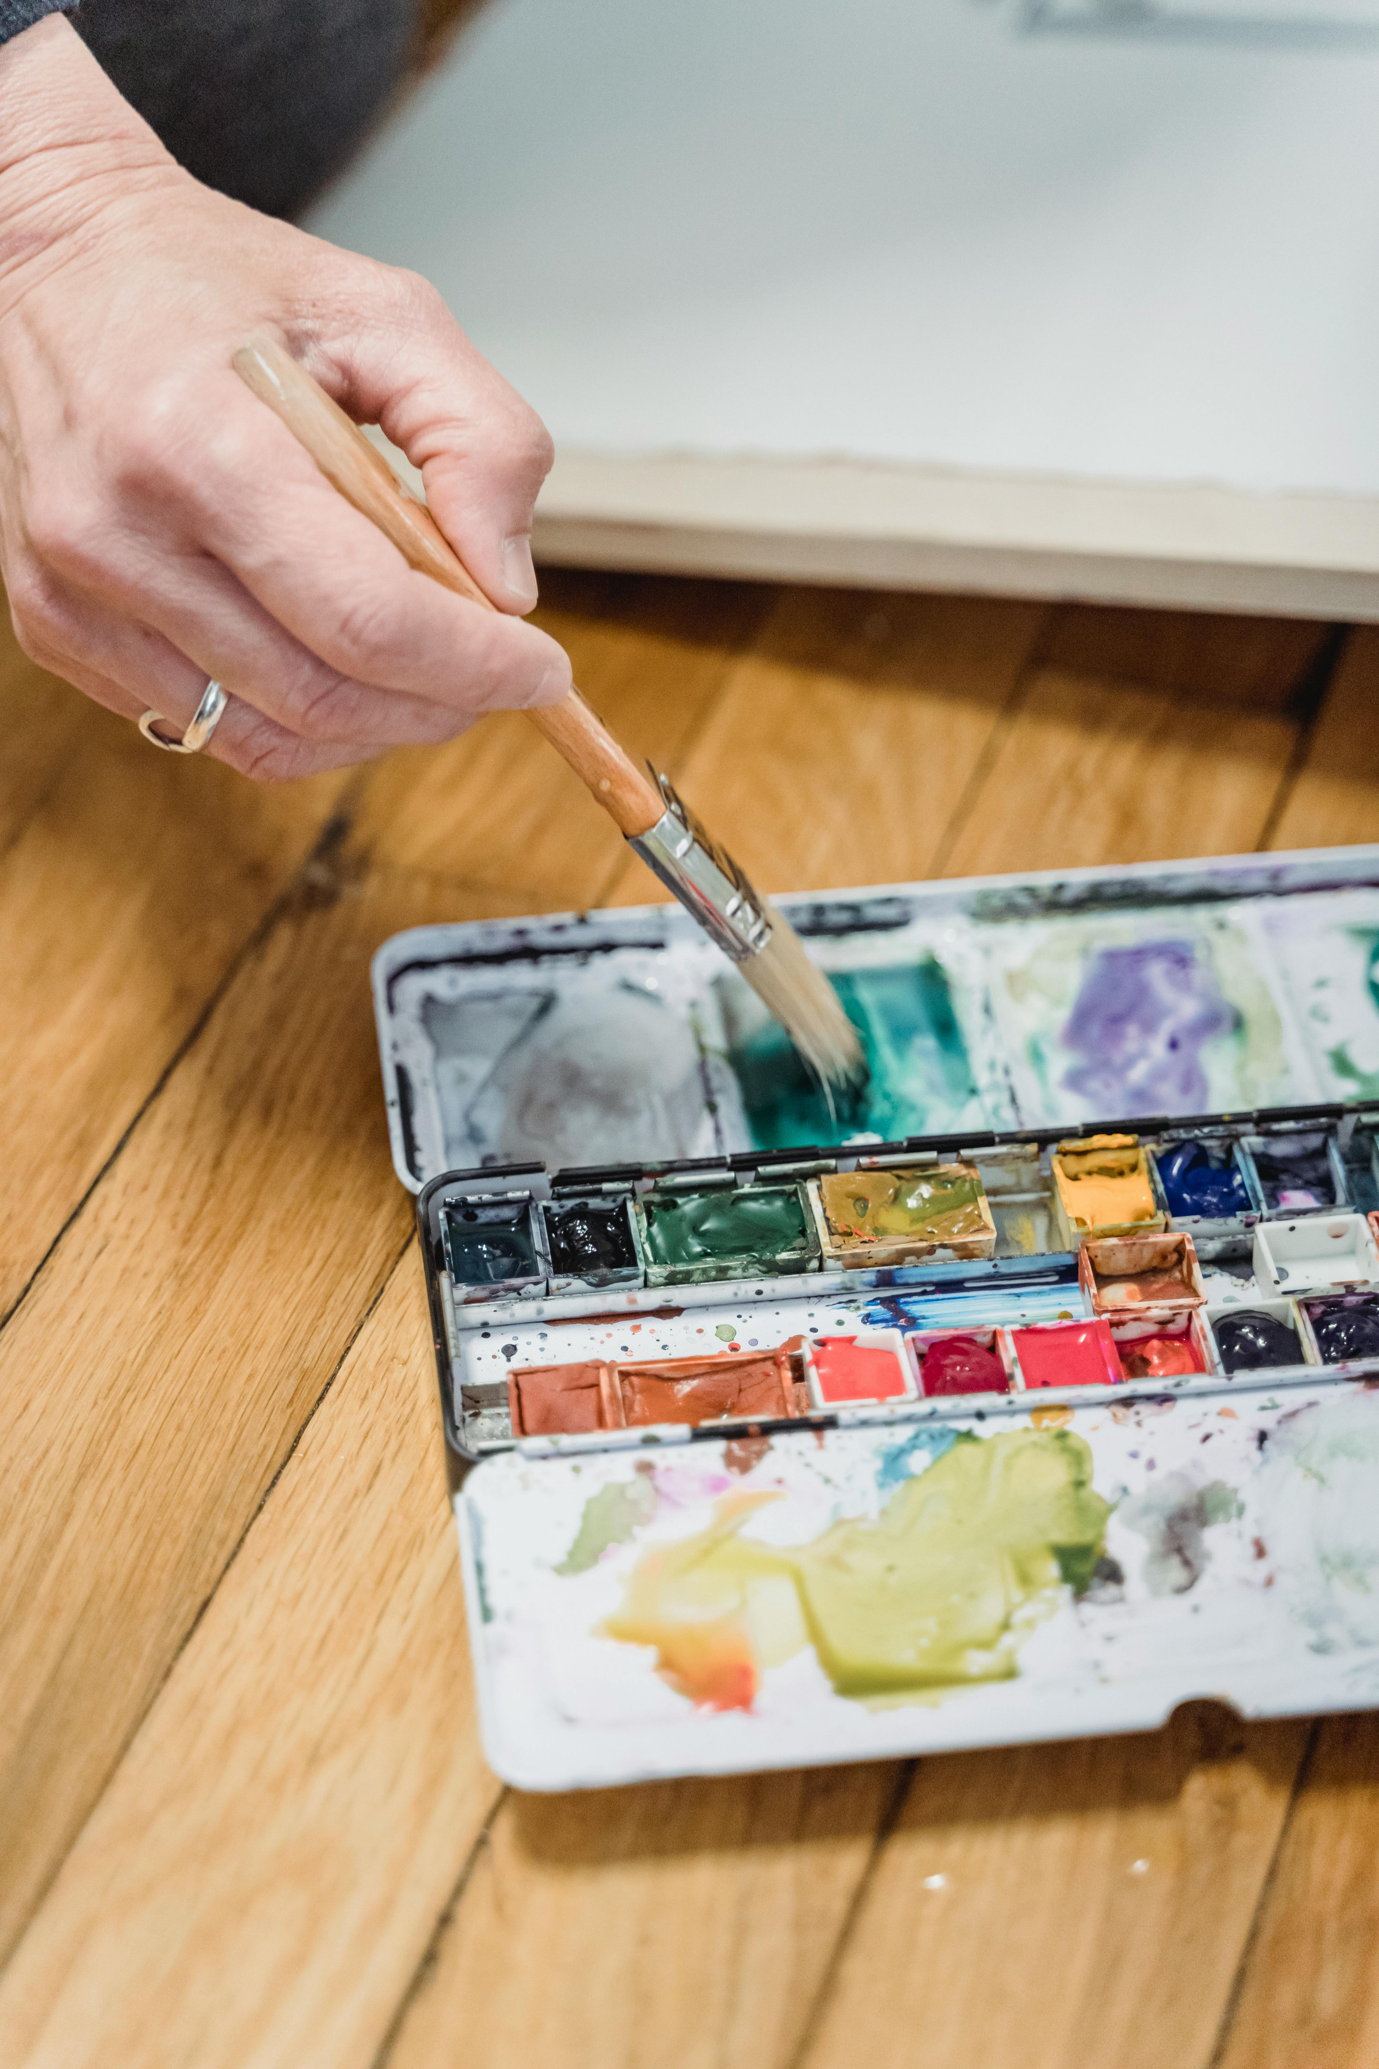
Foundations of Art Education: Procedures, Safety, and Creativity
18
Next Steps
Exploring Art Materials and Techniques
Developing Technical Skills
Hands-On Artistic Exploration
The next lesson will focus on exploring art materials and techniques, such as painting, drawing, and printmaking.
Students will learn about the different tools and materials used in each medium and experiment with different techniques to create unique artworks.
The learning progression will focus on developing students' technical skills.
This will encourage experimentation and creativity in their artistic endeavors.
Students will engage in hands-on activities to better understand various art forms.
This approach aims to foster a deeper connection with the creative process.

Slide 19
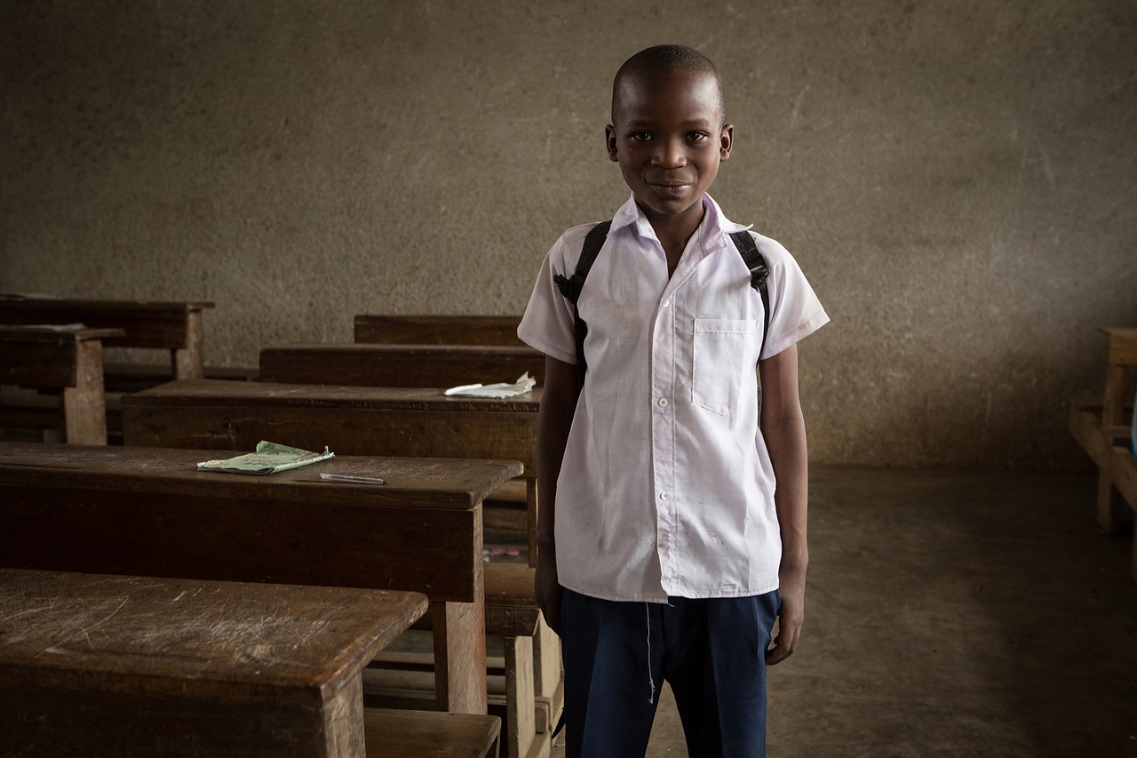
Foundations of Art Education: Procedures, Safety, and Creativity
19
Reflection Questions
Engaging Students Effectively
Understanding Safety Protocols
Leveraging Differentiation Opportunities
What were the most effective strategies for engaging students and promoting a positive classroom environment?
How well did students understand the safety protocols and classroom rules, and what additional support or review may be needed to ensure student safety and responsibility?
How well did students understand the safety protocols and classroom rules, and what additional support or review may be needed to ensure student safety and responsibility?
What opportunities arose for differentiation and scaffolding, and how can these opportunities be leveraged in future lessons to support diverse learner needs?
What opportunities arose for differentiation and scaffolding, and how can these opportunities be leveraged in future lessons to support diverse learner needs?
What were the most effective strategies for engaging students and promoting a positive classroom environment?

Slide 20
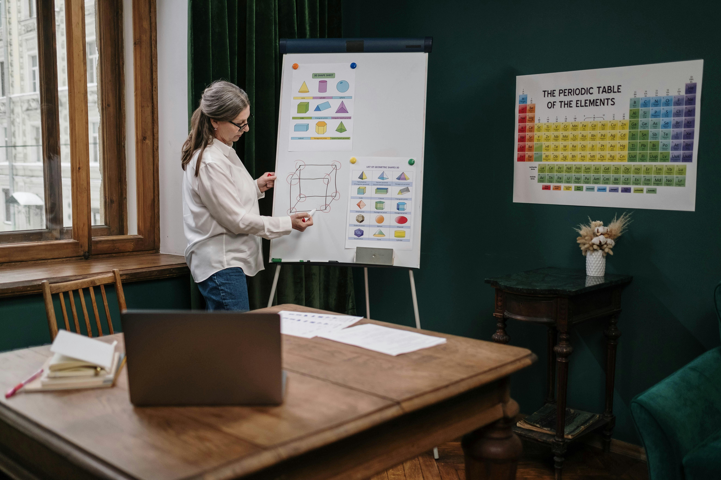
Foundations of Art Education: Procedures, Safety, and Creativity
20
Teaching Tips
Enhancing Understanding with Visual Aids
Use visual aids, such as diagrams and videos, to help students understand complex concepts and procedures.
These tools can simplify abstract ideas and make learning more accessible.
Interactive Learning Strategies
Make the lesson interactive by incorporating games, group activities, and hands-on exercises.
This approach fosters engagement and collaboration among students.
Encouraging Ownership and Reflection
Provide choices and allow students to take ownership of their learning, and encourage reflection and self-assessment to promote metacognitive skills.
This empowers students to develop critical thinking and self-awareness.

Slide 21

Foundations of Art Education: Procedures, Safety, and Creativity
21
Key Takeaways
Setting the Tone
Safety Protocols
Exploring Creativity
The first day of art class is crucial in setting the tone for the rest of the year.
It establishes expectations and creates a foundation for learning.
Students should understand the importance of safety protocols in the art classroom, including proper handling of materials, cleaning up spills, and using protective gear.
These practices ensure a safe and productive environment for everyone.
Students should be introduced to basic art techniques, such as color theory, texture, and composition, and be encouraged to experiment and explore their creativity.
This fosters artistic growth and confidence in their abilities.

Slide 22

Foundations of Art Education: Procedures, Safety, and Creativity
22
Parent Engagement
Parent-Teacher Conferences
Schedule regular parent-teacher conferences to discuss student progress.
Provide feedback to parents during these meetings to foster engagement.
Parent Volunteers in Art Class
Recruit parents to volunteer in the art classroom.
They can assist with activities such as preparing materials and supervising students.
Art Exhibitions for Parents
Host regular art exhibitions to showcase student artwork.
Provide parents with the opportunity to see their child's creations.

