Slide 1
Mastering Microsoft PowerPoint: A Comprehensive Guide for Beginners
Learn to Create Engaging, Professional Presentations with Multimedia, Custom Layouts, and Effective Printing

Slide 2
Mastering Microsoft PowerPoint: A Comprehensive Guide for Beginners
2
Table of Contents
Introduction to Mastering Microsoft PowerPoint
Why Learn Microsoft PowerPoint?
Lesson Objectives
Microsoft PowerPoint Interface
Creating a New Presentation
Inserting Multimedia Elements
Printing Documents
Customizing the Presentation Layout
Best Practices for Presentations
Common Errors to Avoid
Frequently Asked Questions
Conclusion
Next Steps
04
05
06
07
08
09
10
11
12
13
14
15
16

Slide 3
Mastering Microsoft PowerPoint: A Comprehensive Guide for Beginners
3
Table of Contents
Reflection Questions
Key Takeaways
Final Thoughts
17
18
19

Slide 4
Mastering Microsoft PowerPoint: A Comprehensive Guide for Beginners
4
Introduction to Mastering Microsoft PowerPoint
Overview of the Lesson
Learning Objectives
Target Audience
Welcome to Mastering Microsoft PowerPoint, a lesson designed for 14-year-old students to learn the fundamentals of creating engaging presentations.
In this lesson, students will learn how to navigate the PowerPoint interface, create multimedia presentations, and print documents.
By the end of this lesson, students will be able to create a basic presentation, understand the importance of multimedia elements, and effectively use the PowerPoint interface.
The lesson aims to equip students with essential skills for crafting impactful and professional presentations.
This lesson is specifically tailored for 14-year-old students who are new to Microsoft PowerPoint.
It provides a structured approach to mastering the software's features and functionalities.

Slide 5

Mastering Microsoft PowerPoint: A Comprehensive Guide for Beginners
5
Why Learn Microsoft PowerPoint?
Versatility Across Domains
Enhancing Digital Literacy
Microsoft PowerPoint is a widely used presentation software in education, business, and entertainment.
Its versatility makes it an essential tool for various professional and personal applications.
Learning PowerPoint enhances digital literacy, presentation skills, and the ability to convey information in an engaging manner.
These skills are crucial in today's technology-driven world.
Valuable Academic and Professional Skill
Boosting Confidence in Public Speaking
Proficiency in PowerPoint is a valuable skill for future academic and professional pursuits.
It equips individuals to create impactful presentations that stand out.
Understanding how to create engaging presentations can boost confidence in public speaking and presenting.
This skill helps individuals communicate effectively and leave a lasting impression.

Slide 6
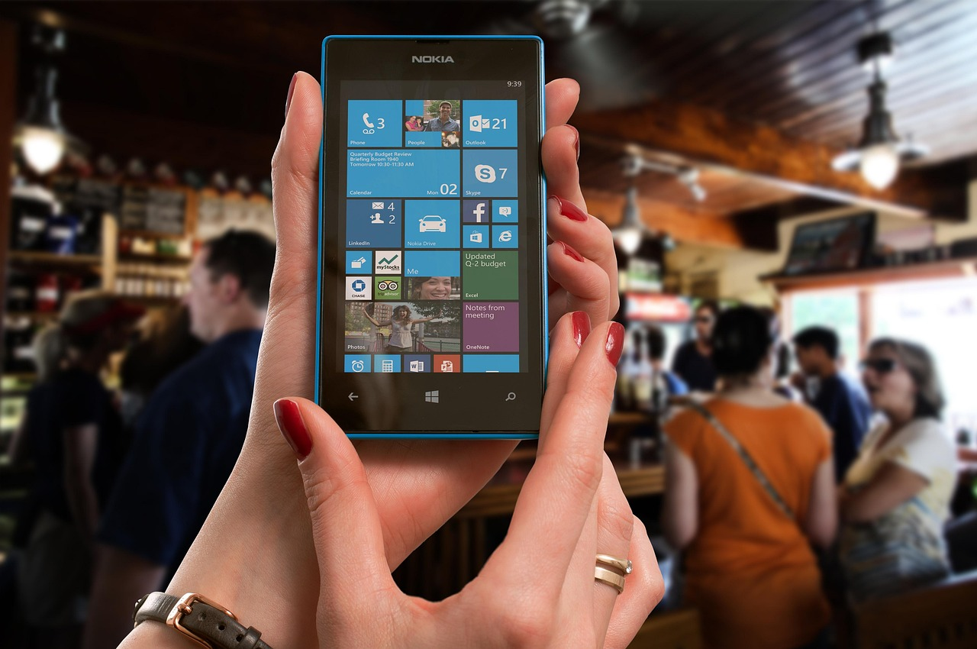
Mastering Microsoft PowerPoint: A Comprehensive Guide for Beginners
6
Lesson Objectives
Understanding the MS PowerPoint Interface
Benefits of Multimedia in Presentations
Recall the basic components of the MS PowerPoint interface, including the ribbon, tabs, and panels.
This foundational knowledge is essential for navigating and utilizing the software effectively.
Explain the purpose and benefits of using multimedia elements in a presentation.
Multimedia enhances engagement and helps convey information more effectively.
Creating a Basic Presentation
Printing Your Presentation
Create a basic PowerPoint presentation that includes at least three slides, with text, images, and transitions.
This hands-on activity builds practical skills in designing professional presentations.
Print the presentation using the appropriate print settings.
Proper printing ensures your presentation is ready for distribution or review.

Slide 7

Mastering Microsoft PowerPoint: A Comprehensive Guide for Beginners
7
Microsoft PowerPoint Interface
The Ribbon
Tabs for Specific Tools
Panels for Additional Options
Customizable Interface
Importance of Understanding the Interface
The ribbon is the topmost section of the interface and provides access to various commands and tools.
It serves as the primary navigation area for users to interact with PowerPoint's features.
Tabs are located below the ribbon and provide more specific tools and features.
These tabs help users quickly find the tools they need for specific tasks.
Panels are located on the right side of the interface and provide additional options and settings.
They offer advanced customization and control over the presentation elements.
The PowerPoint interface is customizable, allowing users to personalize their workspace.
This flexibility ensures that users can adapt the software to their preferences and workflow.
Understanding the interface is crucial for navigating the software and accessing its various features.
A clear grasp of the interface enhances productivity and efficiency in creating presentations.

Slide 8

Mastering Microsoft PowerPoint: A Comprehensive Guide for Beginners
8
Creating a New Presentation
Starting a New Presentation
Choosing a Theme or Template
To create a new presentation, click on the 'File' tab and select 'New.'
This allows you to begin with a blank canvas or choose from available templates.
Select a theme or template to apply a consistent design to the presentation.
This step ensures your slides have a professional and cohesive look.
Adding Slides to Your Presentation
Customizing Slide Layout and Design
Add slides by clicking on the 'Home' tab and selecting 'New Slide.'
This feature lets you expand your presentation with additional content.
Use the tools and features in the ribbon to customize slide layout and design.
This enables you to tailor the presentation to your specific needs and preferences.

Slide 9

Mastering Microsoft PowerPoint: A Comprehensive Guide for Beginners
9
Inserting Multimedia Elements
Enhancing Presentations with Multimedia
Steps to Insert Images
Multimedia elements, such as images, videos, and audio files, can enhance the engagement and effectiveness of a presentation.
They provide visual and auditory stimuli that can make the content more memorable.
To insert an image, click on the 'Insert' tab and select 'Picture.'
This allows you to add visual elements to your slides easily.
Adding Videos to Slides
Including Audio Files
To insert a video, click on the 'Insert' tab and select 'Video.'
Videos can be used to demonstrate concepts or provide dynamic content.
To insert an audio file, click on the 'Insert' tab and select 'Audio.'
Audio files can add narration, music, or sound effects to your presentation.

Slide 10

Mastering Microsoft PowerPoint: A Comprehensive Guide for Beginners
10
Printing Documents
Accessing Print Options
Customizing Print Settings
Selecting Slides to Print
Previewing Before Printing
To print a presentation, click on the "File" tab and select "Print."
This opens the print settings menu where you can configure your preferences.
Choose the print settings, such as the printer, paper size, and layout.
These options allow you to tailor the printout to your specific needs.
Select the slides to print, such as all slides, selected slides, or a range of slides.
This ensures you only print the content you need.
Preview the printout before printing to ensure it meets the requirements.
This step helps avoid errors and ensures the final output is satisfactory.

Slide 11

Mastering Microsoft PowerPoint: A Comprehensive Guide for Beginners
11
Customizing the Presentation Layout
Accessing Layout Options
Applying Themes and Templates
Using Ribbon Tools for Customization
Enhancing Visual Appeal with Animations
To customize the presentation layout, click on the 'Home' tab and select 'Layout.'
This allows you to choose from various predefined slide layouts.
Choose a theme or template to apply a consistent design to the presentation.
Themes ensure uniformity in colors, fonts, and overall style.
Use the tools and features in the ribbon to customize the slide layout and design.
These tools provide flexibility to adjust elements like text boxes, images, and charts.
Add transitions and animations to enhance the presentation's visual appeal.
These effects can make your slides more engaging and dynamic.

Slide 12

Mastering Microsoft PowerPoint: A Comprehensive Guide for Beginners
12
Best Practices for Presentations
Focus on the Main Message
Clarity in Language
Visual Support
Practice for Confidence
Enhance with PowerPoint Tools
Keep the presentation concise and focused on the main message.
This ensures that the audience remains engaged and understands the key points.
Use clear and concise language in the presentation.
This helps in effectively communicating ideas without confusion.
Use images and multimedia elements to support the presentation's content.
These elements can make the presentation more engaging and memorable.
Practice the presentation before delivering it to ensure confidence and fluency.
Rehearsing helps in identifying areas for improvement and builds familiarity with the content.
Use the PowerPoint interface to enhance the presentation's delivery, such as using the presenter view and slide show settings.
These tools can help in managing the flow and timing of the presentation effectively.

Slide 13
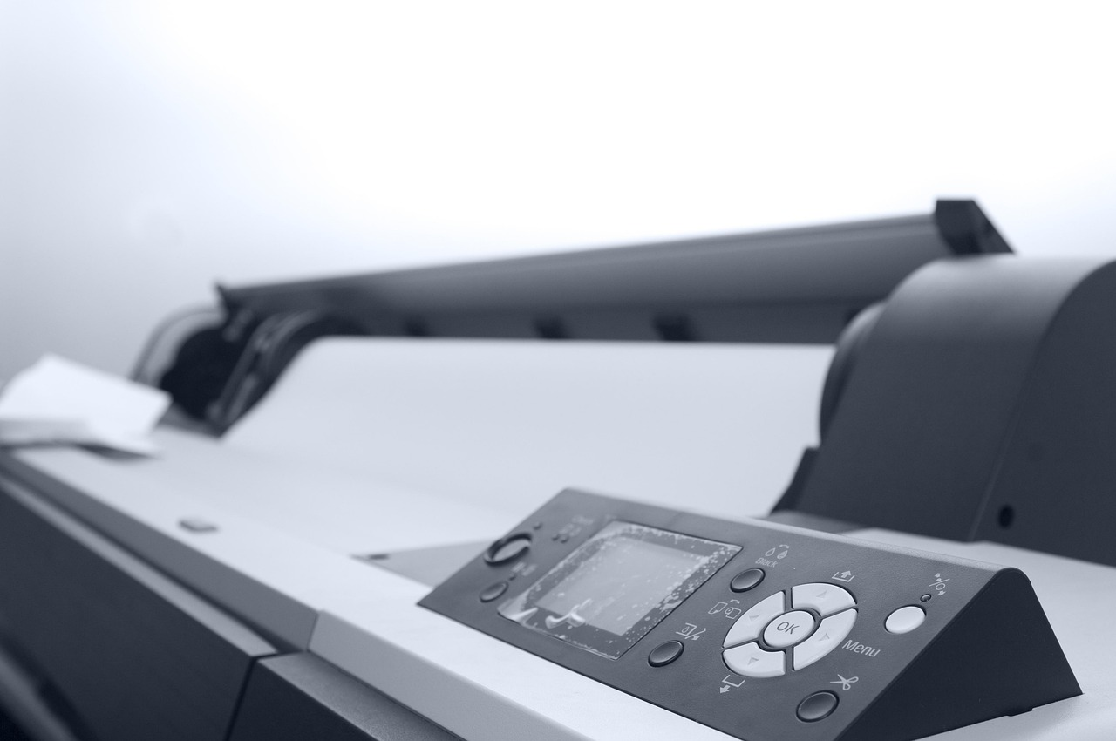
Mastering Microsoft PowerPoint: A Comprehensive Guide for Beginners
13
Common Errors to Avoid
Regular Saving
Not saving the presentation regularly can result in losing valuable work.
Ensure frequent saves to avoid unexpected data loss.
File Format Compatibility
Not using the correct file format can make the presentation incompatible with other versions of PowerPoint.
Choose the appropriate format to ensure seamless sharing and editing.
Video File Compression
Not compressing video files can result in large file sizes and slow loading times.
Optimize video files to enhance performance and reduce storage requirements.
Print Settings
Not selecting the correct print settings can result in poor quality printouts.
Adjust print settings to achieve the desired output quality.

Slide 14

Mastering Microsoft PowerPoint: A Comprehensive Guide for Beginners
14
Frequently Asked Questions
1
Inserting Videos into PowerPoint
4
Printing Presentations as Handouts
Q: How do I insert a video into my PowerPoint presentation?
A: Click on the 'Insert' tab and select 'Video.'
Q: How do I print my PowerPoint presentation as a handout?
A: Click on the 'File' tab, select 'Print,' and choose the 'Handouts' option.
2
Adding Audio to Presentations
5
Collaborating on PowerPoint Files
Q: How do I add audio to my PowerPoint presentation?
A: Click on the 'Insert' tab and select 'Audio.'
Q: How do I collaborate with others on a PowerPoint presentation?
A: Click on the 'File' tab, select 'Share,' and invite others to edit the presentation.
3
Compressing Video Files
Q: How do I compress video files in PowerPoint?
A: Click on the 'File' tab, select 'Compress Media,' and choose the compression settings.

Slide 15

Mastering Microsoft PowerPoint: A Comprehensive Guide for Beginners
15
Conclusion
Valuable Skill for Students
Creating Engaging Presentations
Practice and Application
Mastering Microsoft PowerPoint is a valuable skill for 14-year-old students to learn.
By understanding the basics of PowerPoint, students can enhance their digital literacy and presentation skills.
Creating engaging presentations is an essential aspect of mastering PowerPoint.
Navigating the interface effectively allows students to apply their skills in crafting impactful presentations.
Remember to practice and apply the skills learned in this lesson.
This ensures students can create effective and engaging presentations.

Slide 16
Mastering Microsoft PowerPoint: A Comprehensive Guide for Beginners
16
Next Steps
Building on Foundational Skills
Exploring Advanced Features
Real-World Application and Feedback
The next steps in the lesson progression will build on the foundational skills learned in this introductory lesson.
This ensures a strong base for tackling more advanced topics.
Future lessons will focus on advanced PowerPoint features, designing engaging presentations, and presenting with confidence.
These skills will enhance students' ability to create impactful presentations.
Students will have the opportunity to apply their skills and knowledge in real-world scenarios.
They will also receive feedback and guidance from the teacher to refine their abilities.

Slide 17

Mastering Microsoft PowerPoint: A Comprehensive Guide for Beginners
17
Reflection Questions
Effective Engagement Strategies
Understanding Multimedia Concepts
Practice and Application Opportunities
What strategies were most effective in engaging students during the lesson?
This question prompts reflection on the methods used to capture students' attention and foster active participation.
How well did students understand the concept of multimedia presentations?
This inquiry focuses on assessing students' grasp of the lesson's core ideas and their ability to articulate them.
What opportunities were provided for students to practice and apply their learning?
This question evaluates the practical exercises and real-world applications integrated into the lesson.

Slide 18

Mastering Microsoft PowerPoint: A Comprehensive Guide for Beginners
18
Key Takeaways
Understanding PowerPoint Basics
Creating Engaging Presentations
Understand the basics of Microsoft PowerPoint, including the interface and tools.
Gain familiarity with the essential features to navigate and utilize the software effectively.
Create engaging presentations using multimedia elements and custom layouts.
Learn to captivate your audience with visually appealing and interactive slides.
Printing with Precision
Applying Learned Skills
Print documents using the appropriate print settings.
Ensure your presentations are ready for distribution in the desired format.
Apply the skills and knowledge learned in this lesson to create effective and engaging presentations.
Demonstrate your ability to design impactful slides that convey your message clearly.

Slide 19

Mastering Microsoft PowerPoint: A Comprehensive Guide for Beginners
19
Final Thoughts
The Value of PowerPoint Skills
Effective Communication Through Presentations
Mastering Microsoft PowerPoint is a valuable skill that can benefit students in their academic and professional pursuits.
By applying the skills and knowledge learned in this lesson, students can create effective and engaging presentations that convey their message clearly and confidently.
Mastering Microsoft PowerPoint is a valuable skill that can benefit students in their academic and professional pursuits.
By applying the skills and knowledge learned in this lesson, students can create effective and engaging presentations that convey their message clearly and confidently.

