Slide 1
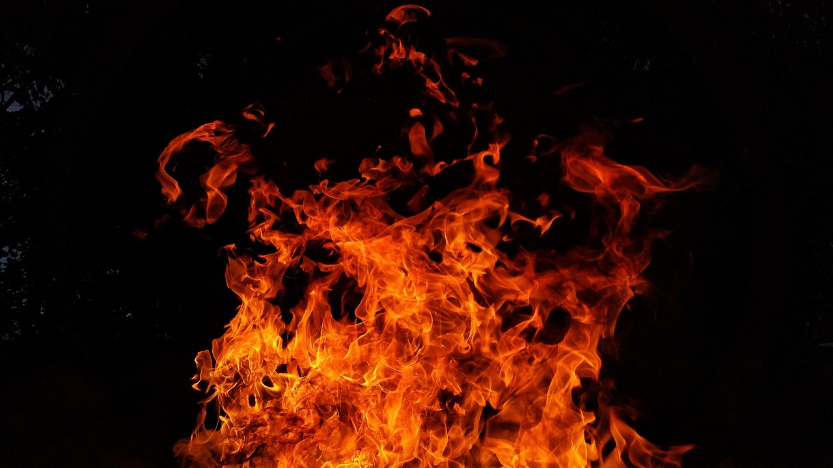
Thermal Energy Transfer: Principles and Applications
Understanding Heat Transfer Mechanisms, Experimental Design, and Real-World Solutions

Slide 2
Table of Contents
Introduction to Thermal Energy Transfer
Conduction: What is it?
Convection: What is it?
Radiation: What is it?
Designing Experiments to Measure Thermal Energ…
Conducting Experiments to Measure Thermal Ener…
Applications of Thermal Energy Transfer
Differentiated Activities for Mixed-Ability Gr…
Experimental Design Challenge
Case Study: Thermal Energy Transfer in a Build…
Thermal Energy Transfer in Real-World Systems
Graphing and Data Analysis
Conclusion
04
05
06
07
08
09
10
11
12
13
14
15
16

Slide 3
Table of Contents
Reflection Questions
Next Steps
Additional Resources
Parent Engagement
Safety Considerations
17
18
19
20
21

Slide 4
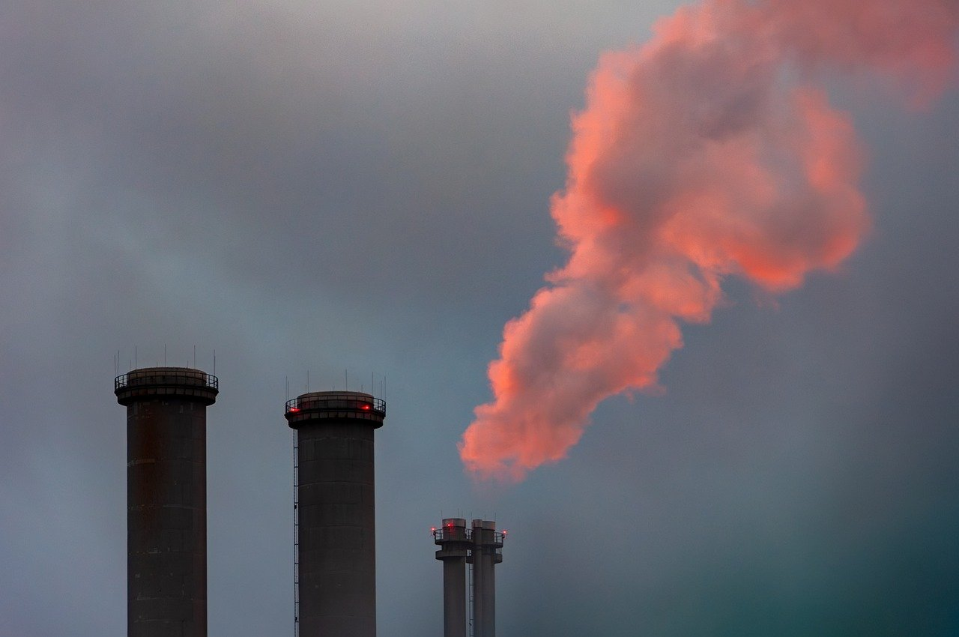
Introduction to Thermal Energy Transfer
Definition of Thermal Energy Transfer
Mechanisms of Heat Transfer
Importance of Thermal Energy Transfer
Thermal energy transfer is the process by which heat energy is transferred from one location to another.
There are three main mechanisms of heat transfer: conduction, convection, and radiation.
Conduction involves the transfer of heat through direct contact between materials.
Convection occurs when heat is transferred through the movement of fluids or gases.
Understanding thermal energy transfer is crucial for designing and optimizing energy-efficient systems.
This knowledge helps in reducing energy waste and improving sustainability.
4
Thermal Energy Transfer: Principles and Applications

Slide 5
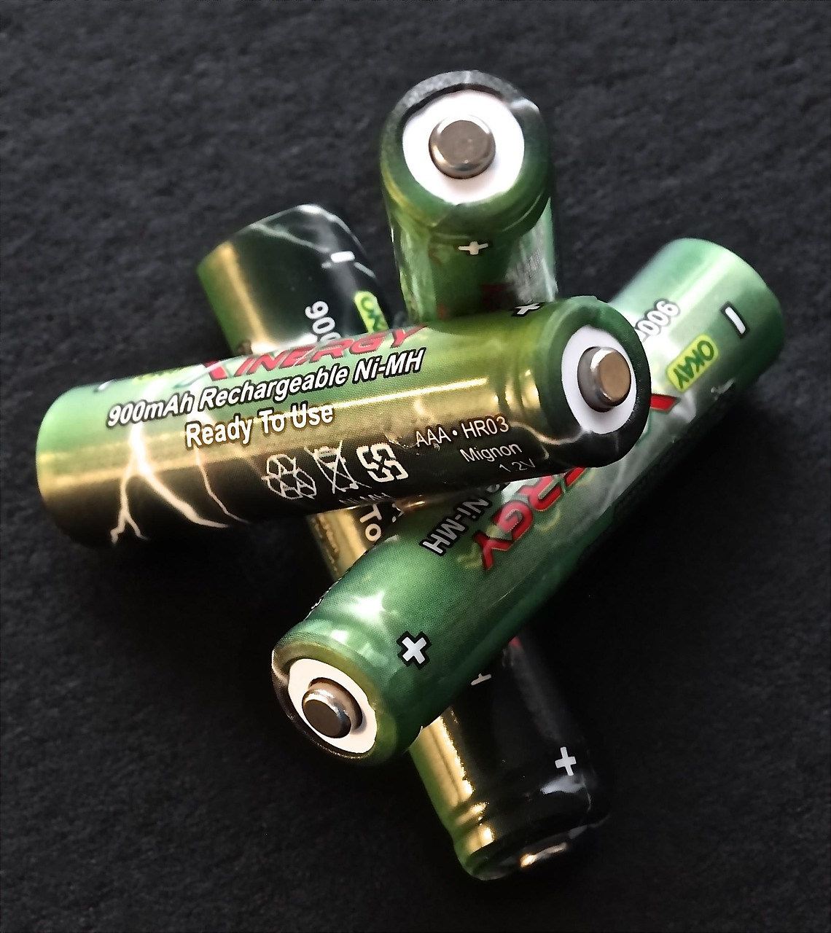
Conduction: What is it?
Definition of Conduction
Examples of Conduction
Efficiency of Conduction
Conduction is the transfer of heat energy through direct contact between particles.
It is a fundamental process in the transfer of thermal energy.
Examples of conduction include touching a hot stove or holding a cold drink.
These everyday occurrences demonstrate how heat moves through direct contact.
Conduction occurs in solids, liquids, and gases, but is most efficient in solids.
This is because particles in solids are closely packed, allowing heat to transfer more effectively.
5
Thermal Energy Transfer: Principles and Applications

Slide 6

Convection: What is it?
1
Understanding Convection
Convection is the transfer of heat energy through the movement of fluids.
It occurs in liquids and gases, playing a key role in heat transfer mechanisms.
2
Examples of Convection
Boiling water and air movement in heating vents are common examples of convection.
These examples illustrate how heat energy is distributed in fluids.
3
Significance of Convection
Convection is an essential process in many systems, facilitating heat transfer.
Its role is particularly important in natural and engineered environments.
6
Thermal Energy Transfer: Principles and Applications

Slide 7
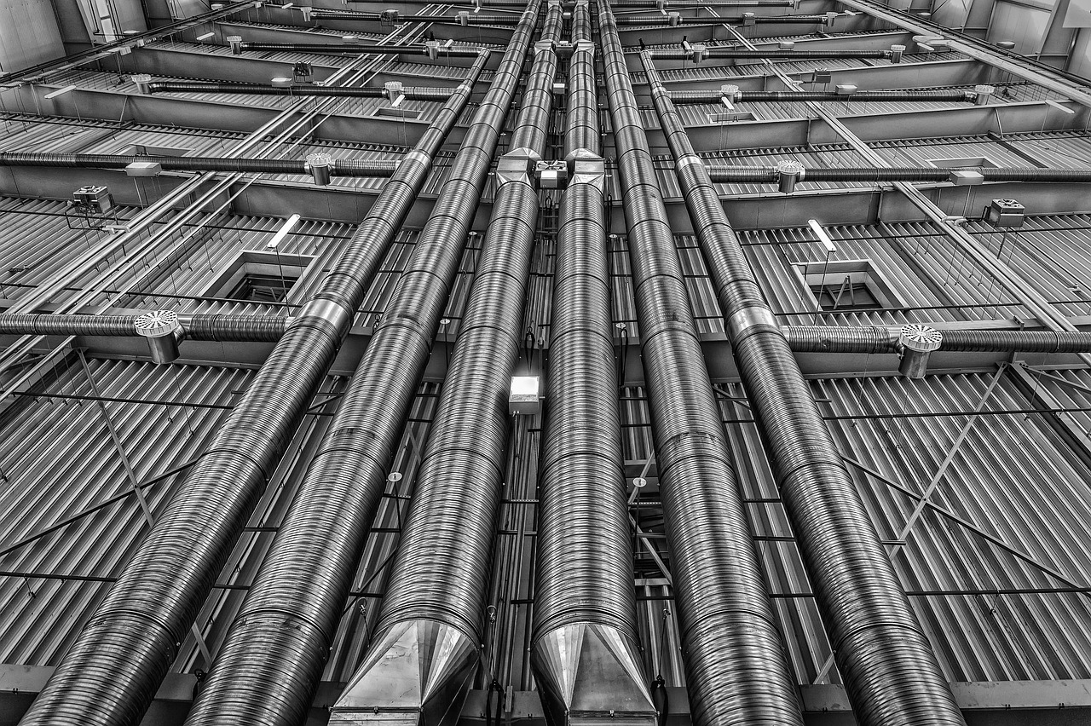
Radiation: What is it?
Definition of Radiation
Examples of Radiation
Radiation in Matter
Radiation is the transfer of heat energy through electromagnetic waves.
It is a fundamental process in the transfer of energy across space.
Examples of radiation include the sun's rays or the heat from a light bulb.
These examples demonstrate how energy can travel without direct contact.
Radiation occurs in all forms of matter.
It plays a crucial role in heat transfer mechanisms across various systems.
7
Thermal Energy Transfer: Principles and Applications

Slide 8
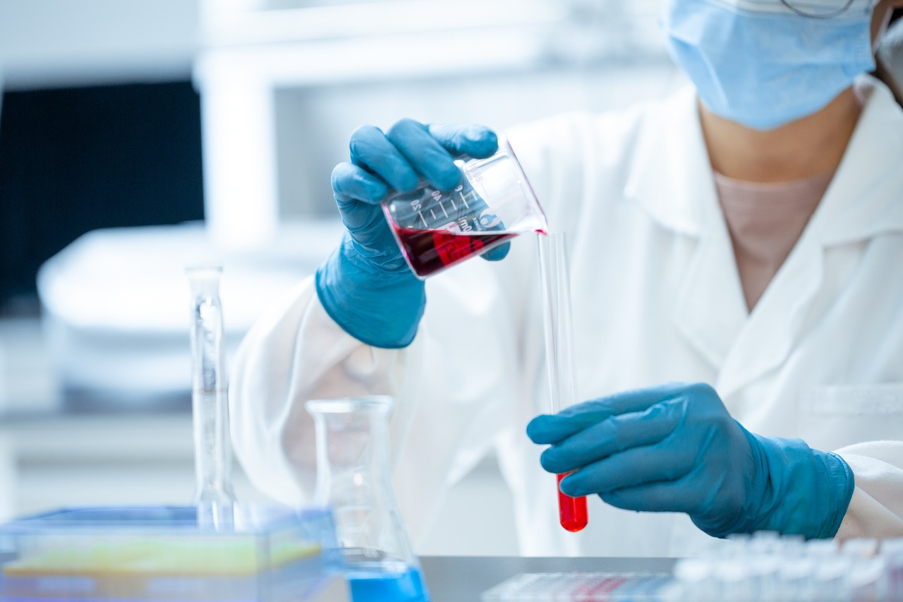
Designing Experiments to Measure Thermal Energy Transfer
1
Identifying Variables and Materials
To design an experiment to measure thermal energy transfer, students should identify the variables and materials needed.
This step ensures the experiment is well-structured and yields meaningful results.
2
Safety Protocols and Procedures
Students should also consider the safety protocols and procedures for conducting the experiment.
Adhering to safety measures is crucial to prevent accidents and ensure a smooth process.
3
Examples of Experiments
Examples of experiments include measuring the thermal conductivity of different materials or designing a heat exchanger.
These activities provide practical insights into the principles of thermal energy transfer.
8
Thermal Energy Transfer: Principles and Applications

Slide 9
Conducting Experiments to Measure Thermal Energy Transfer
Following Established Procedures
Data Collection and Analysis
Examples of Data Analysis
When conducting an experiment to measure thermal energy transfer, students should follow the procedures and protocols established in the design phase.
This ensures the experiment is carried out systematically and yields reliable results.
Students should collect and analyze data, and draw conclusions based on the results.
This step is crucial for understanding the patterns and implications of thermal energy transfer.
Examples of data analysis include graphing temperature changes or calculating heat transfer rates.
These methods help visualize and quantify the transfer of thermal energy effectively.
9
Thermal Energy Transfer: Principles and Applications

Slide 10
Applications of Thermal Energy Transfer
Real-World Applications
Sustainable Energy Solutions
Enhancing Energy Efficiency
Thermal energy transfer has many real-world applications, including heating and cooling systems, power generation, and energy efficiency.
Examples of applications include designing a solar water heater or optimizing the insulation in a building.
Understanding thermal energy transfer is crucial for developing sustainable solutions to global energy challenges.
This knowledge helps in creating innovative technologies to reduce energy consumption and environmental impact.
Thermal energy transfer plays a key role in improving energy efficiency in various systems.
By optimizing thermal processes, we can achieve significant cost savings and reduce carbon footprints.
10
Thermal Energy Transfer: Principles and Applications

Slide 11

Differentiated Activities for Mixed-Ability Groups
Support for Struggling Students
Challenges for Advanced Students
Examples of Differentiated Activities
For struggling students, provide additional support and scaffolding, such as graphic organizers or simplified examples.
These tools help them grasp complex concepts more effectively.
For advanced students, provide additional challenges and open-ended questions, such as designing a complex heat transfer system.
This encourages deeper thinking and application of knowledge.
Examples of differentiated activities include tiered assignments or learning centers.
These approaches cater to diverse learning needs within the same group.
11
Thermal Energy Transfer: Principles and Applications

Slide 12
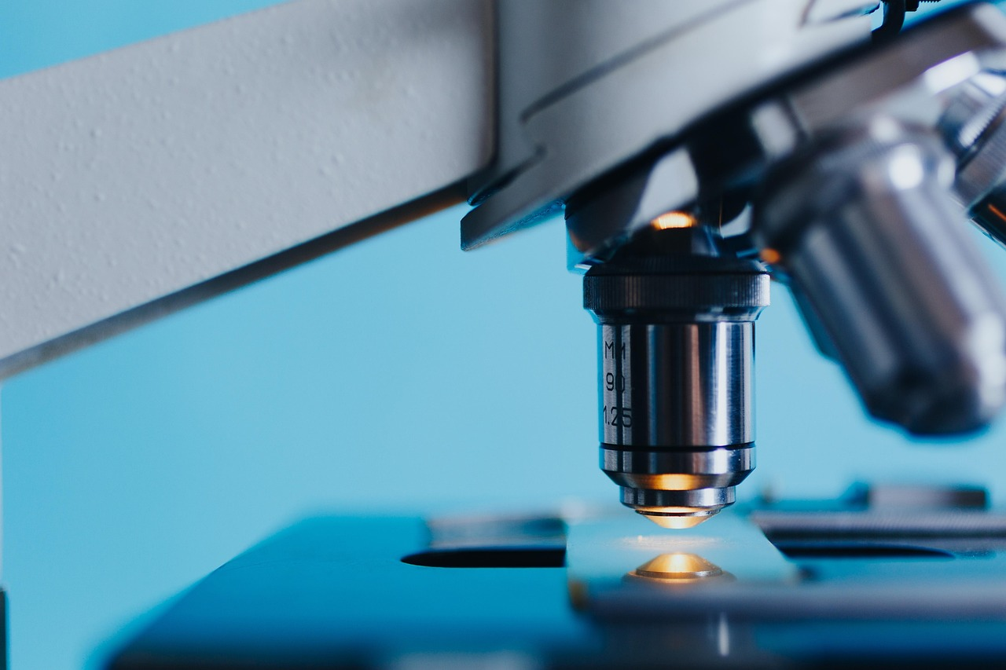
Experimental Design Challenge
Experiment Objective
Design an experiment to measure the thermal conductivity of different materials.
Examples of materials include metals, wood, and insulation.
Key Considerations
Consider the variables and materials needed.
Establish safety protocols and procedures.
Material Examples
Examples of materials include metals, wood, and insulation.
Design an experiment to measure the thermal conductivity of different materials.
12
Thermal Energy Transfer: Principles and Applications

Slide 13
Case Study: Thermal Energy Transfer in a Building
1
2
3
Understanding Heat Transfer Mechanisms
Case Study Examples
Improving Building Efficiency
Analyze the thermal energy transfer in a building, including the heat transfer mechanisms and energy efficiency.
Consider the design and materials used in the building, and identify areas for improvement.
Examples of case studies include a school building or a residential home.
These examples provide insights into practical applications of thermal energy transfer analysis.
Identify areas for improvement in the building's design and materials.
Focus on enhancing energy efficiency through better thermal management.
13
Thermal Energy Transfer: Principles and Applications

Slide 14
Thermal Energy Transfer in Real-World Systems
Thermal Energy in Everyday Systems
Optimizing Energy Efficiency
Applications in Technology
Thermal energy transfer occurs in many real-world systems, including power plants, vehicles, and electronic devices.
Examples of thermal energy transfer in real-world systems include the cooling system in a car or the heating system in a home.
Understanding thermal energy transfer is crucial for optimizing energy efficiency and performance in these systems.
This knowledge helps in designing systems that conserve energy and reduce waste.
Thermal energy transfer plays a key role in the functionality of electronic devices.
Efficient thermal management ensures the longevity and reliability of these devices.
14
Thermal Energy Transfer: Principles and Applications

Slide 15
Graphing and Data Analysis
Importance of Graphing and Data Analysis
Graphing and data analysis are important skills for understanding thermal energy transfer.
They help in visualizing and interpreting complex data effectively.
Examples of Graphing
Examples of graphing include plotting temperature changes or heat transfer rates.
These visual representations make it easier to understand thermal processes.
Role of Data Analysis
Data analysis includes identifying patterns and trends, and drawing conclusions based on the results.
This process is crucial for making informed decisions in scientific studies.
15
Thermal Energy Transfer: Principles and Applications

Slide 16
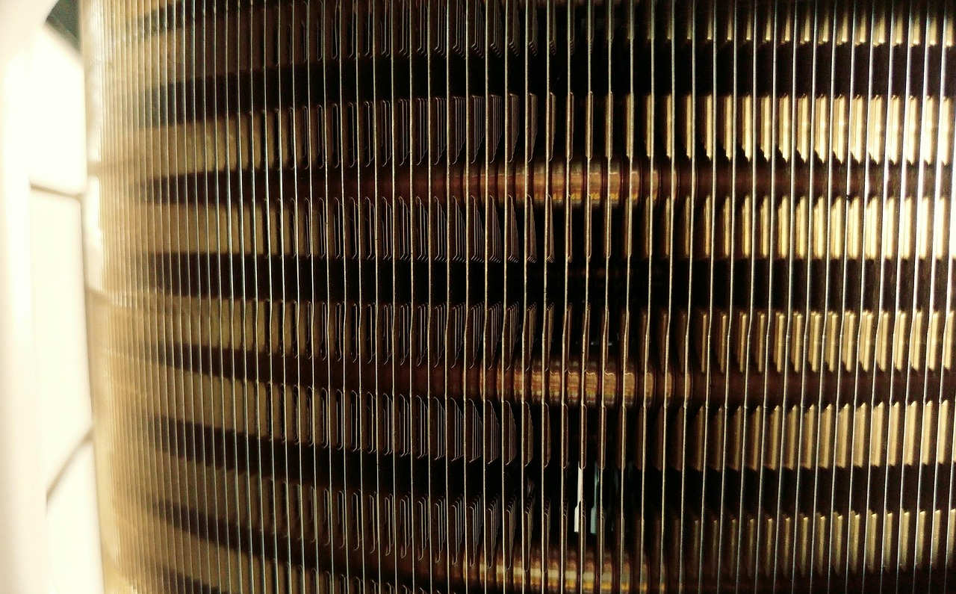
Conclusion
1
2
3
Importance of Thermal Energy Transfer
Applications in Energy Systems
Designing Energy-Efficient Systems
Thermal energy transfer is an important concept in physics and engineering.
It plays a key role in understanding and managing energy systems.
Examples of applications include heating and cooling systems, power generation, and energy efficiency.
These systems rely on effective thermal energy transfer for optimal performance.
Understanding thermal energy transfer is crucial for designing and optimizing energy-efficient systems.
This knowledge helps in reducing energy consumption and improving sustainability.
16
Thermal Energy Transfer: Principles and Applications

Slide 17
Reflection Questions
1
Lesson Insights
What did you learn about thermal energy transfer in this lesson?
How can you apply your understanding of thermal energy transfer to real-world problems?
2
Practical Applications
How can you apply your understanding of thermal energy transfer to real-world problems?
What challenges did you face in designing and conducting experiments to measure thermal energy transfer?
3
Experimental Challenges
What challenges did you face in designing and conducting experiments to measure thermal energy transfer?
What did you learn about thermal energy transfer in this lesson?
17
Thermal Energy Transfer: Principles and Applications

Slide 18
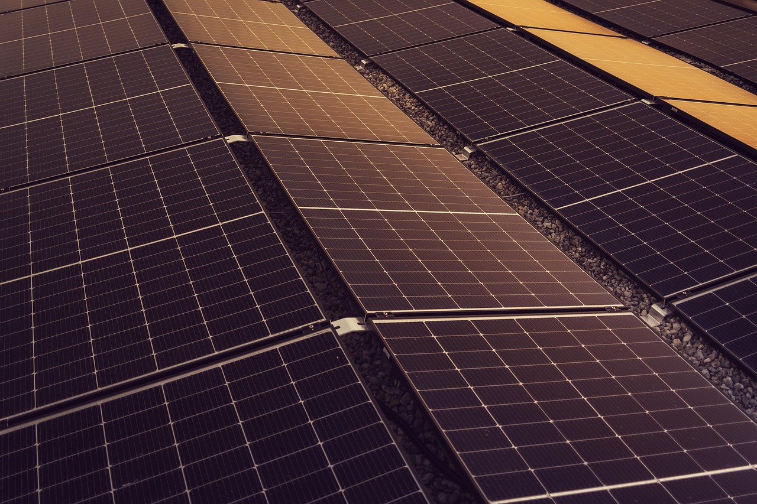
Next Steps
Exploring Thermal Energy Transfer
Applying Knowledge to Real-World Problems
Researching and Innovating in Thermal Properties
Continue to explore thermal energy transfer in more depth, including the design and optimization of energy-efficient systems.
This involves understanding the principles and applications of heat transfer in various contexts.
Apply your understanding of thermal energy transfer to real-world problems, such as designing a solar water heater or optimizing the insulation in a building.
These applications demonstrate the practical importance of thermal energy concepts in everyday life.
Examples of next steps include researching new materials with improved thermal properties or designing a complex heat transfer system.
Such innovations can lead to significant advancements in energy efficiency and sustainability.
18
Thermal Energy Transfer: Principles and Applications

Slide 19
Additional Resources
1
Online Resources for Enrichment
Online resources, such as simulations and tutorials, can provide additional support and enrichment for students.
Examples of online resources include PhET Interactive Simulations or NASA's Jet Propulsion Laboratory.
2
Textbooks and Articles
Additional resources can include textbooks that delve deeper into thermal energy transfer.
Articles on the subject can provide updated and detailed information for advanced learners.
3
Educational Videos
Videos on thermal energy transfer can visually demonstrate concepts for better understanding.
These resources are particularly useful for visual and auditory learners.
19
Thermal Energy Transfer: Principles and Applications

Slide 20

Parent Engagement
Ways Parents Can Engage
Parents can engage with their child's learning by asking questions and providing support.
Examples of parent engagement include attending parent-teacher conferences or volunteering in the classroom.
Support at Home
Parents can provide additional resources and support at home.
Encouraging their child to research thermal energy transfer or providing materials for experiments are examples.
Importance of Engagement
Parent engagement plays a crucial role in a child's learning journey.
It fosters a supportive environment both at school and at home.
20
Thermal Energy Transfer: Principles and Applications

Slide 21
Safety Considerations
Importance of Safety in Experiments
Protective Gear and Protocols
Awareness of Potential Hazards
Safety considerations are crucial when designing and conducting experiments to measure thermal energy transfer.
Ensuring safety helps prevent accidents and promotes a secure learning environment.
Examples of safety considerations include wearing protective gear, such as gloves and goggles, and following established protocols and procedures.
These measures are essential to minimize risks during experimental activities.
Students should also be aware of potential hazards, such as hot surfaces or electrical equipment.
Recognizing these dangers is vital for maintaining safety during experiments.
21
Thermal Energy Transfer: Principles and Applications

