Slide 1

Understanding Negative Numbers: Concepts and Applications
A Comprehensive Guide to Negative Numbers in Mathematics and Real-World Scenarios

Slide 2
Understanding Negative Numbers: Concepts and Applications
2
Table of Contents
Introduction to Negative Numbers
What are Negative Numbers?
Number Line
Comparing and Ordering Negative Numbers
Adding and Subtracting Negative Numbers
Multiplying and Dividing Negative Numbers
Real-World Applications of Negative Numbers
Common Errors and Misconceptions
Practice Exercises
Real-World Scenarios
Conclusion
Summary
Key Takeaways
04
05
06
07
08
09
10
11
12
13
14
15
16

Slide 3
Understanding Negative Numbers: Concepts and Applications
3
Table of Contents
Reflection Questions
Next Steps
Additional Resources
Conclusion and Final Thoughts
17
18
19
20

Slide 4

Understanding Negative Numbers: Concepts and Applications
4
Introduction to Negative Numbers
Definition of Negative Numbers
Importance in Mathematics
Applications of Negative Numbers
Negative numbers are numbers that are less than zero.
They are used to represent debts, temperatures below zero, and other real-world quantities.
Understanding negative numbers is essential in mathematics.
It allows us to solve equations and inequalities, and to model real-world phenomena.
Negative numbers are crucial for representing various real-world scenarios.
These include financial debts and temperatures below freezing.

Slide 5

Understanding Negative Numbers: Concepts and Applications
5
What are Negative Numbers?
Definition of Negative Numbers
Examples of Negative Numbers
Negative numbers are numbers that are less than zero.
They are represented by a minus sign (-) or a negative symbol (−).
Examples of negative numbers include -5, -2, and -10.
These numbers are less than zero and are marked with a negative sign.
Representation of Opposite Directions
Understanding Negative Numbers
Negative numbers can be used to represent opposite directions.
For instance, they can signify directions such as north and south.
Negative numbers are essential in mathematics and real-world applications.
They help in representing values below zero or opposite quantities.

Slide 6
Understanding Negative Numbers: Concepts and Applications
6
Number Line
Visual Representation of Numbers
Positive and Negative Numbers
Comparing and Ordering Numbers
A number line is a visual representation of numbers on a line.
It helps in understanding the placement of numbers relative to zero.
Positive numbers are to the right of zero, and negative numbers are to the left.
This arrangement makes it easy to distinguish between positive and negative values.
The number line can be used to compare and order negative numbers.
It provides a clear method to visualize numerical relationships.

Slide 7
Understanding Negative Numbers: Concepts and Applications
7
Comparing and Ordering Negative Numbers
Understanding Negative Numbers
Using the Number Line
Ordering Negative Numbers
Key Concept in Comparison
When comparing negative numbers, the smaller number is actually larger.
For example, -5 is greater than -10.
The number line can be used to compare and order negative numbers.
It visually represents the relative positions of negative numbers.
Negative numbers can be ordered from least to greatest.
They can also be arranged from greatest to least.
The concept of 'smaller' and 'larger' reverses for negative numbers.
This is crucial for accurate mathematical operations.

Slide 8
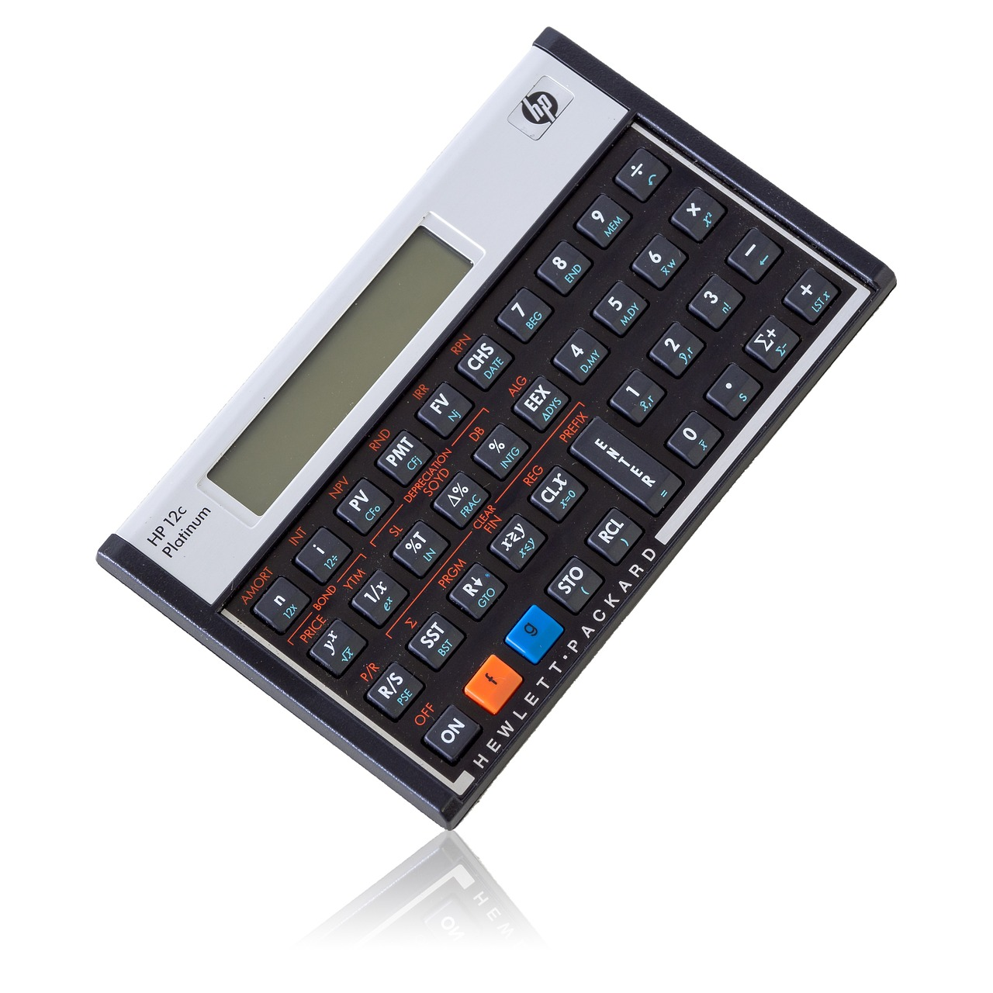
Understanding Negative Numbers: Concepts and Applications
8
Adding and Subtracting Negative Numbers
Understanding Negative Addition
Negative Subtraction Basics
When adding negative numbers, the result is always negative.
For example, -2 + (-3) = -5.
When subtracting negative numbers, the result is always positive.
For example, -2 - (-3) = 1.
Key Rule for Adding Negatives
Key Rule for Subtracting Negatives
Adding two negative numbers combines their absolute values.
This results in a larger negative number.
Subtracting a negative number is equivalent to adding its positive counterpart.
This operation often leads to a positive result.

Slide 9

Understanding Negative Numbers: Concepts and Applications
9
Multiplying and Dividing Negative Numbers
Multiplying Negative Numbers
Dividing Negative Numbers
When multiplying negative numbers, the result is always positive.
For example, -2 x -3 = 6.
When dividing negative numbers, the result is always positive.
For example, -6 ÷ -2 = 3.
Understanding Multiplication
Understanding Division
Negative times negative equals positive.
This rule applies universally in mathematics.
Negative divided by negative equals positive.
This principle ensures consistency in arithmetic operations.

Slide 10

Understanding Negative Numbers: Concepts and Applications
10
Real-World Applications of Negative Numbers
Finance and Negative Numbers
Science and Sub-Zero Temperatures
Engineering Optimization
Programming and Error Representation
Negative numbers are used in finance to represent debts or losses.
They help in understanding financial positions and managing budgets effectively.
Negative numbers are used in science to represent temperatures below zero.
This is crucial for studying climates and conducting experiments in extreme conditions.
Negative numbers are used in engineering to design and optimize systems.
They play a role in analyzing forces, stresses, and other critical parameters.
Negative numbers are used in computer programming to represent negative values or errors.
This aids in debugging and ensuring the accuracy of computational processes.

Slide 11
Understanding Negative Numbers: Concepts and Applications
11
Common Errors and Misconceptions
Confusion Between Negative and Positive Numbers
Misunderstanding Negative Zero
Errors in Operations with Negative Numbers
One common error is confusing the concept of negative and positive numbers.
This often leads to incorrect assumptions about their behavior in mathematical operations.
Another common error is misunderstanding the concept of negative zero.
This can result in unnecessary complications when interpreting numerical values.
A third common error is making mistakes when performing operations with negative numbers.
Such errors can significantly impact the accuracy of calculations.

Slide 12
Understanding Negative Numbers: Concepts and Applications
12
Practice Exercises
Understanding Negative Numbers
Addition of Negative Numbers
Subtraction with Negative Values
Multiplication and Division of Negatives
Complete the following exercises to practice your understanding of negative numbers.
These exercises will help you grasp addition, subtraction, multiplication, and division involving negative values.
Add -2 and -5 to understand how negative numbers combine.
This exercise demonstrates the cumulative effect of negatives in addition.
Subtract -3 from -2 to explore the concept of subtracting negatives.
This task highlights the unique behavior of subtraction in negative arithmetic.
Multiply -4 and -6, then divide -12 by -4 to practice operations with negatives.
These exercises emphasize the rules of multiplication and division involving negative numbers.

Slide 13

Understanding Negative Numbers: Concepts and Applications
13
Real-World Scenarios
Bank Account Balance Adjustment
Temperature Change Over Time
Debt Payment Scenario
A bank account has a balance of -$50.
If $20 is deposited into the account, what is the new balance?
A temperature graph shows a temperature of -5°C at 6 am.
At 12 pm, the temperature is -2°C. What is the change in temperature?
A person has a debt of -$100.
If they pay $50, what is the remaining balance?

Slide 14
Understanding Negative Numbers: Concepts and Applications
14
Conclusion
Importance of Negative Numbers
Applications of Negative Numbers
In conclusion, negative numbers are an essential concept in mathematics.
Understanding negative numbers is crucial for solving equations and inequalities, and for modeling real-world phenomena.
Negative numbers play a key role in various mathematical operations.
They are indispensable for representing and analyzing real-world scenarios.

Slide 15
Understanding Negative Numbers: Concepts and Applications
15
Summary
Definition of Negative Numbers
Importance in Mathematics
Negative numbers are numbers that are less than zero.
They are used to represent debts, temperatures below zero, and other real-world quantities.
Understanding negative numbers is essential in mathematics.
They form a foundational concept for various mathematical operations and theories.
Applications in Real Life
Practical Examples
Negative numbers have many real-world applications, including finance, science, and engineering.
They help in representing and solving problems in these fields effectively.
Debts and temperatures below zero are common examples of negative numbers.
These examples illustrate their relevance in everyday life.

Slide 16

Understanding Negative Numbers: Concepts and Applications
16
Key Takeaways
Understanding Negative Numbers
Comparing and Ordering
Real-World Applications
Understand the concept of negative numbers and their properties.
This includes recognizing their role in mathematics and their unique characteristics.
Be able to compare and order negative numbers.
Learn how to determine their relative values effectively.
Apply negative numbers to real-world problems and scenarios.
This involves using them in practical contexts like temperature and finance.

Slide 17
Understanding Negative Numbers: Concepts and Applications
17
Reflection Questions
Common Errors and Misconceptions
Real-World Applications
Problem-Solving with Negative Numbers
What are some common errors or misconceptions about negative numbers?
These misconceptions can hinder understanding and application in mathematical contexts.
How can negative numbers be used to represent real-world quantities?
They are essential for modeling scenarios like temperature changes or financial debts.
What are some ways to apply negative numbers to solve problems and make informed decisions?
Negative numbers can be used in calculations to analyze trends and make strategic choices.

Slide 18

Understanding Negative Numbers: Concepts and Applications
18
Next Steps
Applying Negative Numbers
Continue to practice and apply negative numbers to real-world problems.
This will help in understanding their practical significance and usage.
Exploring Advanced Concepts
Explore more advanced concepts, such as fractions and decimals.
These topics build on the foundation of negative numbers and expand mathematical knowledge.
Solving Equations and Inequalities
Use negative numbers to solve equations and inequalities.
This skill is essential for tackling more complex mathematical challenges.

Slide 19

Understanding Negative Numbers: Concepts and Applications
19
Additional Resources
Online Learning Platforms
Printed Educational Materials
Personalized Support
Online resources, such as Khan Academy and Mathway, can provide additional practice and support.
These platforms offer interactive tools and lessons to enhance understanding.
Textbooks and workbooks can provide more in-depth explanations and exercises.
They are excellent for structured learning and self-paced study.
Teachers and tutors can provide one-on-one support and guidance.
This approach ensures tailored assistance to address individual learning needs.

Slide 20
Understanding Negative Numbers: Concepts and Applications
20
Conclusion and Final Thoughts
Importance of Negative Numbers
In conclusion, understanding negative numbers is essential for success in mathematics and real-world applications.
Continue to practice and apply negative numbers to become proficient and confident in your abilities.
Mastery Through Practice
In conclusion, understanding negative numbers is essential for success in mathematics and real-world applications.
Continue to practice and apply negative numbers to become proficient and confident in your abilities.

