Slide 1


Mastering Fractions and Decimals: Concepts, Applications, and Skills
A Comprehensive Guide to Understanding, Converting, and Applying Fractions and Decimals in Real-World Contexts

Slide 2
Table of Contents
Introduction to Fractions and Decimals
Converting Between Fractions and Decimals
Applying Fractions and Decimals in Measurement
Applying Fractions and Decimals in Finance
Tiered Activities for Mixed-Ability Groups
Group Activities
Digital Integration
Assessment and Evaluation
Conclusion
Teaching Tips
Key Takeaways
Reflection Questions
Next Steps
04
05
06
07
08
09
10
11
12
13
14
15
16

Slide 3
Table of Contents
Parent Engagement
Safety Considerations
Homework and Extension Activities
Example Questions
17
18
19
20

Slide 4
Introduction to Fractions and Decimals
Fundamental Concepts in Mathematics
Real-World Applications
Importance of Conversion Skills
Fractions and decimals are fundamental concepts in mathematics that represent parts of a whole.
Understanding how to convert between fractions and decimals is crucial for solving problems in measurement and finance.
Real-world applications of fractions and decimals include cooking, construction, and personal finance.
These concepts are essential for practical tasks and everyday problem-solving.
Mastering the conversion between fractions and decimals is vital for accurate calculations.
This skill is particularly useful in fields like measurement and finance.
4
Mastering Fractions and Decimals: Concepts, Applications, and Skills

Slide 5
Converting Between Fractions and Decimals
Understanding Fraction to Decimal Conversion
Decimal to Fraction Transformation
Exploring Equivalent Ratios
Building Fluency in Conversions
To convert a fraction to a decimal, divide the numerator by the denominator.
This process helps in representing fractions in a decimal format for easier calculations.
To convert a decimal to a fraction, write the decimal as the numerator and place it over the denominator, which is a power of 10.
This method ensures accurate representation of decimals as fractions.
Equivalent ratios are fractions that have the same value, such as 1/2 = 2/4 = 3/6.
Recognizing equivalent ratios is essential for understanding relationships between numbers.
Practice converting between fractions and decimals to develop fluency.
Regular practice enhances accuracy and confidence in mathematical operations.
5
Mastering Fractions and Decimals: Concepts, Applications, and Skills

Slide 6
Applying Fractions and Decimals in Measurement
Role of Fractions and Decimals in Measurement
Practical Applications in Everyday Tasks
Importance in Problem Solving
Fractions and decimals are used to represent lengths, weights, and volumes in measurement.
Understanding how to apply these concepts is vital for solving problems in construction, cooking, and science.
Examples of measurement problems include calculating the area of a room, the volume of a container, and the perimeter of a garden.
These applications demonstrate the importance of fractions and decimals in practical scenarios.
Mastery of fractions and decimals is essential for accurate measurements.
This knowledge is crucial for tasks in various fields such as construction, cooking, and science.
6
Mastering Fractions and Decimals: Concepts, Applications, and Skills

Slide 7

Applying Fractions and Decimals in Finance
Role of Fractions and Decimals in Finance
Examples of Financial Calculations
Importance of Financial Literacy
Fractions and decimals are used to calculate percentages, interest rates, and discounts in finance.
Understanding these concepts is essential for making informed financial decisions, such as calculating the interest on a loan or determining the discount on a purchase.
Examples of financial problems include calculating the cost of items on sale, determining the tip at a restaurant, and balancing a budget.
These calculations often rely on fractions and decimals to ensure accuracy and proper decision-making.
Understanding fractions and decimals is crucial for navigating everyday financial scenarios.
This knowledge empowers individuals to make better choices in managing their money and resources.
7
Mastering Fractions and Decimals: Concepts, Applications, and Skills

Slide 8
Tiered Activities for Mixed-Ability Groups
Purpose of Tiered Activities
Basic Level Activities
Tiered activities cater to different learning abilities and provide opportunities for differentiation.
They ensure that all students can engage with the material at their own level of understanding.
Examples of basic tiered activities include converting fractions to decimals.
These tasks are designed for students who are building foundational skills.
Intermediate and Advanced Tasks
Extension Opportunities
Intermediate tasks involve solving measurement problems with fractions and decimals.
Advanced tasks challenge students with calculating percentages and interest rates.
Extension activities include creating a budget or planning a financial scenario.
These tasks encourage students to apply their knowledge in real-world contexts.
8
Mastering Fractions and Decimals: Concepts, Applications, and Skills

Slide 9
Group Activities
Benefits of Group Activities
Measurement Mastery
Finance Frenzy
Escape the Island
Group activities promote collaboration, communication, and problem-solving skills.
They encourage teamwork and enhance interpersonal relationships among participants.
Solving measurement problems in groups helps participants understand practical applications.
It fosters analytical thinking and precision in calculations.
Calculating financial scenarios in groups enhances understanding of financial concepts.
This activity develops budgeting and decision-making skills.
Participants solve problems to escape a hypothetical island, promoting creative thinking.
It encourages strategic planning and teamwork under pressure.
9
Mastering Fractions and Decimals: Concepts, Applications, and Skills

Slide 10
Digital Integration
01
Enhancing Learning with Digital Tools
Digital tools and software enhance the learning experience.
They provide opportunities for differentiation in education.
02
Math Apps for Problem Solving
Examples include apps like Mathway or Photomath.
These apps assist in solving mathematical problems effectively.
03
Real-World Simulations Online
Engaging in online simulations offers real-world scenario practice.
This approach makes learning interactive and practical.
04
Spreadsheets for Problem Solving
Software like Google Sheets or Microsoft Excel is used to solve problems.
These tools are essential for organizing and analyzing data.
10
Mastering Fractions and Decimals: Concepts, Applications, and Skills

Slide 11
Assessment and Evaluation
1
Formative Assessments
2
Summative Assessments
Formative assessments monitor student progress and understanding.
They are conducted throughout the learning process to provide feedback.
Summative assessments evaluate student learning at the end of the lesson.
They measure the overall achievement of learning objectives.
3
Examples of Assessments
4
Peer and Self-Assessment
Examples include quizzes, classwork, projects, and presentations.
These tools help gauge both individual and group performance.
Peer and self-assessment encourage reflective learning.
They allow students to evaluate their own and others' contributions.
11
Mastering Fractions and Decimals: Concepts, Applications, and Skills

Slide 12
Conclusion
Importance of Fractions and Decimals
Differentiation and Engagement Strategies
Skill Development Through Mastery
Applying fractions and decimals to solve multi-step problems is a crucial skill in measurement and finance.
These skills are foundational for understanding complex real-world scenarios.
Tiered activities and digital integration provide opportunities for differentiation and engagement.
Such strategies cater to diverse learning needs and enhance student participation.
By mastering these concepts, students develop problem-solving skills, critical thinking, and collaboration skills.
These abilities are essential for academic and professional success.
12
Mastering Fractions and Decimals: Concepts, Applications, and Skills

Slide 13

Teaching Tips
Differentiated Instruction
Real-World Applications
Technology Integration
Differentiated instruction caters to diverse learning abilities.
It ensures that every student can access and engage with the material effectively.
Real-world applications make learning relevant and engaging.
They help students connect theoretical knowledge to practical scenarios.
Technology integration enhances the learning experience.
It provides innovative tools and resources to support teaching and learning.
Peer-to-Peer Learning
Formative Assessments
Peer-to-peer learning promotes collaboration and communication.
It fosters a supportive environment where students learn from each other.
Formative assessments inform instruction and adjust to student needs.
They provide ongoing feedback to improve both teaching strategies and student outcomes.
13
Mastering Fractions and Decimals: Concepts, Applications, and Skills

Slide 14

Key Takeaways
Mastering Fractions and Decimals
The Power of Collaboration
Understanding how to convert between fractions and decimals is crucial.
Applying fractions and decimals to solve multi-step problems is essential.
Collaboration and peer-to-peer learning are vital skills.
These skills enhance understanding and foster teamwork.
Real-World Relevance
Building Problem-Solving Skills
Real-world applications make learning relevant and engaging.
They help students connect theoretical concepts to practical scenarios.
Applying mathematical concepts to multi-step problems develops critical thinking.
This approach prepares students for complex challenges in academics and beyond.
14
Mastering Fractions and Decimals: Concepts, Applications, and Skills

Slide 15

Reflection Questions
Catering to Diverse Learning Abilities
Promoting Engagement and Motivation
How effectively did the tiered activities cater to diverse learning abilities?
This question explores the adaptability of the lesson to accommodate varying student needs.
What strategies were most effective in promoting student engagement and motivation?
This reflection focuses on identifying the techniques that successfully captured students' interest.
Improving Lesson Effectiveness
Opportunities for Further Learning
How can the lesson be improved to better meet the needs of students?
This inquiry aims to uncover areas for enhancement in lesson delivery and content.
What opportunities are there for further learning and application of fractions and decimals?
This question encourages consideration of extending the lesson's impact beyond the classroom.
15
Mastering Fractions and Decimals: Concepts, Applications, and Skills

Slide 16
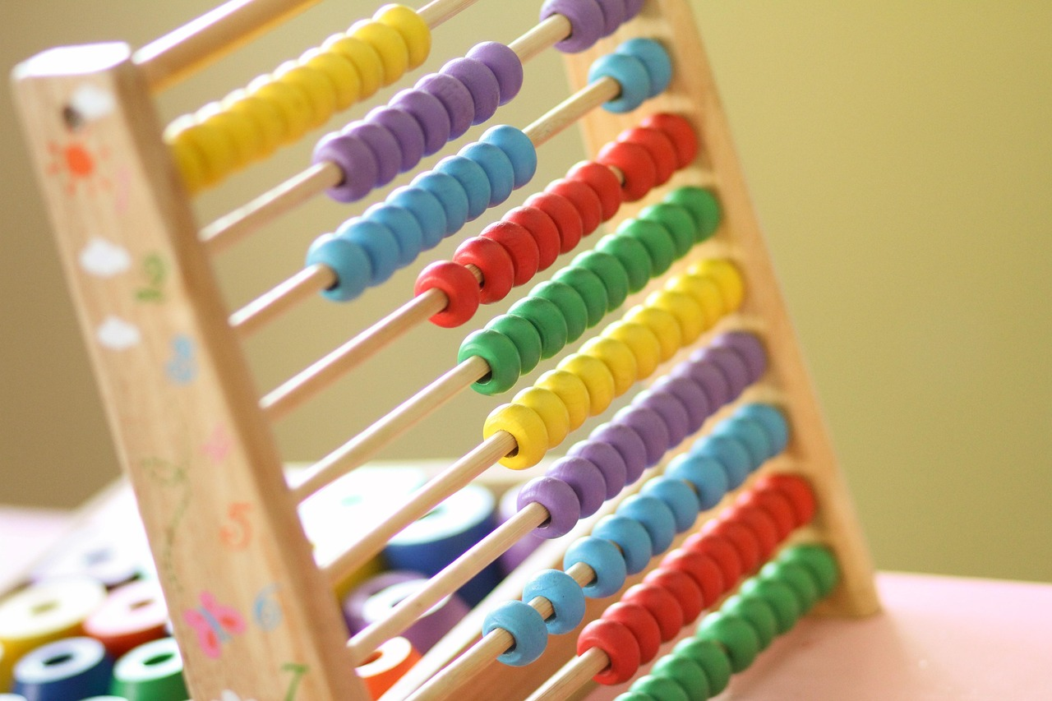
Next Steps
Applying Percentages in Real Life
Mastering Ratios and Proportions
Project-Based Mathematical Applications
Applying percentages in real-world contexts.
This involves understanding and solving problems that require percentage calculations.
Solving problems involving ratios and proportions.
This skill is essential for comparing quantities and understanding relationships between numbers.
Project-based learning: Applying mathematical skills to real-world scenarios.
This approach encourages hands-on learning and practical problem-solving.
16
Mastering Fractions and Decimals: Concepts, Applications, and Skills

Slide 17

Parent Engagement
Math Night
Parent-Child Projects
Regular Progress Updates
Engaging parents and students in fraction and decimal activities.
A fun and interactive way to involve families in learning math concepts.
Working together on real-world problems.
Encouraging collaboration and practical application of skills.
Informing parents of student progress and achievements.
Keeping families involved and aware of their child's academic journey.
17
Mastering Fractions and Decimals: Concepts, Applications, and Skills

Slide 18
Safety Considerations
Inclusive Classroom Environment
Accuracy in Real-World Applications
Creating an inclusive and supportive classroom environment.
This ensures that all students feel valued and respected.
Ensuring accuracy and attention to detail in real-world applications.
This is critical for maintaining safety and reliability.
18
Mastering Fractions and Decimals: Concepts, Applications, and Skills

Slide 19

Homework and Extension Activities
Fraction and Decimal Conversion Practice
Measurement Problem Solving
Engage in exercises to convert fractions to decimals and vice versa.
This activity strengthens foundational math skills essential for advanced topics.
Solve real-world problems involving measurements and unit conversions.
This task enhances critical thinking and practical application of math concepts.
Financial Literacy Project
Design a Dream Bedroom or Fraction and Decimal Escape Room
Learn to manage budgets and understand financial principles through hands-on activities.
This project prepares students for real-life financial decision-making.
Unleash creativity by designing a dream bedroom or solving a themed escape room.
This activity combines math skills with imaginative and engaging challenges.
19
Mastering Fractions and Decimals: Concepts, Applications, and Skills

Slide 20
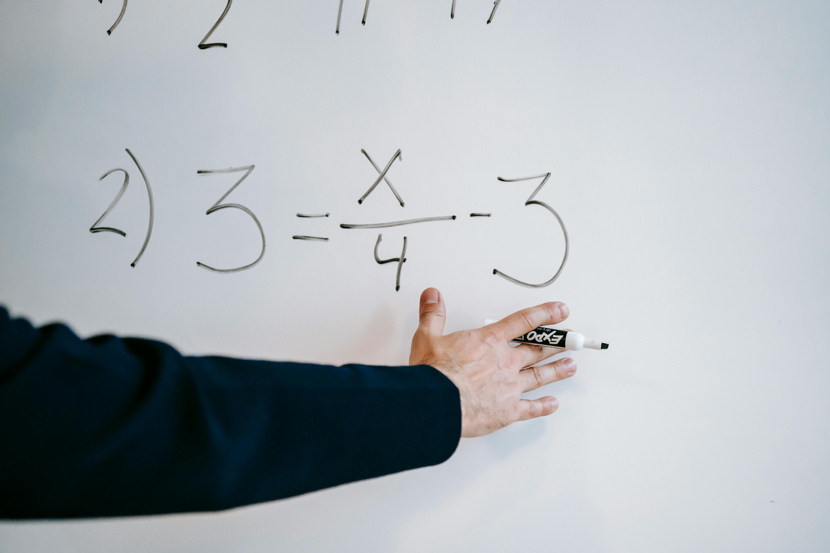
Example Questions
01
Easy Question
A recipe calls for 1/4 cup of sugar.
If you want to make half the recipe, how much sugar will you need?
02
Medium Question
A shirt is on sale for 25% off its original price of $25.
How much will you pay for the shirt?
03
Hard Question
A water tank can hold 3/4 of a gallon of water.
If 1/2 gallon of water is already in the tank, how much more water can be added?
04
Extension Question
A group of friends want to share some candy equally.
If they have 3 3/4 pounds of candy and there are 12 friends, how much candy will each friend get?
20
Mastering Fractions and Decimals: Concepts, Applications, and Skills

