Slide 1

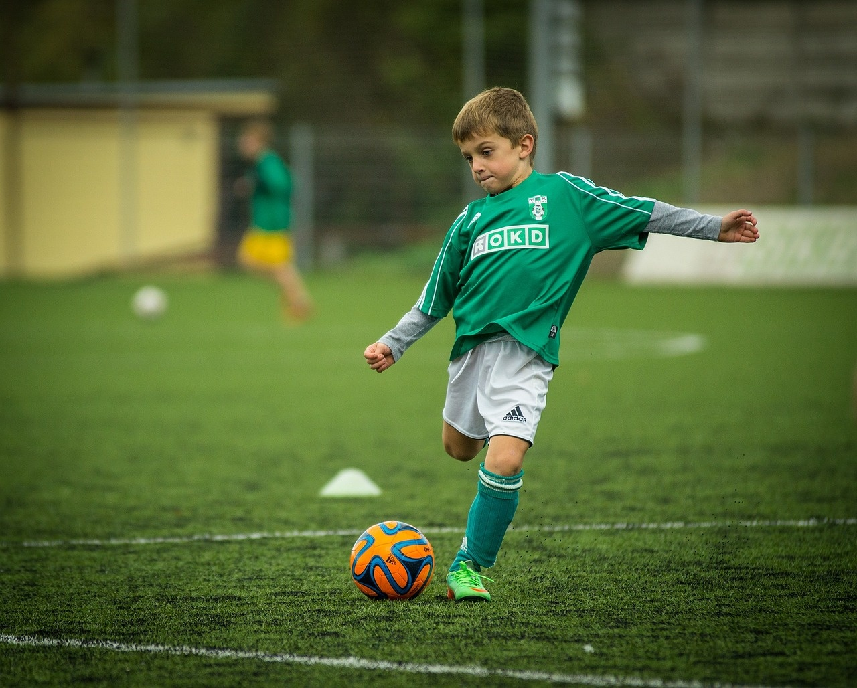
Exploring the Evolution and Strategies of Football
A Comprehensive Journey Through the History, Rules, and Modern Game of Football

Slide 2
Table of contents
Lesson Introduction
Subject Knowledge: History of Football
Subject Knowledge: Rules of Football
Subject Knowledge: Strategies of Football
Engaging Activities for Students
Interactive Discussions
Hands-on Experiences
Evolution of Football
Establishment of Football Clubs
Modern Game of Football
01
02
03
04
05
06
07
08
09
10

Slide 3

Lesson Introduction
Football History
Football has a rich and fascinating history, dating back to ancient civilizations.
The modern game as we know it today emerged in the 19th century, with the establishment of the first official rules and the formation of the world's first football clubs.
Understanding the evolution of the sport provides valuable context and appreciation for the game.
Exploring the Evolution and Strategies of Football

Slide 4
Subject Knowledge: History of Football
01
02
03
04
05
Ancient Origins
19th Century Evolution
First Football Clubs
International Growth
Global Phenomenon
Football traces its roots back to ancient civilizations, with early forms of the game being played in various cultures.
The modern version of football began to take shape in the 19th century, with the codification of rules and the establishment of organized competitions.
The formation of the world's first football clubs, such as Sheffield FC in 1857, marked a significant milestone in the sport's history.
Football's popularity spread rapidly across continents, leading to the formation of international competitions like the FIFA World Cup.
Today, football stands as the world's most popular sport, captivating audiences with its blend of skill, teamwork, and passion.
Exploring the Evolution and Strategies of Football

Slide 5
Subject Knowledge: Rules of Football
Objective
Field of Play
Players
The primary objective of football is to score goals by getting the ball into the opposing team's goal.
The team with the most goals at the end of the match wins.
A football field is rectangular in shape, with goalposts at each end.
The standard dimensions of a football field are approximately 100-110 meters in length and 64-75 meters in width.
A football match is played between two teams, each consisting of 11 players, including one goalkeeper.
Players are not allowed to use their hands or arms to play the ball, except for the goalkeeper within the penalty area.
Duration of the Game
Offside Rule
A standard football match consists of two halves, each lasting 45 minutes, with a 15-minute halftime break.
In case of a tie, some matches may go into extra time or a penalty shootout to determine the winner.
The offside rule is a crucial aspect of football, designed to prevent players from gaining an unfair advantage by being in an offside position when the ball is played to them.
Exploring the Evolution and Strategies of Football

Slide 6
Subject Knowledge: Strategies of Football
01
02
03
04
Football has a rich and fascinating history, dating back to ancient civilizations.
The modern game as we know it today emerged in the 19th century.
The first official rules and the formation of the world's first football clubs were established during this time.
The first official rules and the formation of the world's first football clubs were established during this time.
Exploring the Evolution and Strategies of Football

Slide 7
Engaging Activities for Students
S
W
O
T
Strengths
Weaknesses
Opportunities
Threats
Interactive Football Drills: Engage students in practical sessions to enhance their skills and understanding of the game.
Football Trivia Quizzes: Test students' knowledge of football history, rules, and famous players in a fun and competitive way.
Limited Access to Football Equipment: Ensure all students have equal opportunities to participate by providing necessary gear.
Lack of Diversity in Football Representation: Introduce students to a variety of football cultures and players to broaden their perspectives.
Guest Speaker Sessions: Invite professional players or coaches to share their experiences and insights with the students.
Field Trip to a Football Stadium: Organize a visit to a local stadium for a firsthand experience of the game's atmosphere and history.
Weather Constraints: Plan indoor alternatives or backup activities in case of unfavorable weather conditions.
Student Disinterest: Tailor activities to cater to different learning styles and interests to keep all students engaged and motivated.
Exploring the Evolution and Strategies of Football

Slide 8
Interactive Discussions
01
02
03
04
05
Exploring Football Tactics
Player Roles and Responsibilities
Match Analysis
Interactive Quiz
Debates on Controversial Calls
Engage students in a discussion about various football strategies such as formations, pressing, and counter-attacks.
Encourage them to analyze real-game scenarios and propose their own tactical solutions.
Facilitate a dialogue on the different positions on the field and the specific roles each player fulfills.
Encourage students to discuss the importance of teamwork and communication in executing successful plays.
Encourage students to watch and analyze a recent football match together.
Lead a discussion on key moments, player performances, and strategic decisions made by the teams.
Foster critical thinking and observation skills.
Organize a fun and educational quiz session where students can test their knowledge of football history, rules, and famous players.
Encourage friendly competition and active participation to reinforce learning.
Prompt students to engage in debates about controversial referee decisions or rule interpretations in football matches.
Encourage them to present arguments, listen to different perspectives, and develop critical thinking skills.
Exploring the Evolution and Strategies of Football

Slide 9
Hands-on Experiences
01
02
03
04
Engage students in practical sessions to learn fundamental skills like dribbling, passing, and shooting.
Analyze recorded football matches to understand tactics, player positioning, and strategic decision-making.
Experience the role of a referee by officiating small-sided games, learning about rules and fair play.
Experience the role of a referee by officiating small-sided games, learning about rules and fair play.
Exploring the Evolution and Strategies of Football

Slide 10
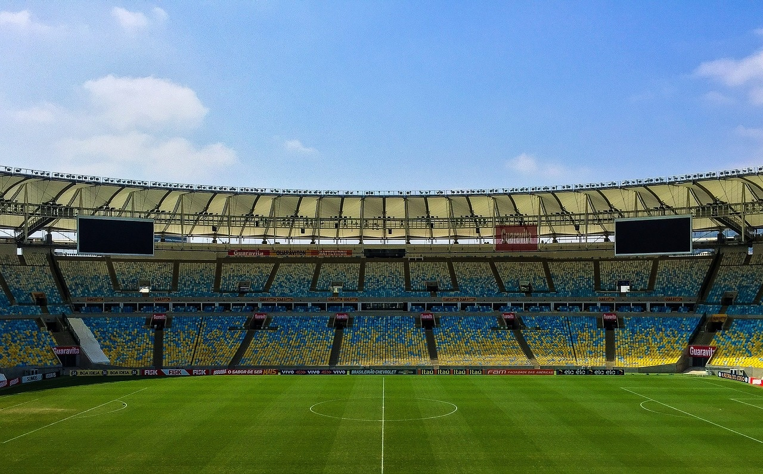
Evolution of Football
Ancient Origins
19th Century Emergence
Football has a rich and fascinating history, dating back to ancient civilizations.
The modern game as we know it today emerged in the 19th century.
Formation of Rules and Clubs
Context and Appreciation
The first official rules were established, and the world's first football clubs were formed during this time.
Understanding the evolution of the sport provides valuable context and appreciation for the game.
Exploring the Evolution and Strategies of Football

Slide 11

Establishment of Football Clubs
Formation of the First Football Clubs
The first official football clubs were established in the 19th century.
The formation of these clubs marked the beginning of organized football competitions.
Role in Shaping the Modern Game
These early clubs played a crucial role in shaping the rules and structure of the game.
They laid the foundation for the development of football as we know it today.
Evolution of Club Competitions
Over time, football clubs evolved from local teams to national and international powerhouses.
Club competitions such as leagues and tournaments became integral to the football landscape.
Global Impact
The establishment of football clubs globally has contributed to the widespread popularity and growth of the sport.
Clubs serve as hubs for talent development, fan engagement, and community involvement.
Exploring the Evolution and Strategies of Football

Slide 12
Modern Game of Football
01
02
03
04
Over the years, football tactics have evolved significantly, from traditional formations like 2-3-5 to modern systems such as 4-3-3 and 4-2-3-1.
Coaches now focus on possession-based play, high pressing, and tactical flexibility to outsmart opponents.
The modern game incorporates technology for VAR (Video Assistant Referee) to ensure fair play and accurate decision-making.
Goal-line technology has also been introduced to determine if the ball has crossed the goal line.
Football has become a global phenomenon, with players from diverse backgrounds showcasing their skills in top leagues worldwide.
The sport's popularity transcends borders, uniting fans and players from different cultures and nations.
Football has become a global phenomenon, with players from diverse backgrounds showcasing their skills in top leagues worldwide.
The sport's popularity transcends borders, uniting fans and players from different cultures and nations.
Exploring the Evolution and Strategies of Football

