Slide 1

Understanding Fractions: A Journey Through Everyday Mathematics
Exploring, Creating, Comparing, and Applying Fractions in Real Life

Slide 2
Table of Contents
Welcome to Fractions!
What is a Fraction?
Real-Life Examples of Fractions
Creating Fractions
Comparing Fractions
Equivalent Fractions
Real-World Applications of Fractions
Interactive Activity: Fraction Match
Interactive Activity: Fraction Scavenger Hunt
Conclusion
Key Takeaways
Next Steps
Reflection Questions
04
05
06
07
08
09
10
11
12
13
14
15
16

Slide 3
Table of Contents
Teaching Tips
Parent Engagement
Safety Considerations
Conclusion and Final Thoughts
17
18
19
20

Slide 4
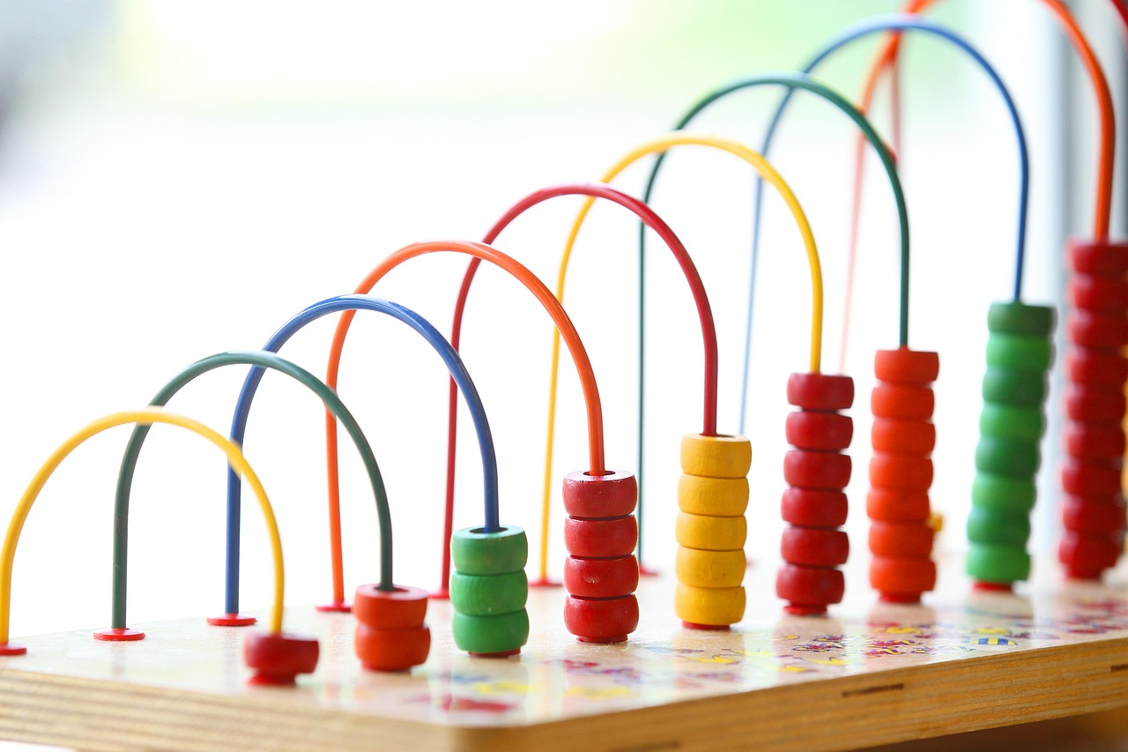
Welcome to Fractions!
Fractions in Everyday Life
Exploring Fractions
The Importance of Fractions
Fractions are all around us, from the pizza we eat to the toys we play with.
Understanding fractions will help you solve problems and make sense of the world in a more precise way.
In this lesson, we're going to explore what fractions are.
We'll learn how to create them and compare them using everyday objects.
Fractions are essential for understanding parts of a whole.
They help us navigate real-world scenarios with accuracy and clarity.
4
Understanding Fractions: A Journey Through Everyday Mathematics

Slide 5
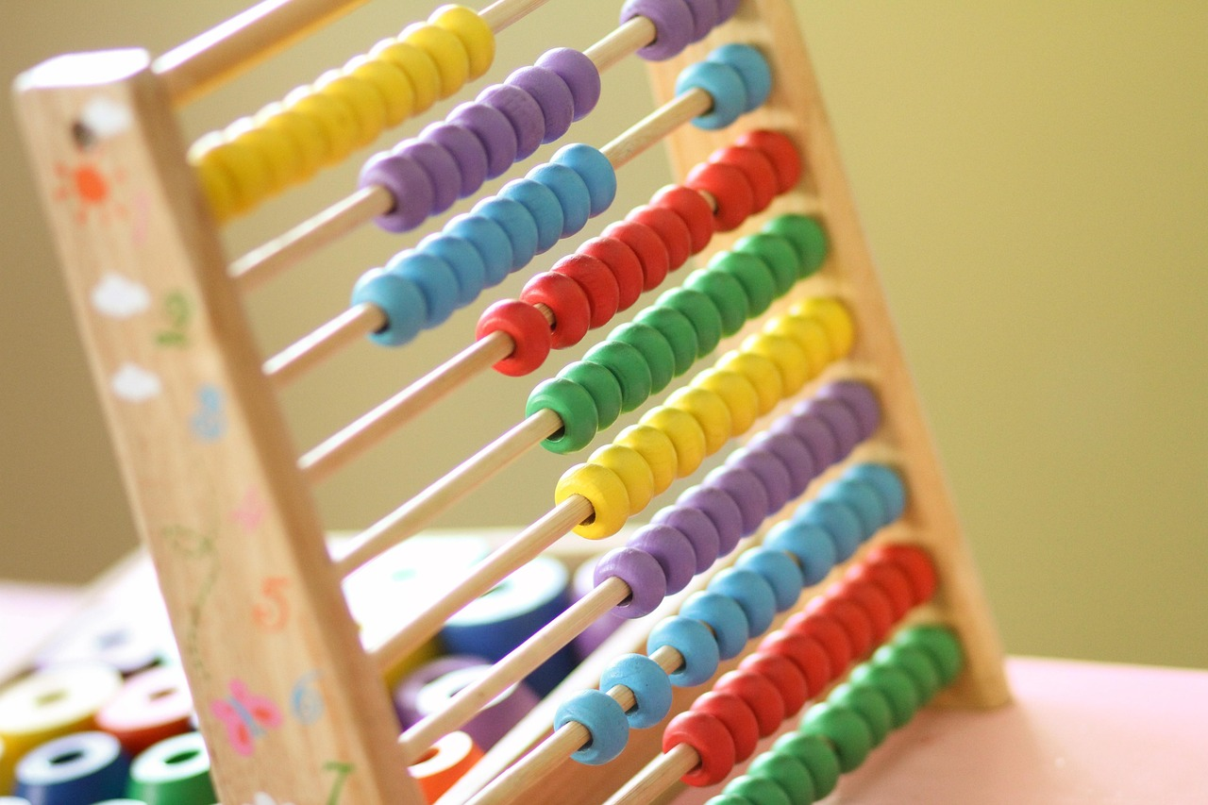
What is a Fraction?
Definition of a Fraction
Components of a Fraction
A fraction is a way to show part of a whole.
It consists of a numerator (the top number) and a denominator (the bottom number), separated by a line.
A fraction is a way to show part of a whole.
It consists of a numerator (the top number) and a denominator (the bottom number), separated by a line.
5
Understanding Fractions: A Journey Through Everyday Mathematics

Slide 6

Real-Life Examples of Fractions
Pizza and Fractions
Cake and Fractions
Fractions in Daily Activities
If you have a pizza that's cut into 8 slices, and you eat 2 of them, you've eaten 2/8 of the pizza.
This is a simple way to understand fractions in everyday life.
If you have a cake that's cut into 12 pieces, and you eat 3 of them, you've eaten 3/12 of the cake.
This demonstrates how fractions are used to represent parts of a whole.
Fractions are used in cooking, measuring ingredients, and dividing objects.
They are essential for precise and fair distribution in various tasks.
6
Understanding Fractions: A Journey Through Everyday Mathematics

Slide 7
Creating Fractions
Understanding Fractions
Example of Fraction Creation
To create a fraction, you need to divide a whole into equal parts.
Fractions represent parts of a whole and are written as one number over another.
If you have a toy box with 12 toys and divide it into 4 parts, each part will have 3 toys.
This division can be represented as the fraction 3/12.
7
Understanding Fractions: A Journey Through Everyday Mathematics

Slide 8
Comparing Fractions
Understanding Fraction Comparison
Using Common Denominators
Comparing Numerators
To compare fractions, you need to consider both the numerator and the denominator.
This ensures an accurate comparison of their values.
For example, to compare 1/4 and 1/2, you need to convert both fractions to equivalent fractions with the same denominator, such as 2/8 and 4/8.
This step simplifies the comparison process.
Then, you can compare the numerators to determine which fraction is bigger or smaller.
This final step reveals the relative size of the fractions.
8
Understanding Fractions: A Journey Through Everyday Mathematics

Slide 9
Equivalent Fractions
01
02
Definition of Equivalent Fractions
Examples of Equivalent Fractions
Equivalent fractions are fractions that have the same value but different forms.
For example, 1/2 is equivalent to 2/4 or 3/6.
For example, 1/2 is equivalent to 2/4 or 3/6.
Equivalent fractions are fractions that have the same value but different forms.
9
Understanding Fractions: A Journey Through Everyday Mathematics

Slide 10

Real-World Applications of Fractions
1
Fractions in Everyday Life
Fractions are used in cooking, measuring ingredients, and dividing objects.
They help in ensuring accuracy and fairness in daily tasks.
2
Fractions in Creative Fields
Fractions are used in music, art, and design to create rhythm, patterns, and proportions.
They play a key role in achieving harmony and balance in creative works.
3
Fractions in Professional Domains
Fractions are used in science, engineering, and finance to solve problems and make informed decisions.
They are essential for precision and effective problem-solving in these fields.
10
Understanding Fractions: A Journey Through Everyday Mathematics

Slide 11

Interactive Activity: Fraction Match
Fraction Cards and Visuals
Matching Activity
Create a set of fraction cards with different fractions (e.g., 1/2, 1/4, 3/4) and their equivalent pictures (e.g., a pizza cut into halves, quarters, or three-quarters).
These cards will help students visually understand the concept of fractions.
Ask students to match the fraction cards with their corresponding pictures.
This interactive activity reinforces their understanding of fractions through hands-on learning.
11
Understanding Fractions: A Journey Through Everyday Mathematics

Slide 12
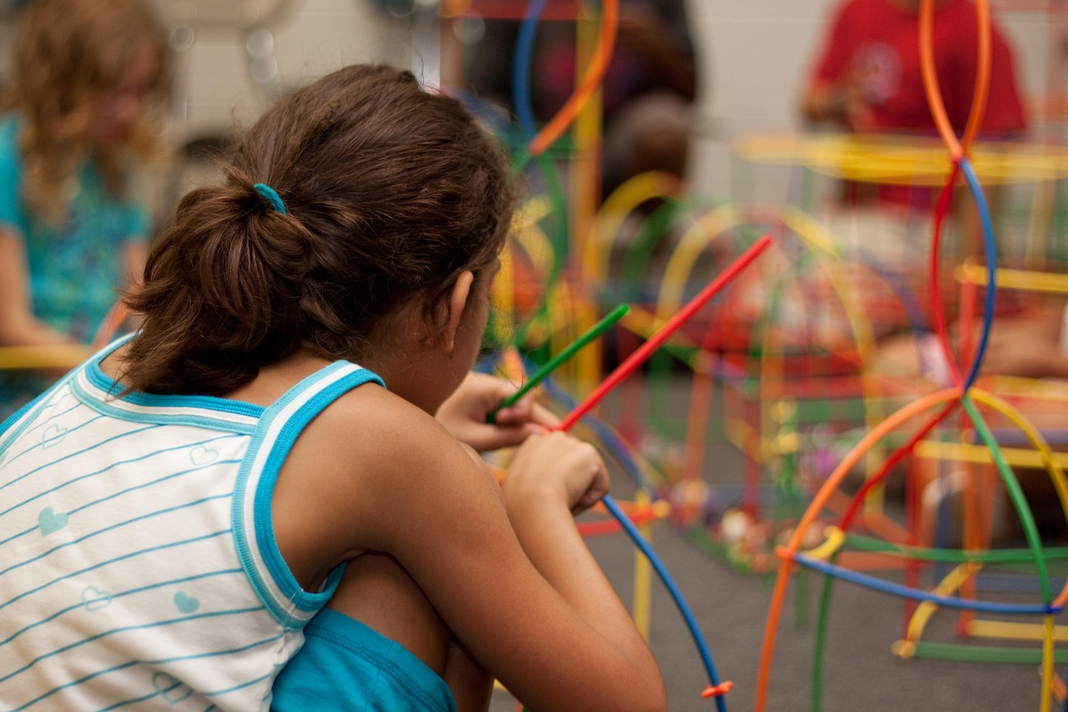
Interactive Activity: Fraction Scavenger Hunt
Activity Objective
Interactive Task
Ask students to find objects at home that can be divided into fractions (e.g., a cake, a toy, a bookshelf).
Have them draw a picture of the object and write the fraction that represents a part of it.
Encourage students to explore their surroundings to identify items that can be fractioned.
This activity helps in visualizing fractions in real-life contexts.
12
Understanding Fractions: A Journey Through Everyday Mathematics

Slide 13

Conclusion
Interactive Learning with Everyday Objects
Real-Life Applications for Strong Foundations
In conclusion, creating and comparing simple fractions with everyday objects is a fun and interactive way to introduce students to the concept of fractions.
By applying these concepts to real-life scenarios, students can enhance their problem-solving skills and develop a strong foundation for future mathematical education.
In conclusion, creating and comparing simple fractions with everyday objects is a fun and interactive way to introduce students to the concept of fractions.
By applying these concepts to real-life scenarios, students can enhance their problem-solving skills and develop a strong foundation for future mathematical education.
13
Understanding Fractions: A Journey Through Everyday Mathematics

Slide 14
Key Takeaways
1
2
3
Understanding Fractions
Creating Fractions
Comparing Fractions
Students will learn that a fraction is a way to show part of a whole.
This concept helps in understanding how parts relate to the entire entity.
Students will learn how to create fractions using everyday objects.
This activity makes the learning process interactive and relatable.
Students will learn how to compare simple fractions.
This skill is essential for grasping the relative sizes of different parts.
14
Understanding Fractions: A Journey Through Everyday Mathematics

Slide 15
Next Steps
01
Exploring Equivalent Fractions
In the next lesson, students will learn about equivalent fractions and how to find them.
This foundational skill will help them understand relationships between fractions.
02
Adding and Subtracting Fractions
Students will also learn how to add and subtract fractions with like denominators.
This will enable them to perform basic operations with fractions confidently.
15
Understanding Fractions: A Journey Through Everyday Mathematics

Slide 16

Reflection Questions
Student Engagement
Understanding Fractions
Were students actively engaged throughout the lesson, and did they show a genuine interest in learning about fractions?
Did students demonstrate a clear understanding of the concept of fractions, including how to create and compare them?
Were students actively engaged throughout the lesson, and did they show a genuine interest in learning about fractions?
Did students demonstrate a clear understanding of the concept of fractions, including how to create and compare them?
16
Understanding Fractions: A Journey Through Everyday Mathematics

Slide 17
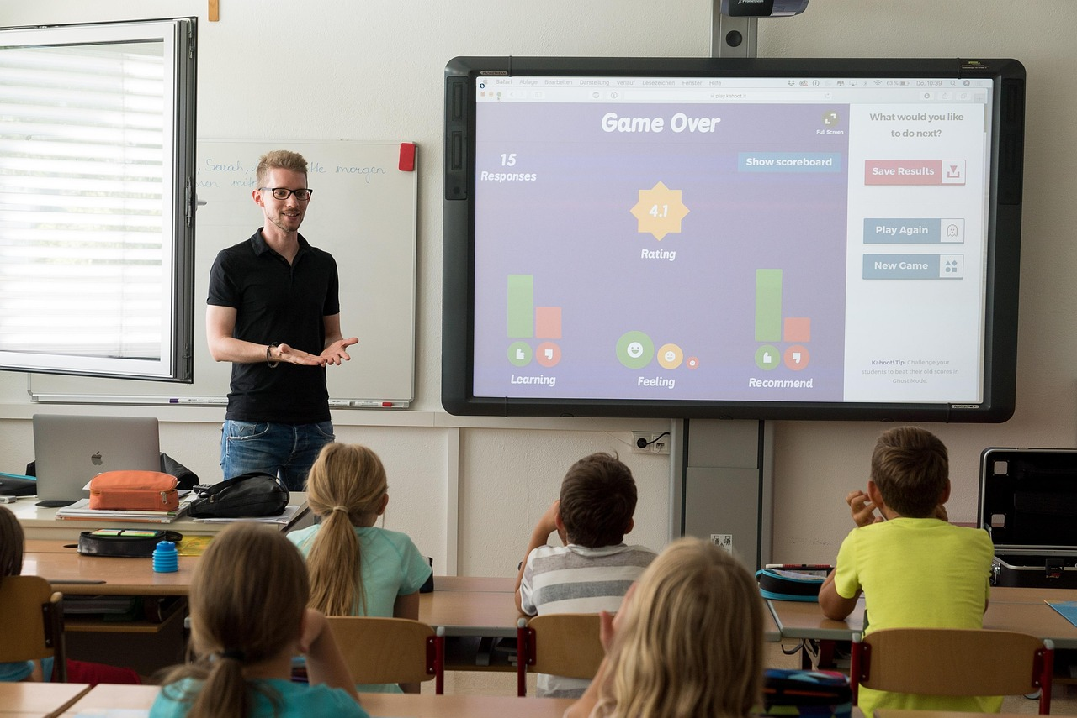
Teaching Tips
Relating Fractions to Real Life
Interactive Learning Techniques
Practical Applications of Fractions
Use real-life examples to make the concept of fractions more relatable and engaging for students.
Provide opportunities for students to apply fraction concepts to real-life scenarios.
Incorporate hands-on activities and interactive games to enhance students' understanding and retention of the material.
Use engaging methods to make learning fractions enjoyable and memorable.
Provide opportunities for students to apply fraction concepts to real-life scenarios.
Encourage students to connect mathematical concepts with everyday experiences.
17
Understanding Fractions: A Journey Through Everyday Mathematics

Slide 18

Parent Engagement
Engaging Parents in Fraction Activities
Supporting Fraction Learning at Home
Encourage parents to participate in fraction-related activities with their child, such as cooking or measuring ingredients.
These activities can make learning fractions fun and practical for children.
Provide parents with resources and tips on how to support their child's learning of fractions at home.
This guidance can empower parents to actively contribute to their child's educational journey.
18
Understanding Fractions: A Journey Through Everyday Mathematics

Slide 19
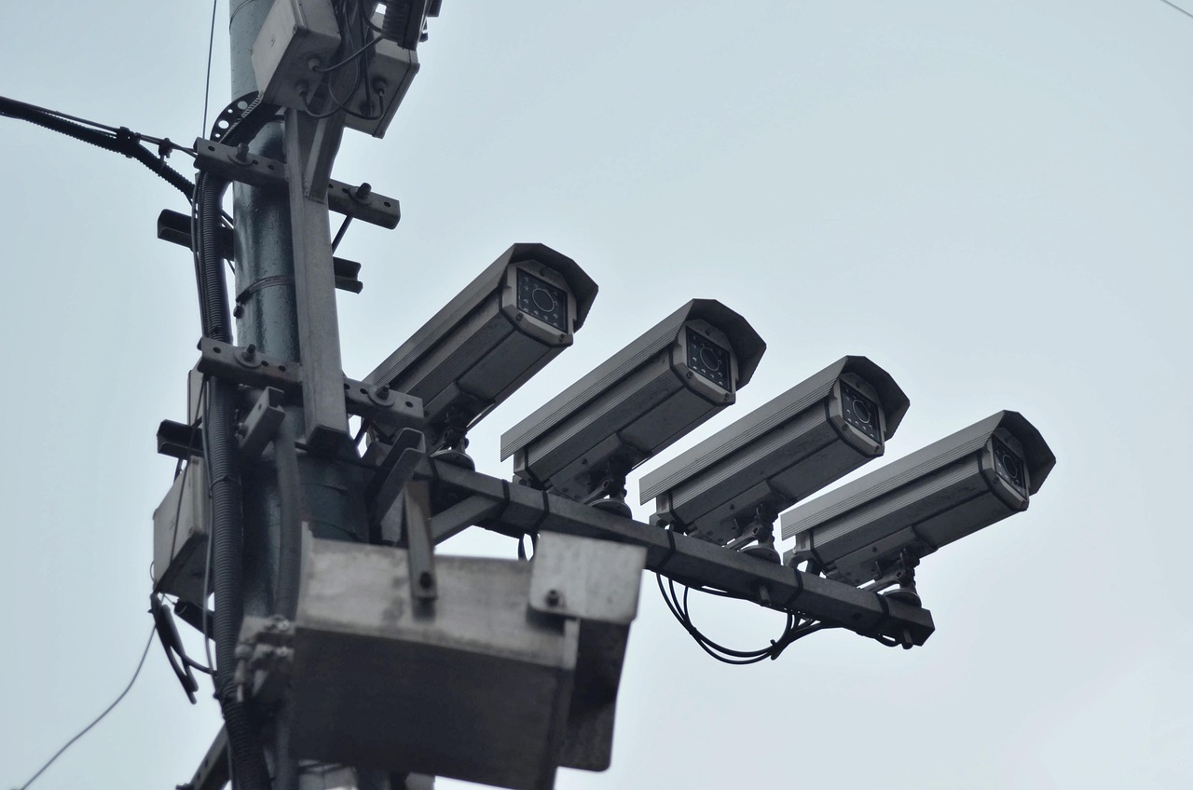
Safety Considerations
Accommodating Dietary Needs
Supervision During Activities
Ensure that students with food allergies or dietary restrictions are accommodated when using food items as teaching aids.
This ensures inclusivity and prevents potential health risks.
Supervise students at all times during activities to prevent accidents and ensure their safety.
This helps maintain a secure and controlled learning environment.
19
Understanding Fractions: A Journey Through Everyday Mathematics

Slide 20
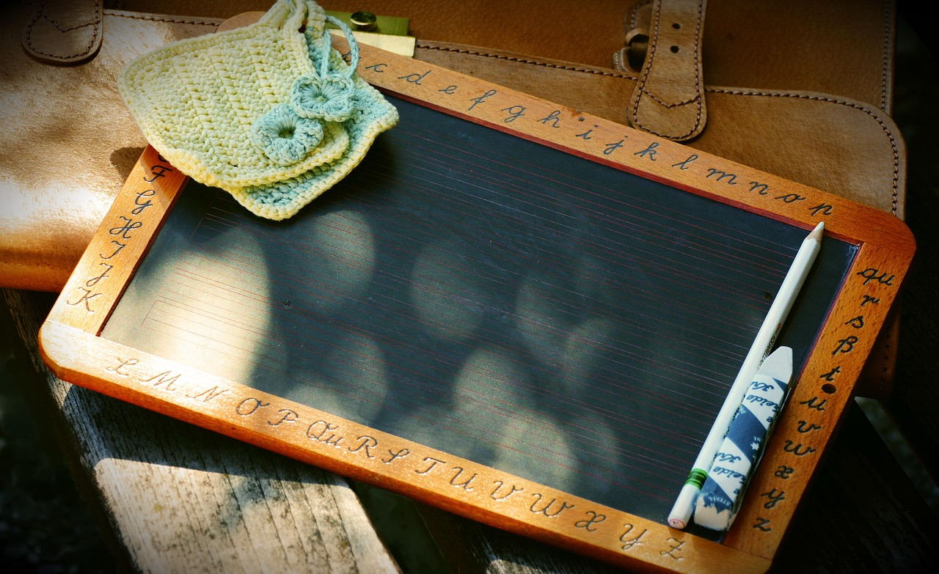
Conclusion and Final Thoughts
Engaging Teaching Methods
Practical Applications of Fractions
In conclusion, teaching fractions to 8-year-old students can be a fun and interactive experience with the right approach.
By using everyday objects, hands-on activities, and real-life examples, students can develop a deep understanding of fractions and their applications.
By using everyday objects, hands-on activities, and real-life examples, students can develop a deep understanding of fractions and their applications.
In conclusion, teaching fractions to 8-year-old students can be a fun and interactive experience with the right approach.
20
Understanding Fractions: A Journey Through Everyday Mathematics

