Slide 1
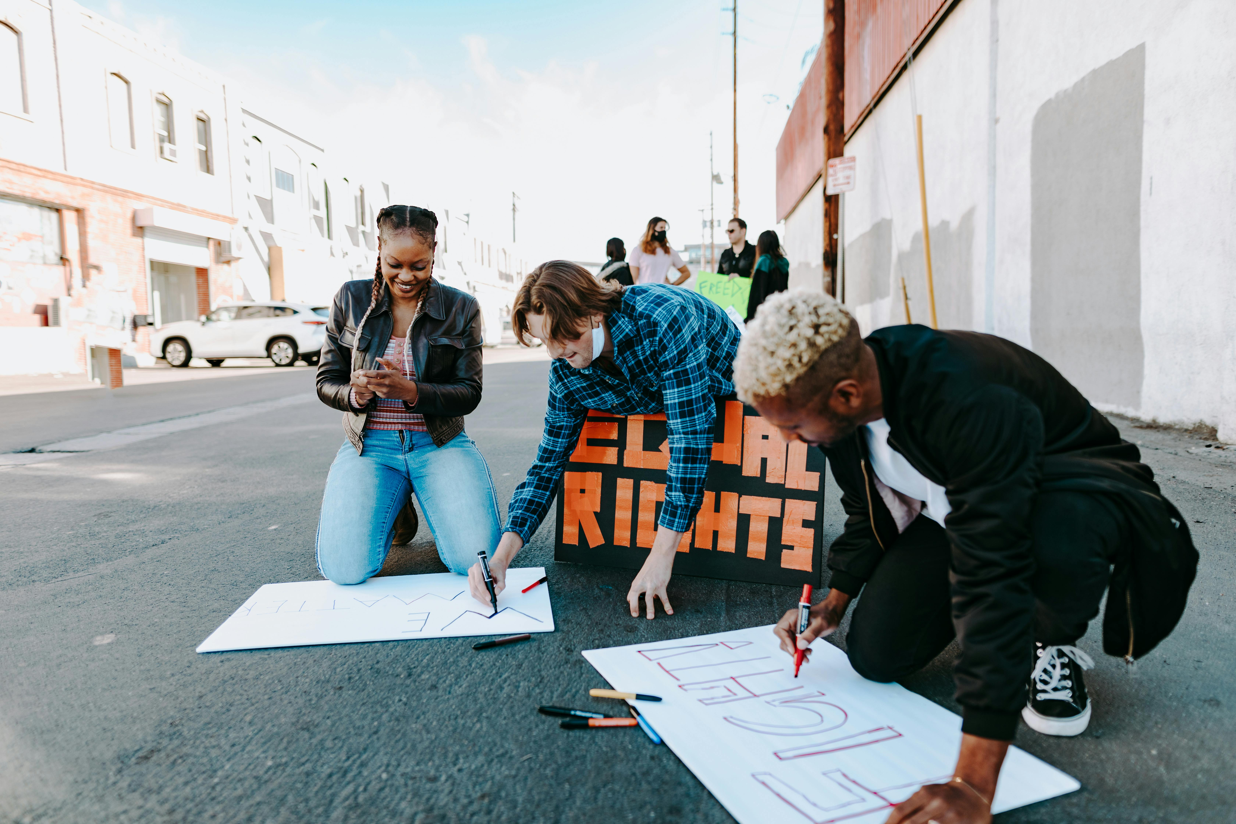
The Civil Rights Movement: Struggle, Leadership, and Legacy
Exploring Key Figures, Events, and Contemporary Relevance

Slide 2
Table of Contents
Introduction to the Civil Rights Movement
Key Figures of the Civil Rights Movement
Significant Events of the Civil Rights Movement
Debates in the Civil Rights Movement
Reflective Writing Assignments
Assessment and Evaluation
Extension Activities
Parent Engagement
Safety Considerations
Conclusion
Key Takeaways
Reflection Questions
Next Steps
04
05
06
07
08
09
10
11
12
13
14
15
16

Slide 3
Table of Contents
Teaching Tips
Summary
Final Thoughts
References
Appendix
Evaluation Form
Credits
Conclusion Slide
17
18
19
20
21
22
23
24

Slide 4
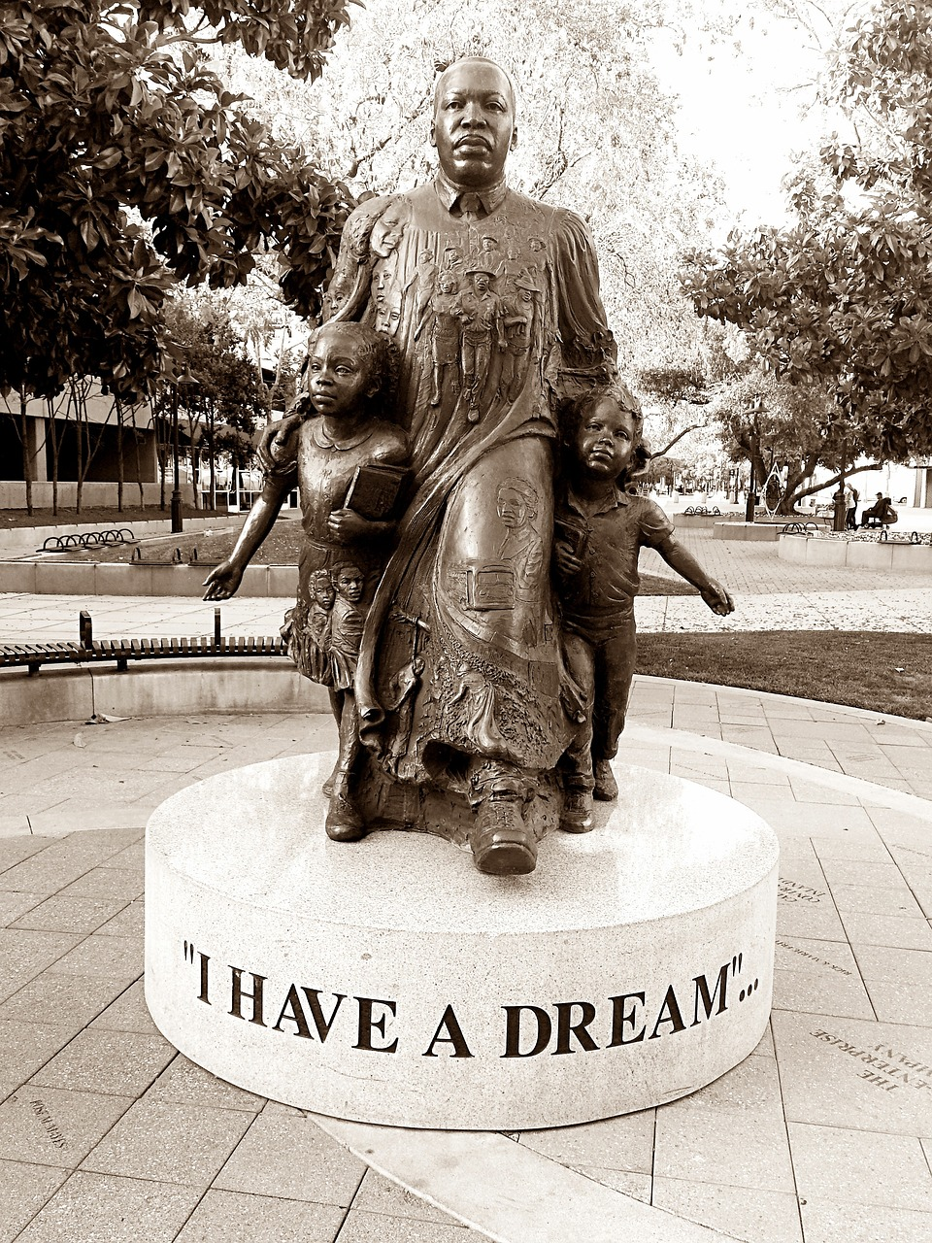
Introduction to the Civil Rights Movement
Key Figures Who Shaped the Movement
Exploring Contemporary Relevance
Exploring Contemporary Relevance
The Civil Rights Movement was a pivotal era in American history, marked by courageous struggles for racial equality and social justice.
It reshaped the nation's understanding of equality and human rights.
Martin Luther King Jr., Rosa Parks, and Malcolm X played crucial roles in shaping the movement.
Their actions and leadership inspired millions to fight for justice and equality.
The movement's significance and relevance to contemporary issues will be explored through debates and reflective writing assignments.
These activities aim to connect historical struggles with modern-day challenges.
4
The Civil Rights Movement: Struggle, Leadership, and Legacy

Slide 5
Key Figures of the Civil Rights Movement
Martin Luther King Jr.
Rosa Parks
Malcolm X
Other Key Figures
A prominent leader advocating for nonviolent civil disobedience.
His leadership was instrumental in the success of the Civil Rights Movement.
An African American woman who refused to give up her seat on a bus, sparking the Montgomery Bus Boycott.
Her act of defiance became a pivotal moment in the fight against racial segregation.
A leader who advocated for the rights of African Americans through a different lens than Martin Luther King Jr.
He emphasized self-reliance and empowerment for African Americans.
Thurgood Marshall and Fannie Lou Hamer also played important roles in the movement.
Their contributions helped shape the broader struggle for civil rights.
5
The Civil Rights Movement: Struggle, Leadership, and Legacy

Slide 6
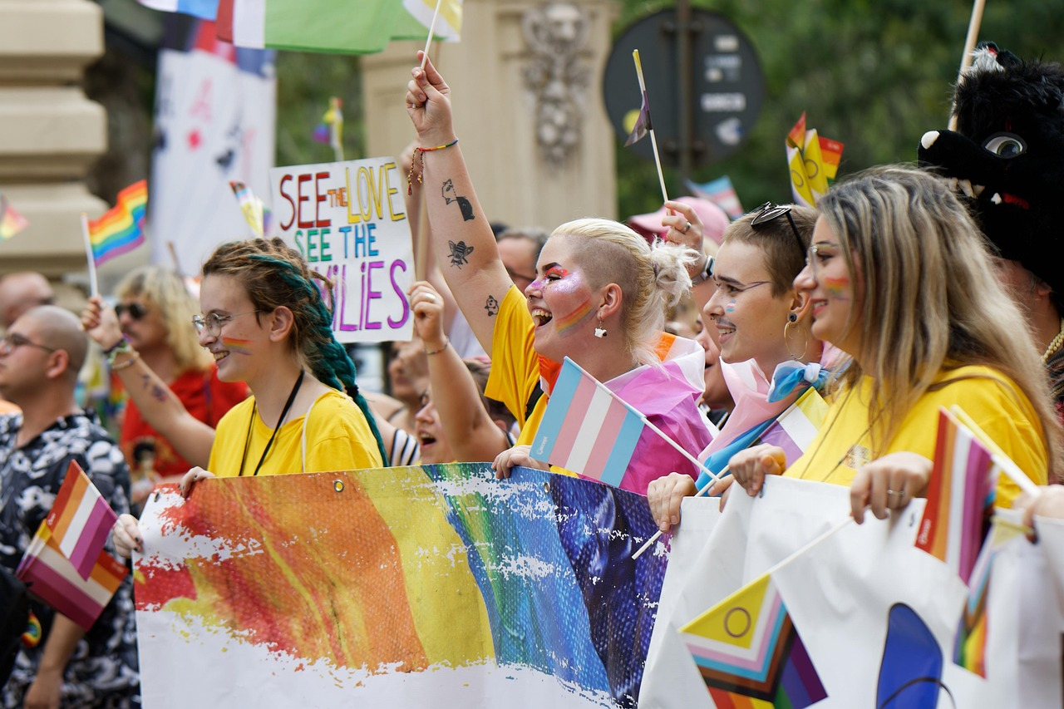
Significant Events of the Civil Rights Movement
The Montgomery Bus Boycott
The March on Washington
The Montgomery Bus Boycott (1955-1956): A 381-day boycott that ended with the U.S. Supreme Court ruling that segregation on public buses was unconstitutional.
This event marked a significant victory in the fight against racial segregation in public transportation.
The March on Washington (1963): A major civil rights event where Martin Luther King Jr. delivered his 'I Have a Dream' speech.
This gathering highlighted the demand for racial equality and economic justice.
The Selma to Montgomery Marches
The Civil Rights Act of 1964
The Selma to Montgomery Marches (1965): A series of protests that culminated in the passage of the Voting Rights Act.
These marches underscored the struggle for African Americans' voting rights in the United States.
The Civil Rights Act of 1964: Landmark legislation that outlawed discrimination based on race, color, religion, sex, or national origin.
This act was a cornerstone in dismantling institutionalized racial discrimination.
6
The Civil Rights Movement: Struggle, Leadership, and Legacy

Slide 7
Debates in the Civil Rights Movement
Nonviolent Resistance vs. Armed Self-Defense
Government's Role in Civil Rights
Civil Rights Act of 1964's Societal Impact
The effectiveness of nonviolent resistance vs. armed self-defense.
This debate highlights contrasting strategies within the Civil Rights Movement.
The role of government in enforcing civil rights.
This issue examines the extent to which federal and state authorities should intervene.
The impact of the Civil Rights Act of 1964 on American society.
This landmark legislation reshaped social and legal norms in the United States.
7
The Civil Rights Movement: Struggle, Leadership, and Legacy

Slide 8

Reflective Writing Assignments
Reflective Journal Entry
Poetic Inspiration
Reflective Essay on Social Justice
Write a reflective journal entry in response to a significant event of the Civil Rights Movement.
This task encourages personal introspection and connection to historical events.
Compose a poem inspired by a key figure or event of the movement.
This creative exercise allows for artistic expression and deeper engagement with the subject.
Write a reflective essay on what you learned and how it has impacted your perspective on social justice.
This assignment fosters critical thinking and personal growth regarding societal issues.
8
The Civil Rights Movement: Struggle, Leadership, and Legacy

Slide 9

Assessment and Evaluation
Engaging in Debates and Discussions
Reflective Writing Quality
Participation in debates and class discussions.
This encourages active engagement and critical thinking among students.
Quality of reflective writing assignments.
These assignments allow students to express their understanding and insights.
Creative Final Project
Knowledge Testing Through Exams
A final project where students can choose to create a presentation, poster, or short film about a key figure or event from the Civil Rights Movement.
This provides an opportunity for students to showcase their creativity and research skills.
A written exam to test knowledge of key figures and events.
This ensures students have a solid grasp of the historical content.
9
The Civil Rights Movement: Struggle, Leadership, and Legacy

Slide 10
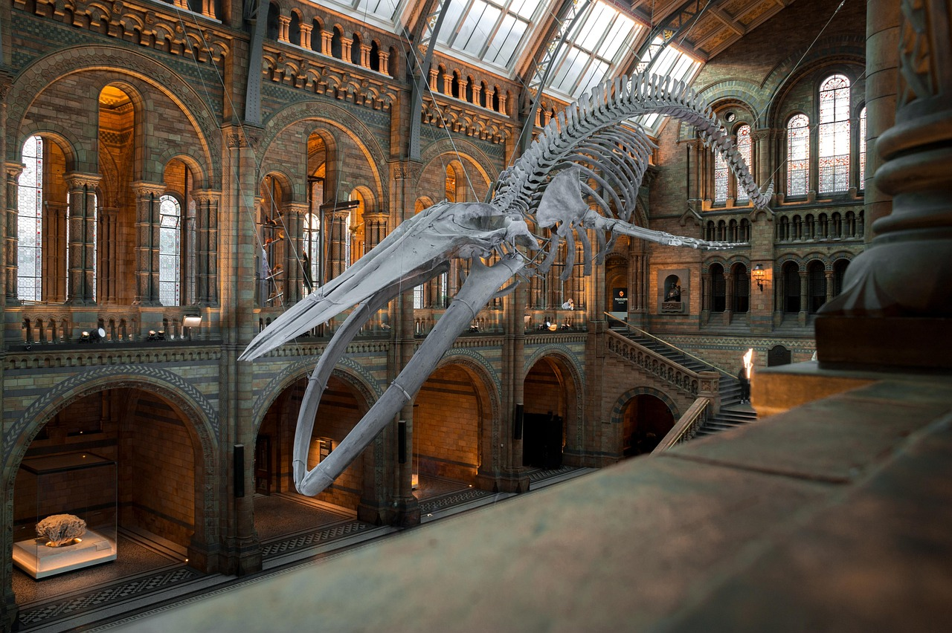
Extension Activities
Debate Competition
Historical Figure Interview
Civil Rights Museum Exhibit
Engage in a debate competition focusing on topics related to the Civil Rights Movement.
Participants will explore diverse perspectives and deepen their understanding of historical and social issues.
Research a key figure from the Civil Rights Movement and conduct an imaginary interview.
This activity encourages critical thinking and empathy by stepping into the shoes of historical figures.
Design and create an exhibit showcasing a selected aspect of the Civil Rights Movement.
This hands-on activity fosters creativity and a deeper appreciation for historical events and their impact.
10
The Civil Rights Movement: Struggle, Leadership, and Legacy

Slide 11
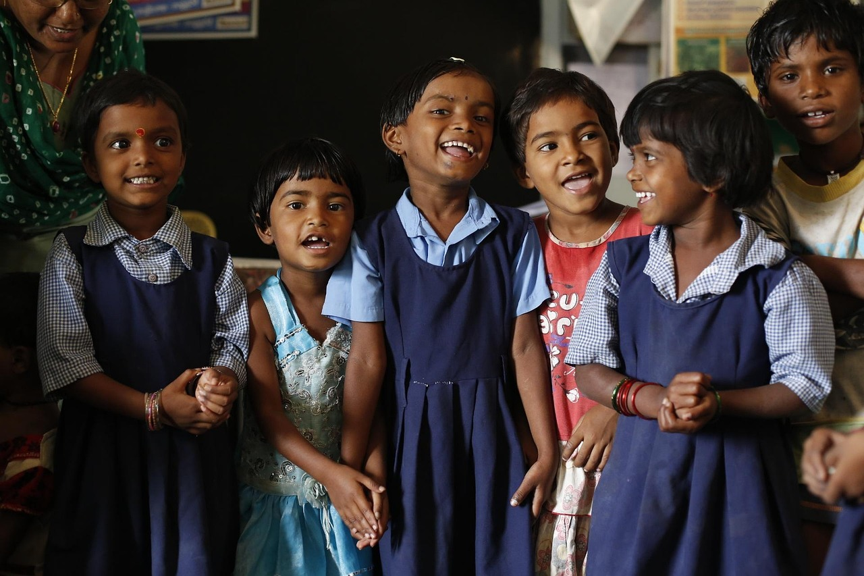
Parent Engagement
Weekly Newsletter
Parent-Student Project Nights
Guest Speaker Series
Weekly newsletter to keep parents informed about the lesson plan and activities.
This ensures parents stay updated on their child's educational journey and classroom happenings.
Parent-student project nights: Work together on assignments or projects related to the Civil Rights Movement.
These collaborative sessions foster family engagement and deepen understanding of historical topics.
Guest speaker series: Invite parents or community members to share their expertise or experiences related to the movement.
This initiative enriches the learning experience by connecting students with real-world insights.
11
The Civil Rights Movement: Struggle, Leadership, and Legacy

Slide 12
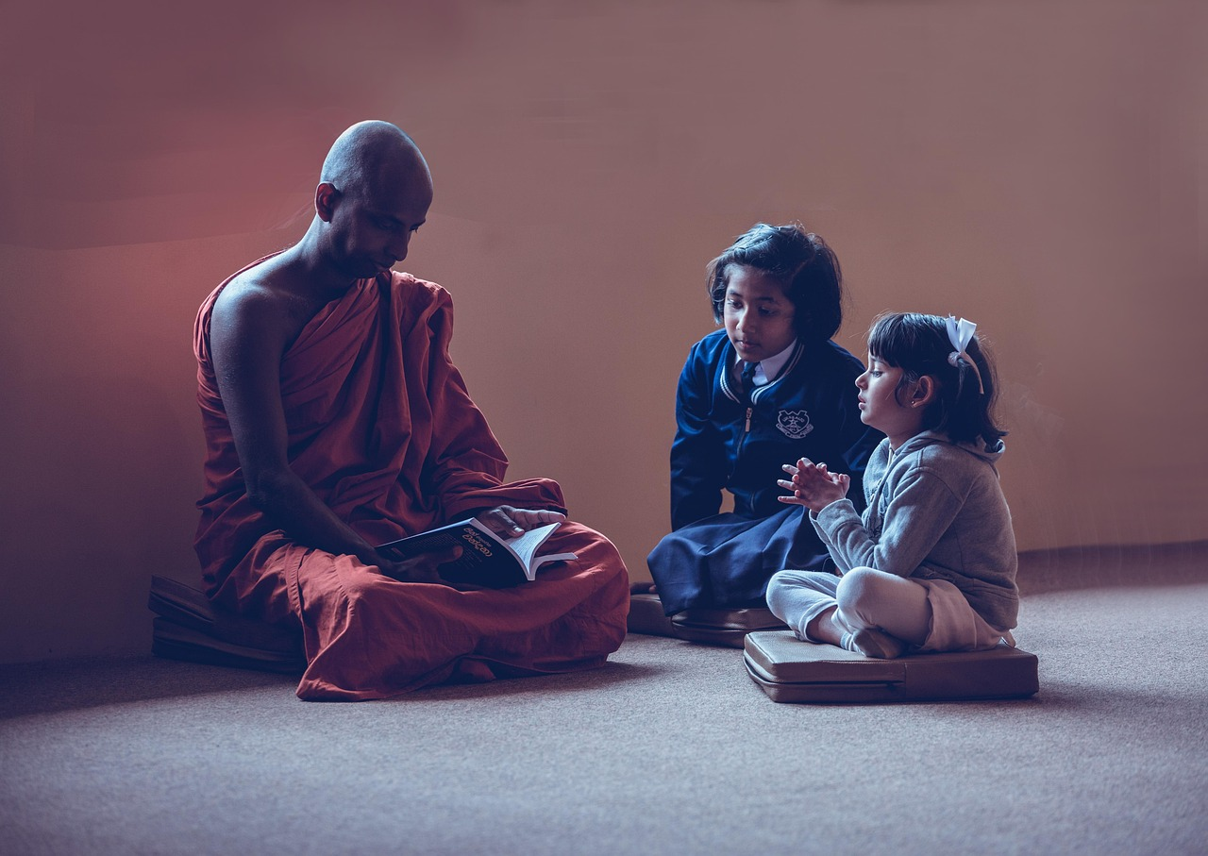
Safety Considerations
1
Creating a Safe Learning Environment
Establish a safe and respectful learning environment.
Set clear ground rules for discussions and debates.
2
Handling Heated Discussions
Be prepared to intervene if discussions become heated.
Ensure students express themselves respectfully.
3
Addressing Discriminatory Views
Take action if students express discriminatory views.
Promote inclusivity and understanding in the classroom.
12
The Civil Rights Movement: Struggle, Leadership, and Legacy

Slide 13
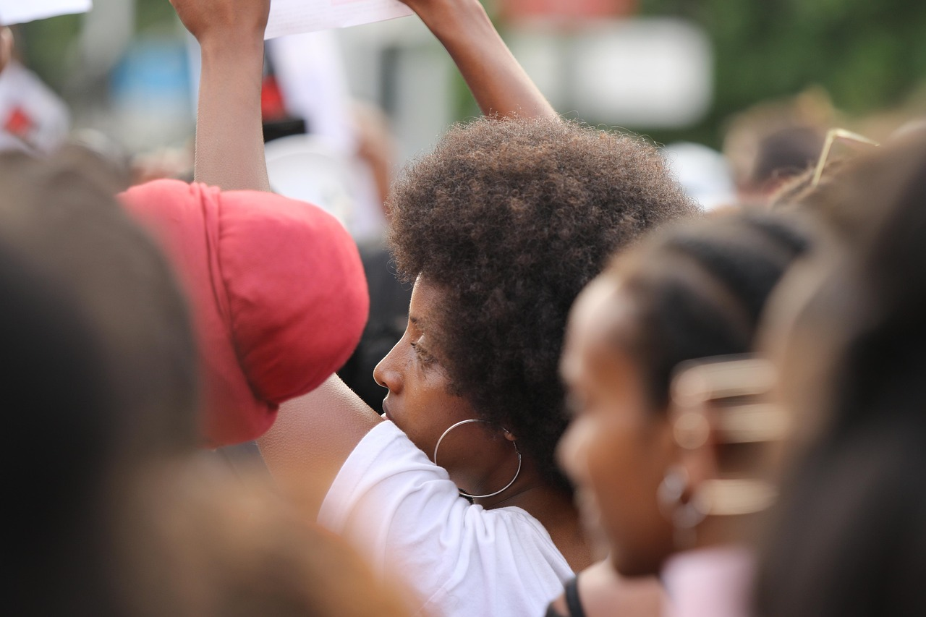
Conclusion
1
Key Figures and Events
The Civil Rights Movement was a complex and multifaceted period in American history.
It involved various dimensions, including social, political, and cultural struggles.
2
Significance and Contemporary Relevance
Key figures and events played crucial roles in shaping the movement.
Their contributions laid the foundation for significant societal changes.
3
Significance and Contemporary Relevance
The movement's significance and relevance to contemporary issues will continue to be explored and debated.
It serves as a lens to understand ongoing struggles for equality and justice.
13
The Civil Rights Movement: Struggle, Leadership, and Legacy

Slide 14
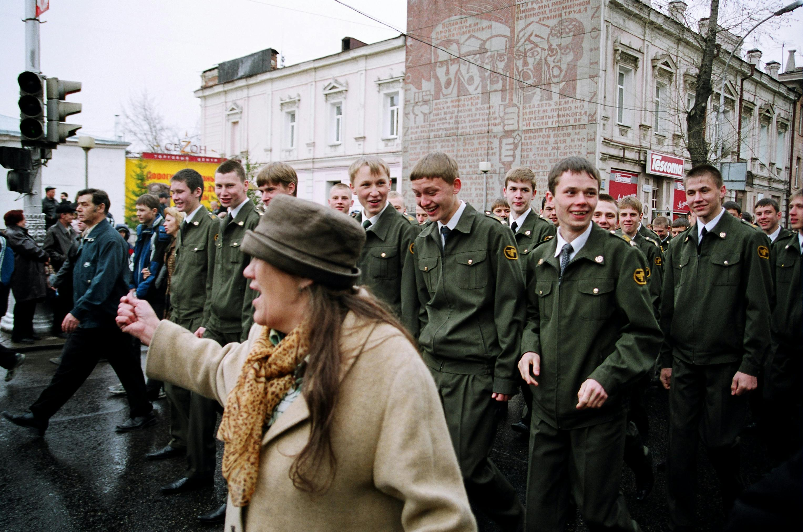
Key Takeaways
1
2
3
Collective Action for Social Change
Influence of Key Figures
Contemporary Relevance
The power of collective action in achieving social change.
This highlights the importance of unity and collaboration in driving societal progress.
The impact of key figures on the movement's progression.
Their leadership and vision were instrumental in shaping the direction and success of the movement.
The enduring relevance of the Civil Rights Movement to contemporary social justice issues.
It serves as a foundation and inspiration for ongoing struggles for equality and justice.
14
The Civil Rights Movement: Struggle, Leadership, and Legacy

Slide 15
Reflection Questions
1
2
3
Encouraging Critical Thinking
Reflective Writing Impact
Future Lesson Development
How effectively did the debates encourage critical thinking and respectful dialogue?
This question explores the role of debates in fostering analytical skills and mutual respect.
To what extent did the reflective writing assignments facilitate personal connections and deeper understanding?
This inquiry examines how writing tasks contribute to personal growth and comprehension.
How can future lessons build upon the knowledge and skills developed in this introductory unit?
This question focuses on leveraging prior learning to enhance future educational experiences.
15
The Civil Rights Movement: Struggle, Leadership, and Legacy

Slide 16
Next Steps
1
Exploring Local Civil Rights History
Lesson on local civil rights history: Explore how national events and figures influenced local actions and individuals.
Understand the interplay between national and local dynamics in shaping civil rights movements.
2
Engaging with Primary Sources
Analyzing primary sources: Engage with speeches, letters, photographs, and songs to analyze perspectives and strategies.
Develop critical thinking by examining diverse materials from the civil rights era.
3
Designing a Civil Rights Museum Exhibit
Creating a Civil Rights Museum exhibit: Design and create an exhibit on a selected aspect of the movement.
Showcase creativity and understanding by curating an impactful educational display.
16
The Civil Rights Movement: Struggle, Leadership, and Legacy

Slide 17
Teaching Tips
Encouraging Participation
Engaging Multimedia
Structured Assignments
Encourage active participation through think-pair-share activities.
This approach fosters collaboration and critical thinking among students.
Use multimedia resources to make the learning experience more engaging.
Incorporating videos, images, and interactive tools can enhance understanding.
Provide clear guidelines and topics for debates and reflective writing assignments.
This ensures students stay focused and produce meaningful work.
17
The Civil Rights Movement: Struggle, Leadership, and Legacy

Slide 18
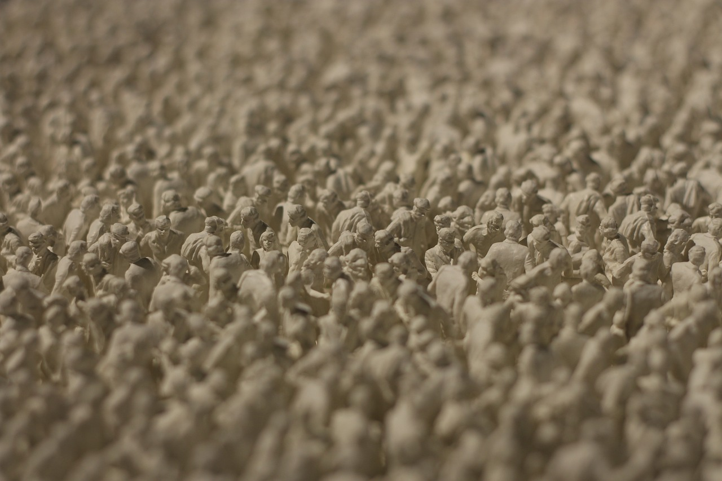
Summary
The Civil Rights Movement's Historical Importance
The Civil Rights Movement was a pivotal era in American history.
Key figures and events played crucial roles in shaping the movement.
Contemporary Relevance of the Movement
The movement's significance and relevance to contemporary issues will continue to be explored and debated.
Key figures and events played crucial roles in shaping the movement.
Ongoing Exploration and Debate
The movement's significance and relevance to contemporary issues will continue to be explored and debated.
The Civil Rights Movement was a pivotal era in American history.
18
The Civil Rights Movement: Struggle, Leadership, and Legacy

Slide 19
Final Thoughts
1
Reflection on Values
The Civil Rights Movement's emphasis on equality, justice, and collective action provides a rich context for students to reflect on their own values.
This reflection encourages a deeper understanding of societal challenges and personal beliefs.
2
Skill Development
Students will develop essential skills in critical thinking, argumentation, and empathy.
These skills are crucial for navigating complex social and ethical issues effectively.
3
Legacy and Inspiration
The movement's legacy continues to inspire social justice activism and inform contemporary issues.
It serves as a powerful reminder of the ongoing struggle for equality and justice.
19
The Civil Rights Movement: Struggle, Leadership, and Legacy

Slide 20
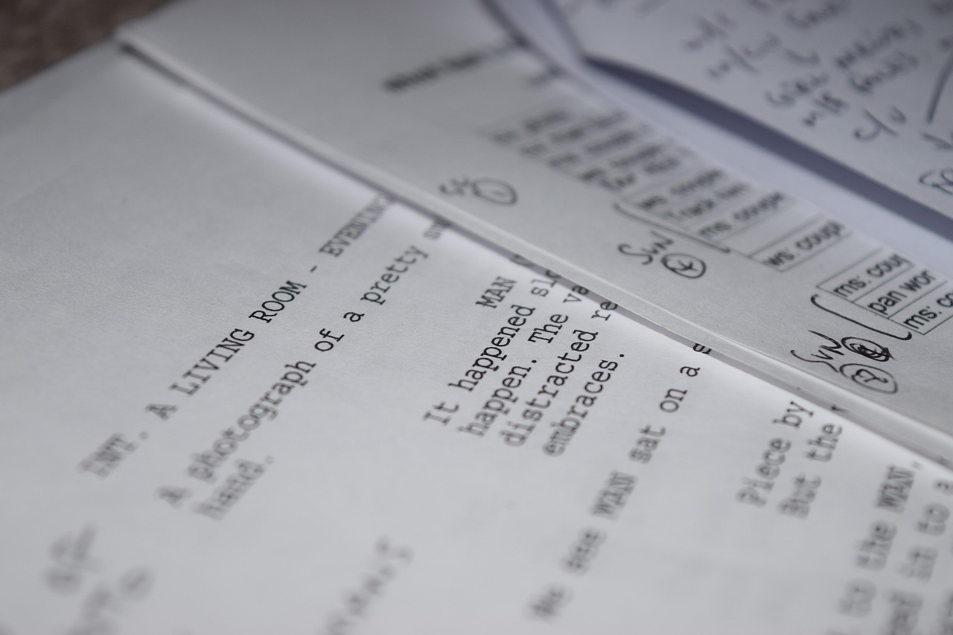
References
Sources and References
List of sources used in the lesson plan, including books, articles, and online resources.
Credits for images, videos, and music used in the presentation.
Acknowledgments
Credits for images, videos, and music used in the presentation.
Recommendations for further reading and research on the Civil Rights Movement.
Further Exploration
Recommendations for further reading and research on the Civil Rights Movement.
List of sources used in the lesson plan, including books, articles, and online resources.
20
The Civil Rights Movement: Struggle, Leadership, and Legacy

Slide 21

Appendix
Teacher Resources
Civil Rights Glossary
Historical Timeline
Additional resources for teachers, including lesson plans and activity ideas.
These materials are designed to enhance classroom engagement and understanding.
Glossary of key terms related to the Civil Rights Movement.
This glossary serves as a quick reference for important concepts and figures.
Timeline of major events in the Civil Rights Movement.
It provides a chronological overview of significant milestones and achievements.
21
The Civil Rights Movement: Struggle, Leadership, and Legacy

Slide 22

Evaluation Form
Purpose of the Evaluation Form
Assessment of Understanding and Engagement
Opportunity for Suggestions
Evaluation form for students to provide feedback on the lesson plan and activities.
Space for students to suggest improvements and provide additional comments.
Questions to assess students' understanding of the material.
Questions to evaluate their engagement with the lesson.
Space for students to suggest improvements.
Space for students to provide additional comments.
22
The Civil Rights Movement: Struggle, Leadership, and Legacy

Slide 23
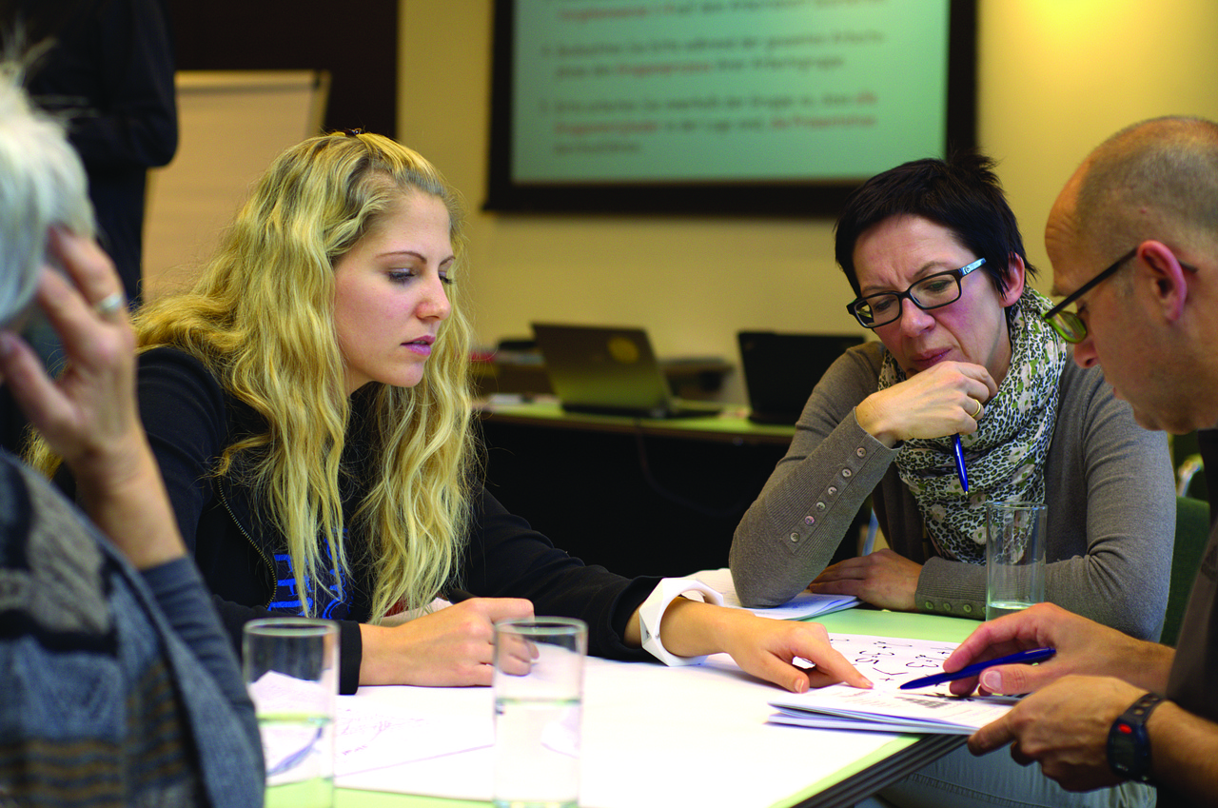
Credits
Development Credits
Acknowledgments
Legal Notice
Credits for the development of the lesson plan and presentation.
Acknowledgments for contributions from experts, educators, and community members.
Acknowledgments for contributions from experts, educators, and community members.
Disclaimer and copyright information.
Disclaimer and copyright information.
Credits for the development of the lesson plan and presentation.
23
The Civil Rights Movement: Struggle, Leadership, and Legacy

Slide 24
Conclusion Slide
Key Points and Takeaways
Significance of the Movement
Call to Action
Summary of key points and takeaways from the lesson.
Final thoughts and reflections on the significance of the Civil Rights Movement.
Final thoughts and reflections on the significance of the Civil Rights Movement.
Call to action for students to continue exploring and learning about the movement.
Call to action for students to continue exploring and learning about the movement.
Summary of key points and takeaways from the lesson.
24
The Civil Rights Movement: Struggle, Leadership, and Legacy

