Slide 1
Introducción a SQL y Fundamentos de Bases de Datos
Conceptos esenciales para la gestión, diseño y seguridad de datos

Slide 2
Table of Contents
Introduction to SQL and Database Fundamentals
What is SQL?
What is a Database?
Key Concepts and Terminology
SQL Syntax
Database Design
Data Modeling
Database Security
Common Errors and Misconceptions
Best Practices
Real-World Applications
Conclusion
Next Steps
04
05
06
07
08
09
10
11
12
13
14
15
16

Slide 3
Table of Contents
Reflection Questions
Additional Resources
Final Thoughts
Assessment and Evaluation
Career Opportunities
Conclusion and Final Thoughts
17
18
19
20
21
22

Slide 4
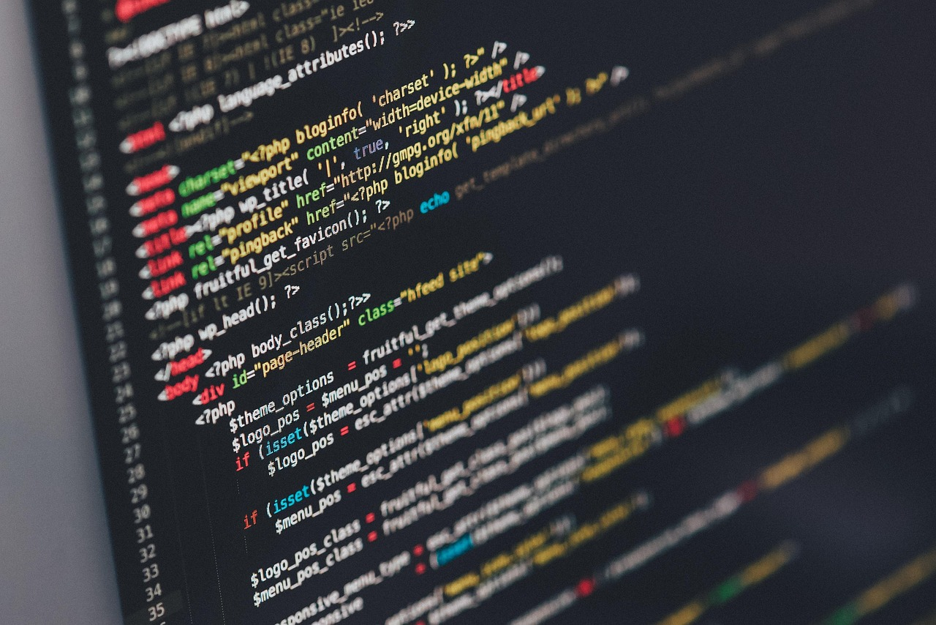
Introduction to SQL and Database Fundamentals
Welcome to SQL and Databases
Learning Objectives
Introduction to Data Management
Welcome to the world of SQL and database fundamentals!
In this lesson, we will explore the basics of data management and learn how to create, manage, and manipulate databases using SQL.
By the end of this lesson, you will gain a solid understanding of the basics of SQL.
You will be able to apply your knowledge to real-world scenarios.
This lesson introduces the foundational concepts of data management.
It focuses on using SQL to handle databases effectively.
4
Introducción a SQL y Fundamentos de Bases de Datos

Slide 5

What is SQL?
Introduction to SQL
Operations in SQL
Applications of SQL
SQL (Structured Query Language) is a programming language designed for managing and manipulating data in relational database management systems.
It is a standard language for accessing and managing relational databases.
SQL is used to perform various operations, including creating and modifying database structures.
It also allows inserting, updating, and deleting data, as well as querying data.
SQL is widely used in a variety of applications, including web development, business intelligence, and data analysis.
Its versatility makes it an essential tool in modern data-driven environments.
5
Introducción a SQL y Fundamentos de Bases de Datos

Slide 6

What is a Database?
Definition of a Database
Types of Databases
Popularity of Relational Databases
A database is a collection of organized data that is stored in a way that allows for efficient retrieval and manipulation.
It serves as a foundational tool for managing and accessing data in various applications.
Databases can be relational, meaning that they store data in tables with well-defined relationships, or non-relational, meaning that they store data in formats like key-value pairs or documents.
These types cater to different needs and use cases depending on the structure and requirements of the data.
Relational databases are the most common type of database and are widely used in a variety of applications.
Their structured format and ability to define relationships make them a preferred choice for many industries.
6
Introducción a SQL y Fundamentos de Bases de Datos

Slide 7

Key Concepts and Terminology
Understanding Data Types
Role of Tables in Databases
Data types include integers, strings, dates, and more.
They define the kind of data that can be stored and manipulated in a database.
Tables are collections of related data organized into rows and columns.
They serve as the fundamental structure for storing information in databases.
Significance of Rows
Function of Columns
Rows represent single records or entries within a database table.
Each row contains data corresponding to one specific entity or instance.
Columns are vertical lists of data within a database table.
They categorize and organize data by specific attributes or fields.
7
Introducción a SQL y Fundamentos de Bases de Datos

Slide 8

SQL Syntax
Core SQL Commands
SQL Functions and Operators
Importance of SQL Syntax
SQL syntax includes commands such as SELECT, INSERT, UPDATE, and DELETE.
These commands are fundamental for interacting with and managing data in databases.
SQL also includes a range of functions and operators, including aggregate functions, such as SUM and AVG, and string functions, such as CONCAT and SUBSTR.
These tools enhance the ability to perform complex data manipulations and calculations.
Understanding the basics of SQL syntax is essential for working with databases and performing data analysis.
A solid grasp of SQL syntax enables efficient and accurate data handling.
8
Introducción a SQL y Fundamentos de Bases de Datos

Slide 9

Database Design
1
Conceptual Model Creation
Database design involves creating a conceptual model of your database, including the entities, attributes, and relationships.
This step lays the foundation for organizing and structuring data effectively.
2
Structural Implementation
Database design includes creating tables, indexes, and constraints to ensure data integrity and scalability.
These elements are crucial for maintaining the reliability and efficiency of the database.
3
Benefits of a Well-Designed Database
A well-designed database can improve data integrity, reduce data redundancy, and enhance query performance.
These advantages contribute to better data management and faster access to information.
9
Introducción a SQL y Fundamentos de Bases de Datos

Slide 10

Data Modeling
1
Conceptual Representation of Data
Data modeling is the process of creating a conceptual representation of data, including entities, attributes, and relationships.
Data modeling involves identifying entities and attributes, defining relationships, and normalizing data.
2
Normalization in Data Modeling
Normalization is the process of organizing data to minimize data redundancy and improve data integrity.
Data modeling involves identifying entities and attributes, defining relationships, and normalizing data.
3
Entities, Attributes, and Relationships
Data modeling is the process of creating a conceptual representation of data, including entities, attributes, and relationships.
Normalization is the process of organizing data to minimize data redundancy and improve data integrity.
10
Introducción a SQL y Fundamentos de Bases de Datos

Slide 11

Database Security
1
2
3
Protecting Databases from Threats
Authentication and Authorization Mechanisms
Encrypting Sensitive Data
Database security is the process of protecting databases from unauthorized access, use, disclosure, disruption, modification, or destruction.
It ensures the integrity and availability of data within the database.
Database security involves implementing authentication and authorization mechanisms, such as usernames and passwords.
These mechanisms help verify user identities and control access to sensitive information.
Database security also involves encrypting sensitive data to prevent unauthorized access.
Encryption ensures that even if data is intercepted, it remains unreadable without the proper decryption key.
11
Introducción a SQL y Fundamentos de Bases de Datos

Slide 12

Common Errors and Misconceptions
Misconception: SQL is a programming language
Error: Not using indexes
Misconception: SQL is a programming language.
This is a common misunderstanding, as SQL is actually a domain-specific language for managing data in relational databases.
Error: Not using indexes.
This can lead to significant performance issues, as indexes are crucial for optimizing database queries.
Misconception: Normalization is not important
Error: Not backing up data
Misconception: Normalization is not important.
This belief can result in inefficient database structures and data redundancy.
Error: Not backing up data.
Failing to back up data can lead to catastrophic data loss in case of system failures or other unforeseen events.
12
Introducción a SQL y Fundamentos de Bases de Datos

Slide 13

Best Practices
Secure Database Access
Stay Updated
Protect Sensitive Data
Use strong and unique passwords for database access.
This ensures that unauthorized users cannot easily gain access to sensitive information.
Keep software and systems up to date with the latest security patches and updates.
This minimizes vulnerabilities and protects against potential threats.
Use encryption to protect sensitive data.
Encryption ensures that even if data is intercepted, it remains unreadable to unauthorized parties.
13
Introducción a SQL y Fundamentos de Bases de Datos

Slide 14

Real-World Applications
Business Applications
Healthcare Applications
Social Media Applications
Databases are used in business to manage customer data, inventory, and financial information.
They enable efficient tracking and organization of essential business operations.
Databases are used in healthcare to manage patient data, medical records, and research data.
They ensure accurate and secure handling of sensitive medical information.
Databases are used in social media to manage user data, posts, and comments.
They support seamless interaction and content sharing among users.
14
Introducción a SQL y Fundamentos de Bases de Datos

Slide 15

Conclusion
1
Importance of SQL and Database Fundamentals
In conclusion, the introduction to SQL and database fundamentals is a crucial topic for beginners.
By mastering the concepts and principles of SQL and database fundamentals, students can develop a strong foundation for further study and career advancement.
2
Practical Application of Knowledge
Remember to practice and apply your knowledge to real-world scenarios.
This will help reinforce your understanding of the material and ensure long-term retention.
3
Building a Strong Foundation
A solid grasp of SQL and database fundamentals opens doors to advanced learning.
It also provides a pathway to career opportunities in the tech industry.
15
Introducción a SQL y Fundamentos de Bases de Datos

Slide 16

Next Steps
1
Advanced SQL Queries
Learn how to create more complex queries, including subqueries, joins, and aggregations.
Mastering these techniques will enhance your ability to manipulate and retrieve data effectively.
2
Database Design and Modeling
Learn how to design and model databases, including how to create entity-relationship diagrams and normalize data.
This knowledge is essential for building efficient and scalable database systems.
3
Data Analysis and Visualization
Learn how to analyze and visualize data, including how to create reports, charts, and graphs.
These skills are crucial for transforming raw data into actionable insights.
16
Introducción a SQL y Fundamentos de Bases de Datos

Slide 17

Reflection Questions
1
2
3
Understanding SQL Basics
Applying Knowledge to Real-World Scenarios
Overcoming Challenges in Learning
Were you able to understand the basics of SQL and database fundamentals?
Reflect on your grasp of foundational concepts and identify areas for improvement.
Were you able to apply your knowledge to real-world scenarios?
Consider how effectively you translated theoretical learning into practical applications.
What areas of the lesson did you find challenging, and how can you improve your understanding of those concepts?
Analyze the difficulties faced and strategize ways to enhance your comprehension.
17
Introducción a SQL y Fundamentos de Bases de Datos

Slide 18

Additional Resources
Practice Exercises and Projects
Use online resources to learn more about SQL and database fundamentals.
These resources can help you build a strong foundation in database concepts.
Practice Exercises and Projects
Practice applying your knowledge to real-world scenarios.
This hands-on approach enhances your understanding and problem-solving skills.
Join Online Communities and Forums
Connect with other learners and professionals in the field to ask questions and share knowledge.
Engaging with a community can provide valuable insights and support.
18
Introducción a SQL y Fundamentos de Bases de Datos

Slide 19

Final Thoughts
Learning is a Journey
Remember that learning SQL and database fundamentals is a process that takes time and practice.
Don't be afraid to ask questions and seek help when you need it.
Practice Makes Perfect
Keep practicing and applying your knowledge to real-world scenarios.
This will reinforce your understanding of the material and help you grow.
Seek Support
Don't hesitate to reach out to peers or mentors for guidance.
Collaboration can provide new insights and accelerate your learning.
19
Introducción a SQL y Fundamentos de Bases de Datos

Slide 20

Assessment and Evaluation
Quiz
Project
Reflection
Test your understanding of the basics of SQL and database fundamentals.
Engage with questions to reinforce your foundational knowledge.
Apply your knowledge to a real-world scenario by designing and implementing a database.
Demonstrate your skills through practical application.
Reflect on your learning and identify areas for improvement.
Analyze your progress and set goals for future development.
20
Introducción a SQL y Fundamentos de Bases de Datos

Slide 21

Career Opportunities
Data Analyst
Database Administrator
Data Scientist
Use SQL and database fundamentals to analyze and interpret data.
This role focuses on deriving actionable insights from structured datasets.
Design, implement, and manage databases to meet the needs of organizations.
Ensure data integrity, security, and optimal database performance.
Use SQL and database fundamentals to extract insights and knowledge from data.
Leverage advanced analytics and machine learning techniques to solve complex problems.
21
Introducción a SQL y Fundamentos de Bases de Datos

Slide 22

Conclusion and Final Thoughts
Importance of SQL and Database Fundamentals
Practice for Mastery
Path to Career Advancement
In conclusion, the introduction to SQL and database fundamentals is a crucial topic for beginners.
By mastering the concepts and principles of SQL and database fundamentals, students can develop a strong foundation for further study and career advancement.
Remember to keep practicing and applying your knowledge to real-world scenarios.
This will help reinforce your understanding of the material and ensure long-term retention.
A solid grasp of SQL and database fundamentals opens doors to numerous career opportunities.
It serves as a stepping stone for advanced learning and professional growth.
22
Introducción a SQL y Fundamentos de Bases de Datos

