Slide 1
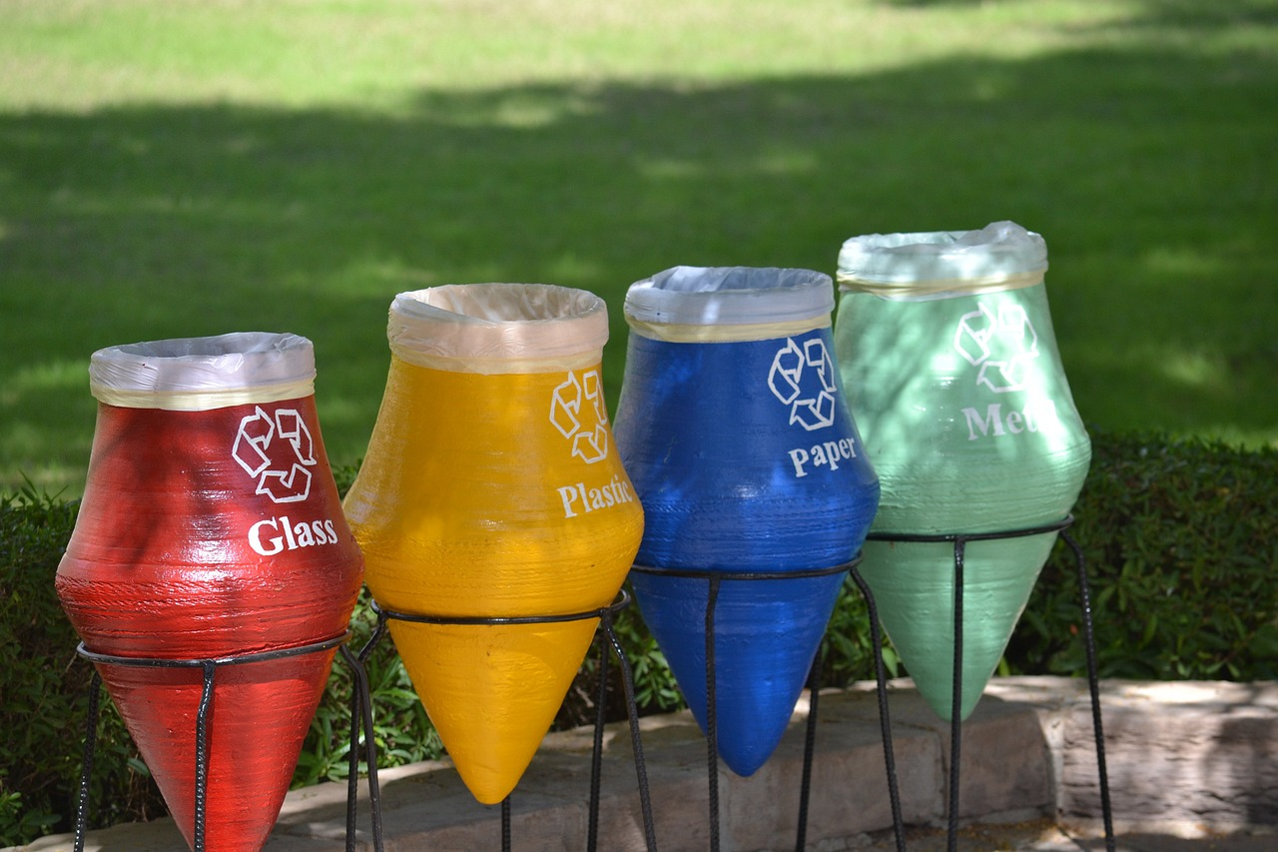
Understanding and Reducing Our Environmental Footprint
A Comprehensive Guide to Personal and Collective Impact on the Planet

Slide 2
Table of Contents
Introduction to Environmental Footprint
What is Environmental Footprint?
Why is Environmental Footprint Important?
Calculating Personal Environmental Footprint
Reducing Environmental Footprint
Strategies for Reducing Environmental Footprint
Developing an Action Plan
Case Studies: Successful Environmental Footprint Re…
Overcoming Challenges
Conclusion
01
02
03
04
05
06
07
08
09
10

Slide 3
Table of Contents
Reflection and Next Steps
Additional Resources
Assessment and Evaluation
Extension Activities
Parent Engagement and Support
Safety Considerations and Precautions
Conclusion and Final Thoughts
References and Credits
11
12
13
14
15
16
17
18

Slide 4
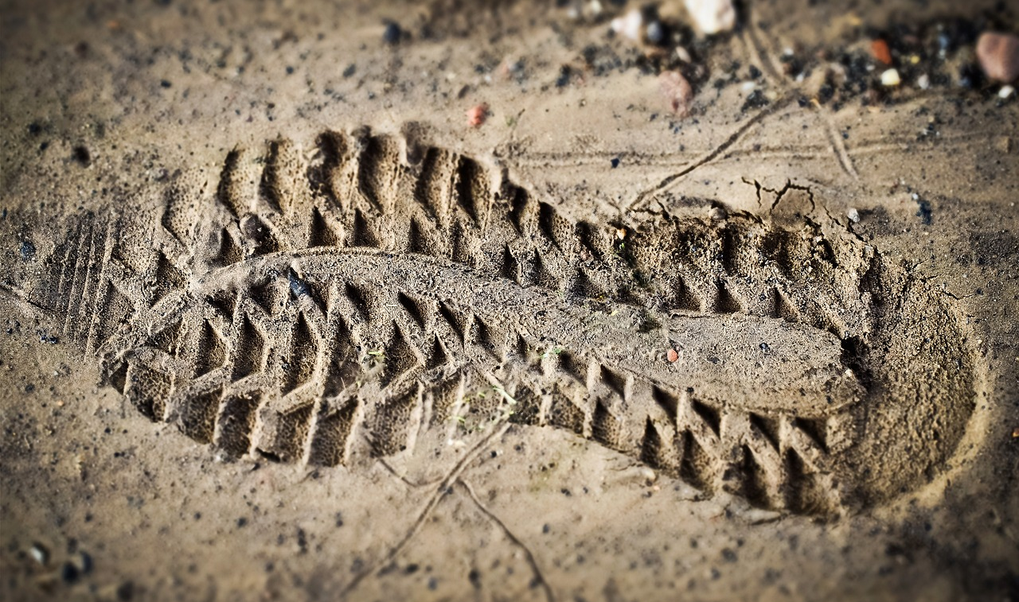
Understanding and Reducing Our Environmental Footprint
1
Introduction to Environmental Footprint
Impact Assessment
Informed Choices
Personal Reduction Plan
Environmental footprint refers to the impact of human activities on the environment, including carbon emissions, water usage, and waste production.
Understanding environmental footprint helps individuals make informed choices to reduce their impact on the planet.
By being aware of our footprint, we can adopt sustainable practices such as reducing waste, conserving water, and choosing eco-friendly products.
By the end of this lesson, students will define their environmental footprint and calculate it.
They will create a personalized plan to effectively reduce their impact on the planet.

Slide 5
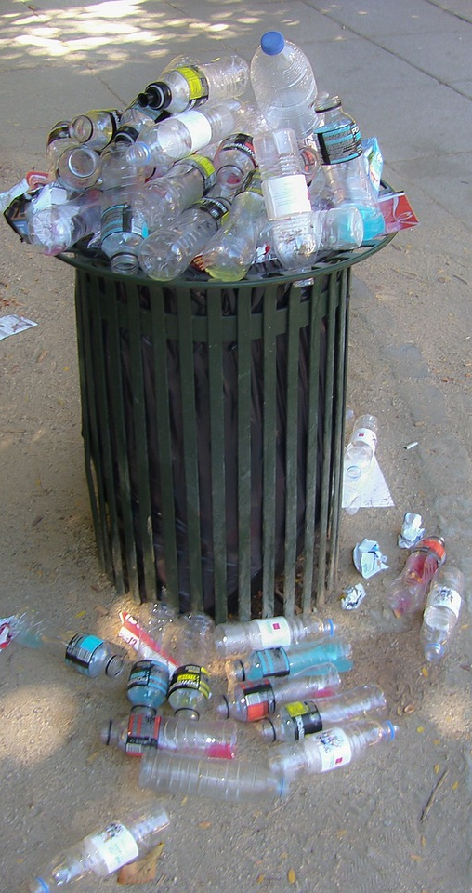
Understanding and Reducing Our Environmental Footprint
2
What is Environmental Footprint?
Resource Use
Waste Production
The environmental footprint includes the use of natural resources such as water, minerals, and energy.
Excessive resource use can lead to depletion and harm to ecosystems.
Human activities generate significant amounts of waste, including plastics and organic materials.
Improper waste management contributes to pollution and environmental degradation.
Greenhouse Gas Emissions
Sustainable Choices
Transportation, energy consumption, and industrial processes release greenhouse gases into the atmosphere.
These emissions are a major driver of climate change, affecting global temperatures and weather patterns.
Understanding our environmental footprint empowers individuals to make more sustainable choices.
Simple actions like reducing waste, conserving energy, and choosing eco-friendly products can make a difference.

Slide 6

Understanding and Reducing Our Environmental Footprint
3
Why is Environmental Footprint Important?
Biodiversity Impact
Climate Change Contribution
Resource Conservation
Environmental footprint significantly affects the planet's biodiversity.
It disrupts ecosystems and threatens various species.
The environmental footprint contributes to climate change.
This leads to rising sea levels and extreme weather events.
Reducing our environmental footprint helps conserve natural resources.
This ensures a sustainable future for generations to come.

Slide 7

Understanding and Reducing Our Environmental Footprint
4
Calculating Personal Environmental Footprint
Online Tools
Key Factors
Online calculators simplify assessing environmental impact and understanding personal footprints. They offer accessible resources for evaluation.
Energy consumption, transportation habits, and dietary choices are crucial factors. These elements significantly shape one's environmental impact.
Student Calculations
Identify Improvements
Students will use an online tool to measure their environmental footprint. This process fosters accountability and awareness.
Analyzing results reveals areas for improvement. This insight encourages more eco-friendly lifestyle choices.

Slide 8

Understanding and Reducing Our Environmental Footprint
5
Reducing Environmental Footprint
Small Actions Matter
Plan for Change
Set Clear Goals
Track Your Progress
Inspire Others
Simple actions like turning off lights and using public transport can significantly reduce our environmental impact.
Recycling also plays a crucial role in conserving resources.
Students should develop a plan with actionable steps and timelines to reduce their environmental footprint.
This structured approach helps in making measurable progress.
Setting specific goals and timelines helps track progress and ensures accountability.
Clear objectives motivate individuals to stay committed.
Regularly reviewing your actions helps identify areas for improvement.
This allows for necessary adjustments to stay on track.
Encouraging friends and family to join amplifies impact.
Sharing your progress can motivate others to take action.

Slide 9

Understanding and Reducing Our Environmental Footprint
6
Strategies for Reducing Environmental Footprint
Energy Efficiency
Sustainable Transport
Use energy-efficient appliances and turn off lights when not in use to reduce energy consumption.
Using public transport, walking, or biking reduces carbon emissions and promotes a healthier lifestyle.
Waste Reduction
Local Eating
Reduce, reuse, and recycle to minimize waste. This practice conserves resources and reduces landfill impact.
Choose locally sourced and seasonal foods to support farmers and minimize transportation emissions.

Slide 10

Understanding and Reducing Our Environmental Footprint
7
Developing an Action Plan
Identify Improvements
Set SMART Goals
Assess your environmental footprint to find key areas for enhancement.
Use available tools to collect data that informs your decisions.
Establish goals that are specific, measurable, achievable, relevant, and time-bound.
Ensure these goals directly support your vision for environmental improvement.
Create Action Plan
Monitor Progress
Draft a comprehensive plan with clear actions and deadlines.
Identify the resources and support needed for implementation.
Regularly evaluate your progress to stay aligned with your goals.
Adapt your strategies based on insights gained during evaluations.

Slide 11
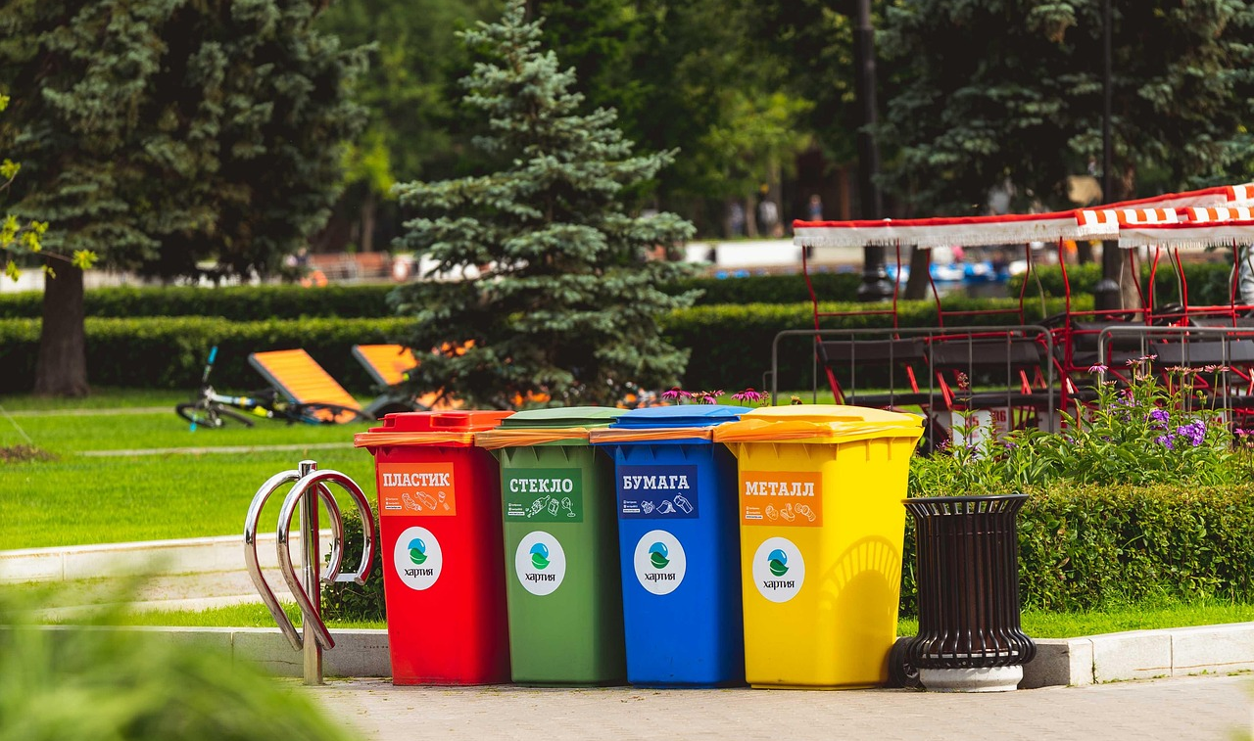
Understanding and Reducing Our Environmental Footprint
8
Case Studies: Successful Environmental Footprint Reduction
Successful Examples
Effective Strategies
Key Takeaways
A community initiative in the Pacific Northwest successfully cut its waste output by half through innovative recycling practices.
A nonprofit organization in Europe reached its sustainability goals by transitioning to 100% renewable energy sources.
Adopting a comprehensive waste management plan can lead to significant reductions in landfill waste.
Collaborating with local businesses and residents enhances the effectiveness of sustainability programs.
Sustained commitment is essential for meaningful progress in environmental conservation efforts.
Documenting and sharing successful strategies can motivate others to implement similar initiatives.

Slide 12

Understanding and Reducing Our Environmental Footprint
9
Overcoming Challenges
Awareness Gaps
Support Networks
Many people are unaware of their environmental impact, which hinders efforts to reduce their footprint.
Increasing awareness is the first step towards meaningful change.
Seek support from friends and community groups to foster collaboration.
This collaboration can lead to innovative solutions and shared resources.
Creative Solutions
Celebrate Progress
Persistence and creativity are essential in making sustainable choices.
Consider specific alternatives, like using public transport or reducing single-use plastics.
Recognizing and celebrating small victories is crucial for motivation.
Acknowledging progress helps maintain momentum in sustainability efforts.

Slide 13

Understanding and Reducing Our Environmental Footprint
10
Conclusion
Key Takeaways
Individual Impact
Sustainable Choices
We have covered the essential strategies for reducing our environmental impact.
Understanding these strategies is the first step towards meaningful change.
Every small action contributes to a larger goal of sustainability.
By making conscious choices, individuals can significantly reduce their environmental footprint.
Continuing to make sustainable choices is crucial for our planet's health.
Promoting environmental awareness helps inspire others to join the movement.

Slide 14

Understanding and Reducing Our Environmental Footprint
11
Reflection and Next Steps
Lessons Learned
Growth Opportunities
We learned the importance of adaptability in facing challenges.
Reflecting on our experiences has revealed key improvement areas.
Identifying new skills will enhance our capabilities.
Exploring partnerships can broaden our impact.
Action Plan
Community Engagement
We will implement specific steps to reduce our environmental footprint, such as increasing recycling efforts and reducing energy consumption.
Setting measurable goals will help us track our progress effectively.
Sharing our journey can inspire others to take action.
We will establish platforms for community dialogue and collaboration.

Slide 15

Understanding and Reducing Our Environmental Footprint
12
Additional Resources
Online Tools
Further Reading
Use online calculators to assess your environmental footprint and understand your impact on the planet.
Explore recommended books and articles to enhance your knowledge of environmental issues.
Sustainability Initiatives
Local Conservation
Learn about organizations that promote sustainability and how they make a difference.
Discover ways to participate in local conservation efforts and contribute to your community's health.

Slide 16

Understanding and Reducing Our Environmental Footprint
13
Assessment and Evaluation
Student Understanding
Evaluation Criteria
Assessing student understanding through quizzes and discussions helps identify progress and areas for improvement.
Effective action plans for reducing environmental footprints should be evaluated with clear benchmarks to ensure measurable outcomes.
Feedback Importance
Self-Assessment Opportunities
Constructive feedback guides students in their learning journey and fosters a supportive environment.
Encouraging self-assessment empowers students to take ownership of their learning. It also helps them recognize their strengths and areas for growth.

Slide 17
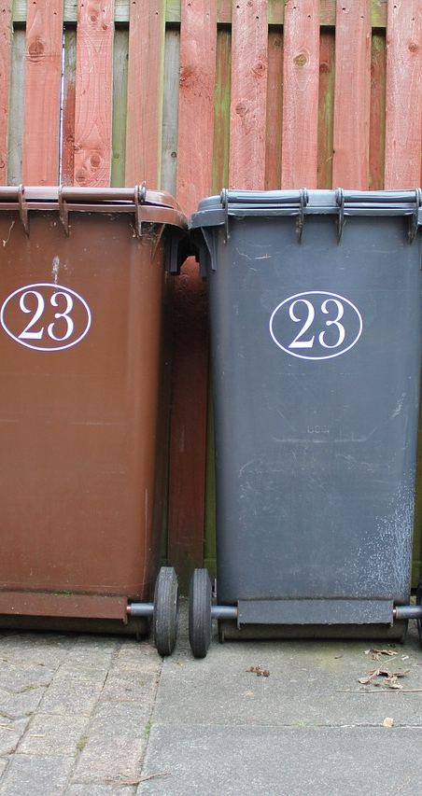
Understanding and Reducing Our Environmental Footprint
14
Extension Activities
Eco-Friendly Research
Community Engagement
Investigate sustainable technologies tailored for educational settings.
Design a focused plan that emphasizes energy conservation and waste management.
Partner with local eco-organizations to enhance community involvement.
Create a fun neighborhood challenge to promote recycling habits.
Collaborative Projects
Environmental Competitions
Launch joint initiatives with neighboring schools to address local environmental challenges.
Establish a student-led group to brainstorm and implement green innovations.
Explore and share information about upcoming environmental contests for students.
Organize skill-building sessions to prepare students for project presentations.

Slide 18

Understanding and Reducing Our Environmental Footprint
15
Parent Engagement and Support
Eco-Friendly Involvement
Family Activities
Encourage parents to take part in local environmental initiatives.
Provide actionable tips for minimizing energy consumption at home.
Organize family outings to explore nearby parks and engage with nature.
Create fun projects like building compost bins to teach sustainability.
Sustainability Resources
Collaborative Learning
Share a curated list of engaging documentaries on environmental topics.
Recommend books that inspire eco-conscious living and practices.
Host interactive workshops where families can learn about sustainability together.
Encourage projects that foster teamwork between parents and children on eco-friendly solutions.

Slide 19

Understanding and Reducing Our Environmental Footprint
16
Safety Considerations and Precautions
Safety Protocols
Hazard Awareness
Safety protocols are essential for protecting individuals during environmental activities.
Adhering to these protocols minimizes risks and ensures a safe experience.
Understanding potential hazards is crucial when engaging in environmental footprint reduction efforts.
Awareness of these risks helps in preparing and preventing accidents.
Risk Mitigation
Emergency Response
Implementing strategies for risk mitigation is vital for a safe learning environment.
Regular training and drills can enhance preparedness and response to potential hazards.
Having clear emergency procedures is necessary for effective crisis management.
A well-defined response plan ensures quick action during unforeseen events.

Slide 20

Understanding and Reducing Our Environmental Footprint
17
Conclusion and Final Thoughts
Key Takeaways
Sustainability Encouragement
Inspire Action
We have explored the importance of environmental sustainability.
Understanding our impact is the first step towards making a change.
Continue to prioritize sustainable practices in your daily life.
Every small effort contributes to a larger positive impact on the environment.
Share your sustainability experiences with peers to motivate them.
Together, we can create a ripple effect of positive change.

Slide 21

Understanding and Reducing Our Environmental Footprint
18
References and Credits
Source List
Media Credits
The sources used include academic journals and reputable websites.
These sources provide a solid foundation for the information presented.
All images and videos are credited to their respective creators.
Special thanks to the media teams for their contributions.
Contributors
Copyright Info
We acknowledge all contributors who helped develop this lesson.
Their expertise was invaluable to the final product.
All content is protected under copyright law and cannot be reproduced without permission.
For inquiries, please contact the author.

