Slide 1


Creative Writing and Storytelling: Foundations and Techniques
Exploring Imagination, Character Development, Plot, Setting, and Writing Skills

Slide 2
Table of Contents
Welcome to Creative Writing and Storytelling B…
What is Creative Writing?
The Basics of Storytelling
Character Development
Plot Structure
Setting and Theme
Writing Techniques
Writing Exercise: Character Development
Writing Exercise: Plot Structure
Writing Exercise: Setting and Theme
Common Mistakes to Avoid
Conclusion
Next Steps
04
05
06
07
08
09
10
11
12
13
14
15
16

Slide 3
Table of Contents
Additional Resources
Reflection and Evaluation
Final Thoughts
Get Started!
17
18
19
20

Slide 4

Welcome to Creative Writing and Storytelling Basics
Introduction to Creative Writing
Storytelling Basics
The Role of Imagination
Introduction to the world of creative writing and storytelling
Importance of imagination and creativity in writing
Overview of the basics of storytelling
Focus on characters, plot, setting, and theme
Imagination is key to crafting compelling stories
Creativity enhances the depth and engagement of writing
4
Creative Writing and Storytelling: Foundations and Techniques

Slide 5

What is Creative Writing?
Types of Creative Writing
Importance of Creative Writing
Creative writing is the art of crafting original and imaginative written works.
It often includes storytelling, character development, and emotional expression.
Creative writing encompasses various forms such as short stories, poetry, and scriptwriting.
Each type allows for unique ways to express ideas and emotions.
Examples in Popular Culture
Examples in Popular Culture
Creative writing plays a significant role in everyday life by fostering creativity and self-expression.
It helps individuals process emotions and communicate complex ideas effectively.
Creative writing is evident in popular culture through novels, movies, and songs.
These works often inspire, entertain, and connect with audiences worldwide.
5
Creative Writing and Storytelling: Foundations and Techniques

Slide 6

The Basics of Storytelling
Introduction to Storytelling Elements
Examples from Popular Stories
Introduction to the basic elements of storytelling, including characters, plot, setting, and theme.
Explanation of each element and its importance in storytelling.
Examples of how these elements are used in popular stories.
Illustrations of storytelling techniques in well-known narratives.
Tips for Developing Story Elements
The Role of Theme in Storytelling
Tips for developing these elements in your own writing.
Practical advice for enhancing storytelling skills.
Discussion on the significance of theme in crafting a compelling story.
Insights into how theme ties together other storytelling elements.
6
Creative Writing and Storytelling: Foundations and Techniques

Slide 7
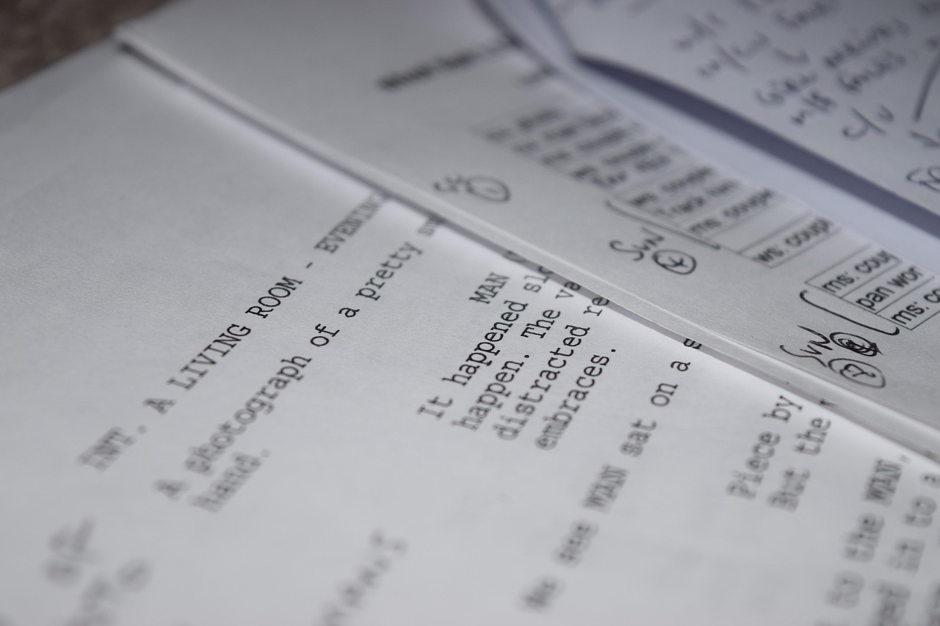
Character Development
01
Significance of Character Development
Character development is crucial in storytelling as it drives the narrative and engages the audience.
It allows readers to connect emotionally with the characters and their journeys.
02
Techniques for Believable Characters
Creating believable characters involves using dialogue, description, and action effectively.
These techniques help in portraying characters as realistic and relatable.
03
Examples from Popular Stories
Well-developed characters in popular stories serve as benchmarks for effective storytelling.
They demonstrate how depth and complexity can enhance the narrative.
04
Tips for Your Own Characters
Developing your own characters requires understanding their motivations and backstories.
This process ensures that they resonate with the audience and contribute meaningfully to the story.
7
Creative Writing and Storytelling: Foundations and Techniques

Slide 8

Plot Structure
01
Understanding Plot Structure
Introduction to the basic structure of a story, including introduction, rising action, climax, falling action, and resolution.
Explanation of each stage and its importance in storytelling.
02
Examples in Popular Stories
Examples of how plot structure is used in popular stories.
These examples highlight the universal application of plot structure.
03
Crafting Your Own Plot
Tips for developing a compelling plot in your own writing.
These tips can help you create engaging and memorable stories.
04
The Importance of Story Stages
Each stage of the plot contributes to the overall impact of the story.
Understanding these stages is crucial for effective storytelling.
8
Creative Writing and Storytelling: Foundations and Techniques

Slide 9

Setting and Theme
01
Importance of Setting and Theme
03
Creating Vivid Settings
Importance of setting and theme in storytelling
Techniques for creating vivid settings and exploring themes
Techniques for creating vivid settings and exploring themes
Examples of how setting and theme are used in popular stories
02
Examples in Popular Stories
04
Developing Your Writing
Examples of how setting and theme are used in popular stories
Tips for developing setting and theme in your own writing
Tips for developing setting and theme in your own writing
Importance of setting and theme in storytelling
9
Creative Writing and Storytelling: Foundations and Techniques

Slide 10
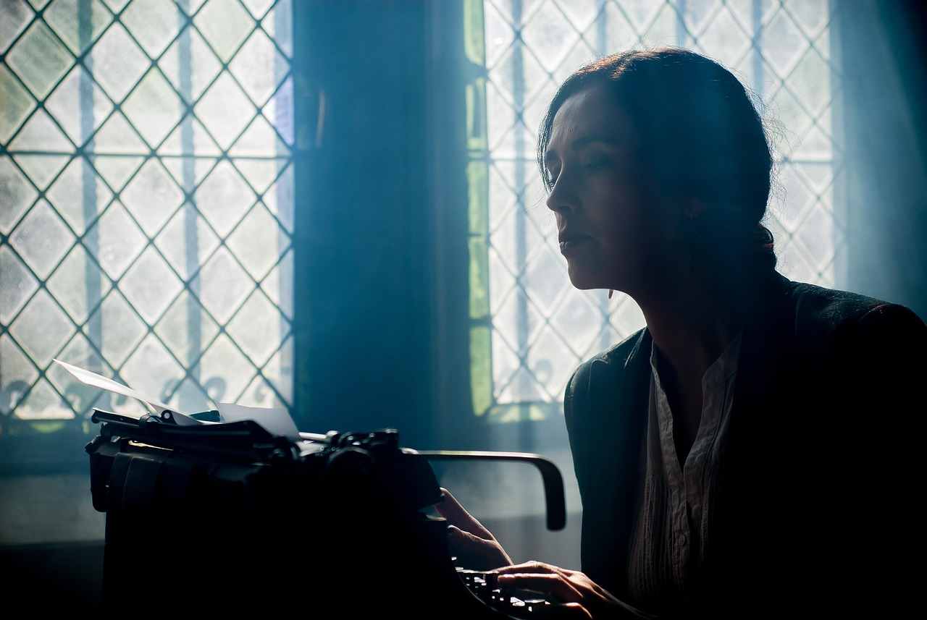
Writing Techniques
Introduction to Writing Techniques
Examples in Popular Stories
Introduction to various writing techniques, including showing vs. telling, dialogue, and descriptive language.
Explanation of each technique and its importance in storytelling.
Examples of how these techniques are used in popular stories.
These examples highlight the effectiveness of each technique in engaging readers.
Tips for Effective Writing
The Role of Descriptive Language
Tips for using these techniques in your own writing.
Practical advice to enhance storytelling and captivate your audience.
Descriptive language adds depth and vivid imagery to stories.
It helps readers visualize scenes and connect emotionally with the narrative.
10
Creative Writing and Storytelling: Foundations and Techniques

Slide 11

Writing Exercise: Character Development
Prompt for Character Profile
Tips for Believable Characters
Example of a Character Profile
Write a character profile, including name, age, appearance, personality, and background.
This exercise helps in creating a detailed and relatable character for storytelling.
Focus on traits and experiences that make the character authentic.
Consider motivations, flaws, and growth to enhance realism.
Create a sample character with specific details like hobbies and challenges.
Use this example to inspire and guide your own character development.
11
Creative Writing and Storytelling: Foundations and Techniques

Slide 12

Writing Exercise: Plot Structure
1
Prompt for the Writing Exercise
Write a short story using the basic plot structure.
This serves as the foundation for the exercise.
2
Tips for Crafting a Compelling Plot
Focus on creating engaging characters and a clear conflict.
Ensure the story has a beginning, middle, and end.
3
Example of a Short Story
Refer to a sample story that effectively uses the basic plot structure.
This can serve as inspiration for your own writing.
12
Creative Writing and Storytelling: Foundations and Techniques

Slide 13

Writing Exercise: Setting and Theme
Prompt for Writing Exercise
Tips for Vivid Settings and Themes
Example of Descriptive Writing
Write a descriptive paragraph about a setting and explore a theme.
Focus on crafting vivid imagery and meaningful connections to the theme.
Use sensory details to bring the setting to life.
Connect the setting to the theme to create a cohesive narrative.
A misty forest at dawn, where sunlight filters through the trees, evokes a sense of mystery.
The theme of solitude is explored as the quiet surroundings mirror the character's inner journey.
13
Creative Writing and Storytelling: Foundations and Techniques

Slide 14

Common Mistakes to Avoid
Introduction to Common Mistakes
Explanation of Mistakes
Introduction to common mistakes to avoid in creative writing, including overusing adverbs and telling instead of showing.
These are frequent pitfalls that can weaken the impact of your writing.
Explanation of each mistake and how to avoid it.
Understanding these errors is key to improving your writing skills.
Examples for Correction
Editing and Revising Tips
Examples of how to correct these mistakes in your own writing.
Practical illustrations help clarify how to implement changes effectively.
Tips for editing and revising your work.
These strategies ensure your writing is polished and impactful.
14
Creative Writing and Storytelling: Foundations and Techniques

Slide 15

Conclusion
Creative Writing Essentials
Practice Makes Perfect
Keep Exploring Creativity
Summary of the basics of creative writing and storytelling
Importance of practice and feedback in developing your writing skills
Importance of practice and feedback in developing your writing skills
Encouragement to continue writing and exploring your creativity
Encouragement to continue writing and exploring your creativity
Summary of the basics of creative writing and storytelling
15
Creative Writing and Storytelling: Foundations and Techniques

Slide 16
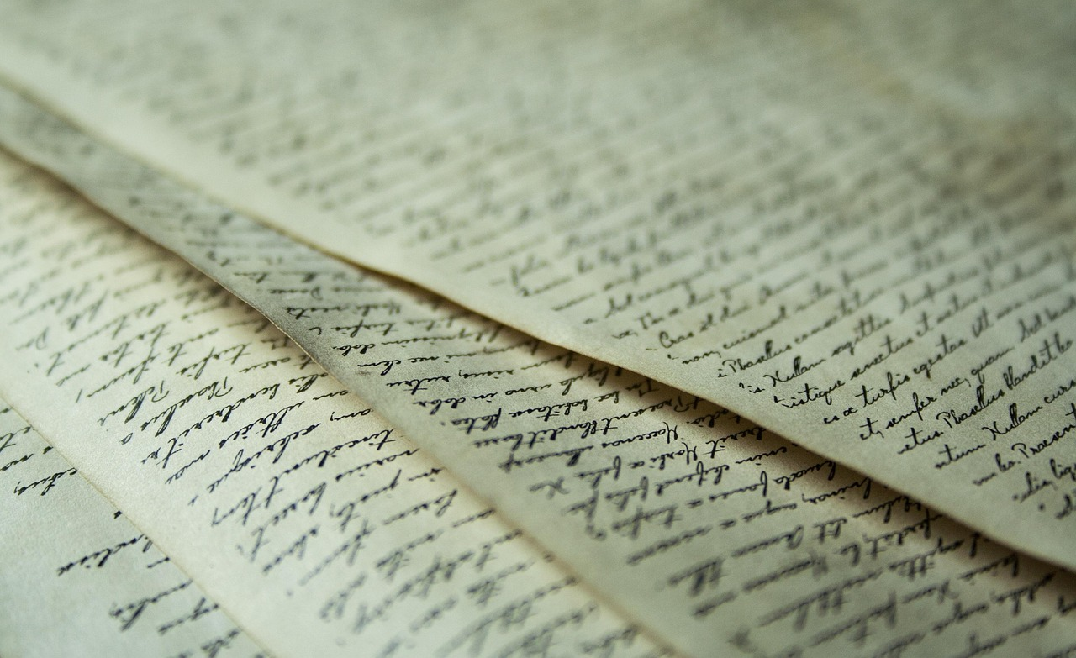
Next Steps
Suggestions for Further Learning
Suggestions for further learning and development, including reading and writing regularly.
Tips for finding inspiration and overcoming writer's block.
Overcoming Writer's Block
Tips for finding inspiration and overcoming writer's block.
Encouragement to share your work and join a writing community.
Joining a Writing Community
Encouragement to share your work and join a writing community.
Suggestions for further learning and development, including reading and writing regularly.
16
Creative Writing and Storytelling: Foundations and Techniques

Slide 17

Additional Resources
Recommended Books and Resources
Online Communities and Writing Groups
List of recommended books and resources for further learning.
These materials can help deepen your understanding and skills in writing.
Online communities and writing groups for support and feedback.
Engage with peers to share experiences and improve your craft.
Writing Prompts and Exercises
Tips for Using Writing Resources
Writing prompts and exercises for continued practice.
These tools can spark creativity and help maintain a regular writing habit.
Tips for finding and using writing resources effectively.
Learn strategies to maximize the benefits of available tools and materials.
17
Creative Writing and Storytelling: Foundations and Techniques

Slide 18

Reflection and Evaluation
1
Significance of Reflection
Importance of reflection and evaluation in the writing process
Tips for reflecting on your own writing and identifying areas for improvement
2
Self-Improvement Techniques
Tips for reflecting on your own writing and identifying areas for improvement
Strategies for evaluating and providing feedback on others' writing
3
Feedback Strategies
Strategies for evaluating and providing feedback on others' writing
Importance of reflection and evaluation in the writing process
18
Creative Writing and Storytelling: Foundations and Techniques

Slide 19

Final Thoughts
Encouragement to Continue Writing
Encouragement to continue writing and exploring your creativity.
Importance of perseverance and practice in developing your writing skills.
Perseverance in Writing
Importance of perseverance and practice in developing your writing skills.
Final tips and advice for success in creative writing and storytelling.
Final Tips for Success
Final tips and advice for success in creative writing and storytelling.
Encouragement to continue writing and exploring your creativity.
19
Creative Writing and Storytelling: Foundations and Techniques

Slide 20

Get Started!
Call to Action
Motivational Push
Start writing and exploring your creativity today!
Final encouragement and motivation to continue on your writing journey.
Unleash your potential and let your imagination soar.
Take the first step towards a fulfilling writing adventure.
20
Creative Writing and Storytelling: Foundations and Techniques

