Slide 1
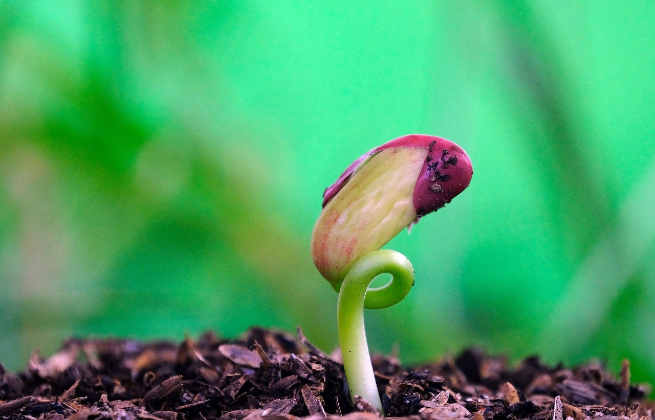
Understanding Germination: A Comprehensive Guide
Exploring the Process, Factors, and Environmental Influences

Slide 2
Table of contents
01
02
03
04
05
06
07
08
09
10
11
Lesson Introduction
Subject Knowledge
Extended Knowledge
Importance of Germination
Stages of Germination
Environmental Factors in Germination
Types of Plants and Germination
Temperature's Role in Germination
Light's Impact on Germination
Water's Influence on Germination
Different Plant Requirements

Slide 3
Table of contents
12
13
14
15
16
17
18
19
20
Promoting Germination
Factors Affecting Germination
Seed Absorption Process
Radicle Emergence
Hypocotyl Development
Plant's Root System
Embryonic Stem Growth
Environmental Control of Germination
Promoting Seed Growth

Slide 4
1
Lesson Introduction
01
02
03
What will you learn?
Objectives of the Lesson
How will you learn?
Understand the importance of germination in plants.
Learn how seeds grow into plants.
Explore the process of germination.
Identify the different stages of germination.
Through fun activities and visuals.
Hands-on exploration of seeds and plants.
Understanding Germination: A Comprehensive Guide

Slide 5
2
Subject Knowledge
01
02
03
04
Germination
Water Absorption
Radicle Emergence
Hypocotyl Emergence
Germination is the process by which a seed begins to grow.
The seed absorbs water and swells, the seed coat opens, and the radicle emerges.
The radicle is the embryonic root that will grow into the plant's root system.
Subsequently, the hypocotyl emerges, which is the embryonic stem that will develop into the stem and leaves of the plant.
Understanding Germination: A Comprehensive Guide

Slide 6

3
Extended Knowledge
01
Temperature
02
Light
Optimal temperature ranges vary for different plants.
Extreme temperatures can inhibit germination.
Some seeds require light to germinate, while others need darkness.
Light quality and duration can affect germination rates.
03
Water
04
Specific Conditions
Adequate moisture is essential for seed germination.
Overwatering can lead to seed rot and inhibit germination.
Some plants require cold stratification to break dormancy.
Certain seeds need fire or smoke exposure to germinate.
Understanding Germination: A Comprehensive Guide

Slide 7
4
Importance of Germination
01
02
03
04
05
Step 1: Water Absorption
Step 2: Radicle Emergence
Step 3: Hypocotyl Emergence
Environmental Factors
Importance of Understanding
The seed absorbs water and swells.
The seed coat opens.
The radicle, or embryonic root, emerges.
It will grow into the plant’s root system.
The hypocotyl, or embryonic stem, emerges.
It will develop into the stem and leaves of the plant.
Germination is influenced by temperature, light, and water.
Different plants require varying levels of these factors.
Understanding these factors is crucial for successful plant growth and development.
Understanding Germination: A Comprehensive Guide

Slide 8
5
Stages of Germination
01
02
03
04
Seed Absorption
Seed Coat Opening
Radicle Emergence
Hypocotyl Emergence
The seed absorbs water and swells, initiating the germination process.
The seed coat opens, allowing the radicle to emerge.
The radicle, the embryonic root, emerges and begins to grow downward to establish the plant's root system.
Following the radicle, the hypocotyl emerges, which is the embryonic stem that will develop into the stem and leaves of the plant.
Understanding Germination: A Comprehensive Guide

Slide 9
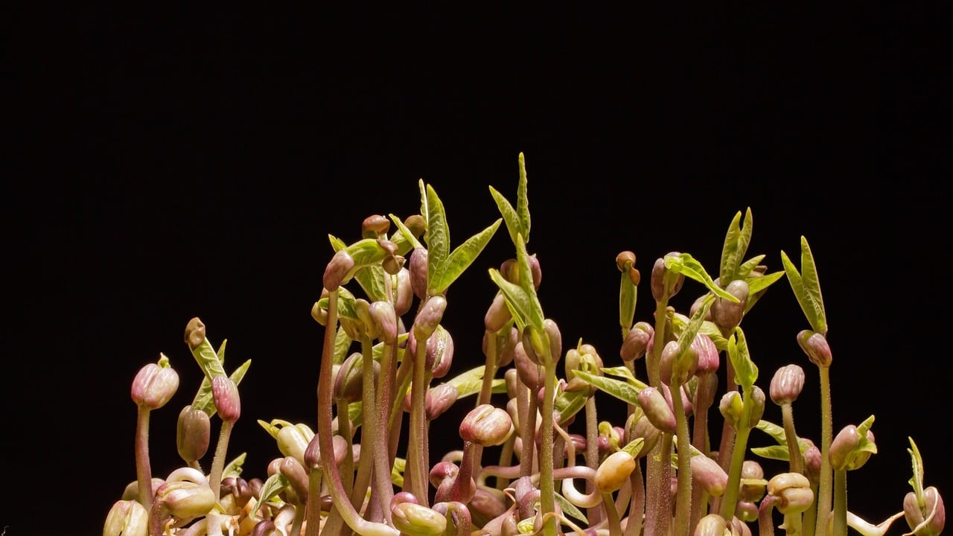
6
Environmental Factors in Germination
01
Temperature
02
Light
Temperature plays a crucial role in germination.
Different plants have specific temperature requirements for optimal germination.
Extreme temperatures can inhibit or delay the germination process.
Light is another important environmental factor influencing germination.
Some seeds require light to germinate, while others need darkness.
Light can trigger the production of hormones that initiate germination.
03
Water
04
Oxygen
Water is essential for the germination process as it activates enzymes in the seed.
Seeds absorb water, causing them to swell and initiate growth.
Lack of water can prevent germination or lead to seed dormancy.
Oxygen is necessary for the metabolic processes involved in germination.
It aids in breaking down stored nutrients in the seed for growth.
Poor aeration can hinder germination and lead to seed rotting.
Understanding Germination: A Comprehensive Guide

Slide 10
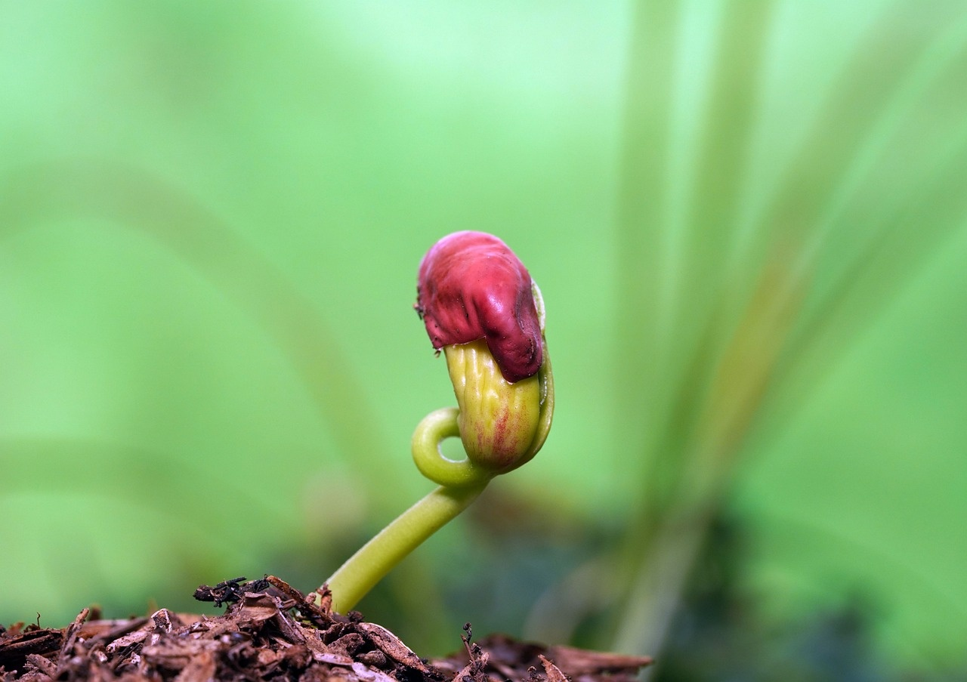
7
Types of Plants and Germination
Monocots
Seeds with one cotyledon (seed leaf)
Examples: corn, rice, wheat
Dicots
Seeds with two cotyledons
Examples: beans, peas, sunflowers
Epigeal Germination
Seedlings emerge above the soil surface
Cotyledons are lifted above ground
Examples: beans, sunflowers
Hypogeal Germination
Seedlings remain below the soil surface
Cotyledons stay below ground
Examples: peas, peanuts
Understanding Germination: A Comprehensive Guide

Slide 11
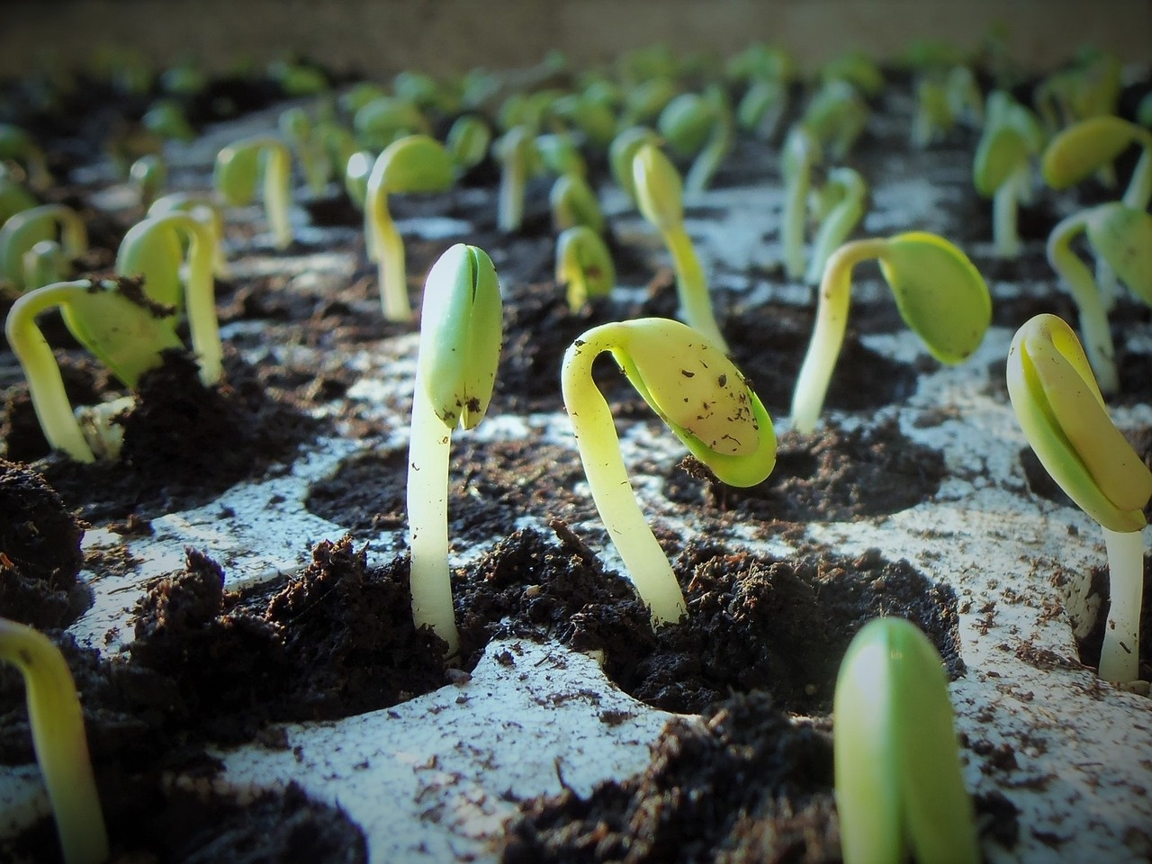
8
Temperature's Role in Germination
Optimal Temperature Range
Different plants have specific temperature requirements for germination.
For example, most common garden vegetables germinate best between 65-75°F (18-24°C).
Cold Stratification
Some seeds require exposure to cold temperatures to break dormancy and germinate.
This process is known as cold stratification and mimics winter conditions.
Heat Requirements
Conversely, certain seeds, like those of desert plants, need higher temperatures to germinate.
These seeds have adapted to hot climates and require warmth to trigger germination.
Temperature Fluctuations
Sudden temperature changes can impact germination success.
Consistent temperatures within the optimal range are ideal for successful germination.
Monitoring and Adjusting
It's important to monitor and regulate temperature conditions during germination.
This ensures that seeds have the best chance of sprouting and growing into healthy plants.
Understanding Germination: A Comprehensive Guide

Slide 12
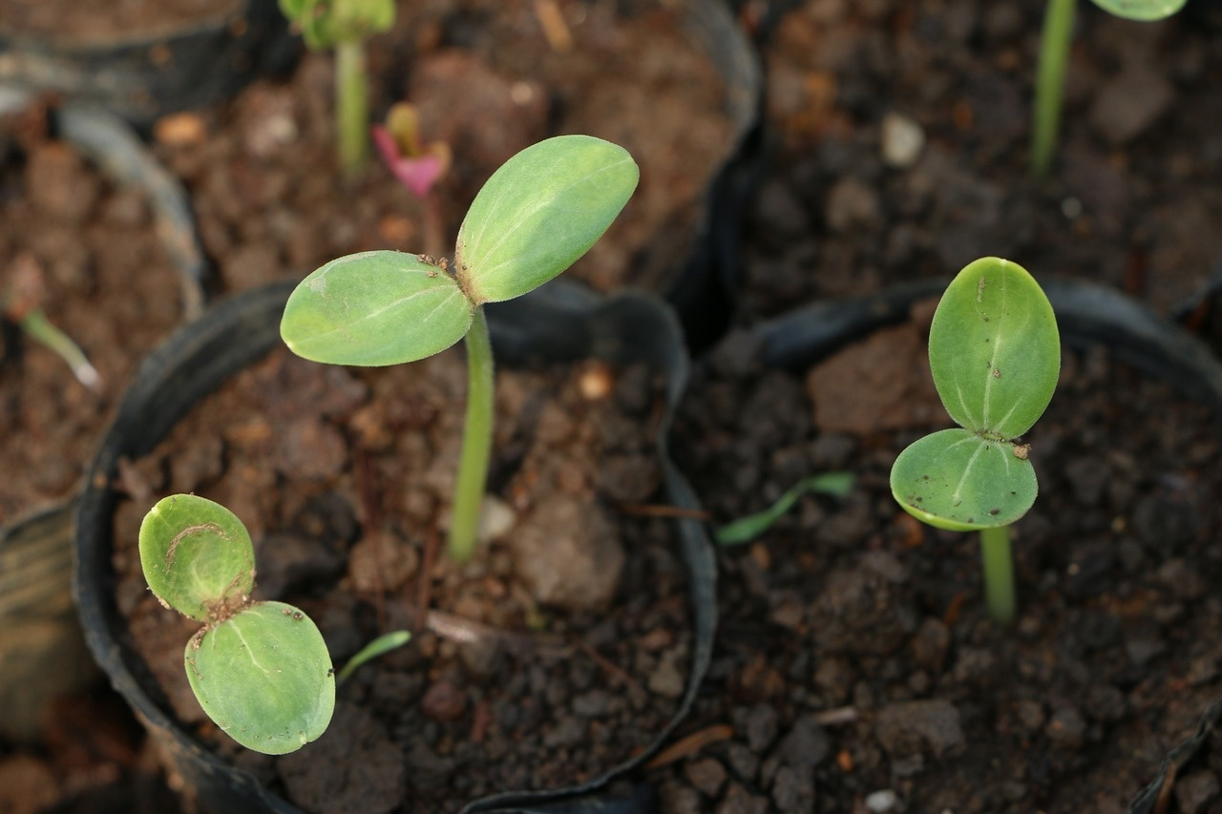
9
Light's Impact on Germination
01
Role of Light in Germination
02
Light as a Signal
Light is crucial for plant germination.
Seeds need light to start growing.
Light triggers seed development.
Different plants have different light needs.
03
Photoblastism
04
Effects of Insufficient Light
Some seeds need light exposure to germinate.
Light affects hormone production in seeds.
Lack of light causes etiolation.
Light quality, intensity, and duration are important.
Understanding Germination: A Comprehensive Guide

Slide 13
10
Water's Influence on Germination
01
02
03
04
05
Absorption
Swelling
Seed Coat Opening
Radicle Emergence
Hypocotyl Emergence
Seeds absorb water to initiate germination process.
Water causes the seed to swell, softening the seed coat.
The softened seed coat opens up, allowing the radicle to emerge.
The radicle, or embryonic root, emerges first to develop into the plant's root system.
Following the radicle, the hypocotyl emerges, which will grow into the stem and leaves of the plant.
Understanding Germination: A Comprehensive Guide

Slide 14
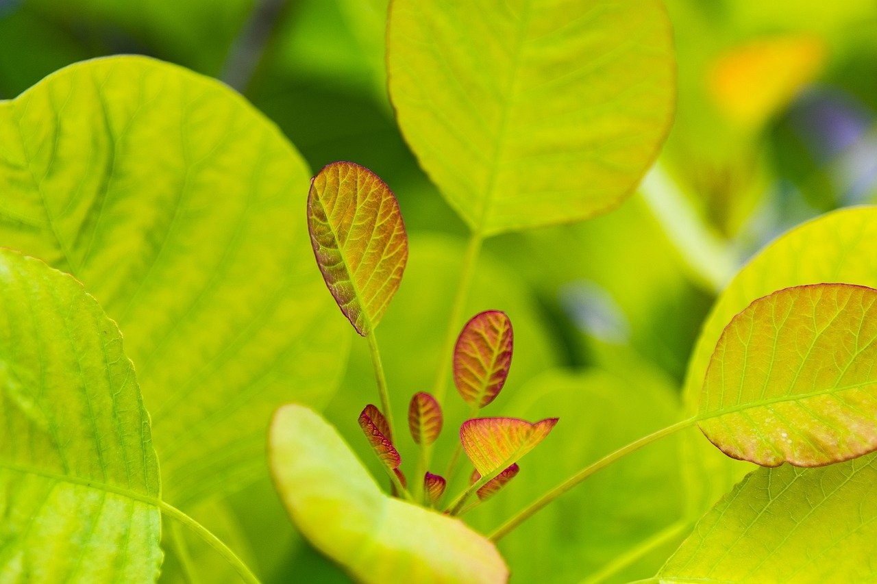
11
Different Plant Requirements
01
Temperature
02
Light
Some plants require specific temperature ranges for germination.
Certain seeds may need warmer temperatures to sprout, while others prefer cooler conditions.
Light plays a crucial role in germination for some plant species.
Seeds of plants like sunflowers and lettuce require light to trigger the germination process.
03
Water
04
Oxygen
Adequate water is essential for germination as it helps soften the seed coat and kickstart the growth process.
Excessive water can lead to rotting of seeds.
Seeds need oxygen to undergo germination as it is essential for the metabolic processes involved in growth.
Proper aeration of the soil is crucial for successful germination.
Understanding Germination: A Comprehensive Guide

Slide 15
12
Promoting Germination
01
02
03
04
Provide Adequate Water
Optimal Temperature
Ensure Sufficient Light
Proper Soil Conditions
Seeds need water to kickstart the germination process.
Ensure the soil is consistently moist but not waterlogged.
Maintain the right temperature for the specific plant species.
Most seeds germinate best within a certain temperature range.
Some seeds require light to germinate, while others need darkness.
Understand the light requirements of the seeds you are planting.
Use well-draining soil with the right nutrients for healthy seed germination.
Avoid compacted or poor-quality soil.
Understanding Germination: A Comprehensive Guide

Slide 16
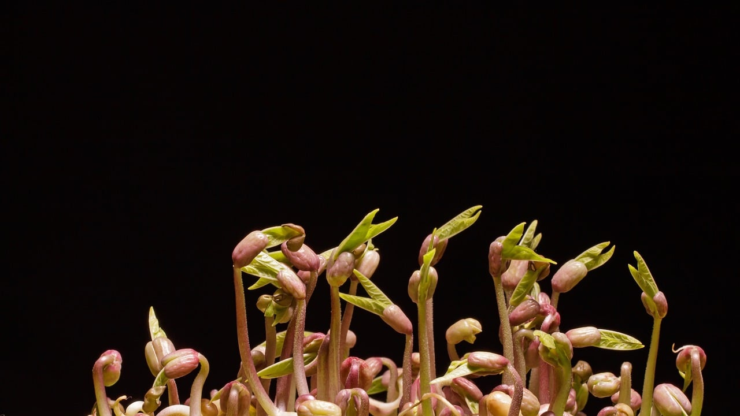
13
Factors Affecting Germination
01
Temperature
02
Light
Optimal temperature ranges vary for different plant species, influencing the speed and success of germination.
Some seeds require light to germinate, while others need darkness. Light can trigger the germination process in certain plants.
03
Water
04
Oxygen
Adequate moisture is essential for seed germination as it activates enzymes and metabolic processes within the seed.
Seeds need oxygen for respiration during germination. Poor aeration can hinder the process and lead to seedling mortality.
Understanding Germination: A Comprehensive Guide

Slide 17
14
Seed Absorption Process
01
02
03
04
05
Step 1
Step 2
Step 3
Step 4
Step 5
Seed absorbs water and swells.
Seed coat opens.
Radicle emerges - embryonic root.
Radicle grows into the plant's root system.
Hypocotyl emerges - embryonic stem.
Understanding Germination: A Comprehensive Guide

Slide 18
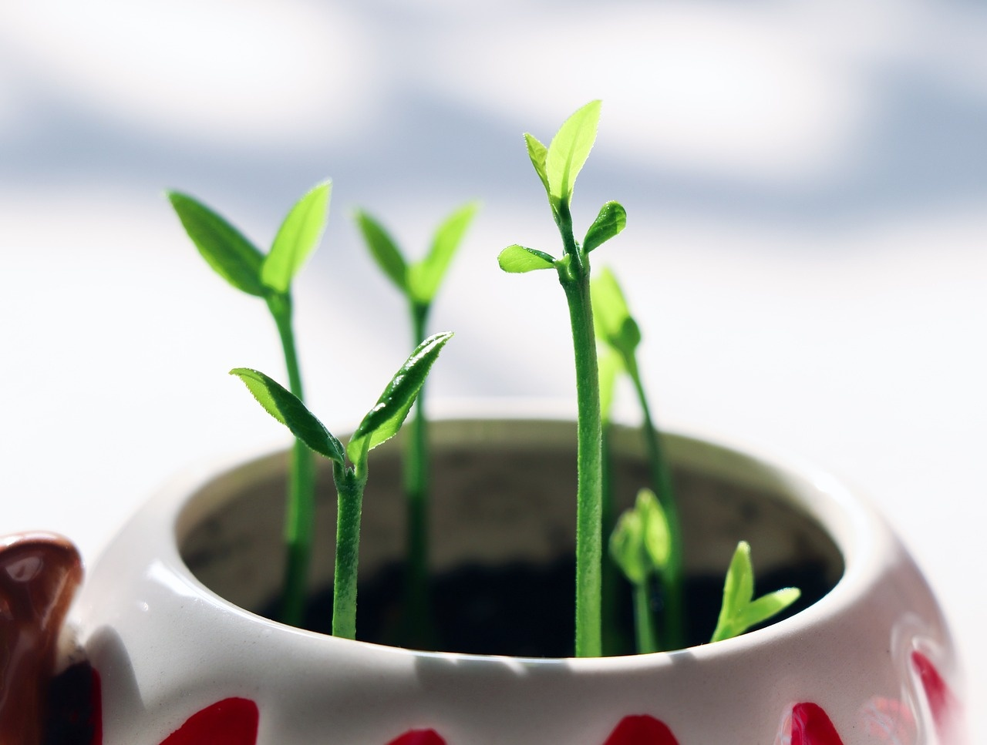
15
Radicle Emergence
Seed Absorbs Water
The germination process begins with the seed absorbing water, causing it to swell.
Seed Coat Opens
As the seed absorbs water, the seed coat opens up, allowing the emerging radicle to grow.
Radicle Emerges
The radicle, which is the embryonic root of the plant, emerges from the seed and starts growing downwards into the soil.
Hypocotyl Emerges
Following the radicle, the hypocotyl emerges next. This is the embryonic stem that will develop into the stem and leaves of the plant.
Importance of Radicle Emergence
Radicle emergence is a crucial stage in germination as it marks the beginning of root development, which is essential for the plant's growth and nutrient absorption.
Understanding Germination: A Comprehensive Guide

Slide 19
16
Hypocotyl Development
01
02
03
04
Seed Absorbs Water
Seed Coat Opens
Radicle Emerges
Hypocotyl Development
The germination process begins with the seed absorbing water, causing it to swell.
As the seed absorbs water, the seed coat opens up, allowing the internal structures to emerge.
The radicle, which is the embryonic root of the plant, emerges from the seed. It will develop into the plant's root system.
Following the radicle, the hypocotyl emerges. This is the embryonic stem that will grow into the stem and leaves of the plant.
Understanding Germination: A Comprehensive Guide

Slide 20

17
Plant's Root System
01
Radicle Emerges
02
Hypocotyl Development
The radicle is the embryonic root that emerges from the seed during germination.
Following the radicle, the hypocotyl emerges, which will develop into the stem and leaves of the plant.
03
Root Growth
04
Importance of Roots
The radicle continues to grow and develop into the plant's root system, anchoring the plant and absorbing nutrients from the soil.
Roots play a crucial role in providing stability to the plant, absorbing water and nutrients, and storing food reserves for future growth.
Understanding Germination: A Comprehensive Guide

Slide 21
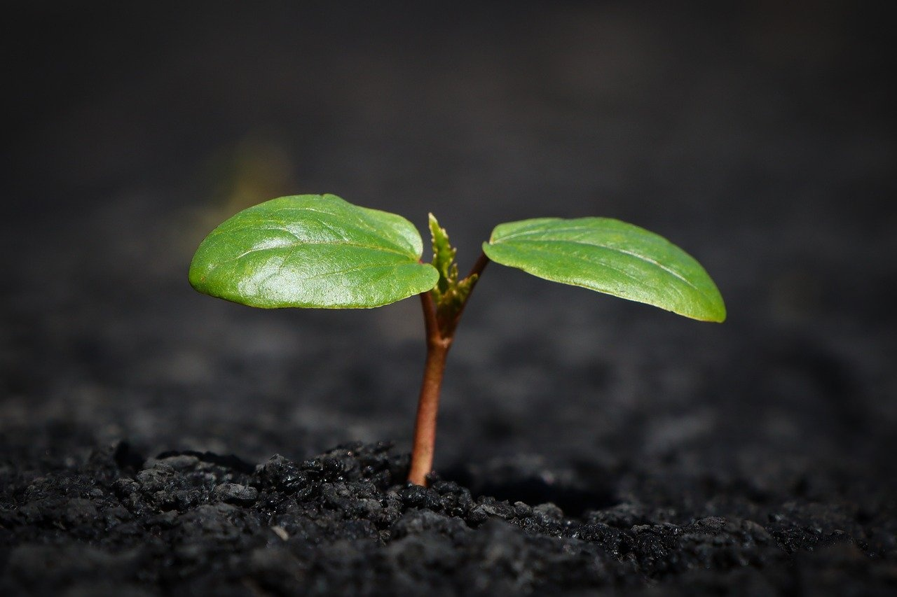
18
Embryonic Stem Growth
Radicle Emerges
The radicle is the embryonic root that emerges from the seed during germination.
Hypocotyl Development
The hypocotyl, the embryonic stem, emerges next and will develop into the stem and leaves of the plant.
Role in Plant Growth
These embryonic structures play crucial roles in establishing the plant's root system and above-ground growth.
Environmental Factors
Germination is influenced by environmental factors like temperature, light, and water, which impact the growth and development of the embryonic stem.
Understanding Germination: A Comprehensive Guide

Slide 22

19
Environmental Control of Germination
01
Temperature
02
Light
Optimal temperature ranges vary for different plant species.
Generally, warmer temperatures promote faster germination.
Some seeds require light to germinate, while others need darkness.
Light can trigger the germination process in certain plant species.
03
Water
04
Oxygen
Adequate moisture is essential for seed germination.
It helps in softening the seed coat and initiating metabolic processes.
Seeds need oxygen for respiration during germination.
Proper aeration of the soil is crucial for successful germination.
Understanding Germination: A Comprehensive Guide

Slide 23
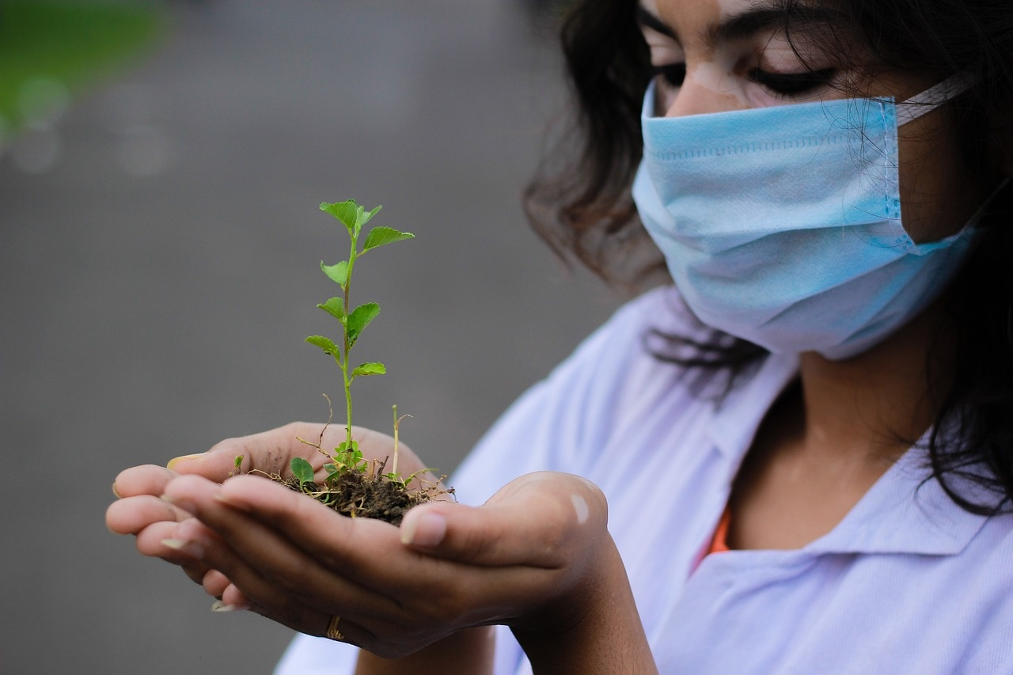
20
Promoting Seed Growth
Provide Adequate Water
Water is essential for seed germination as it helps soften the seed coat and activate enzymes necessary for growth.
Ensure Optimal Temperature
Different seeds have specific temperature requirements for germination. Maintaining the right temperature range can promote successful seed growth.
Expose to Light
Some seeds require light to germinate, while others need darkness. Understanding the light requirements of the seeds being planted is crucial for promoting growth.
Use Quality Soil
Planting seeds in nutrient-rich soil with good drainage can provide the necessary support for seed germination and early growth.
Avoid Overcrowding
Plant seeds at the recommended spacing to prevent competition for resources like water, light, and nutrients, which can hinder germination and growth.
Understanding Germination: A Comprehensive Guide

