Slide 1
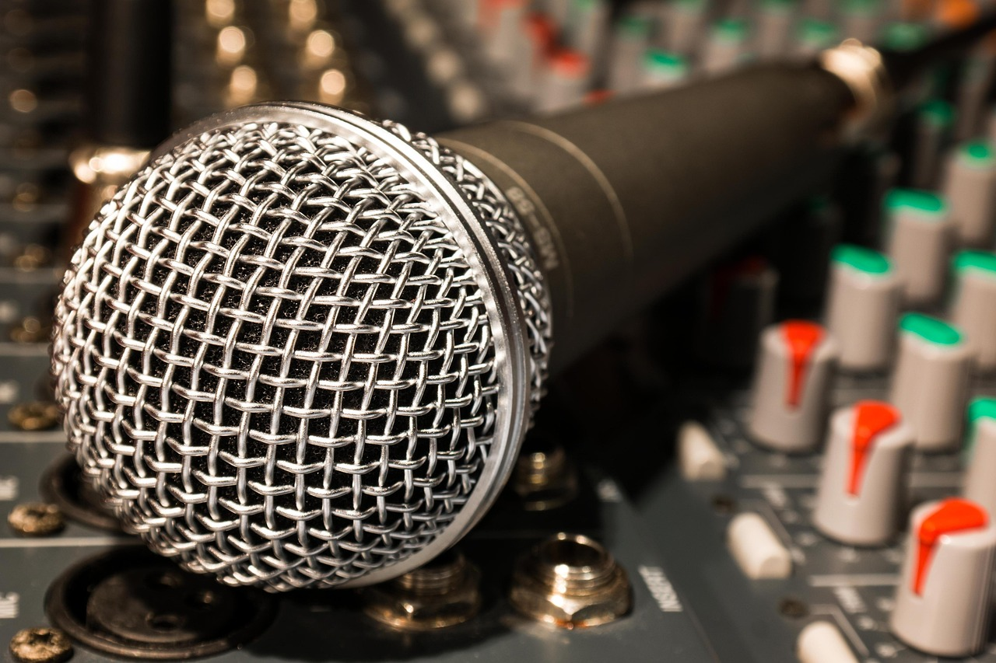
Mastering the Simple Present Tense and Oral Fluency
A Comprehensive Guide to Using Adverbs of Frequency and Enhancing Communication Skills

Slide 2
Mastering the Simple Present Tense and Oral Fluency
2
Table of Contents
Introduction to Oral Fluency
What is Simple Present Tense?
Adverbs of Frequency
Using Simple Present Tense with Adverbs of Fre…
Common Adverbs of Frequency
Practice Exercises
Role-Play Activity
Presentation Activity
Common Errors
FAQs
Objectives
Vocabulary Building
Resources
04
05
06
07
08
09
10
11
12
13
14
15
16

Slide 3
Mastering the Simple Present Tense and Oral Fluency
3
Table of Contents
Conclusion
Next Steps
Reflection Questions
Teaching Tips
Key Takeaways
17
18
19
20
21

Slide 4
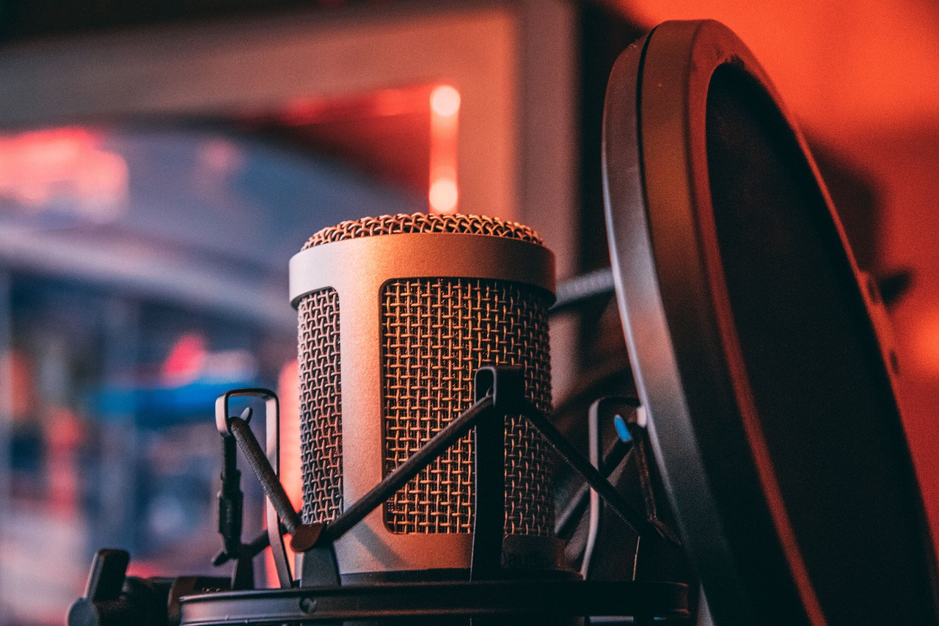
Mastering the Simple Present Tense and Oral Fluency
4
Introduction to Oral Fluency
Definition of Oral Fluency
Importance of Oral Fluency
Focus of the Lesson
Oral fluency is the ability to speak a language smoothly and naturally.
It is a key skill for effective communication in everyday life.
Mastering oral fluency is crucial for effective communication.
It allows individuals to express themselves clearly and confidently.
This lesson emphasizes using simple present tense and adverbs of frequency.
These elements are tools to enhance oral fluency effectively.

Slide 5

Mastering the Simple Present Tense and Oral Fluency
5
What is Simple Present Tense?
Definition of Simple Present Tense
Usage of Simple Present Tense
The simple present tense is a verb tense used to describe habits, routines, and general truths.
It is a fundamental tense in English grammar.
This tense is used to talk about actions that happen regularly or are true in general.
It helps convey information about consistent or universal actions.
Examples of Simple Present Tense
Formation of Simple Present Tense
Examples include: 'I eat breakfast every morning,' and 'She lives in New York.'
These sentences illustrate habitual and factual uses of the tense.
The simple present tense is formed using the base form of the verb.
For the third person singular, an -s or -es is added to the verb.

Slide 6
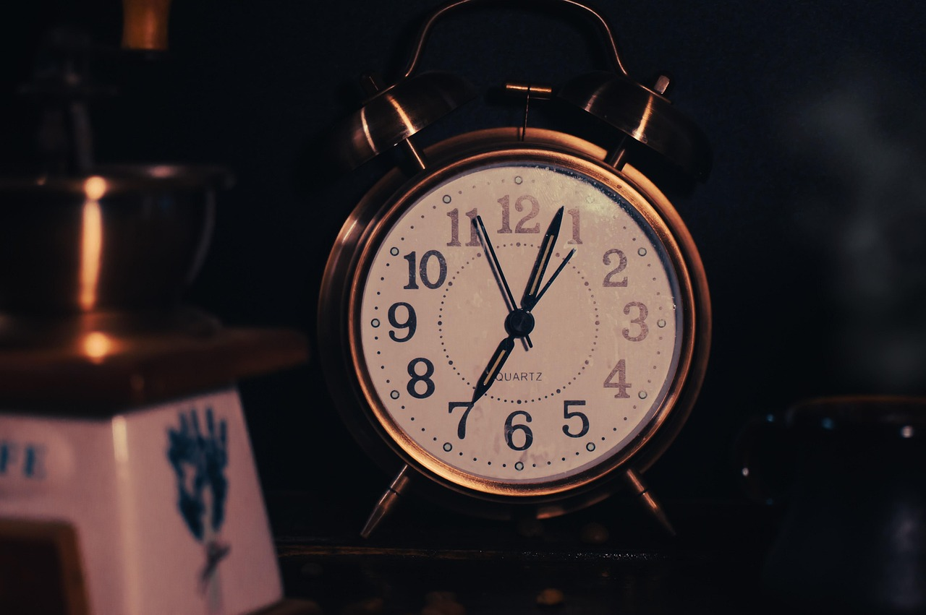
Mastering the Simple Present Tense and Oral Fluency
6
Adverbs of Frequency
Definition of Adverbs of Frequency
Examples of Adverbs of Frequency
Usage in Daily Routines
Application in Descriptions
Importance in Communication
Adverbs of frequency are words that describe how often something happens.
They provide information about the regularity of an action.
Examples include 'always,' 'usually,' 'often,' 'rarely,' and 'sometimes.'
These words help specify the frequency of occurrences.
Adverbs of frequency are used to add nuance and detail to descriptions of daily routines.
They help convey the regularity of habitual actions.
They can be used to describe habits, routines, and general truths.
This makes them essential in providing clarity and detail in communication.
Using adverbs of frequency enhances the expressiveness of language.
They allow speakers to convey precise information about the timing of events.

Slide 7
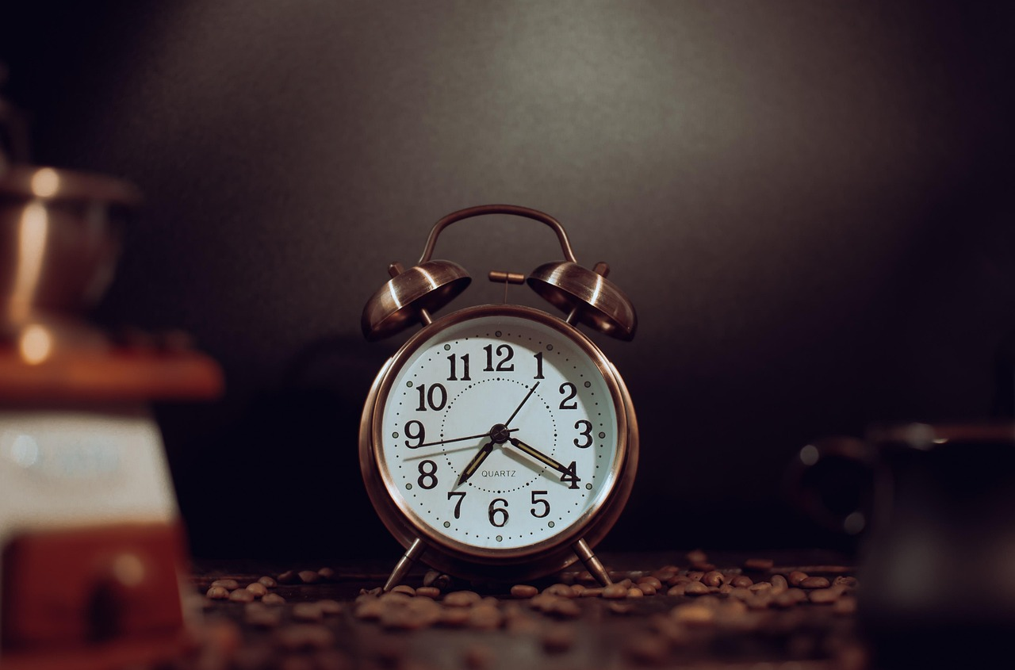
Mastering the Simple Present Tense and Oral Fluency
7
Using Simple Present Tense with Adverbs of Frequency
Introduction to Simple Present Tense with Adverbs of Frequency
Examples of Usage in Daily Routines
The simple present tense can be used with adverbs of frequency to describe habits and routines.
This combination helps in expressing regular actions and their frequency.
Examples include sentences like 'I usually wake up at 6:00 am' and 'She always eats breakfast at 7:00 am.'
These illustrate how adverbs of frequency integrate with the simple present tense.
Enhancing Descriptions with Adverbs of Frequency
Contrasting Habits with Frequency Adverbs
Adverbs of frequency can be used to add emphasis or contrast to descriptions of daily routines and habits.
This allows for a more nuanced expression of regular activities.
Examples such as 'I often go to the gym, but I rarely watch TV' show the contrasting use of adverbs of frequency.
This highlights the flexibility in describing varying habits and routines.

Slide 8
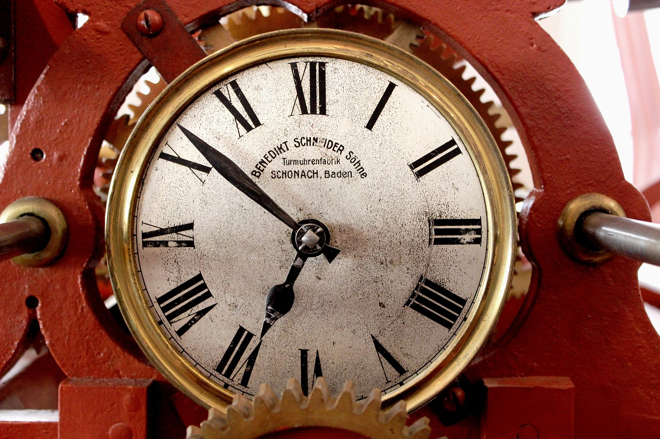
Mastering the Simple Present Tense and Oral Fluency
8
Common Adverbs of Frequency
Always
Usually
Often
Rarely
Sometimes
Used to describe actions that happen every time.
Indicates a consistent and unchanging frequency.
Used to describe actions that happen most of the time.
Represents a high but not absolute frequency.
Used to describe actions that happen frequently.
Denotes a regular occurrence but less than 'usually'.
Used to describe actions that happen infrequently.
Suggests a low frequency of occurrence.
Used to describe actions that happen occasionally.
Implies an irregular and unpredictable frequency.

Slide 9

Mastering the Simple Present Tense and Oral Fluency
9
Practice Exercises
Understanding Simple Present Tense
Applying Grammar to Daily Routines
Enhancing Language Skills
Complete the sentences with the correct form of the simple present tense and adverbs of frequency.
Examples: 'I _______ (play) tennis _______ (often),' 'She _______ (eat) breakfast _______ (always).'
Use the simple present tense and adverbs of frequency to describe your daily routines and habits.
Practice forming sentences that reflect your typical activities and their frequency.
Engage in exercises to improve your understanding of grammar and sentence structure.
Focus on the use of adverbs of frequency to add detail to your descriptions.

Slide 10

Mastering the Simple Present Tense and Oral Fluency
10
Role-Play Activity
Pair Work for Conversation Practice
Utilizing Language Structures
Example Conversations
Engage in pairs to practice conversations focusing on daily routines and habits.
This activity emphasizes the use of the simple present tense and adverbs of frequency.
Incorporate the simple present tense to describe your daily activities and habits.
Use adverbs of frequency to add detail and context to your descriptions.
Sample dialogue includes: 'What time do you usually wake up?' and 'I usually wake up at 6:00 am.'
These examples illustrate the application of the language structures in real-life scenarios.

Slide 11
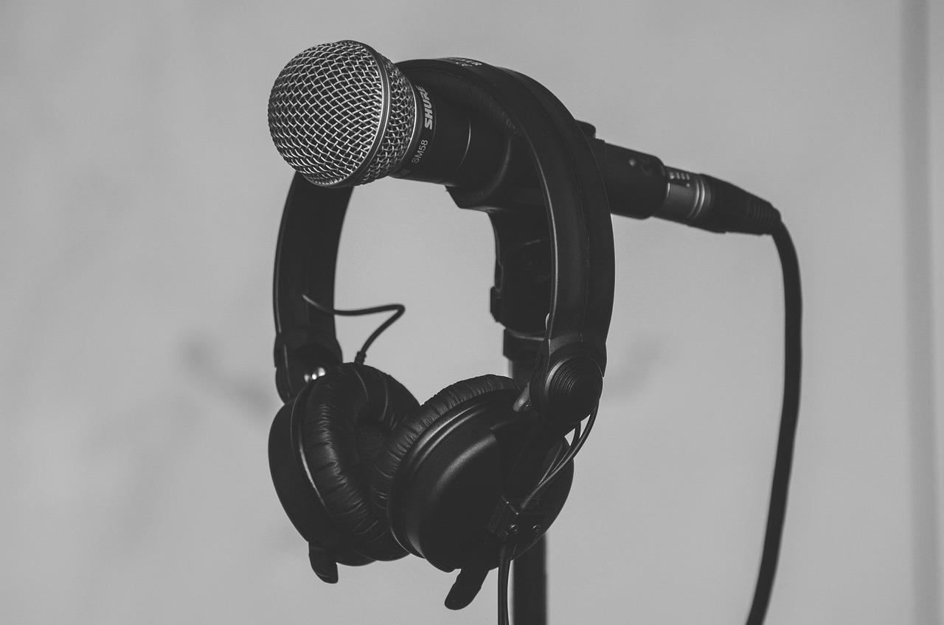
Mastering the Simple Present Tense and Oral Fluency
11
Presentation Activity
Daily Routine Presentation
Example Routine Description
Activity Guidelines
Create a short presentation about your daily routine and habits.
Use the simple present tense and adverbs of frequency to describe your activities and habits.
Examples: "I usually wake up at 6:00 am, then I eat breakfast at 7:00 am."
This demonstrates the use of adverbs of frequency in describing daily activities.
Ensure your presentation is clear and concise.
Focus on using accurate grammar and descriptive language.

Slide 12

Mastering the Simple Present Tense and Oral Fluency
12
Common Errors
Incorrect Verb Usage
Adverb Placement Errors
Using the wrong verb form or tense can lead to misunderstandings.
It is important to ensure verbs match the intended time frame and subject.
Incorrect placement of adverbs of frequency can disrupt sentence clarity.
Adverbs should be positioned to accurately modify the intended verb or clause.
Misuse of Adverbs of Frequency
Simple Present Tense for Habits
Using adverbs of frequency incorrectly can alter the intended meaning.
Proper usage ensures the frequency of actions is clearly communicated.
Not using the simple present tense to describe habits and routines can confuse the listener.
This tense is essential for expressing regular actions and general truths.

Slide 13

Mastering the Simple Present Tense and Oral Fluency
13
FAQs
Understanding 'Always' and 'Usually'
Using Adverbs of Frequency
Examples of 'Always' in Sentences
Examples of 'Usually' in Sentences
Placement of Adverbs of Frequency
'Always' describes actions that occur every time without exception.
'Usually' refers to actions that happen most of the time, indicating a general tendency.
Adverbs of frequency provide detail about how often actions occur.
They are useful for describing daily routines and habits with precision.
An example of 'always' is: 'She always drinks coffee in the morning.'
This indicates that the action happens every single morning without fail.
An example of 'usually' is: 'He usually walks to work.'
This suggests that walking to work is his common practice, though not absolute.
Adverbs of frequency are typically placed before the main verb in a sentence.
For example: 'I always read before bed.'

Slide 14

Mastering the Simple Present Tense and Oral Fluency
14
Objectives
Understanding the Simple Present Tense
Mastering Adverbs of Frequency
Engaging in Conversations
Error Identification and Correction
By the end of this lesson, learners will be able to use the simple present tense correctly.
This includes describing daily routines and habits effectively.
Learners will be able to use adverbs of frequency correctly.
This skill helps in describing the frequency of activities accurately.
Learners will be able to engage in conversations about daily routines and habits.
They will use the simple present tense and adverbs of frequency in these discussions.
Learners will be able to identify and correct common errors.
These errors pertain to the use of the simple present tense and adverbs of frequency.

Slide 15

Mastering the Simple Present Tense and Oral Fluency
15
Vocabulary Building
Daily Routine
Habit
Frequency
Pronunciation
Intonation
Daily routine refers to a regular schedule of activities.
It encompasses the tasks and actions performed consistently each day.
Habit is defined as a regular or usual practice or activity.
It often develops through repetition and becomes a part of one's behavior.
Frequency indicates the number of times something occurs within a given period.
It is a measure of how often an event or action takes place.
Pronunciation is the way in which words are spoken.
It involves the articulation and sound patterns used in speech.
Intonation refers to the rise and fall of pitch when speaking.
It plays a crucial role in conveying meaning and emotion in communication.

Slide 16
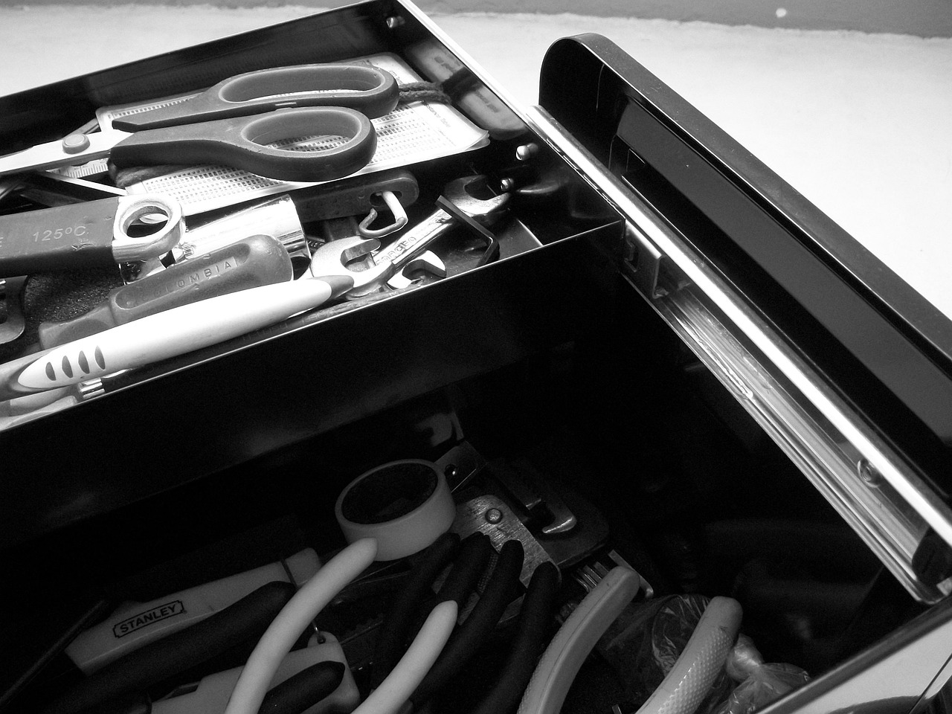
Mastering the Simple Present Tense and Oral Fluency
16
Resources
Grammar Guidebook
Online Quiz
A comprehensive guide to English grammar.
Provides detailed explanations and examples for learners.
A quiz that tests learners' understanding of the simple present tense and adverbs of frequency.
Interactive and engaging for self-assessment.
Flashcards
Audio Recordings
Cards with key vocabulary terms and their definitions.
Useful for memorization and quick reference.
Recordings of native speakers using the simple present tense and adverbs of frequency in conversations.
Enhances listening skills and contextual understanding.

Slide 17

Mastering the Simple Present Tense and Oral Fluency
17
Conclusion
Key Learnings
In this lesson, we learned about the simple present tense and adverbs of frequency.
These elements are essential for describing daily routines and habits.
Practical Application
We practiced using the simple present tense and adverbs of frequency.
This practice helps in effectively communicating everyday activities.
Benefits of Mastery
By mastering these concepts, learners can enhance their oral fluency.
This improvement aids in better communication in daily life scenarios.

Slide 18

Mastering the Simple Present Tense and Oral Fluency
18
Next Steps
Practicing Grammar in Context
Expanding Vocabulary Knowledge
Enhancing Listening Skills
Practice using the simple present tense and adverbs of frequency in context.
Engage in exercises that incorporate these elements into meaningful sentences.
Review and practice the vocabulary related to daily routines and habits.
Utilize flashcards or thematic exercises to reinforce understanding.
Continue to develop your listening skills by listening to conversations about daily routines and habits.
Focus on identifying key phrases and expressions used in these contexts.

Slide 19

Mastering the Simple Present Tense and Oral Fluency
19
Reflection Questions
Understanding the Lesson
What did you learn about the simple present tense and adverbs of frequency in this lesson?
Reflect on the key concepts and rules discussed during the session.
Applying Knowledge
How can you apply what you learned in this lesson to your everyday life?
Consider practical scenarios where these grammatical structures are useful.
Overcoming Challenges
What challenges did you face in this lesson, and how can you overcome them?
Identify difficulties and strategize solutions for better understanding.

Slide 20

Mastering the Simple Present Tense and Oral Fluency
20
Teaching Tips
Utilizing Authentic Materials
Provide authentic materials and real-life scenarios to illustrate the correct usage of the simple present tense and adverbs of frequency.
This approach helps learners connect language concepts to practical applications.
Encouraging Active Participation
Encourage active participation and engagement in the lesson.
Interactive activities foster a dynamic learning environment.
Pronunciation Focus
Focus on pronunciation and provide feedback on learners' pronunciation.
Clear pronunciation enhances communication skills.
Incorporating Visual Aids
Use visual aids and multimedia resources to support the lesson.
These tools make learning more engaging and accessible.

Slide 21

Mastering the Simple Present Tense and Oral Fluency
21
Key Takeaways
Understanding the Simple Present Tense
Role of Adverbs of Frequency
Combining Tense and Adverbs
Benefits of Mastery
The simple present tense is used to describe habits, routines, and general truths.
It provides a framework for expressing regular actions and universal facts.
Adverbs of frequency are used to add nuance and detail to descriptions of daily routines and habits.
They help specify the regularity of actions, enhancing clarity in communication.
The simple present tense can be used with adverbs of frequency to describe habits and routines.
This combination allows for precise and detailed expression of regular activities.
Mastering the simple present tense and adverbs of frequency can enhance oral fluency and communication in everyday life.
It contributes to effective and clear interpersonal interactions.

