Slide 1
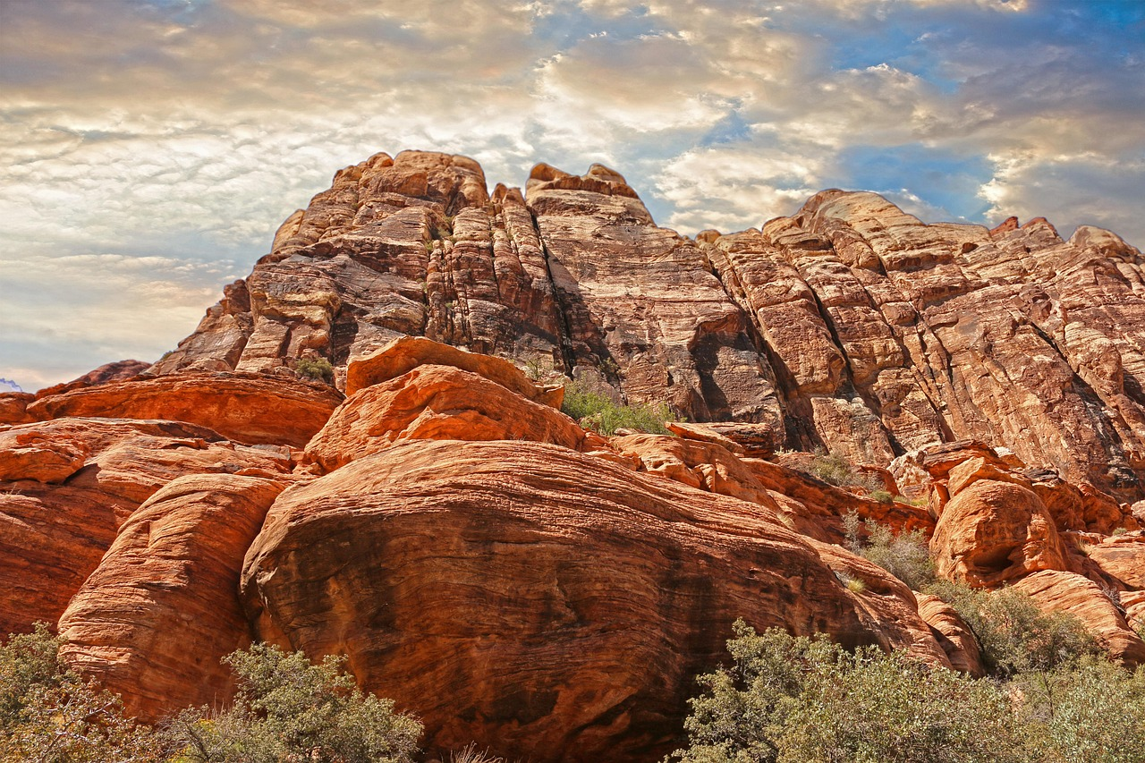

Comprehensive Exploration of Rock Weathering and Geological Processes
Understanding the Types, Impacts, and Significance of Weathering in Earth's Dynamic Landscape

Slide 2
Comprehensive Exploration of Rock Weathering and Geological Processes
2
Table of Contents
Introduction to Rock Weathering
What is Mechanical Weathering?
What is Chemical Weathering?
What is Biological Weathering?
The Rock Cycle
Factors that Influence Weathering
Examples of Weathering in Everyday Life
Preventing or Slowing Down Weathering
Case Study: The Grand Canyon
Case Study: Limestone Caves
Conclusion
Summary
Key Terms
04
05
06
07
08
09
10
11
12
13
14
15
16

Slide 3
Comprehensive Exploration of Rock Weathering and Geological Processes
3
Table of Contents
Assessment
Extension Activities
Parent Engagement
Reflection Questions
Next Steps
17
18
19
20
21

Slide 4
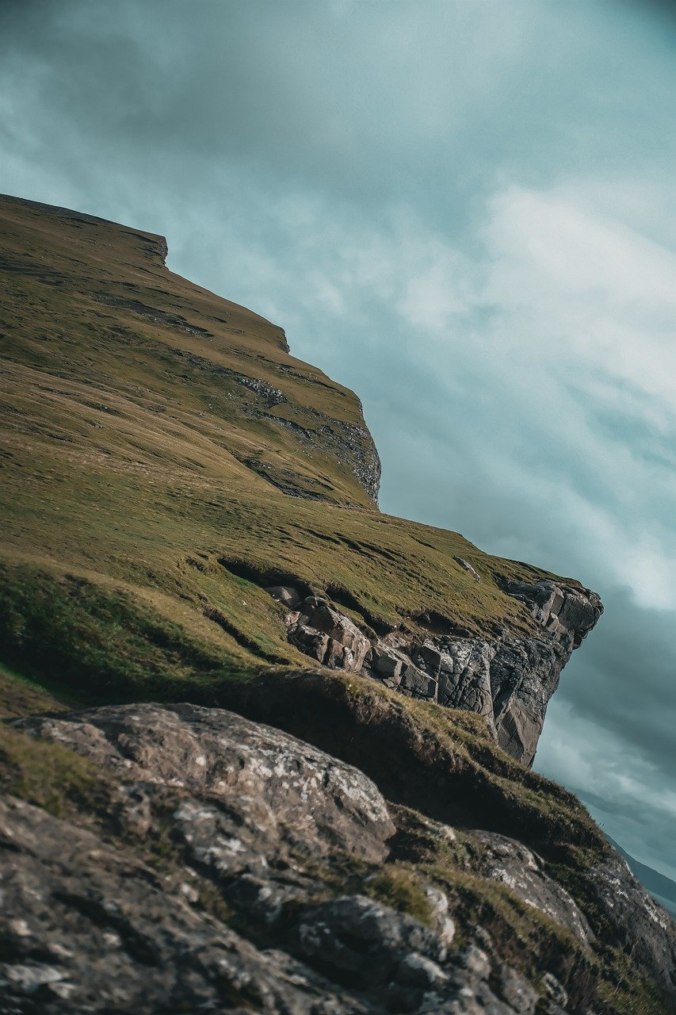
Comprehensive Exploration of Rock Weathering and Geological Processes
4
Introduction to Rock Weathering
Understanding Rock Weathering
Types of Weathering
Significance of Weathering
Rock weathering is the process of breaking down rocks into smaller fragments or minerals.
It plays a crucial role in shaping our planet's landscape.
There are three main types of weathering: mechanical, chemical, and biological.
Each type contributes uniquely to the transformation of rocks.
Weathering is essential for soil formation and ecosystem support.
It influences the Earth's surface and geological processes.

Slide 5
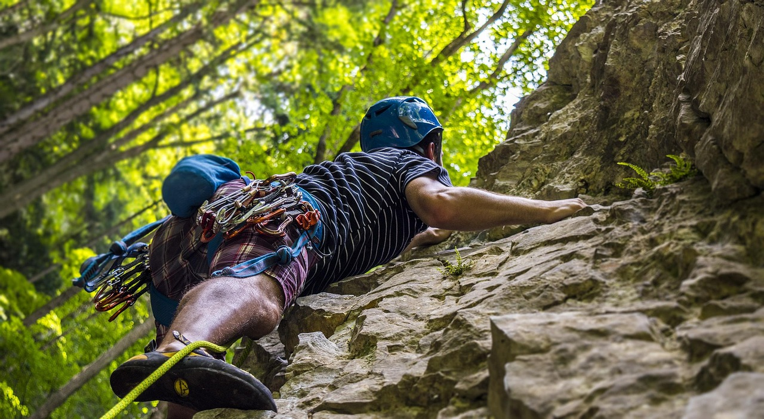
Comprehensive Exploration of Rock Weathering and Geological Processes
5
What is Mechanical Weathering?
Definition of Mechanical Weathering
Examples of Mechanical Weathering
Mechanical weathering involves the physical breakdown of rocks into smaller fragments.
It occurs through forces such as temperature fluctuations, wind, water, and ice.
Examples of mechanical weathering include freeze-thaw, thermal expansion, and abrasion.
These processes demonstrate how physical forces can fragment rocks over time.
Impact on Landscapes
Forces Driving Mechanical Weathering
Mechanical weathering can be seen in the formation of talus slopes and rockfalls.
These features highlight the role of physical weathering in shaping Earth's surface.
Temperature fluctuations, wind, water, and ice are key forces behind mechanical weathering.
These natural elements work together to break down rocks into smaller pieces.

Slide 6
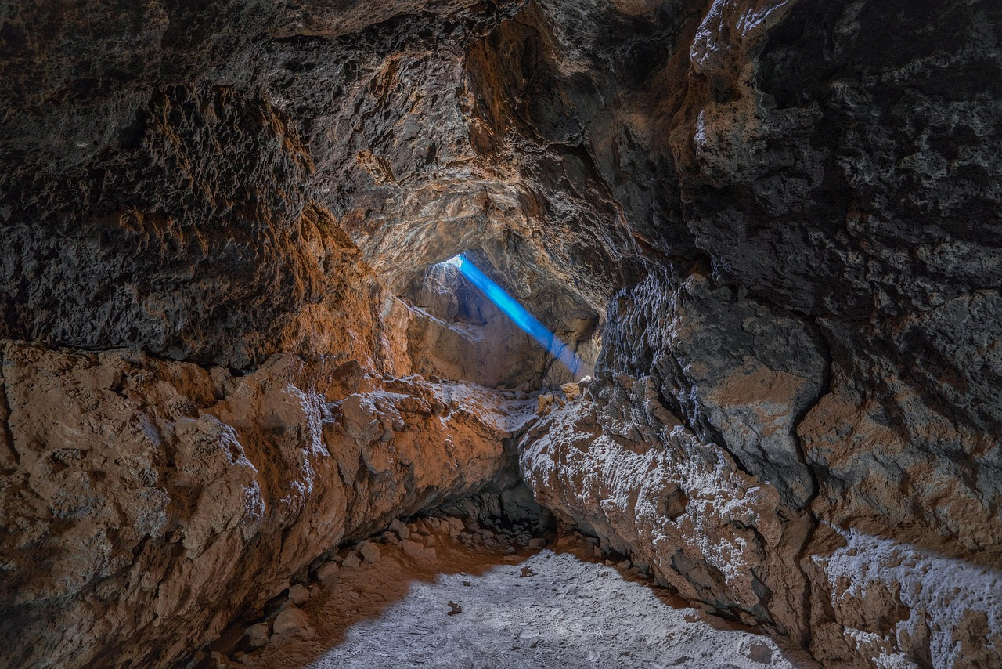
Comprehensive Exploration of Rock Weathering and Geological Processes
6
What is Chemical Weathering?
Definition of Chemical Weathering
Examples of Chemical Weathering
Chemical weathering involves the breakdown of rocks through chemical reactions.
It occurs through reactions with water, air, and other substances.
Examples of chemical weathering include hydrolysis, oxidation, and carbonation.
These processes alter the chemical composition of rocks.
Formation of Limestone Caves
Dissolution of Rocks
Chemical weathering can be seen in the formation of limestone caves.
This occurs when acidic water dissolves limestone over time.
The dissolution of rocks is another result of chemical weathering.
This process contributes to the shaping of landscapes.

Slide 7
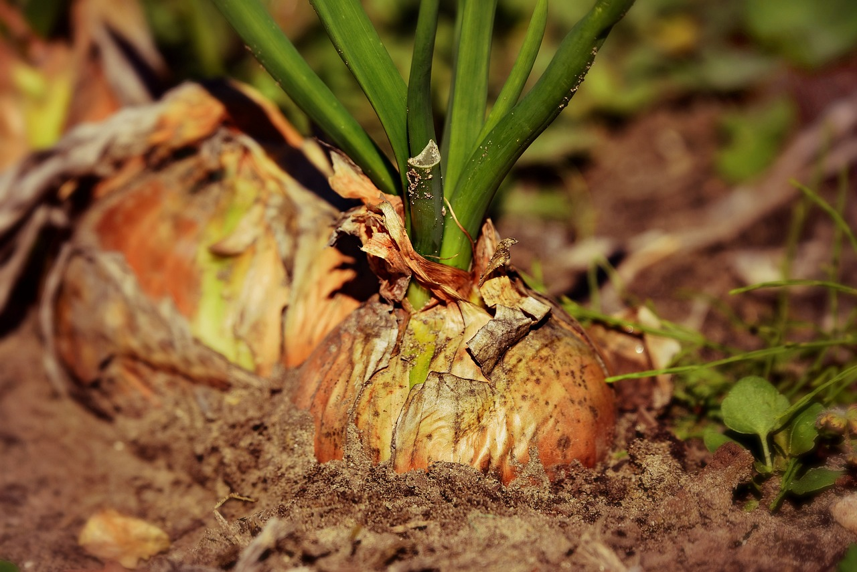
Comprehensive Exploration of Rock Weathering and Geological Processes
7
What is Biological Weathering?
Role of Living Organisms
Biological weathering involves the breakdown of rocks by living organisms.
It occurs through the action of plants, animals, and microorganisms.
Plant Roots and Rocks
The roots of plants breaking down rocks is an example of biological weathering.
This process demonstrates how plants contribute to the disintegration of rocks.
Microorganisms in Soil
The activity of microorganisms in soil is another example of biological weathering.
These microorganisms play a significant role in altering the composition of rocks.

Slide 8
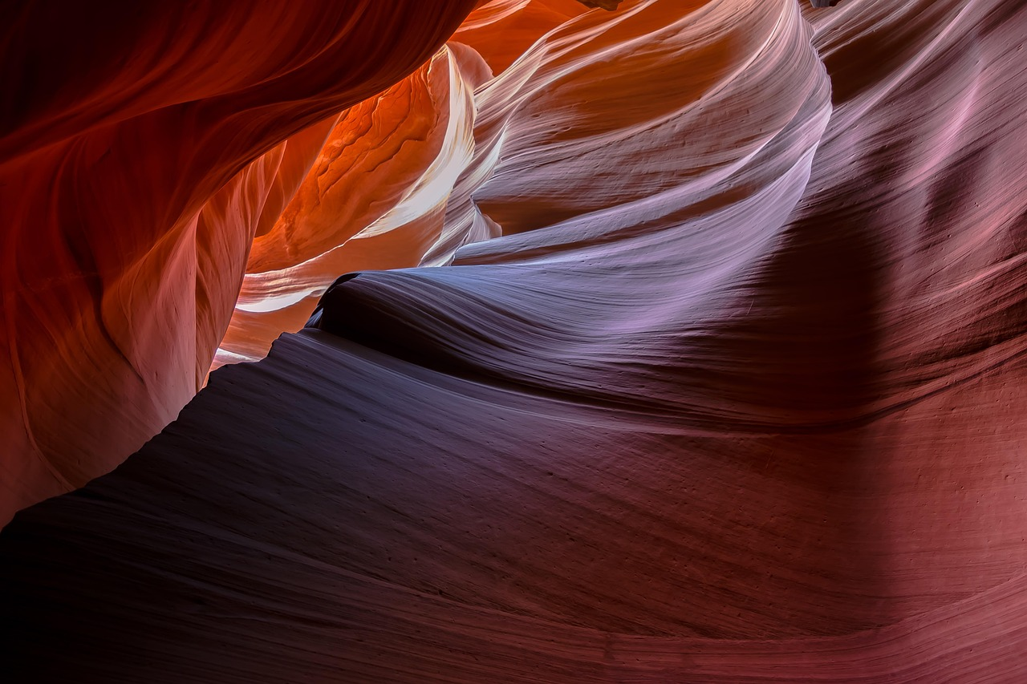
Comprehensive Exploration of Rock Weathering and Geological Processes
8
The Rock Cycle
Understanding the Rock Cycle
Formation of Different Rock Types
The rock cycle is the continuous process of rock formation, transformation, and destruction.
It involves the interaction of geological processes such as weathering, erosion, and plate tectonics.
The rock cycle includes the formation of igneous, sedimentary, and metamorphic rocks.
These rock types are created through various geological processes over time.
Role of Weathering in the Cycle
Geological Processes at Work
Weathering plays a crucial role in the rock cycle.
It breaks down rocks into sediment that can be transported and deposited to form new rocks.
Processes like weathering, erosion, and plate tectonics drive the rock cycle.
These processes ensure the continuous transformation and recycling of Earth's materials.

Slide 9
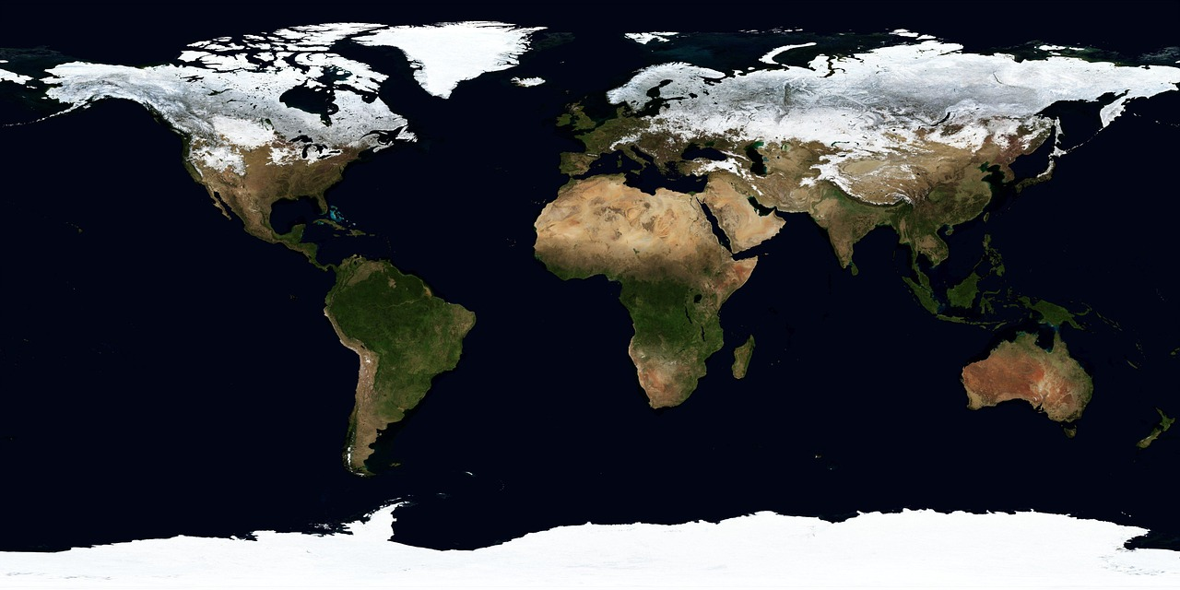
Comprehensive Exploration of Rock Weathering and Geological Processes
9
Factors that Influence Weathering
Climate's Role in Weathering
Impact of Topography on Weathering
Rock Type and Weathering Resistance
Time as a Factor in Weathering
Human Activities Influencing Weathering
Temperature, precipitation, and humidity are key factors that influence the rate of weathering.
These elements determine how quickly or slowly weathering processes occur in different environments.
The shape and elevation of the land play a significant role in the rate of weathering.
Steeper slopes may experience faster weathering due to increased erosion and runoff.
Different rocks exhibit varying levels of resistance to weathering.
For example, granite is more resistant compared to limestone, which weathers more easily.
Weathering is a gradual process that unfolds over thousands or even millions of years.
The extended timeframe allows for significant changes in landscapes and rock formations.
Human actions such as construction and mining can accelerate the rate of weathering.
These activities often expose rocks and soil to conditions that promote faster weathering.

Slide 10
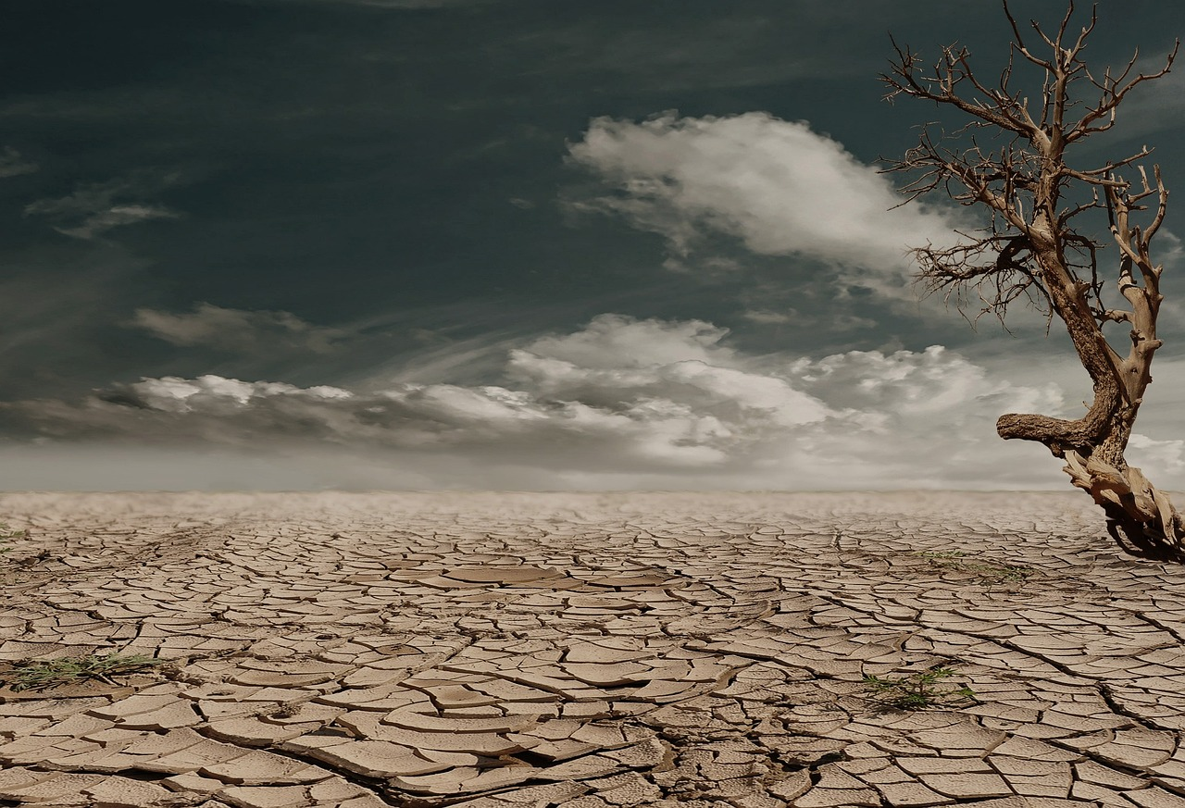
Comprehensive Exploration of Rock Weathering and Geological Processes
10
Examples of Weathering in Everyday Life
Soil Formation
Landscape Formation
Building Deterioration
Erosion and Its Effects
Weathering breaks down rocks into sediment.
This sediment mixes with organic matter to form soil.
Weathering shapes the landscape by breaking down rocks.
It creates unique landforms over time.
Weathering can cause buildings and monuments to deteriorate.
This process happens gradually over time.
Weathering contributes to erosion, leading to landslides.
It can also result in rockfalls in affected areas.

Slide 11

Comprehensive Exploration of Rock Weathering and Geological Processes
11
Preventing or Slowing Down Weathering
Conservation Efforts
Conservation involves protecting rocks and monuments from human activities that can cause weathering.
This helps preserve the integrity and historical value of these structures.
Protective Measures
Using protective coatings or sealants is an effective way to prevent weathering.
These measures create a barrier against environmental factors that contribute to weathering.
Regular Maintenance
Regular maintenance of buildings and structures can help prevent weathering.
This includes inspecting and repairing damages to ensure long-term durability.
Sustainable Practices
Adopting sustainable practices such as reducing pollution and conserving water can help reduce the rate of weathering.
These practices contribute to a healthier environment and slower degradation of materials.

Slide 12
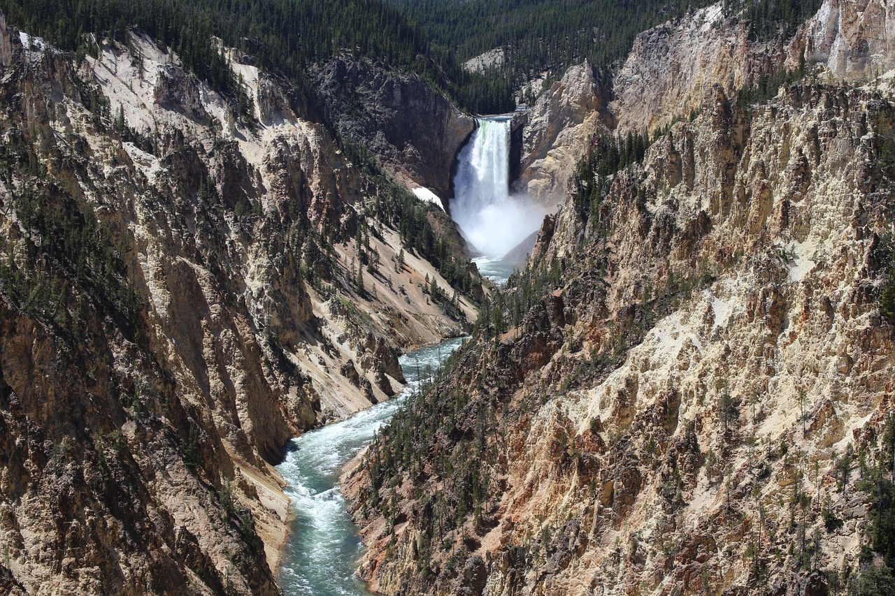
Comprehensive Exploration of Rock Weathering and Geological Processes
12
Case Study: The Grand Canyon
Landscape Shaped by Weathering and Erosion
Role of the Colorado River
The Grand Canyon is an example of a landscape shaped by weathering and erosion.
It showcases the transformative power of natural processes over millions of years.
The Colorado River has carved out the canyon through mechanical and chemical weathering.
This process has taken millions of years, highlighting the river's impact on the landscape.
Unique Geological Formation
Insights into Earth's History
The Grand Canyon is a unique example of the power of weathering and erosion in shaping the landscape.
Its distinct features make it a remarkable natural wonder.
The Grand Canyon provides valuable information about the Earth's history.
Its geological layers offer a glimpse into the planet's past.

Slide 13
Comprehensive Exploration of Rock Weathering and Geological Processes
13
Case Study: Limestone Caves
Chemical Weathering in Limestone Caves
Landscape Shaping by Chemical Weathering
Geological Significance of Limestone Caves
Formation Process of Limestone Caves
Limestone caves are an example of chemical weathering in action.
Acidic water dissolves the limestone, creating underground cavities and passageways.
The caves are a unique example of the power of chemical weathering in shaping the landscape.
They demonstrate how natural processes can sculpt intricate underground formations.
Limestone caves are important geological formations.
They provide valuable information about the Earth's history and past environmental conditions.
Acidic water plays a crucial role in the formation of limestone caves.
This process highlights the interaction between water chemistry and rock composition.

Slide 14
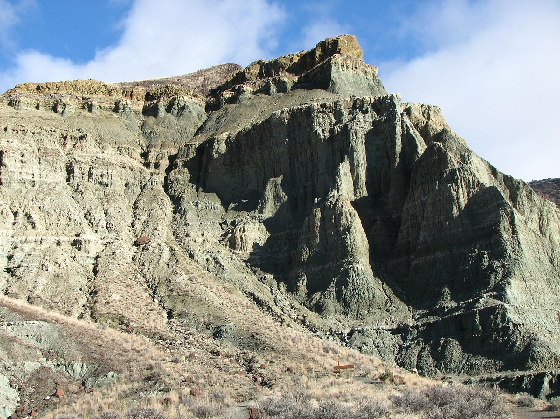
Comprehensive Exploration of Rock Weathering and Geological Processes
14
Conclusion
The Role of Rock Weathering
Understanding Earth's Dynamics
Processes of Rock Weathering
Rock weathering is an important geological process that shapes our planet's landscape.
It occurs through mechanical, chemical, and biological processes.
Understanding rock weathering is crucial for appreciating the dynamic nature of the Earth's surface.
This knowledge highlights the importance of conservation and sustainable practices.
Rock weathering occurs through mechanical, chemical, and biological processes.
These processes collectively contribute to the transformation of Earth's landscape.

Slide 15
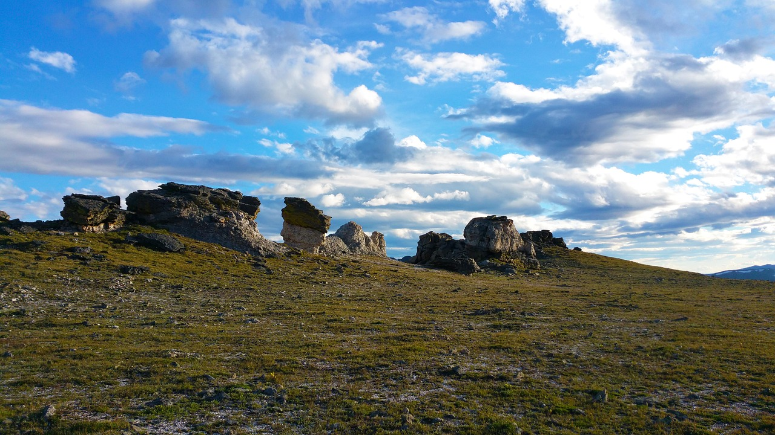
Comprehensive Exploration of Rock Weathering and Geological Processes
15
Summary
Definition of Rock Weathering
Role in the Rock Cycle
Rock weathering is the breakdown of rocks into smaller fragments or minerals.
It occurs through mechanical, chemical, and biological processes.
Weathering plays a crucial role in the rock cycle and shapes the landscape.
It highlights the dynamic interactions between Earth's surface and natural forces.
Importance of Understanding Weathering
Processes of Weathering
Understanding rock weathering is important for appreciating the dynamic nature of the Earth's surface.
It emphasizes the need for conservation and sustainable practices.
Mechanical, chemical, and biological processes contribute to rock weathering.
Each process uniquely impacts the transformation of rocks over time.

Slide 16
Comprehensive Exploration of Rock Weathering and Geological Processes
16
Key Terms
Weathering
Mechanical Weathering
Chemical Weathering
Biological Weathering
Rock Cycle
Weathering refers to the breakdown of rocks into smaller fragments or minerals.
It is a fundamental geological process that shapes the Earth's surface.
Mechanical weathering involves the physical breakdown of rocks into smaller fragments.
This process is driven by forces such as temperature changes, freezing and thawing, and abrasion.
Chemical weathering is the breakdown of rocks through chemical reactions.
It often involves processes like oxidation, hydrolysis, and carbonation.
Biological weathering is the breakdown of rocks by living organisms.
Examples include plant roots growing into cracks and animals burrowing into rock formations.
The rock cycle is the continuous process of rock formation, transformation, and destruction.
It illustrates the dynamic and interconnected nature of Earth's geology.

Slide 17

Comprehensive Exploration of Rock Weathering and Geological Processes
17
Assessment
Quiz Assessment
Project Evaluation
Class Discussion Engagement
Students will be assessed on their understanding of the different types of weathering.
They will also be evaluated on their knowledge of the rock cycle.
Students will be assessed on their ability to apply their knowledge of weathering.
This will involve connecting their understanding to real-world examples.
Students will be assessed on their participation in class discussions.
Their level of engagement will also be evaluated.

Slide 18
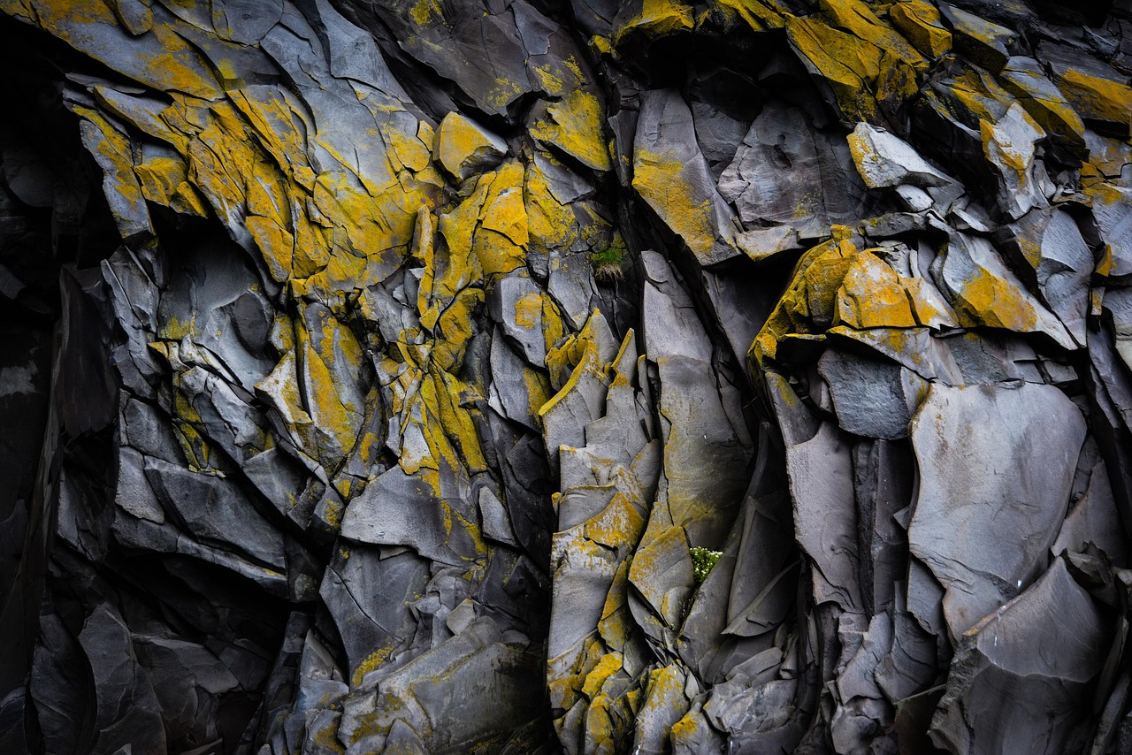
Comprehensive Exploration of Rock Weathering and Geological Processes
18
Extension Activities
Modeling Weathering Processes
Research on Geological Phenomena
Experimental Weathering Demonstration
Illustrating the Rock Cycle
Create a model of a rock or landscape that demonstrates the process of weathering.
This activity helps visualize how natural forces shape geological features over time.
Research and present on a specific type of weathering or geological formation.
This task encourages in-depth understanding of natural processes and their impact on Earth's surface.
Design an experiment to demonstrate the effects of weathering on different types of rocks.
This hands-on activity illustrates the varying resilience of rocks to environmental factors.
Create a diagram or illustration of the rock cycle and the role of weathering in it.
This visual representation highlights the interconnected processes shaping Earth's crust.

Slide 19

Comprehensive Exploration of Rock Weathering and Geological Processes
19
Parent Engagement
Fostering Classroom Involvement
Creating Open Communication Channels
Supporting Learning at Home
Encourage parents to participate in class discussions and activities.
This helps build a stronger connection between parents and the classroom environment.
Provide opportunities for parents to ask questions and seek feedback.
This ensures parents feel heard and involved in their child's education.
Encourage parents to support their child's learning by providing resources and encouragement at home.
This reinforces the child's educational experience beyond the classroom.

Slide 20
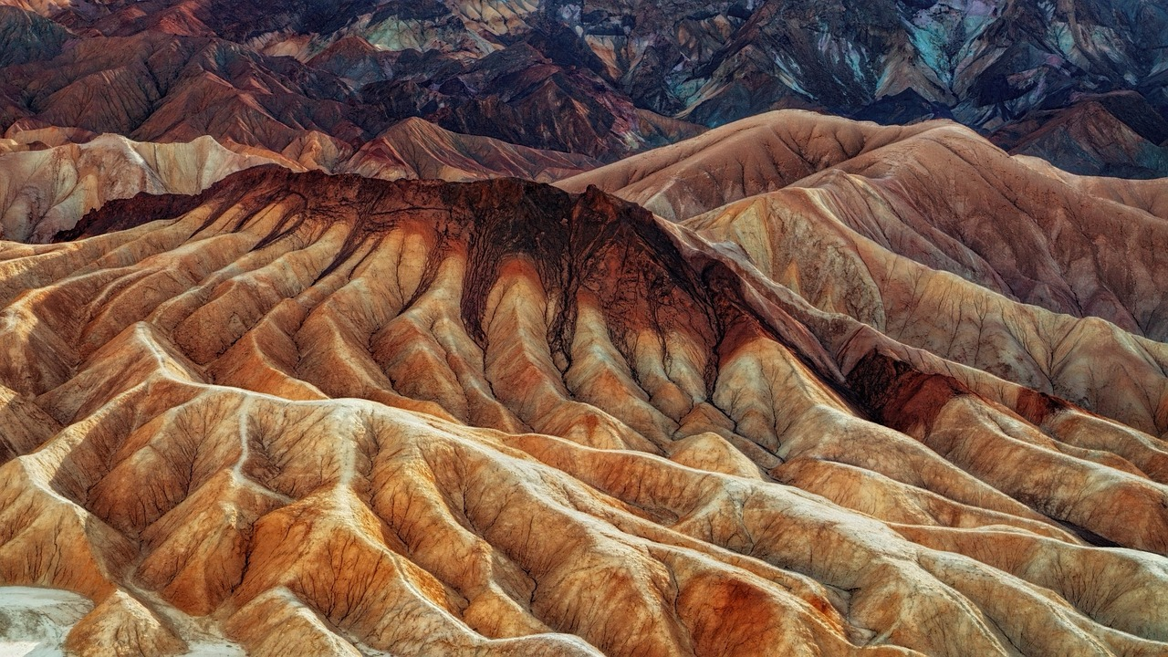
Comprehensive Exploration of Rock Weathering and Geological Processes
20
Reflection Questions
Understanding Rock Weathering
Examples of Weathering
What did you learn about rock weathering in this lesson?
How does weathering shape the landscape?
What are some examples of weathering in everyday life?
How does weathering shape the landscape?
Preventing Weathering
Impact of Weathering
How can we prevent or slow down weathering?
What are some examples of weathering in everyday life?
How does weathering shape the landscape?
How can we prevent or slow down weathering?

Slide 21
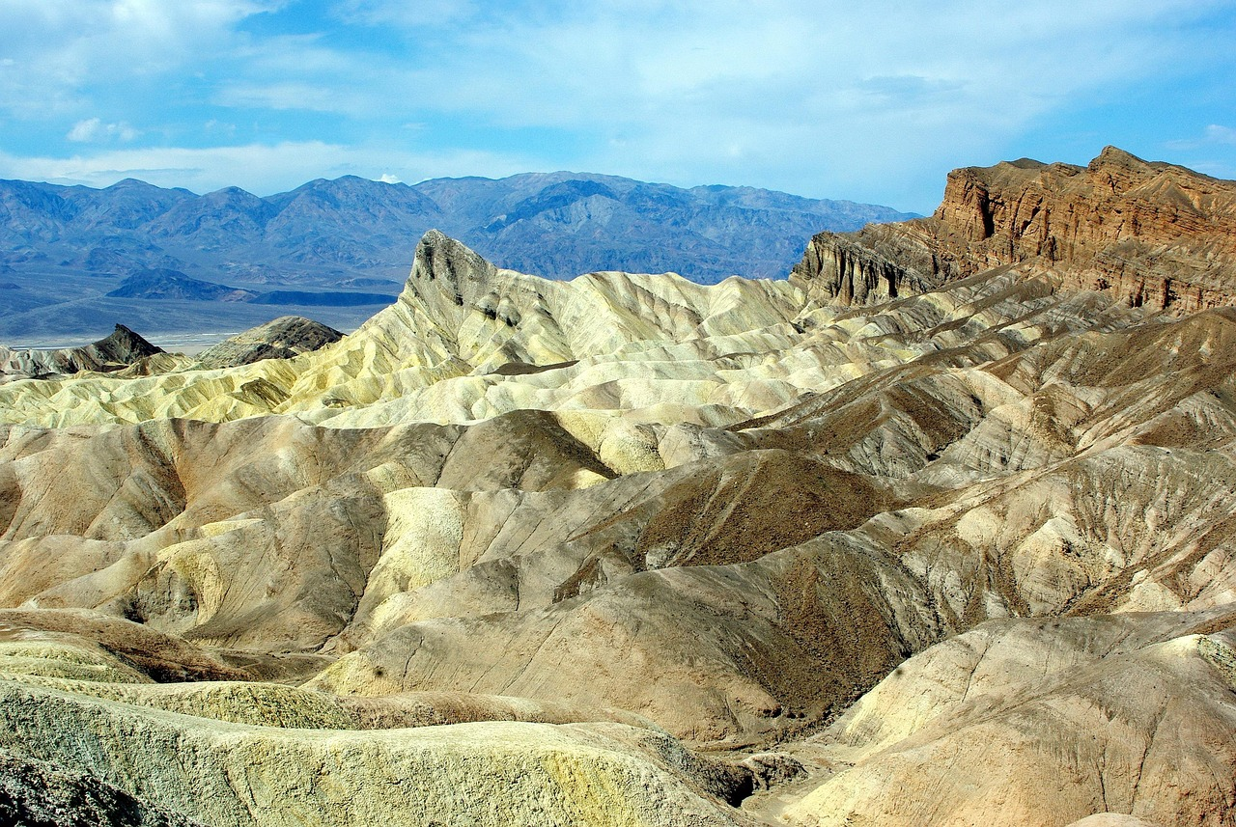
Comprehensive Exploration of Rock Weathering and Geological Processes
21
Next Steps
Lesson on Erosion and Deposition
Investigation of Geological Landforms
Project on Human Impact on Geological Processes
Building on the understanding of weathering, students will explore how weathered materials are transported away.
They will also learn how these materials are deposited in new locations.
Students will conduct an in-depth investigation of specific geological landforms.
This will help them understand how these landforms are formed through the combined actions of weathering, erosion, and deposition.
Students will work on a project that examines the impact of human activities on geological processes.
This includes exploring the effects on weathering, erosion, and deposition.

