Slide 1
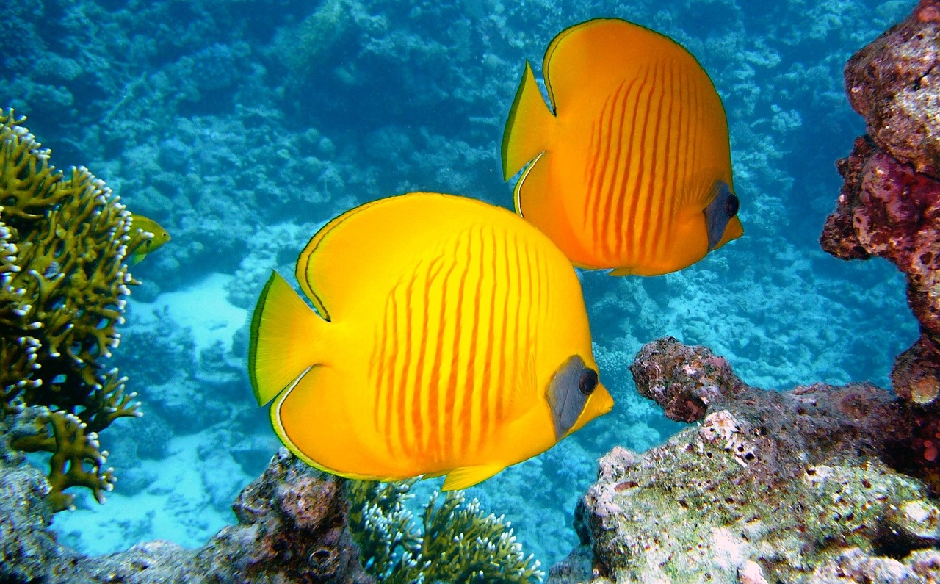
Preserving the Great Barrier Reef
A Call to Action for Marine Conservation and Climate Stewardship

Slide 2
Table of contents
01
02
03
04
05
06
07
08
09
10
11
Lesson Introduction
Biological Complexity of the Great Barrier Reef
Ecological Significance of the Great Barrier Reef
Environmental Challenges Facing the Great Barrier Reef
Interconnected Nature of Marine Ecosystems
Climate Science and the Great Barrier Reef
Human Environmental Responsibility
Marine Biodiversity in Peril
Coral Formations in Danger
Global Environmental Transformation
The Urgent Need for Conservation Efforts

Slide 3
Table of contents
12
13
14
15
16
17
18
19
20
Threats to the Great Barrier Reef
Protecting Marine Ecosystems
Understanding Climate Change Impacts
Conserving Coral Reefs
Sustainable Practices for Ecosystem Preservation
Educating for Environmental Stewardship
Promoting Ocean Conservation
Preserving Marine Biodiversity
Challenges of Climate Crisis

Slide 4
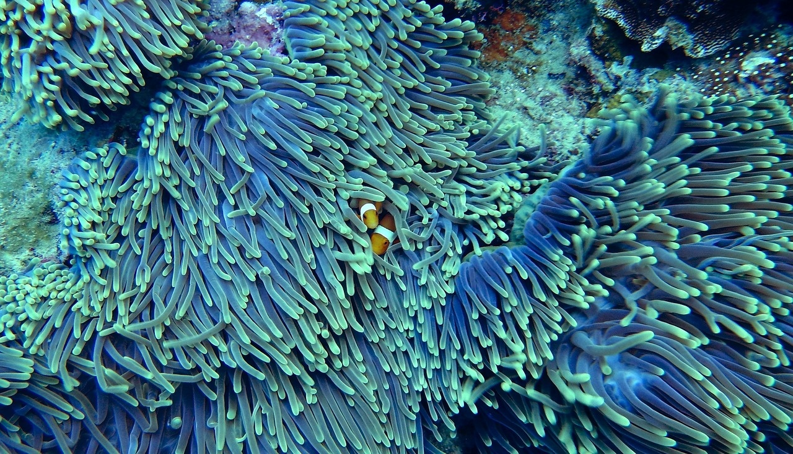
1
Lesson Introduction
01
The Great Barrier Reef
02
Lesson Exploration
Represents one of the most complex and critically endangered marine ecosystems on our planet.
Serves as a profound case study of global environmental transformation.
Spanning approximately 2,300 kilometers along Australia's northeastern coastline, this extraordinary marine ecosystem is not just a collection of coral formations.
It is a living, breathing testament to the intricate balance of marine biodiversity and the devastating impacts of human-induced climate change.
Students will embark on a comprehensive exploration of this remarkable ecosystem, examining its biological complexity.
They will also delve into its ecological significance and the urgent environmental challenges threatening its survival.
This lesson will challenge students to understand the interconnected nature of marine ecosystems, climate science, and human environmental responsibility.
Preserving the Great Barrier Reef

Slide 5
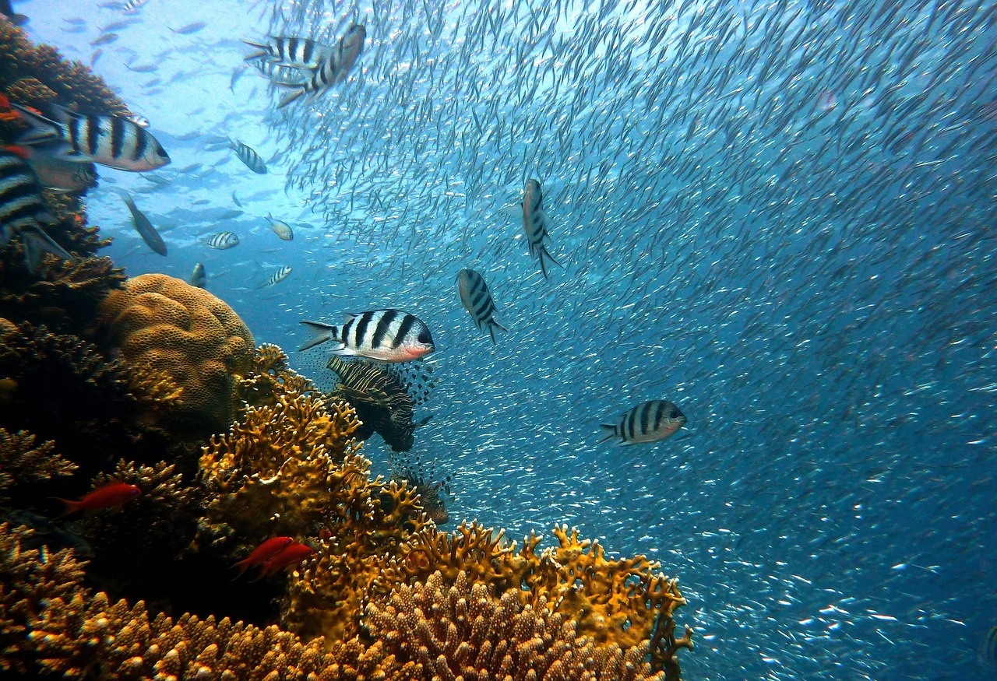
2
Biological Complexity of the Great Barrier Reef
Coral Species Diversity
The Great Barrier Reef is home to over 1,500 species of fish and 400 species of coral, showcasing a high level of biodiversity.
Symbiotic Relationships
Coral reefs rely on symbiotic relationships with algae, providing essential nutrients and energy for growth and survival.
Keystone Species
Species like the parrotfish play a crucial role in maintaining the health of the reef by controlling algae growth and promoting coral growth.
Adaptations to Climate Change
Some coral species within the reef have shown resilience to rising sea temperatures through adaptive mechanisms, offering hope for the reef's future survival.
Interconnected Ecosystem
The Great Barrier Reef's biological complexity highlights the interconnectedness of various species and their dependence on each other for survival.
Preserving the Great Barrier Reef

Slide 6
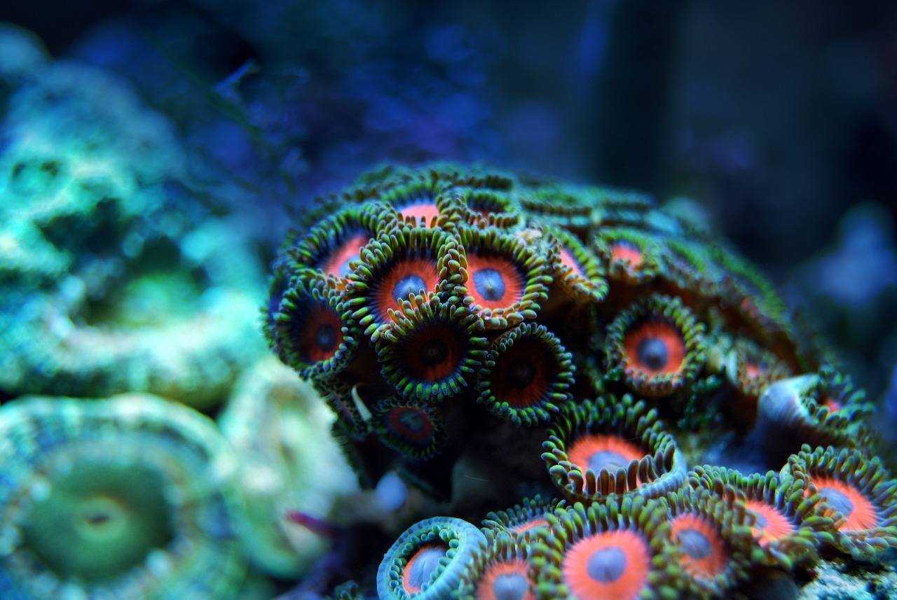
3
Ecological Significance of the Great Barrier Reef
01
Biodiversity Hotspot
02
Marine Life Sanctuary
Home to over 1,500 species of fish
Supports 411 types of hard coral
Provides habitat for endangered species like dugongs and green sea turtles
Supports over 215 species of birds
03
Carbon Sink
04
Economic Value
Absorbs an estimated 48 million tonnes of CO2 annually
Helps mitigate climate change impacts
Generates $6.4 billion annually for the Australian economy
Supports tourism and fishing industries
Preserving the Great Barrier Reef

Slide 7
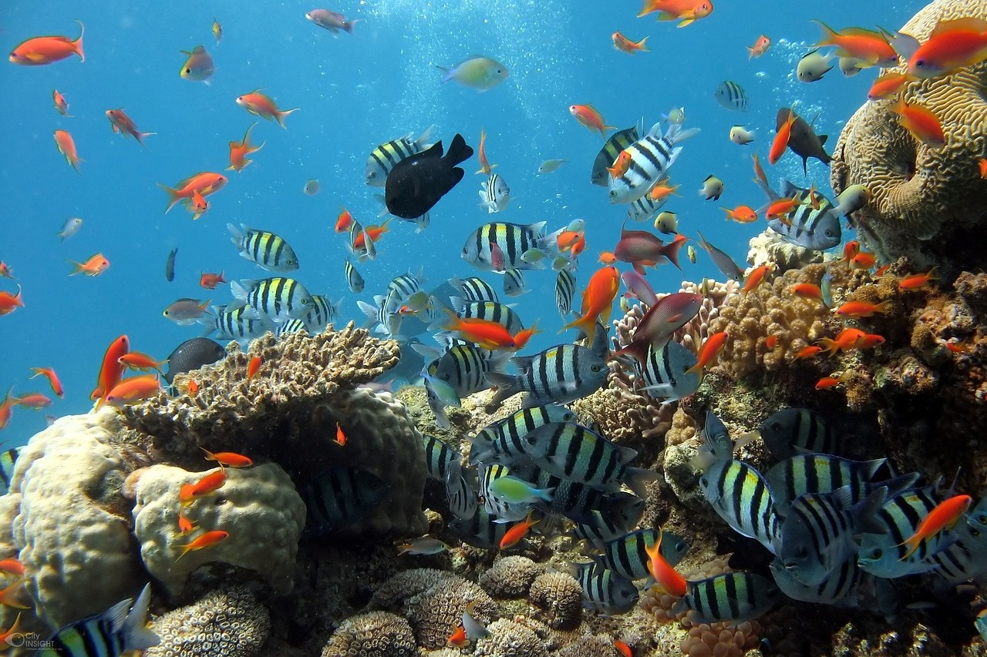
4
Environmental Challenges Facing the Great Barrier Reef
Coral Bleaching Events
Increasing sea temperatures leading to widespread coral bleaching.
Resulting in loss of vibrant colors and vital habitat for marine life.
Ocean Acidification
Absorption of excess carbon dioxide causing a decrease in pH levels.
Hindering coral growth and weakening the reef's resilience.
Pollution and Runoff
Agricultural runoff introducing harmful chemicals and nutrients.
Fueling algal blooms and impacting water quality.
Overfishing and Illegal Fishing
Depletion of key fish species disrupting the reef's delicate ecosystem.
Illegal fishing practices damaging coral structures and marine life.
Preserving the Great Barrier Reef

Slide 8
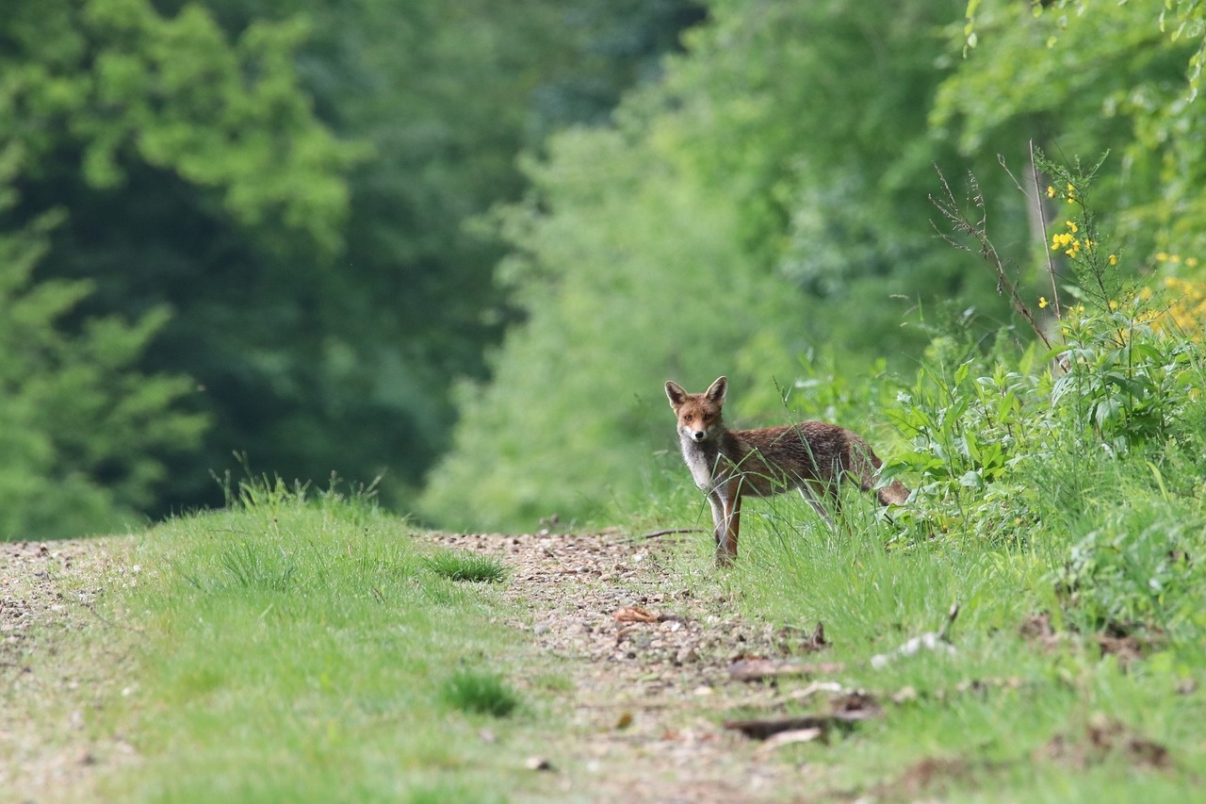
5
Interconnected Nature of Marine Ecosystems
01
Biodiversity
02
Food Chain
The Great Barrier Reef is home to over 1,500 species of fish, 411 types of hard coral, and countless other marine organisms.
From tiny plankton to apex predators like sharks, every species in the reef ecosystem plays a crucial role in maintaining the delicate balance of the food chain.
03
Coral Reefs
04
Climate Impact
Coral reefs provide shelter and breeding grounds for numerous marine species, highlighting the interconnectedness of different habitats within the ecosystem.
Changes in ocean temperature and acidity due to climate change can disrupt the symbiotic relationships between species, leading to cascading effects throughout the ecosystem.
Preserving the Great Barrier Reef

Slide 9
6
Climate Science and the Great Barrier Reef
Length of the Great Barrier Reef
Coral Bleaching Impact
Projected Irreversible Damage Year
2,300 kilometers
93%
2050
This vast ecosystem is a critical part of the world's marine biodiversity.
The percentage of the Great Barrier Reef affected by coral bleaching due to rising sea temperatures. Coral bleaching poses a severe threat to the survival of the reef's delicate ecosystem.
The projected year by which the Great Barrier Reef could face irreversible damage if current climate trends continue. Urgent action is needed to mitigate the impacts of climate change on this iconic natural wonder.
Preserving the Great Barrier Reef

Slide 10
7
Human Environmental Responsibility
01
02
03
04
Reduce Carbon Footprint
Support Sustainable Practices
Promote Conservation Efforts
Engage in Climate Action
Encourage individuals to minimize their carbon emissions by using public transportation, carpooling, and opting for energy-efficient appliances.
Advocate for sustainable fishing methods, responsible tourism, and eco-friendly products to protect marine ecosystems like the Great Barrier Reef.
Participate in beach clean-ups, support marine conservation organizations, and raise awareness about the importance of preserving biodiversity.
Take part in climate strikes, support policies that combat climate change, and educate others on the impact of global warming on marine environments.
Preserving the Great Barrier Reef

Slide 11
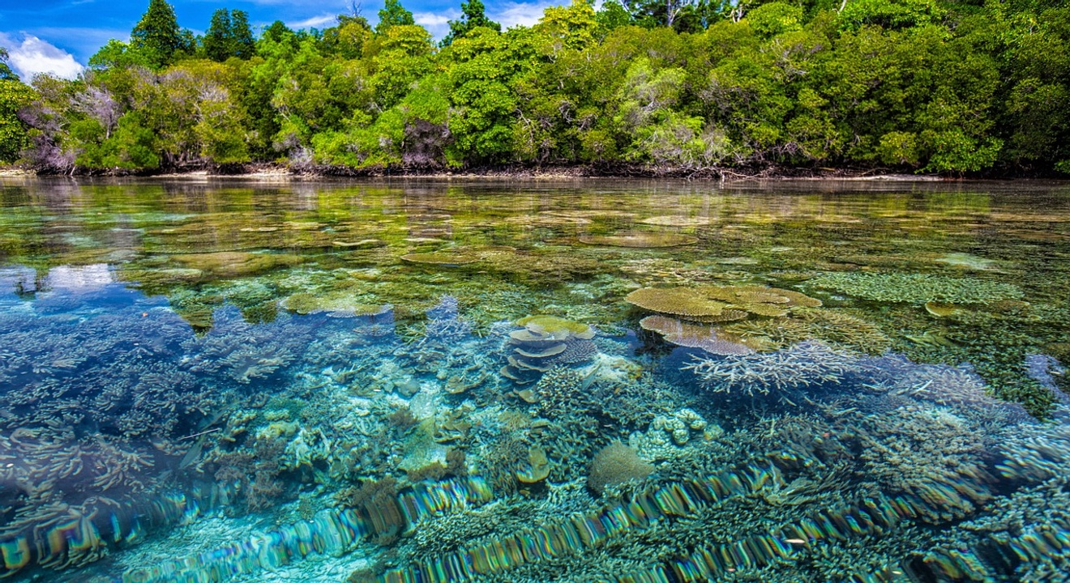
8
Marine Biodiversity in Peril
01
Coral Species Decline
02
Threatened Marine Species
Over 50% of coral species in the Great Barrier Reef are at risk of extinction.
More than 1,500 species of fish and 411 species of hard coral are in danger due to habitat destruction and climate change.
03
Impact on Ecosystem
04
Human Activities
Decline in marine biodiversity can disrupt the delicate balance of the ecosystem, leading to cascading effects on other species.
Pollution, overfishing, and coastal development contribute to the decline of marine biodiversity in the Great Barrier Reef.
Preserving the Great Barrier Reef

Slide 12
9
Coral Formations in Danger
01
02
03
04
05
Coral Bleaching
Ocean Acidification
Overfishing
Pollution
Physical Damage
Rising sea temperatures lead to stress in coral, causing them to expel the algae living in their tissues, turning them white.
Increased carbon dioxide levels in the atmosphere are absorbed by the ocean, leading to a decrease in pH levels, making it harder for corals to build their calcium carbonate structures.
Unregulated fishing practices can disrupt the delicate balance of the reef ecosystem, impacting the health and diversity of coral formations.
Runoff from land-based activities introduces pollutants such as chemicals and plastics into the ocean, further endangering coral health.
Activities like anchoring, diving, and coastal development can directly damage coral formations, leading to their decline.
Preserving the Great Barrier Reef

Slide 13
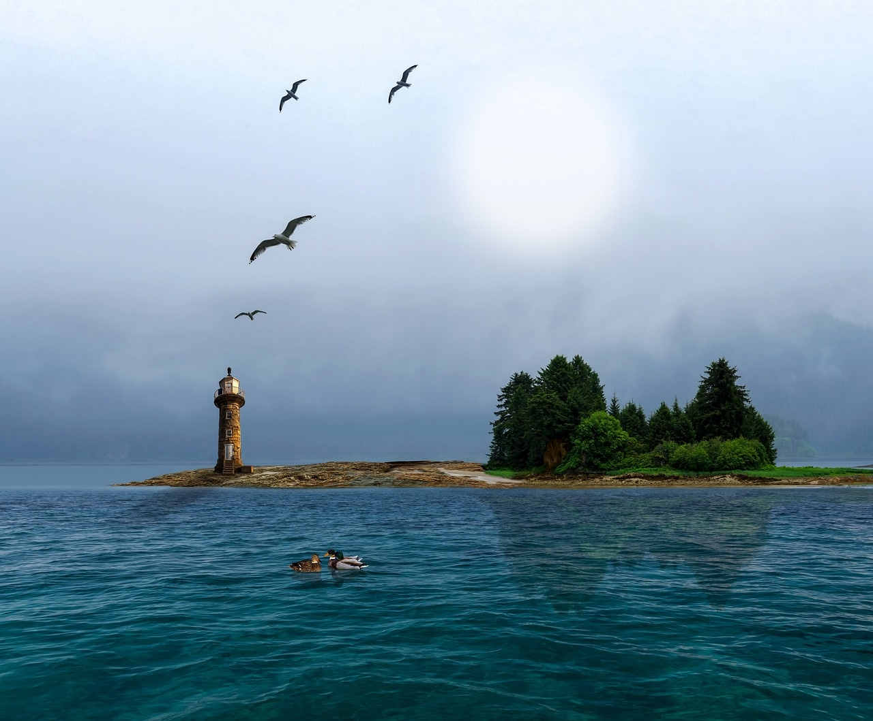
10
Global Environmental Transformation
Rising Sea Temperatures
The Great Barrier Reef has experienced a 0.7°C increase in sea temperatures over the past century.
Coral Bleaching Events
Severe coral bleaching events have become more frequent, with 50% of the reef affected in 2016 and 2017.
Ocean Acidification
The increasing levels of carbon dioxide in the atmosphere have led to ocean acidification, impacting the reef's ability to calcify.
Loss of Biodiversity
The Great Barrier Reef has lost half of its coral cover in the last 30 years, leading to a decline in marine biodiversity.
Urgent Conservation Efforts
Collaborative efforts are underway to protect and restore the reef, including marine park management and reducing carbon emissions.
Preserving the Great Barrier Reef

Slide 14
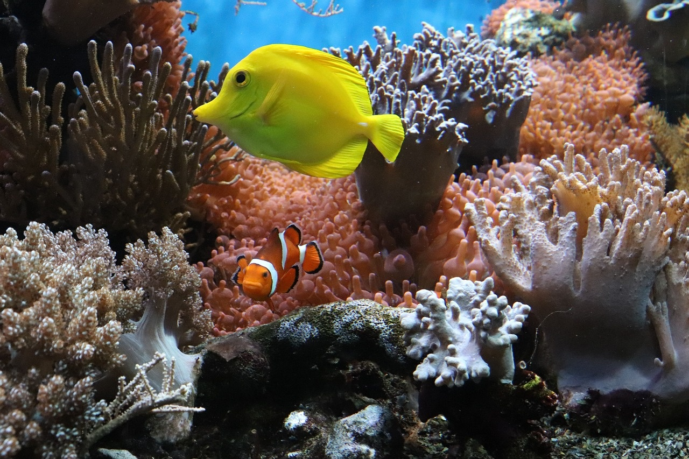
11
The Urgent Need for Conservation Efforts
Declining Coral Cover
The Great Barrier Reef has experienced a significant decline in coral cover, with over 50% loss in the last three decades.
Impact of Climate Change
Rising sea temperatures and ocean acidification are major threats to the reef's delicate ecosystem, leading to coral bleaching and reduced biodiversity.
Loss of Marine Species
The degradation of the Great Barrier Reef puts at risk thousands of marine species that depend on its habitats for survival.
Tourism and Economy
The reef supports a multi-billion dollar tourism industry in Australia, and its decline could have severe economic repercussions.
Global Significance
As one of the world's most iconic marine ecosystems, the preservation of the Great Barrier Reef is crucial for global biodiversity and climate resilience.
Preserving the Great Barrier Reef

Slide 15
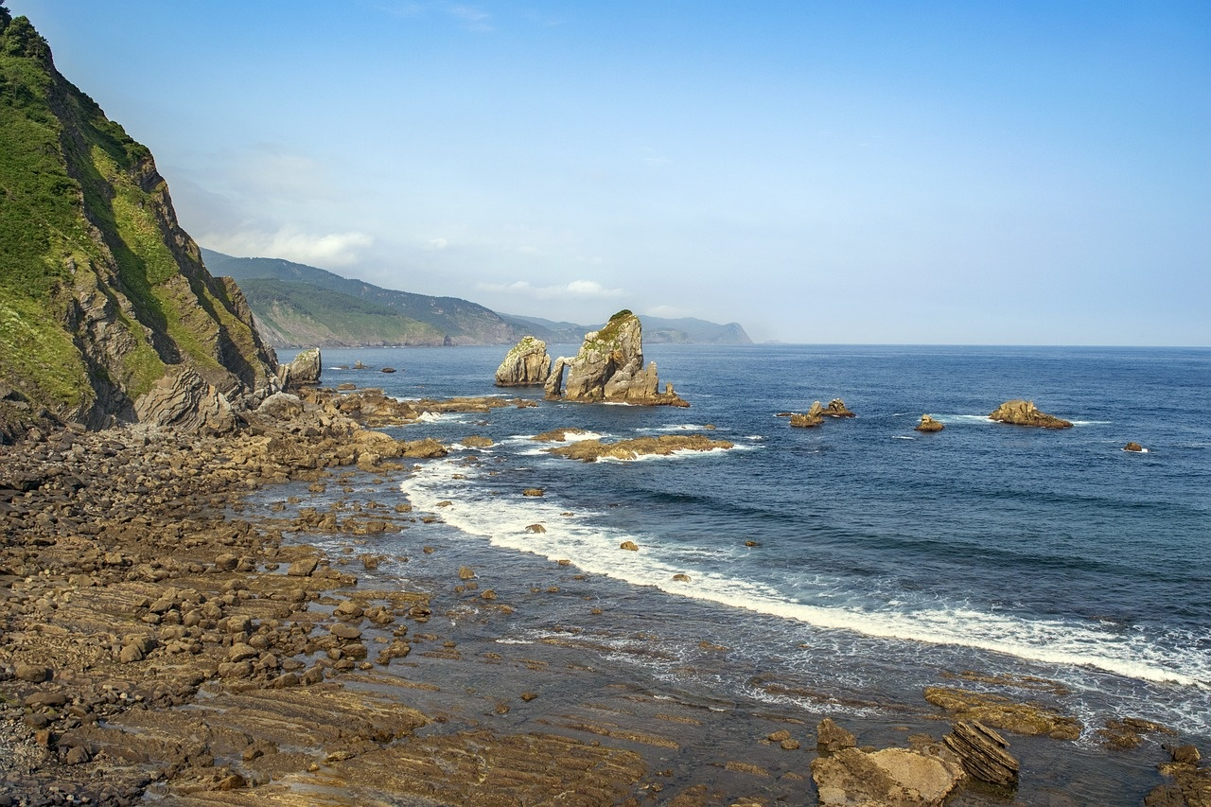
12
Threats to the Great Barrier Reef
Climate Change
Rising sea temperatures leading to coral bleaching
Increased frequency of extreme weather events
Ocean Acidification
Absorption of excess carbon dioxide causing a decrease in pH levels
Impacting coral growth and marine life
Pollution
Runoff from agriculture
Coastal development
Marine debris harming water quality and marine species
Overfishing
Unsustainable fishing practices depleting fish populations
Disrupting the reef's delicate ecosystem
Crown-of-Thorns Starfish
Outbreaks of these coral-eating starfish causing significant damage to coral reefs
Preserving the Great Barrier Reef

Slide 16
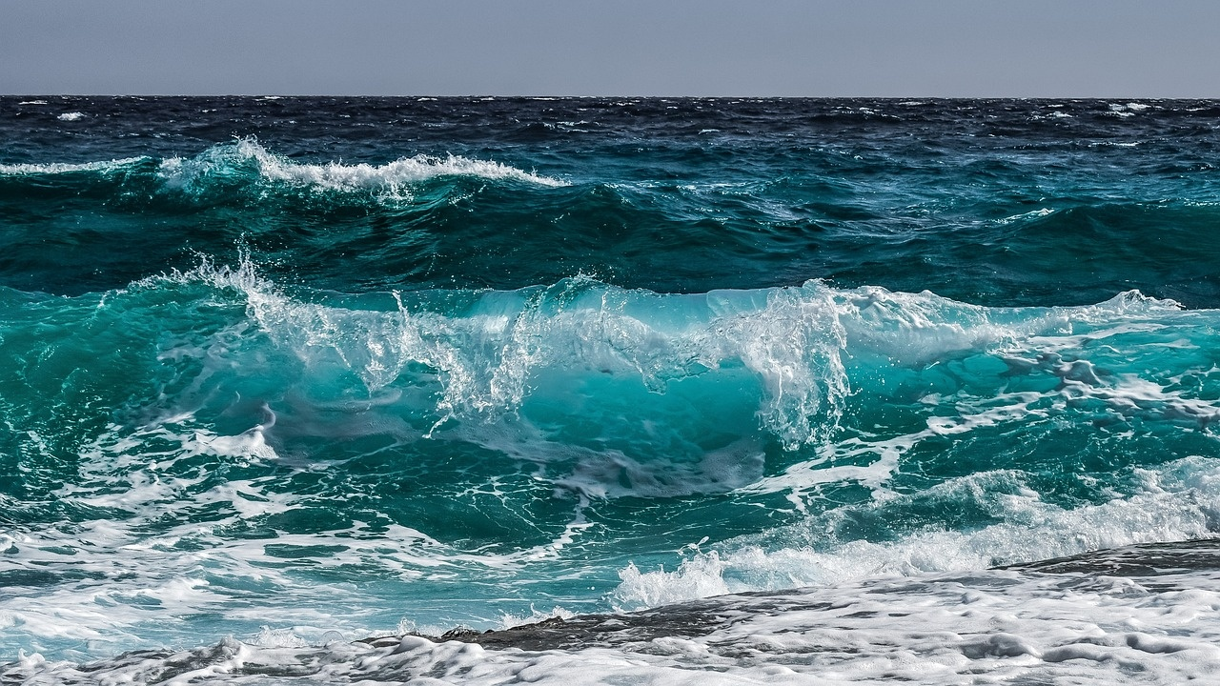
13
Protecting Marine Ecosystems
Implementing Marine Protected Areas (MPAs)
Safeguard critical habitats
Preserve biodiversity
Enforcing Sustainable Fishing Practices
Prevent overexploitation of marine resources
Monitoring and Reducing Pollution
Maintain water quality
Promoting Public Awareness and Education
Importance of marine conservation
Collaborating with Local Communities and Stakeholders
Develop conservation initiatives
Preserving the Great Barrier Reef

Slide 17
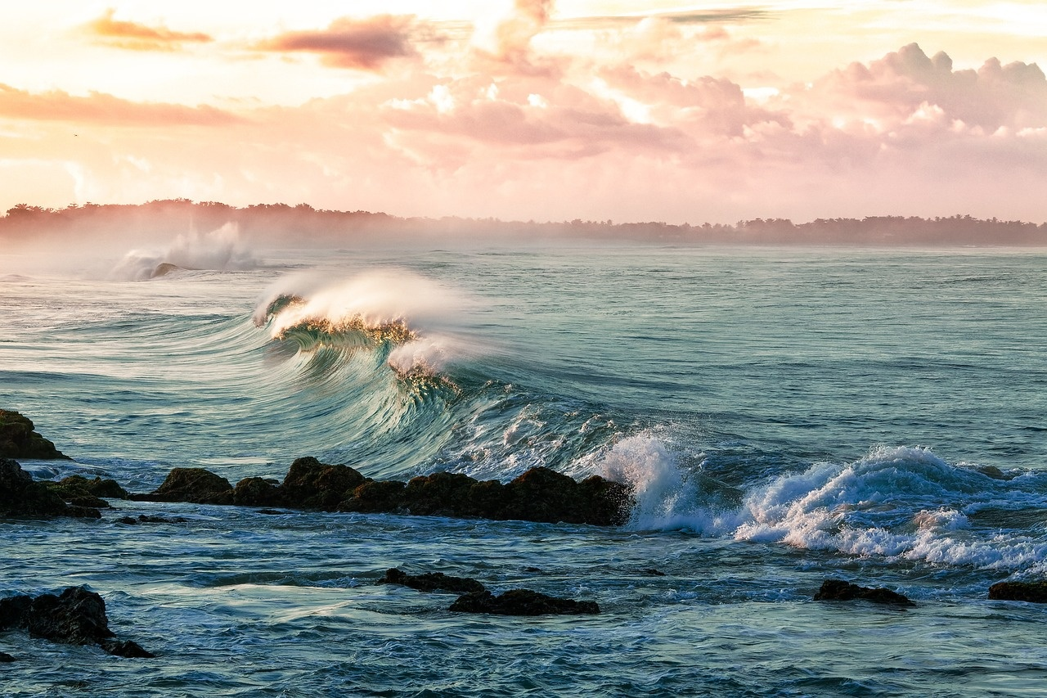
14
Understanding Climate Change Impacts
01
Rising Sea Temperatures
02
Ocean Acidification
The Great Barrier Reef is experiencing an increase in sea temperatures, leading to coral bleaching events.
Warmer waters stress the corals, causing them to expel the algae living in their tissues, which results in the coral turning white.
Increased carbon dioxide levels in the atmosphere are being absorbed by the ocean, leading to ocean acidification.
Acidification hinders the ability of corals to build their calcium carbonate structures, impacting their growth and overall health.
03
Extreme Weather Events
04
Habitat Loss
Climate change is contributing to more frequent and severe extreme weather events, such as cyclones and storms.
These events can physically damage the reef structure and disrupt the delicate balance of the ecosystem.
Climate change is causing shifts in ocean currents and temperatures, leading to habitat loss for many marine species.
Loss of habitat can disrupt the food chain and biodiversity of the Great Barrier Reef ecosystem.
Preserving the Great Barrier Reef

Slide 18
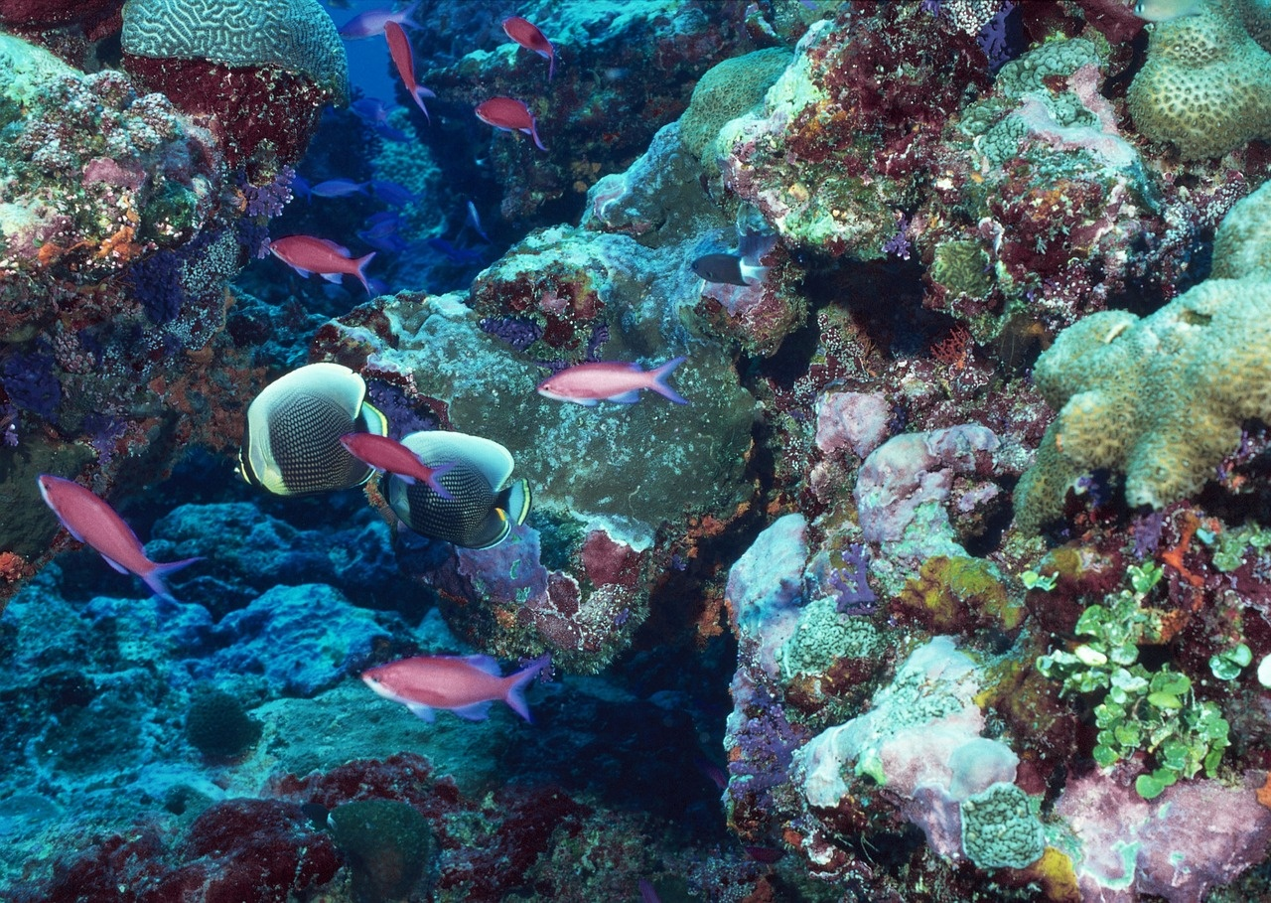
15
Conserving Coral Reefs
Implementing Marine Protected Areas (MPAs)
Safeguard coral reef habitats.
Promoting sustainable fishing practices
Reduce stress on coral reef ecosystems.
Monitoring water quality
Prevent pollution and sedimentation that harm coral reefs.
Supporting research and conservation efforts
Understand and protect coral reef biodiversity.
Engaging local communities
Involve in coral reef conservation through education and awareness programs.
Preserving the Great Barrier Reef

Slide 19
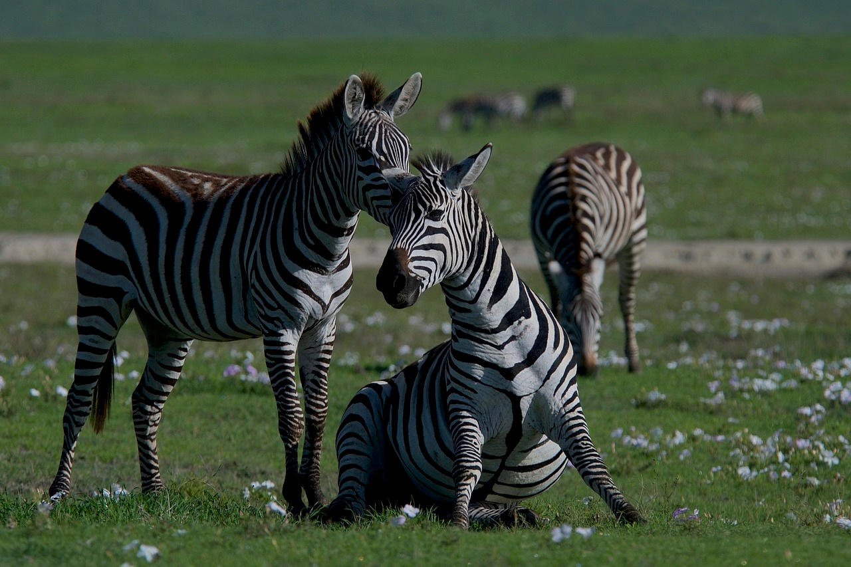
16
Sustainable Practices for Ecosystem Preservation
01
Coral Reef Restoration Projects
02
Sustainable Fishing Practices
Engage in active restoration efforts to rebuild damaged coral reefs.
Implement coral gardening techniques to propagate and transplant coral fragments.
Promote responsible fishing methods to prevent overfishing and protect marine biodiversity.
Establish marine protected areas to safeguard critical habitats for fish species.
03
Reduction of Pollution
04
Climate Change Mitigation
Implement strict regulations to minimize pollution from agricultural runoff and coastal development.
Encourage the use of eco-friendly products to reduce plastic pollution in marine environments.
Advocate for policies that reduce greenhouse gas emissions to combat ocean acidification and coral bleaching.
Support renewable energy initiatives to transition towards a low-carbon economy.
Preserving the Great Barrier Reef

Slide 20
17
Educating for Environmental Stewardship
01
02
03
04
Understanding the Great Barrier Reef
Climate Crisis Impacts
Interconnected Nature
Promoting Responsibility
Explore the biological complexity and ecological significance of the Great Barrier Reef.
Learn about the devastating impacts of human-induced climate change on the marine ecosystem.
Understand the intricate balance of marine biodiversity and the urgent environmental challenges facing the Great Barrier Reef.
Encourage students to recognize their role in environmental stewardship and conservation efforts.
Preserving the Great Barrier Reef

Slide 21
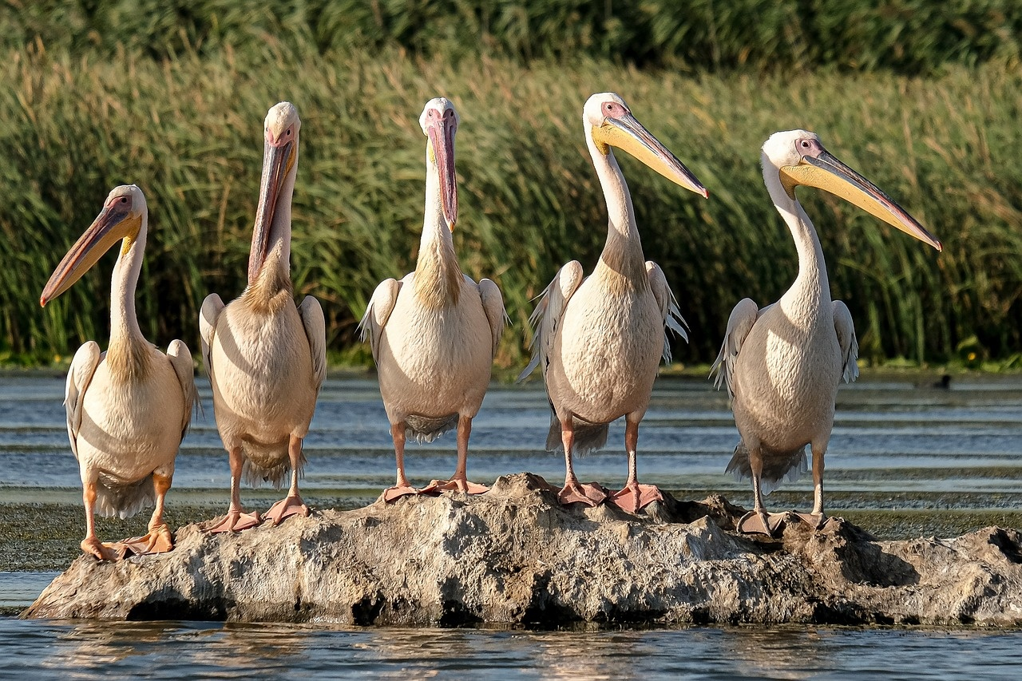
18
Promoting Ocean Conservation
01
Raise Awareness
02
Reduce Plastic Pollution
Educate communities and individuals about the importance of preserving marine ecosystems like the Great Barrier Reef.
Encourage the use of reusable items to minimize plastic waste that harms marine life.
03
Support Sustainable Fishing Practices
04
Engage in Beach Clean-Up Initiatives
Advocate for responsible fishing methods to protect marine biodiversity.
Organize and participate in beach clean-up events to prevent pollution from reaching the ocean.
Preserving the Great Barrier Reef

Slide 22
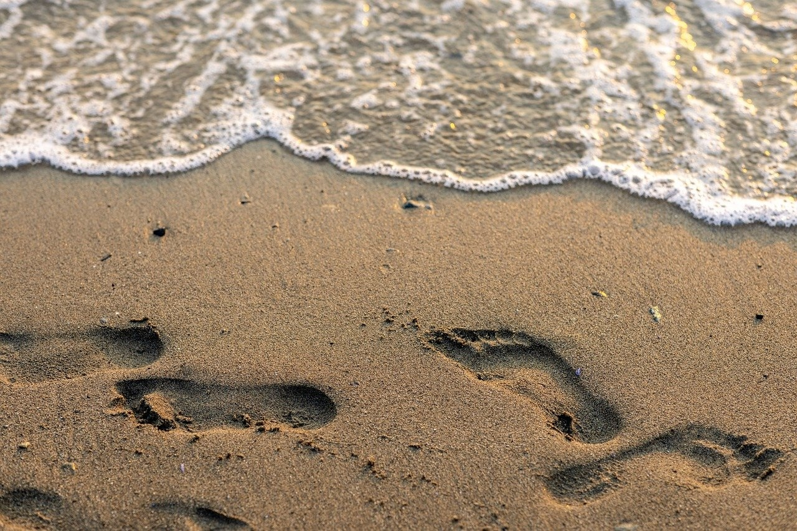
19
Preserving Marine Biodiversity
Implementing Marine Protected Areas (MPAs)
Establishing designated areas to safeguard marine habitats and species.
Regulating human activities to minimize negative impacts on biodiversity.
Sustainable Fishing Practices
Promoting responsible fishing methods to prevent overfishing and protect marine species.
Enforcing regulations to ensure the long-term health of marine ecosystems.
Reducing Pollution
Implementing measures to minimize plastic pollution and chemical runoff into marine environments.
Raising awareness about the importance of clean oceans for marine biodiversity.
Climate Change Mitigation
Addressing carbon emissions to reduce ocean acidification and coral bleaching.
Supporting initiatives to combat global warming and preserve marine ecosystems.
Preserving the Great Barrier Reef

Slide 23
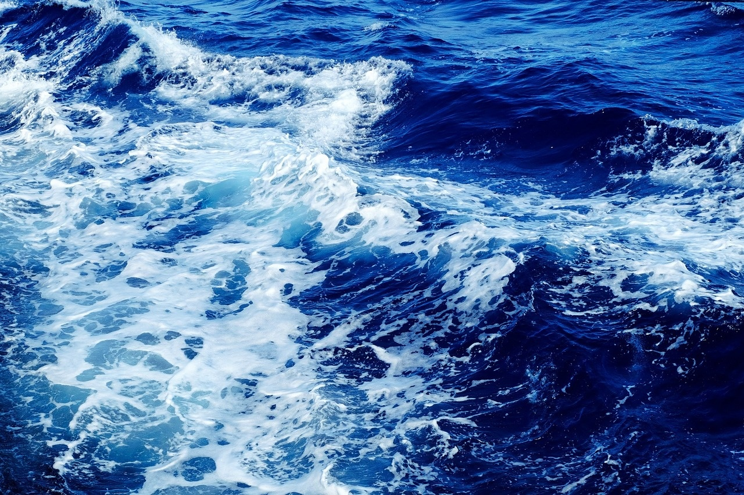
20
Challenges of Climate Crisis
01
Rising Sea Temperatures
02
Ocean Acidification
The Great Barrier Reef is experiencing increased sea temperatures due to climate change.
Warmer waters lead to coral bleaching, endangering the delicate ecosystem.
Increased carbon dioxide levels in the atmosphere are causing ocean acidification.
Acidification hinders the ability of corals to build their calcium carbonate structures.
03
Extreme Weather Events
04
Coral Bleaching
More frequent and severe storms pose a threat to the stability of the reef ecosystem.
Storm damage can disrupt coral growth and recovery processes.
Elevated sea temperatures stress the corals, leading to bleaching events.
Bleaching weakens the corals and makes them more susceptible to disease and death.
Preserving the Great Barrier Reef

