Slide 1

Enhancing English Language Skills for ELL Students
Comprehensive Strategies for Vocabulary Building, Pronunciation Improvement, and Academic Success

Slide 2
Table of Contents
Introduction to Vocabulary Building and Pronun…
Importance of Vocabulary Building
Importance of Pronunciation Improvement
ELL/ESL Support Strategies
Lesson Plan Overview
Vocabulary Building Activities
Pronunciation Practice Activities
Conversation Practice Activities
Assessment and Feedback
Technology Integration
Conclusion
Future Lessons
Reflection and Evaluation
04
05
06
07
08
09
10
11
12
13
14
15
16

Slide 3
Table of Contents
Final Thoughts
References
17
18

Slide 4

Introduction to Vocabulary Building and Pronunciation Improvement
Importance of Vocabulary and Pronunciation
Interactive Strategies for Language Skills
Lesson Outcomes for Students
Vocabulary building and pronunciation improvement are crucial for ELL students to communicate effectively and confidently in English.
These skills are essential for both academic success and social integration.
This lesson plan aims to provide interactive strategies to enhance language skills.
The focus is on promoting academic success and fostering social integration.
By the end of this lesson, students will be able to identify and pronounce new vocabulary words correctly.
They will also use context clues to understand unfamiliar words and engage in conversations with improved fluency and accuracy.
4
Enhancing English Language Skills for ELL Students

Slide 5
Importance of Vocabulary Building
Effective Communication
Academic Success
Reading Comprehension
Writing Proficiency
Vocabulary building is essential for language learning, as it provides students with the tools they need to communicate effectively and confidently.
It helps students to express their thoughts and ideas clearly, and to understand the thoughts and ideas of others.
Research has shown that students who have a strong vocabulary foundation are better able to comprehend and produce language.
These students are more likely to succeed academically.
A strong vocabulary foundation is critical for reading comprehension.
It enables students to better understand written texts and improve their overall literacy skills.
Vocabulary building plays a key role in enhancing writing skills.
It allows students to articulate their ideas more effectively in written form.
5
Enhancing English Language Skills for ELL Students

Slide 6
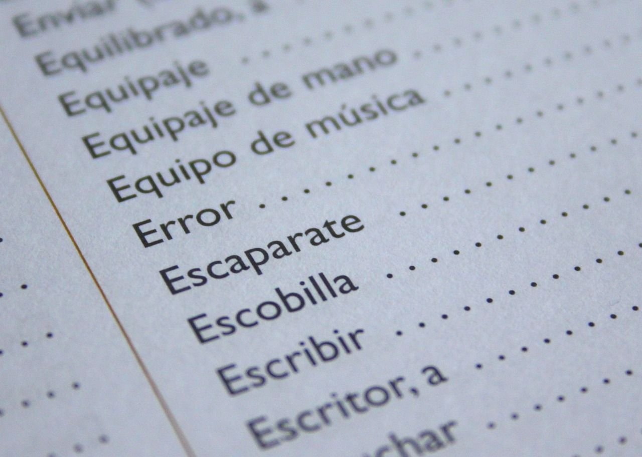
Importance of Pronunciation Improvement
Role of Pronunciation in Communication
Benefits of Explicit Pronunciation Instruction
Pronunciation is a critical component of language learning, as it enables students to communicate effectively and be understood by others.
It plays a key role in ensuring clarity and mutual understanding in conversations.
Research has shown that students who receive explicit instruction in pronunciation are better able to develop accurate and fluent pronunciation.
These students are more likely to succeed in their language learning endeavors.
Enhancing Confidence and Clarity
Importance in Real-Life Scenarios
Pronunciation improvement helps students to express themselves clearly and confidently.
It also aids in understanding the speech of others, fostering better communication.
Accurate pronunciation is critical for effective communication in real-life situations, such as in the workplace, in education, and in social interactions.
It ensures that speakers can convey their messages accurately and be understood in diverse contexts.
6
Enhancing English Language Skills for ELL Students

Slide 7

ELL/ESL Support Strategies
Using Visual Aids
Organizing Vocabulary with Graphic Organizers
Collaborative Learning Opportunities
Visual aids, such as pictures, diagrams, and videos, can help ELL students connect new words to their meanings and contexts.
These tools make abstract concepts more tangible and accessible for language learners.
Graphic organizers, such as concept maps and Venn diagrams, can help ELL students organize and retain new vocabulary.
These tools provide a structured way to visually represent relationships between words and ideas.
Collaborative learning activities, such as pair and group work, can provide ELL students with opportunities to practice their language skills and receive feedback from peers.
This approach fosters communication and builds confidence in using the language in real-life contexts.
Integrating Technology in Learning
Scaffolding Instruction for Language Development
Technology integration, such as online resources and multimedia materials, can provide ELL students with interactive and engaging ways to learn and practice new vocabulary.
These tools offer diverse and flexible methods to accommodate different learning styles.
Scaffolding instruction, such as providing temporary support and guidance, can help ELL students access the curriculum and build their language skills.
This method ensures that learners gradually gain independence as they become more proficient.
7
Enhancing English Language Skills for ELL Students

Slide 8

Lesson Plan Overview
Introduction to the Lesson
Vocabulary Building Activity
Pronunciation Practice Session
Introduction (5 minutes): Introduce the topic of vocabulary building and pronunciation improvement, and provide an overview of the lesson objectives and outcomes.
This sets the stage for the activities and ensures students understand the goals of the session.
Vocabulary Building (15 minutes): Present a set of new vocabulary words related to a specific theme, and have students work in pairs or small groups to match the words with their definitions.
This activity encourages collaboration and helps students understand the meaning of the new words.
Pronunciation Practice (15 minutes): Model the correct pronunciation of the new vocabulary words, and have students practice pronouncing the words in pairs or small groups.
This step focuses on improving students' pronunciation skills through guided practice.
Engaging in Conversations
Lesson Wrap-Up
Conversation Practice (15 minutes): Have students engage in conversations using the new vocabulary, focusing on fluency and accuracy.
This activity allows students to apply their learning in a practical and interactive way.
Conclusion (5 minutes): Review the key vocabulary and pronunciation focus, and provide feedback and encouragement to students.
This ensures students leave the lesson with a clear understanding of what they have learned.
8
Enhancing English Language Skills for ELL Students

Slide 9

Vocabulary Building Activities
Vocabulary Matching
Vocabulary Sorting
Have students match new vocabulary words with their definitions, using visual aids such as pictures or diagrams.
This activity helps students connect words with their meanings in a visual and engaging way.
Have students sort new vocabulary words into categories, such as nouns, verbs, or adjectives.
This encourages students to analyze word types and understand their grammatical roles.
Vocabulary Building Games
Vocabulary Writing
Play games such as Bingo or Scavenger Hunt to practice new vocabulary in a fun and interactive way.
These games make learning enjoyable and help reinforce vocabulary retention.
Have students write their own sentences or short paragraphs using the new vocabulary words.
Provide feedback on grammar and vocabulary usage to enhance their writing skills.
9
Enhancing English Language Skills for ELL Students

Slide 10

Pronunciation Practice Activities
01
Pronunciation Drills
Have students repeat new vocabulary words after the teacher, focusing on accurate pronunciation.
This activity helps students develop confidence and precision in their speech.
02
Pair Practice
Have students practice pronouncing new vocabulary words in pairs.
Provide feedback on pronunciation and intonation to enhance learning.
03
Recording Exercises
Have students record themselves pronouncing new vocabulary words.
Offer constructive feedback to improve pronunciation and intonation.
04
Interactive Pronunciation Games
Play games such as 'Pronunciation Charades' to practice pronunciation.
These activities make learning fun and engaging for students.
10
Enhancing English Language Skills for ELL Students

Slide 11

Conversation Practice Activities
01
Role-plays
Have students engage in role-plays using the new vocabulary, focusing on fluency and accuracy.
This activity helps students practice real-life scenarios in a controlled environment.
02
Conversations
Have students engage in conversations using the new vocabulary, focusing on fluency and accuracy.
This encourages spontaneous use of language and builds confidence.
03
Discussions
Have students participate in discussions using the new vocabulary, focusing on fluency and accuracy.
This promotes critical thinking and collaborative learning.
04
Presentations
Have students give short presentations using the new vocabulary, focusing on fluency and accuracy.
This activity enhances public speaking skills and vocabulary retention.
11
Enhancing English Language Skills for ELL Students

Slide 12

Assessment and Feedback
Vocabulary Quizzes
Pronunciation Assessments
Administer quizzes to assess students' understanding of new vocabulary.
These quizzes help identify areas where students may need additional support.
Assess students' pronunciation of new vocabulary words using audio or video recordings.
This approach ensures students develop accurate and confident pronunciation skills.
Conversation Assessments
Feedback Mechanism
Evaluate students' ability to use new vocabulary in conversations, focusing on fluency and accuracy.
Such assessments encourage practical application of vocabulary in real-life scenarios.
Provide regular feedback to students on their vocabulary and pronunciation skills.
Feedback should be based on criteria such as accuracy, fluency, and confidence.
12
Enhancing English Language Skills for ELL Students

Slide 13

Technology Integration
1
Interactive Online Resources
4
Audio and Video Recordings
Utilize online resources such as vocabulary apps, language learning websites, and multimedia materials to provide interactive and engaging ways to learn and practice new vocabulary.
These tools offer diverse methods to enhance language acquisition and retention.
Use audio and video recordings to model correct pronunciation and provide feedback to students.
These resources help learners improve their listening and speaking skills effectively.
2
Engaging Online Discussions
5
Immersive Virtual Field Trips
Use online discussions to provide opportunities for students to practice their language skills and receive feedback from peers.
This fosters collaboration and enhances communication skills in a virtual environment.
Organize virtual field trips to provide students with opportunities to practice their language skills in real-life situations.
These experiences simulate real-world interactions, enriching the learning process.
3
Interactive Language Learning Apps
Utilize language learning apps to provide students with interactive and engaging ways to learn and practice new vocabulary.
These apps offer personalized learning experiences tailored to individual needs.
13
Enhancing English Language Skills for ELL Students

Slide 14

Conclusion
Importance of Vocabulary and Pronunciation
Strategies for Academic Success
Promoting Inclusive Learning Environments
Vocabulary building and pronunciation improvement are crucial for ELL students to communicate effectively and confidently in English.
These skills form the foundation for successful language acquisition and communication.
The strategies outlined in this lesson plan, including ELL/ESL support strategies, can help ELL students build their language skills and achieve academic success.
These approaches are designed to address the unique challenges faced by ELL students.
By incorporating these strategies into their instructional practice, teachers can provide ELL students with the support they need to succeed.
This fosters a more inclusive and supportive learning environment for all students.
14
Enhancing English Language Skills for ELL Students

Slide 15

Future Lessons
Building on Learning Progressions
Future lessons can build on the learning progressions established in this lesson, focusing on more complex vocabulary and nuanced aspects of pronunciation.
Teachers can incorporate more advanced ELL/ESL support strategies, such as scaffolding and technology integration, to provide additional support and challenge for ELL students.
Advanced Support Strategies
Teachers can incorporate more advanced ELL/ESL support strategies, such as scaffolding and technology integration, to provide additional support and challenge for ELL students.
By continuing to provide opportunities for ELL students to practice and apply their language skills, teachers can help students achieve greater fluency and accuracy in their language use.
Achieving Greater Fluency
By continuing to provide opportunities for ELL students to practice and apply their language skills, teachers can help students achieve greater fluency and accuracy in their language use.
Future lessons can build on the learning progressions established in this lesson, focusing on more complex vocabulary and nuanced aspects of pronunciation.
15
Enhancing English Language Skills for ELL Students

Slide 16
Reflection and Evaluation
Lesson Plan Effectiveness
Impact of ELL/ESL Strategies
Reflect on the effectiveness of the lesson plan and identify areas for improvement.
Evaluate how well the lesson plan meets the learning objectives and supports ELL students.
Evaluate the impact of the ELL/ESL support strategies on student learning and adjust instruction accordingly.
Analyze student progress to determine the effectiveness of these strategies in promoting academic success.
Technology and Multimedia Integration
Continuous Strategy Refinement
Consider the use of technology and multimedia materials to enhance instruction and provide additional support for ELL students.
Explore innovative tools and resources that can make learning more engaging and accessible for diverse learners.
Continuously assess and refine instructional strategies to ensure that they meet the diverse needs of ELL students and promote academic success.
Implement feedback loops to adapt teaching methods based on student performance and needs.
16
Enhancing English Language Skills for ELL Students

Slide 17

Final Thoughts
Importance of Vocabulary and Pronunciation
Vocabulary building and pronunciation improvement are essential for ELL students to achieve academic success.
These skills enable effective communication in English.
Strategies for Teacher Support
The strategies outlined in this lesson plan can help teachers provide ELL students with the support they need to succeed.
This promotes a more inclusive and supportive learning environment.
Collaboration for Academic Success
By working together and providing ongoing support, teachers and students can achieve greater fluency and accuracy in language use.
This collaboration promotes academic success for all.
17
Enhancing English Language Skills for ELL Students

Slide 18

References
Policy Research Brief
TESOL Principles
Teaching Guide
National Council of Teachers of English. (2019).
English Language Learners: A Policy Research Brief.
TESOL International Association. (2020).
Principles and Practices of Teaching English as a Second Language.
Oxford, R. L. (2017).
Teaching English as a Second Language: A Guide for Teachers.
Language Teaching Matrix
Practice of Teaching
Richards, J. C. (2015).
The Language Teaching Matrix: Curriculum, Methodology, and Classroom Management.
Harmer, J. (2015).
The Practice of English Language Teaching.
18
Enhancing English Language Skills for ELL Students

