Slide 1












Mastering Communication: Essential Skills for Effective Interactions
A Comprehensive Guide to Building Strong Relationships Through Engaging Conversations

Slide 2

Table of contents
Lesson Introduction
Subject Knowledge
Importance of Introductions
Fundamental Skills for Introductions
Engaging in Conversations
Sharing Personal Information
Active Listening Skills
Confidence in Conversations
Navigating Social Interactions
Building Relationships
01
02
03
04
05
06
07
08
09
10

Slide 3



Lesson Introduction
Welcome to the first lesson in our introductions series for adult beginners!
In this lesson, we will focus on the fundamental skills needed to introduce yourself and engage in basic conversational exchanges.
As adult learners, you bring a wealth of life experiences that will enrich our discussions.
Over the course of this lesson, you will gain confidence in initiating conversations, sharing personal information, and learning how to actively listen to others.
By the end of the session, you will have the necessary tools to navigate introductory social interactions in a variety of settings.
01
02
03
04
05
Mastering Communication: Essential Skills for Effective Interactions

Slide 4

Subject Knowledge
The Importance of Introductions
Building Trust
Tailoring Information
Introductions are the foundation of interpersonal communication.
They allow us to make a positive first impression, establish rapport, and begin building relationships with others.
Effective introductions can open doors to new opportunities and connections.
Demonstrating subject knowledge during introductions can help build trust and credibility.
When you showcase your expertise and understanding of a topic, it enhances your credibility and encourages meaningful conversations.
Understanding your audience and adjusting the level of detail in your introductions based on their knowledge and interest is crucial.
Tailoring your subject knowledge to suit the context ensures effective communication and engagement.
Mastering Communication: Essential Skills for Effective Interactions

Slide 5
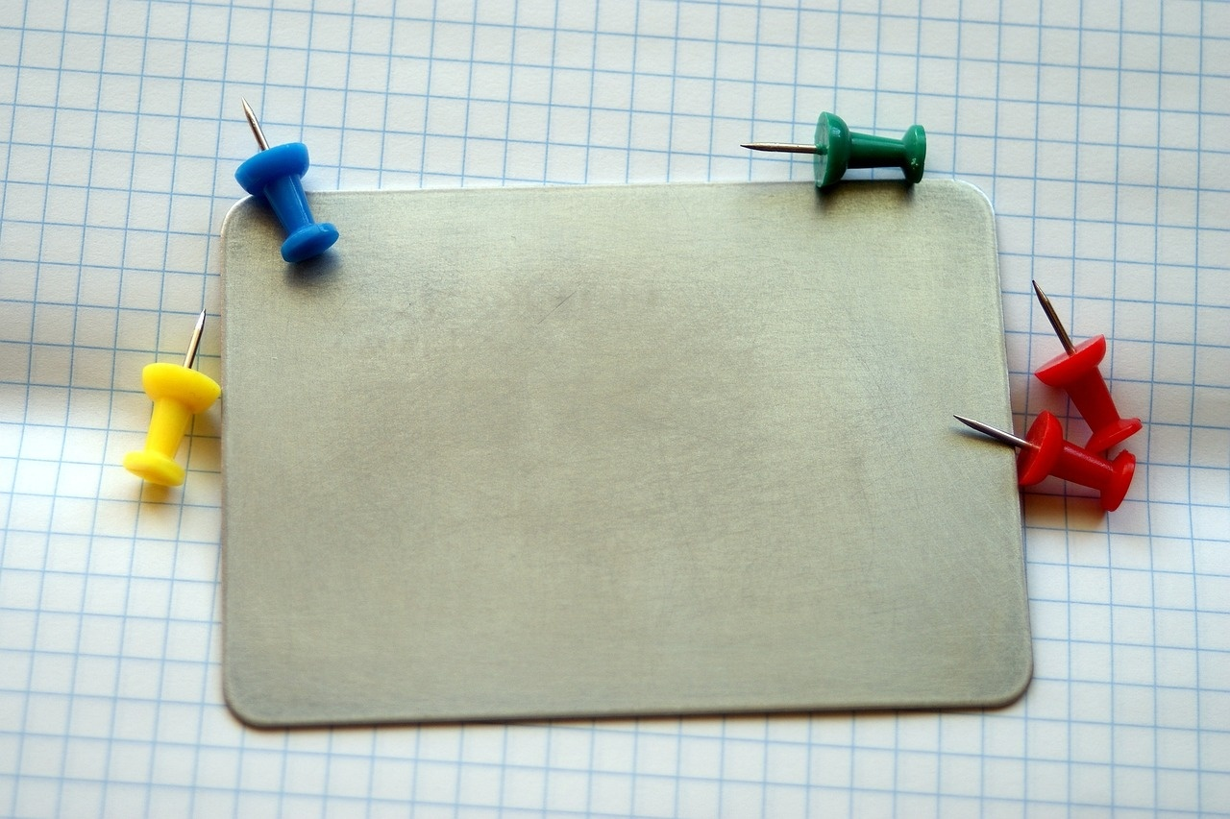
Importance of Introductions
Lesson Introduction
The Importance of Introductions
Welcome to the first lesson in our introductions series for adult beginners!
In this lesson, we will focus on the fundamental skills needed to introduce yourself and engage in basic conversational exchanges.
As adult learners, you bring a wealth of life experiences that will enrich our discussions.
Over the course of this lesson, you will gain confidence in initiating conversations, sharing personal information, and learning how to actively listen to others.
By the end of the session, you will have the necessary tools to navigate introductory social interactions in a variety of settings. Let's dive in and get to know one another!
Introductions are the foundation of interpersonal communication.
They allow us to make a positive first impression, establish rapport, and begin building relationships with others.
Effective introductions can open doors to new opportunities, collaborations, and friendships.
Mastering the art of introductions sets the tone for successful interactions and lays the groundwork for meaningful connections.
Mastering Communication: Essential Skills for Effective Interactions

Slide 6
Fundamental Skills for Introductions
Understanding the Importance of Introductions
Establishing a Positive First Impression
Sharing Personal Information
Active Listening
Navigating Social Interactions
Introductions are the cornerstone of effective communication.
Make eye contact, offer a firm handshake, and smile warmly.
Share your name, occupation, and a brief personal detail to initiate conversation.
Pay attention, nod to show understanding, and ask follow-up questions.
Practice introducing yourself in various settings to build confidence.
01
02
03
04
05
Mastering Communication: Essential Skills for Effective Interactions

Slide 7

Engaging in Conversations
Active Listening
Asking Open-Ended Questions
Give full attention to the speaker
Maintain eye contact
Show genuine interest
Encourage meaningful dialogue
Ask questions that require more than yes or no answers
Keep the conversation flowing
Sharing Personal Experiences
Showing Empathy
Respecting Different Perspectives
Relate to the speaker with relevant stories
Create a connection
Foster deeper conversation
Acknowledge the speaker's feelings
Show understanding
Build trust and rapport
Be open-minded
Respect different viewpoints
Willingness to learn from others
Mastering Communication: Essential Skills for Effective Interactions

Slide 8
Sharing Personal Information
Start with a Greeting
Share Your Name
Provide Context
Share Relevant Details
Ask Open-Ended Questions
Begin by greeting the person you are interacting with.
A simple "Hello" or "Hi" sets a friendly tone for the conversation.
Introduce yourself by stating your name clearly.
This helps establish your identity and allows the other person to address you correctly.
Offer some context about yourself, such as your occupation or where you are from.
This helps the other person understand more about you.
Share information that is appropriate for the situation, such as your interests, hobbies, or any relevant experiences that may spark further conversation.
Encourage the other person to share about themselves by asking open-ended questions.
This shows genuine interest and helps in building a connection.
01
02
03
04
05
Mastering Communication: Essential Skills for Effective Interactions

Slide 9

Active Listening Skills
Focus on the Speaker
Avoid Interrupting
Give your full attention to the person speaking
Maintain eye contact
Show interest in what they are saying
Let the speaker finish their thoughts before responding
Avoid interruptions that can disrupt the flow of conversation
Ask Clarifying Questions
Reflect on What You Heard
Show Empathy
Seek clarification on points that are unclear
Ensure you understand the speaker's message accurately
Summarize or paraphrase what the speaker said
Demonstrate understanding
Show that you are actively listening
Acknowledge the speaker's emotions and feelings
Show empathy and understanding towards their perspective
Mastering Communication: Essential Skills for Effective Interactions

Slide 10
Confidence in Conversations
Maintain Eye Contact
Speak Clearly and Concisely
Use Positive Body Language
Practice Active Listening
Prepare and Research
Establishing and maintaining eye contact shows confidence and interest in the conversation.
Articulate your words clearly and avoid rambling to convey your message effectively.
Open posture, smiling, and nodding can enhance your communication and show confidence.
Engage with the speaker by nodding, paraphrasing, and asking relevant questions to demonstrate attentiveness.
Before conversations, gather information about the topic or person to feel more confident and prepared.
01
02
03
04
05
Mastering Communication: Essential Skills for Effective Interactions

Slide 11

Navigating Social Interactions
Lesson Introduction
Subject Knowledge
Welcome to the first lesson in our introductions series for adult beginners!
Focus on fundamental skills for introducing yourself and engaging in basic conversational exchanges.
Gain confidence in initiating conversations, sharing personal information, and actively listening to others.
By the end of the session, you will have the necessary tools to navigate introductory social interactions in various settings.
The Importance of Introductions:
Foundation of interpersonal communication.
Make a positive first impression, establish rapport, and build relationships.
Effective introductions can open doors for meaningful connections.
Mastering Communication: Essential Skills for Effective Interactions

Slide 12
Building Relationships
Establishing Trust
Active Listening
Communication
Empathy
Mutual Respect
Building relationships starts with establishing trust.
Be genuine, reliable, and consistent in your interactions.
Practice active listening by giving your full attention, asking clarifying questions, and showing empathy towards others.
Effective communication is key to building strong relationships.
Be clear, respectful, and open in your conversations.
Show empathy towards others by understanding their perspectives, emotions, and experiences.
Treat others with respect, kindness, and consideration to foster positive relationships.
01
02
03
04
05
Mastering Communication: Essential Skills for Effective Interactions

