Slide 1


Exploring Triangle Congruence Theorems
Understanding the Key Concepts and Proof Strategies

Slide 2
Table of contents
Title Slide: Triangle Congruence Theorems
Learning Objectives
Vocabulary Key Terms
Congruence Theorems Explained
Problem Type 1 - SSS Congruence
Problem Type 2 - SAS Congruence
Problem Type 3 - ASA Congruence
Problem Type 4 - AAS Congruence
Common Proof Strategies
Accommodations and Support
01
02
03
04
05
06
07
08
09
10

Slide 3
Table of contents
Reflection and Assessment
Additional Resources
Guided Notes Handout Outline
Export Requirements
11
12
13
14

Slide 4

Title Slide: Triangle Congruence Theorems
Triangle Congruence Theorems
Proving Geometric Relationships in 10th Grade Geometry
Exploring Triangle Congruence Theorems
1

Slide 5

Learning Objectives
Understand triangle congruence theorems
Apply SSS, SAS, ASA, and AAS theorems
Develop logical reasoning skills
Construct geometric proofs
Exploring Triangle Congruence Theorems
2

Slide 6

Vocabulary Key Terms
Vocabulary Key Terms
Congruence: Identical shape and size
Congruence Symbols (≅)
SSS: Side-Side-Side Theorem
SAS: Side-Angle-Side Theorem
ASA: Angle-Side-Angle Theorem
Exploring Triangle Congruence Theorems
3

Slide 7

Congruence Theorems Explained
SSS Theorem
SAS Theorem
All three sides must be equal.
Two sides and included angle must be equal.
ASA Theorem
AAS Theorem
Two angles and included side must be equal.
Two angles and non-included side must be equal.
Exploring Triangle Congruence Theorems
4

Slide 8
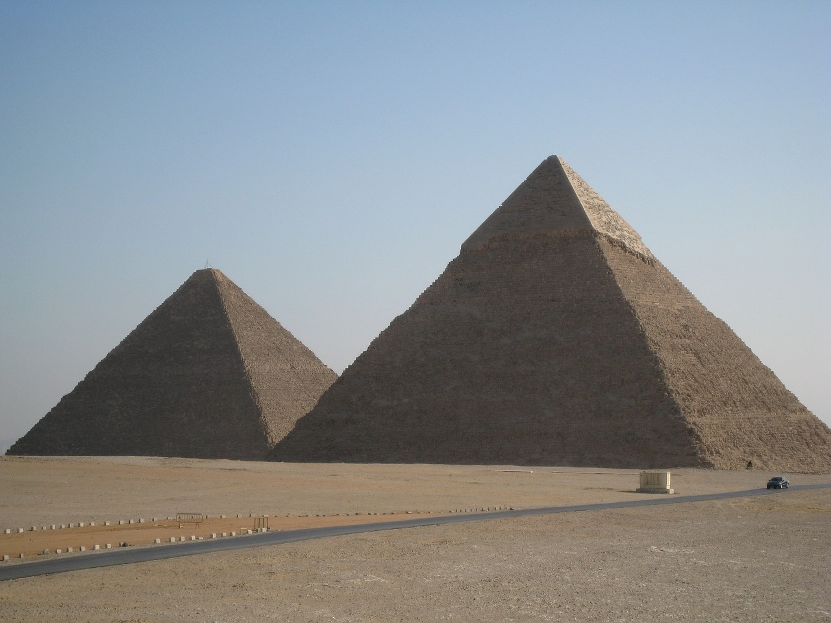
Problem Type 1 - SSS Congruence
Given Triangles
Triangle ABC: AB = 5, BC = 7, AC = 6
Triangle DEF: DE = 5, EF = 7, DF = 6
Objective
Prove that Triangle ABC ≅ Triangle DEF using SSS Congruence Theorem.
SSS Congruence Theorem
States that if three sides of one triangle are congruent to three sides of another triangle, then the triangles are congruent.
Proof Steps
Measure each side of Triangle ABC and Triangle DEF.
Show that AB = DE, BC = EF, and AC = DF.
Conclude that Triangle ABC ≅ Triangle DEF by SSS Congruence.
Solution Walkthrough
Step-by-step demonstration of proving the congruence of the triangles using the SSS theorem.
Exploring Triangle Congruence Theorems
5

Slide 9
Given
Problem Type 2 - SAS Congruence
PQ = 4, QR = 6, ∠PQR = 45°
XY = 4, YZ = 6, ∠XYZ = 45°
01
Side Comparisons
Side PQ = Side XY (4 = 4)
Side QR = Side YZ (6 = 6)
02
Angle Comparison
03
∠PQR = ∠XYZ (45° = 45°)
Conclusion
04
By SAS Congruence Theorem, Triangles PQR and XYZ are congruent.
Exploring Triangle Congruence Theorems
6

Slide 10

Problem Type 3 - ASA Congruence
01
03
05
Step 1
Step 3
Step 5
02
04
Start by identifying the corresponding angles and sides.
Also, ∠MNL = ∠STR = 50°.
By ASA Congruence, if two angles and the included side of one triangle are congruent to two angles and the included side of another triangle, then the triangles are congruent.
Step 2
Step 4
Given that ∠LMN = ∠RST = 60°.
LM = RS = 8 (Given).
Exploring Triangle Congruence Theorems
7

Slide 11

Problem Type 4 - AAS Congruence
Given Information
Congruence Criteria
Triangle JKL and Triangle PQR
∠JKL = 35°, ∠KLJ = 65°, KL = 9
∠PQR = 35°, ∠QRP = 65°, QR = 9
AAS (Angle-Angle-Side) Theorem states that if two angles and a non-included side of one triangle are congruent to two angles and the corresponding non-included side of another triangle, then the triangles are congruent.
Step-by-Step Solution
Conclusion
Step 1: Given that ∠JKL = ∠PQR = 35°.
Step 2: Given that ∠KLJ = ∠QRP = 65°.
Step 3: Given that KL = QR = 9.
Step 4: By AAS Congruence Theorem, triangles JKL and PQR are congruent.
Step 5: Therefore, ∆JKL ≅ ∆PQR.
Triangles JKL and PQR are congruent by AAS Congruence Theorem.
Exploring Triangle Congruence Theorems
8

Slide 12
Common Proof Strategies
01
03
05
Identify Given Information
Match Corresponding Sides/Angles
State Final Congruence
02
04
Understand the provided data about the triangles.
Pair up sides and angles that are congruent in both triangles.
Clearly state that the triangles are congruent based on the theorem criteria met.
List Congruence Theorem Criteria
Draw Logical Conclusions
Determine which congruence theorem applies (SSS, SAS, ASA, AAS).
Use the congruence theorems to draw conclusions about the triangles.
Exploring Triangle Congruence Theorems
9

Slide 13

Accommodations and Support
Visual aids for better understanding
Color-coded theorem guides for clarity
Manipulative triangle sets for hands-on learning
Extended time for complex proofs completion
Assistive technology options for accessibility
Exploring Triangle Congruence Theorems
10

Slide 14

Reflection and Assessment
Importance of Logical Reasoning
Real-World Applications
Logical reasoning is crucial in proving triangle congruence theorems as it ensures the accuracy and validity of the proofs.
It helps in systematically establishing the relationships between different geometric elements.
Understanding geometric relationships is essential in fields such as architecture, engineering, and computer graphics.
It aids in the design and construction of structures, as well as in the development of visual simulations.
Enhancing Problem-Solving Abilities
Self-Assessment Strategies
Developing spatial thinking skills allows individuals to visualize and manipulate objects mentally.
It improves the ability to solve complex problems by understanding the spatial relationships between different components.
Regular practice and review of geometric proofs can help in identifying areas of improvement.
Using tools such as peer review and feedback can enhance proficiency in constructing accurate and logical proofs.
Exploring Triangle Congruence Theorems
11

Slide 15

Additional Resources
Digital Geometry Platforms
Explore interactive tools for visualizing geometric concepts.
Online Proof Construction Websites
Access platforms offering step-by-step guidance on constructing proofs.
Interactive Geometry Software
Utilize software for hands-on exploration of triangle congruence theorems.
Supplemental Practice Worksheets
Enhance understanding with extra practice sheets for reinforcement.
Exploring Triangle Congruence Theorems
12

Slide 16
Guided Notes Handout Outline
01
03
05
Theorem Definitions
Problem-Solving Workspace
Self-Assessment Checklist
02
04
Definition of key theorems
Examples and non-examples
Step-by-step problem-solving guide
Space for practice problems
Checklist for self-assessment
Criteria for evaluating understanding
Proof Vocabulary
Theorem Comparison Chart
Key terms used in proofs
Definitions and examples
Comparison of different theorems
Visual aids and charts
Exploring Triangle Congruence Theorems
13

Slide 17

Export Requirements
SSS Congruence Theorem
SAS Congruence Theorem
Problem Type: Given three sides of one triangle and three sides of another triangle, prove the triangles are congruent.
Step-by-Step Solution:
1. Identify the three sides of both triangles.
2. Use the SSS theorem to compare the sides.
3. Conclude that the triangles are congruent if all three sides are equal.
Problem Type: Given two sides and the included angle of one triangle and two sides and the included angle of another triangle, prove the triangles are congruent.
Step-by-Step Solution:
1. Identify the two sides and the included angle of both triangles.
2. Use the SAS theorem to compare the sides and the included angle.
3. Conclude that the triangles are congruent if the two sides and the included angle are equal.
ASA Congruence Theorem
AAS Congruence Theorem
Problem Type: Given two angles and the included side of one triangle and two angles and the included side of another triangle, prove the triangles are congruent.
Step-by-Step Solution:
1. Identify the two angles and the included side of both triangles.
2. Use the ASA theorem to compare the angles and the included side.
3. Conclude that the triangles are congruent if the two angles and the included side are equal.
Problem Type: Given two angles and a non-included side of one triangle and two angles and a non-included side of another triangle, prove the triangles are congruent.
Step-by-Step Solution:
1. Identify the two angles and the non-included side of both triangles.
2. Use the AAS theorem to compare the angles and the non-included side.
3. Conclude that the triangles are congruent if the two angles and the non-included side are equal.
Exploring Triangle Congruence Theorems
14

