Slide 1

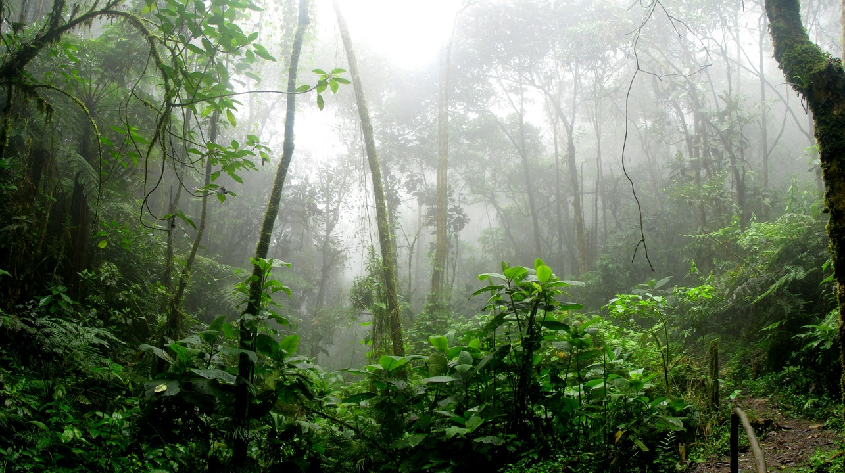
Exploring Rainforest Conservation
Educating and Engaging for Environmental Preservation

Slide 2
Table of contents
Introduction to Rainforest Protection
Importance of Trees in the Rainforest
Effects of Deforestation on the Planet
Actions to Protect Forests
Visual Aids in Environmental Education
Storytelling in Environmental Lessons
Simplifying Scientific Concepts for Kids
Connection Between Trees, Animals, and People
Empathy for Environmental Conservation
Relatable Comparisons in Education
01
02
03
04
05
06
07
08
09
10

Slide 3
Table of contents
Rainforest as a Habitat for Animals
Understanding Environmental Impact on Ecosystems
Creating a Classroom Rainforest Display
Role-Play Activities in Environmental Education
Exploring Deforestation in Brazil
Amazon Rainforest: A Crucial Ecosystem
Engaging Young Learners in Environmental Topics
Hands-On Activities for Environmental Learning
Interactive Learning for 7-Year-Olds
Environmental Education for Kids
11
12
13
14
15
16
17
18
19
20

Slide 4
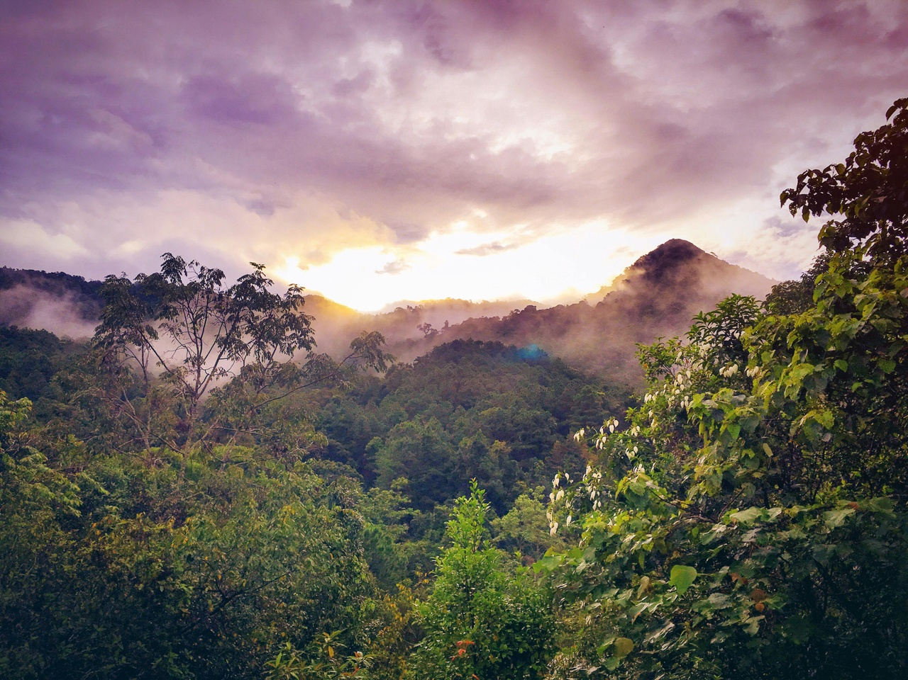
Introduction to Rainforest Protection
Engaging Lesson
Introduces young learners to deforestation in Brazil's Amazon rainforest.
Importance of Trees
Learn why trees are crucial for our planet's health and biodiversity.
Effects of Deforestation
Understand how cutting down trees impacts the environment and wildlife.
Actions to Protect Forests
Discover simple ways to help conserve rainforests and support environmental sustainability.
Interactive Learning
Engage in hands-on activities, storytelling, and visual aids to make complex topics accessible.
Exploring Rainforest Conservation

Slide 5
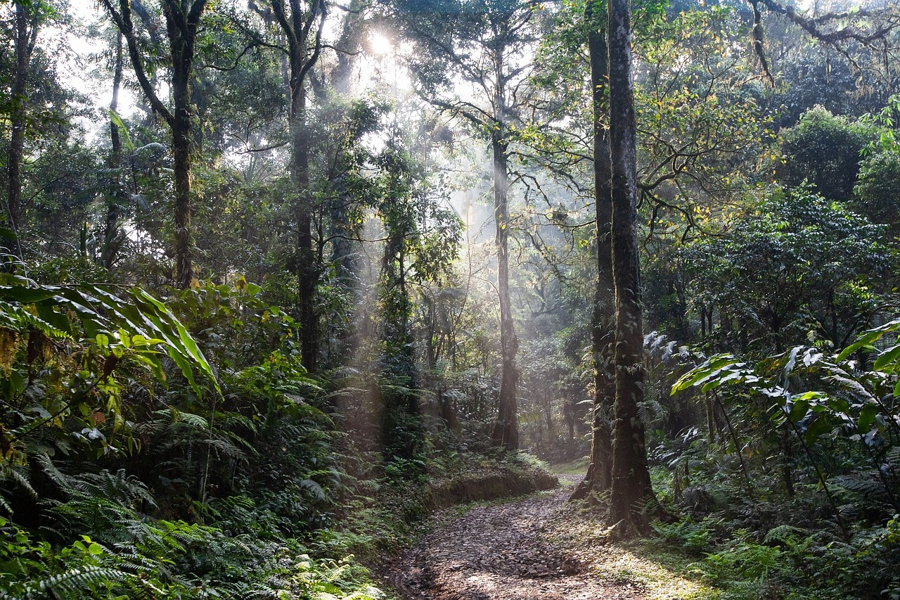
Importance of Trees in the Rainforest
Oxygen Production
Biodiversity Support
Trees in the rainforest play a vital role in producing oxygen through photosynthesis.
Trees provide habitats for a diverse range of plant and animal species, contributing to the rich biodiversity of the rainforest.
Carbon Sequestration
Soil Conservation
Trees help in absorbing carbon dioxide from the atmosphere, playing a crucial role in mitigating climate change.
Tree roots help prevent soil erosion and maintain the fertility of the rainforest soil.
Exploring Rainforest Conservation

Slide 6
Effects of Deforestation on the Planet
Trees Cut Down
Greenhouse Gas Emissions
Species in Forests
People Relying on Forests
15 Billion
20%
80%
1.6 Billion
The estimated number of trees cut down globally each year due to deforestation.
The percentage of global greenhouse gas emissions caused by deforestation, contributing to climate change.
The percentage of Earth's land-based species that live in forests, facing habitat loss and extinction due to deforestation.
The number of people worldwide who rely on forests for their livelihoods, facing impacts from deforestation on their communities and resources.
Exploring Rainforest Conservation

Slide 7
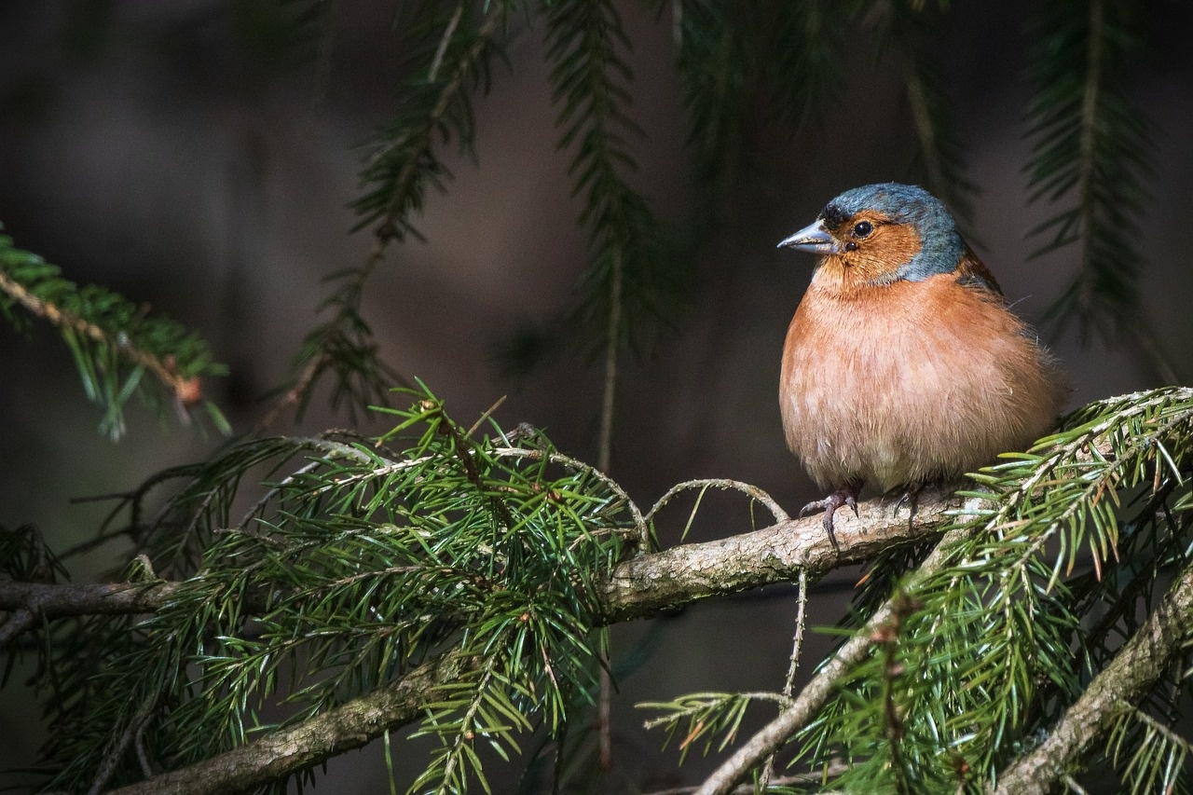
Actions to Protect Forests
Reduce Paper Usage
Encourage double-sided printing
Opt for digital documents when possible
Support Sustainable Products
Choose FSC-certified wood products
Purchase items made from recycled materials
Plant Trees
Participate in tree-planting initiatives
Support reforestation projects
Raise Awareness
Educate others about deforestation
Share information on social media
Advocate for Policy Changes
Support legislation to protect forests
Engage in environmental activism
Exploring Rainforest Conservation

Slide 8
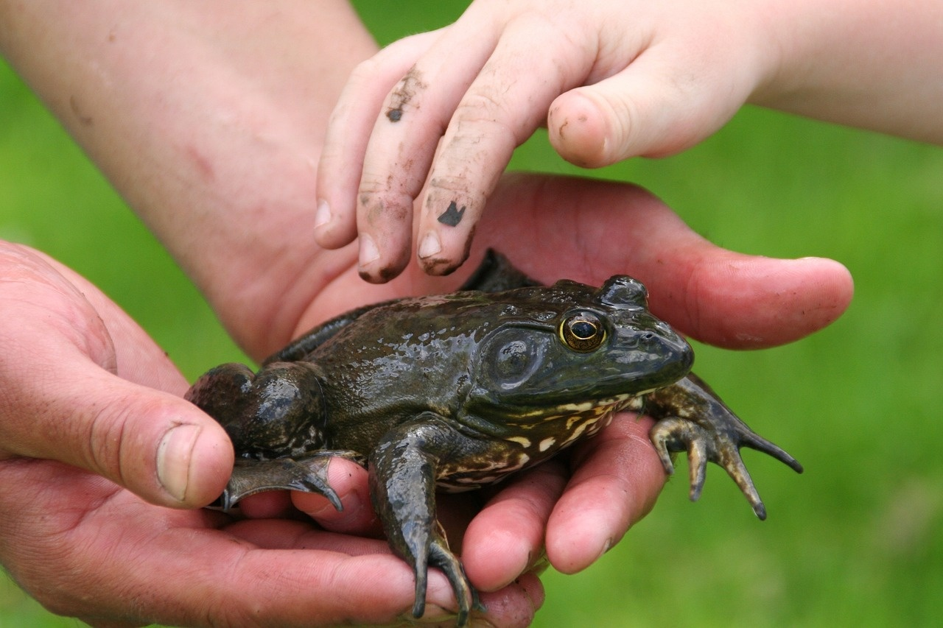
Visual Aids in Environmental Education
Interactive Classroom Display
Role-Playing Activities
Engage students by creating a vibrant rainforest display in the classroom
Showcase the diversity of plant and animal life
Encourage students to participate in role-playing scenarios
Understand the impact of deforestation on different stakeholders like animals, indigenous communities, and the environment
Comparative Visuals
Storytelling Elements
Use visuals like before-and-after images of deforested areas
Help students visualize the effects of human activities on the rainforest ecosystem
Incorporate storytelling with visuals
Convey the interconnectedness of all living beings in the rainforest
Highlight the importance of conservation efforts
Exploring Rainforest Conservation

Slide 9
Storytelling in Environmental Lessons
01
02
03
04
05
Introduction to Deforestation
Importance of Trees
Effects of Deforestation
Actions for Protection
Interactive Learning
Introduce the concept of deforestation in the Amazon rainforest.
Explain why trees are crucial for our planet's health and biodiversity.
Discuss how deforestation impacts the environment, climate, and wildlife.
Explore ways in which we can help protect forests and combat deforestation.
Engage students through visual aids, storytelling, and hands-on activities.
Exploring Rainforest Conservation

Slide 10
Simplifying Scientific Concepts for Kids
01
02
03
04
Explain why trees are important for our planet
Use visuals to show how trees provide oxygen and homes for animals
Define deforestation in simple terms
Discuss how cutting down trees affects the environment and animals
Teach kids about ways to help protect forests
Encourage them to plant trees or participate in conservation activities
Show the relationship between trees, animals, and humans
Use storytelling elements to engage young minds in environmental conservation
Exploring Rainforest Conservation

Slide 11

Connection Between Trees, Animals, and People
Trees provide oxygen
Trees produce oxygen through photosynthesis, which is essential for the survival of animals and humans.
Animals rely on trees
Trees offer shelter and food sources for various animal species, creating a habitat for wildlife.
People benefit from trees
Trees are used for building materials, medicine, and other resources that support human life.
Deforestation disrupts balance
Cutting down trees leads to habitat loss for animals and affects the livelihoods of indigenous communities.
Conservation efforts
Protecting trees helps preserve animal habitats and supports the well-being of local communities.
Exploring Rainforest Conservation

Slide 12
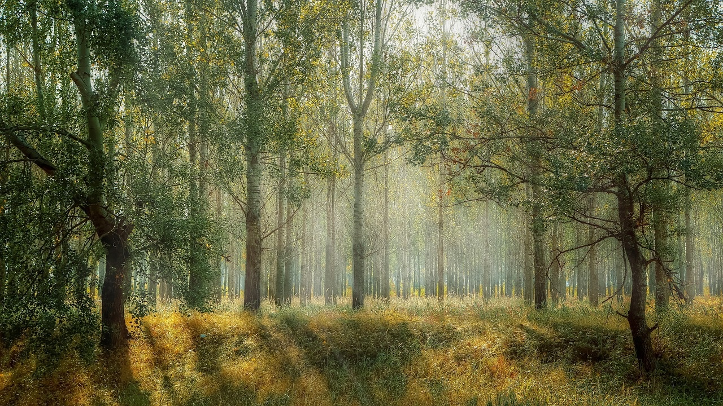
Empathy for Environmental Conservation
Understanding the Importance of Trees
Effects of Deforestation
Trees provide oxygen for us to breathe.
Trees are homes for many animals and insects.
Deforestation leads to loss of habitats for animals.
It contributes to climate change and global warming.
Actions to Protect Forests
Developing Empathy for Environmental Conservation
Planting trees helps in reforestation efforts.
Supporting sustainable logging practices can help preserve forests.
Encouraging empathy towards nature helps in understanding the importance of conservation.
Teaching children to respect and care for the environment fosters a sense of responsibility.
Exploring Rainforest Conservation

Slide 13
Relatable Comparisons in Education
01
02
03
04
05
Introduction to Deforestation
Importance of Trees
Effects of Deforestation
Actions for Protection
Connection Between Trees, Animals, and People
Introduce the concept of deforestation in the Amazon rainforest.
Explain why trees are crucial for our planet's health and balance.
Discuss how deforestation impacts the environment, animals, and people.
Explore ways in which we can help protect forests and combat deforestation.
Highlight the interdependence of trees, animals, and humans in the ecosystem.
Exploring Rainforest Conservation

Slide 14
Rainforest as a Habitat for Animals
01
02
03
04
The rainforest is home to a vast array of animal species, including jaguars, sloths, toucans, and tree frogs.
Animals in the rainforest rely on each other for survival, creating a complex food chain where each species plays a vital role.
Many rainforest animals have evolved special characteristics to thrive in their habitat, such as camouflage, strong claws, or the ability to glide through the canopy.
Due to deforestation and habitat loss, many rainforest animals are facing extinction, highlighting the urgent need for conservation efforts.
Exploring Rainforest Conservation

Slide 15
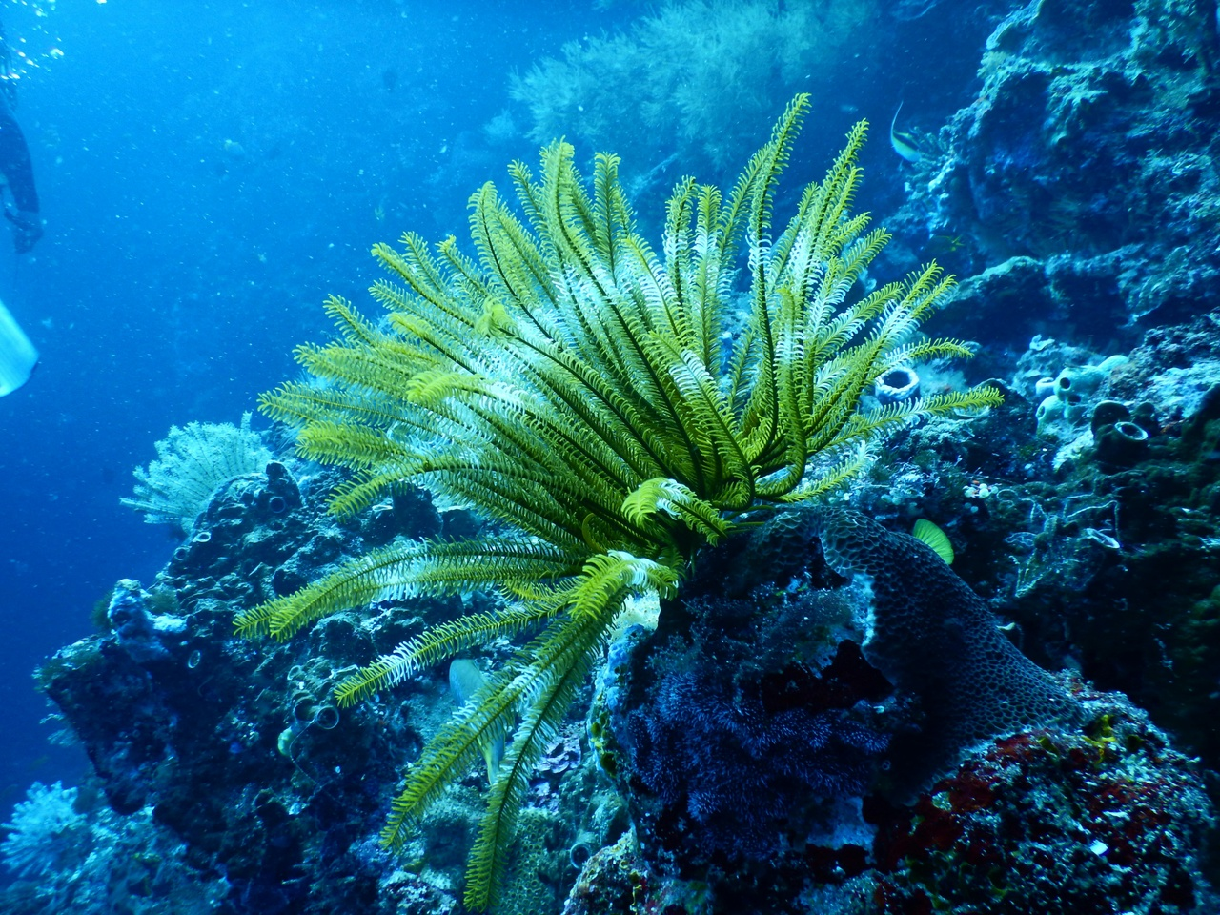
Understanding Environmental Impact on Ecosystems
Importance of Trees
Effects of Deforestation
Trees provide oxygen for us to breathe.
Trees offer habitats for animals to live in.
Deforestation leads to loss of animal habitats.
Deforestation contributes to climate change.
Actions for Protection
Connecting Trees, Animals, and People
Planting more trees helps combat deforestation.
Supporting sustainable logging practices can preserve forests.
Trees are like homes for animals in the forest.
People rely on forests for resources like wood and medicine.
Exploring Rainforest Conservation

Slide 16
Creating a Classroom Rainforest Display
01
02
03
04
05
Gather Materials
Create Trees
Build Animal Habitats
Discuss Importance
Engage in Role-Play
Green construction paper
Cardboard boxes
Scissors
Markers
Toy animals
Cut out tree shapes from green paper
Attach them to cardboard for stability
Decorate with markers to add details
Use cardboard boxes as homes for toy animals
Add leaves and branches for a realistic touch
Place animals in their respective habitats
Explain how trees provide homes for animals
Emphasize the interconnectedness of the rainforest ecosystem
Encourage students to think about conservation efforts
Let students act out scenarios of animals in the rainforest
Discuss the impact of deforestation on their habitats
Encourage empathy and understanding through play
Exploring Rainforest Conservation

Slide 17
Role-Play Activities in Environmental Education
01
02
03
04
Start by explaining what deforestation is and why it is happening in the Amazon rainforest.
Divide students into groups and assign roles such as loggers, animals, activists, and trees.
Encourage students to act out scenarios where loggers cut down trees, animals lose their homes, and activists protest deforestation.
Facilitate a discussion after the role-play to reflect on the impact of deforestation on the environment and brainstorm solutions.
Exploring Rainforest Conservation

Slide 18
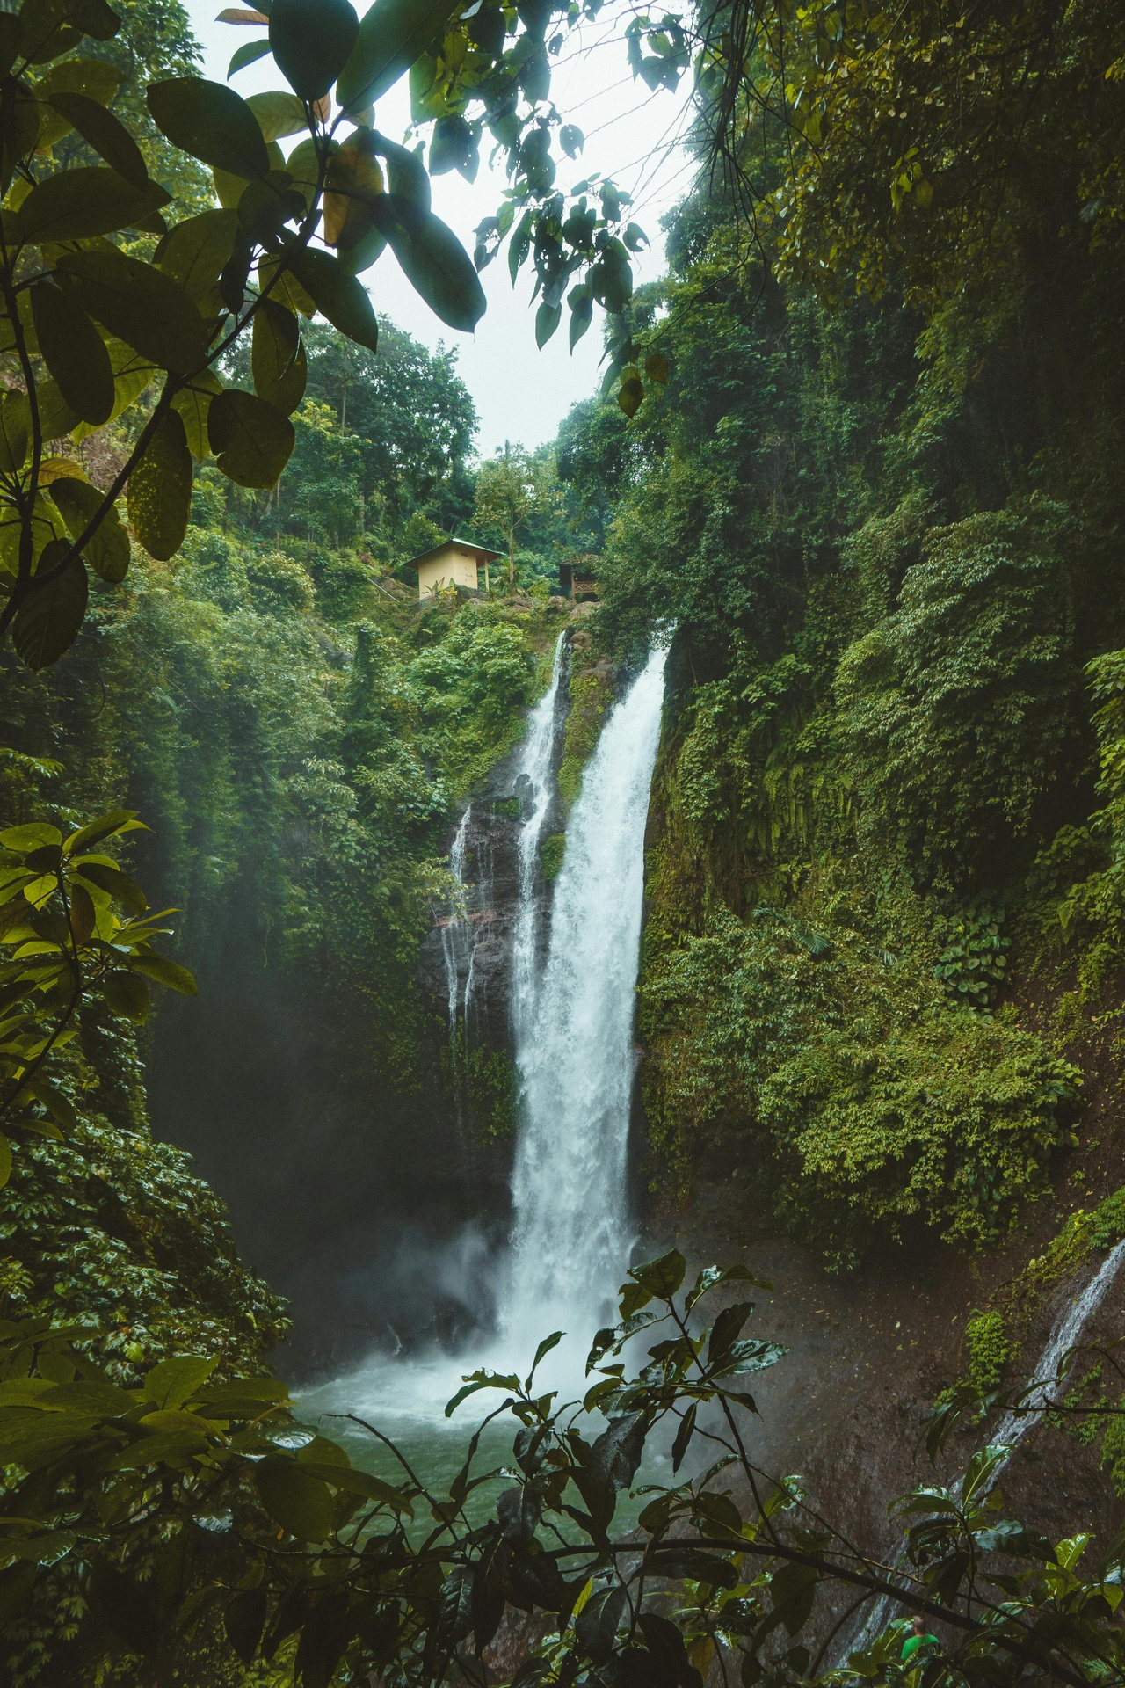
Exploring Deforestation in Brazil
Introduction
Interactive Elements
Introducing young learners to the environmental issue of deforestation in Brazil's Amazon rainforest.
Engaging lesson with age-appropriate content and hands-on activities.
Focus on the importance of trees, the impact of deforestation on the planet, and actions to protect forests.
Incorporating visual aids, storytelling, and simple scientific concepts for 7-year-olds.
Connecting trees, animals, and people to foster empathy for environmental conservation.
Using relatable comparisons like likening the rainforest to a bustling city for better understanding.
Creating a classroom rainforest display.
Role-playing activities to understand the impact of deforestation.
Hands-on projects to explore the connection between trees, animals, and people.
Key Concepts
Takeaway
Why trees are important.
How deforestation affects the planet.
Actions we can take to protect forests.
Developing empathy for environmental conservation at a young age.
Exploring Rainforest Conservation

Slide 19
Amazon Rainforest: A Crucial Ecosystem
Biodiversity Hotspot
Carbon Sink
Indigenous Communities
Global Impact
1
2
3
4
Home to millions of plant and animal species. Supports diverse ecosystems and habitats.
Absorbs and stores large amounts of carbon dioxide. Helps mitigate climate change by reducing greenhouse gases.
Provides livelihoods and cultural heritage for indigenous tribes. Traditional knowledge crucial for sustainable forest management.
Affects global weather patterns and water cycles. Plays a vital role in maintaining ecological balance worldwide.
Exploring Rainforest Conservation

Slide 20

Engaging Young Learners in Environmental Topics
Lesson Introduction
Introduces young learners to the crucial environmental topic of deforestation in Brazil's Amazon rainforest.
Age-Appropriate Content
Presents information in a way that is suitable and understandable for 7-year-olds.
Hands-On Activities
Engages students through interactive activities to enhance learning experience.
Understanding Importance of Trees
Helps students grasp why trees are important for the environment and our planet.
Effects of Deforestation
Explains how deforestation impacts the environment and biodiversity.
Exploring Rainforest Conservation

Slide 21
Hands-On Activities for Environmental Learning
01
02
03
04
Students will work together to design and build a mini rainforest display using recycled materials.
Engage students in a role-play activity where they act out the impact of deforestation on animals and communities in the rainforest.
Organize a tree planting activity in the schoolyard or a local green space to emphasize the importance of reforestation.
Use storytelling elements to narrate a tale about the interconnectedness of life in the rainforest, encouraging empathy and understanding.
Exploring Rainforest Conservation

Slide 22
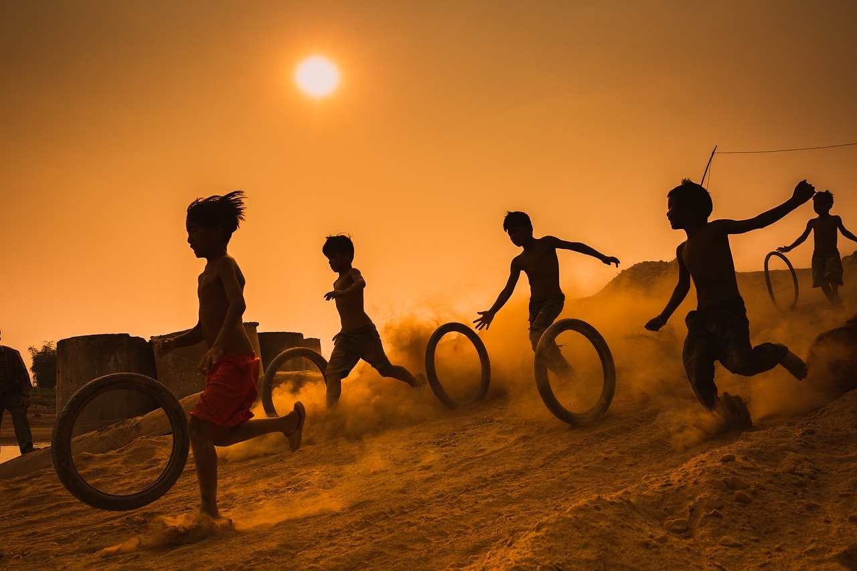
Interactive Learning for 7-Year-Olds
Introduction
Hands-On Activities
Engaging lesson on deforestation in Brazil's Amazon rainforest
Age-appropriate content to understand the importance of trees
Explore how deforestation impacts our planet
Create a classroom rainforest display for interactive learning
Developing Empathy
Taking Action
Understand the connection between trees, animals, and people
Role-play to experience the impact of environmental conservation
Learn about actions to help protect forests
Use relatable comparisons to grasp complex environmental concepts
Exploring Rainforest Conservation

Slide 23
Environmental Education for Kids
01
02
03
Step 1: Introduction to Deforestation
Step 2: Actions to Protect Forests
Step 3: Interactive Learning
Learn why trees are important for our planet.
Understand how deforestation impacts the environment.
Discover what actions we can take to help protect forests.
Explore the connection between trees, animals, and people.
Engage in hands-on activities like creating a classroom rainforest display.
Participate in role-playing to understand the importance of conservation.
Exploring Rainforest Conservation

