Slide 1


Exploring Autumn in Canada
A Comprehensive Study of Geographical, Cultural, Economic, and Environmental Aspects

Slide 2
Table of contents
Lesson Introduction
Subject Knowledge: Geographical Diversity of Canadi…
Subject Knowledge: Cultural Significance of Canadia…
Subject Knowledge: Economic Impact of Autumn in Can…
Subject Knowledge: Environmental Changes in Canadia…
Subject Knowledge: Canadian Identity in Autumn
Subject Knowledge: Social Structures in Fall
Subject Knowledge: Transition Period in Canadian Li…
Subject Knowledge: Interconnected Nature of Seasona…
Subject Knowledge: Implications for Canadian Enviro…
01
02
03
04
05
06
07
08
09
10

Slide 3
Table of contents
Subject Knowledge: Autumn in Maritime Provinces
Subject Knowledge: Autumn in the Rocky Mountains
Subject Knowledge: Ecological Transition in Canadia…
Subject Knowledge: Canadian Landscape Transformatio…
Subject Knowledge: Seasonal Changes and Canadian Id…
Subject Knowledge: Autumn's Impact on Environmental…
Subject Knowledge: Multifaceted Phenomenon of Fall …
Subject Knowledge: Critical Period of Transition in…
Subject Knowledge: Fall's Influence on Social Struc…
Subject Knowledge: Environmental and Cultural Dimen…
11
12
13
14
15
16
17
18
19
20

Slide 4
01
Exploring Fall in Canada
Lesson Introduction
This lesson will delve into the multifaceted phenomenon of autumn in Canada, examining its environmental, cultural, economic, and ecological dimensions.
02
Comprehensive Analysis
Students will engage in a thorough analysis of how the autumn season transforms the Canadian landscape, impacts social structures, and signifies a crucial period of transition in various aspects of Canadian life.
03
Critical Examination
The lesson will challenge students to critically evaluate the interconnected nature of seasonal changes and their profound implications for Canadian identity and environmental systems.
Exploring Autumn in Canada
1

Slide 5
Coastal Regions
Subject Knowledge: Geographical Diversity of Canadian Autumn
Mild temperatures and vibrant foliage characterize autumn in the maritime provinces.
Coastal breezes bring a mix of reds, oranges, and yellows to the landscape.
01
Central Canada
Ontario and Quebec experience a classic fall with cool temperatures and stunning maple leaves.
The Great Lakes influence the weather patterns, creating picturesque autumn scenes.
02
Prairie Provinces
03
Alberta and Saskatchewan showcase a drier autumn with golden fields and clear blue skies.
Harvest season in full swing, showcasing the agricultural richness of the region.
Western Mountains
04
British Columbia and the Rocky Mountains boast a diverse autumn palette with snow-capped peaks and colorful forests.
Outdoor enthusiasts flock to witness the breathtaking transition from summer to winter.
Exploring Autumn in Canada
2

Slide 6

Subject Knowledge: Cultural Significance of Canadian Fall
Geographical Diversity of Canadian Autumn
The Canadian autumn represents an extraordinarily complex ecological transition spanning multiple climate zones.
From the maritime provinces to the Rocky Mountains, fall manifests differently across vast geographical regions.
Each ecosystem experiences unique changes during this season, contributing to the rich tapestry of Canadian landscapes.
Exploring Autumn in Canada
3

Slide 7
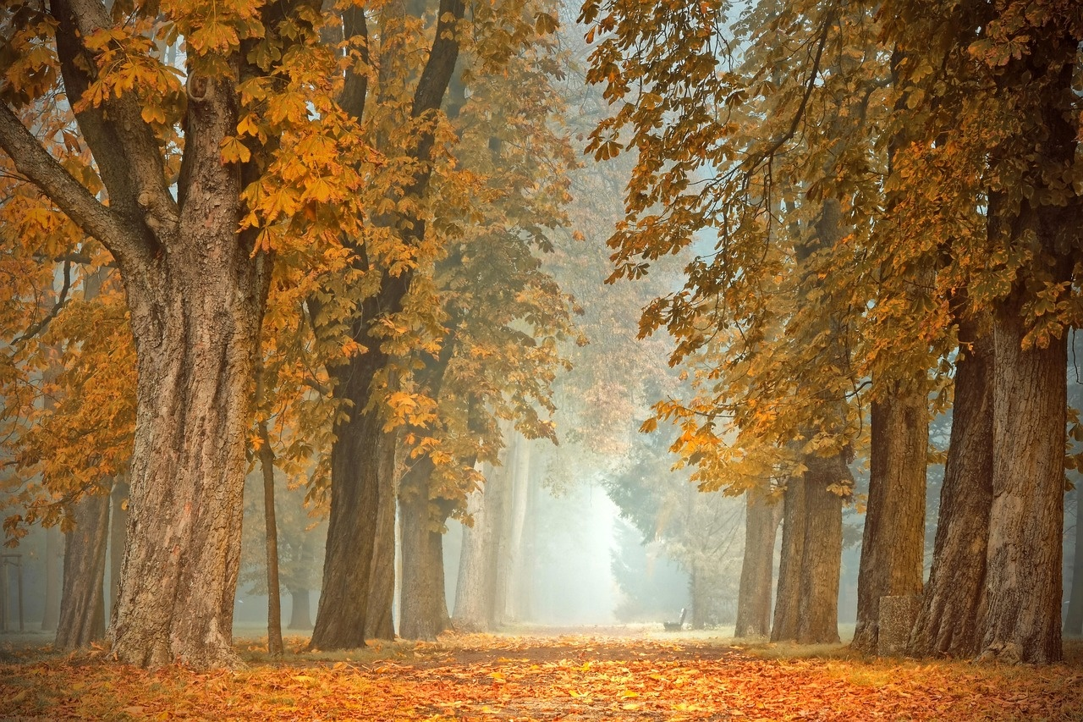
Subject Knowledge: Economic Impact of Autumn in Canada
Tourism Boost
Agricultural Harvest
Autumn foliage attracts tourists from around the world.
Increase in hotel bookings and local businesses thrive during peak leaf-peeping season.
Fall harvest season contributes significantly to the economy.
Farmers benefit from the abundance of crops like apples, pumpkins, and cranberries.
Seasonal Employment
Outdoor Recreation
Many industries, such as tourism, agriculture, and retail, experience a surge in seasonal job opportunities.
Employment rates rise during the autumn months, providing income for many Canadians.
Activities like hiking, camping, and wildlife viewing peak during the fall season.
Outdoor gear retailers and adventure tour operators see a rise in sales and demand.
Exploring Autumn in Canada
4

Slide 8

Subject Knowledge: Environmental Changes in Canadian Autumn
Geographical Diversity of Canadian Autumn
The Canadian autumn represents an extraordinarily complex ecological transition spanning multiple climate zones.
From the maritime provinces to the Rocky Mountains, fall manifests differently across vast geographical regions.
Each ecosystem experiences unique changes during this season, influencing flora, fauna, and overall biodiversity.
Impact on Wildlife Migration
Autumn in Canada plays a crucial role in wildlife migration patterns.
Many species, such as birds and mammals, rely on the changing seasons to guide their movements.
Understanding these migrations is essential for conservation efforts and maintaining ecological balance.
Cultural Traditions and Harvest Festivals
Canadian autumn is rich in cultural traditions and harvest festivals celebrated by diverse communities.
These events highlight the significance of agriculture, food, and community gatherings during this season.
Exploring these traditions provides insights into the cultural fabric of Canadian society.
Climate Change Effects
The changing patterns of autumn in Canada are also influenced by climate change.
Shifts in temperature, precipitation, and weather patterns impact the timing and intensity of fall.
Studying these effects is crucial for understanding the broader implications of environmental changes.
Exploring Autumn in Canada
5

Slide 9

Subject Knowledge: Canadian Identity in Autumn
Geographical Diversity of Canadian Autumn
Cultural Significance of Autumn Festivals
The Canadian autumn showcases a diverse ecological transition across various climate zones.
From the maritime provinces to the Rocky Mountains, fall displays unique characteristics in different regions.
Each ecosystem experiences distinct changes during this season, contributing to the rich tapestry of Canadian landscapes.
Autumn in Canada is marked by vibrant festivals celebrating harvest, culture, and traditions.
Events like the Toronto International Film Festival and Thanksgiving reflect the cultural richness of the season.
Indigenous communities also observe traditional ceremonies during autumn, emphasizing the deep connection to the land and nature.
Economic Impact of Fall Tourism
Environmental Conservation Efforts in Autumn
Autumn drives significant tourism in Canada, attracting visitors to witness the stunning fall foliage.
The tourism industry experiences a boost during this season, with activities like leaf-peeping tours and outdoor adventures.
Businesses in rural areas benefit from the influx of tourists seeking to experience the beauty of Canadian autumn firsthand.
Autumn serves as a crucial period for environmental conservation initiatives in Canada.
Organizations focus on preserving biodiversity, protecting wildlife habitats, and promoting sustainable practices during this season.
Efforts to mitigate the impact of climate change on Canadian ecosystems are heightened in the autumn months.
Exploring Autumn in Canada
6

Slide 10

Subject Knowledge: Social Structures in Fall
Geographical Diversity of Canadian Autumn
The Canadian autumn represents an extraordinarily complex ecological transition spanning multiple climate zones.
From the maritime provinces to the Rocky Mountains, fall manifests differently across vast geographical regions.
Each ecosystem experiences unique changes during this season, influencing social structures and activities.
Impact on Community Dynamics
Fall in Canada plays a significant role in shaping community dynamics and social interactions.
Seasonal events such as harvest festivals and Thanksgiving gatherings strengthen social bonds and traditions.
The transition to colder weather prompts collaborative efforts within communities for winter preparations.
Economic Implications
The autumn season in Canada has profound economic implications on various industries.
Sectors like agriculture, tourism, and retail experience shifts in demand and activities during fall.
Businesses adapt their strategies to cater to seasonal changes, reflecting the interconnectedness of social structures and economic systems.
Cultural Significance
Autumn holds cultural significance in Canada, reflected in traditions, art, and celebrations.
Indigenous communities mark the season with ceremonies honoring nature and harvest.
Canadian art and literature often draw inspiration from the vibrant colors and natural beauty of fall landscapes.
Exploring Autumn in Canada
7

Slide 11
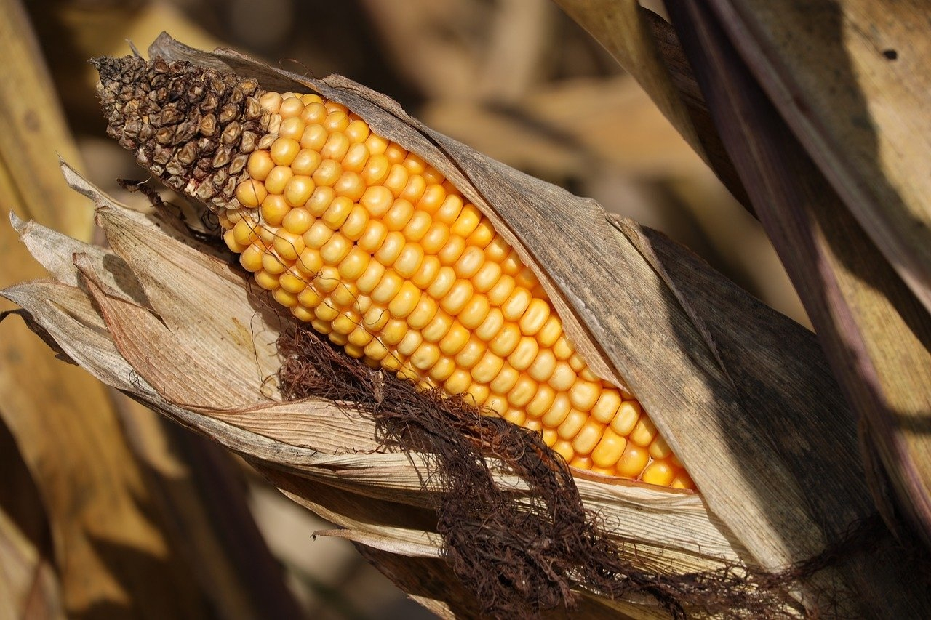
Subject Knowledge: Transition Period in Canadian Life
Geographical Diversity of Canadian Autumn
Cultural Significance of Autumn Festivals
The Canadian autumn represents an extraordinarily complex ecological transition spanning multiple climate zones.
From the maritime provinces to the Rocky Mountains, fall manifests differently across vast geographical regions.
Each ecosystem experiences unique changes during this transition period.
Autumn in Canada is marked by various cultural festivals celebrating the harvest season.
Events like Thanksgiving and Oktoberfest showcase the importance of autumn in Canadian traditions.
These festivals bring communities together and highlight the cultural richness of the season.
Economic Impact of Fall Harvest
Social Structures and Seasonal Changes
Autumn plays a crucial role in the Canadian economy through the fall harvest.
Industries such as agriculture, tourism, and retail experience shifts during this period.
The abundance of seasonal produce and tourism activities contribute significantly to the economy.
Autumn serves as a transition period in Canadian social structures.
Activities like back-to-school, fall sports, and community gatherings reflect the changing dynamics of society.
The season influences social interactions and behaviors across different demographics.
Exploring Autumn in Canada
8

Slide 12

Subject Knowledge: Interconnected Nature of Seasonal Changes
Geographical Diversity of Canadian Autumn
The Canadian autumn showcases a diverse ecological transition across various climate zones.
From the maritime provinces to the Rocky Mountains, fall displays unique characteristics in different regions.
Each ecosystem experiences distinct changes, reflecting the interconnectedness of seasonal shifts.
Cultural Significance of Autumn Festivals
Autumn in Canada is marked by vibrant festivals celebrating the harvest season.
Events like Thanksgiving and Oktoberfest highlight the cultural importance of autumn traditions.
These festivals emphasize the connection between seasonal changes, community gatherings, and cultural heritage.
Economic Impact of Fall Tourism
Autumn foliage attracts tourists from around the world, contributing significantly to Canada's tourism industry.
The peak season for fall foliage drives economic activity in rural areas through activities like leaf-peeping tours and outdoor adventures.
The interconnected nature of seasonal changes influences tourism patterns and economic opportunities in Canada.
Environmental Implications of Autumn Transition
The shift to autumn brings changes in wildlife behavior, plant life cycles, and ecosystem dynamics.
Leaf litter decomposition, migration patterns, and temperature fluctuations are key environmental factors affected by seasonal transitions.
Understanding the interconnected nature of seasonal changes is crucial for conservation efforts and ecosystem management.
Exploring Autumn in Canada
9

Slide 13
Maritime Provinces
Subject Knowledge: Implications for Canadian Environmental Systems
Mild temperatures
Vibrant foliage
Frequent rainfall
01
Rocky Mountains
Cooler temperatures
Snowfall at higher elevations
Golden larch trees
02
Prairies
03
Dry conditions
Harvest season
Migratory bird patterns
Northern Territories
04
Rapid temperature drop
Shortened daylight hours
Aurora borealis visibility
Exploring Autumn in Canada
10

Slide 14
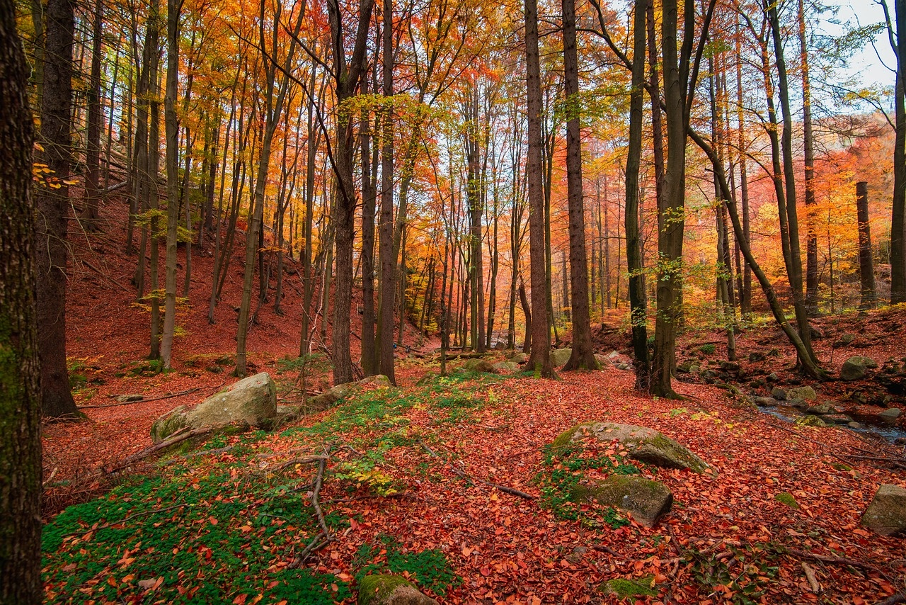
Subject Knowledge: Autumn in Maritime Provinces
Geographical Diversity of Canadian Autumn
Economic Impact of Autumn Tourism
Cultural Traditions and Festivals
The Maritime Provinces experience a unique blend of fall colors due to their proximity to the Atlantic Ocean.
The cooler ocean temperatures influence the timing of leaf changes, creating a picturesque autumn landscape.
Coastal areas like Nova Scotia and New Brunswick boast vibrant hues of red, orange, and yellow during the fall season.
Fall foliage drives tourism in the Maritime Provinces, attracting visitors from around the world to witness the stunning autumn colors.
The hospitality industry experiences a surge in bookings during the fall months, contributing significantly to the local economy.
Outdoor activities like hiking, apple picking, and scenic drives become popular among tourists seeking the beauty of autumn in the Maritimes.
The Maritime Provinces celebrate autumn with various cultural events such as harvest festivals and pumpkin fairs.
Indigenous communities in the region mark the season with traditional ceremonies honoring nature and the harvest.
Local artisans showcase their craft at autumn markets, offering handmade goods inspired by the season.
Exploring Autumn in Canada
11

Slide 15
Elevation Impact on Fall Foliage
Subject Knowledge: Autumn in the Rocky Mountains
The varying elevations in the Rocky Mountains result in a stunning array of fall colors.
Higher altitudes experience earlier changes compared to lower regions.
01
Wildlife Migration Patterns
Autumn marks the time when wildlife, such as elk and deer, begin their seasonal migrations.
Animals move to lower elevations in search of food and shelter.
02
Weather Fluctuations
03
The Rocky Mountains witness rapid weather changes in the fall.
Conditions range from warm sunny days to sudden snowstorms, creating a dynamic environment.
Outdoor Recreation Opportunities
04
Autumn offers a plethora of outdoor activities, including hiking, camping, and wildlife watching.
The season attracts adventurers and nature enthusiasts from around the world.
Exploring Autumn in Canada
12

Slide 16

Subject Knowledge: Ecological Transition in Canadian Autumn
Geographical Diversity of Canadian Autumn
Impact on Biodiversity
The Canadian autumn showcases a diverse ecological transition across various climate zones.
From the maritime provinces to the Rocky Mountains, each region experiences fall uniquely.
Ecosystems undergo significant changes, influencing flora, fauna, and natural processes.
Autumn in Canada plays a crucial role in shaping biodiversity patterns.
Migration of birds and animals, changing habitats, and seasonal adaptations are key features.
Understanding these dynamics is essential for conservation efforts and ecosystem management.
Climate Change Implications
Cultural Perspectives
Canadian autumn provides insights into the effects of climate change on seasonal transitions.
Shifts in temperature, precipitation patterns, and phenology impact ecological processes.
Studying these changes is vital for assessing environmental sustainability and resilience.
Autumn holds cultural significance for Indigenous communities in Canada.
Traditional practices, ceremonies, and storytelling are intertwined with the seasonal transition.
Exploring these cultural connections enriches our understanding of the ecological and social dimensions of fall in Canada.
Exploring Autumn in Canada
13

Slide 17

Subject Knowledge: Canadian Landscape Transformation in Fall
Geographical Diversity of Canadian Autumn
The Canadian autumn showcases a diverse ecological transition across various climate zones.
From the maritime provinces to the Rocky Mountains, fall displays unique characteristics in different geographical regions.
Each ecosystem experiences distinct changes during this transformative season.
Exploring Autumn in Canada
14

Slide 18
01
Maritime Provinces
Subject Knowledge: Seasonal Changes and Canadian Identity
Mild temperatures
Vibrant foliage
Frequent rainfall
02
Central Canada
Cooler temperatures
Colorful leaves
Harvest season
03
Rocky Mountains
Early snowfall
Crisp air
Golden aspen trees
Exploring Autumn in Canada
15

Slide 19
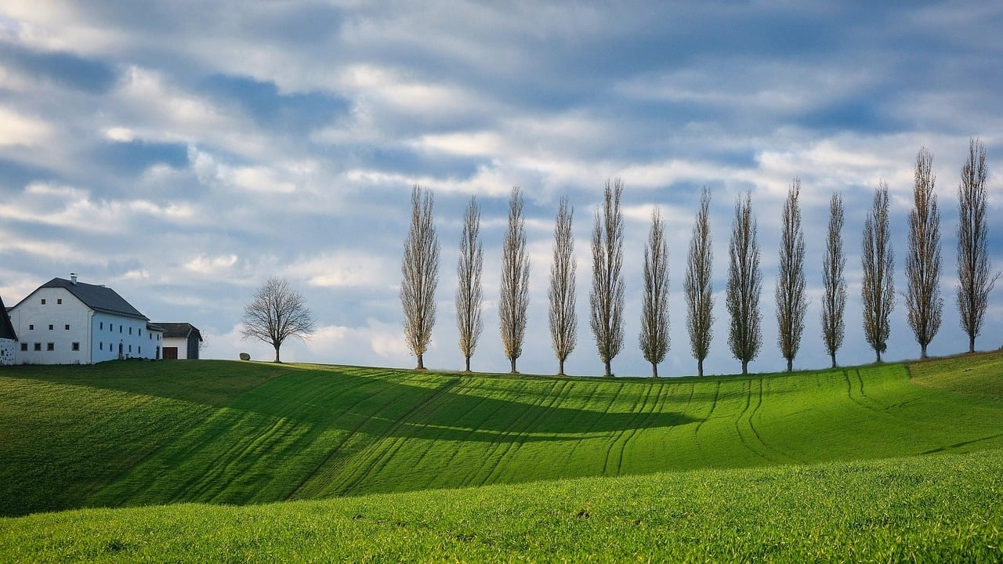
Subject Knowledge: Autumn's Impact on Environmental Systems
Maritime Provinces
Rocky Mountains
Central Canada
Mild temperatures
Vibrant foliage
Increased precipitation
Early snowfall
Coniferous forests
Wildlife migration
Cooler temperatures
Mixed forests
Harvest season
Exploring Autumn in Canada
16

Slide 20
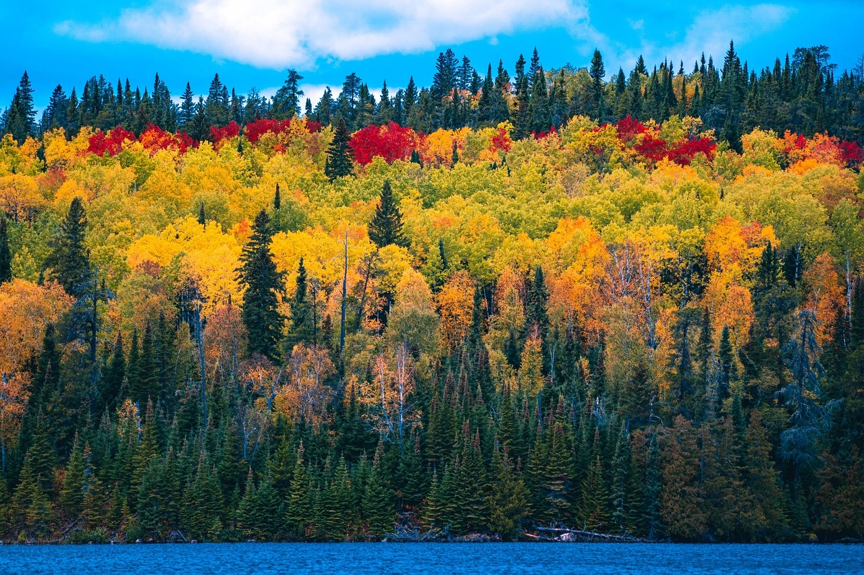
Subject Knowledge: Multifaceted Phenomenon of Fall in Canada
Geographical Diversity of Canadian Autumn
The Canadian autumn showcases a diverse ecological transition across various climate zones.
From the maritime provinces to the Rocky Mountains, fall displays unique characteristics in different geographical regions.
Each ecosystem experiences distinct changes during this season, contributing to the overall richness of Canada's autumn landscape.
Exploring Autumn in Canada
17

Slide 21

Subject Knowledge: Critical Period of Transition in Canadian Life
Geographical Diversity of Canadian Autumn
Cultural Significance of Autumn Festivals
The Canadian autumn showcases a diverse ecological transition across various climate zones.
From the maritime provinces to the Rocky Mountains, fall displays unique characteristics in different regions.
Each ecosystem experiences distinct changes during this critical period of transition.
Autumn in Canada is marked by vibrant festivals celebrating the harvest season.
Events like the Thanksgiving weekend and Oktoberfest bring communities together to honor traditions and local produce.
These festivals reflect the cultural importance of autumn as a time of abundance and gratitude.
Economic Impact of Fall Tourism
Environmental Changes and Wildlife Adaptations
Autumn foliage attracts tourists from around the world, contributing significantly to Canada's tourism industry.
The peak season for leaf-peeping drives economic activity in rural areas through accommodations, dining, and outdoor activities.
Businesses strategically leverage the beauty of fall to boost revenue and support local economies.
As temperatures drop and daylight hours decrease, Canadian wildlife undergoes adaptations to survive the approaching winter.
Migratory birds begin their journey south, while bears and other animals prepare for hibernation.
The ecological shifts during autumn highlight the interconnectedness of nature and the seasonal rhythms of life.
Exploring Autumn in Canada
18

Slide 22
Maritime Provinces
Subject Knowledge: Fall's Influence on Social Structures
Mild temperatures
Vibrant foliage
Harvest festivals
01
Rocky Mountains
Cooler temperatures
Snowfall begins
Winter sports preparation
02
Prairies
03
Crisp air
Golden fields
Agricultural fairs
Northern Territories
04
Rapid temperature drop
Aurora Borealis
Hunting season
Exploring Autumn in Canada
19

Slide 23

Subject Knowledge: Environmental and Cultural Dimensions of Autumn
Geographical Diversity of Canadian Autumn
The Canadian autumn represents an extraordinarily complex ecological transition spanning multiple climate zones.
From the maritime provinces to the Rocky Mountains, fall manifests differently across vast geographical regions.
Each ecosystem experiences unique changes during this season, contributing to the overall diversity of Canadian autumn.
Exploring Autumn in Canada
20

