Slide 1

Global Shifts: Post-World War II
Exploring the Impact and Legacy

Slide 2
Table of contents
01
02
03
04
05
06
07
08
09
10
11
Title Slide: Global Transformations After World War II
Learning Objectives
World War II Aftermath - Key Context
Cold War Origins
Decolonization Movement
United Nations Formation
Global Political Transformation Mechanisms
Technological and Economic Impact
Long-Term Political Reconfiguration
Key Misconceptions
Interactive Learning Opportunities

Slide 3
Table of contents
12
13
14
15
16
17
18
Assessment Strategies
Vocabulary Highlights
Conclusion
Reflection Questions
Additional Resources
Design Recommendations
Export Requirements

Slide 4

1
Title Slide: Global Transformations After World War II
Global Transformations After World War II
Understanding Geopolitical Shifts (1945-1960)
Global Shifts: Post-World War II

Slide 5
2
Learning Objectives
01
Comprehend post-World War II geopolitical transformations
02
Analyze Cold War emergence and dynamics
03
Understand global decolonization process
Explore the shifting global power dynamics
Understand the impact of World War II on international relations
Examine the ideological conflict between capitalism and communism
Investigate the strategies and tactics employed during the Cold War
Study the movements for independence in Africa, Asia, and the Caribbean
Analyze the challenges faced by newly independent nations
04
Evaluate United Nations' role in international relations
05
Develop critical historical thinking skills
Assess the UN's efforts in maintaining peace and security
Explore the organization's impact on global diplomacy
Enhance analytical skills through historical context
Foster a deeper understanding of complex geopolitical events
Global Shifts: Post-World War II

Slide 6

3
World War II Aftermath - Key Context
01
Global Power Landscape Dramatically Transformed
02
Traditional Imperial Structures Collapsing
Shift from European dominance to the rise of the USA and USSR
Decline of colonial empires and the emergence of independent nations
03
Two Emerging Superpowers: USA and USSR
04
Bipolar World Order Established
Ideological differences leading to the Cold War rivalry
Division of the world into Western and Eastern blocs
Global Shifts: Post-World War II

Slide 7

4
Cold War Origins
01
Ideological Battle
02
Key Characteristics
Capitalism vs Communism
No Direct Military Confrontation
Proxy Wars
Nuclear Arms Race
Global Diplomatic Tensions
Global Shifts: Post-World War II

Slide 8
5
Decolonization Movement
01
Definition
02
Significance
03
Regions Involved
Colonized Nations Gaining Independence
Shift in Global Power Dynamics
Africa
Asia
Caribbean
04
Key Players in Africa
05
Key Players in Asia
Ghana
Kenya
Algeria
India
Indonesia
Vietnam
Global Shifts: Post-World War II

Slide 9
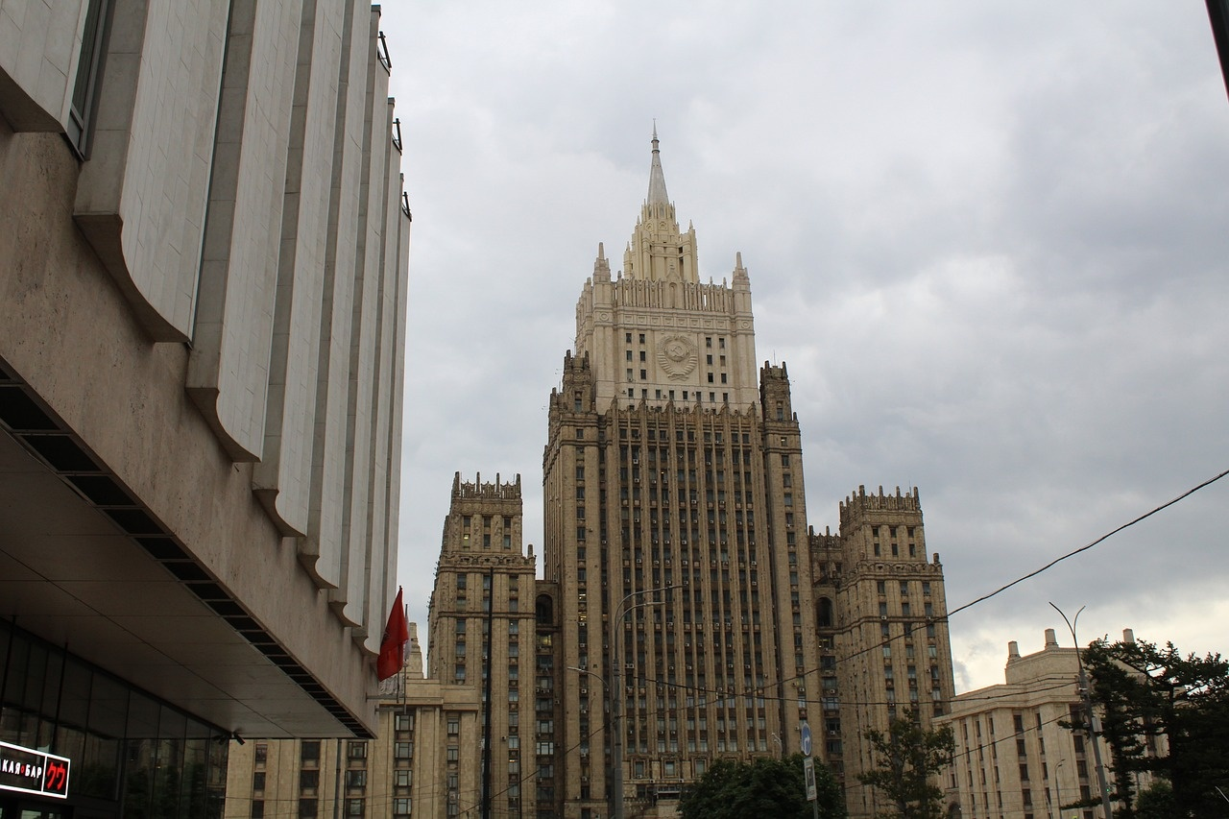
6
United Nations Formation
01
Established
02
Primary Objectives
1945
Prevent Future Global Conflicts
Promote International Cooperation
Protect Human Rights
03
Structural Components
General Assembly
Security Council
Peacekeeping Missions
Global Shifts: Post-World War II

Slide 10

7
Global Political Transformation Mechanisms
01
Technological Advancements
02
Communication Revolution
Impact on communication and information dissemination
Influence on diplomatic relations and global governance
Shift in how nations interact and negotiate
Facilitation of international cooperation and conflict resolution
03
Diplomatic Frameworks
04
Emerging International Institutions
Evolution of diplomatic norms and practices
Establishment of new diplomatic channels and protocols
Role of organizations like the United Nations
Influence of regional alliances on global politics
Global Shifts: Post-World War II

Slide 11

8
Technological and Economic Impact
01
Marshall Plan
02
Rapid Technological Innovation
A U.S. initiative to aid Western Europe's economic recovery post-WWII.
Provided financial assistance for infrastructure rebuilding and modernization.
Advancements in technology accelerated post-WWII.
Innovations in industries such as aerospace, electronics, and computing.
03
Global Economic Reconstruction
04
Increased International Interconnectedness
Efforts to rebuild war-torn economies and establish stability.
Economic policies aimed at promoting growth and trade.
Expansion of global trade and interconnected economies.
Emergence of multinational corporations and global supply chains.
Global Shifts: Post-World War II

Slide 12
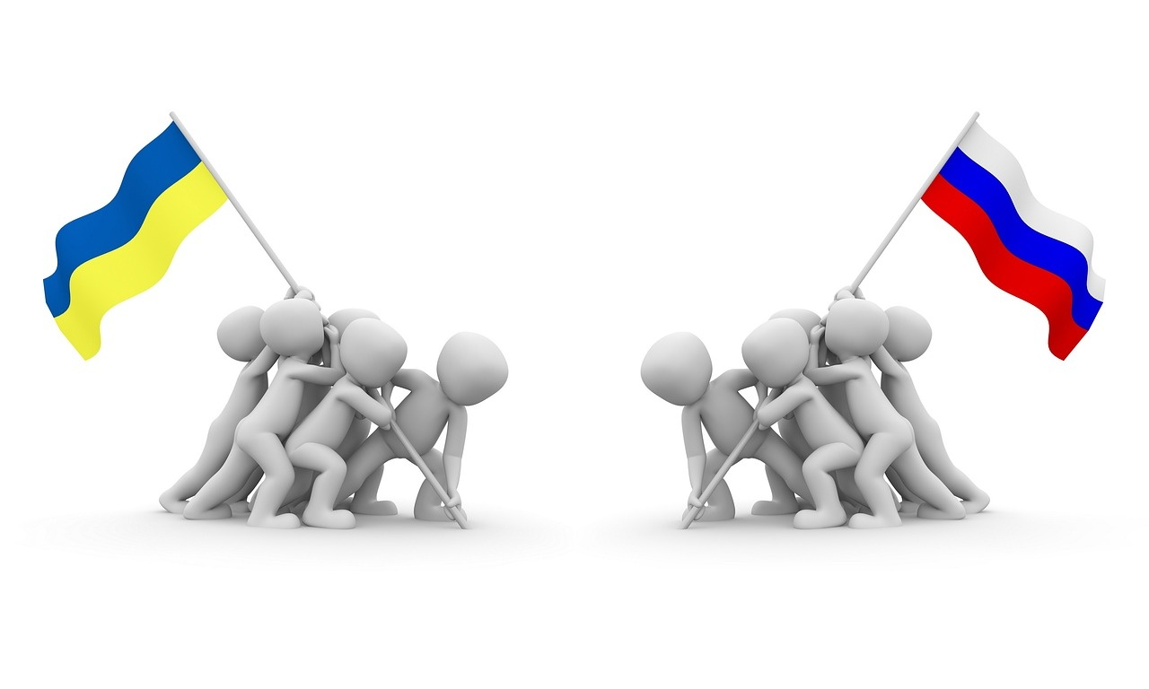
9
Long-Term Political Reconfiguration
01
Emergence of New Nation-States
02
Challenging Western-Dominated Systems
Former colonies gaining independence
Redrawing of political boundaries
Rise of non-aligned movements
Shift in power dynamics
03
Multipolar Political Landscapes
04
Complex Diplomatic Negotiations
Diversification of global power centers
Increased diplomatic complexities
Treaty formations and alliances
Balancing of interests and ideologies
Global Shifts: Post-World War II

Slide 13

10
Key Misconceptions
01
Cold War Was Not Just Military Conflict
02
Decolonization Was Complex and Varied
Misconception: Many believe the Cold War was solely about military confrontation between the USA and USSR.
Reality: The Cold War also involved ideological battles, proxy wars, nuclear arms race, and global diplomatic tensions.
Misconception: Decolonization was a straightforward process with all colonies gaining independence smoothly.
Reality: Decolonization faced challenges such as political restructuring, economic development issues, and cultural identity reconstruction in different regions.
03
UN Not Always Successful in Conflict Prevention
04
Global Changes Were Not Uniform
Misconception: The United Nations always effectively prevented global conflicts.
Reality: While the UN aims to prevent conflicts, it has faced limitations and instances where conflicts were not averted.
Misconception: The post-World War II global shifts affected all regions in the same way.
Reality: Different regions experienced transformations differently based on their unique historical, political, and economic contexts.
Global Shifts: Post-World War II

Slide 14

11
Interactive Learning Opportunities
01
Geopolitical Mapping Exercises
02
Cold War Simulation Debates
Engage students in mapping key geopolitical shifts post-World War II.
Analyze the changing boundaries and power dynamics on a global scale.
Encourage students to role-play as different countries or leaders during the Cold War.
Explore the ideological tensions and diplomatic strategies of the era.
03
UN Resolution Workshops
04
Decolonization Role-Playing
Task students with drafting resolutions for hypothetical international conflicts.
Promote understanding of the UN's role in maintaining peace and security.
Allow students to embody leaders of decolonizing nations.
Investigate the challenges and complexities of gaining independence.
Global Shifts: Post-World War II

Slide 15

12
Assessment Strategies
01
Digital Interactive Quizzes
02
Research Portfolios
03
Multimedia Presentations
04
Comparative Analysis Essays
Global Shifts: Post-World War II

Slide 16
13
Vocabulary Highlights
01
Decolonization
02
Cold War
03
Geopolitical Transformation
Definition: Process of formerly colonized nations gaining independence
Significance: Shifted global power dynamics and reshaped geopolitical landscapes
Definition: Ideological conflict between the USA and USSR
Characteristics: Proxy wars, nuclear arms race, diplomatic tensions
Definition: Significant changes in global political structures
Impact: Establishment of new power dynamics and international relations
04
Sovereignty
05
Proxy War
Definition: Independent authority of a state over its territory
Importance: Key principle in post-World War II geopolitical discussions
Definition: Indirect conflict between two opposing powers
Examples: Korean War, Vietnam War, Afghan War
Global Shifts: Post-World War II

Slide 17
14
Conclusion
Profound Global Transformation
Interconnected Historical Narratives
Continuing Influence on Contemporary Geopolitics
The aftermath of World War II led to significant shifts in global power dynamics, shaping the geopolitical landscape for decades to come.
The intertwined stories of decolonization, the Cold War, and the formation of the United Nations highlight the complex web of historical events that defined this era.
The legacies of post-World War II developments continue to impact modern international relations, underscoring the enduring relevance of this transformative period.
Global Shifts: Post-World War II

Slide 18

15
Reflection Questions
01
How did global power structures change?
02
What were the key challenges in decolonization?
Explore the shift in influence from traditional powers to emerging superpowers.
Analyze the impact of the bipolar world order on international relations.
Examine the political restructuring processes in decolonized nations.
Discuss the economic development hurdles faced by newly independent countries.
03
How did the UN impact international relations?
04
What lessons can we learn from this period?
Evaluate the effectiveness of the UN in preventing global conflicts.
Consider the role of the UN in promoting international cooperation and protecting human rights.
Reflect on the consequences of ideological conflicts like the Cold War.
Consider the importance of diplomacy and international institutions in maintaining global stability.
Global Shifts: Post-World War II

Slide 19

16
Additional Resources
01
Recommended Documentaries
02
Online Historical Archives
"The Cold War" by CNN
"Decolonization and Independence" by PBS
Library of Congress Digital Collections
British Library Online Archives
03
Interactive Digital Platforms
04
Suggested Reading List
History.com Interactive Timeline
National Geographic History Explorer
"Postwar: A History of Europe Since 1945" by Tony Judt
"The Cold War: A New History" by John Lewis Gaddis
Global Shifts: Post-World War II

Slide 20
17
Design Recommendations
01
Consistent Color Scheme
02
Historical Photographs and Maps
03
Infographics for Complex Information
Use a harmonious color palette throughout the presentation.
Incorporate relevant historical images and maps to visually enhance content.
Utilize infographics to simplify and illustrate complex historical data effectively.
04
Clean, Readable Typography
05
Subtle Animated Transitions
Choose clear and legible fonts for easy readability by the audience.
Add subtle animations to transition between slides for a professional touch.
Global Shifts: Post-World War II

Slide 21
18
Export Requirements
01
Compliance with Trade Regulations
02
Product Classification
03
Packaging and Labeling
Understanding of import/export laws
Documentation accuracy for customs clearance
Proper classification of goods for export
Adherence to tariff codes and regulations
Packaging requirements for safe transport
Clear labeling for product identification
04
Quality Standards
05
Shipping and Logistics
Meeting quality standards for export markets
Certifications and testing requirements
Choosing appropriate shipping methods
Coordination with freight forwarders for smooth delivery
Global Shifts: Post-World War II

