Slide 1
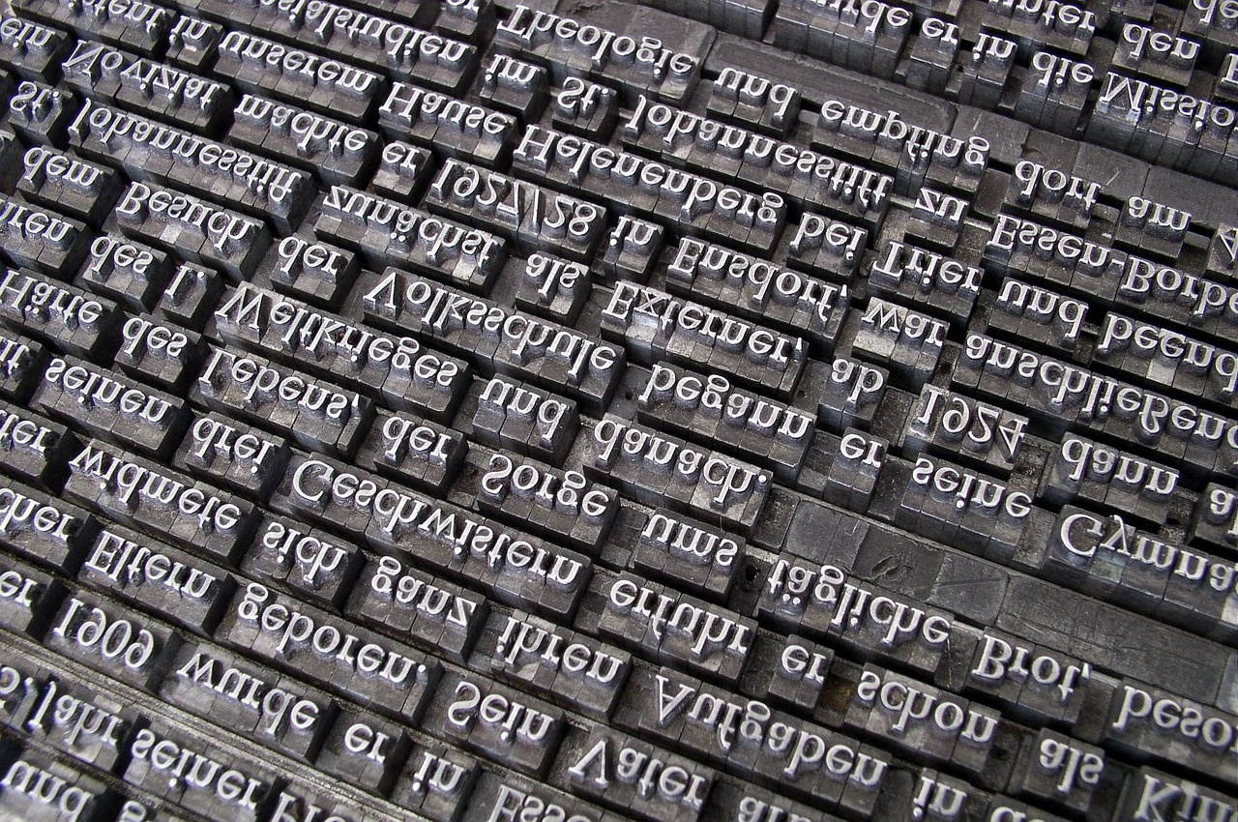
Mastering Adverbs of Frequency: Enhancing Language Proficiency
Exploring Usage, Impact, and Integration

Slide 2
Table of contents
01
02
03
04
05
06
07
08
09
10
11
Title Slide: Mastering Adverbs of Frequency
Lesson Objectives: Analyzing and Identifying
What are Adverbs of Frequency?
Placement Rules for Adverbs
Communication Impact of Frequency Adverbs
Practical Application in Daily Routines
Interactive Learning Activities
Common Challenges and Correction Strategies
Cross-Curricular Connections with Adverbs
Technology Integration for Language Learning
Assessment Strategies and Evaluation Methods

Slide 3
Table of contents
12
13
14
15
16
17
Parent Engagement in Language Learning
Key Takeaways from the Lesson
Next Steps for Advanced Learning
Conclusion: Empowering Communication
Design Recommendations for Presentation
Suggested Visual Elements for Slides

Slide 4

1
Title Slide: Mastering Adverbs of Frequency
Mastering Adverbs of Frequency
Communication Strategies for Grade 9 English Language Learners
Mastering Adverbs of Frequency: Enhancing Language Proficiency

Slide 5

2
Lesson Objectives: Analyzing and Identifying
01
Cognitive Objectives
02
Language Objectives
Analyze grammatical structure of frequency adverbs
Identify correct placement in sentences
Distinguish frequency levels in communication
Produce sentences using 5+ frequency adverbs
Describe personal routines
Engage in meaningful conversations
Mastering Adverbs of Frequency: Enhancing Language Proficiency

Slide 6

3
What are Adverbs of Frequency?
01
What are Adverbs of Frequency?
02
Key Examples
Definition: Words that describe how often an action occurs
Always (100%)
Usually (90%)
Frequently (80%)
Sometimes (50%)
Rarely (20%)
Mastering Adverbs of Frequency: Enhancing Language Proficiency

Slide 7

4
Placement Rules for Adverbs
01
Before main verb
02
After auxiliary verbs
Example: "She always arrives early."
Example: "They have never been to Europe."
03
Examples
"I usually walk to school."
"He sometimes forgets his keys."
Mastering Adverbs of Frequency: Enhancing Language Proficiency

Slide 8
5
Communication Impact of Frequency Adverbs
01
Enhancing Clarity
02
Establishing Routine
03
Adding Depth
Using frequency adverbs helps in clearly conveying how often an action occurs.
Example: "She always arrives early for meetings."
Frequency adverbs assist in describing regular habits and routines.
Example: "I usually walk my dog in the evening."
Incorporating frequency adverbs adds nuance and detail to communication.
Example: "They rarely go out on weekdays."
04
Highlighting Consistency
05
Improving Understanding
Frequency adverbs emphasize the consistency or variability of actions.
Example: "He sometimes forgets his keys."
Proper use of frequency adverbs aids in better comprehension of messages.
Example: "We never miss our weekly team meetings."
Mastering Adverbs of Frequency: Enhancing Language Proficiency

Slide 9
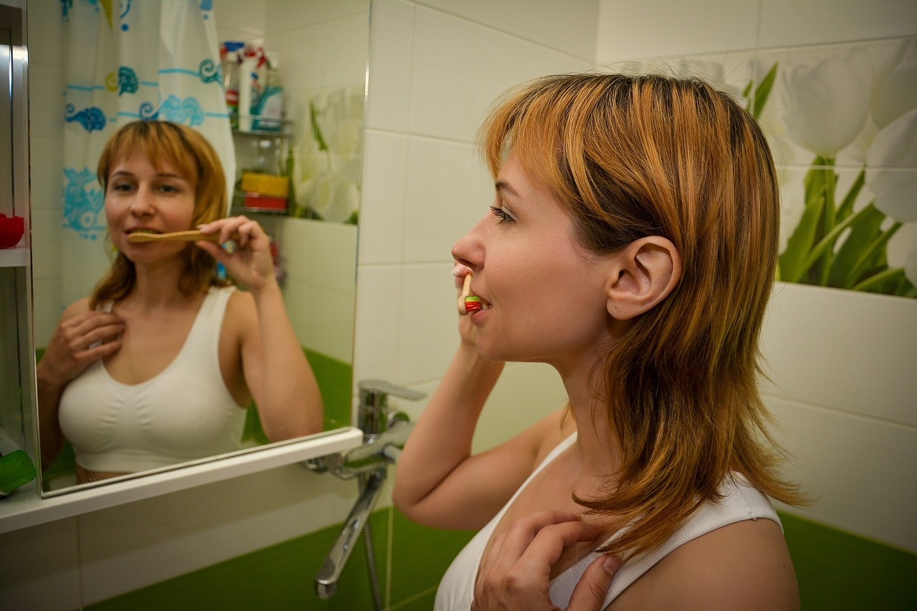
6
Practical Application in Daily Routines
01
Morning Routine
02
Work/School Routine
I always wake up at 6:00 AM.
I usually have a cup of coffee for breakfast.
I frequently check my emails throughout the day.
I sometimes have meetings in the afternoon.
03
Evening Routine
I rarely go out on weekdays.
I never forget to brush my teeth before bed.
Mastering Adverbs of Frequency: Enhancing Language Proficiency

Slide 10

7
Interactive Learning Activities
01
Frequency Ladder Challenge
02
Habit Detective Interview
Students arrange adverbs of frequency in order from least to most frequent.
Pair activity where students interview each other to uncover daily habits using frequency adverbs.
03
Routine Visualization Mapping
04
Frequency Bingo Game
Create visual representations of personal routines using frequency adverbs.
Engaging game where students mark off activities on a bingo card based on frequency adverbs.
Mastering Adverbs of Frequency: Enhancing Language Proficiency

Slide 11

8
Common Challenges and Correction Strategies
01
Incorrect Adverb Placement
02
Overusing Absolute Adverbs
Address confusion in placing adverbs correctly in sentences.
Provide clear examples and practice exercises for reinforcement.
Discuss the impact of using absolute adverbs excessively.
Encourage varied adverb usage to enhance language proficiency.
03
Misunderstanding Frequency Percentages
Clarify the meaning behind different frequency percentages.
Offer guidance on interpreting and using adverbs of frequency effectively.
Mastering Adverbs of Frequency: Enhancing Language Proficiency

Slide 12

9
Cross-Curricular Connections with Adverbs
01
Mathematics
02
Social Studies
Analyzing frequency percentages
Creating statistical representations
Exploring cultural routines and traditions
Understanding societal norms and practices
03
Health Education
Discussing personal habits and routines
Promoting healthy lifestyle choices
Mastering Adverbs of Frequency: Enhancing Language Proficiency

Slide 13

10
Technology Integration for Language Learning
Digital Learning Tools
Language learning apps
Interactive online platforms
Multimedia communication challenges
Mastering Adverbs of Frequency: Enhancing Language Proficiency

Slide 14

11
Assessment Strategies and Evaluation Methods
01
Written Portfolio
02
Oral Presentations
Students compile a collection of written work showcasing the correct usage of adverbs of frequency in sentences.
Students deliver speeches or presentations incorporating a variety of frequency adverbs to describe routines or habits.
03
Interactive Communication Tests
04
Comprehensive Written Examination
Engage students in real-time conversations where they must use adverbs of frequency appropriately to communicate.
Assess students' understanding of adverbs of frequency through a structured exam covering grammar rules and practical application.
Mastering Adverbs of Frequency: Enhancing Language Proficiency

Slide 15

12
Parent Engagement in Language Learning
01
Weekly Communication Challenges
02
Family Language Learning Activities
Encourage parents to engage in weekly language challenges with their children.
Provide prompts or topics for discussion to practice language skills at home.
Suggest fun and interactive language learning activities for families to do together.
Include games, storytelling, or cooking activities that incorporate language practice.
03
Digital Progress Tracking
Utilize digital tools to track and monitor language learning progress.
Share resources or apps that parents can use to support their child's language development.
Mastering Adverbs of Frequency: Enhancing Language Proficiency

Slide 16

13
Key Takeaways from the Lesson
01
Understanding Adverbs of Frequency
02
Placement Rules
Words that describe how often an action occurs
Examples: Always, Usually, Frequently, Sometimes, Rarely, Never
Before the main verb or after auxiliary verbs
Examples: 'I always eat breakfast.' 'She never watches TV late.'
03
Impact on Communication
Conveying personal habits and routine behaviors
Adding nuance and specificity to conversations
Mastering Adverbs of Frequency: Enhancing Language Proficiency

Slide 17

14
Next Steps for Advanced Learning
01
Frequency Expression Workshop
02
Comparative Communication Seminar
Dive deeper into nuances of using adverbs of frequency
Practice advanced sentence structures and communication strategies
Explore how different frequency levels impact meaning and tone
Analyze cultural variations in frequency adverb usage
03
Integrated Multimedia Project
Apply frequency adverbs creatively in multimedia presentations
Collaborate with peers to enhance language proficiency through diverse mediums
Mastering Adverbs of Frequency: Enhancing Language Proficiency

Slide 18

15
Conclusion: Empowering Communication
Conclusion: Empowering Communication
Mastering adverbs of frequency enhances language proficiency.
Mastering Adverbs of Frequency: Enhancing Language Proficiency

Slide 19
16
Design Recommendations for Presentation
01
Color Scheme
02
Imagery
03
Bullet Points
Use a consistent and clean color scheme throughout the presentation.
Incorporate language-related imagery to enhance visual appeal and reinforce the topic.
Utilize bullet points for readability and to highlight key design recommendations effectively.
04
Visual Elements
05
Professional Aesthetic
Include engaging visual elements such as icons, graphics, and interactive dialogue bubbles to make the presentation visually appealing.
Maintain a professional and educational aesthetic in the design to align with the topic of language proficiency.
Mastering Adverbs of Frequency: Enhancing Language Proficiency

Slide 20

17
Suggested Visual Elements for Slides
01
Language Communication Icons
02
Frequency Percentage Graphics
Icons representing different modes of communication (e.g., speech bubbles, letters)
Visual representations showing the frequency levels (e.g., pie charts, bar graphs)
03
Interactive Dialogue Bubbles
04
Global Communication Imagery
Engaging visuals of dialogue bubbles for interactive examples
Images depicting global connections through language and communication
Mastering Adverbs of Frequency: Enhancing Language Proficiency

