Slide 1

The Evolution of Gaming: A Technological Journey
Exploring the Past, Present, and Future of Gaming Technology

Slide 2
Table of contents
01
02
03
04
05
06
07
08
09
10
11
Title Slide: The Evolution of Gaming: A Technological Journ…
Introduction: Gaming's Transformative Power
Early Gaming Era (1970s): Arcade Beginnings
Home Console Revolution (1980s): Living Room Gaming Emerges
3D Graphics Era (1990s): Technological Quantum Leap
Online Multiplayer Revolution (2000s): Connected Gaming Wor…
Contemporary Gaming Landscape: Modern Gaming Technologies
Technological Progression Timeline: Gaming's Technological …
Cultural Impact of Gaming: Beyond Entertainment
Future of Gaming: Emerging Technologies
Critical Thinking Prompt: Reflect and Analyze

Slide 3
Table of contents
12
13
14
Conclusion: Gaming - A Continuous Evolution
Resources and Further Learning: Recommended Resources
Q&A and Discussion: Your Questions, Insights, Experiences

Slide 4

1
Title Slide: The Evolution of Gaming: A Technological Journey
The Evolution of Gaming: A Technological Journey
Exploring Interactive Entertainment from 1970s to Present
The Evolution of Gaming: A Technological Journey

Slide 5

2
Introduction: Gaming's Transformative Power
Gaming's Transformative Power
From simple pixels to immersive digital worlds
Multi-billion dollar global industry
Reflection of technological and cultural innovation
The Evolution of Gaming: A Technological Journey

Slide 6

3
Early Gaming Era (1970s): Arcade Beginnings
Arcade Beginnings
Pong (1972) - First commercially successful video game
The Evolution of Gaming: A Technological Journey

Slide 7

4
Home Console Revolution (1980s): Living Room Gaming Emerges
01
Nintendo Entertainment System (NES)
02
Introduction of iconic franchises
Introduced in 1985
Popularized iconic characters like Mario and Zelda
Super Mario Bros.
The Legend of Zelda
Metroid
03
Shift from public arcades to home entertainment
Families and individuals could enjoy gaming in their living rooms
The Evolution of Gaming: A Technological Journey

Slide 8
5
3D Graphics Era (1990s): Technological Quantum Leap
Introduction of PlayStation and Nintendo 64
Advancements in 3D graphics technology
PlayStation: Revolutionized gaming with CD-ROM technology
Nintendo 64: Introduced analog stick for 3D movement
Transition from 2D sprites to fully rendered 3D environments
Enhanced visual realism and depth perception in games
The Evolution of Gaming: A Technological Journey

Slide 9

6
Online Multiplayer Revolution (2000s): Connected Gaming Worlds
Connected Gaming Worlds
World of Warcraft and massive online platforms
Global virtual communities
Social interaction through gaming
The Evolution of Gaming: A Technological Journey

Slide 10

7
Contemporary Gaming Landscape: Modern Gaming Technologies
01
Virtual Reality
02
Cloud Gaming
Immersive gaming experiences
VR headsets like Oculus Rift and HTC Vive
Streaming games over the internet
Services like Google Stadia and NVIDIA GeForce Now
03
eSports
04
Mobile Gaming Platforms
Competitive gaming tournaments
Huge global audience and professional players
Gaming on smartphones and tablets
Popular games like PUBG Mobile and Candy Crush
The Evolution of Gaming: A Technological Journey

Slide 11
8
Technological Progression Timeline: Gaming's Technological Evolution
Introduction of Pong (1972)
Introduction of PlayStation and Nintendo 64
Expansion of mobile gaming platforms
1970s: Arcade Machines
1980s: Home Consoles
1990s: 3D Graphics
2000s: Online Multiplayer
2010s: Mobile and VR Gaming
Launch of Nintendo Entertainment System (NES)
Rise of massive online platforms like World of Warcraft
The Evolution of Gaming: A Technological Journey

Slide 12

9
Cultural Impact of Gaming: Beyond Entertainment
01
Technological Innovation Driver
02
Social Connection Platform
Gaming industry pushes boundaries of technology.
Advances in graphics, AI, and virtual reality driven by gaming demands.
Gaming fosters global communities and friendships.
Online multiplayer games enable social interaction and teamwork.
03
Artistic and Narrative Medium
04
Economic Significance
Games showcase storytelling and artistic creativity.
Interactive narratives engage players in immersive experiences.
Gaming industry contributes significantly to global economy.
Job creation, revenue generation, and market growth driven by gaming sector.
The Evolution of Gaming: A Technological Journey

Slide 13

10
Future of Gaming: Emerging Technologies
01
Neural Interface Gaming
02
Augmented Reality Experiences
Direct brain-computer interaction for immersive gameplay experiences.
Integration of virtual elements into real-world environments for enhanced gaming interactions.
03
AI-Driven Interactive Worlds
04
Hyper-Realistic Simulations
Utilizing artificial intelligence to create dynamic and responsive gaming environments.
Advancements in graphics and physics simulation for unparalleled realism in gaming.
The Evolution of Gaming: A Technological Journey

Slide 14

11
Critical Thinking Prompt: Reflect and Analyze
01
Evolution of Gaming Technology
02
Gaming and Technological Innovation
Shift from simple pixelated games to immersive virtual worlds
Enhanced user interaction and engagement
Development of complex game mechanics and narratives
Advancements in graphics and visual effects
Progress in artificial intelligence for NPC behavior
Innovations in interactive storytelling and game design
03
Impact on Social Connections
04
Future Technologies in Gaming
Rise of online multiplayer platforms
Formation of global gaming communities
Increased social interaction and collaboration through gaming
Potential of virtual reality and augmented reality
Neural interface gaming possibilities
Development of hyper-realistic simulations
The Evolution of Gaming: A Technological Journey

Slide 15
12
Conclusion: Gaming - A Continuous Evolution
Technological Advancements
Cultural Impact
Future Innovations
From basic 2D graphics to photorealistic visuals
Gaming as a form of art and storytelling
Potential for neural interface gaming
The Evolution of Gaming: A Technological Journey

Slide 16

13
Resources and Further Learning: Recommended Resources
01
Documentaries
02
Books
"High Score" on Netflix
"The King of Kong: A Fistful of Quarters"
"Masters of Doom" by David Kushner
"Console Wars" by Blake J. Harris
03
Online Courses
04
Gaming History Websites
Coursera: "The Video Game Industry"
Udemy: "Introduction to Game Development"
IGN's History of Video Games
The Strong National Museum of Play's Online Exhibits
The Evolution of Gaming: A Technological Journey

Slide 17
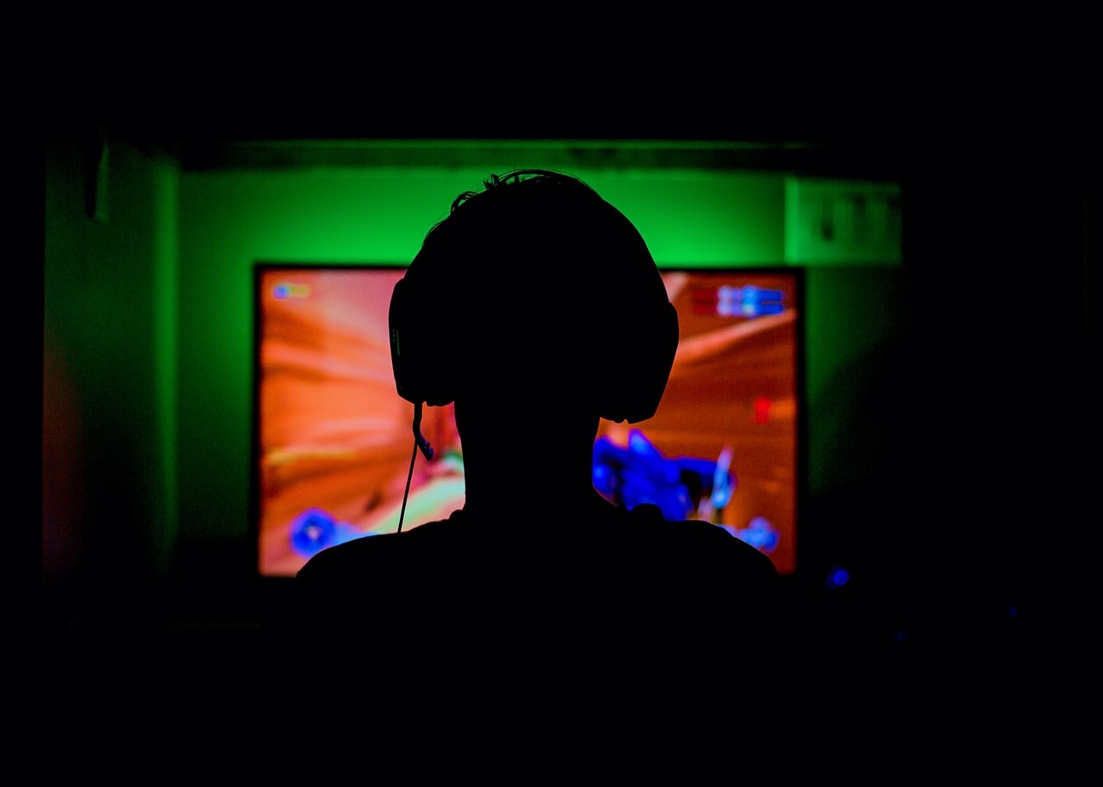
14
Q&A and Discussion: Your Questions, Insights, Experiences
01
Impact of Gaming on Technological Advancements
02
Experiences with Multiplayer Online Gaming Communities
Gaming technology has significantly influenced various fields such as healthcare, education, and military training.
In healthcare, virtual reality (VR) and augmented reality (AR) are used for therapy and surgical training.
Educational tools and platforms have adopted gamification to enhance learning experiences.
Military training programs utilize simulation technologies developed for gaming to create realistic training environments.
Multiplayer online gaming platforms have fostered social connections and friendships.
Players often form strong bonds and communities through shared gaming experiences.
These communities can provide support, collaboration, and a sense of belonging.
03
Future of Gaming with Emerging Technologies
04
Cultural Shifts and Stereotypes in Gaming
Artificial intelligence (AI) and virtual reality (VR) are set to revolutionize the gaming industry.
AI can create more responsive and adaptive game environments.
VR offers immersive experiences that can transform how games are played and experienced.
These technologies have the potential to enhance realism and interactivity in games.
Perceptions of gamers and gaming culture have evolved over the years.
Gaming is now seen as a mainstream and diverse activity enjoyed by people of all ages and backgrounds.
Stereotypes of gamers as isolated or antisocial have diminished as the social aspects of gaming have become more recognized.
The gaming industry has also become more inclusive, with a wider representation of characters and stories.
The Evolution of Gaming: A Technological Journey

