Slide 1

Exploring Professional Identity and Linguistic Concepts in GCSE Spanish
A Comprehensive Overview of Jobs, Household Roles, and Language Transformation Rules

Slide 2
Table of contents
01
02
03
04
05
06
07
08
09
10
11
Title Slide: GCSE Spanish - Jobs, Household Roles, and Prof…
Lesson Objectives
Key Linguistic Concepts
Vocabulary Introduction
Gender Noun Transformation Rules
Sentence Construction Templates
Interactive Learning Activities
Digital Integration Strategies
Assessment Strategies
Summative Assessment Overview
Common Challenges and Solutions

Slide 3
Table of contents
12
13
14
15
16
17
18
19
Cross-Curricular Connections
Parent and Home Learning Support
Extension and Advanced Learning
Conclusion and Key Takeaways
Reflection and Next Steps
Visual Design Recommendations
Interaction Suggestions
Accessibility Considerations

Slide 4
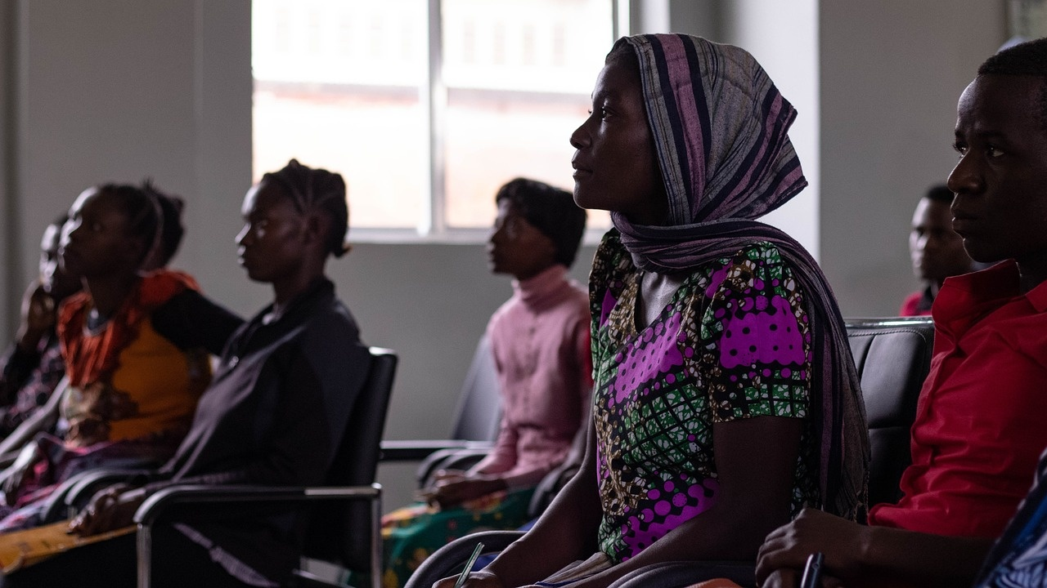
1
Title Slide: GCSE Spanish - Jobs, Household Roles, and Professional Identity
GCSE Spanish: Jobs, Household Roles, and Professional Identity
Exploring Professional Vocabulary and Language Skills
Exploring Professional Identity and Linguistic Concepts in GCSE Spanish

Slide 5
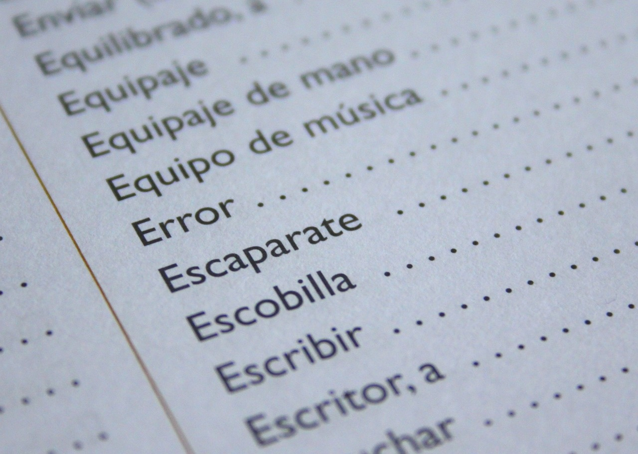
2
Lesson Objectives
Develop comprehensive Spanish job-related vocabulary
Learn common job titles and descriptions
Expand vocabulary related to professional roles
Exploring Professional Identity and Linguistic Concepts in GCSE Spanish

Slide 6

3
Key Linguistic Concepts
01
Job Vocabulary Structure
02
Grammatical Gender in Professional Terminology
Understanding different job titles in Spanish
Learning common professional terms and expressions
Recognizing masculine and feminine noun forms
Applying gender agreement rules in job descriptions
03
Verb Conjugation in Job Descriptions
04
Sociolinguistic Implications of Professional Language
Practicing verb forms for different professions
Using appropriate verb tenses in job-related sentences
Exploring how language reflects social roles
Understanding cultural nuances in professional communication
Exploring Professional Identity and Linguistic Concepts in GCSE Spanish

Slide 7

4
Vocabulary Introduction
Vocabulary Introduction
Job Title Transformations
Camarero (Male Waiter)
Camarera (Female Waiter)
Exploring Professional Identity and Linguistic Concepts in GCSE Spanish

Slide 8
5
Gender Noun Transformation Rules
01
Masculine Endings (-o)
02
Feminine Endings (-a)
03
Exception Scenarios
Examples:
Camarero (Waiter)
Profesor (Teacher)
Examples:
Camarera (Waitress)
Profesora (Female Teacher)
Some nouns change completely:
Hombre (Man) -> Mujer (Woman)
04
Interactive Examples
05
Visual Color-Coding Recommendations
Practice transforming nouns:
Actor (Actor) -> Actriz (Actress)
Use blue for masculine and pink for feminine nouns.
Exploring Professional Identity and Linguistic Concepts in GCSE Spanish

Slide 9

6
Sentence Construction Templates
01
Template 1
02
Verb Conjugation Demonstrations
"Soy [job title] a tiempo parcial"
Example: "Soy camarero a tiempo parcial"
03
Personal Pronoun Integration
04
Practical Example Sentences
"La camarera trabaja a tiempo completo"
"El médico gana un buen sueldo"
Exploring Professional Identity and Linguistic Concepts in GCSE Spanish

Slide 10

7
Interactive Learning Activities
01
Job Role Carousel
02
Household Chores Translation Challenge
Students rotate through different professional roles
Act out job responsibilities in Spanish
Translate common household chores from English to Spanish
Practice vocabulary and sentence structure
03
Salary Negotiation Role-Play
04
Professional Identity Creation
Engage in simulated salary negotiations in Spanish
Focus on professional communication skills
Students create and present their ideal professional identity in Spanish
Incorporate job titles and descriptions
Exploring Professional Identity and Linguistic Concepts in GCSE Spanish

Slide 11

8
Digital Integration Strategies
01
Interactive Vocabulary Apps
02
Augmented Reality Job Exploration
Engage students with interactive tools for vocabulary acquisition.
Provide gamified learning experiences to enhance retention.
Offer immersive experiences for exploring various professional roles.
Enhance understanding of job environments through virtual simulations.
03
Virtual Job Interview Simulation
04
Digital Verb Conjugation Workshop
Prepare students for real-world scenarios in a controlled digital environment.
Develop communication skills and confidence in professional interactions.
Utilize online platforms for interactive verb practice.
Offer personalized feedback and guidance for mastering conjugation skills.
Exploring Professional Identity and Linguistic Concepts in GCSE Spanish

Slide 12
9
Assessment Strategies
01
Vocabulary Retrieval Quizzes
02
Pronunciation Self-Recording
03
Grammatical Error Analysis
Assess students' understanding of job-related vocabulary through interactive quizzes.
Encourage students to record themselves pronouncing job titles and professional terms for self-assessment.
Analyze students' written work to identify and correct grammatical errors related to job descriptions.
04
Peer Translation Challenges
05
Digital Portfolio Development
Engage students in translating job-related sentences and terms with their peers to enhance language skills.
Task students with creating digital portfolios showcasing their understanding of professional vocabulary and linguistic concepts.
Exploring Professional Identity and Linguistic Concepts in GCSE Spanish

Slide 13

10
Summative Assessment Overview
01
Written Portfolio Requirements
02
Oral Presentation Criteria
Include job descriptions and professional vocabulary
Demonstrate understanding of gender noun transformations
Showcase verb conjugation skills in job-related contexts
Present a detailed job profile using Spanish language
Engage in role-play scenarios related to professional settings
Demonstrate fluency in job-related conversations
03
Digital Multimedia Job Profile
04
Comprehensive Written Examination
Create a visually engaging presentation showcasing professional identity
Incorporate audio or video elements to enhance the profile
Include interactive features for viewer engagement
Assess understanding of job vocabulary and linguistic concepts
Evaluate proficiency in constructing job-related sentences
Test verb conjugation skills in various job descriptions
Exploring Professional Identity and Linguistic Concepts in GCSE Spanish

Slide 14

11
Common Challenges and Solutions
01
Linguistic Misconceptions
02
Error Correction Strategies
Challenge: Misunderstanding gender noun transformations.
Solution: Provide clear explanations and practice exercises on noun gender rules.
Challenge: Difficulty in identifying and correcting language errors.
Solution: Implement peer review sessions and offer feedback on common mistakes.
03
Pronunciation Support
04
Contextual Language Application
Challenge: Pronunciation barriers affecting communication.
Solution: Integrate pronunciation drills and audio resources for practice.
Challenge: Applying professional vocabulary in real-world scenarios.
Solution: Engage students in role-plays and simulations to practice language use.
Exploring Professional Identity and Linguistic Concepts in GCSE Spanish

Slide 15

12
Cross-Curricular Connections
01
Mathematics: Exploring Salary Calculations
02
Citizenship: Embracing Workforce Diversity
Understanding how job roles and salaries are mathematically linked
Calculating part-time earnings based on hourly rates
Discussing the importance of diversity in professional environments
Exploring how different backgrounds contribute to a dynamic workforce
03
Business Studies: Enhancing Professional Communication
04
Personal Development: Fostering Career Planning
Analyzing effective communication strategies in the workplace
Studying the impact of language skills on business interactions
Encouraging students to reflect on their future career aspirations
Connecting language skills to personal and professional growth
Exploring Professional Identity and Linguistic Concepts in GCSE Spanish

Slide 16

13
Parent and Home Learning Support
01
Language Learning Partnerships
02
Cultural Immersion Strategies
Encourage parents to practice Spanish with their child regularly.
Provide resources for parents to improve their own Spanish language skills.
Suggest watching Spanish movies or TV shows as a family.
Explore Spanish cultural events or festivals in the local community.
03
Home Learning Environment Tips
04
Family Engagement Activities
Create a designated study area with Spanish learning materials.
Establish a consistent daily routine for language practice at home.
Organize Spanish-themed family game nights.
Plan cooking sessions to prepare traditional Spanish dishes together.
Exploring Professional Identity and Linguistic Concepts in GCSE Spanish

Slide 17

14
Extension and Advanced Learning
01
Professional Podcast Creation
02
Virtual Job Fair Simulation
Develop a podcast discussing various professional roles in Spanish-speaking countries.
Invite guest speakers to share insights on career paths and industry trends.
Organize a virtual job fair where students can explore different professions in Spanish.
Engage with industry professionals through virtual booths and informational sessions.
03
Entrepreneurship Project
04
Advanced Language Challenges
Task students with creating a business plan in Spanish for a unique entrepreneurial venture.
Encourage creativity and innovation in developing sustainable business ideas.
Introduce complex language exercises focusing on professional communication nuances.
Challenge students with advanced grammar structures and idiomatic expressions.
Exploring Professional Identity and Linguistic Concepts in GCSE Spanish

Slide 18

15
Conclusion and Key Takeaways
Conclusion and Key Takeaways
Understanding the importance of gender-specific vocabulary in professional contexts
Acquiring practical job description skills for effective communication
Building confidence and proficiency in constructing professional sentences
Exploring future learning pathways to enhance Spanish language skills
Exploring Professional Identity and Linguistic Concepts in GCSE Spanish

Slide 19
16
Reflection and Next Steps
01
02
03
04
05
Reflect on Your Progress
Set Goals for Continued Learning
Seek Additional Resources
Practice Regularly
Stay Motivated
Consider how your understanding of professional vocabulary and linguistic concepts in Spanish has evolved.
Identify areas of strength and areas for improvement in your learning journey.
Establish specific language goals for further enhancing your Spanish skills.
Plan to practice verb conjugations regularly to solidify your understanding.
Explore online platforms or language learning apps to supplement your studies.
Engage in Spanish language communities or forums to practice conversational skills.
Dedicate time each day to review vocabulary, practice sentence construction, and work on verb conjugations.
Utilize interactive learning activities to reinforce your knowledge in a fun and engaging way.
Celebrate small victories in your language learning journey to maintain enthusiasm.
Visualize your progress and imagine how mastering Spanish will benefit your future endeavors.
Exploring Professional Identity and Linguistic Concepts in GCSE Spanish

Slide 20
17
Visual Design Recommendations
01
Consistent Color Scheme
02
Spanish Flag Colors
03
Job-Related Imagery
Utilize a harmonious color palette throughout the presentation.
Incorporate red and yellow hues to reflect the Spanish flag.
Include relevant visuals of various professional roles.
04
Clear, Readable Fonts
05
Modern Design
Opt for easy-to-read fonts for better legibility.
Maintain a sleek and contemporary visual style.
Exploring Professional Identity and Linguistic Concepts in GCSE Spanish

Slide 21

18
Interaction Suggestions
01
Incorporate QR codes for additional resources
02
Add interactive elements where possible
Enhances accessibility to supplementary materials
Allows for easy access to extended learning content
Engages students in active learning
Promotes participation and retention of information
03
Use animations to reveal content progressively
04
Incorporate small translation or vocabulary challenges
Creates visual interest and engagement
Helps in focusing attention on key points
Encourages language practice and retention
Provides interactive learning opportunities
Exploring Professional Identity and Linguistic Concepts in GCSE Spanish

Slide 22

19
Accessibility Considerations
01
High Color Contrast
02
Large, Readable Fonts
Ensure text and background colors have sufficient contrast for readability.
Use font sizes that are easy to read, especially for individuals with visual impairments.
03
Alt Text for Images
04
Downloadable Text Version
Provide alternative text descriptions for images to assist visually impaired individuals using screen readers.
Offer a downloadable text version of the content for those who may have difficulty accessing visual content.
Exploring Professional Identity and Linguistic Concepts in GCSE Spanish

