Slide 1


Comprehensive Conservation Strategies and Education
Exploring Collaborative Approaches, Communication, and Inclusive Practices for Sustainable Environmental Stewardship

Slide 2
Table of Contents
Introduction to Conservation Strategies
Collaborative Group Work in Conservation
Sentence Frames for Conservation Discussions
Developing Conservation Strategies
Presenting Conservation Solutions
Case Studies in Conservation
ELL/ESL Support Strategies
Technology Integration in Conservation Educati…
Assessment and Evaluation in Conservation Educ…
Conclusion and Next Steps
References and Resources
Appendix: Sentence Frames for Conservation Dis…
Glossary of Conservation Terms
04
05
06
07
08
09
10
11
12
13
14
15
16

Slide 3
Table of Contents
ELL/ESL Support: Tips for Teachers
Conservation Education: A Collective Responsib…
Final Thoughts and Recommendations
17
18
19

Slide 4

Introduction to Conservation Strategies
Definition of Conservation
Significance of Conservation
Individual Contributions to Conservation
Conservation is the act of preserving or protecting something, especially the natural environment.
It involves efforts to safeguard resources and habitats for future generations.
The importance of conservation lies in maintaining biodiversity, ensuring sustainable development, and protecting ecosystem services.
These efforts are crucial for the health and balance of the planet's ecosystems.
Individuals play a vital role by making conscious choices, supporting conservation efforts, and spreading awareness.
Personal actions can collectively lead to significant positive impacts on the environment.
4
Comprehensive Conservation Strategies and Education

Slide 5

Collaborative Group Work in Conservation
Benefits of Collaborative Group Work
Strategies for Effective Group Work
ELL/ESL Support in Group Work
Diverse perspectives, shared knowledge, and collective problem-solving are key benefits.
These elements foster innovation and enhance the quality of conservation efforts.
Active listening, respectful communication, and task delegation are essential strategies.
They ensure smooth collaboration and maximize group productivity.
Providing visual aids, simplifying complex vocabulary, and encouraging participation are crucial.
These measures help create an inclusive environment for all group members.
5
Comprehensive Conservation Strategies and Education

Slide 6

Sentence Frames for Conservation Discussions
Definition of Sentence Frames
Examples of Conservation Sentence Frames
Benefits of Using Sentence Frames
Definition of sentence frames: structured sentences that help express thoughts and ideas.
They provide a framework for organizing and articulating ideas effectively.
Examples of sentence frames for conservation: 'One way to conserve water is _______,' or 'The importance of reducing plastic use is _______.'
These examples guide discussions on environmental conservation.
Benefits of using sentence frames: clarity, coherence, and confidence in expressing ideas.
They enhance communication by providing a clear structure for thoughts.
6
Comprehensive Conservation Strategies and Education

Slide 7

Developing Conservation Strategies
Steps in Conservation Strategy Development
Incorporating Diverse Perspectives
Research as a Foundation
Steps in developing conservation strategies: identifying problems, brainstorming solutions, and evaluating effectiveness.
These steps provide a structured approach to addressing conservation challenges.
Importance of considering multiple perspectives and stakeholders in conservation efforts.
This ensures that strategies are inclusive and address the needs of all affected parties.
Role of research and data in informing conservation strategies.
Data-driven approaches enhance the effectiveness and sustainability of conservation efforts.
7
Comprehensive Conservation Strategies and Education

Slide 8

Presenting Conservation Solutions
Effective Communication in Conservation
Importance of effective communication in presenting conservation solutions.
Strategies for engaging presentations: using visual aids, telling stories, and providing evidence.
Engaging Presentation Strategies
Using visual aids, telling stories, and providing evidence are key strategies.
These methods help in making conservation solutions more relatable and impactful.
Support for ELL/ESL Learners
Providing feedback, encouraging practice, and offering resources for language development.
These approaches ensure inclusivity and better understanding of conservation solutions.
8
Comprehensive Conservation Strategies and Education

Slide 9
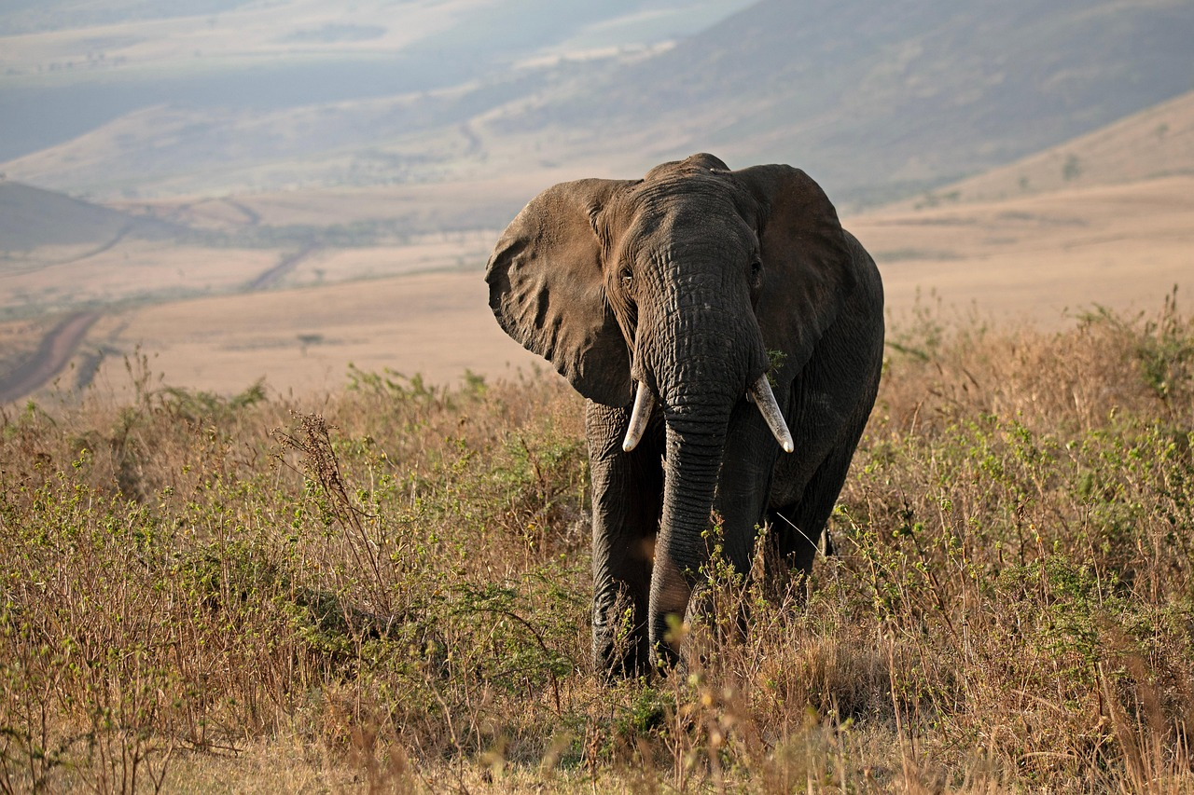
Case Studies in Conservation
Successful Conservation Projects
Examples of successful conservation projects include reforestation efforts, wildlife conservation, and sustainable development initiatives.
These projects demonstrate the potential for positive environmental impact when executed effectively.
Analyzing Case Studies
Analysis of case studies involves identifying strengths, weaknesses, and areas for improvement.
This process helps refine strategies and enhance future conservation efforts.
Lessons from Conservation Case Studies
Lessons learned emphasize the importance of community engagement, adaptive management, and continuous evaluation.
These principles are crucial for achieving long-term success in conservation initiatives.
9
Comprehensive Conservation Strategies and Education

Slide 10

ELL/ESL Support Strategies
1
Visual Aids and Multimedia
Providing visual aids and multimedia resources to support language development.
These tools help learners grasp concepts more effectively and enhance engagement.
2
Simplified Vocabulary and Concepts
Simplifying complex vocabulary and concepts to facilitate understanding.
This approach ensures learners can follow along without feeling overwhelmed.
3
Participation and Feedback
Encouraging participation and feedback to build confidence and fluency.
Active involvement fosters a supportive environment for language practice.
10
Comprehensive Conservation Strategies and Education

Slide 11

Technology Integration in Conservation Education
Benefits of Technology Integration
Examples of Technology Integration
Strategies for Effective Technology Integration
Access to resources, collaborative tools, and real-time feedback.
These benefits enhance learning experiences and foster engagement in conservation education.
Online research, digital presentations, and social media campaigns.
These examples showcase practical applications of technology in conservation education.
Providing guidance, encouraging critical thinking, and addressing digital divides.
These strategies ensure equitable and impactful use of technology in conservation education.
11
Comprehensive Conservation Strategies and Education

Slide 12

Assessment and Evaluation in Conservation Education
1
Importance of Assessment and Evaluation
Importance of assessment and evaluation in conservation education: measuring knowledge, skills, and attitudes.
These processes help gauge the effectiveness of educational programs and identify areas for improvement.
2
Strategies for Effective Evaluation
Strategies for assessment and evaluation: quizzes, presentations, and project-based evaluations.
These methods provide diverse ways to measure student understanding and engagement.
3
Supporting ELL/ESL Learners
ELL/ESL support: providing accommodations, modifying assessments, and offering feedback.
This ensures inclusivity and equal opportunities for all learners to succeed.
12
Comprehensive Conservation Strategies and Education

Slide 13

Conclusion and Next Steps
Key Takeaways
Next Steps
Final Thoughts
The importance of conservation, collaborative group work, and effective communication were highlighted.
These elements are essential for addressing environmental challenges effectively.
Applying knowledge and skills to real-world conservation efforts is the immediate focus.
Continuing education and professional development will ensure sustained impact.
Conservation is a collective responsibility that demands both individual and group action.
This shared commitment is vital for achieving meaningful environmental progress.
13
Comprehensive Conservation Strategies and Education

Slide 14

References and Resources
References Utilized
Additional Conservation Resources
Call to Action
List of references: books, articles, and online resources used in the presentation.
These materials provide foundational knowledge and insights into conservation education.
Additional resources: websites, organizations, and initiatives related to conservation education.
These platforms offer opportunities for deeper exploration and engagement in conservation topics.
Call to action: encouraging further learning, exploration, and engagement in conservation efforts.
This serves as an invitation to actively participate in preserving and understanding our environment.
14
Comprehensive Conservation Strategies and Education

Slide 15

Appendix: Sentence Frames for Conservation Discussions
1
2
3
Examples of Sentence Frames
Student Completion Frames
Tips for Effective Use
Examples of sentence frames for conservation discussions.
These frames help structure meaningful conversations about conservation topics.
Blank sentence frames for students to complete.
These frames encourage active participation and personalized responses.
Tips for using sentence frames: encouraging creativity, building confidence, and facilitating discussion.
These strategies enhance engagement and foster deeper understanding.
15
Comprehensive Conservation Strategies and Education

Slide 16

Glossary of Conservation Terms
Key Conservation Definitions
Definitions of key conservation terms: biodiversity, ecosystem, sustainability, and conservation.
These terms form the foundation for understanding and implementing conservation efforts.
Contextual Examples of Conservation Terms
Examples of conservation terms in context: case studies, research articles, and policy documents.
These examples illustrate the practical application and relevance of conservation terminology.
Effective Use of Conservation Terminology
Tips for using conservation terminology: precision, clarity, and consistency.
Adhering to these tips ensures effective communication and understanding in conservation discussions.
16
Comprehensive Conservation Strategies and Education

Slide 17

ELL/ESL Support: Tips for Teachers
Strategies for Supporting ELL/ESL Students
Providing visual aids, simplifying complex vocabulary, and encouraging participation are key strategies.
These approaches help create an inclusive and effective learning environment for ELL/ESL students.
Tips for Modifying Assessments and Evaluations
Accommodations, modifications, and feedback are essential for fair assessments.
These practices ensure that ELL/ESL students can demonstrate their knowledge effectively.
Resources for ELL/ESL Support
Websites, organizations, and initiatives offer valuable tools for teachers.
These resources can enhance teaching strategies and provide additional support for ELL/ESL students.
17
Comprehensive Conservation Strategies and Education

Slide 18

Conservation Education: A Collective Responsibility
Importance of Conservation Education
Role of Educators in Conservation
Call to Action for Collective Responsibility
Conservation education plays a vital role in raising awareness about environmental issues.
It builds knowledge and promotes actionable steps towards sustainable practices.
Educators are key in providing guidance and facilitating discussions on conservation topics.
They encourage critical thinking to empower individuals in making informed decisions.
Conservation efforts require collective responsibility and active participation from everyone.
Individual actions and community engagement are essential for meaningful environmental impact.
18
Comprehensive Conservation Strategies and Education

Slide 19

Final Thoughts and Recommendations
Key Takeaways
Recommendations for Future Efforts
Conservation as a Journey
The importance of conservation, collaborative group work, and effective communication are essential lessons.
These elements form the foundation for successful conservation efforts and teamwork.
Continued education, community engagement, and collective action are vital for advancing conservation.
These strategies ensure sustainable practices and foster a sense of shared responsibility.
Conservation requires ongoing learning, adaptation, and commitment to achieve long-term goals.
It is a continuous process that evolves with new challenges and opportunities.
19
Comprehensive Conservation Strategies and Education

