Slide 1












Understanding Determiners: A Comprehensive Guide
Exploring the Various Types and Usage of Determiners in Writing and Speech

Slide 2

Table of contents
Lesson Introduction
Subject Knowledge
Types of Determiners
Main Types of Determiners
Articles
Demonstratives
Possessives
Quantifiers
Numbers
Determiners in Writing and Speech
01
02
03
04
05
06
07
08
09
10

Slide 3

Lesson Introduction
Definition
Main Types of Determiners
Determiners are a class of words that provide additional information about nouns.
They help specify the noun's meaning, whether it's a particular or general item, or how many of the item is being referred to.
Articles (a, an, the)
Demonstratives (this, that, these, those)
Possessives (my, your, his, her, its, our, their)
Quantifiers (some, any, many, few, a lot of)
Numbers (one, two, three, ...)
Understanding Determiners: A Comprehensive Guide

Slide 4
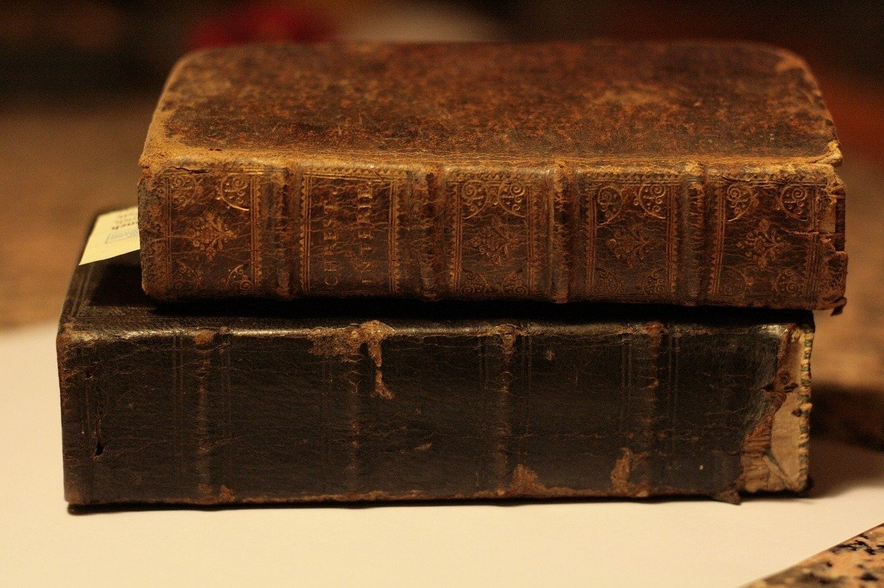
Subject Knowledge
Determiners Definition
Determiners provide additional information about nouns.
They specify the noun's meaning, indicating if it's a particular or general item and how many are being referred to.
Types of Determiners
Articles: a, an, the
Demonstratives: this, that, these, those
Possessives: my, your, his, her, its, our, their
Quantifiers: some, any, many, few, a lot of
Numbers: one, two, three...
Understanding Determiners: A Comprehensive Guide

Slide 5

Types of Determiners
Articles
Demonstratives
Definite article: "the"
Indefinite articles: "a" and "an"
This, that, these, those
Possessives
Quantifiers
Numbers
My, your, his, her, its, our, their
Some, any, many, few, a lot of
One, two, three, etc.
Understanding Determiners: A Comprehensive Guide

Slide 6

Main Types of Determiners
Articles
a
an
the
Demonstratives
this
that
these
those
Possessives
my
your
his
her
its
our
their
Quantifiers
some
any
many
few
a lot of
Numbers
one
two
three
...
Understanding Determiners: A Comprehensive Guide

Slide 7

Articles
Definite Article (the)
Indefinite Articles (a, an)
Used before singular or plural nouns to specify a particular item or items.
Example: "Please pass me the book on the table."
Used before singular countable nouns to refer to any member of a general group.
Example: "I need a pen to write this note."
Definite Article (the)
Indefinite Articles (a, an)
Used before singular or plural nouns to specify a particular item or items.
Example: "Please pass me the book on the table."
Used before singular countable nouns to refer to any member of a general group.
Example: "I need a pen to write this note."
Understanding Determiners: A Comprehensive Guide

Slide 8

Demonstratives
This
Indicates something that is close to the speaker.
That
Indicates something that is farther away from the speaker.
These
Indicates multiple items that are close to the speaker.
Those
Indicates multiple items that are farther away from the speaker.
Understanding Determiners: A Comprehensive Guide

Slide 9

Possessives
Possessive Determiners
Examples of Possessive Determiners
Possessive determiners indicate ownership or possession of a noun.
my
your
his
her
its
our
their
Understanding Determiners: A Comprehensive Guide

Slide 10

Quantifiers
Some
Any
Indicates an unspecified quantity or number.
Used to refer to one or more unspecified items.
Many
Few
A lot of
Denotes a large quantity or number.
Indicates a small quantity or number.
Refers to a significant amount or number.
Understanding Determiners: A Comprehensive Guide

Slide 11
Numbers
1
2
3
10
One
Two
Three
Ten
Used to indicate a singular noun or item.
Denotes a quantity of two items.
Represents a count of three objects.
Signifies a larger quantity, often used as a benchmark number.
Understanding Determiners: A Comprehensive Guide

Slide 12

Determiners in Writing and Speech
Definition
Types of Determiners
Determiners are a class of words that provide additional information about nouns.
They help specify the noun's meaning, whether it's a particular or general item, or how many of the item is being referred to.
Articles (a, an, the)
Demonstratives (this, that, these, those)
Possessives (my, your, his, her, its, our, their)
Quantifiers (some, any, many, few, a lot of)
Numbers (one, two, three, etc.)
Understanding Determiners: A Comprehensive Guide

