Slide 1
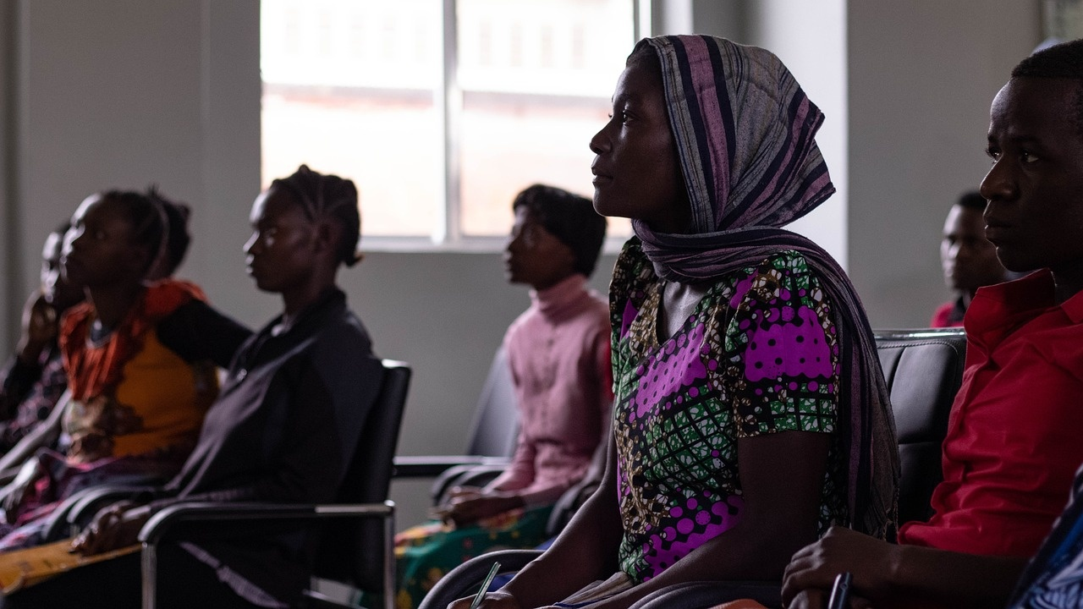
Mastering Numerical Literacy and Communication
Empowering Through Language and Numbers

Slide 2
Table of contents
01
02
03
04
05
06
07
08
09
10
11
Title Slide: Navigating Numbers and Language
Lesson Overview: Develop essential numerical literacy and c…
Why Communication Matters: Language complexity and communic…
Lesson Structure: 5 Dynamic Learning Segments
Activity 1 - Shopping Scenario: Develop numerical communica…
Activity 2 - Time Expression Challenge: Master time-related…
Activity 3 - Directional Communication: Enhance spatial voc…
Common Communication Challenges: Identified misconceptions …
Technology Integration: Digital learning tools and benefits
Assessment Strategies: Comprehensive evaluation methods and…
Parent Engagement: Supporting language learning at home

Slide 3
Table of contents
12
13
14
15
Key Takeaways: Developed skills and empowerment through com…
Next Steps: Advanced learning pathways and continuous journ…
Conclusion: Transformative language learning experience
Q&A / Contact Information: Presenter details and resources

Slide 4

1
Title Slide: Navigating Numbers and Language
Navigating Numbers and Language
Practical Communication Skills for Teenagers
Mastering Numerical Literacy and Communication

Slide 5

2
Lesson Overview: Develop essential numerical literacy and communication skills
01
Objective
02
Key Focus Areas
Develop essential numerical literacy and communication skills
Shopping interactions
Time expressions
Directional communication
03
Goal
Transform theoretical language learning into practical skills
Mastering Numerical Literacy and Communication

Slide 6

3
Why Communication Matters: Language complexity and communication strategies
Why Communication Matters
Language is more than vocabulary
It encompasses nuances, tone, and cultural context
Real-world communication requires:
Numerical precision for clarity
Cultural awareness to avoid misunderstandings
Mastering Numerical Literacy and Communication

Slide 7
4
Lesson Structure: 5 Dynamic Learning Segments
01
02
03
04
05
Numerical Warm-Up
Number Systems in Practice
Time Expression Mastery
Directional Communication Workshop
Integrated Communication Challenge
5 mins
7 mins
6 mins
7 mins
5 mins
Mastering Numerical Literacy and Communication

Slide 8

5
Activity 1 - Shopping Scenario: Develop numerical communication skills
01
Objective
02
Key Components
Develop numerical communication skills
Mock currency and price lists
Role-play interactions
Price negotiation techniques
03
Learning Outcomes
Practical numerical vocabulary
Conversational confidence
Mastering Numerical Literacy and Communication

Slide 9

6
Activity 2 - Time Expression Challenge: Master time-related communication
Activity 2 - Time Expression Challenge
Focus: Master time-related communication
Skill Development:
Understanding 12-hour and 24-hour time systems
Exploring cultural variations in time expressions
Practicing precise time communication
Mastering Numerical Literacy and Communication

Slide 10

7
Activity 3 - Directional Communication: Enhance spatial vocabulary
01
Key Skills
02
Learning Approach
Map reading
Giving/receiving directions
Prepositional phrases
Large-scale map exercises
Progressive navigation challenges
Mastering Numerical Literacy and Communication

Slide 11

8
Common Communication Challenges: Identified misconceptions and remediation strategies
01
Identified Misconceptions
02
Remediation Strategies
Literal numerical translation
Overformalized language
Cultural communication variations
Cultural comparative analysis
Contextual communication practice
Mastering Numerical Literacy and Communication

Slide 12

9
Technology Integration: Digital learning tools and benefits
01
Digital Learning Tools
02
Benefits
Interactive language apps
Virtual reality simulators
AI-powered assessment platforms
Personalized learning
Real-time feedback
Adaptive skill development
Mastering Numerical Literacy and Communication

Slide 13

10
Assessment Strategies: Comprehensive evaluation methods and criteria
01
Practical Communication Portfolio
02
Simulated Interaction Scenarios
Compilation of real-world communication tasks
Includes written, verbal, and visual components
Role-playing exercises for practical application
Assess interpersonal communication skills
03
Multimedia Language Projects
04
Assessment Criteria
Creation of videos, presentations, or podcasts
Demonstrates linguistic and cultural understanding
Numerical accuracy: Precision in numerical expressions, Application of mathematical concepts
Linguistic complexity: Varied vocabulary usage, Grammar and syntax proficiency
Cultural communication effectiveness: Sensitivity to cultural nuances, Adaptation of communication style
Mastering Numerical Literacy and Communication

Slide 14

11
Parent Engagement: Supporting language learning at home
Parent Engagement - Supporting Language Learning at Home
Weekly communication workshops
Digital learning platform
Practical home practice strategies
Goal: Create a collaborative learning environment
Mastering Numerical Literacy and Communication

Slide 15

12
Key Takeaways: Developed skills and empowerment through communication
01
Enhanced Numerical Communication Proficiency
02
Improved Time Expression and Cultural Literacy
03
Practical Application Strategies for Language Mastery
Mastering Numerical Literacy and Communication

Slide 16

13
Next Steps: Advanced learning pathways and continuous journey
01
Advanced Learning Pathways
02
Continuous Learning Journey
Numerical communication workshop
Cultural communication exploration
Integrated real-world simulation
Mastering Numerical Literacy and Communication

Slide 17

14
Conclusion: Transformative language learning experience
01
Empowered Communication
02
Confidence Boost
Developed practical communication skills
Enhanced numerical literacy
Cultivated cultural awareness
Improved conversational fluency
Mastered time expressions
Proficient in directional communication
03
Real-World Application
04
Key Takeaway
Applied theoretical knowledge practically
Navigated complex communication scenarios
Transformed language learning into a dynamic experience
Language learning goes beyond words; it's a journey of growth, understanding, and connection.
Mastering Numerical Literacy and Communication

Slide 18
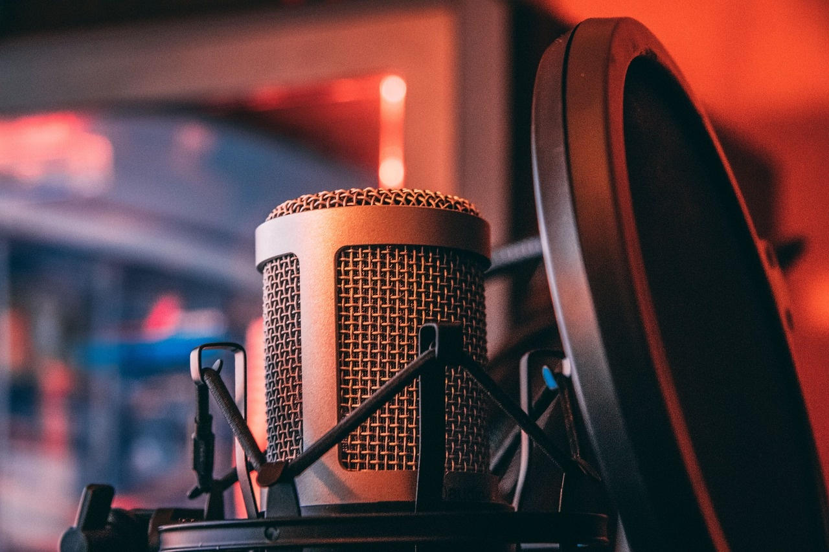
15
Q&A / Contact Information: Presenter details and resources
01
Presenter
02
Additional Resources
Name: [Presenter's Name]
Email: [Presenter's Email]
Phone: [Presenter's Phone Number]
Website: [Presenter's Website]
Social Media: [Presenter's Social Media Handles]
Recommended Reading: [List of Recommended Books or Articles]
03
Contact Information
04
Resources for Further Exploration
For inquiries or collaborations, please reach out to the presenter using the provided contact details.
Stay connected for updates, resources, and upcoming events through the presenter's website and social media platforms.
Access additional learning materials, tools, and interactive platforms to continue mastering numerical literacy and communication skills.
Explore the recommended reading list for in-depth knowledge and practical insights.
Mastering Numerical Literacy and Communication

