Slide 1
Explorando la Creación de Historias Inspiradas en Prometeo y Frankenstein
Un viaje a través de la ética, la ciencia y la creatividad literaria

Slide 2
Table of Contents
Introduction to Creating Your Own Prometheus-I…
The Prometheus Myth
Mary Shelley's Frankenstein
Historical and Literary Context
Themes and Motifs
Creating Your Own Prometheus-Inspired Story
Writing Tips and Strategies
Character Development
Plot Structure
Science and Ethics
Conclusion
Assessment and Evaluation
Extension Activities
04
05
06
07
08
09
10
11
12
13
14
15
16

Slide 3
Table of Contents
Resources and References
Conclusion and Final Thoughts
Final Assessment and Evaluation
Next Steps and Future Directions
Conclusion and Final Thoughts
Final Thoughts and Reflections
Assessment and Evaluation Rubric
Extension Activities and Resources
Conclusion and Final Thoughts
Final Assessment and Evaluation
Next Steps and Future Directions
Conclusion and Final Thoughts
17
18
19
20
21
22
23
24
25
26
27
28

Slide 4

Introduction to Creating Your Own Prometheus-Inspired Story
Exploring Frankenstein's Themes
Learning Objectives
Interactive and Engaging Approach
Welcome to our lesson on creating your own Prometheus-inspired story with Mary Shelley's Frankenstein as a guide.
In this engaging and interactive lesson, we will explore the classic novel Frankenstein and its themes of science, ethics, and responsibility.
By the end of this lesson, you will be able to analyze literary texts, think critically about scientific ethics.
You will also gain the skills to create your own original stories inspired by Prometheus and Frankenstein.
This lesson is designed to be both engaging and interactive, encouraging deep exploration of the novel.
Through discussions and activities, you will connect with the themes and ideas presented in Frankenstein.
4
Explorando la Creación de Historias Inspiradas en Prometeo y Frankenstein

Slide 5
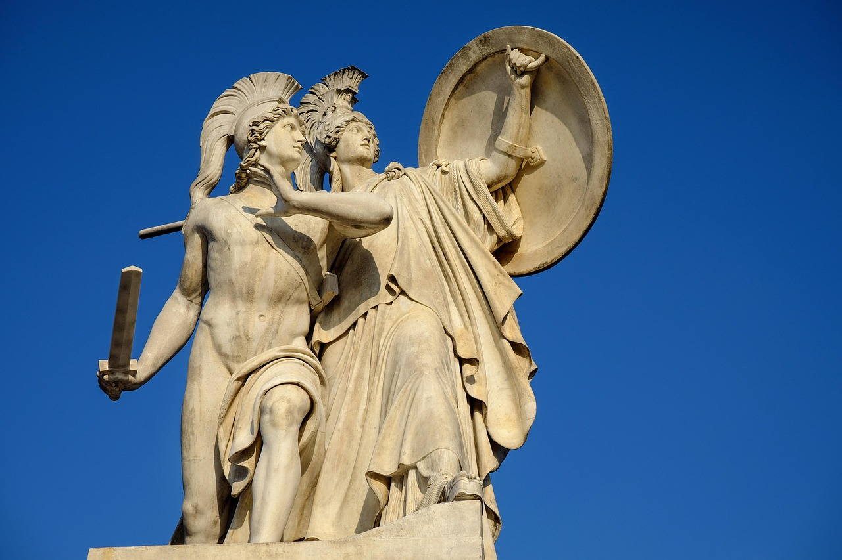
The Prometheus Myth
Prometheus: The Titan's Defiance
Frankenstein and Prometheus
The Prometheus myth is an ancient Greek story about a titan who defies the gods by stealing fire and giving it to humanity.
This act of rebellion symbolizes the pursuit of knowledge and the empowerment of mankind.
In the context of Frankenstein, the myth represents the dangers of unchecked ambition and the consequences of playing God.
It serves as a cautionary tale about the ethical limits of scientific exploration.
Cultural Impact of the Myth
Relevance to Frankenstein's Themes
The Prometheus myth has influenced literature and art, with many works referencing or reinterpreting the story.
Its themes of defiance and innovation resonate across various creative disciplines.
Understanding the Prometheus myth is essential to appreciating the themes and motifs of Frankenstein.
It provides a deeper insight into the narrative's exploration of human ambition and its repercussions.
5
Explorando la Creación de Historias Inspiradas en Prometeo y Frankenstein

Slide 6

Mary Shelley's Frankenstein
Overview of Frankenstein
Themes and Questions
Mary Shelley's Frankenstein is a classic novel that tells the story of Victor Frankenstein and his creation.
The novel explores themes of science, ethics, and responsibility, and raises important questions about the nature of humanity and the consequences of playing God.
The novel delves into profound themes such as the ethics of scientific discovery and the responsibilities of creators.
It raises critical questions about the consequences of playing God and the essence of humanity.
Cultural Impact
Relevance to Storytelling
Frankenstein has had a significant impact on literature and popular culture.
It continues to be widely read and studied today, influencing countless works across various media.
Understanding the novel's themes, motifs, and historical context is essential to creating a compelling Prometheus-inspired story.
This knowledge provides a foundation for exploring similar ethical and philosophical dilemmas in new narratives.
6
Explorando la Creación de Historias Inspiradas en Prometeo y Frankenstein

Slide 7
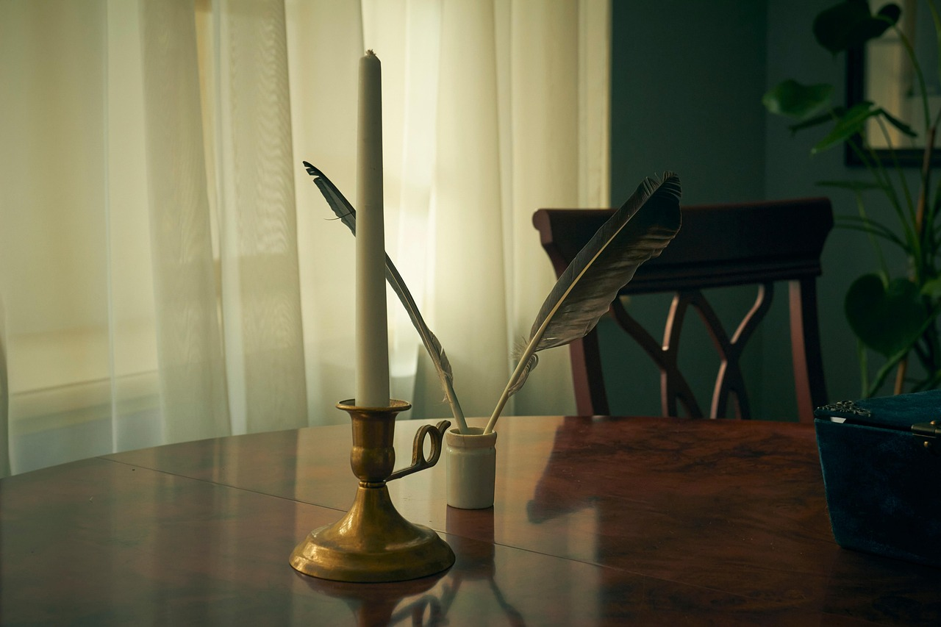
Historical and Literary Context
01
Romantic Era Influence
Frankenstein is a product of the Romantic era, a time of great literary and artistic innovation.
The novel reflects the values and concerns of this era, including the emphasis on emotion, nature, and the individual.
02
Scientific Discoveries
The novel has been influenced by the scientific discoveries of the 19th century, including the work of Galvanism.
It explores the concept of the 'spark of life' as a central theme.
03
Themes and Motifs
Understanding the historical and literary context of the novel is essential to appreciating its themes and motifs.
This context provides insight into the novel's deeper meanings and artistic intentions.
04
Cultural Reflection
Frankenstein mirrors the cultural and intellectual currents of its time.
It serves as a bridge between scientific exploration and literary imagination.
7
Explorando la Creación de Historias Inspiradas en Prometeo y Frankenstein

Slide 8

Themes and Motifs
01
Key Themes Explored
The novel explores several key themes, including the dangers of unchecked ambition, the consequences of playing God, and the importance of responsibility.
These themes are central to understanding the moral and philosophical questions posed by the story.
02
Motifs in the Novel
The novel features several motifs, including the use of light and darkness to symbolize good and evil.
Nature imagery is also used to describe the monster's appearance and actions, adding depth to the narrative.
03
Relevance of Themes and Motifs
The novel's themes and motifs continue to be relevant today.
They can be applied to contemporary issues in science and technology, making the story timeless.
04
Creating a Prometheus-Inspired Story
Understanding the themes and motifs of the novel is essential to creating a compelling Prometheus-inspired story.
These elements provide a framework for exploring complex ideas and emotions.
8
Explorando la Creación de Historias Inspiradas en Prometeo y Frankenstein

Slide 9

Creating Your Own Prometheus-Inspired Story
01
Analyzing Frankenstein's Themes
03
Embracing Creativity
To create your own Prometheus-inspired story, start by reading and analyzing Frankenstein, and considering its themes and motifs.
Think about how you can use these themes and motifs to explore your own ideas and concerns, and use the novel as a starting point for your own creative writing.
Don't be afraid to take risks and try new things.
The most compelling stories often come from unexpected places.
02
Leveraging Historical Context
04
Using Frankenstein as Inspiration
Consider the historical and literary context of the novel.
Think about how you can use this context to inform your own writing.
Use the novel as a starting point for your own creative writing.
Explore your own ideas and concerns through its themes and motifs.
9
Explorando la Creación de Historias Inspiradas en Prometeo y Frankenstein

Slide 10

Writing Tips and Strategies
Brainstorming and Plot Development
Using Descriptive Language
Start by brainstorming ideas and developing a plot outline for your story.
This will help you organize your thoughts and create a strong foundation for your narrative.
Use descriptive language and imagery to bring your story to life.
Consider using symbolism and motifs to add depth and complexity to your writing.
Inspiration from Frankenstein
Revising and Editing
Think about the themes and motifs of Frankenstein.
Consider how you can use these to explore your own ideas and concerns.
Don't be afraid to revise and edit your work.
The most compelling stories often require multiple drafts and revisions.
10
Explorando la Creación de Historias Inspiradas en Prometeo y Frankenstein

Slide 11
Character Development
Importance of Well-Developed Characters
Exploring Relationships Between Characters
Using Frankenstein as Inspiration
Experimenting with Character Traits
Well-developed characters are essential to any compelling story, and should have clear motivations, traits, and backstories.
Consider the characters in Frankenstein, and think about how you can use these characters as inspiration for your own writing.
Think about the relationships between characters, and consider how you can use these relationships to explore themes and motifs.
Don't be afraid to experiment with different character types and traits – the most compelling characters often come from unexpected places.
Consider the characters in Frankenstein, and think about how you can use these characters as inspiration for your own writing.
Think about the relationships between characters, and consider how you can use these relationships to explore themes and motifs.
Don't be afraid to experiment with different character types and traits – the most compelling characters often come from unexpected places.
Well-developed characters are essential to any compelling story, and should have clear motivations, traits, and backstories.
11
Explorando la Creación de Historias Inspiradas en Prometeo y Frankenstein

Slide 12

Plot Structure
Essential Elements of Plot Structure
Learning from Frankenstein
A clear and compelling plot structure is essential to any story, and should include a clear exposition, rising action, climax, falling action, and resolution.
These elements work together to create a cohesive and engaging narrative.
Consider the plot structure of Frankenstein, and think about how you can use this structure as inspiration for your own writing.
Analyzing classic works can provide valuable insights into effective storytelling techniques.
Adding Complexity with Plot Twists
Experimenting with Plot Techniques
Think about the use of plot twists and turns, and consider how you can use these to add surprise and complexity to your story.
Unexpected developments can keep readers engaged and invested in the narrative.
Don't be afraid to experiment with different plot structures and techniques – the most compelling stories often come from unexpected places.
Innovation in storytelling can lead to unique and memorable narratives.
12
Explorando la Creación de Historias Inspiradas en Prometeo y Frankenstein

Slide 13

Science and Ethics
Ethics in Scientific Discovery
Scientific Foundations in Frankenstein
The novel Frankenstein raises important questions about the ethics of scientific discovery and the responsible use of science and technology.
It challenges readers to think critically about the moral responsibilities of scientists and innovators.
Consider the scientific concepts and theories that underpin the novel, including the principles of galvanism and the concept of the 'spark of life'.
These ideas reflect the scientific curiosity and experimentation of the era in which the novel was written.
Contemporary Implications of Science
Exploring Scientific Ethics
Think about the implications of scientific discovery for contemporary issues in science and technology.
These reflections can help inform your own writing and understanding of modern scientific challenges.
Don't be afraid to explore the complexities and nuances of scientific ethics.
The most compelling stories often come from unexpected places, offering rich opportunities for discussion and analysis.
13
Explorando la Creación de Historias Inspiradas en Prometeo y Frankenstein

Slide 14

Conclusion
Exploring Themes Through Creative Writing
Crafting Compelling Stories
Unleashing Creativity
Creating your own Prometheus-inspired story with Mary Shelley's Frankenstein as a guide is a fun and engaging way to explore the themes and motifs of the novel.
By analyzing the novel and its historical and literary context, you can find inspiration for your own creative writing.
Using the analysis of Frankenstein as a foundation, you can create a compelling and original story.
Don't be afraid to take risks and try new things – the most compelling stories often come from unexpected places.
The process of creating your own story allows for a deeper understanding of the novel's themes.
It encourages experimentation and innovation, leading to unique and unexpected narratives.
14
Explorando la Creación de Historias Inspiradas en Prometeo y Frankenstein

Slide 15
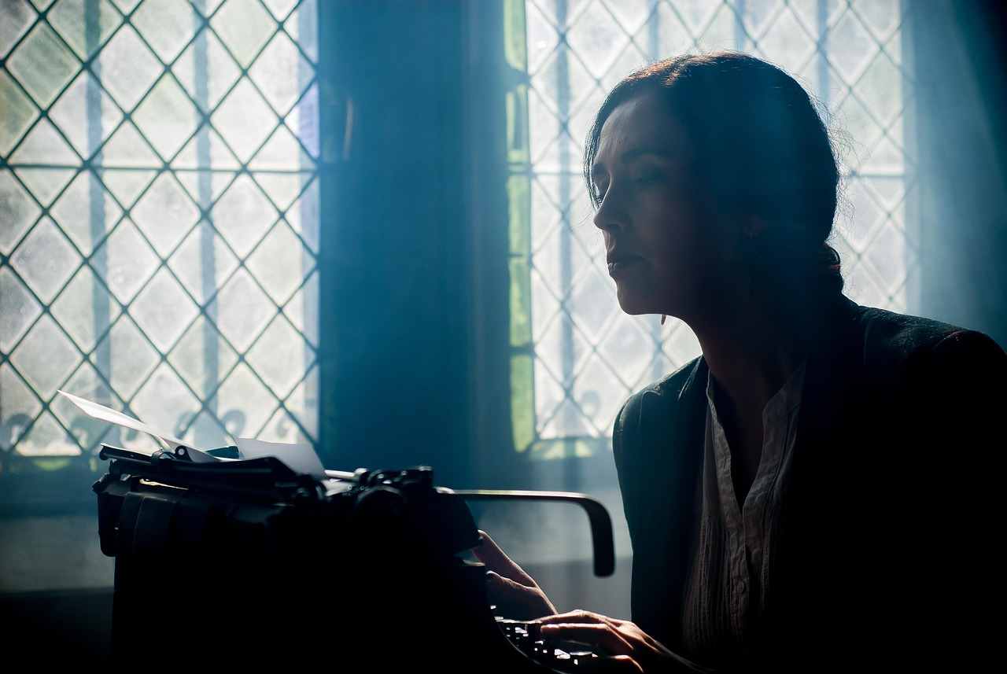
Assessment and Evaluation
01
Story Assessment Criteria
Your story will be assessed on its creativity, coherence, and overall quality.
Consider the themes and motifs of Frankenstein, and think about how you can use these to explore your own ideas and concerns.
02
Descriptive Language and Imagery
Use descriptive language and imagery to bring your story to life.
Consider using symbolism and motifs to add depth and complexity.
03
Importance of Revision
Don't be afraid to revise and edit your work.
The most compelling stories often require multiple drafts and revisions.
04
Exploring Themes and Motifs
Think about how the themes and motifs of Frankenstein can inspire your story.
Use these elements to delve into your own ideas and concerns.
15
Explorando la Creación de Historias Inspiradas en Prometeo y Frankenstein

Slide 16
Extension Activities
01
Adapting Your Story
Consider adapting your story into a different medium, such as a screenplay or graphic novel.
This allows you to explore new ways of storytelling and reach different audiences.
02
Contemporary Implications
Think about the implications of your story for contemporary issues in science and technology.
Use these implications to inform your own writing and make it relevant to modern discussions.
03
Exploring Themes and Motifs
Use your story as a starting point for further exploration of the themes and motifs of Frankenstein.
Consider how these themes can help you delve into your own ideas and concerns.
04
Experimentation in Storytelling
Don't be afraid to experiment with different forms and styles.
The most compelling stories often emerge from unexpected places and creative risks.
16
Explorando la Creación de Historias Inspiradas en Prometeo y Frankenstein

Slide 17

Resources and References
Exploration of Themes in Frankenstein
Online Resources for Writing
Mary Shelley's Frankenstein is a classic novel that explores themes of science, ethics, and responsibility.
The novel has been influenced by the scientific discoveries of the 19th century, including the work of Galvanism and the concept of the 'spark of life'.
Consider using online resources and references to inform your writing, such as articles and websites on the history of science and technology.
These resources can provide valuable insights and context for your work.
The Value of Additional References
Historical Context in Frankenstein
Don't be afraid to seek out additional resources and references.
The most compelling stories often come from unexpected places.
The novel reflects the scientific curiosity and advancements of its time.
It serves as a lens to examine the ethical implications of scientific progress.
17
Explorando la Creación de Historias Inspiradas en Prometeo y Frankenstein

Slide 18

Conclusion and Final Thoughts
1
Exploring Themes and Motifs
Creating your own Prometheus-inspired story with Mary Shelley's Frankenstein as a guide is a fun and engaging way to explore the themes and motifs of the novel.
By analyzing the novel and its historical and literary context, you can gain inspiration for your own creative writing.
2
Crafting Original Stories
Using analysis as inspiration, you can create a compelling and original story.
Don't be afraid to take risks and try new things to make your story unique.
3
Embracing Creativity
The most compelling stories often come from unexpected places.
Taking risks in your creative process can lead to extraordinary results.
18
Explorando la Creación de Historias Inspiradas en Prometeo y Frankenstein

Slide 19
Final Assessment and Evaluation
Assessment Criteria
Descriptive Techniques
Revision Importance
Thematic Exploration
Your final story will be assessed on its creativity, coherence, and overall quality.
Consider the themes and motifs of Frankenstein, and think about how you can use these to explore your own ideas and concerns.
Use descriptive language and imagery to bring your story to life.
Consider using symbolism and motifs to add depth and complexity.
Don't be afraid to revise and edit your work.
The most compelling stories often require multiple drafts and revisions.
Think about how the themes and motifs of Frankenstein can inspire your narrative.
Use these elements to delve into your personal ideas and concerns.
19
Explorando la Creación de Historias Inspiradas en Prometeo y Frankenstein

Slide 20

Next Steps and Future Directions
Exploring Themes and Motifs
Consider using your story as a starting point for further exploration of the themes and motifs of Frankenstein.
Think about how these elements can deepen your understanding of the novel and its relevance.
Contemporary Implications
Think about the implications of your story for contemporary issues in science and technology.
Consider how you can use these implications to inform your own writing and perspective.
Developing Critical Skills
Use your story as a way to develop your critical thinking and analytical skills.
Reflect on how these skills can be applied to other areas of your life and decision-making.
Experimenting with Creativity
Don't be afraid to experiment with different forms and styles.
Remember that the most compelling stories often come from unexpected places and approaches.
20
Explorando la Creación de Historias Inspiradas en Prometeo y Frankenstein

Slide 21
Conclusion and Final Thoughts
Exploring Themes and Motifs
Crafting Original Stories
Embracing Creativity
Creating your own Prometheus-inspired story with Mary Shelley's Frankenstein as a guide is a fun and engaging way to explore the themes and motifs of the novel.
By analyzing the novel and its historical and literary context, you can gain inspiration for your own creative writing.
Using analysis as inspiration, you can create a compelling and original story.
Don't be afraid to take risks and try new things to make your story unique.
The most compelling stories often come from unexpected places.
Taking risks in your creative process can lead to surprising and rewarding results.
21
Explorando la Creación de Historias Inspiradas en Prometeo y Frankenstein

Slide 22

Final Thoughts and Reflections
01
Reflecting on Lessons Learned
Take a moment to reflect on what you have learned throughout this lesson.
Consider how you can apply the skills and knowledge you have gained to other areas of your life.
02
Exploring Novel Themes
Think about the implications of the novel and its themes for contemporary issues in science and technology.
Don't be afraid to continue exploring and learning – the most compelling stories often come from unexpected places.
03
Applying Knowledge Beyond the Lesson
Consider how you can apply the skills and knowledge you have gained to other areas of your life.
Think about the implications of the novel and its themes for contemporary issues in science and technology.
04
Embracing Lifelong Learning
Don't be afraid to continue exploring and learning – the most compelling stories often come from unexpected places.
Take a moment to reflect on what you have learned throughout this lesson.
22
Explorando la Creación de Historias Inspiradas en Prometeo y Frankenstein

Slide 23
Assessment and Evaluation Rubric
Creativity and Coherence
Descriptive Language and Imagery
Your story will be assessed on its creativity, coherence, and overall quality.
Consider the themes and motifs of Frankenstein, and think about how you can use these to explore your own ideas and concerns.
Use descriptive language and imagery to bring your story to life.
Consider using symbolism and motifs to add depth and complexity.
Revision and Editing
Exploring Themes and Motifs
Don't be afraid to revise and edit your work.
The most compelling stories often require multiple drafts and revisions.
Think about how the themes and motifs of Frankenstein can inspire your story.
Use these elements to delve into your own ideas and concerns.
23
Explorando la Creación de Historias Inspiradas en Prometeo y Frankenstein

Slide 24
Extension Activities and Resources
1
Adapting Your Story
2
Exploring Contemporary Implications
Consider adapting your story into a different medium, such as a screenplay or graphic novel.
This can provide a fresh perspective and reach a broader audience.
Think about the implications of your story for contemporary issues in science and technology.
Use these implications to inform and enrich your own writing.
3
Themes and Motifs of Frankenstein
4
Experimenting with Forms and Styles
Use your story as a starting point for further exploration of the themes and motifs of Frankenstein.
Consider how these themes can help you explore your own ideas and concerns.
Don't be afraid to experiment with different forms and styles.
The most compelling stories often emerge from unexpected places.
24
Explorando la Creación de Historias Inspiradas en Prometeo y Frankenstein

Slide 25

Conclusion and Final Thoughts
1
Exploring Themes Through Creativity
In conclusion, creating your own Prometheus-inspired story with Mary Shelley's Frankenstein as a guide is a fun and engaging way to explore the themes and motifs of the novel.
By analyzing the novel and its historical and literary context, and using this analysis as inspiration for your own creative writing, you can create a compelling and original story.
2
The Power of Analysis
By analyzing the novel and its historical and literary context, and using this analysis as inspiration for your own creative writing, you can create a compelling and original story.
Don't be afraid to take risks and try new things – the most compelling stories often come from unexpected places.
3
Embracing Creativity and Risk
Don't be afraid to take risks and try new things – the most compelling stories often come from unexpected places.
In conclusion, creating your own Prometheus-inspired story with Mary Shelley's Frankenstein as a guide is a fun and engaging way to explore the themes and motifs of the novel.
25
Explorando la Creación de Historias Inspiradas en Prometeo y Frankenstein

Slide 26
Final Assessment and Evaluation
Assessment Criteria
Your final story will be assessed on its creativity, coherence, and overall quality.
Consider the themes and motifs of Frankenstein, and think about how you can use these to explore your own ideas and concerns.
Descriptive Techniques
Use descriptive language and imagery to bring your story to life.
Consider using symbolism and motifs to add depth and complexity.
Revision Importance
Don't be afraid to revise and edit your work.
The most compelling stories often require multiple drafts and revisions.
Thematic Exploration
Think about how the themes and motifs of Frankenstein can inspire your narrative.
Use these elements to delve into your personal ideas and concerns.
26
Explorando la Creación de Historias Inspiradas en Prometeo y Frankenstein

Slide 27

Next Steps and Future Directions
Exploring Themes and Motifs
Consider using your story as a starting point for further exploration of the themes and motifs of Frankenstein.
Think about how these elements can deepen your understanding of the novel and inspire new creative directions.
Contemporary Implications
Think about the implications of your story for contemporary issues in science and technology.
Consider how you can use these implications to inform your own writing and engage with modern debates.
Developing Critical Skills
Use your story as a way to develop your critical thinking and analytical skills.
Consider how you can apply these skills to other areas of your life for broader personal growth.
Experimenting with Creativity
Don't be afraid to experiment with different forms and styles.
The most compelling stories often come from unexpected places and innovative approaches.
27
Explorando la Creación de Historias Inspiradas en Prometeo y Frankenstein

Slide 28
Conclusion and Final Thoughts
1
2
3
Exploring Themes and Motifs
Crafting Original Stories
Embracing Creativity
Creating your own Prometheus-inspired story with Mary Shelley's Frankenstein as a guide is a fun and engaging way to explore the themes and motifs of the novel.
By analyzing the novel and its historical and literary context, you can gain inspiration for your own creative writing.
Using analysis as inspiration, you can create a compelling and original story.
Don't be afraid to take risks and try new things to make your story unique.
The most compelling stories often come from unexpected places.
Taking risks in your creative process can lead to innovative and captivating narratives.
28
Explorando la Creación de Historias Inspiradas en Prometeo y Frankenstein

