Slide 1

Comprehensive Guide to Descriptive Language in French
Mastering Physical and Moral Descriptions with Adjectives and Adverbs

Slide 2
Comprehensive Guide to Descriptive Language in French
2
Table of Contents
Introduction to Physical and Moral Description
Importance of Description in French
Adjectives and Adverbs in Description
Physical Description
Moral Description
Using Adjectives and Adverbs in Context
Practice Exercise: Describing a Person
Group Discussion: Describing Places
Writing Activity: Describing an Object
Common Errors and Difficulties
Conclusion and Next Steps
Additional Resources
Assessment and Evaluation
04
05
06
07
08
09
10
11
12
13
14
15
16

Slide 3
Comprehensive Guide to Descriptive Language in French
3
Table of Contents
Reflection and Feedback
Final Project: Describing a Person or Place
Conclusion and Farewell
17
18
19

Slide 4

Comprehensive Guide to Descriptive Language in French
4
Introduction to Physical and Moral Description
Overview of the Lesson
Learning Objectives
Expected Outcomes
Welcome to the lesson on physical and moral description in French.
This lesson focuses on using adjectives and adverbs to describe various entities.
In this lesson, we will learn how to describe people, places, and objects.
The emphasis will be on employing descriptive language effectively.
By the end of this lesson, you will be able to describe physical and moral characteristics.
Your descriptions will be precise and detailed.

Slide 5

Comprehensive Guide to Descriptive Language in French
5
Importance of Description in French
Role of Description in Communication
Accuracy in Descriptions
Applications of Descriptive Communication
Description is a crucial aspect of communication in French.
It helps us to convey information about people, places, and objects.
Accurate description is essential for effective communication.
It ensures clarity and understanding in various situations.
Using descriptions effectively allows us to share detailed information.
This is particularly important in contexts involving people, places, and objects.

Slide 6

Comprehensive Guide to Descriptive Language in French
6
Adjectives and Adverbs in Description
Role of Adjectives
Function of Adverbs
Adjectives describe nouns and pronouns.
Examples include 'grand', 'petit', and 'brun'.
Adverbs modify verbs, adjectives, and other adverbs.
Examples include 'rapidement' and 'lentement'.
Usage in Descriptions
Illustrative Examples
Adjectives and adverbs are used to describe physical and moral characteristics.
They enhance the expressiveness of language.
Example: 'Il est grand et brun' (He is tall and brown).
Example: 'Elle est très gentille' (She is very kind).

Slide 7
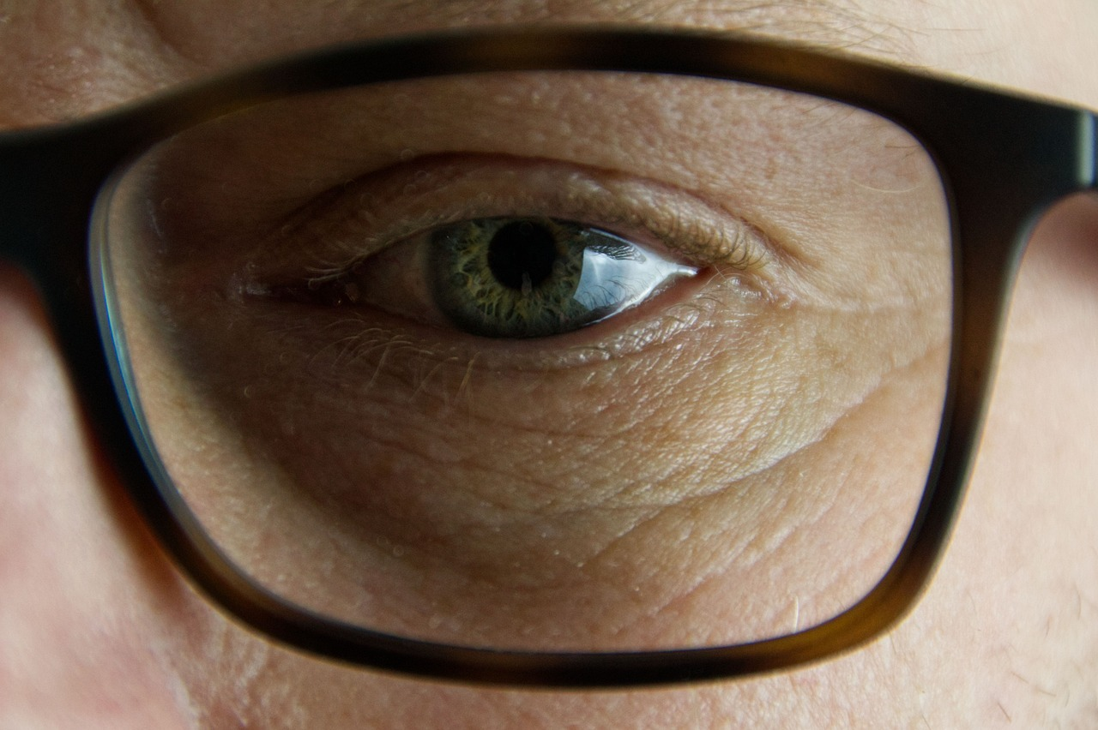
Comprehensive Guide to Descriptive Language in French
7
Physical Description
Definition of Physical Description
Adjectives for Physical Appearance
Example of Physical Description
Physical description includes characteristics like height, weight, eye color, and hair color.
These attributes help in identifying and describing individuals.
We use adjectives like grand, petit, brun, and blond to describe physical appearance.
These descriptive words provide a clear image of someone's physical traits.
Example: Mon frère est grand et brun (My brother is tall and brown).
This sentence illustrates how physical attributes are described in context.

Slide 8

Comprehensive Guide to Descriptive Language in French
8
Moral Description
Definition of Moral Description
Moral description includes personality traits and behavior.
It encompasses characteristics that define how individuals interact with others.
Adjectives for Moral Characteristics
We use adjectives like gentil, sympatique, and intelligent to describe moral characteristics.
These words help convey the essence of a person's moral traits.
Example of Moral Description
Mon ami est très gentil et toujours prêt à aider.
This illustrates how moral characteristics can be expressed in everyday language.

Slide 9

Comprehensive Guide to Descriptive Language in French
9
Using Adjectives and Adverbs in Context
Introduction to Adjectives and Adverbs
Example of Usage
Encouragement for Practice
Adjectives and adverbs are used in sentences to describe various aspects of people, places, and objects.
They enhance the meaning and provide detailed descriptions in communication.
Consider the sentence: 'La femme est grande et mince, avec des cheveux bruns' (The woman is tall and thin, with brown hair).
This demonstrates how adjectives and adverbs can be applied to describe physical characteristics.
Engage in exercises to practice using adjectives and adverbs in your own descriptions.
This will improve your ability to create vivid and accurate portrayals in language.

Slide 10

Comprehensive Guide to Descriptive Language in French
10
Practice Exercise: Describing a Person
Describing Physical and Moral Traits
Using Adverbs for Behavior and Actions
Describe a family member or friend using physical and moral adjectives.
Focus on their appearance and character traits to provide a vivid description.
Use adverbs to describe their behavior or actions.
Highlight how they perform tasks or interact with others.

Slide 11

Comprehensive Guide to Descriptive Language in French
11
Group Discussion: Describing Places
Describing a Familiar Place
Engaging in Group Discussion
Describe a place you know well, using physical and moral adjectives.
Share your observations and insights with your group.
Discuss with your partner or in a group, using adverbs to describe the atmosphere or environment.
Collaborate to create a vivid depiction of the place.

Slide 12

Comprehensive Guide to Descriptive Language in French
12
Writing Activity: Describing an Object
Object Description Using Physical Adjectives
Choose an object and describe its physical characteristics using adjectives.
Focus on attributes such as size, shape, color, texture, and material.
Functionality Description Using Adverbs
Describe how the object functions or serves its purpose using adverbs.
Consider aspects like efficiency, speed, reliability, and manner of operation.

Slide 13
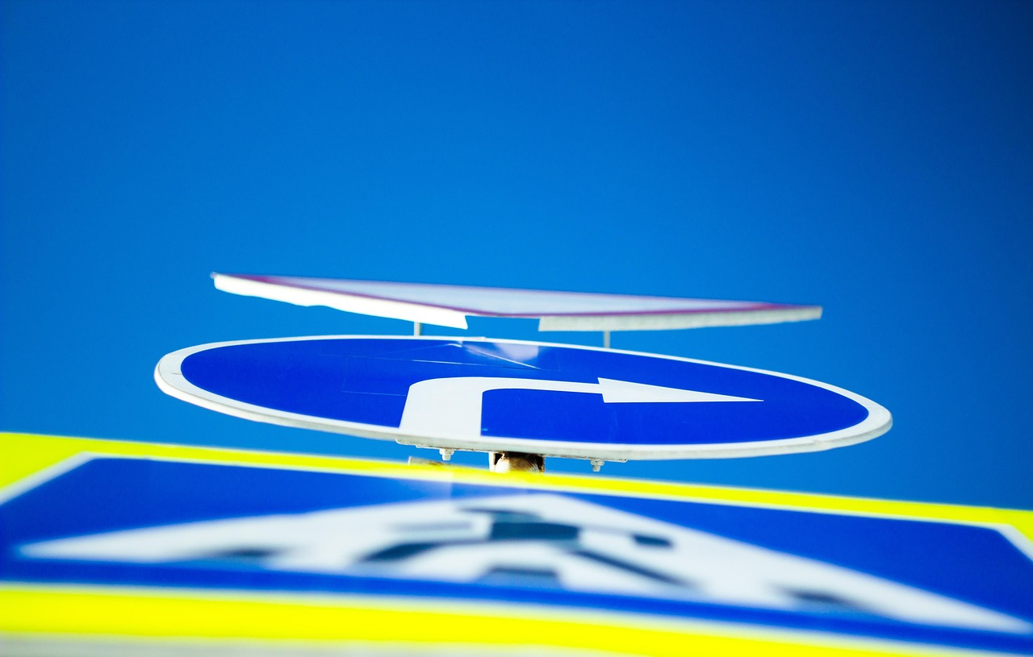
Comprehensive Guide to Descriptive Language in French
13
Common Errors and Difficulties
Common Errors in Language Usage
Confusing physical and moral adjectives is a frequent mistake.
Incorrect adjective agreement can lead to misunderstandings in communication.
Challenges in Expressing Ideas
Using adverbs correctly poses a significant difficulty for many learners.
Describing abstract concepts requires a nuanced understanding of language.
Strategies for Improvement
Regular practice is essential for mastering language intricacies.
Focusing on correct adjective agreement and employing adverbs effectively enhances descriptive skills.

Slide 14

Comprehensive Guide to Descriptive Language in French
14
Conclusion and Next Steps
Key Points Recap
Next Steps in Learning
Recap the key points learned in this lesson.
Reflect on the foundational concepts covered to solidify understanding.
Next steps: practice describing people, places, and objects.
Explore more advanced topics in French description to enhance proficiency.

Slide 15

Comprehensive Guide to Descriptive Language in French
15
Additional Resources
Recommended Textbooks and Online Resources
Language Exchange Platforms
Technology in Language Learning
Explore a variety of textbooks and online platforms to deepen your understanding of the language.
These resources provide structured lessons and exercises for comprehensive learning.
Engage with language exchange websites and apps to practice speaking and writing.
These tools connect you with native speakers for real-time communication and feedback.
Utilize modern technology to enhance your language acquisition process.
Discover apps and tools designed to make learning interactive and enjoyable.

Slide 16

Comprehensive Guide to Descriptive Language in French
16
Assessment and Evaluation
Formative Assessment Techniques
Summative Assessment Approaches
Formative assessment includes methods such as quizzes, class discussions, and writing exercises.
These techniques aim to provide ongoing feedback to improve learning and understanding.
Summative assessment involves final projects or presentations.
These assessments often require using adjectives and adverbs to describe a person, place, or object.

Slide 17

Comprehensive Guide to Descriptive Language in French
17
Reflection and Feedback
Progress Reflection
Reflect on your progress and identify areas for improvement.
Consider your achievements and challenges to better understand your development.
Feedback Exchange
Provide feedback to your peers and receive feedback from your instructor.
Engage in constructive discussions to enhance learning and growth.

Slide 18

Comprehensive Guide to Descriptive Language in French
18
Final Project: Describing a Person or Place
Choosing a Subject
Select a person or place to describe, focusing on their physical and moral characteristics.
Ensure the description is vivid and engaging by carefully choosing your adjectives.
Enhancing Descriptions
Incorporate adverbs to provide additional nuance and detail to your descriptions.
This approach will help create a more dynamic and immersive portrayal.

Slide 19

Comprehensive Guide to Descriptive Language in French
19
Conclusion and Farewell
Conclusion and Farewell
Congratulations on completing the lesson on physical and moral description in French!
Continue practicing and exploring the French language.

