Slide 1
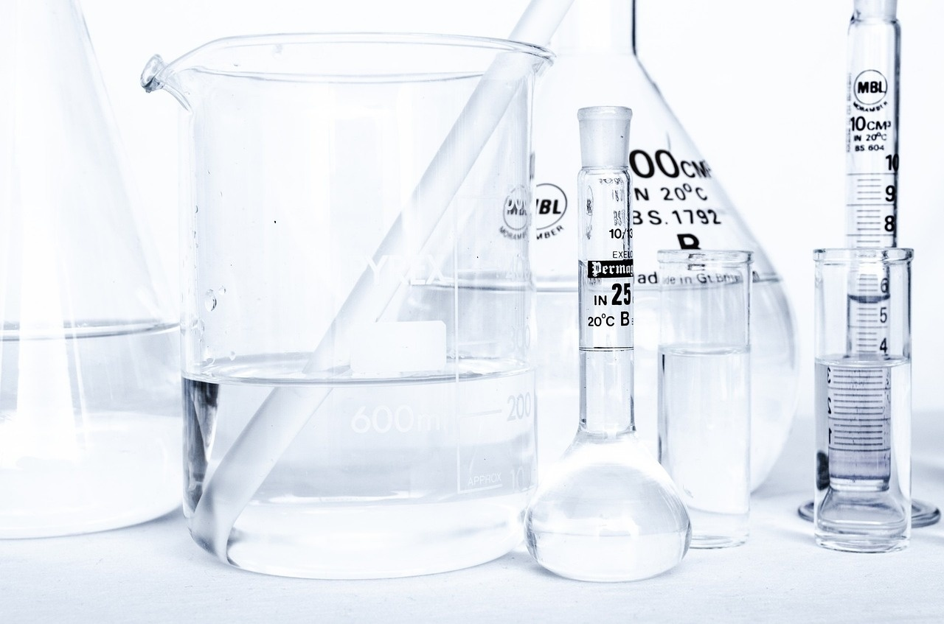
Exploring the Wonders of the Periodic Table
A Comprehensive Journey Through Elements, Trends, and Applications

Slide 2
Table of contents
01
02
03
04
05
06
07
08
09
10
11
Title Slide: Discovering the Periodic Table
What is the Periodic Table?
Periodic Table Structure
Elements - The Basics
Element Groups
Atomic Structure
Reading the Periodic Table
Periodic Trends
Real-World Element Applications
Fun Element Facts
Common Misconceptions

Slide 3
Table of contents
12
13
14
15
16
17
18
19
20
21
Interactive Challenge
Career Connections
Conclusion
Q&A and Further Exploration
Key Features of the Periodic Table
Benefits of Understanding the Periodic Table
Steps to Mastering the Periodic Table
SWOT Analysis of the Periodic Table
Revenue Growth in Element Research
Benefits vs. Costs of Element Exploration

Slide 4
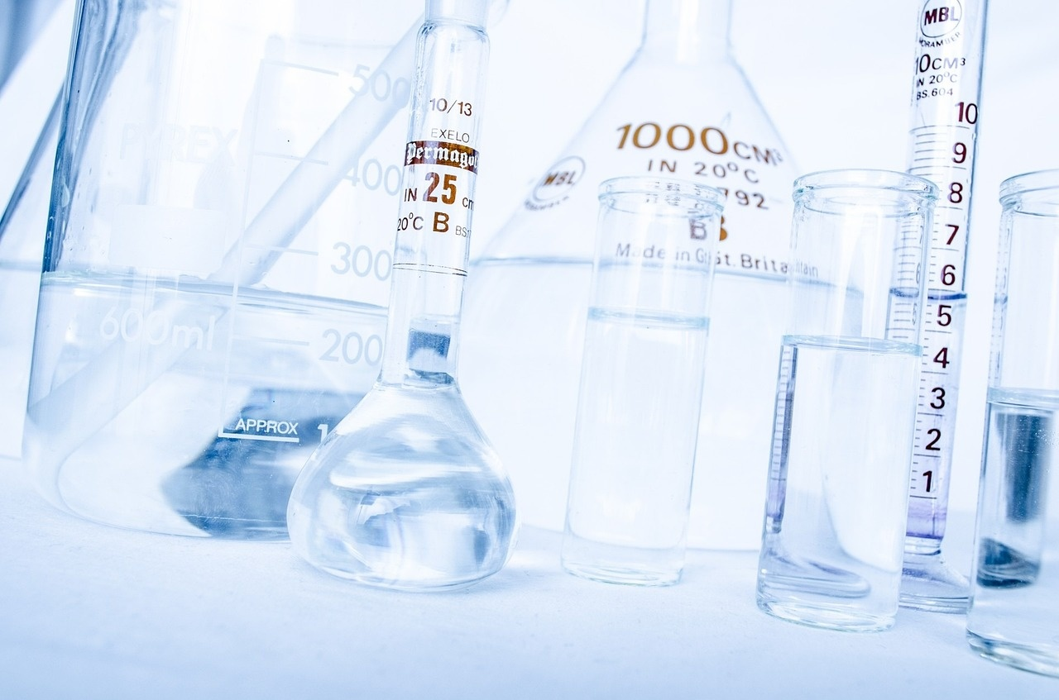
1
Title Slide: Discovering the Periodic Table
Discovering the Periodic Table: A Scientific Adventure
Exploring the Building Blocks of Our Universe
Exploring the Wonders of the Periodic Table

Slide 5

2
What is the Periodic Table?
01
What is the Periodic Table?
02
Key Points
A systematic arrangement of chemical elements
Organizes all known elements
Reveals element properties and relationships
Created by Dmitri Mendeleev in 1869
Exploring the Wonders of the Periodic Table

Slide 6

3
Periodic Table Structure
01
Rows (Periods)
02
Columns (Groups)
Horizontal rows in the periodic table
Elements in the same row have the same number of electron shells
Vertical columns in the periodic table
Elements in the same group have similar chemical properties
03
Atomic Number
Number of protons in the nucleus of an atom
Determines the element's identity and its position in the table
Exploring the Wonders of the Periodic Table

Slide 7

4
Elements - The Basics
01
What is an Element?
02
Key Characteristics
Pure substance with unique atomic structure
Cannot be broken down chemically
Defined by number of protons
Unique atomic identity
Exploring the Wonders of the Periodic Table

Slide 8
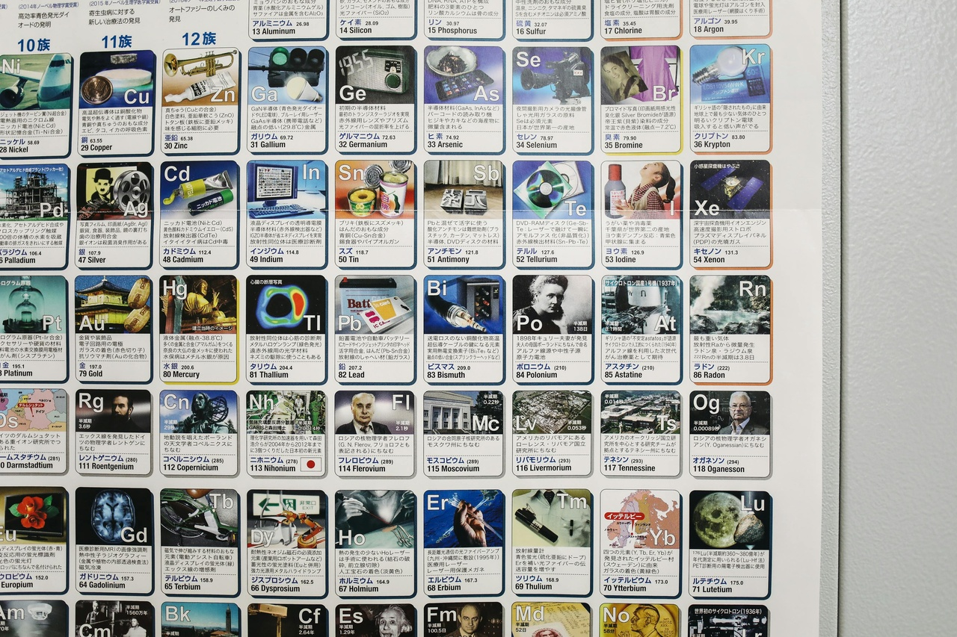
5
Element Groups
01
Metals
02
Non-Metals
Good conductors of heat and electricity
Malleable and ductile
High melting and boiling points
Poor conductors of heat and electricity
Brittle in solid form
Lower melting and boiling points compared to metals
03
Metalloids
Properties intermediate between metals and non-metals
Can conduct electricity better than non-metals but not as well as metals
Often used in semiconductors
Exploring the Wonders of the Periodic Table

Slide 9

6
Atomic Structure
01
Components of an Atom
02
Electron Configuration
Protons
Neutrons
Electrons
Shell structure
Impact on chemical behavior
Exploring the Wonders of the Periodic Table

Slide 10

7
Reading the Periodic Table
01
Atomic Number
02
Element Symbol
Represents the number of protons in an atom
Unique identifier for each element
Abbreviation used to represent an element
Often derived from the element's name
03
Atomic Weight
04
Electron Configuration
Average mass of an element's isotopes
Influences the element's position in the table
Describes the arrangement of electrons
Determines the element's chemical properties
Exploring the Wonders of the Periodic Table

Slide 11
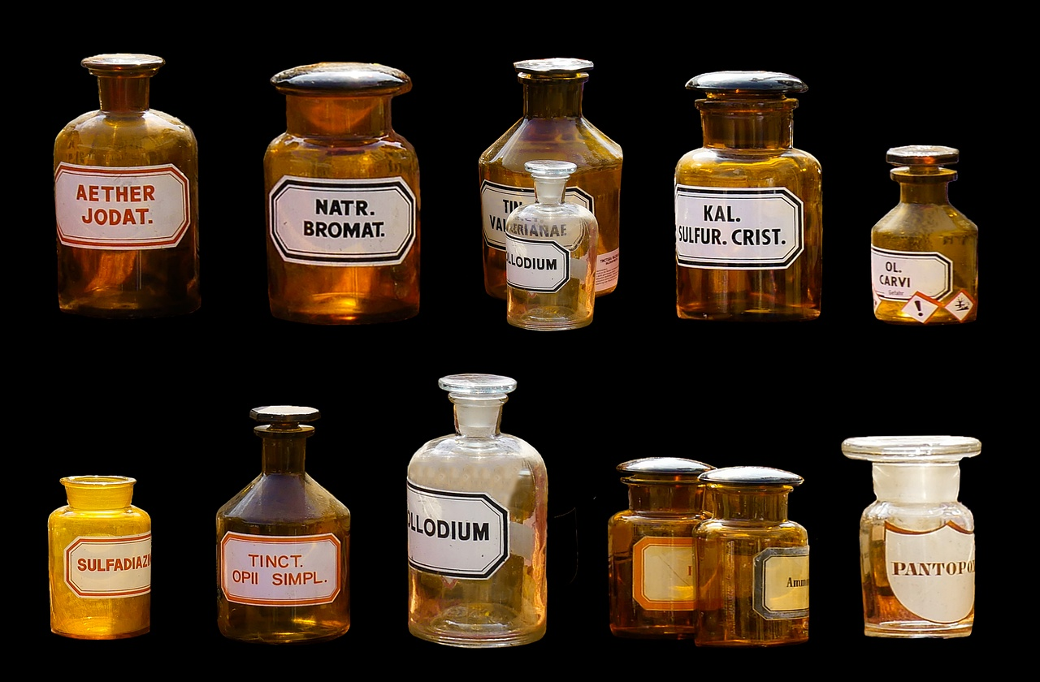
8
Periodic Trends
01
Atomic Radius
02
Electronegativity
Definition: The distance from the nucleus to the outermost electron cloud.
Trend: Increases down a group, decreases across a period.
Definition: The ability of an atom to attract electrons in a chemical bond.
Trend: Increases across a period, decreases down a group.
03
Ionization Energy
Definition: The energy required to remove an electron from an atom.
Trend: Increases across a period, decreases down a group.
Exploring the Wonders of the Periodic Table

Slide 12

9
Real-World Element Applications
01
Copper in Electrical Wiring
02
Carbon in Living Organisms
Conducts electricity efficiently
Widely used in power cables and electronics
Forms the basis of organic molecules
Essential for life processes like photosynthesis
03
Oxygen in Respiration
Vital for cellular respiration
Supports human and animal survival
Exploring the Wonders of the Periodic Table

Slide 13

10
Fun Element Facts
01
Newest Elements
02
Rare Elements
Oganesson (Og) - discovered in 2002
Tennessine (Ts) - discovered in 2010
Francium (Fr) - one of the rarest naturally occurring elements
Astatine (At) - rare and radioactive, only small amounts found in nature
03
Radioactive Elements
Uranium (U) - well-known radioactive element
Plutonium (Pu) - used in nuclear reactors and weapons
Exploring the Wonders of the Periodic Table

Slide 14

11
Common Misconceptions
01
Common Misconceptions
02
Elements can change
Not all elements are solid
Elements can exist in various states of matter: solid, liquid, or gas.
Example: Mercury is a liquid metal at room temperature.
Elements can undergo chemical reactions to form new compounds.
Example: Hydrogen and oxygen combine to form water.
03
Atomic structure is dynamic
Atoms can gain or lose electrons, changing their charge.
Example: Sodium losing an electron to become a positively charged ion.
Exploring the Wonders of the Periodic Table

Slide 15
12
Interactive Challenge
01
02
03
Identify Elements in Household Items
Match Elements to Their Properties
Interactive Challenge
Explore common household items and identify the elements present in them.
Learn about the properties of these elements and how they contribute to the functionality of household items.
Engage in a scavenger hunt to find elements in your home and match them to their properties.
Exploring the Wonders of the Periodic Table

Slide 16

13
Career Connections
01
Chemists
02
Materials Scientists
Conduct research and experiments to study the properties and behavior of elements.
Develop new materials, chemicals, and pharmaceuticals based on periodic table knowledge.
Study the structure and properties of materials to enhance their performance.
Utilize periodic table information to design and create innovative materials for various applications.
03
Researchers
Explore new scientific frontiers by investigating the properties and interactions of elements.
Contribute to advancements in technology, medicine, and environmental sustainability through periodic table insights.
Exploring the Wonders of the Periodic Table

Slide 17

14
Conclusion
01
Conclusion
02
Inspirational Closing Message
The Periodic Table serves as a universal scientific language, organizing elements based on their properties and relationships.
Each element within the table tells a unique story through its atomic structure and characteristics.
Continuous scientific exploration and discovery within the realm of chemistry further enrich our understanding of the elements and their applications.
The pursuit of knowledge in chemistry is a journey that continually unveils the wonders of the natural world, inspiring future generations to explore, discover, and innovate.
Exploring the Wonders of the Periodic Table

Slide 18

15
Q&A and Further Exploration
01
Q&A Session
02
Further Exploration
Address any questions or clarifications on the Periodic Table
Encourage audience participation and engagement
Recommended Websites:
PeriodicTable.com
Royal Society of Chemistry
Interactive Apps:
"Elements: The Periodic Table" app
03
Contact Information
For further questions or inquiries:
Email: info@periodictableexploration.com
Phone: +1-800-123-4567
Exploring the Wonders of the Periodic Table

Slide 19
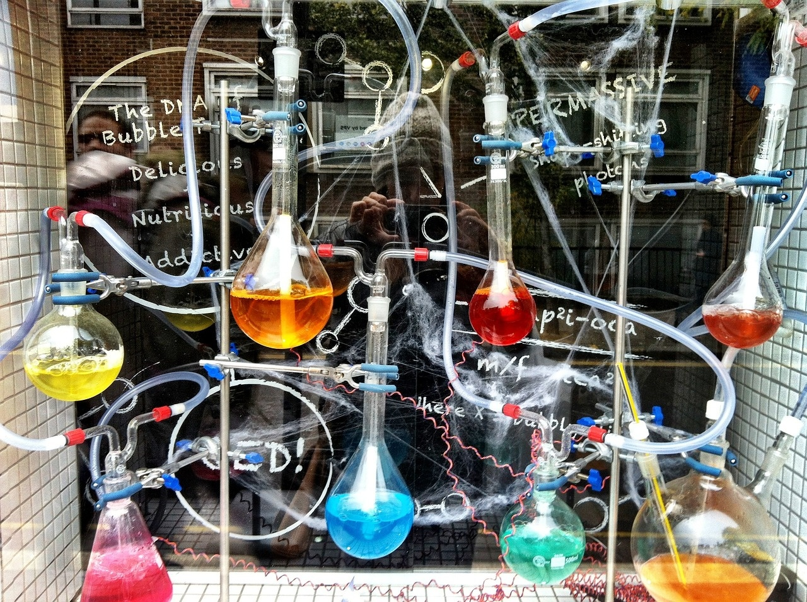
16
Key Features of the Periodic Table
01
Systematic Arrangement
02
Table Components
Organizes all known chemical elements
Reveals element properties and relationships
Created by Dmitri Mendeleev in 1869
Rows (Periods)
Columns (Groups)
Atomic Number
Exploring the Wonders of the Periodic Table

Slide 20
17
Benefits of Understanding the Periodic Table
01
Enhanced Chemical Knowledge
02
Predicting Element Properties
03
Facilitates Research and Discoveries
Understanding the periodic table provides insights into the behavior and properties of elements.
Knowledge of the periodic table allows for predicting the properties of unknown elements based on their position.
Scientists use the periodic table as a tool to guide research and make new discoveries in the field of chemistry.
04
Foundation for Advanced Studies
05
Practical Applications
Mastery of the periodic table is essential for pursuing advanced studies in chemistry and related fields.
Understanding the periodic table is crucial for various industries such as pharmaceuticals, materials science, and environmental science.
Exploring the Wonders of the Periodic Table

Slide 21
18
Steps to Mastering the Periodic Table
01
02
03
04
05
Understand the Periodic Table Layout
Study Element Properties
Grasp Atomic Structure
Interpret Element Information
Explore Periodic Trends
Learn about rows (periods) and columns (groups)
Familiarize yourself with atomic numbers
Explore the characteristics of metals, non-metals, and metalloids
Understand how elements are defined by their atomic structure
Identify the components of an atom: protons, neutrons, electrons
Learn about electron configuration and its impact on chemical behavior
Know how to read atomic number, element symbol, atomic weight, and electron configuration
Practice interpreting element details from the periodic table
Discover key trends like atomic radius, electronegativity, and ionization energy
Visualize trends through graphical representations
Exploring the Wonders of the Periodic Table

Slide 22
19
SWOT Analysis of the Periodic Table
STRENTHS
WEAKNESSES
Systematic organization of elements
Facilitates understanding of element properties
Widely used in chemistry education and research
Limited to known elements
Doesn't account for all possible chemical behaviors
Complexity may be challenging for beginners
S
W
O
T
OPPORTUNITIES
THREATS
Discovering new elements and their properties
Enhancing predictive capabilities in chemistry
Integration with advanced technologies for element analysis
Misinterpretation of element data
Potential gaps in periodic table accuracy
Competition from alternative classification systems
Exploring the Wonders of the Periodic Table

Slide 23

20
Revenue Growth in Element Research
01
Research Funding Increase
02
Collaboration Opportunities
Government grants for element studies
Corporate investments in research projects
Partnerships with universities and research institutions
Joint ventures with industry leaders
03
Technological Advancements
04
Market Demand for Element Applications
High-tech equipment for element analysis
Innovative research methodologies
Growing need for rare earth elements
Increased interest in sustainable materials
Exploring the Wonders of the Periodic Table

Slide 24
21
Benefits vs. Costs of Element Exploration
Benefits of Element Exploration
Costs of Element Exploration
Advancing scientific knowledge
Discovering new materials with unique properties
Innovating technologies for various industries
High research and development expenses
Environmental impact of extraction and processing
Ethical considerations in handling hazardous elements
Exploring the Wonders of the Periodic Table

