Slide 1
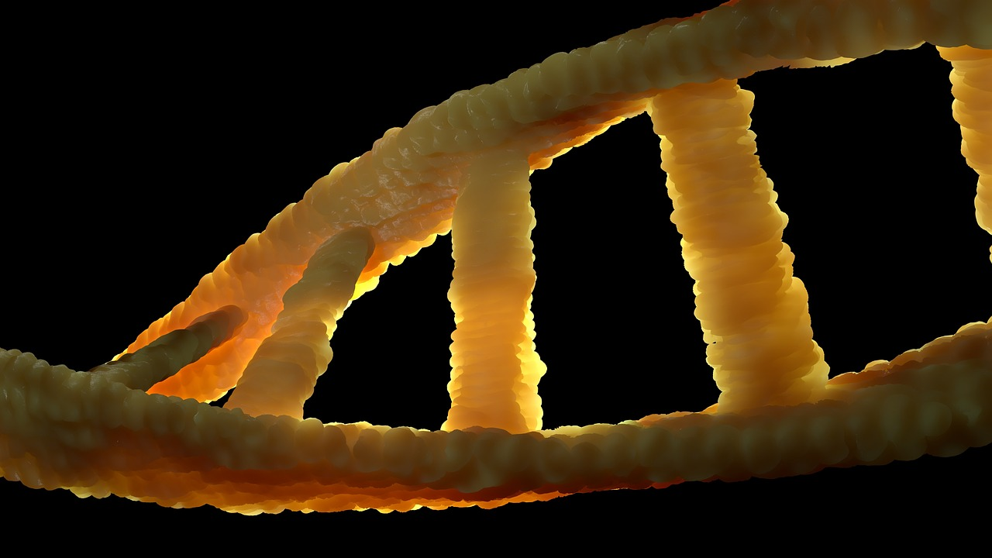

Foundations and Frontiers of Genetics
Exploring the Principles, Applications, and Ethical Dimensions of Genetic Science

Slide 2
Foundations and Frontiers of Genetics
2
Table of Contents
Introduction to Genetics
What is DNA?
Genetic Principles
Genetic Variation
Genetic Engineering
Genomics
Applications of Genetics
Ethics of Genetics
Genetic Counseling
Genetic Testing
Gene Therapy
Conclusion
References
04
05
06
07
08
09
10
11
12
13
14
15
16

Slide 3
Foundations and Frontiers of Genetics
3
Table of Contents
Glossary
Further Reading
Image Credits
17
18
19

Slide 4
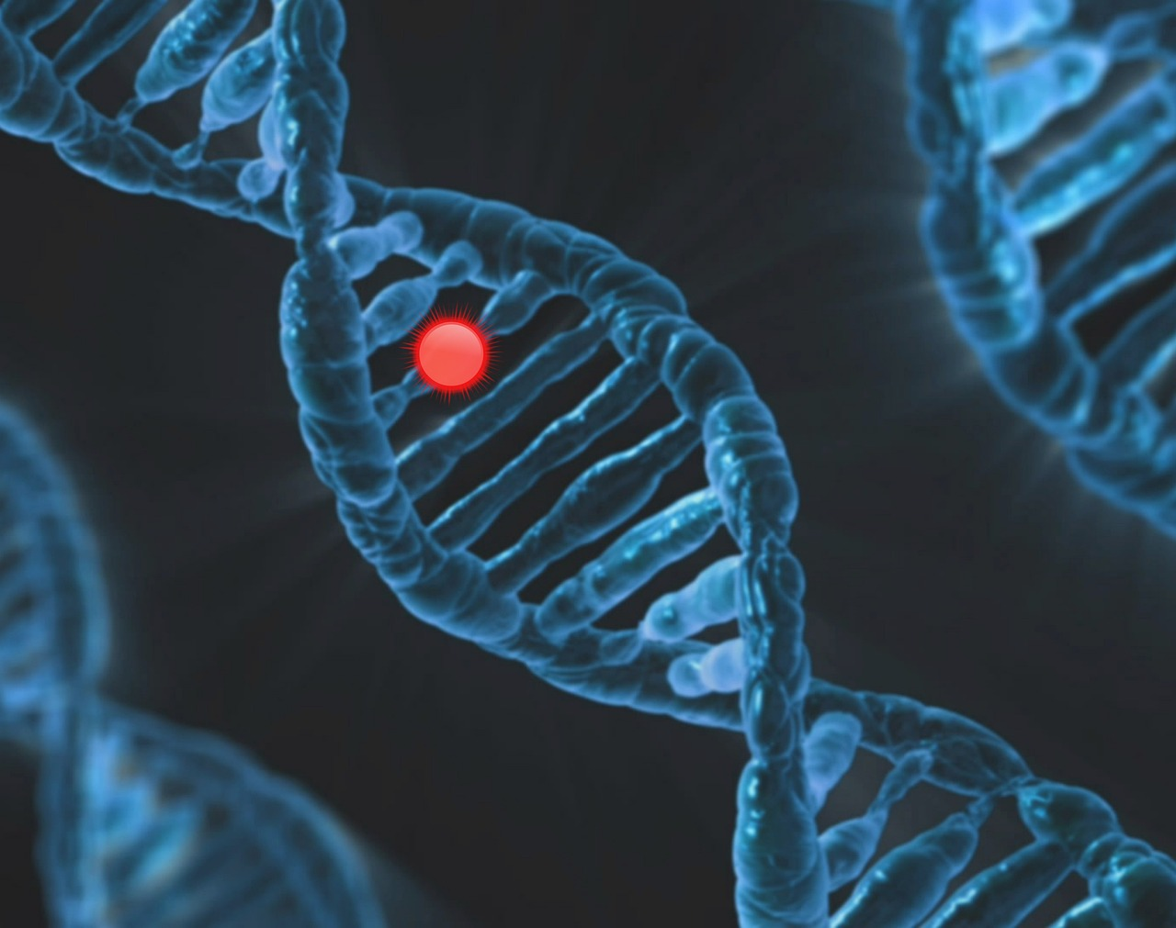
Foundations and Frontiers of Genetics
4
Introduction to Genetics
Understanding Genetics
The Role of Genetics
The Scope of Genetics
Genetics is the study of heredity and variation in organisms.
It involves the study of genes, genetic variation, and heredity.
Understanding genetics is crucial for understanding life.
It helps explain the diversity of organisms.
Genetics encompasses the study of genes and their functions.
It also explores how traits are passed from one generation to the next.

Slide 5
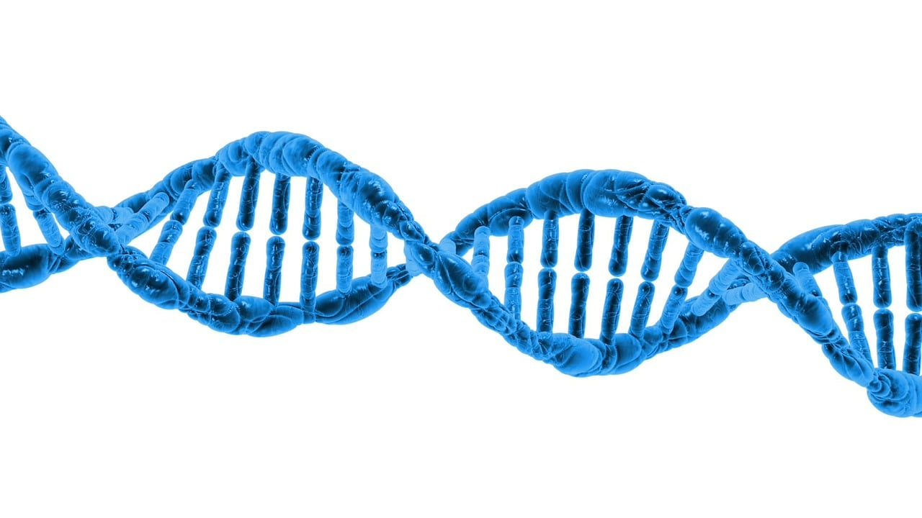
Foundations and Frontiers of Genetics
5
What is DNA?
DNA as the Blueprint of Life
DNA (Deoxyribonucleic acid) is a molecule that contains genetic instructions.
It is found in the cells of all living organisms.
Role of DNA in Organisms
DNA determines the characteristics of an organism.
These characteristics include traits such as eye color and height.
Ubiquity of DNA
DNA is a universal molecule present in all living organisms.
Its presence underscores its importance in the continuity of life.

Slide 6
Foundations and Frontiers of Genetics
6
Genetic Principles
Law of Segregation
Law of Independent Assortment
Law of Dominance
Understanding Genetic Inheritance
The law of segregation states that each pair of alleles separates during gamete formation.
This ensures that offspring inherit one allele from each parent.
The law of independent assortment states that alleles for different genes are sorted independently.
This explains the genetic variation observed in offspring.
The law of dominance states that one allele can be dominant over another allele.
This dominance determines the expressed trait in an organism.
These laws help us understand how genetic traits are inherited.
They form the foundation of classical genetics.

Slide 7
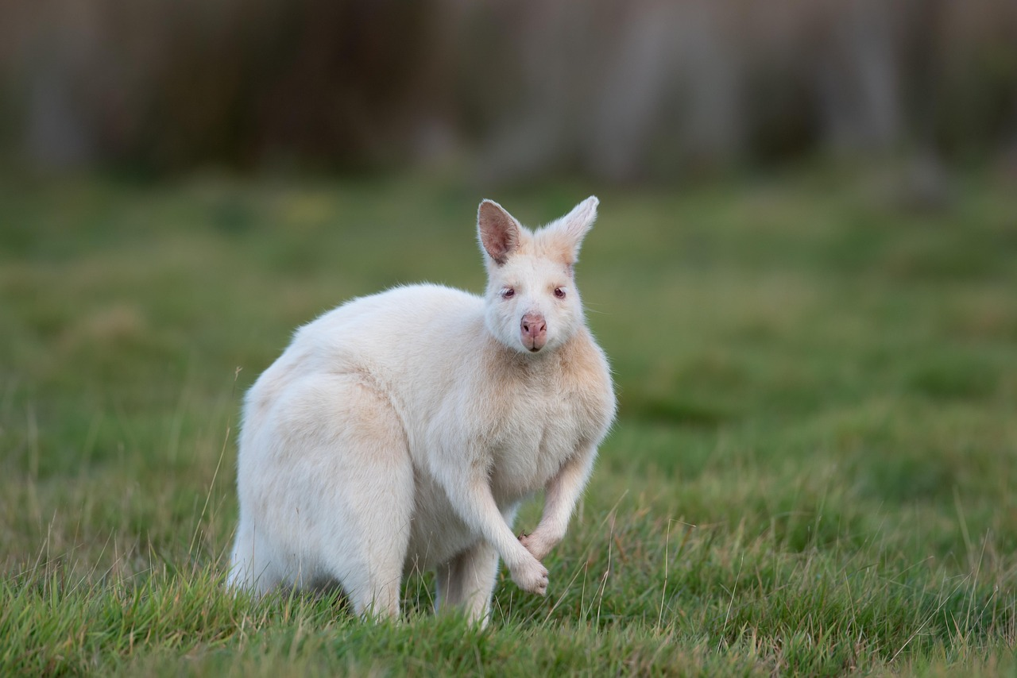
Foundations and Frontiers of Genetics
7
Genetic Variation
Definition of Genetic Variation
Importance of Genetic Variation
Mechanisms of Genetic Variation
Genetic variation refers to the differences in genetic information between individuals.
It can occur through mutations, genetic recombination, and gene flow.
Genetic variation is essential for the survival and adaptation of species.
It allows populations to respond to environmental changes and challenges.
Mutations, genetic recombination, and gene flow are key processes that create genetic variation.
These mechanisms ensure diversity within and between populations.

Slide 8

Foundations and Frontiers of Genetics
8
Genetic Engineering
Manipulation of Genes
Applications in Medicine
Impact on Agriculture and Biotechnology
Genetic engineering involves the manipulation of an organism's genes.
It can be used to introduce new traits or modify existing ones.
Genetic engineering has applications in medicine.
It enables advancements in treatments and therapies.
Genetic engineering plays a role in agriculture and biotechnology.
It helps improve crop yields and develop innovative solutions.

Slide 9
Foundations and Frontiers of Genetics
9
Genomics
Understanding Genomics
Advances in Genetics
Exploring Genome Evolution
Genomics is the study of genomes, which are the complete set of genetic information in an organism.
It involves the analysis of genome structure, function, and evolution.
Genomics has led to significant advances in our understanding of genetics.
These advances have broad applications in science and medicine.
The study of genomics includes understanding how genomes evolve over time.
This exploration provides insights into the history and diversity of life.

Slide 10
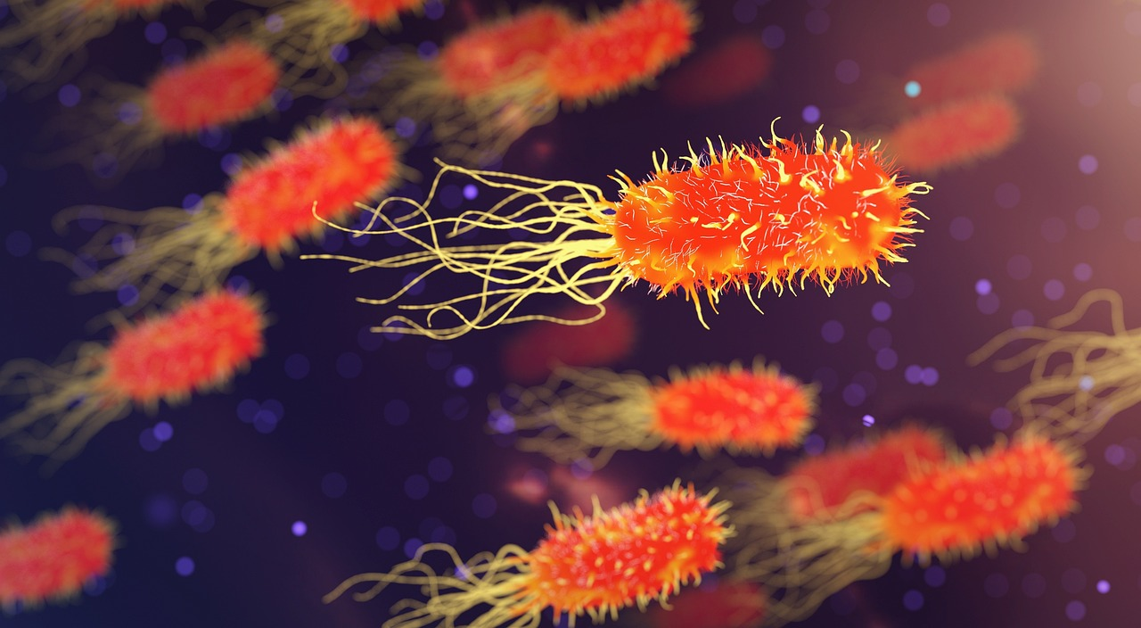
Foundations and Frontiers of Genetics
10
Applications of Genetics
Genetics in Medicine
Agricultural Innovations
Genetics has applications in medicine, such as genetic testing and gene therapy.
These advancements help in diagnosing and treating genetic disorders.
It is used in agriculture to develop crops with desirable traits.
This includes improving resistance to pests and enhancing nutritional value.
Forensic Science Applications
Conservation Biology Efforts
Genetics is also used in forensic science to identify individuals and solve crimes.
DNA analysis plays a crucial role in criminal investigations.
Additionally, genetics is used in conservation biology to protect endangered species.
It aids in understanding genetic diversity and planning conservation strategies.

Slide 11
Foundations and Frontiers of Genetics
11
Ethics of Genetics
Ethical Concerns in Genetic Information
Ethical Questions in Genetic Engineering
Importance of Ethical Considerations in Genetics
The use of genetic information raises ethical concerns, such as privacy and consent.
These issues highlight the need for careful handling of genetic data.
Genetic engineering and gene editing also raise ethical questions about the potential consequences.
These technologies require thorough ethical evaluation before widespread application.
It is essential to consider the ethical implications of genetic research and its applications.
This ensures responsible and beneficial use of genetic advancements.

Slide 12
Foundations and Frontiers of Genetics
12
Genetic Counseling
Understanding Genetic Counseling
Importance of Family History
Making Informed Decisions
Genetic counseling involves providing information and guidance to individuals about genetic disorders.
It helps individuals understand their genetic risks and make informed decisions.
Genetic counseling is essential for individuals with a family history of genetic disorders.
It enables them to assess their risks and take preventive measures.
Through genetic counseling, individuals can make informed choices about their health.
This process empowers them with knowledge about their genetic makeup.

Slide 13
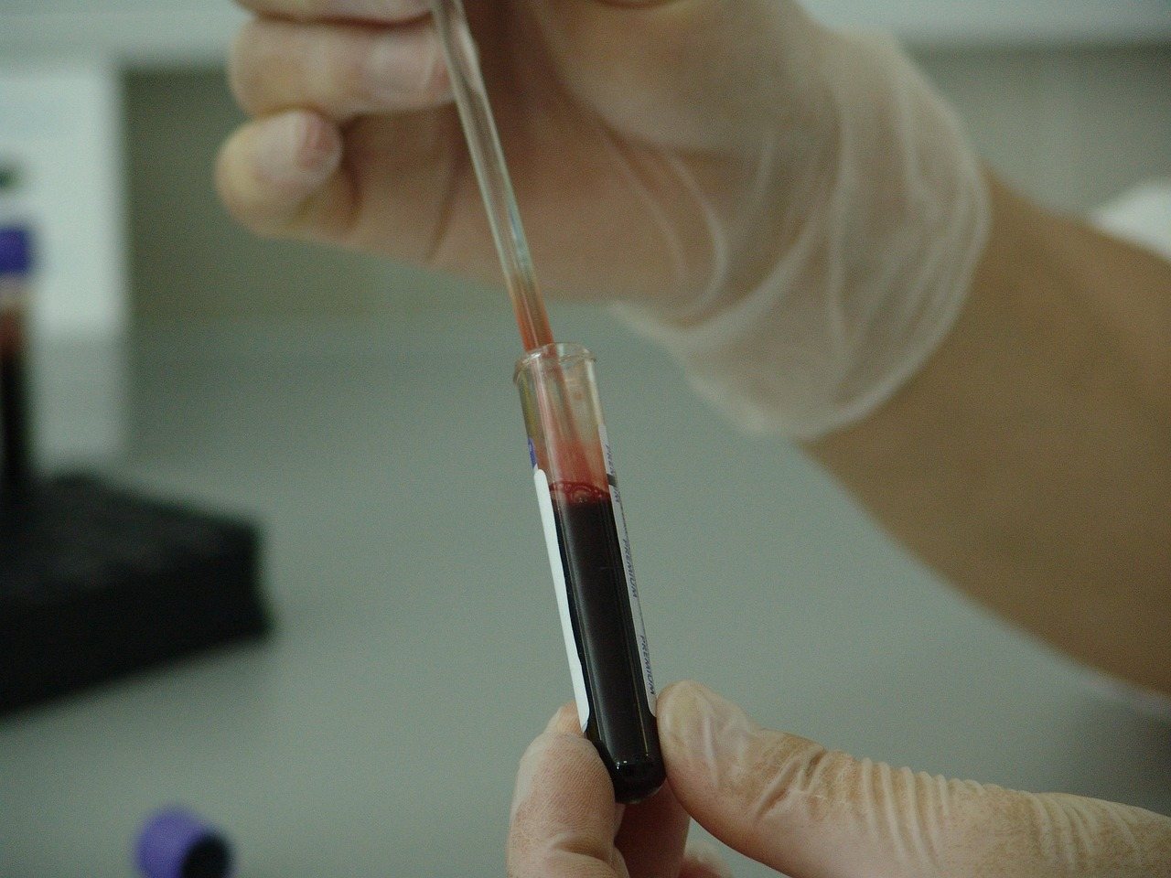
Foundations and Frontiers of Genetics
13
Genetic Testing
Understanding Genetic Testing
Applications of Genetic Testing
Ethical Considerations in Genetic Testing
Genetic testing involves analyzing an individual's genetic information to identify genetic disorders.
It can be used to diagnose genetic disorders or identify genetic risks.
It can be used to diagnose genetic disorders or identify genetic risks.
Genetic testing involves analyzing an individual's genetic information to identify genetic disorders.
Genetic testing raises ethical concerns about privacy and consent.
It can be used to diagnose genetic disorders or identify genetic risks.

Slide 14
Foundations and Frontiers of Genetics
14
Gene Therapy
Introduction to Gene Therapy
Promise of Gene Therapy
Ethical Considerations
Gene therapy involves introducing healthy copies of a gene into an individual's cells.
It is used to treat genetic disorders by replacing or repairing faulty genes.
Gene therapy is a promising area of research.
It has the potential to revolutionize the treatment of genetic disorders.
Gene therapy raises ethical concerns.
These concerns include accessibility and long-term effects on future generations.

Slide 15
Foundations and Frontiers of Genetics
15
Conclusion
The Importance of Genetics
The Role of Genetics in Health
Genetics is a fascinating field that helps us understand life and its diversity.
Understanding genetics is essential for making informed decisions about our health and well-being.
Understanding genetics is essential for making informed decisions about our health and well-being.
Genetics is a fascinating field that helps us understand life and its diversity.

Slide 16

Foundations and Frontiers of Genetics
16
References
National Institutes of Health Reference
American Society of Human Genetics Guide
National Institutes of Health. (2022). Genetics Home Reference.
Provides comprehensive information on genetic conditions and genes.
American Society of Human Genetics. (2022). Genetics 101.
Offers foundational knowledge on genetics and its applications.

Slide 17
Foundations and Frontiers of Genetics
17
Glossary
Gene
Genome
A unit of heredity that carries information from one generation to the next.
Genes are fundamental to the process of inheritance.
The complete set of genetic information in an organism.
It includes all of the organism's genes and non-coding sequences.
Genetic Engineering
Genomics
The manipulation of an organism's genes.
This technology is used in medicine, agriculture, and research.
The study of genomes and their structure, function, and evolution.
It provides insights into genetic variation and biological processes.

Slide 18

Foundations and Frontiers of Genetics
18
Further Reading
Comprehensive Guide to Genetic Analysis
Molecular Approach to Genetics
Hartl, D. L. (2019). Genetics: Analysis of Genes and Genomes.
Jones & Bartlett Learning.
Russell, P. J. (2020). Genetics: A Molecular Approach.
Pearson Education.

Slide 19

Foundations and Frontiers of Genetics
19
Image Credits
Image Credits
Images used in this presentation are from public domain sources.
Images are licensed under Creative Commons.

