Slide 1
Understanding Migration: A Comprehensive Overview
Exploring the Causes, Challenges, and Impacts of Human Movement in a Globalized World

Slide 2
Table of Contents
Introduction to Migration
Why Do People Migrate?
Types of Migration
Challenges Faced by Migrants
Impact of Migration on the Environment
Migration and Globalization
Case Study: Refugee Migration
Case Study: Economic Migration
Migration and Culture
Migration and Education
Migration and Health
Conclusion
Reflection Questions
04
05
06
07
08
09
10
11
12
13
14
15
16

Slide 3
Table of Contents
Next Steps
Additional Resources
References
Image Credits
Copyright Information
17
18
19
20
21

Slide 4

Introduction to Migration
Definition of Migration
Importance of Understanding Migration
Migration in Context
Migration is the movement of people or animals from one place to another.
It is a natural process that occurs in both human and animal populations.
Understanding migration is essential for promoting empathy and tolerance.
It fosters global citizenship and awareness of diverse experiences.
Migration shapes societies and ecosystems through its dynamic nature.
It reflects the interconnectedness of life across regions and species.
4
Understanding Migration: A Comprehensive Overview

Slide 5

Why Do People Migrate?
Economic Opportunities
Conflict and Persecution
People may migrate to find better job opportunities.
Higher wages in other regions can also be a driving factor for migration.
People may migrate to escape war, violence, or persecution.
Seeking safety and security is a primary motivator for such migrations.
Environmental Factors
Family Reunification
Natural disasters, climate change, or environmental degradation can prompt migration.
These factors often make living conditions unsustainable in affected areas.
People may migrate to join their family members who have already migrated.
Reuniting with loved ones is a significant reason for migration.
5
Understanding Migration: A Comprehensive Overview

Slide 6

Types of Migration
Voluntary Migration
Forced Migration
Voluntary migration occurs when individuals choose to relocate.
Reasons for this type of migration include economic opportunities, educational pursuits, or personal preferences.
Forced migration happens when individuals are compelled to move.
This can be due to factors such as conflict, persecution, or natural disasters.
Seasonal Migration
Internal Migration
Seasonal migration involves temporary relocation for specific purposes.
Common reasons include seasonal work or other time-bound activities.
Internal migration refers to movement within a single country.
People may migrate internally for reasons such as employment, education, or lifestyle changes.
6
Understanding Migration: A Comprehensive Overview

Slide 7

Challenges Faced by Migrants
01
Cultural Adjustment Challenges
Migrants may experience difficulty adjusting to a new culture.
This adjustment period can lead to feelings of isolation and confusion.
02
Language Communication Barriers
Migrants may face challenges communicating in a new language.
This can hinder their ability to access services and integrate into the community.
03
Facing Discrimination
Migrants may face prejudice or discrimination in their host country.
Such experiences can impact their mental health and sense of belonging.
04
Dealing with Homesickness
Migrants may feel homesick or lonely in their new environment.
This emotional struggle can affect their overall well-being and adaptation process.
7
Understanding Migration: A Comprehensive Overview

Slide 8

Impact of Migration on the Environment
Loss of Biodiversity
Pollution and Environmental Degradation
Contribution to Climate Change
Migration can lead to the loss of species and ecosystems.
This occurs when habitats are disrupted or destroyed due to human movement.
Migration can lead to increased pollution and environmental degradation.
This is often a result of urbanization and industrial activities associated with population shifts.
Migration can contribute to climate change by increasing greenhouse gas emissions.
This is due to the energy demands and transportation needs of migrating populations.
8
Understanding Migration: A Comprehensive Overview

Slide 9

Migration and Globalization
Globalization's Role in Migration
Migration's Impact on Globalization
Challenges of Migration in Globalization
Globalization has increased migration.
Globalization has created new opportunities for migration.
Migration has contributed to globalization.
Migration has helped to spread ideas, cultures, and technologies.
Migration has challenges for globalization.
Migration has also created challenges for globalization, such as cultural and economic integration.
9
Understanding Migration: A Comprehensive Overview

Slide 10

Case Study: Refugee Migration
Definition of Refugees
Examples of Refugee Crises
Challenges Faced by Refugees
Refugees are individuals who have been compelled to leave their home country.
This displacement is often due to conflict, persecution, or natural disasters.
The Syrian refugee crisis and the Rohingya refugee crisis are notable examples.
These situations highlight the global impact of forced migration.
Refugees often encounter barriers to accessing education, healthcare, and employment.
These challenges hinder their ability to rebuild their lives in host countries.
10
Understanding Migration: A Comprehensive Overview

Slide 11
Case Study: Economic Migration
Definition of Economic Migration
Examples of Economic Migration
Challenges Faced by Economic Migrants
Economic migrants are people who migrate for economic opportunities.
This involves relocating to regions or countries with better job prospects or economic conditions.
Instances include migration from Mexico to the United States and migration from India to the United Kingdom.
These examples highlight common patterns of economic migration across the globe.
Economic migrants encounter obstacles such as language barriers, cultural differences, and discrimination.
These challenges can impact their integration and success in the new environment.
11
Understanding Migration: A Comprehensive Overview

Slide 12
Migration and Culture
Cultural Exchange
Cultural Diversity
Cultural Identity
Migration facilitates the exchange of cultures and ideas.
This interaction enriches societies and fosters mutual understanding.
Migration contributes to increased cultural diversity within communities.
It promotes tolerance and appreciation for different traditions and perspectives.
Migration challenges existing cultural identities and fosters the creation of new cultural forms.
This dynamic process shapes the evolution of societal norms and values.
12
Understanding Migration: A Comprehensive Overview

Slide 13
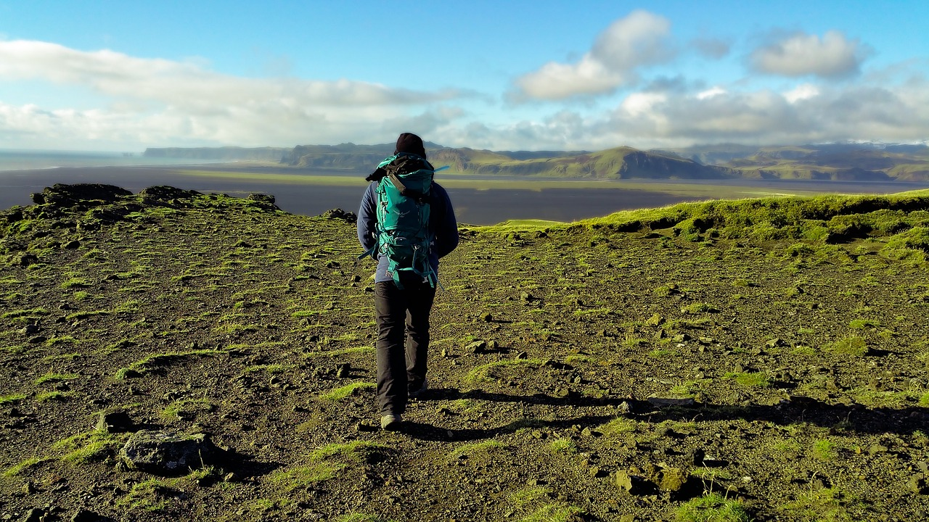
Migration and Education
Impact on Educational Access
Migration can affect access to education for migrants and their children.
This impact may vary depending on the resources and policies of the host country.
Challenges of Language Barriers
Migrants may face language barriers in accessing education.
These barriers can hinder effective communication and learning processes.
Navigating Cultural Differences
Migrants may face cultural differences in education systems.
Such differences can influence their integration and adaptation within the educational environment.
13
Understanding Migration: A Comprehensive Overview

Slide 14

Migration and Health
1
Impact on Healthcare Access
Migration can affect access to healthcare for migrants.
This can result in disparities in health outcomes and availability of medical services.
2
Challenges of Language Barriers
Migrants may face language barriers in accessing healthcare.
These barriers can hinder effective communication between patients and healthcare providers.
3
Navigating Cultural Differences
Migrants may face cultural differences in healthcare systems.
Such differences can influence their understanding and utilization of medical services.
14
Understanding Migration: A Comprehensive Overview

Slide 15

Conclusion
Migration's Impact
Promoting Global Citizenship
Migration is a complex and multifaceted issue that affects individuals, communities, and the environment.
Understanding its dynamics is crucial for addressing its challenges effectively.
Understanding migration is essential for promoting empathy, tolerance, and global citizenship.
This knowledge fosters a more inclusive and harmonious global society.
15
Understanding Migration: A Comprehensive Overview

Slide 16

Reflection Questions
1
Learning About Migration
What did you learn about migration in this presentation?
Reflect on the key insights and knowledge gained regarding migration topics.
2
Applying Knowledge to Life
How can you apply what you learned to your own life or community?
Consider practical ways to integrate the understanding of migration into personal or communal contexts.
3
Challenges and Opportunities for Migrants
What are some challenges or opportunities that migrants may face in your community?
Identify and analyze the potential difficulties and benefits migrants encounter locally.
16
Understanding Migration: A Comprehensive Overview

Slide 17

Next Steps
Understanding Migration
Community Engagement
Learn more about migration and its impact on individuals, communities, and the environment.
Explore the various factors that influence migration and its consequences on society.
Get involved in your community to support migrants and promote cultural diversity and understanding.
Participate in initiatives that foster inclusivity and celebrate diverse cultures.
17
Understanding Migration: A Comprehensive Overview

Slide 18

Additional Resources
1
2
3
Recommended Books
Informative Websites
Engaging Documentaries
"The Migration Book" by IOM provides comprehensive insights into migration dynamics.
"Migration and Culture" by Stephen Castles explores the interplay between migration and cultural transformations.
The International Organization for Migration (IOM) website offers extensive resources on migration topics.
The United Nations High Commissioner for Refugees (UNHCR) website provides information and support for refugees worldwide.
"The Migration Story" presents personal narratives and global perspectives on migration.
"The Refugee Crisis" examines the challenges and responses to the global refugee situation.
18
Understanding Migration: A Comprehensive Overview

Slide 19

References
World Migration Report 2020
Global Trends: Forced Displacement in 2020
International Organization for Migration (IOM).
(2020). World Migration Report 2020.
United Nations High Commissioner for Refugees (UNHCR).
(2020). Global Trends: Forced Displacement in 2020.
19
Understanding Migration: A Comprehensive Overview

Slide 20

Image Credits
Image 1 Credit
Image 2 Credit
Image 1: "Migration" by Pixabay.
This image is credited to Pixabay and titled "Migration".
Image 2: "Refugees" by UNHCR.
This image is credited to UNHCR and titled "Refugees".
20
Understanding Migration: A Comprehensive Overview

Slide 21

Copyright Information
Copyright Notice
This presentation is copyrighted by [Your Name].
It is licensed under a Creative Commons Attribution-NonCommercial-ShareAlike 4.0 International License.
21
Understanding Migration: A Comprehensive Overview

