Slide 1

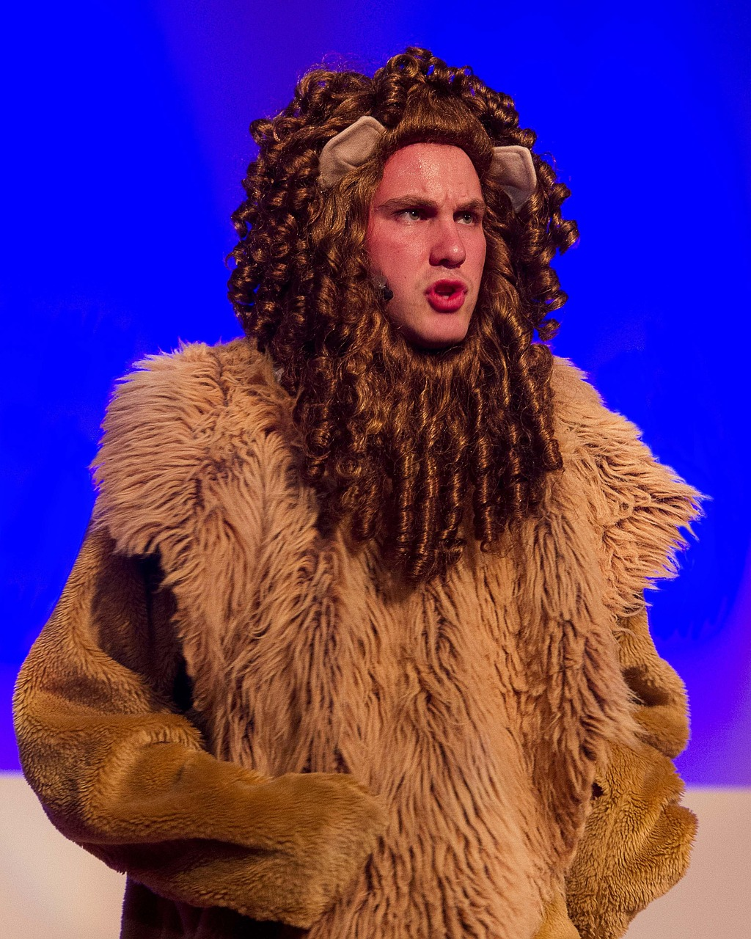
Courage and Sacrifice in Literature and Life
Exploring Themes through Aslan, the Pevensie Children, and Real-Life Applications

Slide 2
Table of Contents
Introduction to Courage and Sacrifice
Character Analysis: Aslan
Character Analysis: The Pevensie Children
Theme: Courage
Theme: Sacrifice
Literary Devices: Symbolism
Literary Devices: Imagery
Real-Life Applications: Courage
Real-Life Applications: Sacrifice
Group Activity: Character Analysis
Group Activity: Creative Project
Conclusion
Reflection Questions
04
05
06
07
08
09
10
11
12
13
14
15
16

Slide 3
Table of Contents
Next Steps
Additional Resources
Assessment and Evaluation
Conclusion and Final Thoughts
Final Reflection
17
18
19
20
21

Slide 4
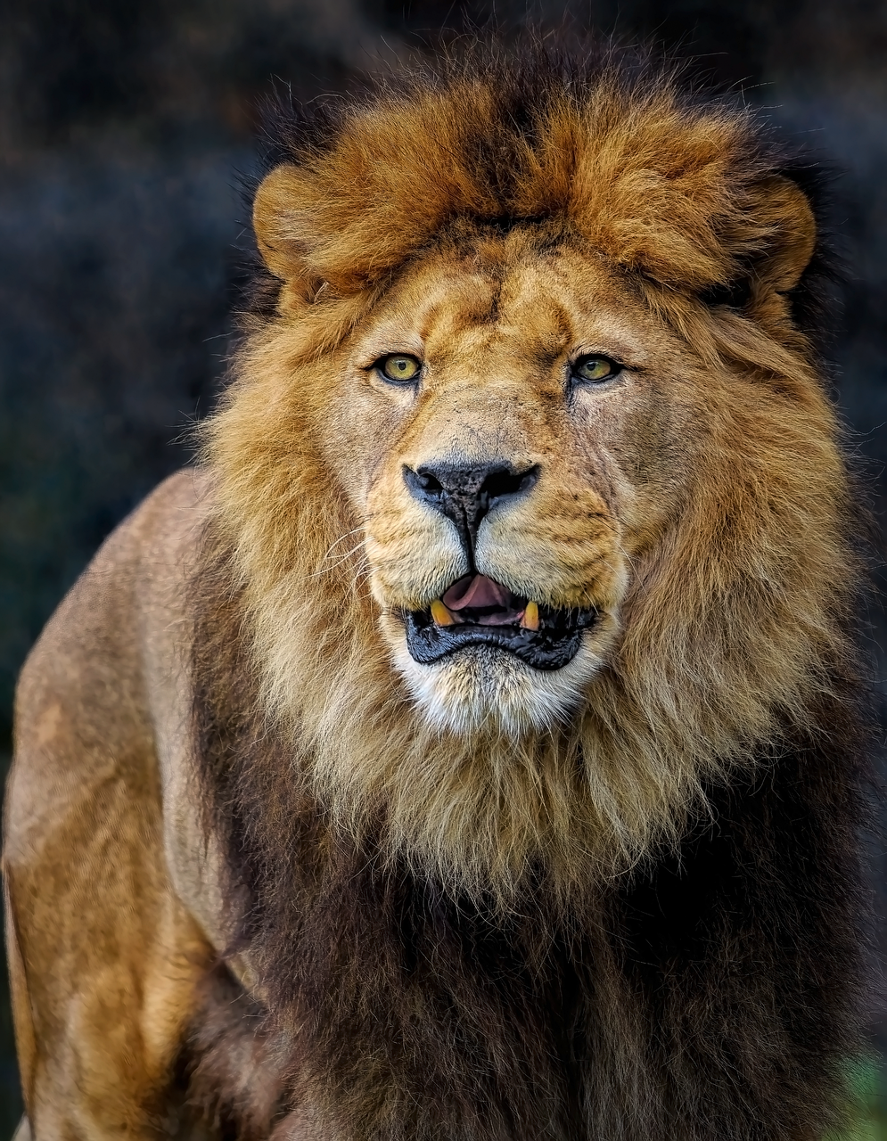
Introduction to Courage and Sacrifice
Exploring Courage and Sacrifice
Themes in Focus
Introduction to Literary Analysis
Welcome to our lesson on exploring courage and sacrifice through the character of Aslan and the Pevensie children.
In this lesson, we will delve into the themes of courage and sacrifice as depicted in 'The Lion, the Witch, and the Wardrobe' by C.S. Lewis.
By the end of this lesson, you will be able to analyze literary characters.
You will also understand the significance of courage and sacrifice, and apply these concepts to your own life.
This lesson provides an opportunity to explore the depth of literary themes.
It emphasizes the importance of understanding character motivations and their broader implications.
4
Courage and Sacrifice in Literature and Life

Slide 5

Character Analysis: Aslan
Symbol of Goodness and Redemption
Courage in the Face of Danger
Aslan is a symbol of goodness, wisdom, and redemption in the story.
His presence embodies the moral compass and hope for the characters.
He demonstrates courage by facing the White Witch and sacrificing himself to save Edmund.
This act showcases his bravery and willingness to protect others at great personal risk.
Lesson in Selflessness
True Courage and Personal Cost
Aslan's character teaches us about the importance of selflessness and putting others before oneself.
His actions inspire the characters and readers to value altruism.
Through Aslan's actions, we learn that true courage can lead to profound personal cost.
His sacrifice serves as a powerful example of the depth of his character.
5
Courage and Sacrifice in Literature and Life

Slide 6

Character Analysis: The Pevensie Children
Courage in Narnia
Teamwork and Unity
The Pevensie children (Peter, Susan, Edmund, and Lucy) demonstrate courage in various ways throughout the story.
Each child has their unique moments of bravery, from Lucy's initial step into Narnia to Peter's leadership in battle.
The Pevensie children learn to work together, using their unique skills and strengths, to overcome challenges.
Through their experiences, we see the importance of teamwork, perseverance, and loyalty.
Lucy’s Bravery
Peter’s Leadership
Lucy’s initial step into Narnia showcases her courage and curiosity.
Her actions set the stage for the adventures that follow and inspire her siblings.
Peter’s leadership in battle highlights his bravery and sense of responsibility.
He becomes a symbol of strength and guidance for his siblings in their journey.
6
Courage and Sacrifice in Literature and Life

Slide 7

Theme: Courage
Definition of Courage
Aslan's Bravery
The Essence of Courage
Courage is the ability to do something that frightens one; bravery.
Courage is not the absence of fear, but the judgment that something else is more important than fear.
Aslan and the Pevensie children show courage in the face of danger, fear, and uncertainty.
Their bravery inspires others to stand strong in difficult times.
Courage involves confronting fear and uncertainty head-on.
It is a quality that defines heroes and leaders in challenging situations.
7
Courage and Sacrifice in Literature and Life

Slide 8
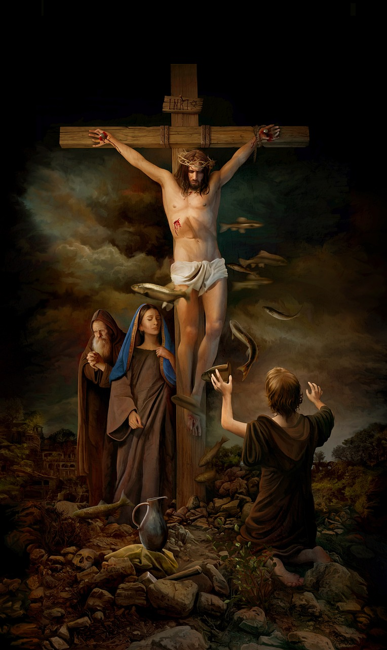
Theme: Sacrifice
1
Definition of Sacrifice
Sacrifice is giving up something valuable or important for the sake of someone or something else.
It often involves selflessness and prioritizing the needs of others over one's own desires.
2
Aslan's Pivotal Sacrifice
Aslan's sacrifice on the Stone Table is a pivotal moment in the story, demonstrating his love and commitment to saving Edmund.
This act of selflessness underscores the theme of redemption and the power of sacrificial love.
3
The Pevensie Children's Sacrifices
The Pevensie children make sacrifices, such as leaving their home and family to live in the Professor's house.
They also risk their lives to save Narnia, showcasing their courage and dedication to a greater cause.
8
Courage and Sacrifice in Literature and Life

Slide 9

Literary Devices: Symbolism
1
Understanding Symbolism
Symbolism is the use of objects, colors, or characters to represent abstract ideas or concepts.
It allows authors to convey deeper meanings and themes within their stories.
2
Aslan as a Symbol
Aslan is a symbol of goodness, wisdom, and redemption in the story.
His character embodies hope and the triumph of virtue over adversity.
3
The White Witch's Representation
The White Witch represents evil, tyranny, and the destructive power of selfishness.
Her actions and presence highlight the consequences of greed and cruelty.
9
Courage and Sacrifice in Literature and Life

Slide 10

Literary Devices: Imagery
1
2
3
Definition of Imagery
Imagery in Narnia
Themes Enhanced by Imagery
Imagery is the use of language to create vivid sensory experiences for the reader.
It allows readers to visualize and feel the scenes described in a story.
C.S. Lewis uses imagery to describe the beauty of Narnia, making it easier for readers to imagine the setting.
This vivid description brings the magical world to life for readers.
Imagery helps to convey the themes of courage and sacrifice, making the story more engaging and immersive.
These themes resonate deeply with readers, adding depth to the narrative.
10
Courage and Sacrifice in Literature and Life

Slide 11
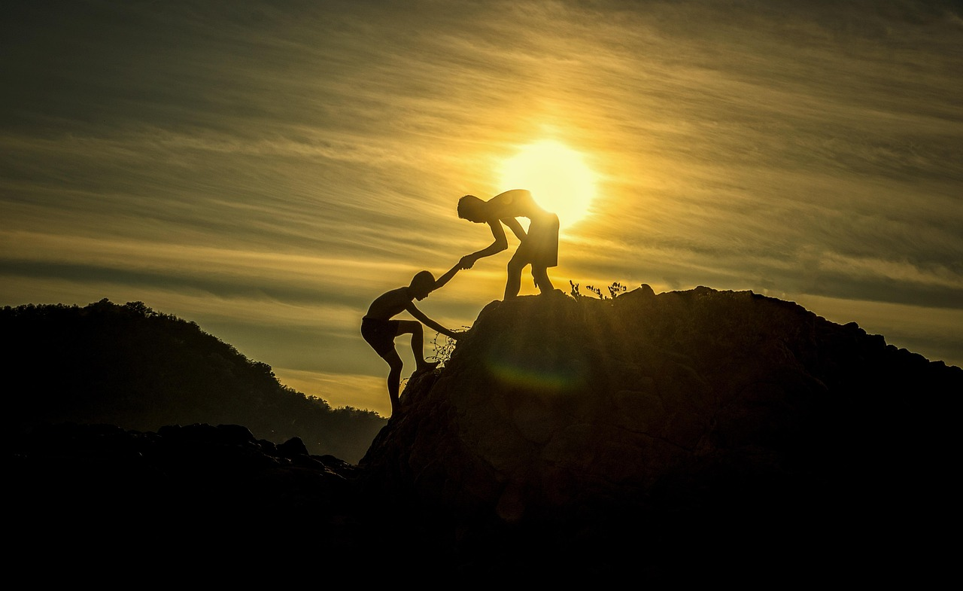
Real-Life Applications: Courage
Courage in Everyday Life
Facing Challenges Head-On
The Essence of Courage
Courage is essential in real-life situations, such as standing up for what is right, helping others, and overcoming personal fears.
Courage is not limited to grand, heroic acts; it can be demonstrated in small, everyday actions.
We can apply the concept of courage to our own lives by facing challenges head-on.
Taking risks is a key aspect of demonstrating courage in our daily lives.
Courage involves making difficult choices and taking action despite fear.
It is a quality that empowers individuals to confront adversity and make a positive impact.
11
Courage and Sacrifice in Literature and Life

Slide 12
Real-Life Applications: Sacrifice
Sacrifice in Daily Life
Selflessness in Action
The Greater Good
Sacrifice is a vital aspect of human experience, as people face situations every day that require giving up something valuable for the greater good.
Sacrifice can take many forms, from small, everyday acts to grand, life-changing decisions.
We can apply the concept of sacrifice to our own lives by putting others before ourselves.
Making selfless decisions often involves prioritizing the needs of others over personal desires.
Sacrifice often serves the greater good, emphasizing the importance of collective well-being.
It highlights the value of giving up personal gains for the benefit of others.
12
Courage and Sacrifice in Literature and Life

Slide 13

Group Activity: Character Analysis
Group Division and Character Assignment
Character Analysis Focus
Class Presentation and Discussion
Divide into small groups and assign each group a character from 'The Lion, the Witch, and the Wardrobe'.
Ensure each group focuses on one character to analyze in detail.
Analyze the character's actions and decisions throughout the story, focusing on moments that demonstrate courage and sacrifice.
Encourage groups to identify key events that highlight these traits.
Share findings with the class and discuss how the characters' actions relate to real-life situations.
Facilitate a discussion to connect the story's themes to everyday experiences.
13
Courage and Sacrifice in Literature and Life

Slide 14

Group Activity: Creative Project
1
Visual Representation of Courage
Create a visual project such as a poster, infographic, or comic strip.
Illustrate a scene from the book where a character shows courage or makes a sacrifice.
2
Character Actions and Impact
Include a brief description of the situation and the character's actions.
Explain the impact of their decision on the story or other characters.
3
Classroom Discussion
Share projects with the class to showcase creative interpretations.
Discuss how the characters' actions demonstrate courage and sacrifice.
14
Courage and Sacrifice in Literature and Life

Slide 15

Conclusion
1
Exploring Courage and Sacrifice
In conclusion, exploring courage and sacrifice through the character of Aslan and the Pevensie children offers a rich and engaging way to introduce students to complex moral and ethical themes.
Through literary analysis, group discussions, and creative activities, students can develop a deeper understanding of what it means to be courageous and make sacrifices for the greater good.
2
Applying Concepts to Real-Life Situations
By applying these concepts to real-life situations, students can become more empathetic, compassionate, and courageous individuals.
This approach helps students connect literary themes to their own lives, fostering personal growth and ethical awareness.
3
Engaging Students Through Creative Activities
Creative activities provide students with opportunities to explore themes of courage and sacrifice in an interactive and meaningful way.
These activities encourage collaboration and critical thinking, enhancing their overall learning experience.
15
Courage and Sacrifice in Literature and Life

Slide 16

Reflection Questions
1
2
3
Courage and Sacrifice in Aslan's Story
Personal Application of Courage
Overcoming Life's Challenges
What did you learn about courage and sacrifice from the story of Aslan and the Pevensie children?
How can you apply the concepts of courage and sacrifice to your own life?
What challenges do you face in your own life that require courage and sacrifice?
How can you overcome them?
What did you learn about courage and sacrifice from the story of Aslan and the Pevensie children?
What challenges do you face in your own life that require courage and sacrifice, and how can you overcome them?
16
Courage and Sacrifice in Literature and Life

Slide 17
Next Steps
1
2
3
Exploring Courage and Sacrifice
Personal Reflection on Courage
Applying Courage and Sacrifice Daily
Continue to explore the themes of courage and sacrifice through other literary works or real-life examples.
Reflect on how these themes are portrayed and their impact on individuals and society.
Reflect on your own experiences and identify moments where you demonstrated courage or made sacrifices.
Consider how these moments have shaped your character and personal growth.
Apply the concepts of courage and sacrifice to your everyday life, making selfless decisions and facing challenges head-on.
Strive to make choices that reflect these values in both small and significant ways.
17
Courage and Sacrifice in Literature and Life

Slide 18

Additional Resources
Explore Works by C.S. Lewis
Watch Movie Adaptations
Engage in Discussions
For further reading, explore other works by C.S. Lewis, such as 'The Chronicles of Narnia' series.
These books offer a rich narrative and themes that complement 'The Lion, the Witch, and the Wardrobe'.
Watch movie adaptations of 'The Lion, the Witch, and the Wardrobe' to visualize the story and its themes.
These films provide a visual representation that can enhance your understanding of the book.
Discuss the story and its themes with your peers, family, or teacher to deepen your understanding.
Such conversations can help you gain new insights and perspectives on the narrative.
18
Courage and Sacrifice in Literature and Life

Slide 19

Assessment and Evaluation
Engage in Discussions and Activities
Showcase Critical Thinking Through Writing
Illustrate Themes Visually
Participate in class discussions and group activities to demonstrate your understanding of the themes and characters.
These interactions help to showcase your comprehension and ability to connect with the story.
Complete written assignments, such as character analyses or reflective essays, to showcase your critical thinking and writing skills.
These tasks allow you to explore deeper meanings and articulate your insights effectively.
Create a visual project or presentation that illustrates your understanding of courage and sacrifice.
This creative approach highlights how these themes are demonstrated in the story.
19
Courage and Sacrifice in Literature and Life

Slide 20
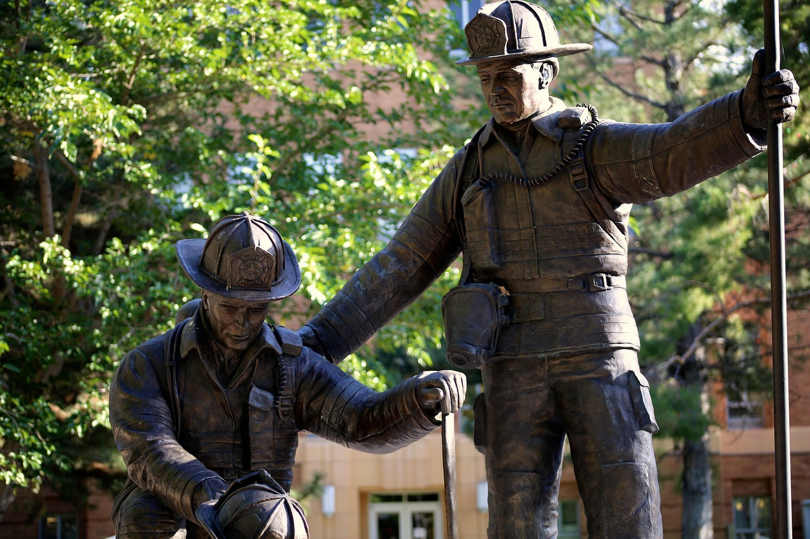
Conclusion and Final Thoughts
1
Exploration of Courage and Sacrifice
In conclusion, our exploration of courage and sacrifice through the character of Aslan and the Pevensie children has been a journey of discovery and growth.
We have learned about the importance of courage and sacrifice in literature and real life, and how these values can be applied to our everyday lives.
2
The Everyday Acts of Courage
Remember that courage and sacrifice are not limited to grand, heroic acts.
They can be demonstrated in small, everyday actions, and it is up to us to make selfless decisions and face challenges head-on.
3
Applying Values to Life
Courage and sacrifice are essential values that resonate beyond the pages of literature.
They inspire us to act with integrity and bravery in our daily lives.
20
Courage and Sacrifice in Literature and Life

Slide 21
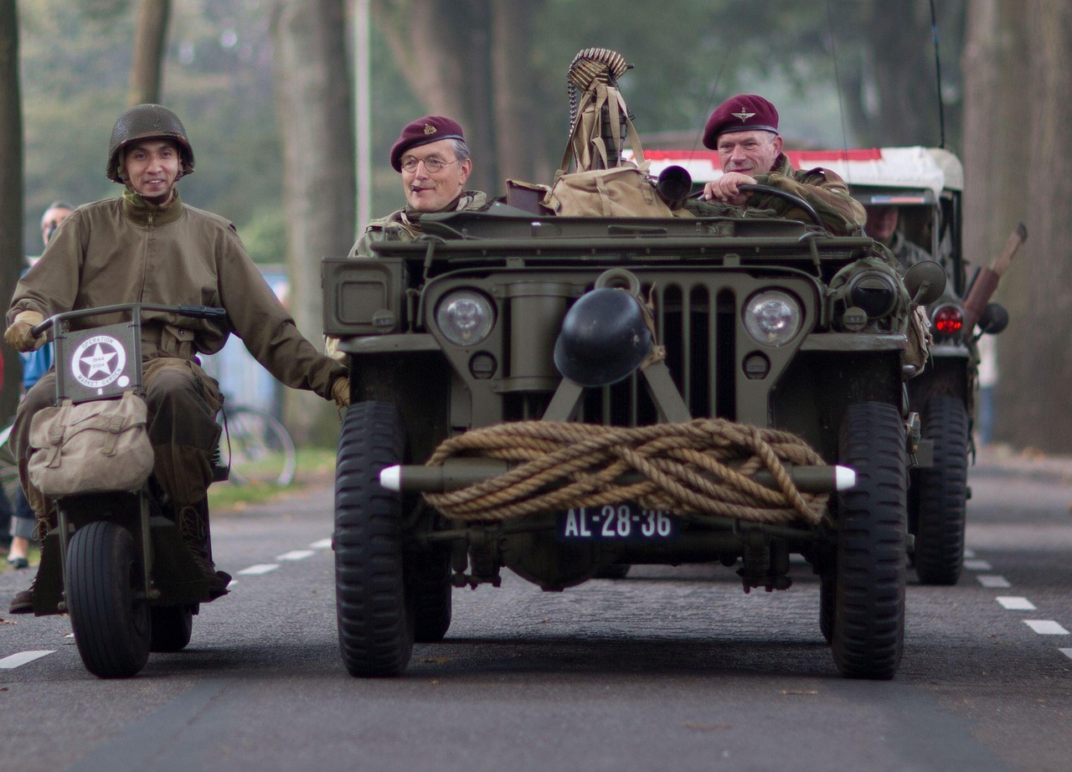
Final Reflection
1
Reflect on Your Learning
Take a moment to reflect on what you have learned throughout this lesson.
Think about how you can apply the concepts of courage and sacrifice to your own life, and what challenges you may face in doing so.
2
The Role of Courage and Sacrifice
Remember that courage and sacrifice are essential values that can help you grow and develop as a person.
It is up to you to make a positive impact in the world by embracing these values.
3
Personal Growth Through Values
Consider how these lessons can shape your personal growth and character.
Use this reflection as a stepping stone to overcome challenges and inspire others.
21
Courage and Sacrifice in Literature and Life

